Slide 1
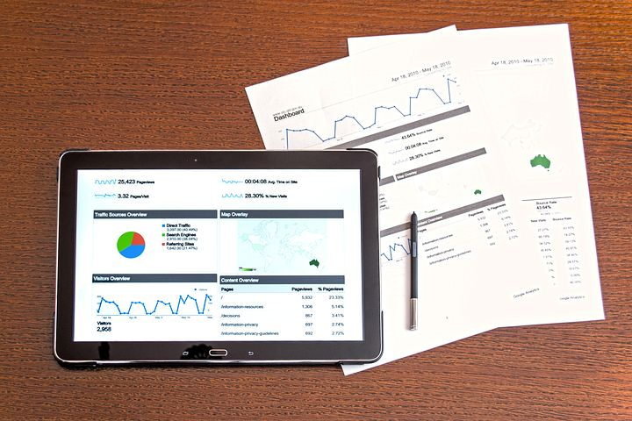


Welcome to: Build a Python GUI with Tkinter
Dave Dalsveen

Slide 2
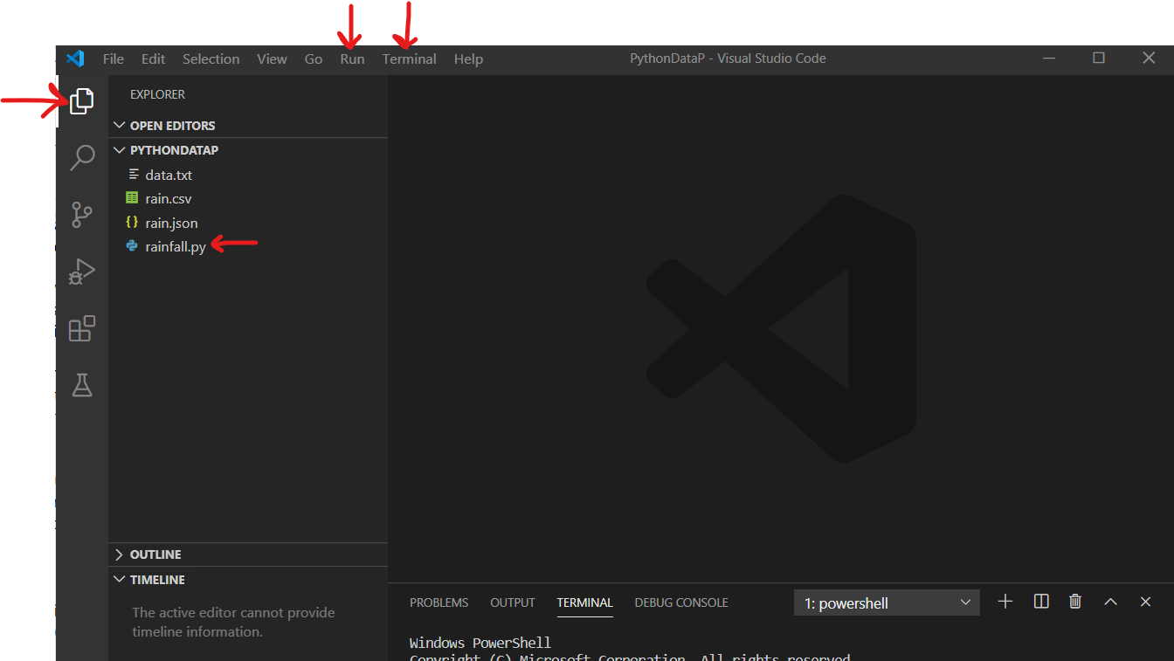
Visual Studio Code
The main Visual Studio Icons we are using are:
Explorer
Run->run without debugging
Run->start debugging
Code editor Window

Slide 3
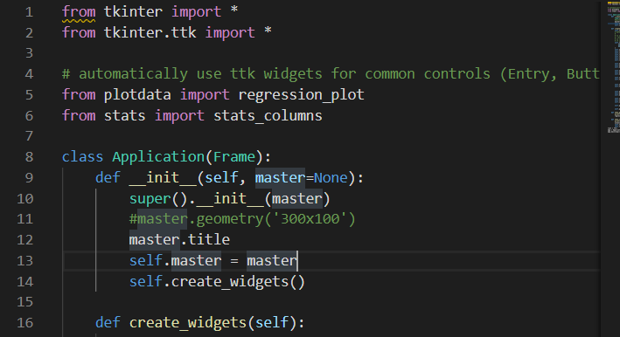
Task1: Inherit from the Frame class to create the Application Window
Import tkinter and tkinter.ttk .
Ttk widgets offer custom styling options.
Better appearance than standard widgets
Create the Application class.
Instantiate the Application and pass it the Tk object.
Start the main loop to launch the GUI and event loop.

Slide 4
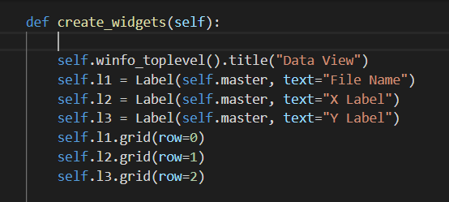
Task2: Create a method to add the Window frame title and add the Labels to the grid
Pass the self variable to the method.
Self identifies methods and variables intended to belong to the instance of the Application.
Add the title for the window.
Create the Labels and add them to the grid.

Slide 5
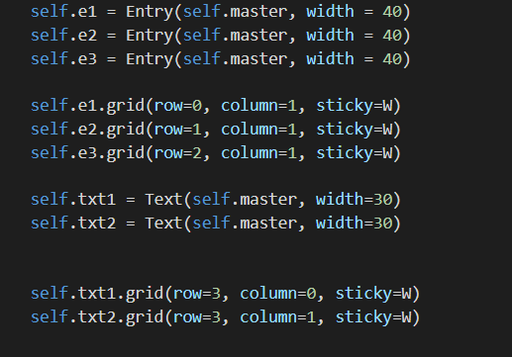
Task3: Add the Entry Widgets and Text Widgets
Create the Entry Widgets.
Add the Entry Widgets to the grid.
Add the Text Widgets to display statistics for X-data and Y data.

Slide 6
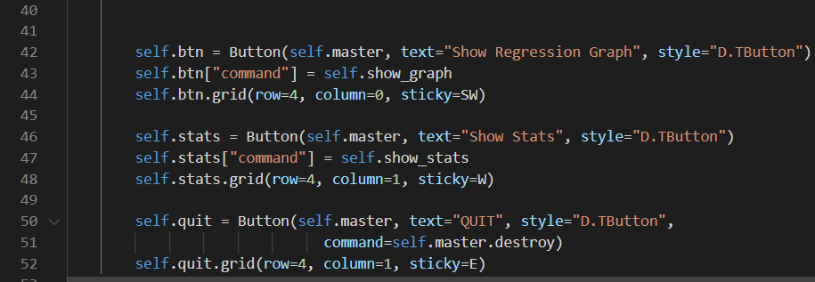
Task4: Add the buttons to the grid.
Create the button widgets.
Add each button to the appropriate grid location.
Add the button styling.

Slide 7
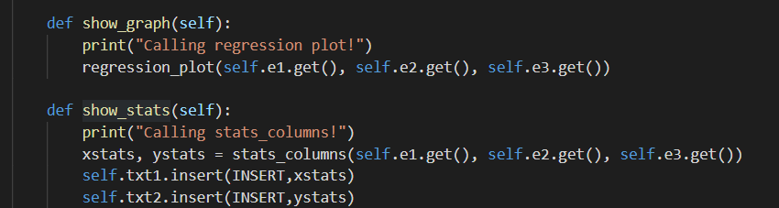
Task5: Create the button event handlers and retrieve and set data using widget methods.
Implement the event handler methods for each button.
Obtain the data from the entry widgets for use in the function call.
Obtain data from the function call and insert data into text areas.
Test the completed application.

