Slide 1
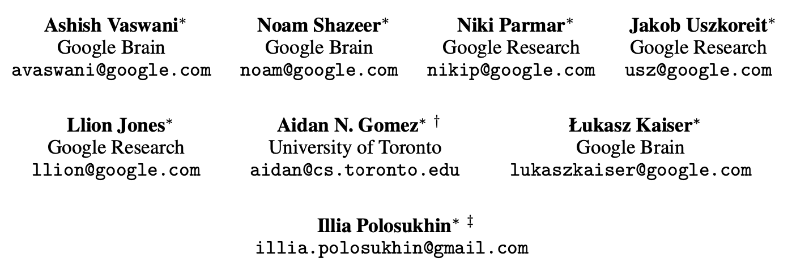
Attention is All You Need
Presentation: Kerem Güra

Slide 2
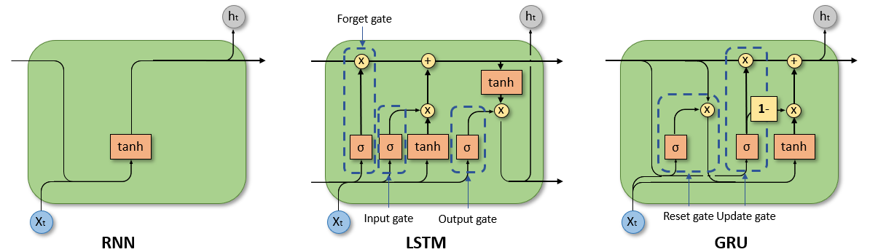
Background: NLP
State-of-art solutions
Notes:
Long short-term memory
Long short-term memory (LSTM) is an RNN variant that enables the model to expand its memory capacity to accommodate a longer timeline. An RNN can only remember the immediate past input. It can’t use inputs from several previous sequences to improve its prediction.
Consider the following sentences: Tom is a cat. Tom’s favorite food is fish. When you’re using an RNN, the model can’t remember that Tom is a cat. It might generate various foods when it predicts the last word. LSTM networks add a special memory block called cells in the hidden layer. Each cell is controlled by an input gate, output gate, and forget gate, which enables the layer to remember helpful information. For example, the cell remembers the words Tom and cat, enabling the model to predict the word fish.
Gated recurrent units
A gated recurrent unit (GRU) is an RNN that enables selective memory retention. The model adds an update and forgets the gate to its hidden layer, which can store or remove information in the memory.

Slide 3
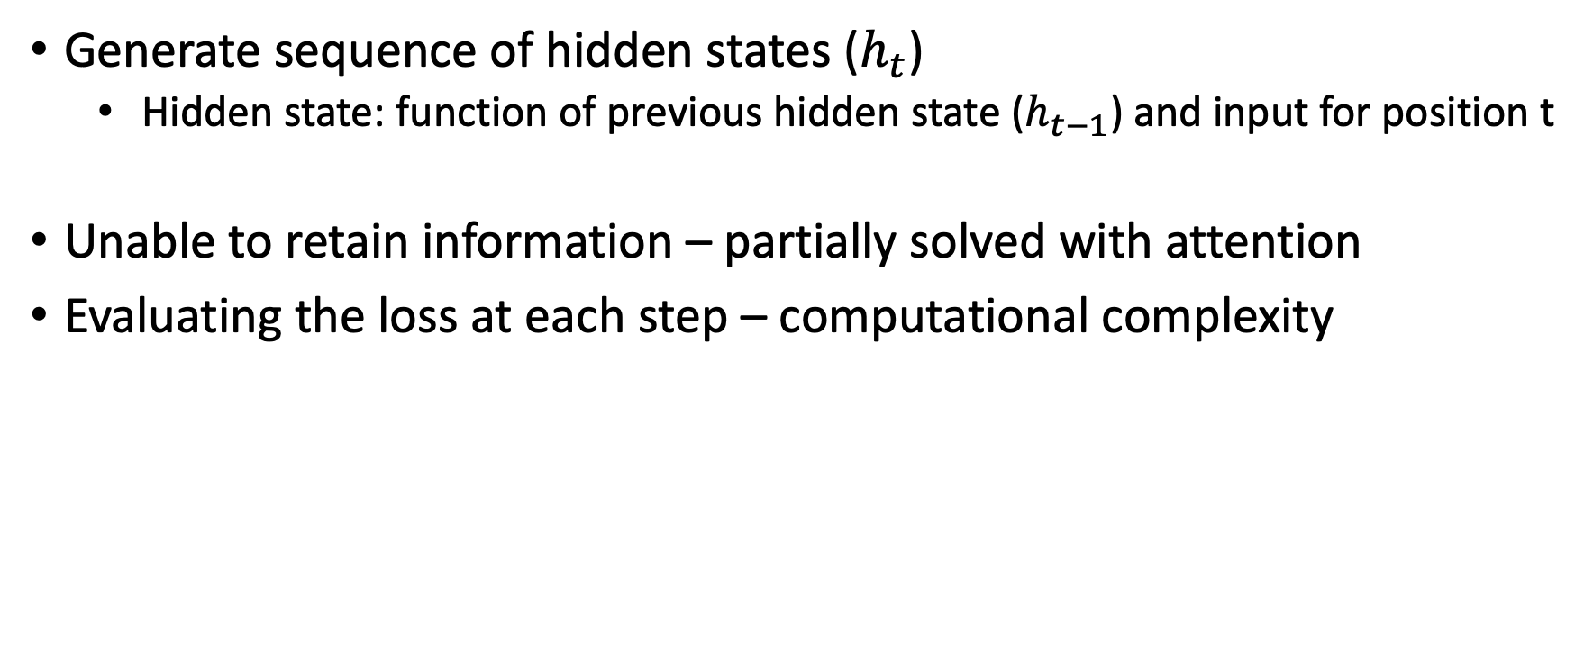
Background: Problems of RNNs
Generate sequence of hidden states ($h_{t}$)
Hidden state: function of previous hidden state ($h_{t−1}$) and input for position t
Unable to retain information – partially solved with attention
Evaluating the loss at each step – computational complexity

Slide 4
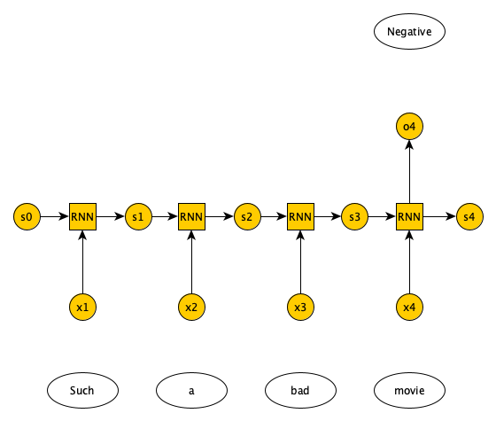
Background: RNN Example
Notes:
Recurrent Neural Network(RNN) is a type of Neural Network where the output from the previous step is fed as input to the current step.

Slide 5
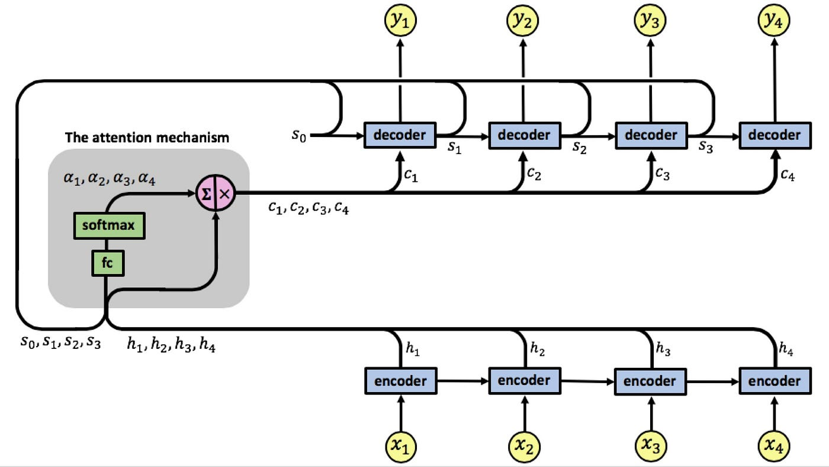
Background: Attention Mechanisms
Allow modeling dependencies – not dependent on distance
Used in conjuction with recurrent networks
Notes:
Problem of retaining information solved
Attention is a mechanism combined in the RNN allowing it to focus on certain parts of the input sequence when predicting a certain part of the output sequence, enabling easier learning and of higher quality.
The attention weights αij reflect the importance of hj with respect to the previous hidden state si−1 in deciding the next state si and generating yi. A large αij attention weight causes the RNN to focus on input xj (represented by the encoder’s output hj), when predicting the output yi

Slide 6
Transformer
No recurrence or convolution
Based solely on attention mechanisms to model dependencies in data
Parallel architecture
Higher:
Model quality
Parallelizability
Lower:
Time to train

Slide 7
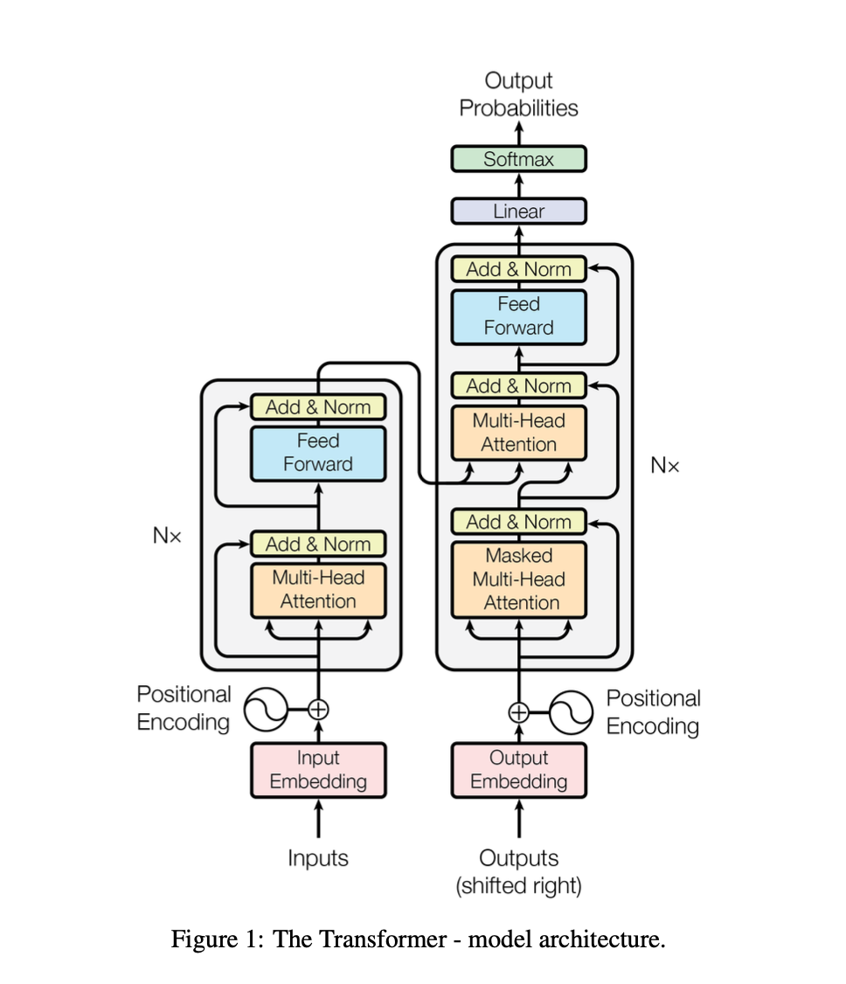
Model Architecture

Slide 8
Embeddings
Initial step in processing sequence
Convert discrete tokens into vectors encoder can process
Input: map tokens to high dimensional vectors
Output: map previously generated tokens to vectors

Slide 9
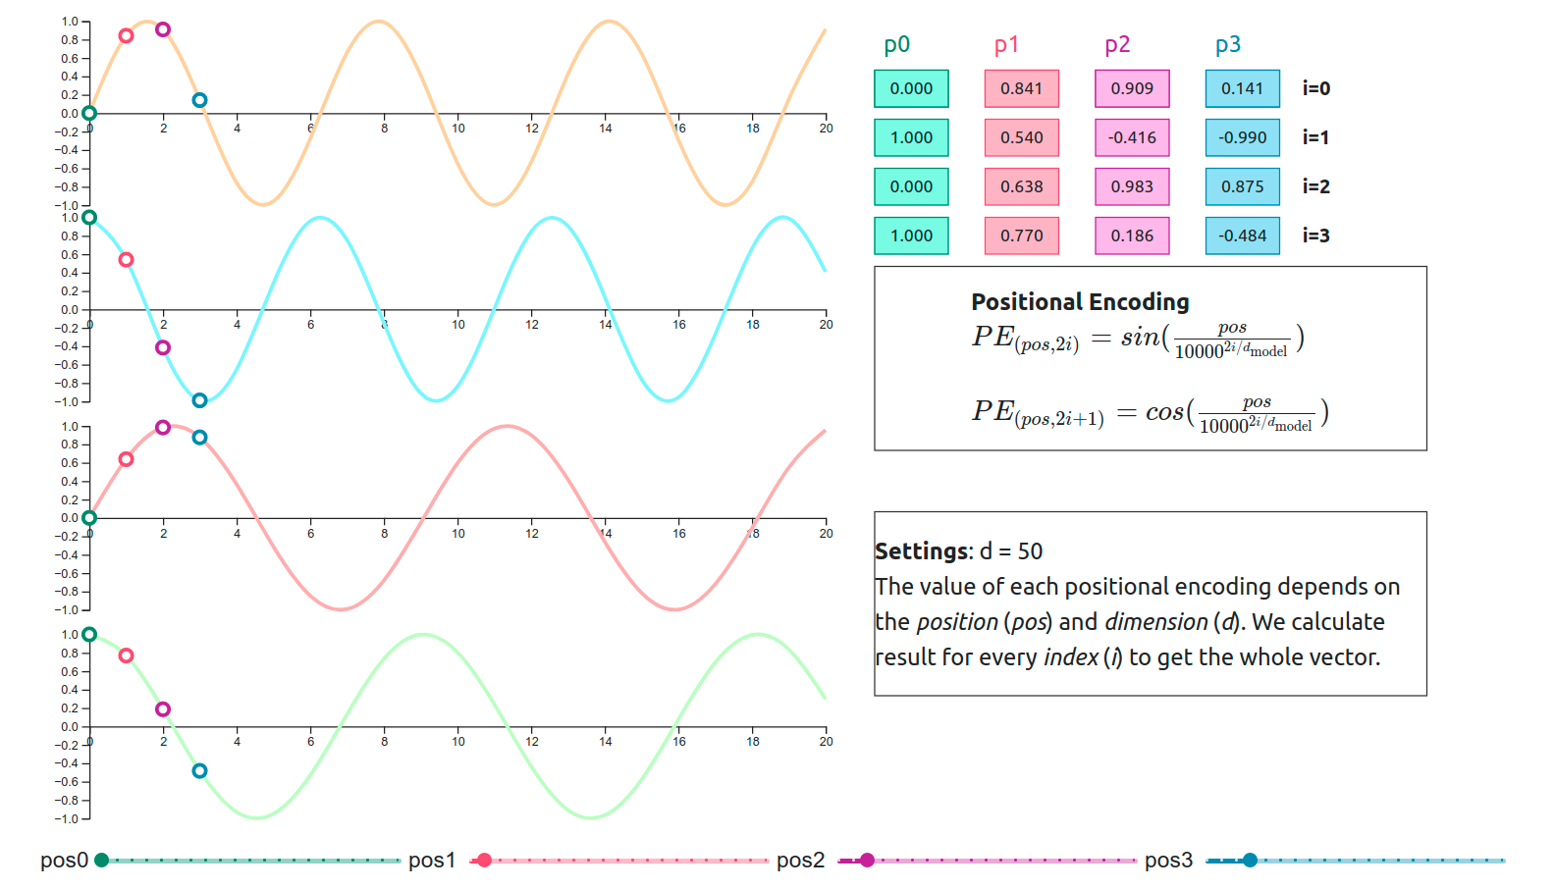
Positional Encoding
Self-attention doesn’t process sequential data in order- drawback
Unique encoding for each position
Allow model to learn to attend by relative positions

Slide 10
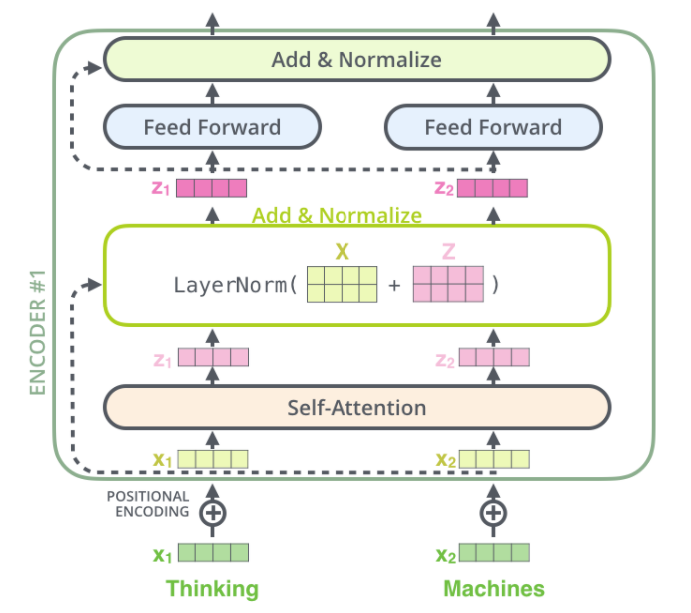
Encoder Stack
Understand, encode entire input sequence into continuous representation
Self attention – captures context around each token regardless of distance
Each layer captures more complex relationships

Slide 11
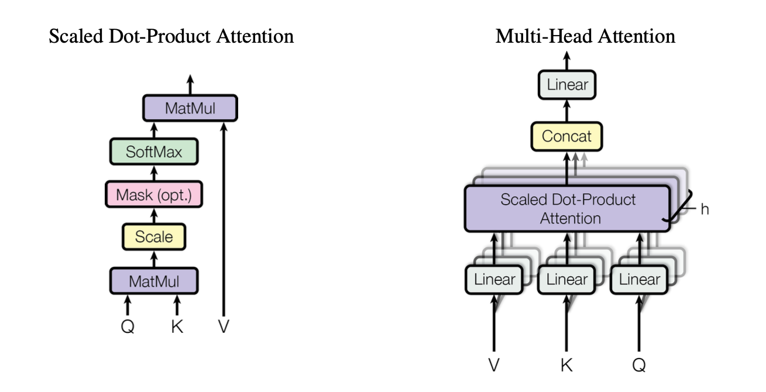
Self-Attention
Attention scores determine importance of each key-value pair to given query
Allow each position in input sequence to attend to all positions in the same sequence
Compute representation of sequence
Capture long range dependencies

Slide 12
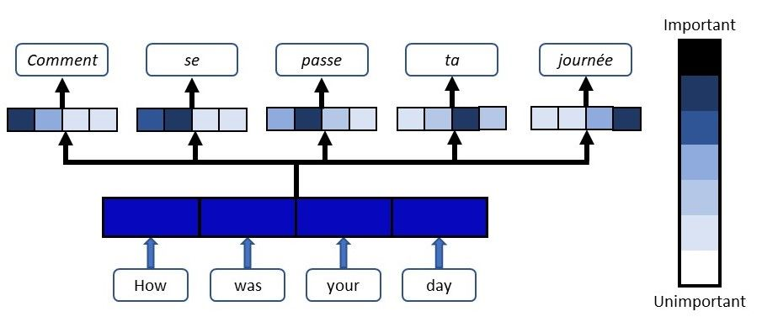
Self-attention example

Slide 13
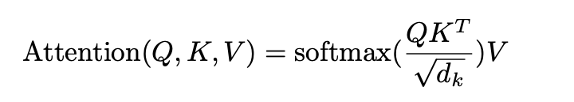
Scaled Dot-Product Attention

Slide 14
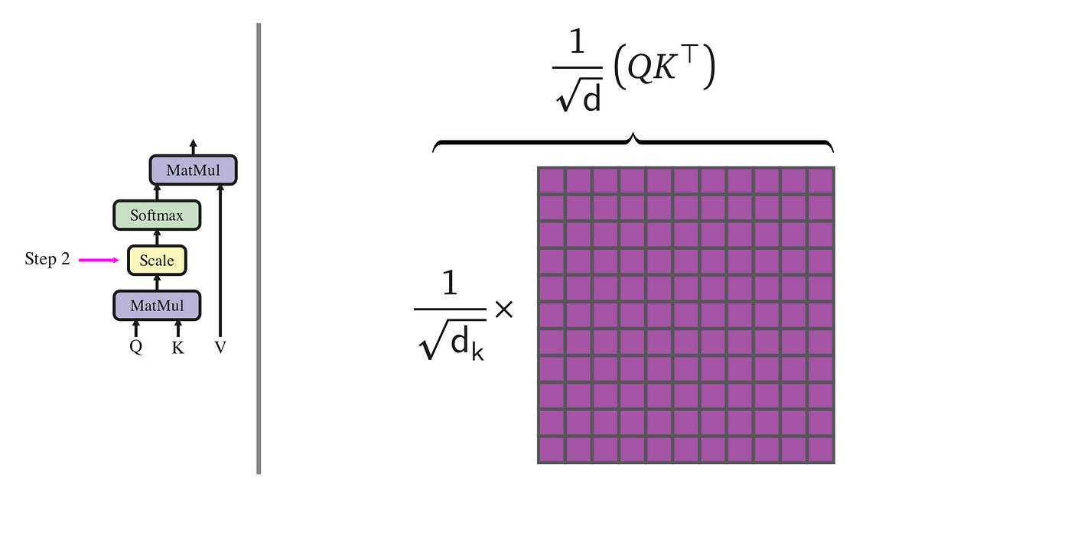
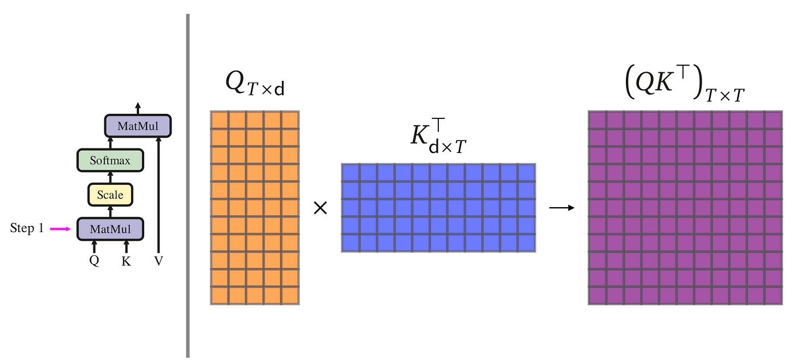
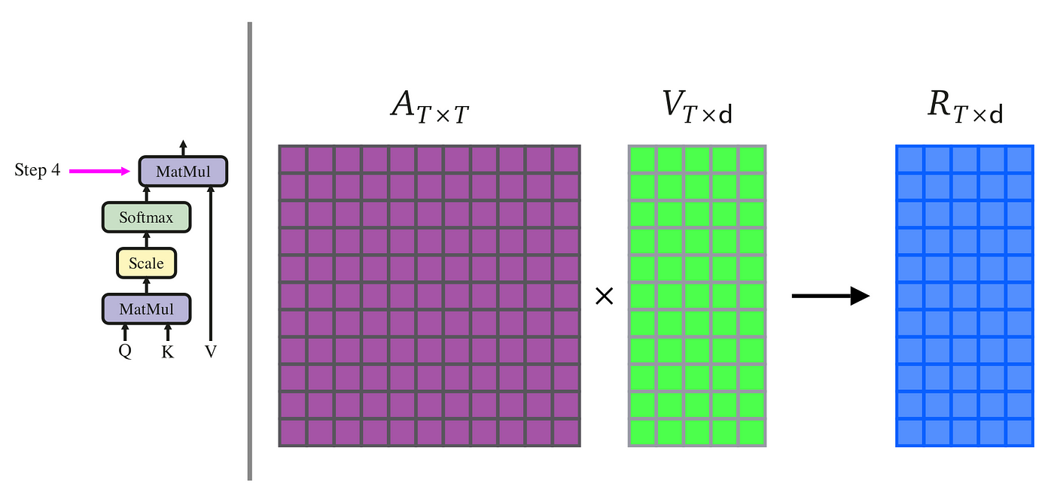
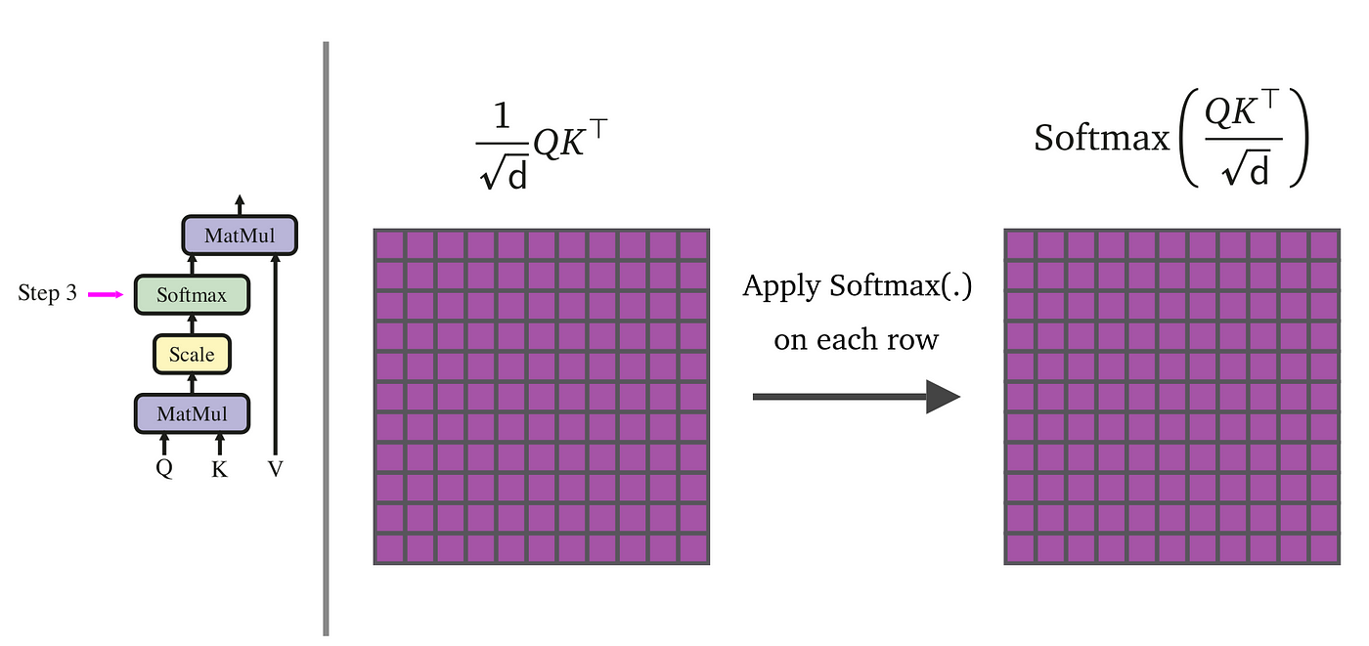
Scaled Dot-Product Attention
Notes:
Q (Queries): Produced by multiplying the input by a weight matrix ��WQ.
�K (Keys): Produced by multiplying the input by a weight matrix ��WK.
�V (Values): Produced by multiplying the input by a weight matrix ��WV.
The ��WQ, ��WK, and ��WV are learned matrices specific to each role. During training, the model learns the optimal weights for these matrices to effectively map the input into queries, keys, and values that facilitate the attention mechanism. Essentially, they are parameters that the model optimizes through backpropagation based on the task-specific loss function.

Slide 15
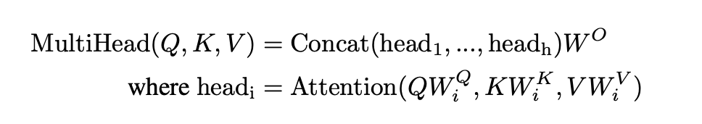
Multi-head Attention
Each head focuses on different part of sequence
Model can jointly attend information from different representation subspaces at different positions

Slide 16
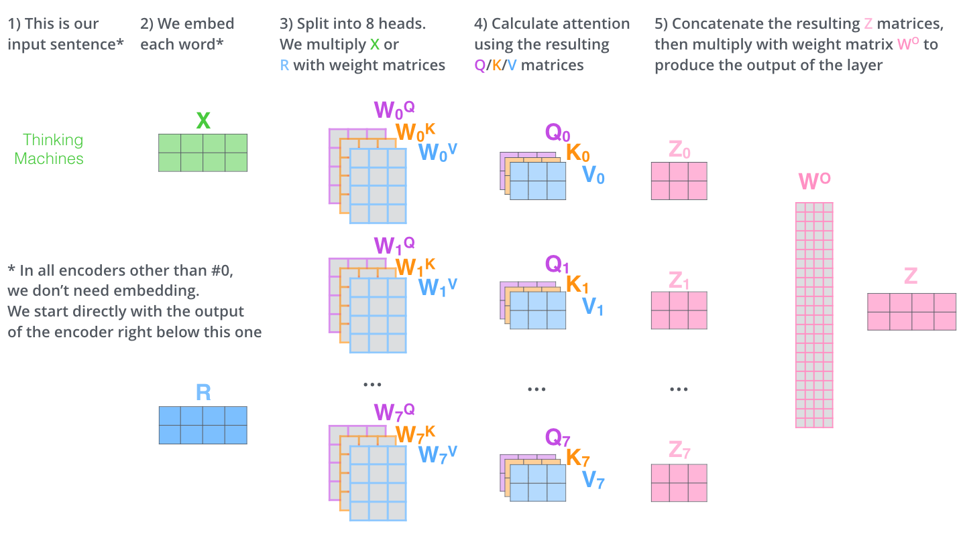
Multi-head Attention

Slide 17
Applications of Attention in Model
Self-attention layers in encoder
Encoder-decoder attention
Self-attention layers in decoder
Notes:
Allow every position in decoder to attend over all positions in input sequence
Every position in encoder can attend to all positions in previous layer of encoder
Each position in decoder can attend to all positions in decoder up to that position
Prevent leftover information flow – preserve autoregressive property

Slide 18
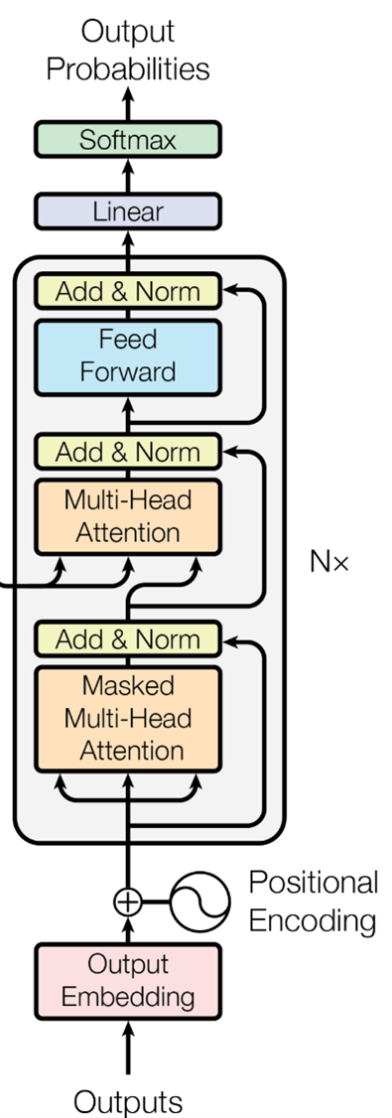
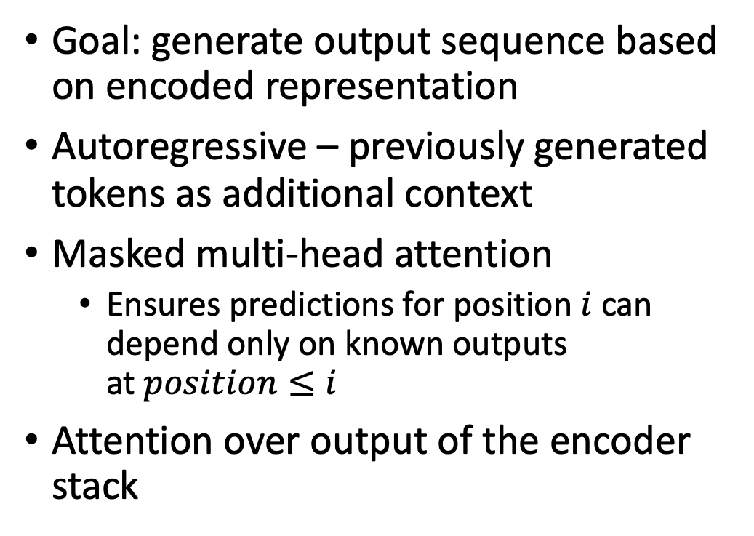
Decoder Stack
Goal: generate output sequence based on encoded representation
Autoregressive – previously generated tokens as additional context
Masked multi-head attention
Ensures predictions for position $i$ can depend only on known outputs at$position≤i$
Attention over output of the encoder stack
Notes:
Allows the decoder to focus on relevant parts of the input sequence
Difference from encoder:
Self-attention is masked
We need masked since output generated one word at a time

Slide 19
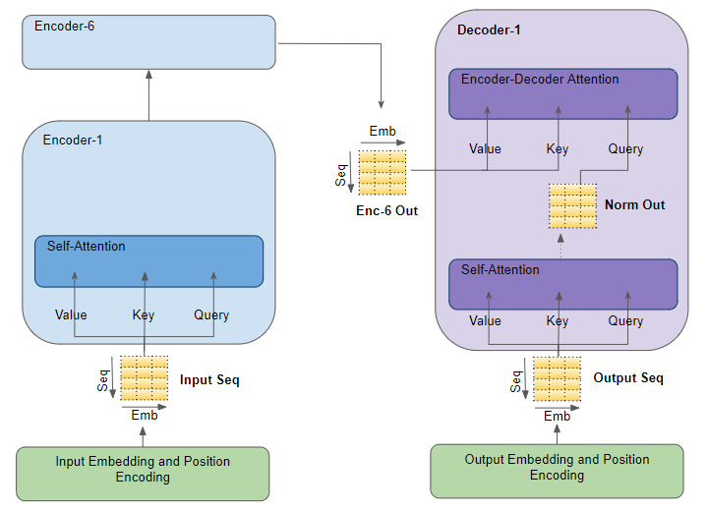
Encoder-Decoder Attention
Allow every position in decoder to attend over all positions in encoder’s output
Decoder focuses on relevant parts of input sequence

Slide 20
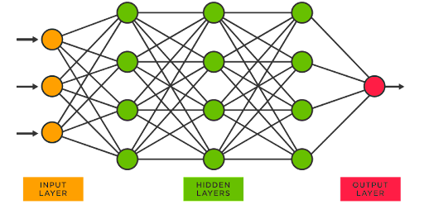

Position-wise Feed-Forward Networks
Allow more complex transformations of data
Operate on each position independently – maintain sequence order
Add depth and complexity to representation

Slide 21
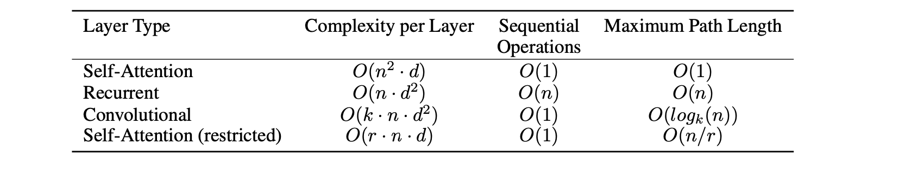
Why Self Attention?
Total computational complexity per layer
Amount of computation that can be parallelized
Path length between long range dependencies in network
Notes:
N – token number

Slide 22
Training
Standard WMT 2014 English-German dataset
Adam optimizer
β1 = 0.9, β2 = 0.98 and ε = 10−9
Varied learning rate
Increases LR linearly for warmup steps and then starts to decrease

Slide 23
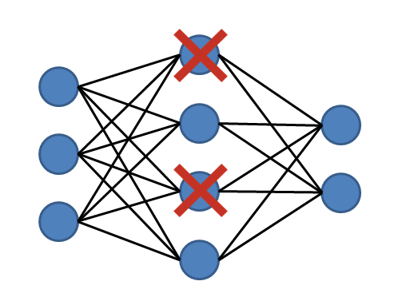
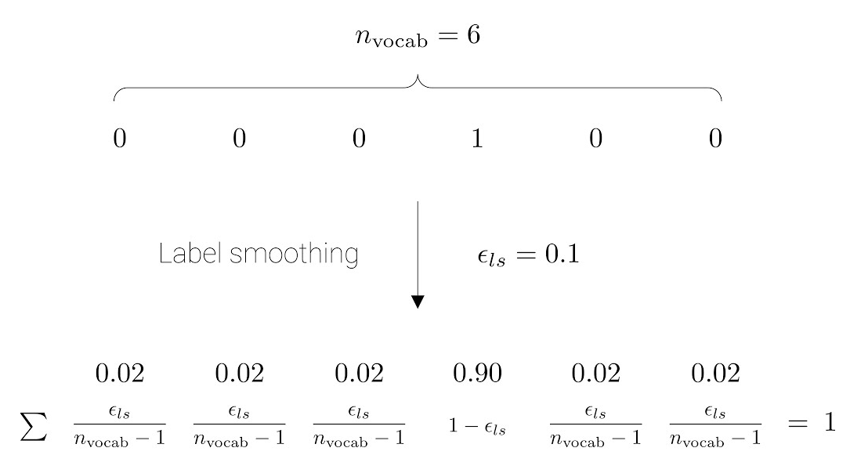
Regularization
Residual Dropout
Dropout to the output of each sub-layer before adding to the sub-layer input and normalized
Dropout to sum of embeddings and positional encodings
Label smoothing – penalize overconfident outputs
Model learns to be more unsure
Improves accuracy, BLEU score

Slide 24
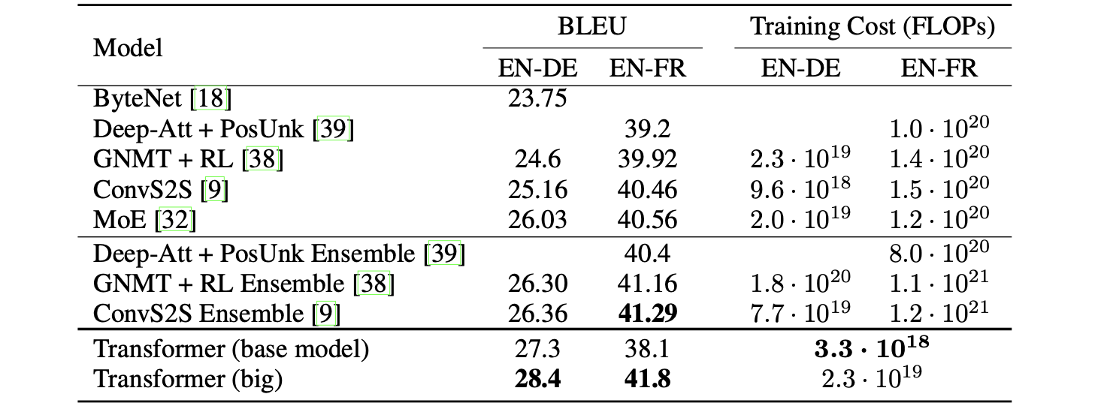
Results

Slide 25
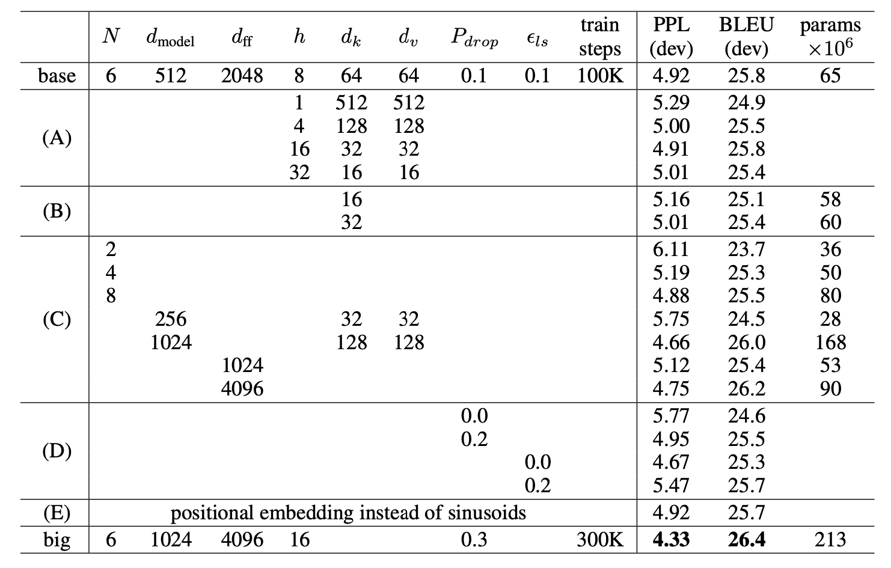
Model Variations

Slide 26
Conclusion
Transformer: based solely on self-attention
Replace recurrent layers with multi-headed self-attention
Trained much faster
Model outperforms previous state-of-art ensembles
Positional encodings allow processing data in order
Future of transformer architecture
BERT, GPT foundations (either encoder or decoder)
Vision - input and output modalities other than text

Slide 27
Critic
Strengths:
Efficient, scalable algorithm
Parallel architecture, attention
Results indicated in detail
Multiple experiments conducted
Foundation of BERT, GPT
Weaknesses:
Large dataset, computational recourses necessary
Fine-tuning needed for different tasks

Slide 28
Thank you for listening! Questions?

Slide 29
References
https://medium.datadriveninvestor.com/attention-in-rnns-321fbcd64f05
https://blog.floydhub.com/attention-mechanism/
https://medium.com/@vmirly/tutorial-on-scaled-dot-product-attention-with-pytorch-implementation-from-scratch-66ed898bf817
https://towardsdatascience.com/transformers-explained-visually-part-3-multi-head-attention-deep-dive-1c1ff1024853
https://towardsdatascience.com/understanding-positional-encoding-in-transformers-dc6bafc021ab
https://jalammar.github.io/illustrated-transformer/
https://www.spotfire.com/glossary/what-is-a-neural-network
https://towardsdatascience.com/coding-neural-network-dropout-3095632d25ce
https://www.youtube.com/watch?app=desktop&v=K0ytQ_KFkYM
https://jalammar.github.io/illustrated-transformer/

