Slide 1

Dropout as a Bayesian Approximation
Representing Model Uncertainty in Deep Learning
Original authors:
Yaring Gal and Zoubin Ghahramani – University of Cambridge
Presentation by: Simone Libutti – ETH Zürich

Slide 2
Introduction
Neural networks are extremely powerful tools for regression, classification, etc
The limiting factor is they can only make point estimates: no way to quantify uncertainty
Epistemic uncertainty: caused by lack of data
Aleatoric uncertainty: cause by the randomness of the observations
In this paper, Gal and Ghahramani use dropout to approximate a probabilistic model: a method they refer to as Monte Carlo dropout

Slide 3
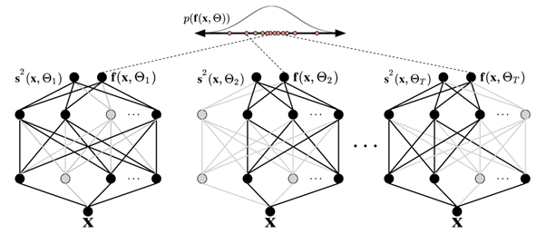
Introduction
MC dropout model: running a sample through an ensemble of networks and averaging $→$ defines distribution over outputs
Image credit

Slide 4
Motivation
There are multiple justifications to the usefulness of knowing the degree of confidence of a network prediction, such as:
High uncertainty results in classification can be passed to a human operator for further analysis
In reinforcement learning, an agent can decide whether to explore or exploit its environment using uncertainty
Automatic pipelines can be developed in regression tasks to discard doubtful results
These use cases are impactful and provide clear understanding of the benefits of the topic explored in the paper

Slide 5
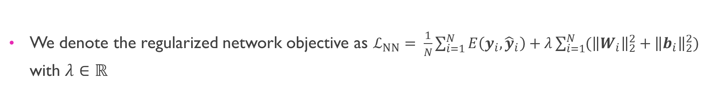
Background – neural networks
We can consider an $L$-layer neural network as a function $f=f_{1}∘…∘f_{L}$ where $f_{i}\left(x\right)=σ\left(W_{i}x+b_{i}\right)$
$W_{i}$ is a matrix, $b_{i}$ is a vector, $σ$is an element-wise non-linearity and $x$ is the network input
We denote the regularized network objective as $ℒ_{NN}= \frac{1}{N}\sum_{i=1}^{N}{E\left(y_{i}, {\hat{y}}_{i}\right)+λ\sum_{i=1}^{N}{({\left\|W_{i}\right\|}_{2}^{2}+{\left\|b_{i}\right\|}_{2}^{2})}}$ with $λ∈ℝ$
$E$ is a loss function (e.g., Mean Squared Error in regression), ${\left\{\left(x_{i}, y_{i}\right)\right\}}_{i=1}^{N}$ is a set of training points, and ${\hat{y}}_{i}≜{\hat{y}}_{i}\left(x_{i};W_{i}, b_{i}\right)=f_{i}\left(x_{i}\right)$ is the network output
The network is trained by minimizing the regularized objective as a function of the network parameters

Slide 6
Background – Dropout
Dropout is a regularization strategy that consists in randomly removing units from the network for each training sample
We sample $L$ binary vectors $z_{1},…,z_{L}$ such that $z_{i,j}∼Bern\left(p_{i}\right)$ and set $W_{i}=diag\left(z_{i}\right)W_{i}$ in the network (for example, $z=\left[0, 1, 1, 0,…,0\right]$)
The above operation zeros some of the rows of $W_{i}$, which is equivalent to “dropping” the corresponding units

Slide 7
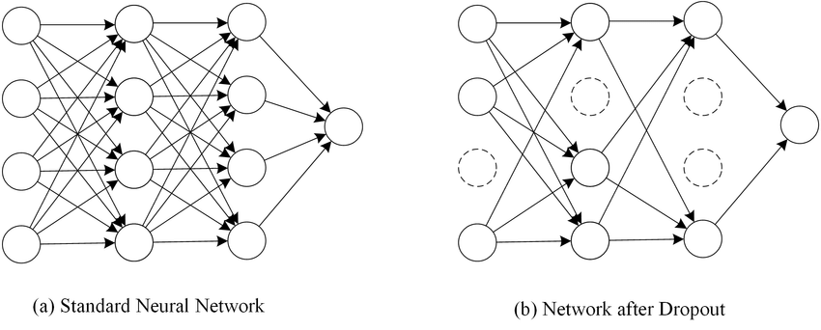
Background – Dropout
Image credit

Slide 8
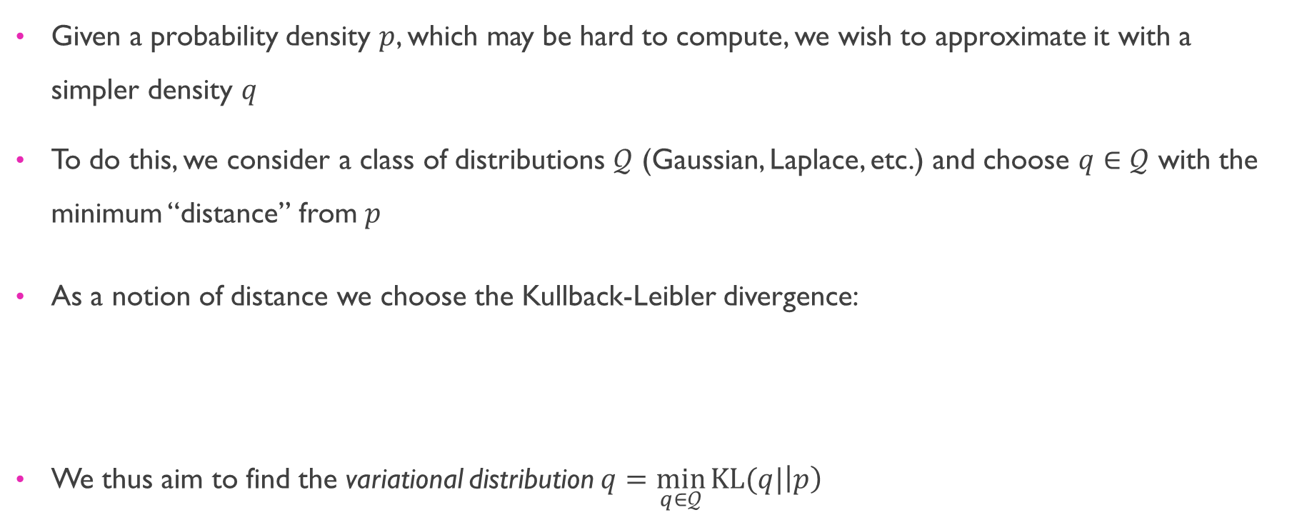
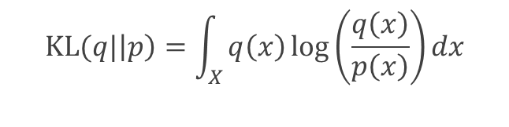
Background – Variational Inference
Given a probability density $p$, which may be hard to compute, we wish to approximate it with a simpler density $q$
To do this, we consider a class of distributions $𝒬$ (Gaussian, Laplace, etc.) and choose $q∈$ $𝒬$ with the minimum “distance” from $p$
As a notion of distance we choose the Kullback-Leibler divergence:
We thus aim to find the variational distribution $q=\min_{q∈𝒬}{KL(q|\left|p\right)}$
$$KL(q|\left|p\right)=\int_{X}{q\left(x\right)\log\left(\frac{q\left(x\right)}{p\left(x\right)}\right)dx}$$

Slide 9
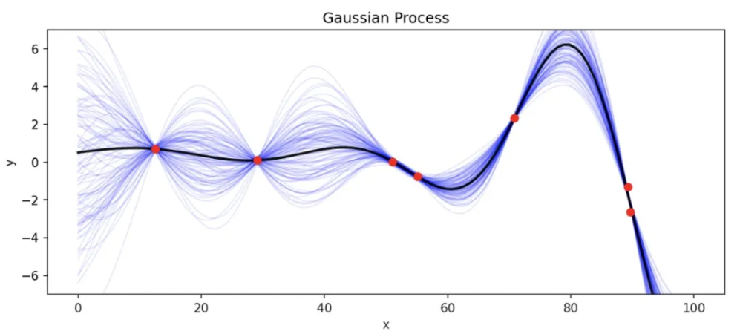
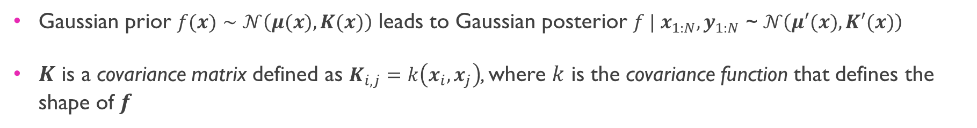
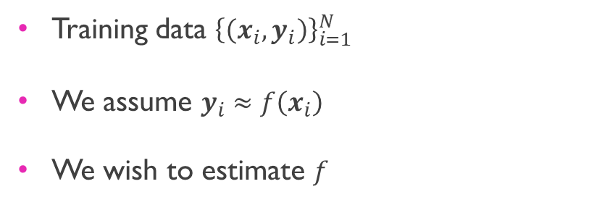
Background – Gaussian Processes
Image credit
Training data ${\left\{\left(x_{i}, y_{i}\right)\right\}}_{i=1}^{N}$
We assume $y_{i}≈f\left(x_{i}\right)$
We wish to estimate $f$
Gaussian prior $f(x)∼𝒩\left(μ(x), K(x)\right)$ leads to Gaussian posterior $f | x_{1:N}, y_{1:N}$ ~ $𝒩\left(μ′(x), K′(x)\right)$
$K$ is a covariance matrix defined as $K_{i,j}=k\left(x_{i}, x_{j}\right)$, where $k$ is the covariance function that defines the shape of $f$

Slide 10
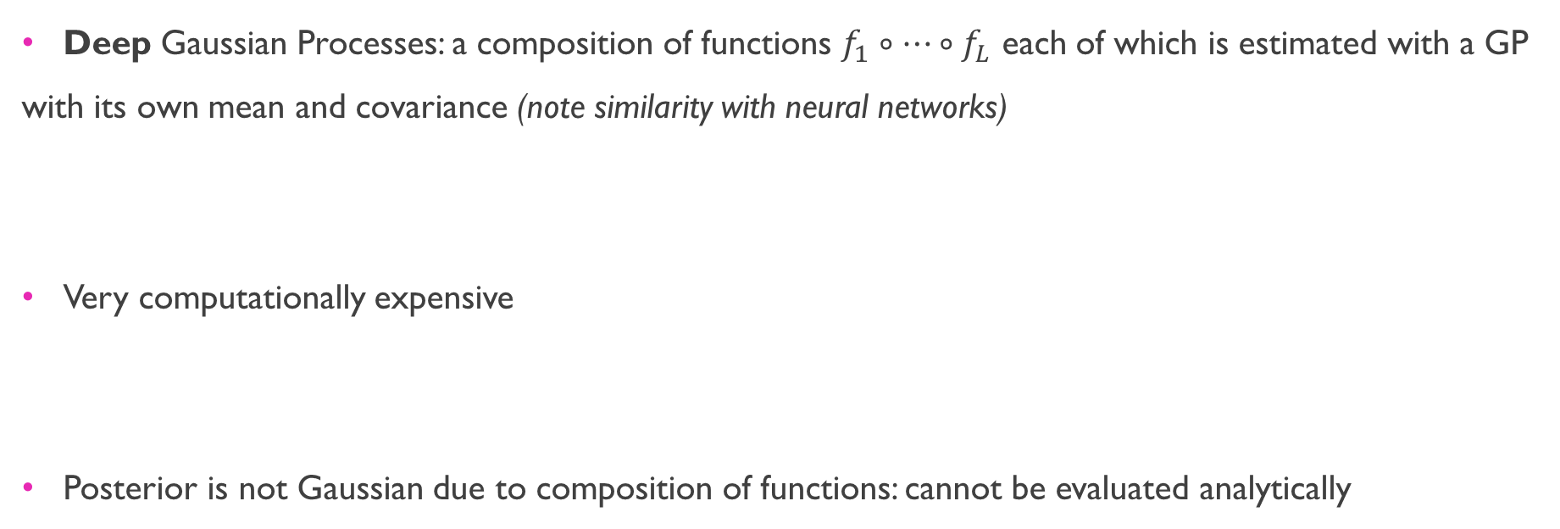
Background – Deep Gaussian Processes
Deep Gaussian Processes: a composition of functions $f_{1}∘…∘f_{L}$ each of which is estimated with a GP with its own mean and covariance (note similarity with neural networks)
Very computationally expensive
Posterior is not Gaussian due to composition of functions: cannot be evaluated analytically

Slide 11
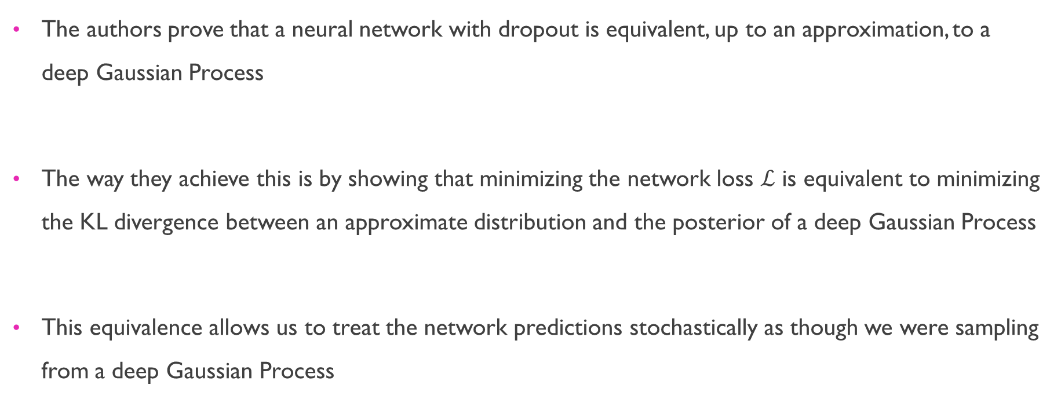
idea
The authors prove that a neural network with dropout is equivalent, up to an approximation, to a deep Gaussian Process
The way they achieve this is by showing that minimizing the network loss $ℒ$ is equivalent to minimizing the KL divergence between an approximate distribution and the posterior of a deep Gaussian Process
This equivalence allows us to treat the network predictions stochastically as though we were sampling from a deep Gaussian Process

Slide 12
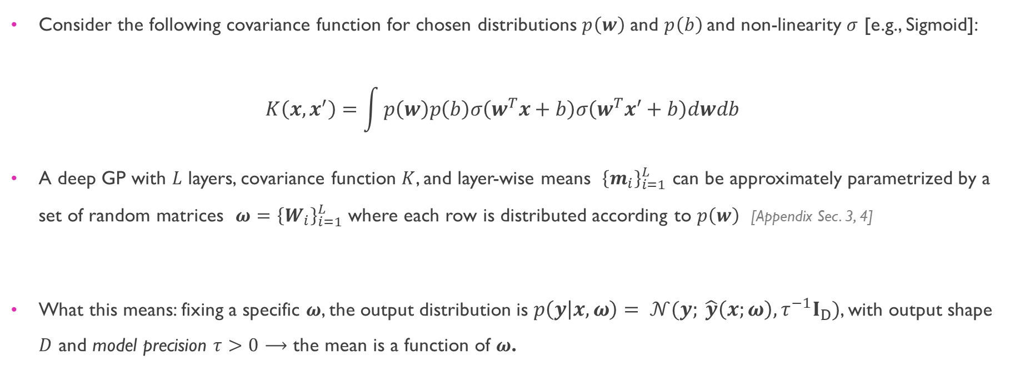
Execution – Building the Gaussian process
Consider the following covariance function for chosen distributions $p\left(w\right)$ and $p\left(b\right)$and non-linearity $σ$ [e.g., Sigmoid]:
$$K\left(x,x^{′}\right)=\int{p\left(w\right)p\left(b\right)σ\left(w^{T}x+b\right)σ\left(w^{T}x^{′}+b\right)dwdb }$$
A deep GP with $L$ layers, covariance function $K$, and layer-wise means ${\left\{m_{i}\right\}}_{i=1}^{L}$ can be approximately parametrized by a set of random matrices $ω={\left\{W_{i}\right\}}_{i=1}^{L}$ where each row is distributed according to $p\left(w\right)$ [Appendix Sec. 3, 4]
What this means: fixing a specific $ω$, the output distribution is $p\left(y | x,ω\right)= 𝒩(y; \hat{y}\left(x;ω\right), τ^{−1}I_{D})$, with output shape $D$ and model precision $τ>0$ $⟶$ the mean is a function of $ω$.

Slide 13
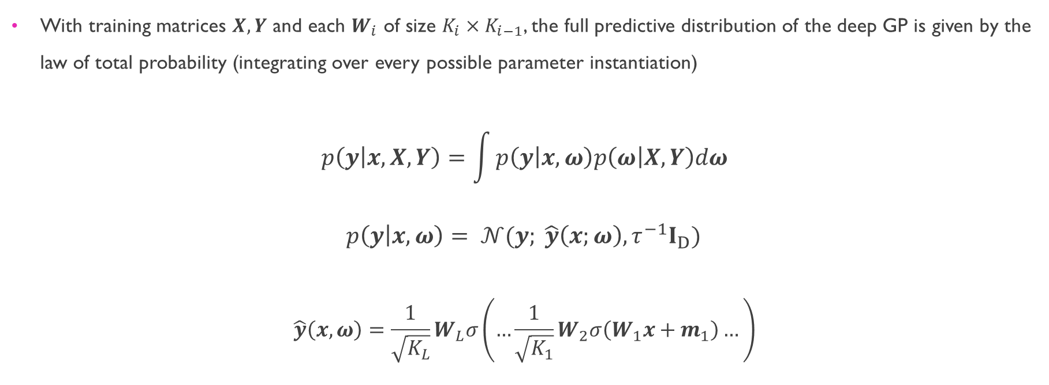
Execution – Building the Gaussian process
With training matrices $X, Y$ and each $W_{i}$ of size $K_{i}×K_{i−1}$, the full predictive distribution of the deep GP is given by the law of total probability (integrating over every possible parameter instantiation)
$$p\left(y | x, X, Y\right)=\int{p\left(y | x, ω\right)p\left(ω | X, Y\right)dω}$$
$p\left(y | x,ω\right)= 𝒩(y; \hat{y}\left(x;ω\right), τ^{−1}I_{D})$
$$\hat{y}\left(x,ω\right)=\frac{1}{\sqrt{K_{L}}}W_{L}σ\left(…\frac{1}{\sqrt{K_{1}}}W_{2}σ\left(W_{1}x+m_{1}\right)…\right)$$

Slide 14
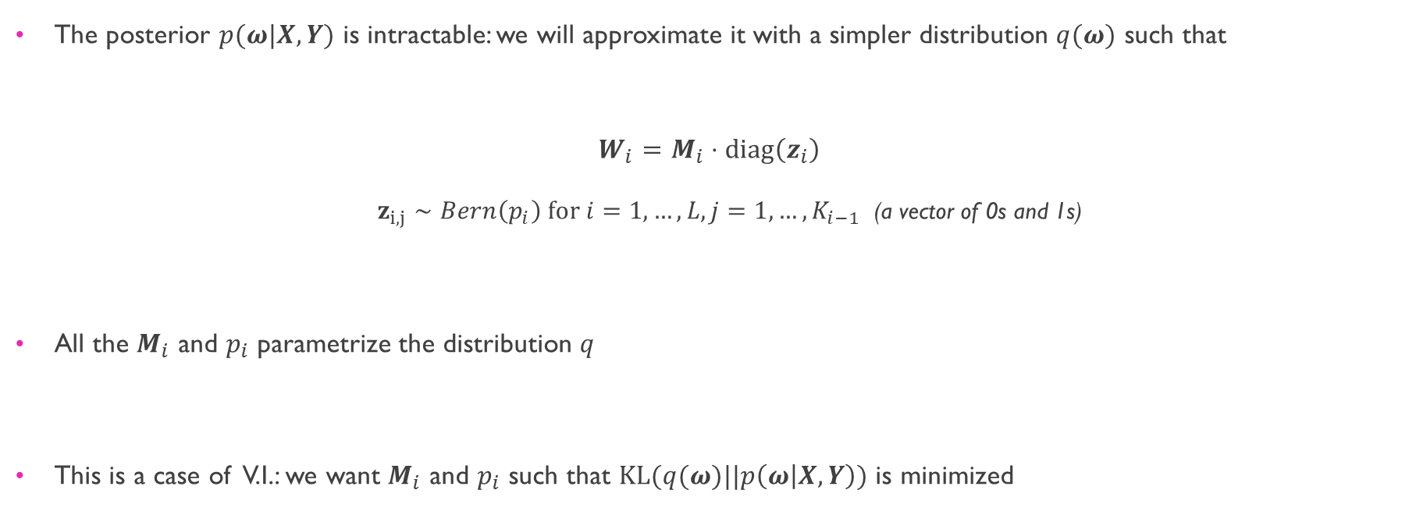
Execution – Approximating the gp posterior
The posterior $p(ω|X, Y)$ is intractable: we will approximate it with a simpler distribution $q(ω)$ such that
$$W_{i}=M_{i}⋅diag\left(z_{i}\right)$$
$z_{i, j}∼Bern\left(p_{i}\right) for i=1,…,L, j=1,…,K_{i−1}$ (a vector of 0s and 1s)
All the $M_{i}$ and $p_{i}$ parametrize the distribution $q$
This is a case of V.I.: we want $M_{i}$ and $p_{i}$ such that $KL(q(ω)||p\left(ω | X, Y\right))$ is minimized

Slide 15
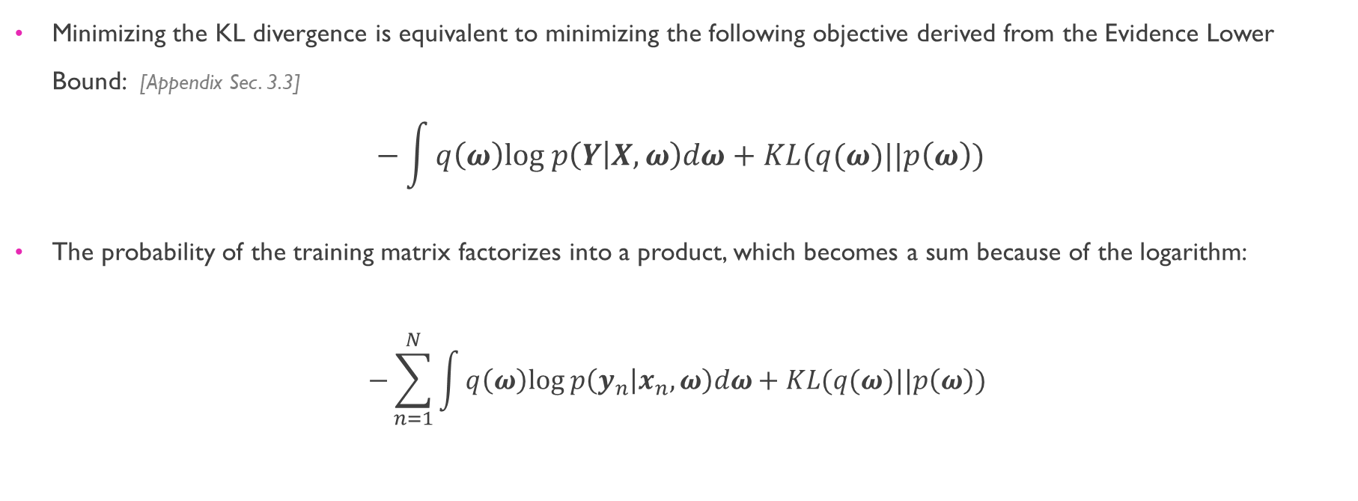
Execution – Approximating the gp posterior
Minimizing the KL divergence is equivalent to minimizing the following objective derived from the Evidence Lower Bound: [Appendix Sec. 3.3]
$$−\int{q\left(ω\right)log p\left(Y | X, ω\right)dω}+KL(q(ω)||p\left(ω\right))$$
The probability of the training matrix factorizes into a product, which becomes a sum because of the logarithm:
$$−\sum_{n=1}^{N}{\int{q\left(ω\right)log p\left(y_{n} | x_{n}, ω\right)dω+KL(q(ω)||p\left(ω\right)) }}$$

Slide 16
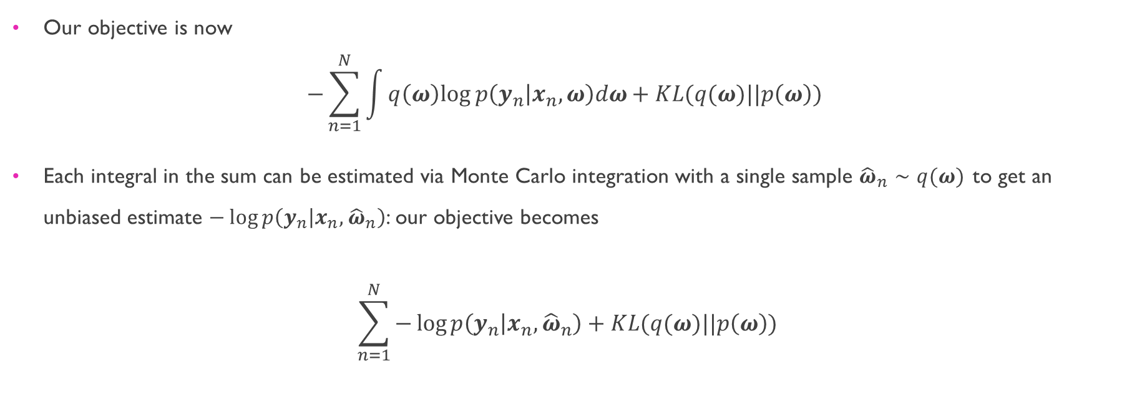
Execution – Approximating the gp posterior
Our objective is now
$$−\sum_{n=1}^{N}{\int{q\left(ω\right)log p\left(y_{n} | x_{n}, ω\right)dω+KL(q(ω)||p\left(ω\right)) }}$$
Each integral in the sum can be estimated via Monte Carlo integration with a single sample ${\hat{ω}}_{n}∼q(ω)$ to get an unbiased estimate $−\log{p\left(y_{n} | x_{n}, {\hat{ω}}_{n}\right)}$: our objective becomes
$$\sum_{n=1}^{N}{−\log{p\left(y_{n} | x_{n}, {\hat{ω}}_{n}\right)}}+KL(q(ω)||p\left(ω\right))$$

Slide 17
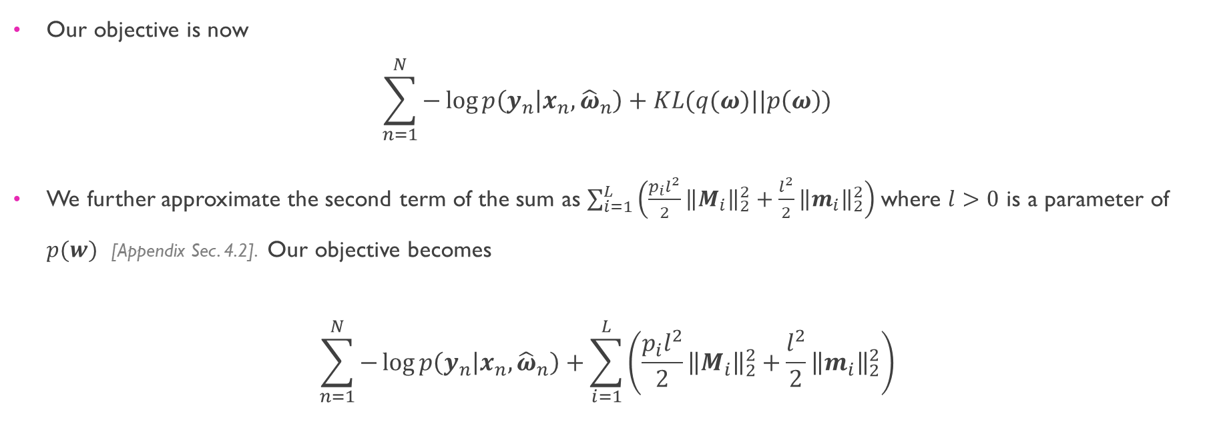
Execution – Approximating the gp posterior
Our objective is now
$$\sum_{n=1}^{N}{−\log{p\left(y_{n} | x_{n}, {\hat{ω}}_{n}\right)}}+KL(q(ω)||p\left(ω\right))$$
We further approximate the second term of the sum as $\sum_{i=1}^{L}{\left(\frac{p_{i}l^{2}}{2}{\left\|M_{i}\right\|}_{2}^{2}+\frac{l^{2}}{2}{\left\|m_{i}\right\|}_{2}^{2}\right)}$ where $l>0$ is a parameter of $p(w)$ [Appendix Sec. 4.2]. Our objective becomes
$$\sum_{n=1}^{N}{−\log{p\left(y_{n} | x_{n}, {\hat{ω}}_{n}\right)}}+\sum_{i=1}^{L}{\left(\frac{p_{i}l^{2}}{2}{\left\|M_{i}\right\|}_{2}^{2}+\frac{l^{2}}{2}{\left\|m_{i}\right\|}_{2}^{2}\right)}$$

Slide 18

Execution – Approximating the gp posterior
Scaling by $1/τN$, we get the final objective:
$$ℒ_{GP}∝\frac{1}{N}\sum_{n=1}^{N}{\frac{−\log{p\left(y_{n} | x_{n}, {\hat{ω}}_{n}\right)}}{τ}}+\sum_{i=1}^{L}{\left(\frac{p_{i}l^{2}}{2}{\left\|M_{i}\right\|}_{2}^{2}+\frac{l^{2}}{2}{\left\|m_{i}\right\|}_{2}^{2}\right)}$$
Letting $E\left(y_{n}, {\hat{y}}_{n}\right)=−\log{p\left(y_{n} | x_{n}, {\hat{ω}}_{n}\right)/τ}$ and setting $τ$ and $l$ appropriately, we recover the objective of a neural network with weight matrices $M_{i}$ and biases $m_{i}$
$$\frac{1}{N}\sum_{n=1}^{N}{E\left(y_{n}, {\hat{y}}_{n}\right)}+λ\sum_{i=1}^{L}{\left({\left\|M_{i}\right\|}_{2}^{2}+{\left\|m_{i}\right\|}_{2}^{2}\right)}$$

Slide 19
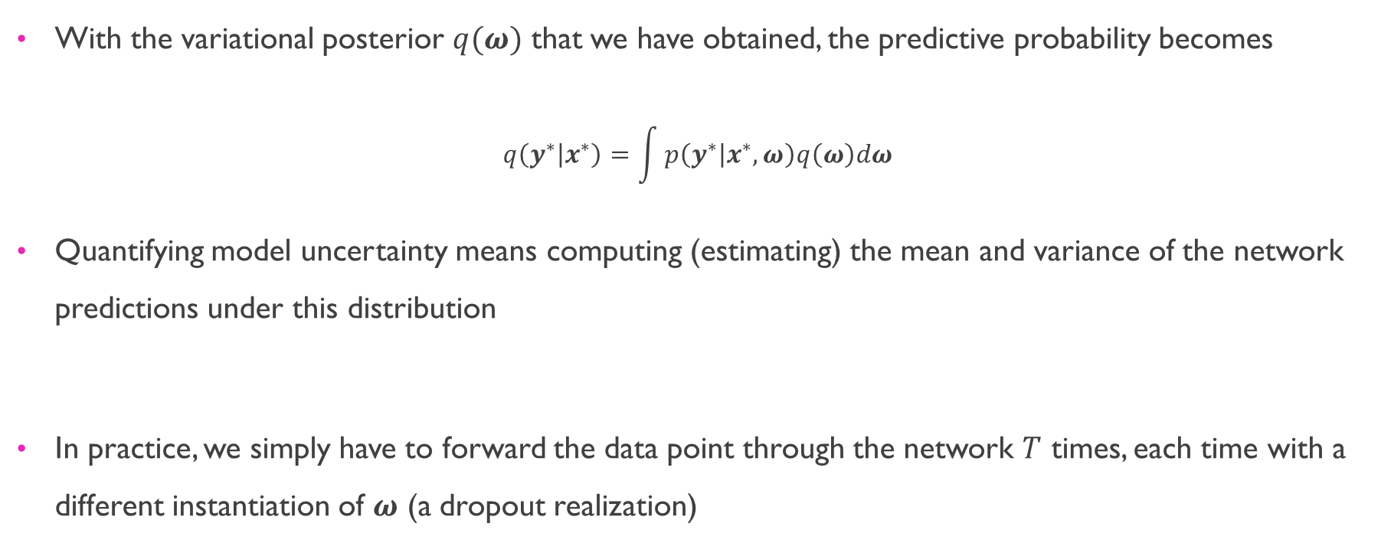
Execution – Obtaining model uncertainty
With the variational posterior $q(ω)$ that we have obtained, the predictive probability becomes
$$q\left(y^{∗} | x^{∗}\right)=\int{p\left(y^{∗} | x^{∗}, ω\right)q\left(ω\right)dω}$$
Quantifying model uncertainty means computing (estimating) the mean and variance of the network predictions under this distribution
In practice, we simply have to forward the data point through the network $T$ times, each time with a different instantiation of $ω$ (a dropout realization)

Slide 20
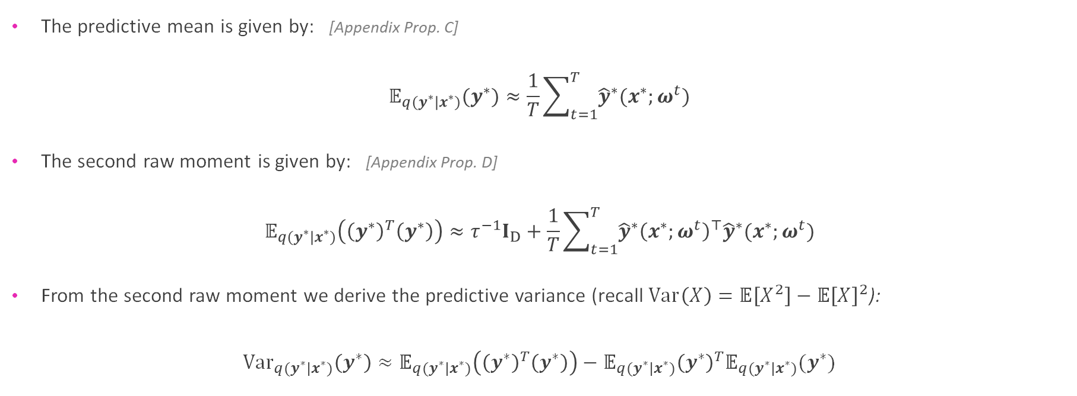
Execution – Obtaining model uncertainty
The predictive mean is given by: [Appendix Prop. C]
$$𝔼_{q(y^{∗}|x^{∗})}(y^{∗})≈\frac{1}{T}\sum_{t=1}^{T}{{\hat{y}}^{∗}(x^{∗};ω^{t})}$$
The second raw moment is given by: [Appendix Prop. D]
$$𝔼_{q(y^{∗}|x^{∗})}\left({\left(y^{∗}\right)}^{T}\left(y^{∗}\right)\right)≈τ^{−1}I_{D}+\frac{1}{T}\sum_{t=1}^{T}{{\hat{y}}^{∗}{\left(x^{∗};ω^{t}\right)}^{⊤}{\hat{y}}^{∗}(x^{∗};ω^{t})}$$
From the second raw moment we derive the predictive variance (recall $Var\left(X\right)=𝔼\left[X^{2}\right]−𝔼{\left[X\right]}^{2}$):
${Var}_{q(y^{∗}|x^{∗})}\left(y^{∗}\right)≈𝔼_{q(y^{∗}|x^{∗})}\left({\left(y^{∗}\right)}^{T}\left(y^{∗}\right)\right)−$ $𝔼_{q(y^{∗}|x^{∗})}{\left(y^{∗}\right)}^{T}𝔼_{q(y^{∗}|x^{∗})}(y^{∗})$

Slide 21
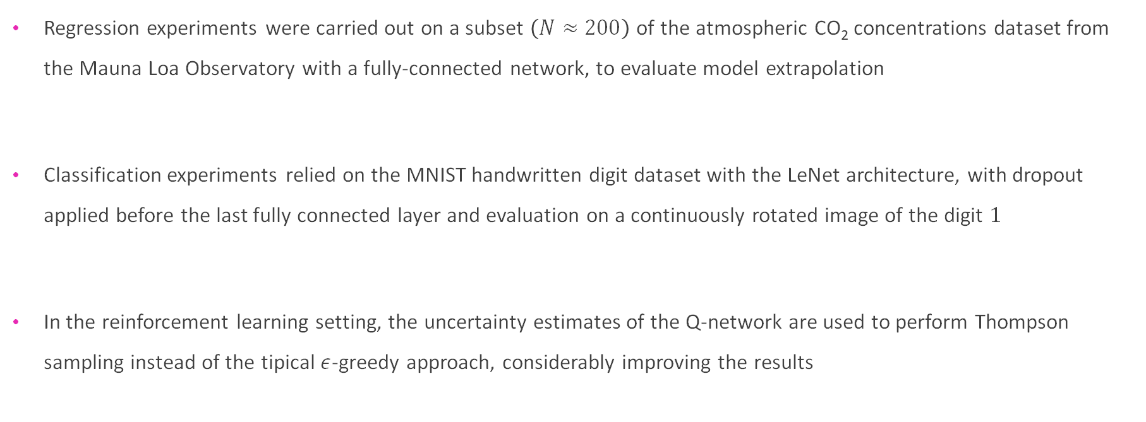
Experiments
Regression experiments were carried out on a subset $\left(N≈200\right)$ of the atmospheric CO₂ concentrations dataset from the Mauna Loa Observatory with a fully-connected network, to evaluate model extrapolation
Classification experiments relied on the MNIST handwritten digit dataset with the LeNet architecture, with dropout applied before the last fully connected layer and evaluation on a continuously rotated image of the digit $1$
In the reinforcement learning setting, the uncertainty estimates of the Q-network are used to perform Thompson sampling instead of the tipical $ε$-greedy approach, considerably improving the results

Slide 22
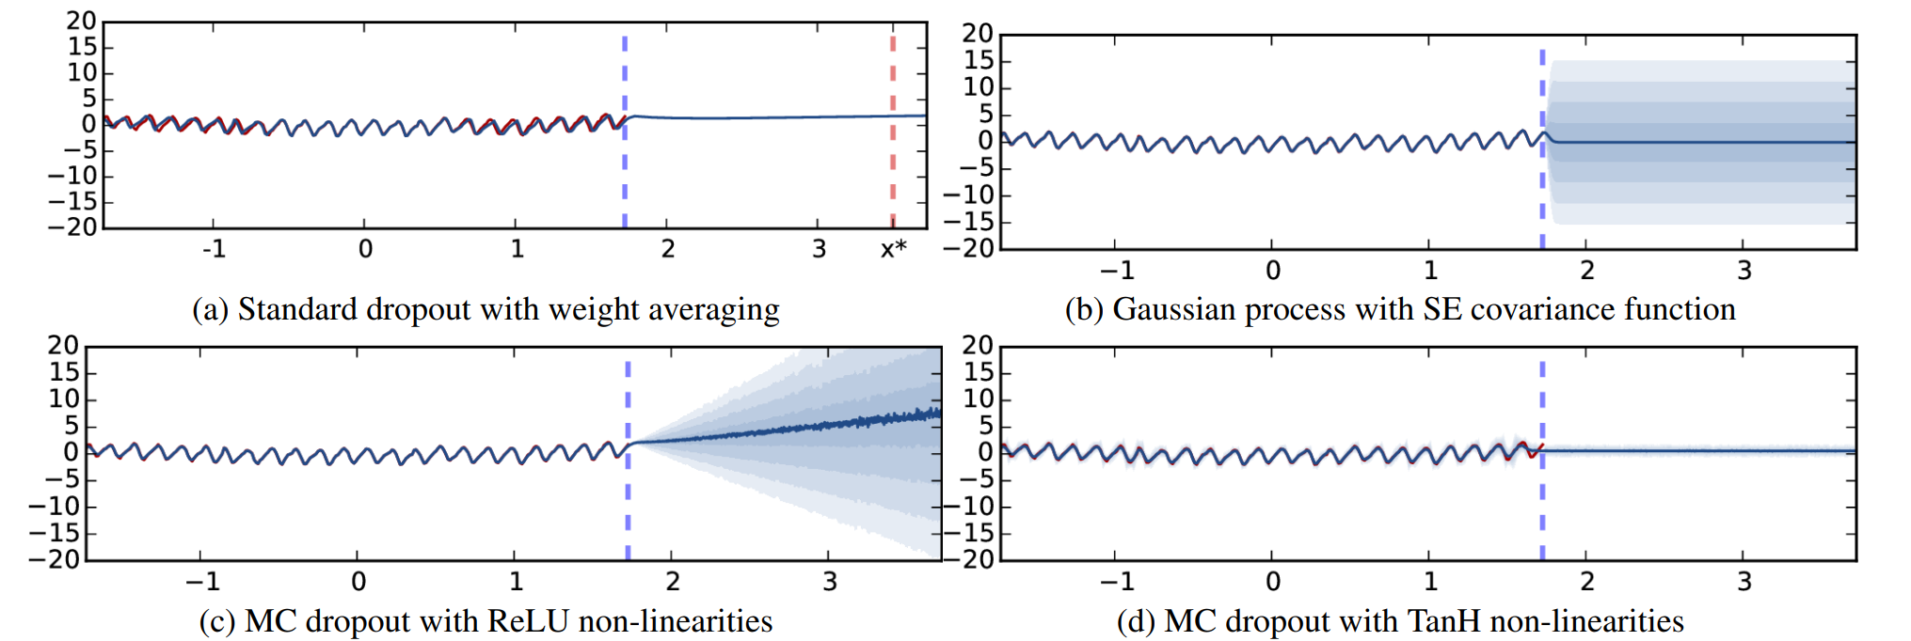
Experiments – REGRESSION
Image from original paper
Left of the dashed line: training predictions and ground truth
Right of the dashed line: test predictions
Model extrapolates poorly (doesn’t capture periodicity) but shows uncertainty
Each shade of blue represents ½ standard deviation
ReLU: farther points have more uncertainty, TanH: uncertainty is constant

Slide 23
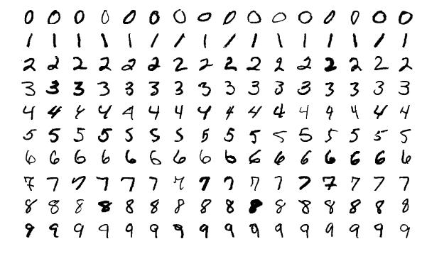
Experiments – CLASSIFICATION
Image credit

Slide 24
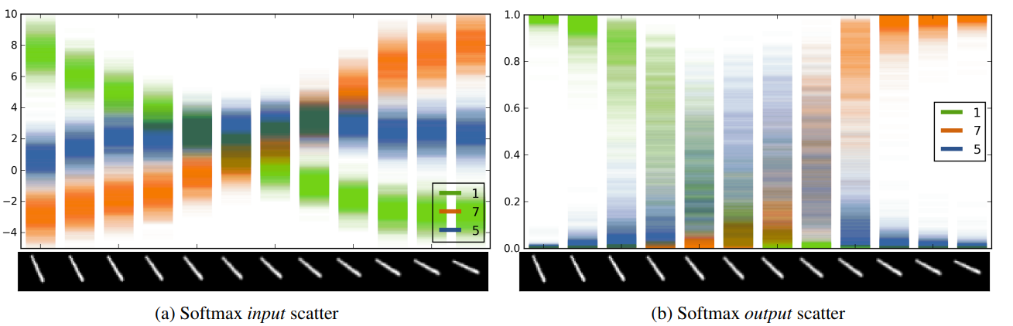
Experiments – CLASSIFICATION
Image from original paper
For each image, 100 forward passes
Top 3 values for softmax input and output are shown
For the 12 images, the model predicts classes [1 1 1 1 1 5 5 7 7 7 7 7 ]
In the middle images, uncertainty is high
There is significant overlap between softmax values
This means the networks in the “ensemble” predict very different values from one another

Slide 25
Experiments – CLASSIFICATION
Image from original paper

Slide 26
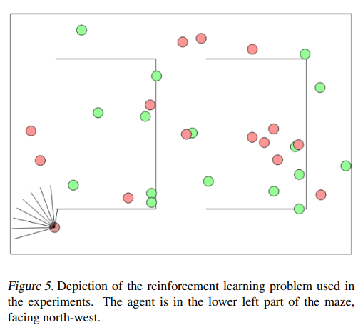
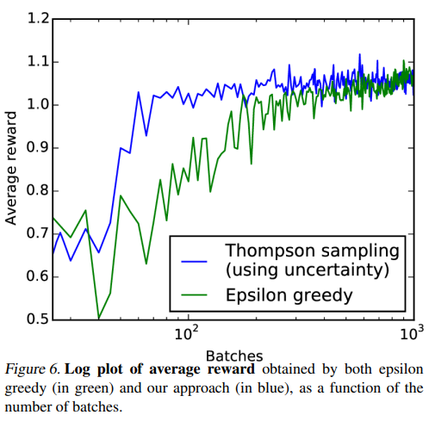
Experiments – Reinforcement Learning
Images from original paper

Slide 27
Remarks – Strengths
As already stated in the motivation section, the wide range of applications of uncertainty estimation make it an essential tool for the deep learning practitioner
The mathematical examination of the topic is rigorous and doesn’t rely, as is common in deep learning, on purely empirical justifications of the results
Despite the theoretical complexity of the analysis that is carried out in the paper, the results are extremely straightforward to implement in practice

Slide 28
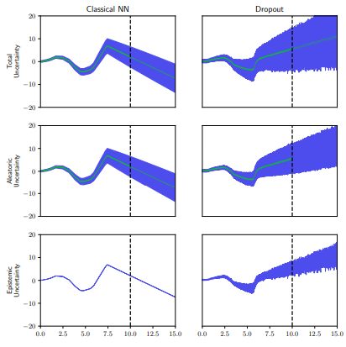
Remarks – Weaknesses
Monte Carlo dropout cannot disentangle aleatoric and epistemic uncertainty
In A Deeper Look into Aleatoric and Epistemic Uncertainty Disentanglement, the authors train the model to estimate the two uncertainties separately
In the picture on the right, in the case of the MC Dropout method, the artificial aleatoric noise is grossly overestimated

Slide 29
Thank you
Questions?

