Slide 1
Pay attention to mlps!
MLPs = Multi Layer Perceptrons
Google Research, Brain Team
2021

Slide 2
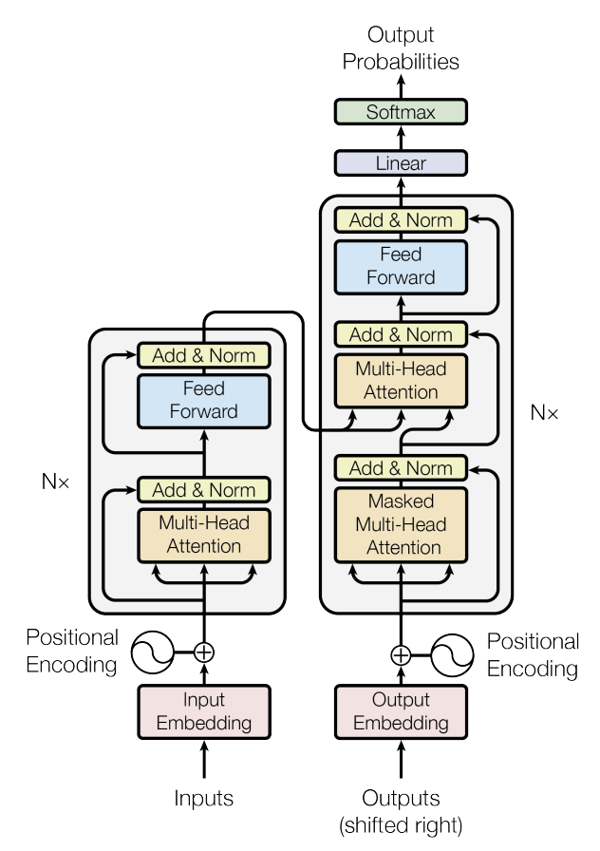
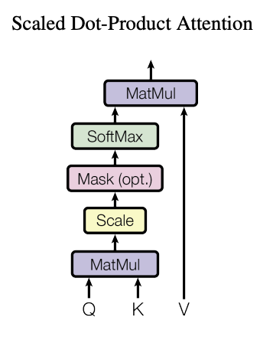
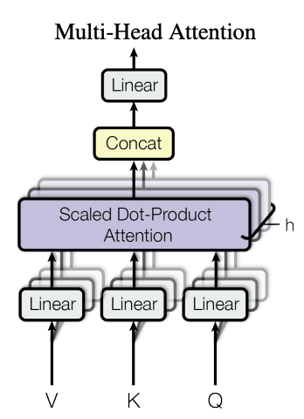
Example What a nice day
Q: nice
K: What a nice day
Notes:
Vector representation
key: set of words
query: relevance to this specific word
Value: value of query within the sentence
Multihead attention: do it with several versions in parallel

Slide 3
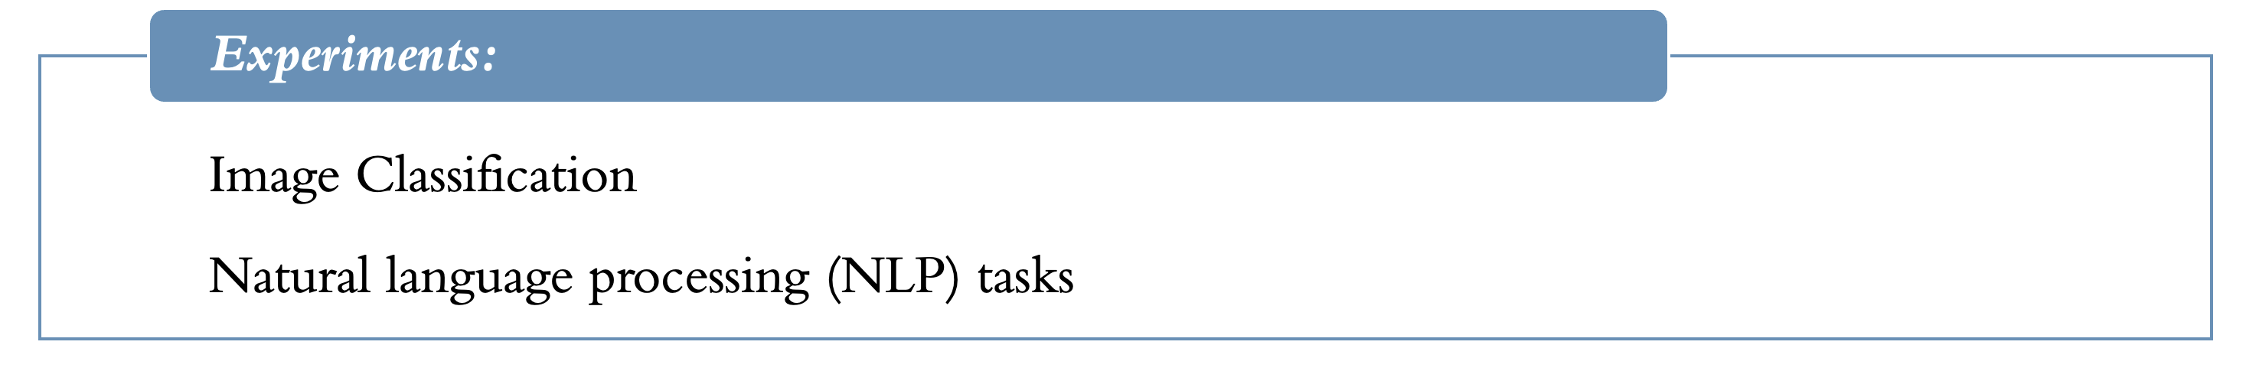
About the paper
Motivation:
Is self-attention necessary?
⇒ Gated multi layer perceptron (gMLP)
Experiments:
Image Classification
Natural language processing (NLP) tasks

Slide 4
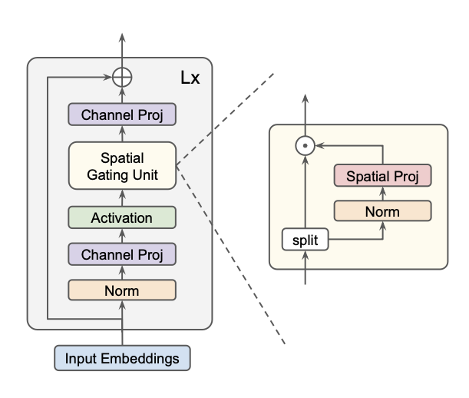





Gated Multi-Layer Perceptron (gMLP)
1.
GELU
2.
3.
Init:
W near 0’s
b all 1’s
Notes:
Channel projection 1: convert input to a more informative data e.g. colored image -> information about the red, blue, green
Channel projection 2: reformate input from SGU to as cp1
Split: focus only on one part of the information to find valuable insights
Only gradually injects spatial information during training

Slide 5
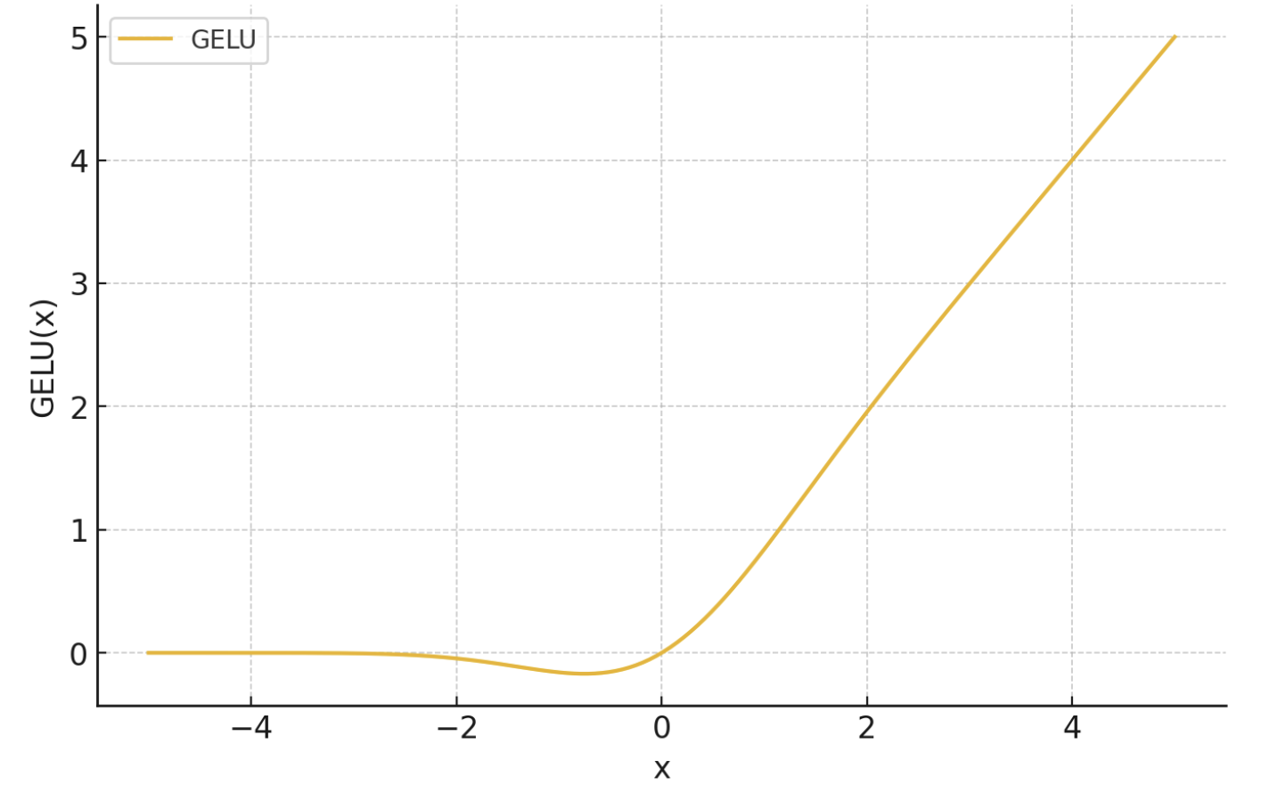
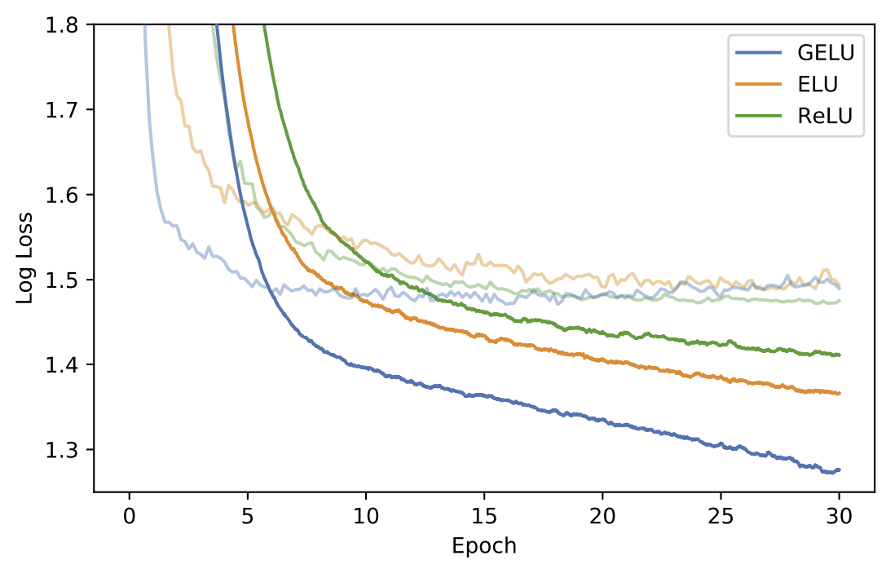
Gaussian Error Linear Unit (GELU)
GELU(x) = xP(X ≤ x) = xΦ(x)
Idea
Combine ReLU, dropout and zoneout
where X ~ N(0,1)
⇒ GELU has faster convergence rate
TIMIT Frame Classification
Notes:
Advantage: it is non-monoton and and non-convex => approx. more complicated functions (Relu is linear in the pos. domain)
MNIST classification, MNIST autoencoder
SOURCE Gelu:
Hendrycks, D. and Gimpel, K. (2016). Gaussian error linear units (GELUs)

Slide 6
Image classification

Slide 7
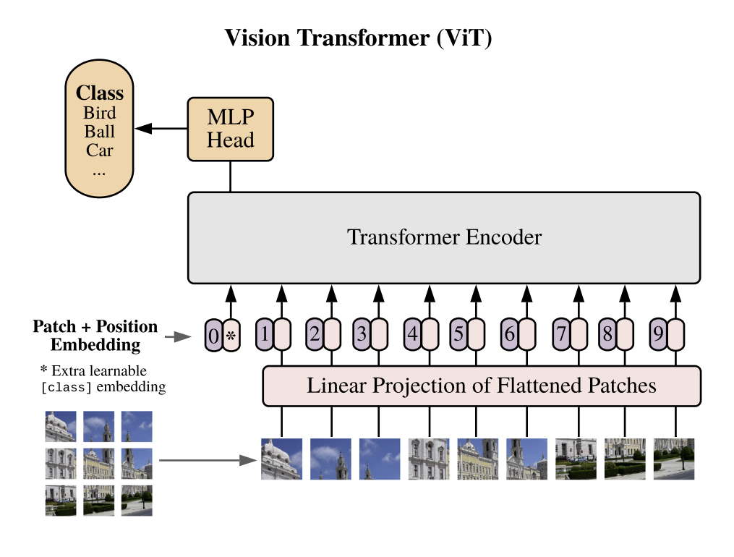
Setup
Input/Output: ViT/B16
Regularization like DeiT:
L2-regularization
Stochastic depth
gMLP
16 x 16
Notes:
MLP in Transformer Encoder: use same/similar width and depth of the layer
Stochastic depth for increasing model size (avoid vanishing gradient)
- randomly (based on stochastic value) drops layer
DeiT: Data efficient image transformer

Slide 8









Results
gMLP
greater model size
⇒ higher accuracy
gMLP as good as Transformer
⇒ No self-attention needed.
gMLP best among MLPs
But ConvNets are better!
Transformer
MLP-Mixer
ConvNets

Slide 9
NLP tasks

Slide 10
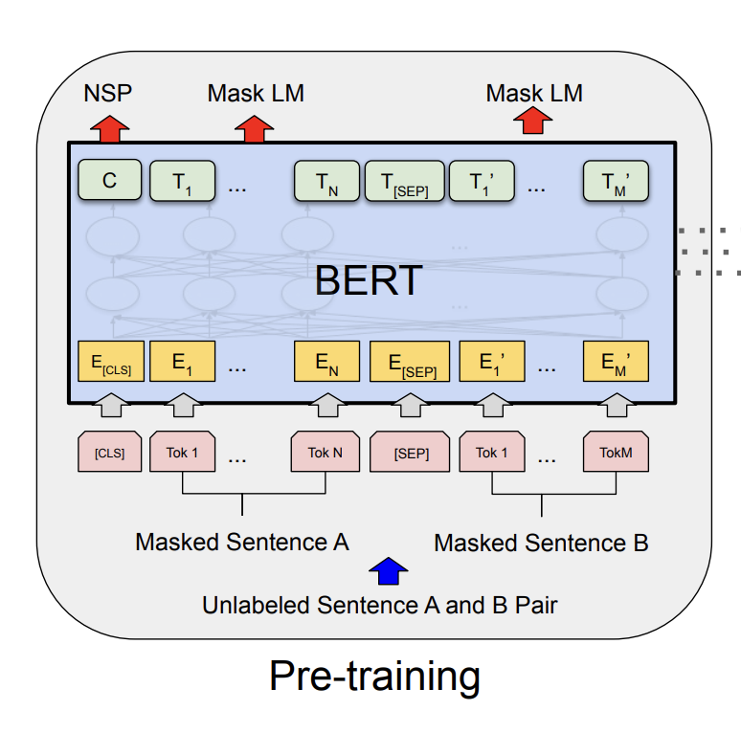
Setup
Only difference:
No positional encoding
Notes:
No positional encoding, mask out pad-tokens in finetuning (bc model learns to ignore)

Slide 11

Ablation study
Definition (Wikipedia):
“An ablation study investigates the performance of an AI system by removing certain components to understand the contribution of the component to the overall system.”
Baselines:
BERT
BERT + relative position bias (rel. pos)
BERT + rel. pos – attention
MLP-Mixer
gMLP with $s\left(Z\right)=$ …
$f(Z)$
$Z+ f\left(Z\right)$
$Z ⨀ f\left(Z\right)$
$Z_{1} ⨀ f\left(Z_{2}\right)$
Notes:
Learnable relative position bias: https://arxiv.org/pdf/1910.10683
how much emphasis on the position embedings should be given relative to other tokens (positional influence of a token included – in attention usually ignored)
Wikipedia definition: https://en.wikipedia.org/wiki/Ablation_(artificial_intelligence)

Slide 12
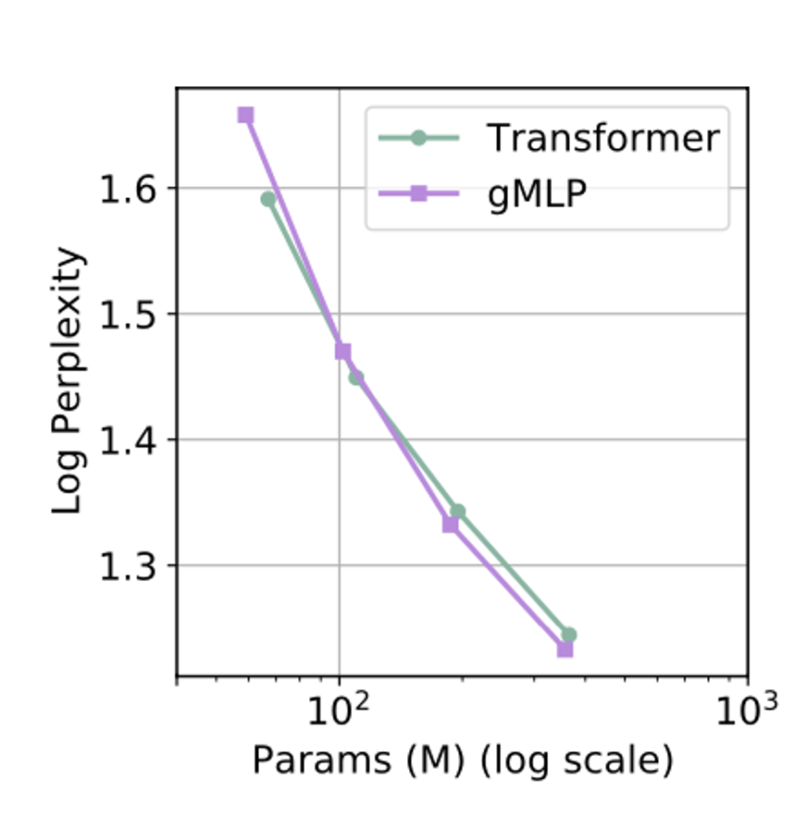
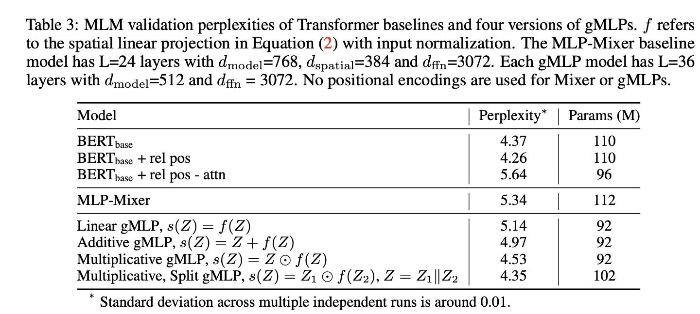
Ablation study Results
Data
RealNews-like subset of C4

Slide 13
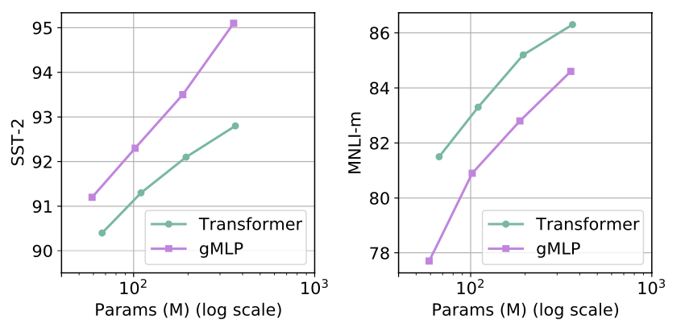
Finetuning Results
Notes:
Perplexity only important in model size not attention

Slide 14
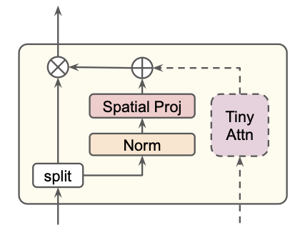
Tiny Attention
1 head with size 64

Slide 15
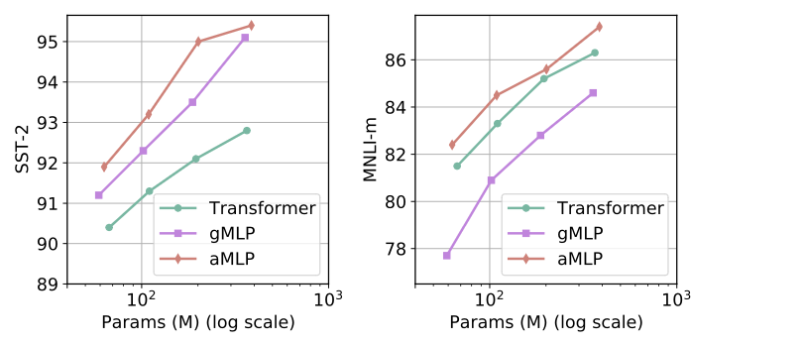
Finetuning Results Again…

Slide 16
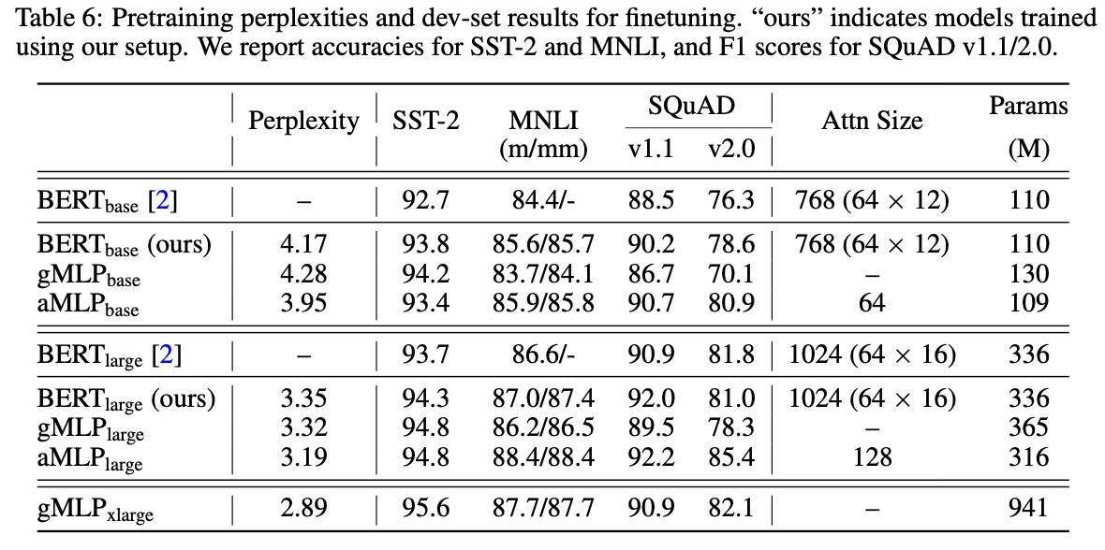
Main results
Increase model size !
Add some attention !

Slide 17
Related work
Gating techniques
Yann N. Dauphin et al. (2017).
Language Modeling with Gated Convolutional Networks.
Hochreiter, S. and Schmidhuber, J. (1997).
Long Short-term Memory. Neural computation, 9, 1735-80.
Attention alternatives
Ilya Tolstikhin et al. (2021).
MLP-Mixer: An all-MLP Architecture for Vision.
James Lee-Thorp et al. (2022).
FNet: Mixing Tokens with Fourier Transforms.
Junxiong Wang et al. (2023).
Pretraining Without Attention.
Tiny attention
Daniel Y. Fu et al. (2023).
Hungry Hungry Hippos: Towards Language Modeling with State Space Models.
Notes:
self-attention mechanism commonly used in transformer models with Fourier transforms: achieve faster processing speeds and use fewer resources
Bidirectional Gated State Space Model (BiGS) which employs state-space models (SSMs) and a multiplicative gating architecture for sequence routing

Slide 18


How did I like the paper?
Well structured
Describes setup understandably
Broad application
Considers attention
Unexplained abbreviations
Advantages?
many references regarding
the setup

Slide 19
Summary
Image classification
gMLP as good as Transformers
Self-attention not necessary
But very helpful
NLP tasks
For outperforming transformers:
Increase model size
Add attention
Perplexity is defined by model size

Slide 20
Thank you!!!

Slide 21
SST-2
Stanford sentiment treebank: binary classification
This is an amazing holiday => positive
I hate sleep => negative

Slide 22
MNLI-m
Multi-Genre Natural Language Inference-matched
Premise: It is dry outside.
Hypothesis: It is raining.
Contradiction
Hypothesis: It is sunny.
Neutral
Hypothesis: I don’t need an umbrella.
=> Entailment: Reasonable conclusion

Slide 23
SQuAD
Stanford Question Answering Dataset
Info: “The grey elephant is 34 kg and was walking around.
Question V1.1: “What was the grey elephant doing?”
Walking around.
Question V2.0: “How old is the elephant?”
I don’t know.
Notes:
Show only ‘til 25

Slide 24
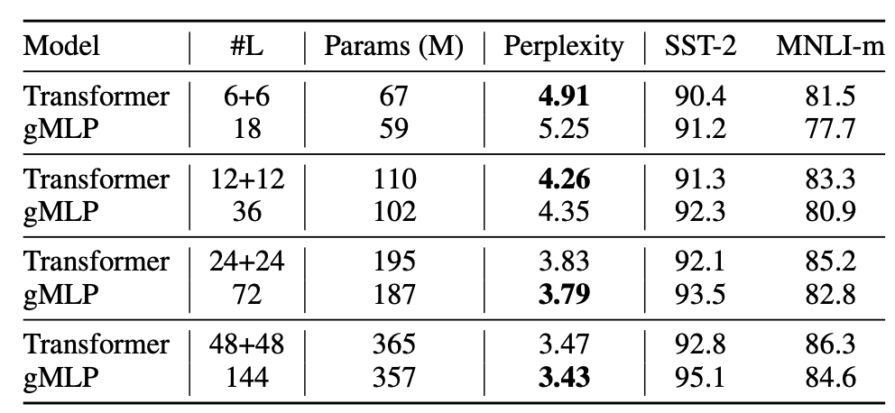
Finetuning results

Slide 25
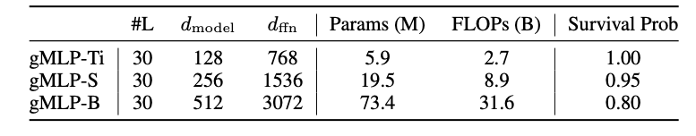
gMLP specifications
Apply strength of stochastic depths for increasing model size

Slide 26
Ablation & case study (2 NLP tasks):
Batch size: 2048
Max length: 128
125K steps
- Subset of C4 English dataset
Main results:
Batch size: 256
Max length: 512
1M steps
Full C4 English dataset

