Slide 1
gRPC
RPC the right way
Bruno Mendes
Fernando Rego
José Costa

Slide 2
TABLE OF CONTENTS
01
02
03
04
What is RPC?
gRPC (and protobuf)
A small introduction on RPC and its history
Core concepts, architecture, lifecycle and features
gRPC for microservices
Demo
Advantages and downsides in a microservices context
A calculator app using gRPC to communicate between heterogeneous architecture components.

Slide 3
—Sam Newman, Building Microservices: Designing Fine-Grained Systems
“if bridge building were like programming, halfway through we’d find out that the far bank was now 50 meters farther out, that it was actually mud rather than granite, and that rather than building a footbridge we were instead building a road bridge.”

Slide 4
01
What is RPC?
A small introduction on RPC and its history

Slide 5
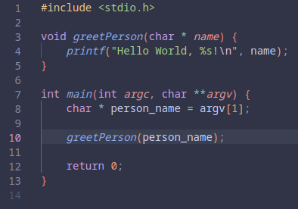

Context
What if we want to call a procedure in a different address space, i.e., remote computer?
Calling a local procedure

Slide 6
Concept
Make remote calls just as simple as local calls
RPC is a protocol that enables users to work with remote procedures as if it were a local procedure call without explicit details about remote interactions
Implemented by various platforms and programming languages (e.g. Java RMI for Java and RPyC for Python)
History:
1970s - theoretical proposals of remote procedure calls
1980s - practical implementations of RPC
1981 - Bruce J. Nelson became known as the creator of the RPC

Slide 7
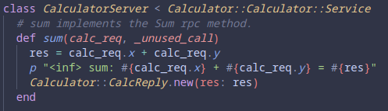
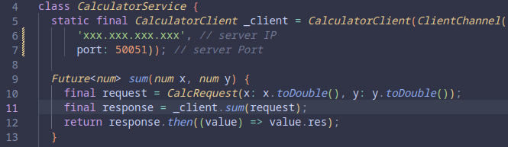
Example: generated code
Server - developed using Ruby
Client - developed using Dart

Slide 8
02
gRPC
(and protobuf)
Core concepts, architecture, lifecycle and features

Slide 9
What is gRPC? - introduction
gRPC (Google Remote Procedure Call) is an open-source remote procedure call system.
Developed initially by Google in 2015.
Uses Protocol Buffers and enables authentication, bidirectional streaming and flow control, among other features.
This technology is used by various companies, such as Netflix, Cisco, and others.

Slide 10
gRPC - presentation
What does gRPC stand for?
gRPC Remote Procedure Calls, of course!
But what it is?
gRPC is a modern open source high performance Remote Procedure Call (RPC) framework that can run in any environment. It can efficiently connect services in and across data centers with pluggable support for load balancing, tracing, health checking and authentication. It is also applicable in last mile of distributed computing to connect devices, mobile applications and browsers to backend services.
More on gRPC: History and Principles
Notes:
As presented in the gRPC website
gRPC was initially created by Google, which has used a single general-purpose RPC infrastructure called Stubby to connect the large number of microservices running within and across its data centers for over a decade. In March 2015, Google decided to build the next version of Stubby and make it open source. The result was gRPC, which is now used in many organizations outside of Google to power use cases from microservices to the “last mile” of computing (mobile, web, and Internet of Things).

Slide 11
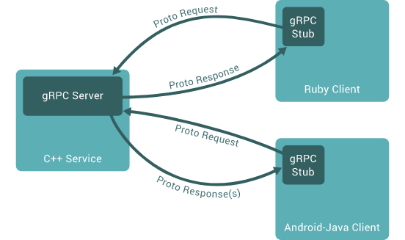
gRPC - architecture overview
Notes:
As in a traditional RPC service the server provides a set of services that other client applications can request and use remotely. These services are invoked with the necessary parameters and return, if any, a response with the result.
One of the features of gRPC is being language agnostic, with official support for several popular languages, making it attractive for heterogeneous environments.
On the server, the service interface is implemented. Client applications have a so called stub (many times referred to as the client depending on the language) that exposes the same methods declared in the interface and defined in the server. The application, after invoking one of the services exposed by the stub, connects to the server where the service makes the necessary operations. Messages exchanged follow the protobuf protocol.

Slide 12
gRPC - protobuf
Protocol Buffers are a language-neutral, platform-neutral extensible mechanism for serializing structured data.
Main features:
Smaller and faster than JSON
Native language bindings
Allow for update of definition without code update
Notes:
Not only messages, but also the service interface, are built using protocol buffers.
By default, gRPC uses protobuf for structured data serialization and deserialization needs (it can be used with other formats like json).
The service interface and methods, as well as the message structure for parameters and return messages is defined in a protofile.

Slide 13
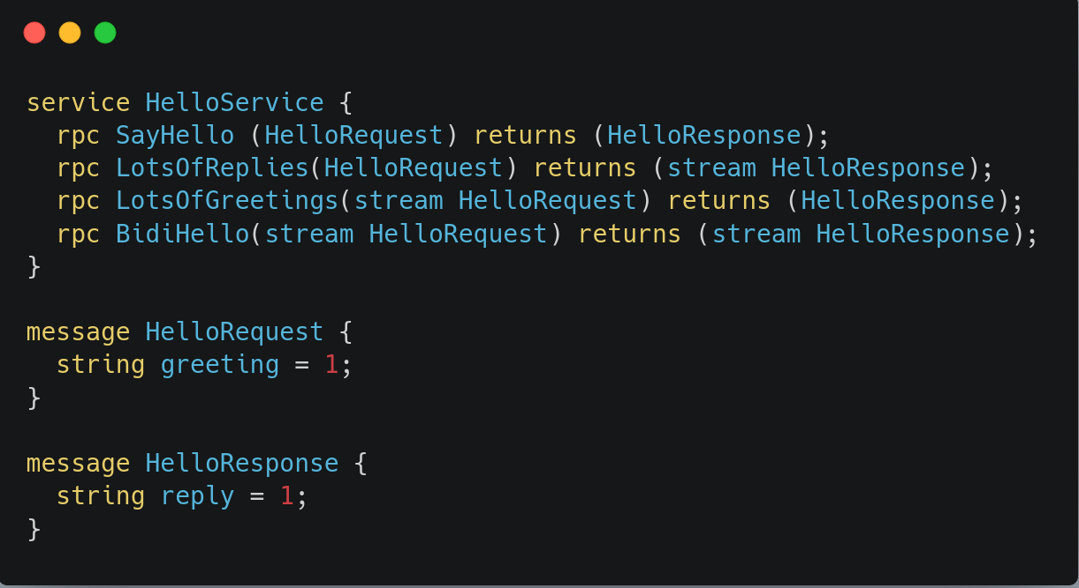
gRPC - protobuf
Notes:
From a file like this and running the protobuff compiler we get the service server interface and client stub as well as the message types to be used in the application code. This generated code is language dependent, allowing for seamless integration with the application.
gRPC supports 4 kinds of service:
Unary RPCs - normal function call
Server streaming RPCs - client sends request and gets a stream to read a sequence of messages. The client reads from the stream until there are no more messages.
Client streaming RPCs - where the client writes a sequence of messages and sends them to the server, again using a provided stream. Once the client finishes writing wait for the server to read them and for its response
Bidirectional streaming RPCs - both sides write sequences of messages using different streams, so clients and servers can write and read in whatever order they want.

Slide 14
gRPC - core concepts
Synchronous and asynchronous flavours
Deadlines/timeouts
Specification is languanguage specific (using durations or fixed points in time)
Independent and local termination
Server and client may not agree on call success
Server or client can cancel RPC at any time
Metadata
Extra information about a specific RPC call
Channels
Provides a connection to a server on a specified host and port
Notes:
Independent and local termination - This means that, for example, you could have an RPC that finishes successfully on the server side (“I have sent all my responses!”) but fails on the client side (“The responses arrived after my deadline!”).
Metadata - User-defined metadata is not used by gRPC, which allows the client to provide information associated with the call to the server and vice versa. Access to metadata is language dependent
Channels - Clients can specify channel arguments to modify gRPC’s default behavior, such as switching message compression on or off. A channel has state, including connected and idle. How gRPC deals with closing a channel is language dependent. Some languages also permit querying channel state.

Slide 15
gRPC - extra features
Authentication
Compression
Custom metrics and load balancing
Health checking
Metadata
Wait-for-ready
Cascading call-cancellation
Notes:
Authentication - encrypt and authenticate gRPC communications
Compression - control over whether data sent using gRPC gets compressed and what compression mechanisms to use
Custom metrics and load balancing - for use with intelligent load balancing algorithms to accommodate unique environments
Health checking - check for the health of the server to connect to
Metadata - extra information about RPC calls, can be used by application specific logic
Wait-for-ready - Queue requests to when the server is ready to answer to remote calls

Slide 16
03
gRPC for microservices
Advantages and downsides in a microservices context
Notes:
Why is it useful for the microservices context

Slide 17
gRPC for microservices - pros
Performance
Better support for large data transfers (binary encoding)
Language agnostic
Support for heterogeneous implementations, using different technologies (generated code)
Ease of use
Strong typing and well defined interfaces reduce errors and improve developer experience
Highly extensible
Interfaces can be extended without introducing breaking changes to deployed code
Notes:
Ease of use - Add that profobuf generates code automatically according to the definition

Slide 18
gRPC for microservices - cons
Initial setup
Possibly unnecessary complexity
Tech stack restrictions
Problems when handling failed distributed transactions
Notes:
J-RPC

Slide 19
04
Demo
A calculator app using gRPC to communicate between heterogeneous architecture components

Slide 20
References
https://grpc.io/docs/
https://codeopinion.com/where-should-you-use-grpc-and-where-not/
https://github.com/fernandorego/feup-cosn-grpc-calc-demo
Notes:
J-RPC

