Slide 1
1. Simple Present
Affirmative
I, you, we,they live
He lives
She lives
It lives
Negative
I don´t live
He doesn´t live
She doesn´t live
It doesn´t live
Interrogative
Do I live?
Do You live?
Does He live?
Does She live?
Does It live?
1.3 REGRAS PARA A 3° PESSOA DO SINGULAR
1 – Verbos terminados em ss, sh, ch, x, z e o : acrescenta-se ES:
kiss – kisses wash - washes
watch – watches fix – fixes
buzz- buzzes go – goes
2 – Verbos terminados em y procedido de consoante, troca-se o y por IES.
Ex: try – tries fly – flies study – studies
3 -Verbo Irregular: have - HAS
Sample Questions ?
Do I like to study?
Does he, she, it like?
Short Answer +
Yes, I do.
Yes, he does.
Short Answer –
No, I don´t.
No, he doesn´t.
TrainUp

Slide 2
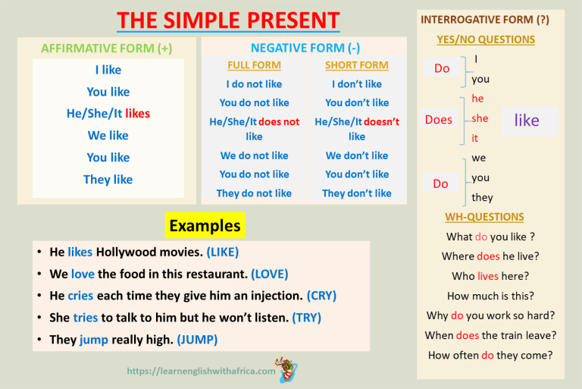
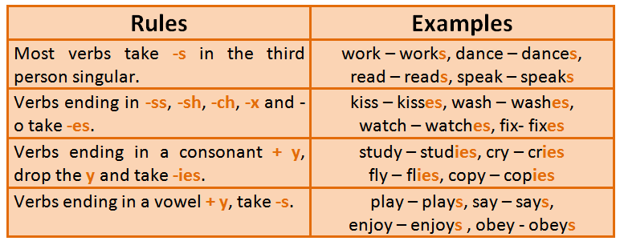
TrainUp

Slide 3
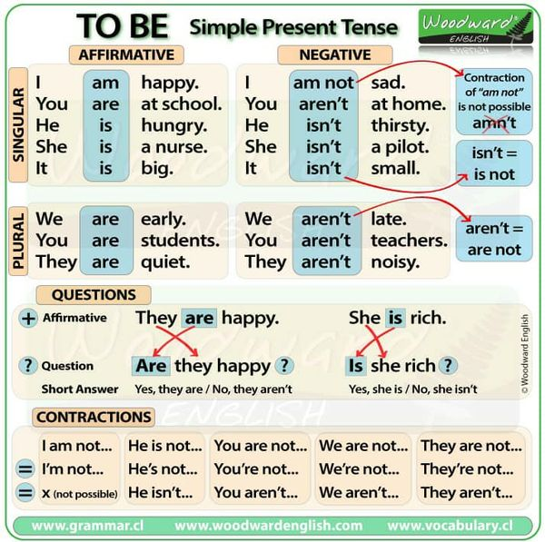
TrainUP

Slide 4
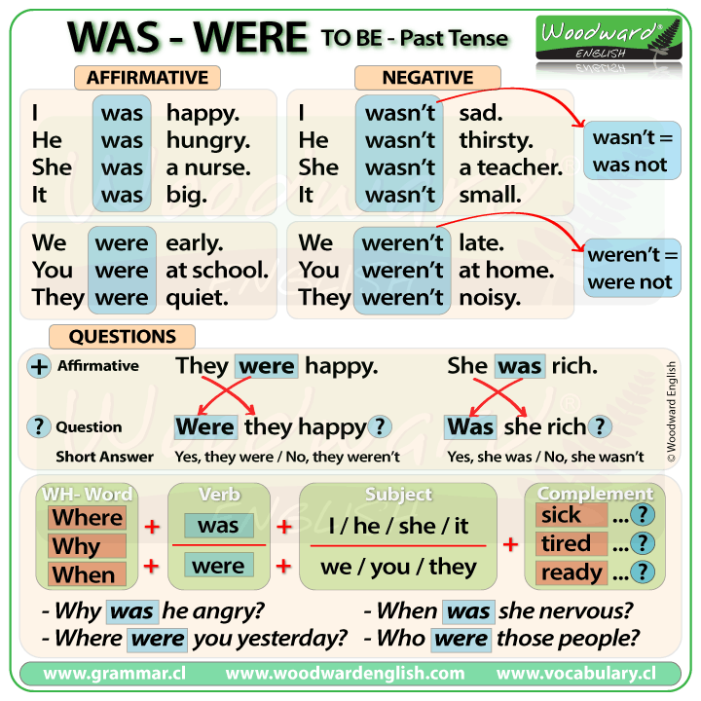
TrainUP

Slide 5
SIMPLE PAST
Affirmative | Negative | Interrogative
I lived You lived He lived She lived It lived We lived You lived They lived | I didn´t live You didn´t live He didn´t live She didn´t live It didn´t live We didn´t live You didn´t live They didn´t live | Did I live? Did You live? Did He live? Did She live? Did It live? Did We live? Did You live? Did They live?
Sample Questions | Short Answer + | Short Answer
Did I, you, we, they like to study? Did he, she, it like to study? | Yes, I did. Yes, he did. | No, I didn´t. No, he didn´t.
Simple Past – Regular Verbs
Base + ed | Walk - > walked
Verbos terminandos em: -e | Like - > liked
Verbos terminandos em: Consoante+ Y | Carry - > carried
Terminando em: vogal + consoante | Plan - > planned Stop - > stopped
TrainUp
TrainUP

Slide 6
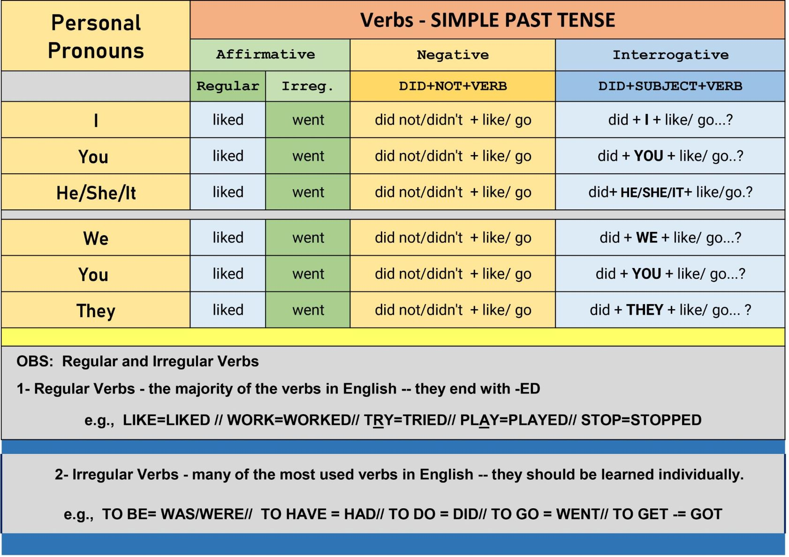
Simple Past – Regular Verbs
Base + ed | Walk - > walked
Verbos terminandos em: -e | Like - > liked
Verbos terminandos em: Consoante+ Y | Carry - > carried
Terminando em: vogal + consoante | Plan - > planned Stop - > stopped
TrainUp
TrainUP

Slide 7
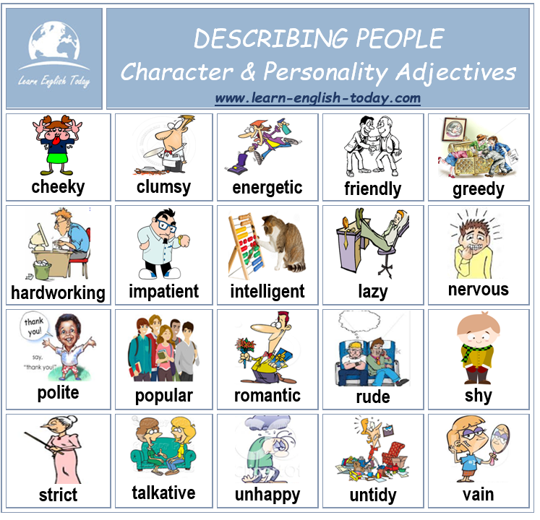
TrainUp
TrainUP

Slide 8
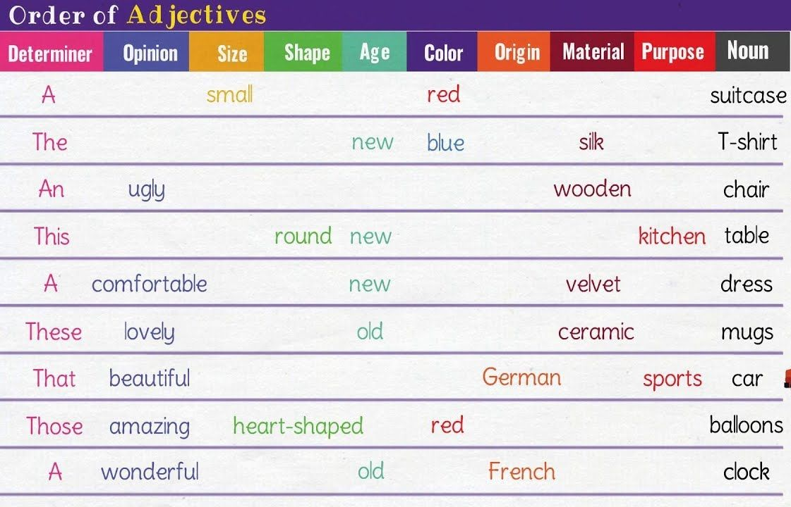
TrainUp
TrainUP

Slide 9

TrainUp
TrainUP

