Slide 1
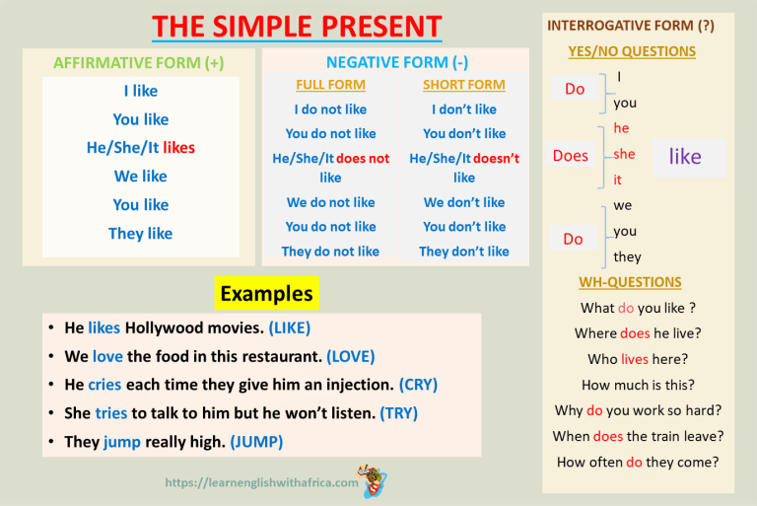
TrainUp
I work at the wonderful English school
where there are the best students.
Estude sozinho. Pratique com alguém.
Intensivo em 13 LIÇÕES
1) Presente
+ Work, Works
- Don´t, doesn´t
? Do, Does
6) Artigos
A, an, the
Existir / haver
+ There is/ are
- There isn´t / aren´t
? Is There / Are There?
10) Pronomes
I, you,he, she, it,you,we,they
2) To Be
+ Am, is, are
Isn´t, aren´t
Was, were
Wasn´t, weren´t
11) Modal
Would work
Could work
Should Work
Must ...
Will ...
7) Futuro
Be + going to
Will work
3) Passado
+ Worked,
- Didn´t
? Did
12) Comparative
/Superlative
Good – better than - The best
8) Advérbios
always
4) Adjectives
Wonderful,
9) Progressivo
Am / Is /are working
Was / were working
Will be working
13) Present Perfect
+ Have worked
+ Has worked
- Haven´t worked
- Hasn´t worked
5) Plural
Student - Students
Preposition
In, on, at

Slide 2
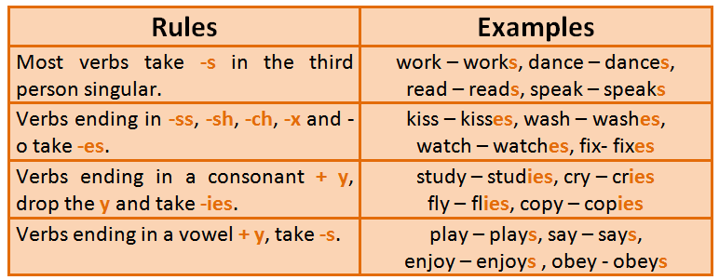
TrainUp
I work at the wonderful English school
where there are the best students.
Estude sozinho. Pratique com alguém.
Intensivo em 13 LIÇÕES
1) Presente
+ Work, Works
- Don´t, doesn´t
? Do, Does
6) Artigos
A, an, the
Existir / haver
+ There is/ are
- There isn´t / aren´t
? Is There / Are There?
10) Pronomes
I, you,he, she, it,you,we,they
2) To Be
+ Am, is, are
Isn´t, aren´t
Was, were
Wasn´t, weren´t
11) Modal
Would work
Could work
Should Work
Must ...
Will ...
7) Futuro
Be + going to
Will work
3) Passado
+ Worked,
- Didn´t
? Did
12) Comparative
/Superlative
Good – better than - The best
8) Advérbios
always
4) Adjectives
Wonderful,
9) Progressivo
Am / Is /are working
Was / were working
Will be working
13) Present Perfect
+ Have worked
+ Has worked
- Haven´t worked
- Hasn´t worked
5) Plural
Student - Students
Preposition
In, on, at

Slide 3
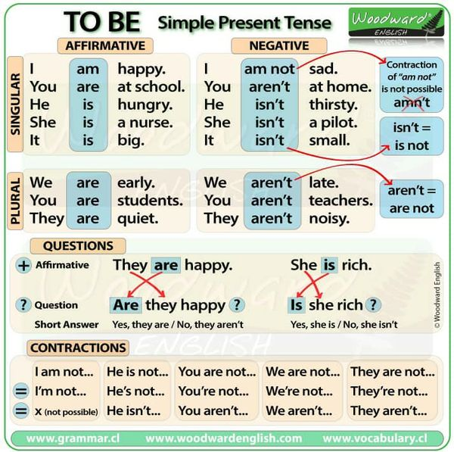
TrainUp
I work at the wonderful English school
where there are the best students.
Estude sozinho. Pratique com alguém.
Intensivo em 13 LIÇÕES
1) Presente
+ Work, Works
- Don´t, doesn´t
? Do, Does
6) Artigos
A, an, the
Existir / haver
+ There is/ are
- There isn´t / aren´t
? Is There / Are There?
10) Pronomes
I, you,he, she, it,you,we,they
2) To Be
+ Am, is, are
Isn´t, aren´t
Was, were
Wasn´t, weren´t
11) Modal
Would work
Could work
Should Work
Must ...
Will ...
7) Futuro
Be + going to
Will work
3) Passado
+ Worked,
- Didn´t
? Did
12) Comparative
/Superlative
Good – better than - The best
8) Advérbios
always
4) Adjectives
Wonderful,
9) Progressivo
Am / Is /are working
Was / were working
Will be working
13) Present Perfect
+ Have worked
+ Has worked
- Haven´t worked
- Hasn´t worked
5) Plural
Student - Students
Preposition
In, on, at

Slide 4
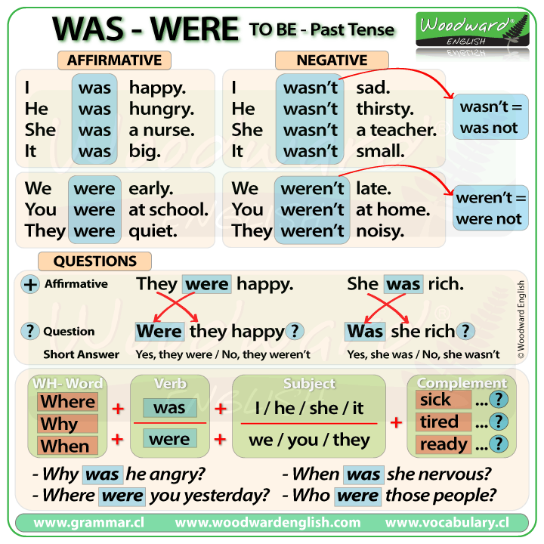
TrainUp
I work at the wonderful English school
where there are the best students.
Estude sozinho. Pratique com alguém.
Intensivo em 13 LIÇÕES
1) Presente
+ Work, Works
- Don´t, doesn´t
? Do, Does
6) Artigos
A, an, the
Existir / haver
+ There is/ are
- There isn´t / aren´t
? Is There / Are There?
10) Pronomes
I, you,he, she, it,you,we,they
2) To Be
+ Am, is, are
Isn´t, aren´t
Was, were
Wasn´t, weren´t
11) Modal
Would work
Could work
Should Work
Must ...
Will ...
7) Futuro
Be + going to
Will work
3) Passado
+ Worked,
- Didn´t
? Did
12) Comparative
/Superlative
Good – better than - The best
8) Advérbios
always
4) Adjectives
Wonderful,
9) Progressivo
Am / Is /are working
Was / were working
Will be working
13) Present Perfect
+ Have worked
+ Has worked
- Haven´t worked
- Hasn´t worked
5) Plural
Student - Students
Preposition
In, on, at

Slide 5
TrainUp
I work at the wonderful English school
where there are the best students.
Estude sozinho. Pratique com alguém.
Intensivo em 13 LIÇÕES
1) Presente
+ Work, Works
- Don´t, doesn´t
? Do, Does
SIMPLE PAST
Affirmative | Negative | Interrogative
I lived You lived He lived She lived It lived We lived You lived They lived | I didn´t live You didn´t live He didn´t live She didn´t live It didn´t live We didn´t live You didn´t live They didn´t live | Do I live? Did You live? Did He live? Did She live? Did It live? Did We live? Did You live? Did They live?
Sample Questions | Short Answer + | Short Answer -
Did I, you, we, they like to study? Did he, she, it like to study? | Yes, I did. Yes, he did. | No, I didn´t. No, he didn´t.
6) Artigos
A, an, the
Existir / haver
+ There is/ are
- There isn´t / aren´t
? Is There / Are There?
10) Pronomes
I, you,he, she, it,you,we,they
2) To Be
+ Am, is, are
Isn´t, aren´t
Was, were
Wasn´t, weren´t
11) Modal
Would work
Could work
Should Work
Must ...
Will ...
7) Futuro
Be + going to
Will work
3) Passado
+ Worked,
- Didn´t
? Did
12) Comparative
/Superlative
Good – better than - The best
8) Advérbios
always
4) Adjectives
Wonderful,
Simple Past – Regular Verbs
Base + ed | Walk - > walked Play - > played
Verbos terminandos em: -e | Like - > liked Move - > moved
Verbos terminandos em: Consoante+ Y | Carry - > carried Study - > studied
Terminando em: vogal + consoante | Plan - > planned Stop - > stopped
9) Progressivo
Am / Is /are working
Was / were working
Will be working
13) Present Perfect
+ Have worked
+ Has worked
- Haven´t worked
- Hasn´t worked
5) Plural
Student - Students
Preposition
In, on, at

Slide 6
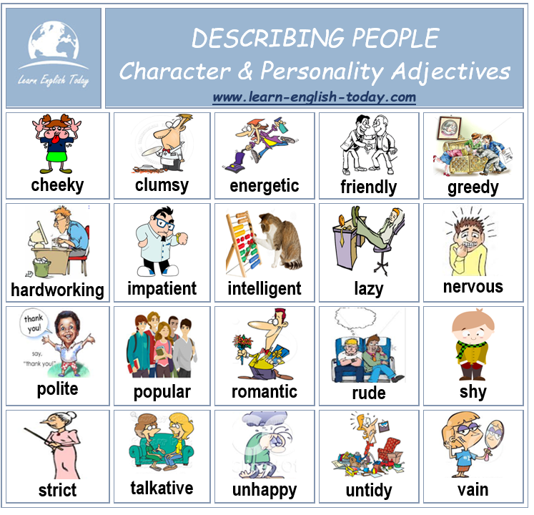
TrainUp
I work at the wonderful English school
where there are the best students.
Estude sozinho. Pratique com alguém.
Intensivo em 13 LIÇÕES
1) Presente
+ Work, Works
- Don´t, doesn´t
? Do, Does
6) Artigos
A, an, the
Existir / haver
+ There is/ are
- There isn´t / aren´t
? Is There / Are There?
10) Pronomes
I, you,he, she, it,you,we,they
2) To Be
+ Am, is, are
Isn´t, aren´t
Was, were
Wasn´t, weren´t
11) Modal
Would work
Could work
Should Work
Must ...
Will ...
7) Futuro
Be + going to
Will work
3) Passado
+ Worked,
- Didn´t
? Did
12) Comparative
/Superlative
Good – better than - The best
8) Advérbios
always
4) Adjectives
Wonderful,
9) Progressivo
Am / Is /are working
Was / were working
Will be working
13) Present Perfect
+ Have worked
+ Has worked
- Haven´t worked
- Hasn´t worked
5) Plural
Student - Students
Preposition
In, on, at

Slide 7
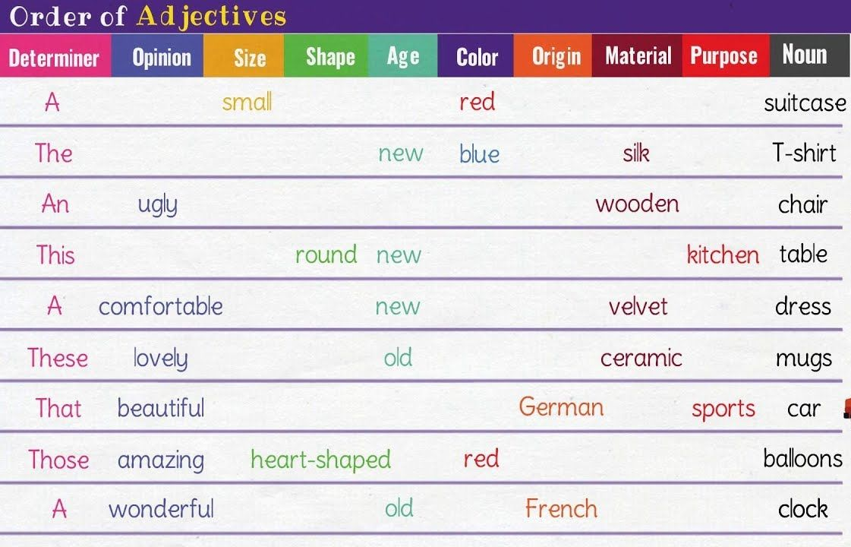
TrainUp
I work at the wonderful English school
where there are the best students.
Estude sozinho. Pratique com alguém.
Intensivo em 13 LIÇÕES
1) Presente
+ Work, Works
- Don´t, doesn´t
? Do, Does
6) Artigos
A, an, the
Existir / haver
+ There is/ are
- There isn´t / aren´t
? Is There / Are There?
10) Pronomes
I, you,he, she, it,you,we,they
2) To Be
+ Am, is, are
Isn´t, aren´t
Was, were
Wasn´t, weren´t
11) Modal
Would work
Could work
Should Work
Must ...
Will ...
7) Futuro
Be + going to
Will work
3) Passado
+ Worked,
- Didn´t
? Did
12) Comparative
/Superlative
Good – better than - The best
8) Advérbios
always
4) Adjectives
Wonderful,
9) Progressivo
Am / Is /are working
Was / were working
Will be working
13) Present Perfect
+ Have worked
+ Has worked
- Haven´t worked
- Hasn´t worked
5) Plural
Student - Students
Preposition
In, on, at

Slide 8
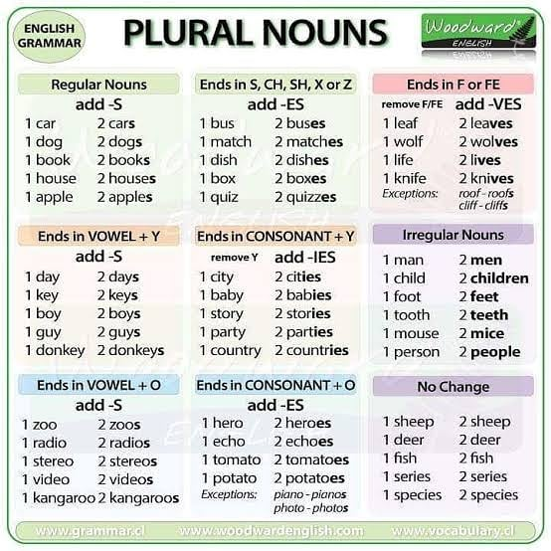
TrainUp
I work at the wonderful English school
where there are the best students.
Estude sozinho. Pratique com alguém.
Intensivo em 13 LIÇÕES
1) Presente
+ Work, Works
- Don´t, doesn´t
? Do, Does
6) Artigos
A, an, the
Existir / haver
+ There is/ are
- There isn´t / aren´t
? Is There / Are There?
10) Pronomes
I, you,he, she, it,you,we,they
2) To Be
+ Am, is, are
Isn´t, aren´t
Was, were
Wasn´t, weren´t
11) Modal
Would work
Could work
Should Work
Must ...
Will ...
7) Futuro
Be + going to
Will work
3) Passado
+ Worked,
- Didn´t
? Did
12) Comparative
/Superlative
Good – better than - The best
8) Advérbios
always
4) Adjectives
Wonderful,
9) Progressivo
Am / Is /are working
Was / were working
Will be working
13) Present Perfect
+ Have worked
+ Has worked
- Haven´t worked
- Hasn´t worked
5) Plural
Student - Students
Preposition
In, on, at

Slide 9
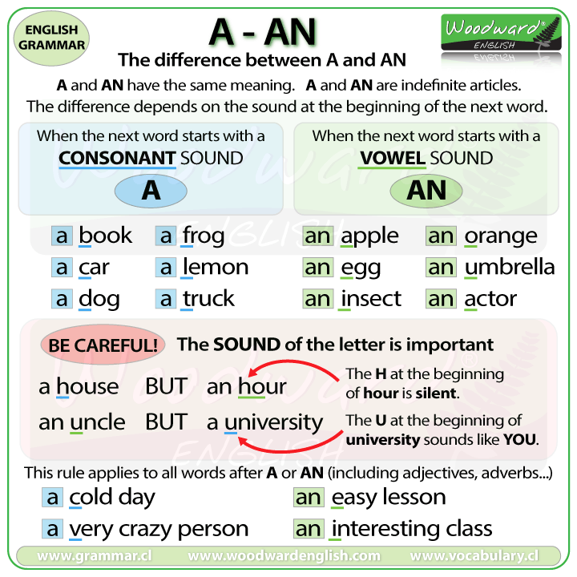
TrainUp
I work at the wonderful English school
where there are the best students.
Estude sozinho. Pratique com alguém.
Intensivo em 13 LIÇÕES
1) Presente
+ Work, Works
- Don´t, doesn´t
? Do, Does
6) Artigos
A, an, the
Existir / haver
+ There is/ are
- There isn´t / aren´t
? Is There / Are There?
10) Pronomes
I, you,he, she, it,you,we,they
2) To Be
+ Am, is, are
Isn´t, aren´t
Was, were
Wasn´t, weren´t
11) Modal
Would work
Could work
Should Work
Must ...
Will ...
7) Futuro
Be + going to
Will work
3) Passado
+ Worked,
- Didn´t
? Did
12) Comparative
/Superlative
Good – better than - The best
8) Advérbios
always
4) Adjectives
Wonderful,
9) Progressivo
Am / Is /are working
Was / were working
Will be working
13) Present Perfect
+ Have worked
+ Has worked
- Haven´t worked
- Hasn´t worked
5) Plural
Student - Students
Preposition
In, on, at

Slide 10
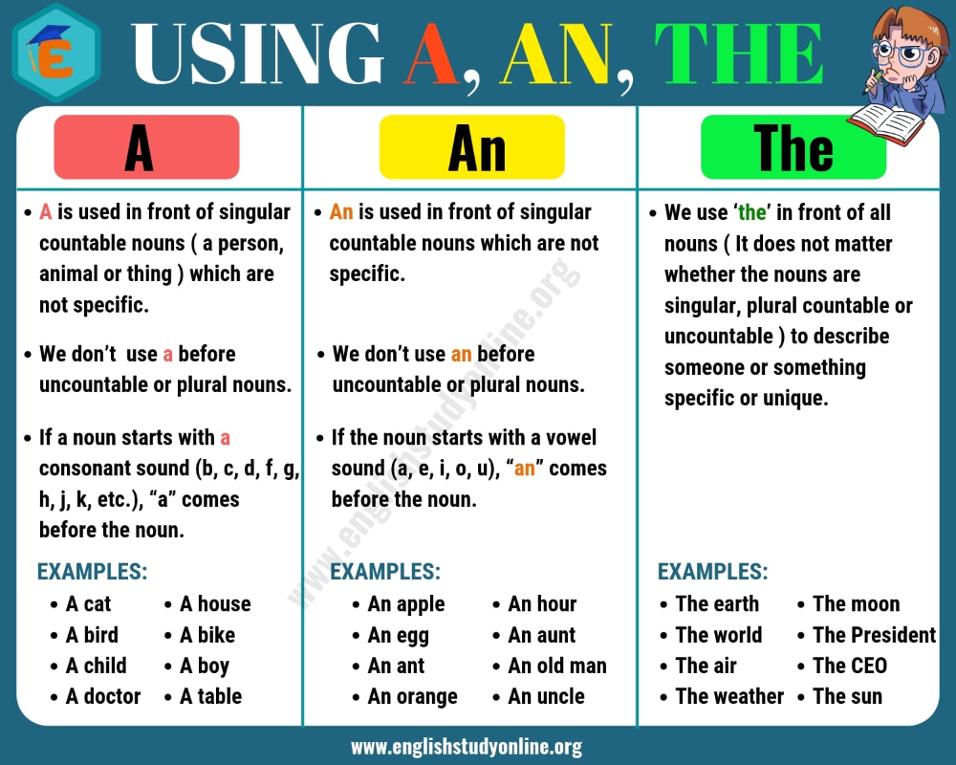
TrainUp
I work at the wonderful English school
where there are the best students.
Estude sozinho. Pratique com alguém.
Intensivo em 13 LIÇÕES
1) Presente
+ Work, Works
- Don´t, doesn´t
? Do, Does
6) Artigos
A, an, the
Existir / haver
+ There is/ are
- There isn´t / aren´t
? Is There / Are There?
10) Pronomes
I, you,he, she, it,you,we,they
2) To Be
+ Am, is, are
Isn´t, aren´t
Was, were
Wasn´t, weren´t
11) Modal
Would work
Could work
Should Work
Must ...
Will ...
7) Futuro
Be + going to
Will work
3) Passado
+ Worked,
- Didn´t
? Did
12) Comparative
/Superlative
Good – better than - The best
8) Advérbios
always
4) Adjectives
Wonderful,
9) Progressivo
Am / Is /are working
Was / were working
Will be working
13) Present Perfect
+ Have worked
+ Has worked
- Haven´t worked
- Hasn´t worked
5) Plural
Student - Students
Preposition
In, on, at

Slide 11
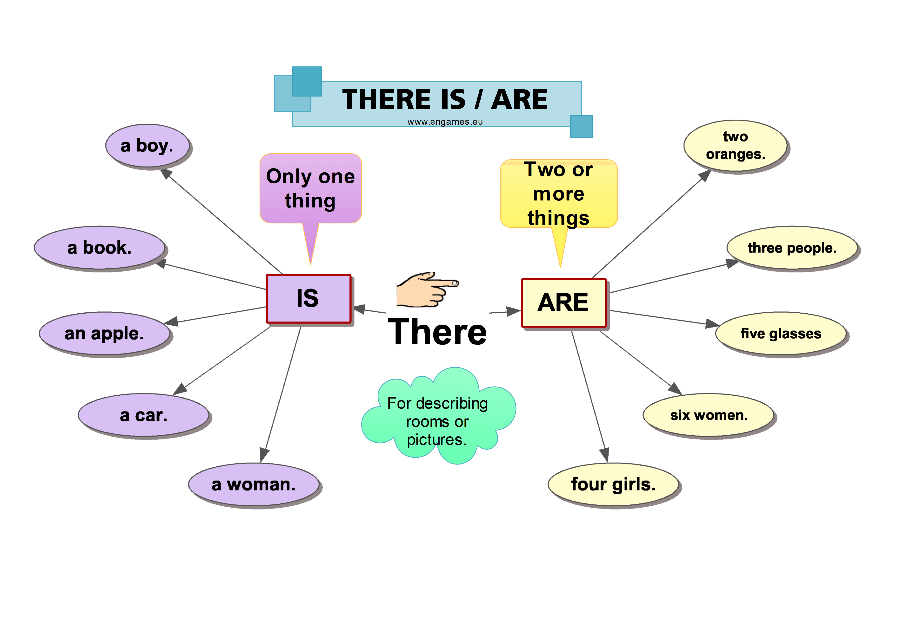
TrainUp
I work at the wonderful English school
where there are the best students.
Estude sozinho. Pratique com alguém.
Intensivo em 13 LIÇÕES
1) Presente
+ Work, Works
- Don´t, doesn´t
? Do, Does
6) Artigos
A, an, the
Existir / haver
+ There is/ are
- There isn´t / aren´t
? Is There / Are There?
10) Pronomes
I, you,he, she, it,you,we,they
2) To Be
+ Am, is, are
Isn´t, aren´t
Was, were
Wasn´t, weren´t
11) Modal
Would work
Could work
Should Work
Must ...
Will ...
7) Futuro
Be + going to
Will work
3) Passado
+ Worked,
- Didn´t
? Did
12) Comparative
/Superlative
Good – better than - The best
8) Advérbios
always
4) Adjectives
Wonderful,
9) Progressivo
Am / Is /are working
Was / were working
Will be working
13) Present Perfect
+ Have worked
+ Has worked
- Haven´t worked
- Hasn´t worked
5) Plural
Student - Students
Preposition
In, on, at

Slide 12
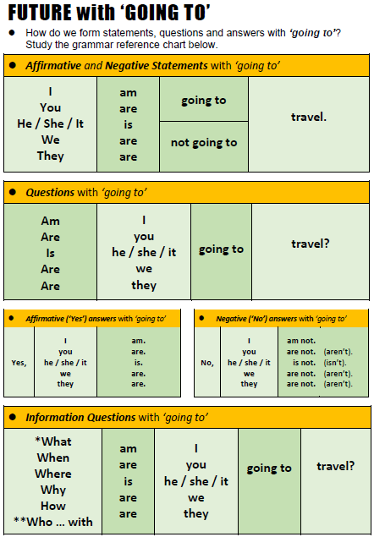
TrainUp
I work at the wonderful English school
where there are the best students.
Estude sozinho. Pratique com alguém.
Intensivo em 13 LIÇÕES
1) Presente
+ Work, Works
- Don´t, doesn´t
? Do, Does
6) Artigos
A, an, the
Existir / haver
+ There is/ are
- There isn´t / aren´t
? Is There / Are There?
10) Pronomes
I, you,he, she, it,you,we,they
2) To Be
+ Am, is, are
Isn´t, aren´t
Was, were
Wasn´t, weren´t
11) Modal
Would work
Could work
Should Work
Must ...
Will ...
7) Futuro
Be + going to
Will work
3) Passado
+ Worked,
- Didn´t
? Did
12) Comparative
/Superlative
Good – better than - The best
8) Advérbios
always
4) Adjectives
Wonderful,
9) Progressivo
Am / Is /are working
Was / were working
Will be working
13) Present Perfect
+ Have worked
+ Has worked
- Haven´t worked
- Hasn´t worked
5) Plural
Student - Students
Preposition
In, on, at

Slide 13
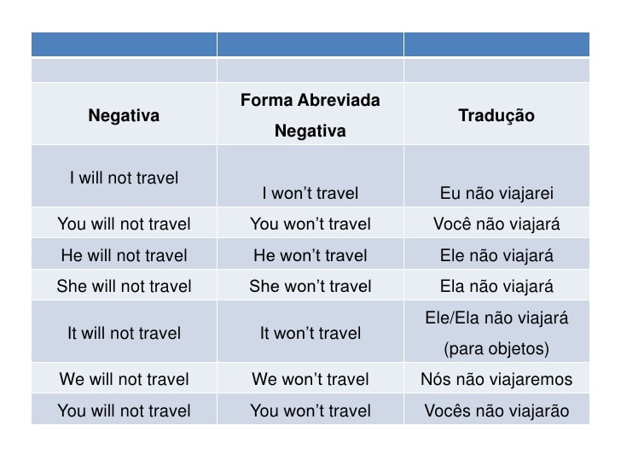
TrainUp
I work at the wonderful English school
where there are the best students.
Estude sozinho. Pratique com alguém.
Intensivo em 13 LIÇÕES
1) Presente
+ Work, Works
- Don´t, doesn´t
? Do, Does
6) Artigos
A, an, the
Existir / haver
+ There is/ are
- There isn´t / aren´t
? Is There / Are There?
10) Pronomes
I, you,he, she, it,you,we,they
2) To Be
+ Am, is, are
Isn´t, aren´t
Was, were
Wasn´t, weren´t
11) Modal
Would work
Could work
Should Work
Must ...
Will ...
7) Futuro
Be + going to
Will work
3) Passado
+ Worked,
- Didn´t
? Did
12) Comparative
/Superlative
Good – better than - The best
8) Advérbios
always
4) Adjectives
Wonderful,
9) Progressivo
Am / Is /are working
Was / were working
Will be working
13) Present Perfect
+ Have worked
+ Has worked
- Haven´t worked
- Hasn´t worked
5) Plural
Student - Students
Preposition
In, on, at

Slide 14
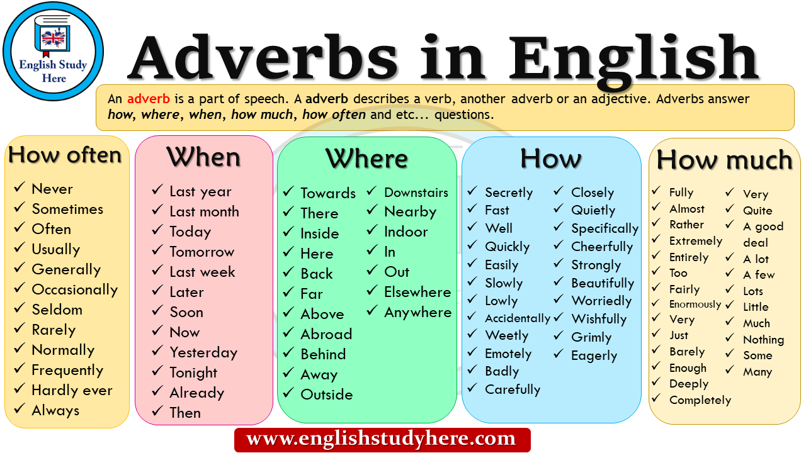
TrainUp
I work at the wonderful English school
where there are the best students.
Estude sozinho. Pratique com alguém.
Intensivo em 13 LIÇÕES
1) Presente
+ Work, Works
- Don´t, doesn´t
? Do, Does
6) Artigos
A, an, the
Existir / haver
+ There is/ are
- There isn´t / aren´t
? Is There / Are There?
10) Pronomes
I, you,he, she, it,you,we,they
2) To Be
+ Am, is, are
Isn´t, aren´t
Was, were
Wasn´t, weren´t
11) Modal
Would work
Could work
Should Work
Must ...
Will ...
7) Futuro
Be + going to
Will work
3) Passado
+ Worked,
- Didn´t
? Did
12) Comparative
/Superlative
Good – better than - The best
8) Advérbios
always
4) Adjectives
Wonderful,
9) Progressivo
Am / Is /are working
Was / were working
Will be working
13) Present Perfect
+ Have worked
+ Has worked
- Haven´t worked
- Hasn´t worked
5) Plural
Student - Students
Preposition
In, on, at

Slide 15
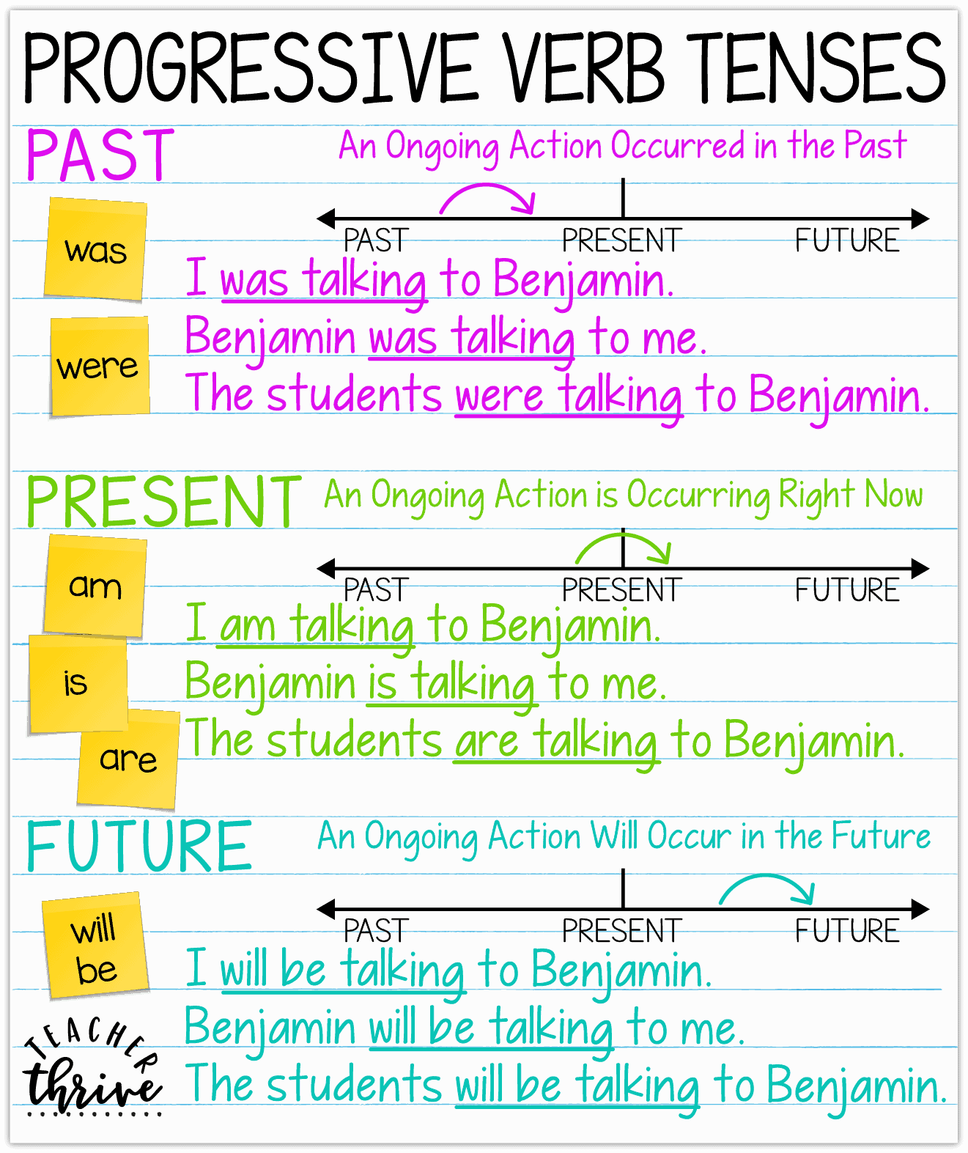
TrainUp
I work at the wonderful English school
where there are the best students.
Estude sozinho. Pratique com alguém.
Intensivo em 13 LIÇÕES
1) Presente
+ Work, Works
- Don´t, doesn´t
? Do, Does
6) Artigos
A, an, the
Existir / haver
+ There is/ are
- There isn´t / aren´t
? Is There / Are There?
10) Pronomes
I, you,he, she, it,you,we,they
2) To Be
+ Am, is, are
Isn´t, aren´t
Was, were
Wasn´t, weren´t
11) Modal
Would work
Could work
Should Work
Must ...
Will ...
7) Futuro
Be + going to
Will work
3) Passado
+ Worked,
- Didn´t
? Did
12) Comparative
/Superlative
Good – better than - The best
8) Advérbios
always
4) Adjectives
Wonderful,
9) Progressivo
Am / Is /are working
Was / were working
Will be working
13) Present Perfect
+ Have worked
+ Has worked
- Haven´t worked
- Hasn´t worked
5) Plural
Student - Students
Preposition
In, on, at

Slide 16
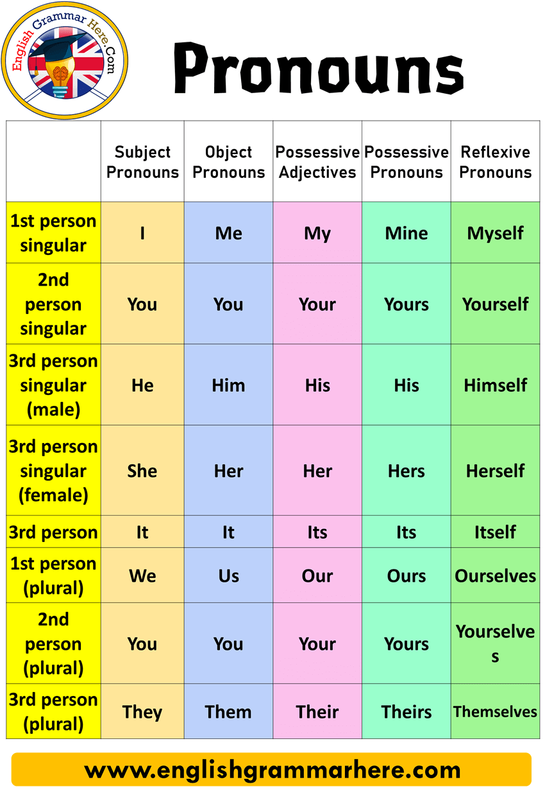
TrainUp
I work at the wonderful English school
where there are the best students.
Estude sozinho. Pratique com alguém.
Intensivo em 12 LIÇÕES
1) Presente
+ Work, Works
- Don´t, doesn´t
? Do, Does
6) Artigos
A, an, the
Existir / haver
+ There is/ are
- There isn´t / aren´t
? Is There / Are There?
10) Pronomes
I, you,he, she, it,you,we,they
2) To Be
+ Am, is, are
Isn´t, aren´t
Was, were
Wasn´t, weren´t
11) Modal
Would work
Could work
Should Work
Must ...
Will ...
7) Futuro
Be + going to
Will work
3) Passado
+ Worked,
- Didn´t
? Did
12) Comparative
/Superlative
Good – better than - The best
8) Advérbios
always
4) Adjectives
Wonderful,
9) Progressivo
Am / Is /are working
Was / were working
Will be working
13) Present Perfect
+ Have worked
+ Has worked
- Haven´t worked
- Hasn´t worked
5) Plural
Student - Students
Preposition
In, on, at

Slide 17
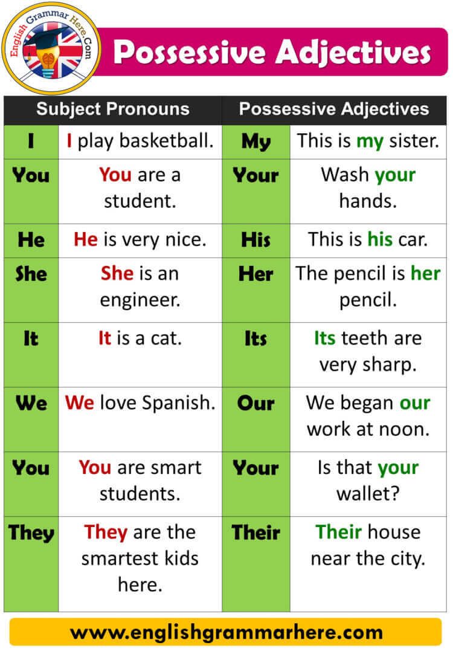
TrainUp
I work at the wonderful English school
where there are the best students.
Estude sozinho. Pratique com alguém.
Intensivo em 13 LIÇÕES
1) Presente
+ Work, Works
- Don´t, doesn´t
? Do, Does
6) Artigos
A, an, the
Existir / haver
+ There is/ are
- There isn´t / aren´t
? Is There / Are There?
10) Pronomes
I, you,he, she, it,you,we,they
2) To Be
+ Am, is, are
Isn´t, aren´t
Was, were
Wasn´t, weren´t
11) Modal
Would work
Could work
Should Work
Must ...
Will ...
7) Futuro
Be + going to
Will work
3) Passado
+ Worked,
- Didn´t
? Did
12) Comparative
/Superlative
Good – better than - The best
8) Advérbios
always
4) Adjectives
Wonderful,
9) Progressivo
Am / Is /are working
Was / were working
Will be working
13) Present Perfect
+ Have worked
+ Has worked
- Haven´t worked
- Hasn´t worked
5) Plural
Student - Students
Preposition
In, on, at

Slide 18
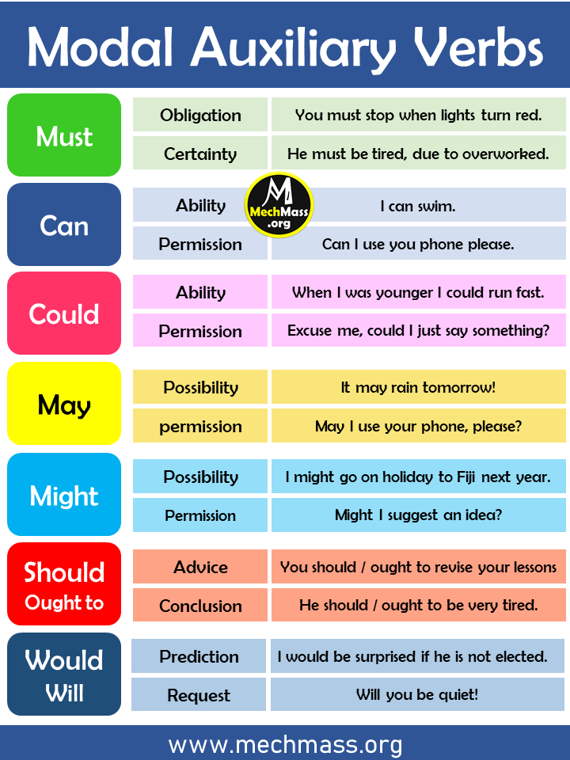
TrainUp
I work at the wonderful English school
where there are the best students.
Estude sozinho. Pratique com alguém.
Intensivo em 13 LIÇÕES
1) Presente
+ Work, Works
- Don´t, doesn´t
? Do, Does
6) Artigos
A, an, the
Existir / haver
+ There is/ are
- There isn´t / aren´t
? Is There / Are There?
10) Pronomes
I, you,he, she, it,you,we,they
2) To Be
+ Am, is, are
Isn´t, aren´t
Was, were
Wasn´t, weren´t
11) Modal
Would work
Could work
Should Work
Must ...
Will ...
7) Futuro
Be + going to
Will work
3) Passado
+ Worked,
- Didn´t
? Did
12) Comparative
/Superlative
Good – better than - The best
8) Advérbios
always
4) Adjectives
Wonderful,
9) Progressivo
Am / Is /are working
Was / were working
Will be working
13) Present Perfect
+ Have worked
+ Has worked
- Haven´t worked
- Hasn´t worked
5) Plural
Student - Students
Preposition
In, on, at

Slide 19
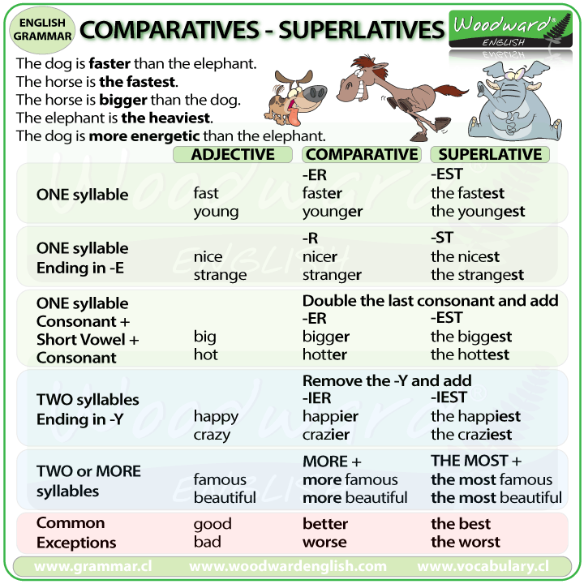
TrainUp
I work at the wonderful English school
where there are the best students.
Estude sozinho. Pratique com alguém.
Intensivo em 13 LIÇÕES
1) Presente
+ Work, Works
- Don´t, doesn´t
? Do, Does
6) Artigos
A, an, the
Existir / haver
+ There is/ are
- There isn´t / aren´t
? Is There / Are There?
10) Pronomes
I, you,he, she, it,you,we,they
2) To Be
+ Am, is, are
Isn´t, aren´t
Was, were
Wasn´t, weren´t
11) Modal
Would work
Could work
Should Work
Must ...
Will ...
7) Futuro
Be + going to
Will work
3) Passado
+ Worked,
- Didn´t
? Did
12) Comparative
/Superlative
Good – better than - The best
8) Advérbios
always
4) Adjectives
Wonderful,
9) Progressivo
Am / Is /are working
Was / were working
Will be working
13) Present Perfect
+ Have worked
+ Has worked
- Haven´t worked
- Hasn´t worked
5) Plural
Student - Students
Preposition
In, on, at

Slide 20
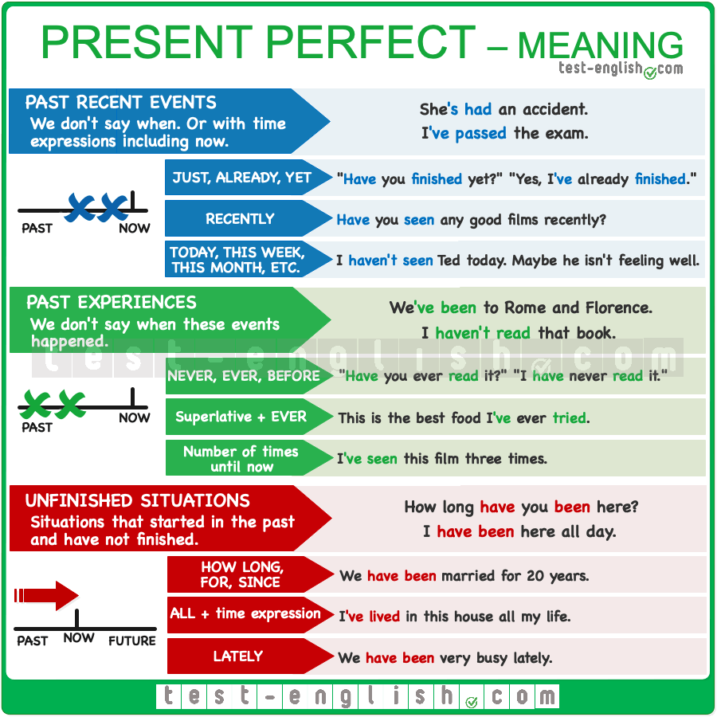
TrainUp
I work at the wonderful English school
where there are the best students.
Estude sozinho. Pratique com alguém.
Intensivo em 13 LIÇÕES
1) Presente
+ Work, Works
- Don´t, doesn´t
? Do, Does
6) Artigos
A, an, the
Existir / haver
+ There is/ are
- There isn´t / aren´t
? Is There / Are There?
10) Pronomes
I, you,he, she, it,you,we,they
2) To Be
+ Am, is, are
Isn´t, aren´t
Was, were
Wasn´t, weren´t
11) Modal
Would work
Could work
Should Work
Must ...
Will ...
7) Futuro
Be + going to
Will work
3) Passado
+ Worked,
- Didn´t
? Did
12) Comparative
/Superlative
Good – better than - The best
8) Advérbios
always
4) Adjectives
Wonderful,
9) Progressivo
Am / Is /are working
Was / were working
Will be working
13) Present Perfect
+ Have worked
+ Has worked
- Haven´t worked
- Hasn´t worked
5) Plural
Student - Students
Preposition
In, on, at

Slide 21
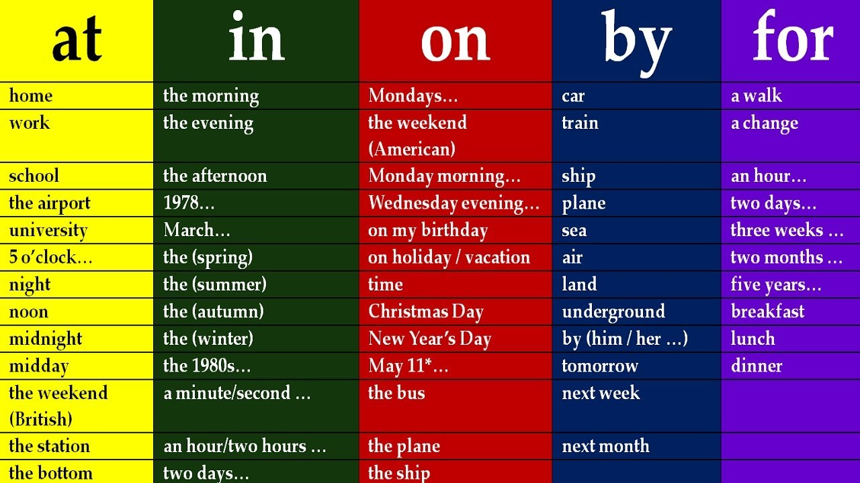
TrainUp
I work at the wonderful English school
where there are the best students.
Estude sozinho. Pratique com alguém.
Intensivo em 13 LIÇÕES
1) Presente
+ Work, Works
- Don´t, doesn´t
? Do, Does
6) Artigos
A, an, the
Existir / haver
+ There is/ are
- There isn´t / aren´t
? Is There / Are There?
10) Pronomes
I, you,he, she, it,you,we,they
2) To Be
+ Am, is, are
Isn´t, aren´t
Was, were
Wasn´t, weren´t
11) Modal
Would work
Could work
Should Work
Must ...
Will ...
7) Futuro
Be + going to
Will work
3) Passado
+ Worked,
- Didn´t
? Did
12) Comparative
/Superlative
Good – better than - The best
8) Advérbios
always
4) Adjectives
Wonderful,
9) Progressivo
Am / Is /are working
Was / were working
Will be working
13) Present Perfect
+ Have worked
+ Has worked
- Haven´t worked
- Hasn´t worked
5) Plural
Student - Students
Preposition
In, on, at

Slide 22
TrainUp
Estude sozinho. Pratique com alguém.
DIALOGUE
A: Hello, Can I ask you some questions for an (6) interview?
B: Some questions (5)? Yes, I can.
A: Thank you for taking the time. Now, first question: What do you do?
B: I work (1) in a hospital. I'm (2) a doctor.
A: Are you happy (4) in this profession?
B: I am most of the time but I admit There are (6) some stressful moments. Yesterday, a patient died (3). It was (3) terrible.
A: When will you (7) work again?
B: I will work tomorrow.
A: What do you do to relax?
B: Oh! I love to cook for my family. I just love to see their (10) faces when eating.
A: How often do you cook?
B: I sometimes (8) cook four times a week. In fact, I was cooking (9) before coming to this park.
A: What do you like to do in this park?
B: I like to run. I could (11) do it all day long. However, I haven´t had (13) time for that.
A: How would you describe this park?
B: This is the best (12) park in town.
A: Thank you very much for answering my questions.
Intensivo em 13 LIÇÕES
1) Presente
+ Work, Works
- Don´t, doesn´t
? Do, Does
6) Artigos
A, an, the
Existir / haver
+ There is/ are
- There isn´t / aren´t
? Is There / Are There?
10) Pronomes
I, you,he, she, it,you,we,they
2) To Be
+ Am, is, are
Isn´t, aren´t
Was, were
Wasn´t, weren´t
11) Modal
Would work
Could work
Should Work
Must ...
Will ...
7) Futuro
Be + going to
Will work
3) Passado
+ Worked,
- Didn´t
? Did
12) Comparative
/Superlative
Good – better than - The best
8) Advérbios
always
4) Adjectives
Wonderful,
9) Progressivo
Am / Is /are working
Was / were working
Will be working
13) Present Perfect
+ Have worked
+ Has worked
- Haven´t worked
- Hasn´t worked
5) Plural
Student - Students
Preposition
In, on, at

Slide 23
