Slide 1

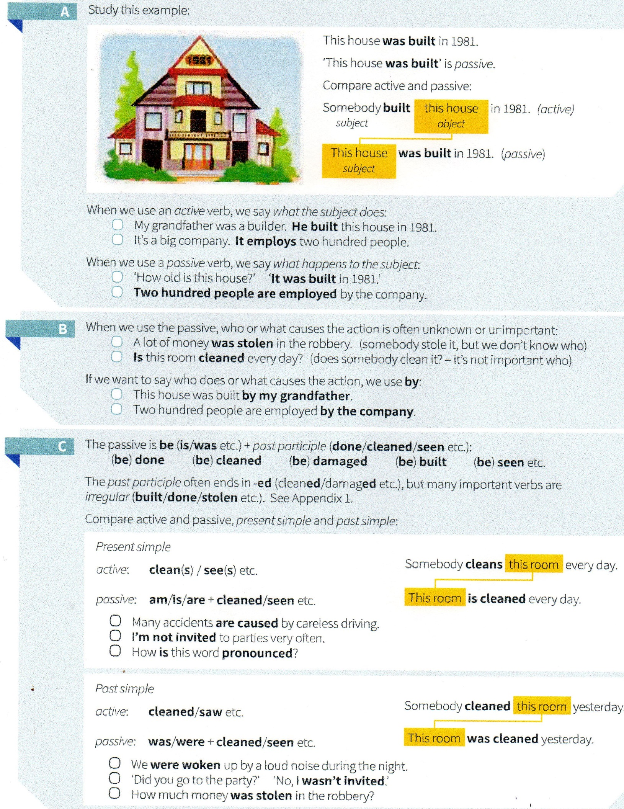
GRAMMAR
Lesson 15
Passive Voice
EXERCISES
© www.trainup.com Page | 1 - 6

Slide 2
GRAMMAR
Lesson 15
Passive Voice
VIDEOS
VIDEO 1
https://www.youtube.com/watch?v=Kr4tQ-xdAAI&t=537s
VIDEO 2
https://www.youtube.com/watch?v=z-Q9RHcgCqs
EXPLICAÇÃO EM TEXTO
https://www.todamateria.com.br/passive-voice/
ENGLISH GRAMMAR IN USE
Passive
42 Passive 1 (is done / was done)
43 Passive 2 (be done / been done / being done)
44 Passive 3
45 it is said that … he is said to … he is supposed to …
46 have something done
TODAS AS CONJUGAÇÕES DE ACTIVE/PASSIVE VOICE:
SIMPLE PRESENT:
Active – John Helps his sister
Passive – His sister is helped by John
PRESENT PROGRESSIVE:
Active – John is helping his sister
Passive – His sister is being helped by John
SIMPLE PAST:
Active – John helped his sister
Passive – His sister was helped by John
PRESENT PERFECT:
Active – John has helped his sister
Passive – His sister has been helped by John
PAST PROGRESSIVE:
Active – John was helping his sister
Passive – His sister was been helped by John
PAST PERFECT:
Active – John had helped his sister
Passive – His sister had been helped by John
SIMPLE FUTURE:
Active – John will help his sister
Passive – His sister will be helped by John
FUTURE PERFECT:
Active – John will have helped his sister
Passive – His sister will have been helped by John
© www.trainup.com Page | 2 - 6

Slide 3
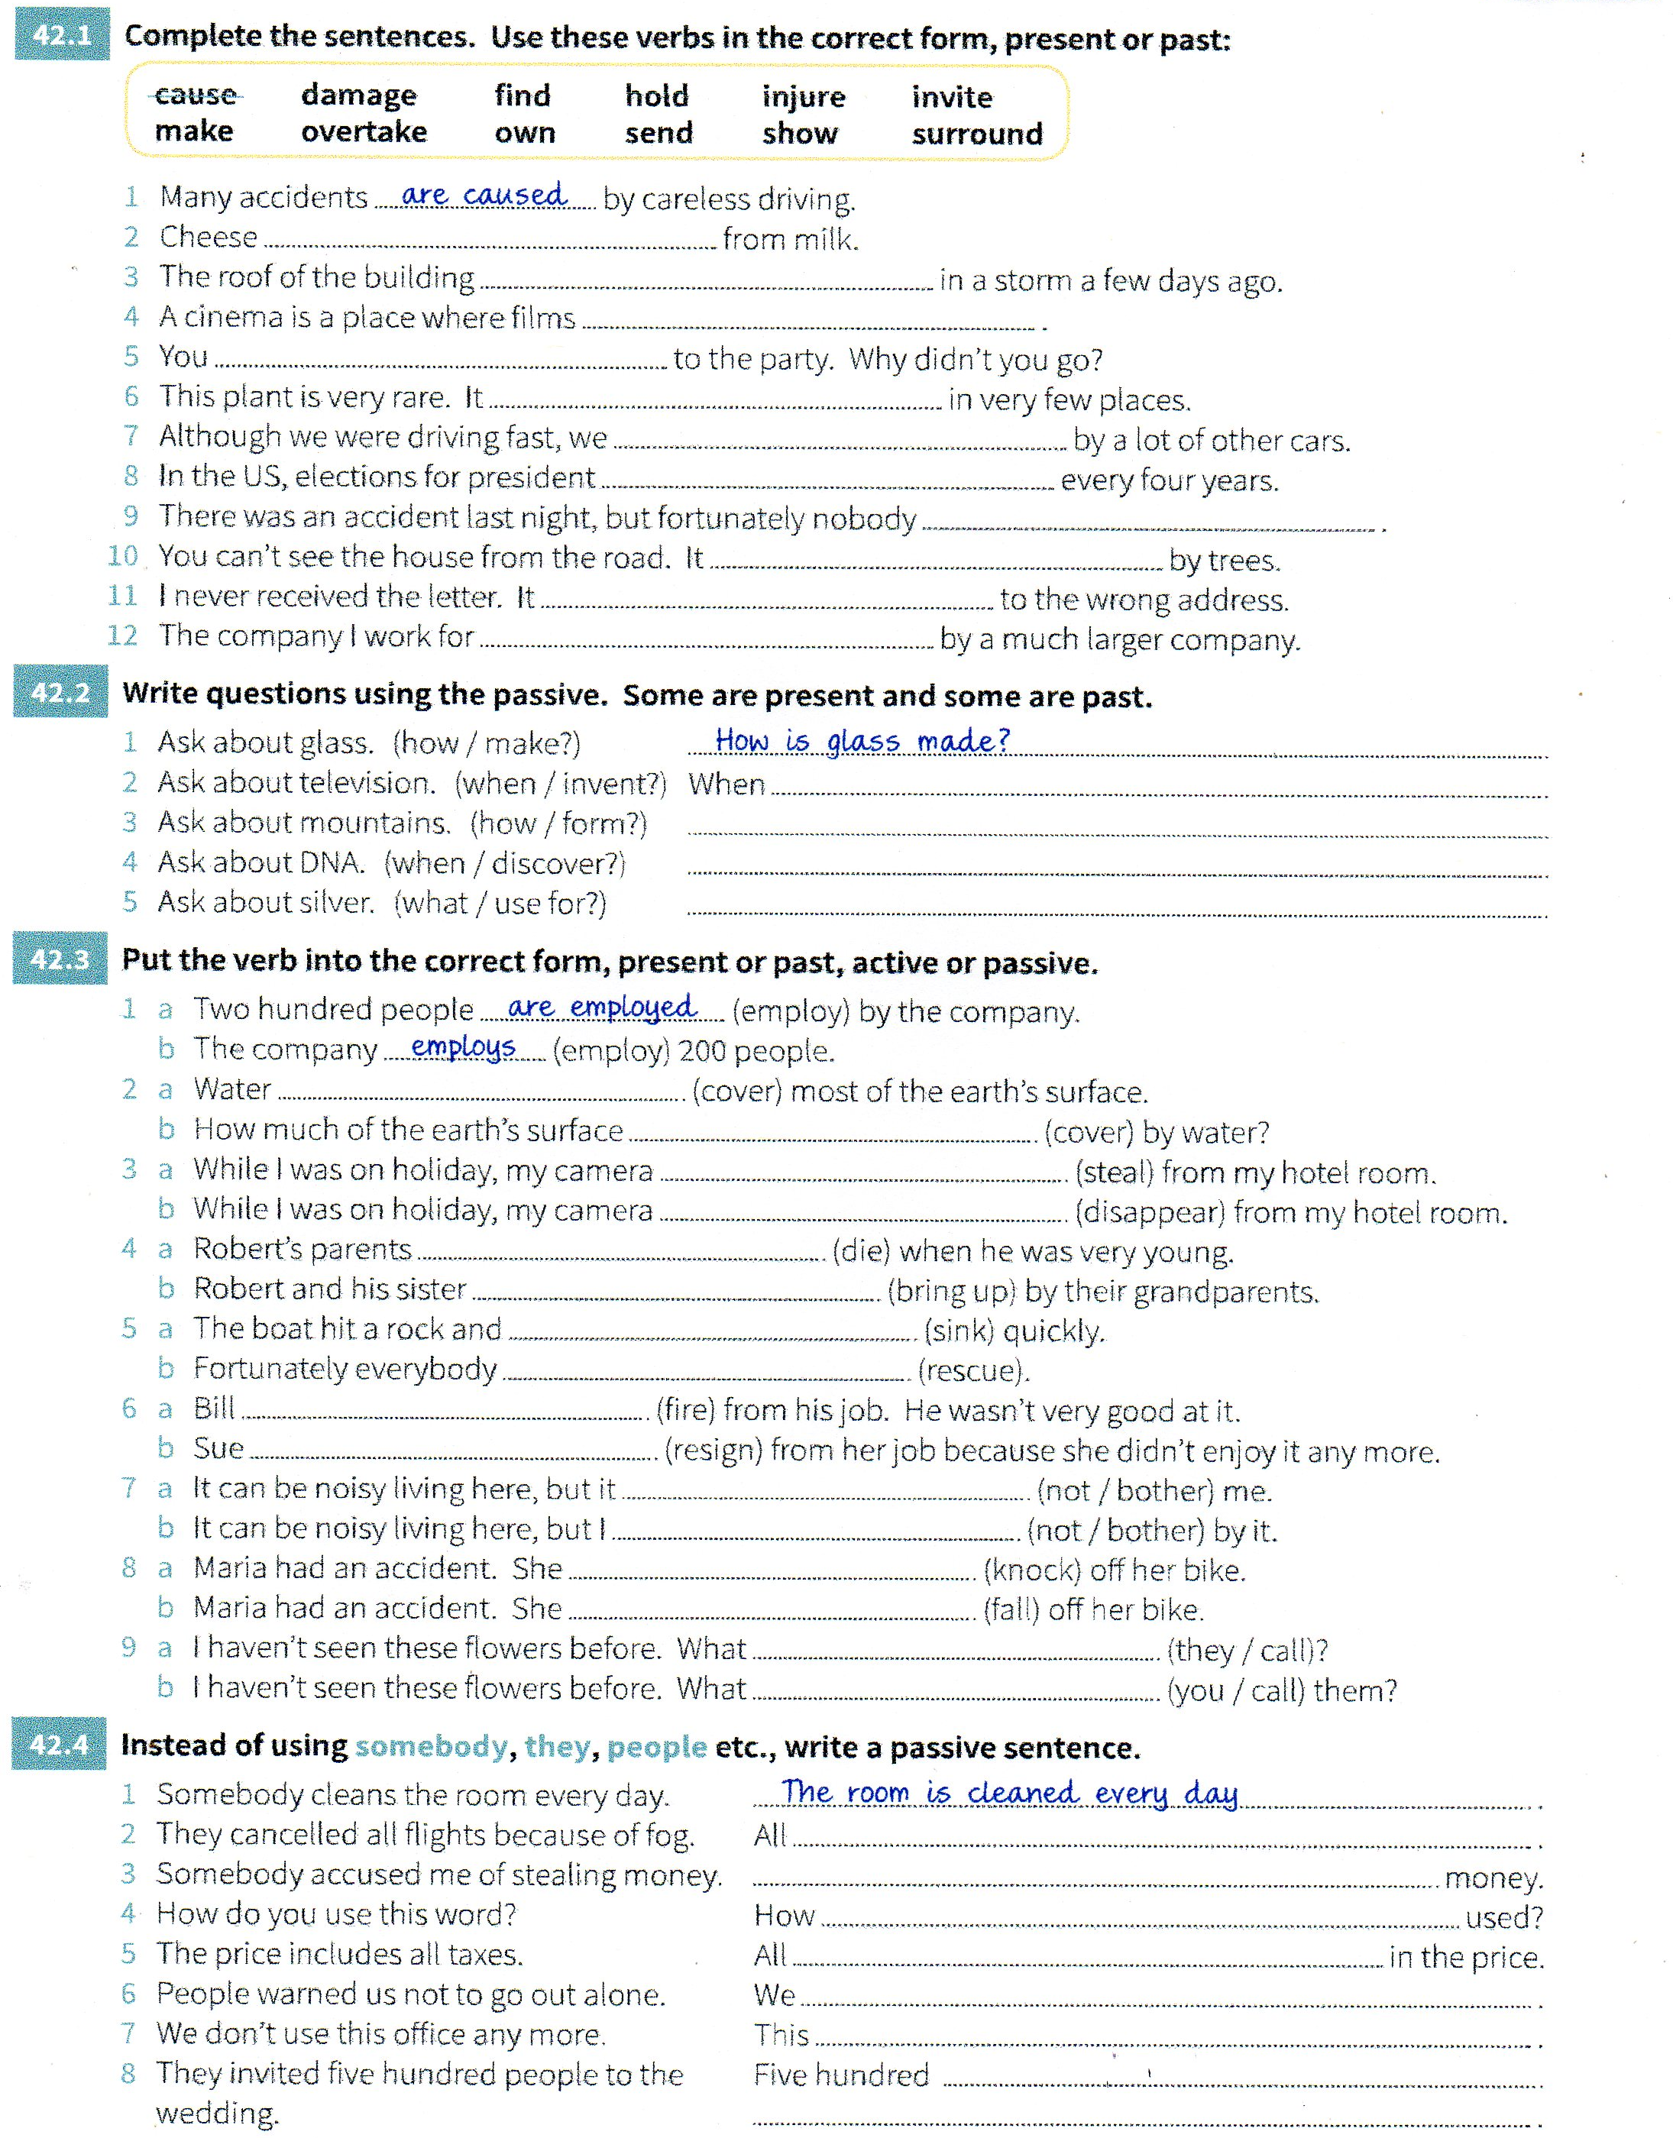
GRAMMAR
Lesson 15
Passive Voice
EXERCISES
© www.trainup.com Page | 3 - 6

Slide 4

GRAMMAR
Lesson 15
Passive Voice
VERBS & TENSES
ORAL EXERCISE
Student A reads the sentence;
Student B listens to it and change into negative.
17. Dance – dançar
The band played the guitar while we danced.
He dances well for a man of his years.
I'm going to dance.
They will dance two performances of "Romeo and Juliet".
She has danced and taught all over the world.
I can dance reasonably well.
18. Date – namorar, datar
That suit dated from the 19th century.
Chris dates a lot of women.
I am going to have an exact date.
Will you go on a date with me?
He has dated anyone lately.
I can't give you a precise date.
19. Depend– depender
The organization depended heavily on voluntary help.
Your future depends on your dreams.
A lot is going to depend on how effectively you can manage your problem.
The outcome will depend on a number of factors.
The farmer has depended heavily on the weather.
The decision should depend on the situation as a whole.
20. Die – morrer
Her grandfather died ten years ago.
Envy never dies.
I fear he is going to die.
Surrender to the enemy? We will die first.
John is sad because his dog has died.
She also knew that he could die within five minutes.
21. Do – fazer
Worrying never did anyone any good.
When in Rome, do as the Romans do.
What are you going to do?
I will do whatever you wish.
I am sorry for what I have done.
This is the way you should do it.
22. Dream - sonhar
She dreamed of becoming a chef.
I dream about you every night.
She´s going to dream with her vacation.
I'll dream with this show.
I have dreamed of this day for a long time.
If you can dream it, you can do it.
23. Drink – beber
We drank a whole bottle each.
She drinks wine and beer but no liquor.
We are going to drink a lot tonight.
I will drink gin and tonic.
He can't possibly have drunk all that on his own!
You should not drink wine.
24. Drive - dirigir
He drove away in a car.
Drive your business, do not let it drive you.
No way am I going to drive them there.
Anna will drive me home after work.
By his own admission he should never have driven so fast.
You must drive on the left-hand side of the road in Britain.
© www.trainup.com Page | 4 - 6

Slide 5

VOCABULARY
Lesson 15
Passive Voice
PHRASAL VERBS
https://www.youtube.com/watch?v=nIlnxm8m2ec&t=382s
To add Up (1:40s)
Something that makes sense ; usually negative.
Her story didn´t add up. I think she’s lying.
A história dela não batia. Acho que ela está mentindo.
To Back (somebody) Up (3:10s)
To support someone
My parents backed me up when I decided to apply for graduate.
Meus pais me apoiaram quando decidi me candidatar a pós-graduação.
I’ve got your back.
Eu te dou cobertura.
To Blow Up (4:48s)
To become suddenly angry
When I told her I couldn’t come to her party she blew up.
To Bring it One (5:36s)
To accept a challenge with confidence
Fifty new phrasal verbs? Yeah, bring it on!
Cinquenta novos phrasal verbs? Sim, traga-os!
His evidence didn't really add up to very much
My family backed me up in my fight for compensation.
My dad blew up (at me) when he saw the bill.
England versus Brazil - bring it on!
Complete as frases com os Phrasal Verbs:
My dad ________ (at me) when he saw the bill.
His evidence didn't really _________ to very much
English vs Brazil - ___________!
My family ______ me ___ in my fight for compensation.
VOCABULARY
COMMON SENTENCES
How about singing?.
How about considering it?
It’s up to you to help those in need.
It’s up to you.
How much does it cost to fly to Europe?.
How much would it cost to rent a car?.
It may surprise you, but she refused my proposal.
It may surprise you, but Bob was once in prison.
© www.trainup.com Page | 5 - 6

Slide 6

VOCABULARY
Lesson 15
Passive Voice
MOTIVATIONAL QUOTES
Simple Present 2. Verb To Be 3. Past Tense 4. Adjectives
5. Articles / There is 6. Plural / Pronouns 7. Future 8. Adverbs / Prepositions
9. Progressive Tense 10. Modal 11. Comparative / Superlative
12. Present Perfect 13.Had Better/ Would rather 14. Although/ Though/ Even though
15. Passive Voice
Instruções:
SUBLINHE o que você já estudou & ESCREVA o número da Lição.
1. “The same boiling water that softens the potato hardens the egg. It’s what you’re made of. Not the circumstances.”
A mesma água fervente que amolece a batata endurece o ovo. É do que você é feito. Não as circunstâncias.
2. “If we have the attitude that it’s going to be a great day, it usually is.”
Se tivermos a atitude de que será um ótimo dia, geralmente é.
“You can either experience the pain of discipline or the pain of regret. The choice is yours.” – Unknown
Você pode experimentar a dor da disciplina ou a dor do arrependimento. A escolha é sua.
3. “Impossible is just an opinion.”
Impossível é apenas uma opinião.
4. “Your passion is waiting for your courage to catch up.”
Sua paixão está esperando por sua coragem para alcançá-la.”
5. “Magic is believing in yourself. If you can make that happen, you can make anything happen.”
Magia é acreditar em si mesmo. Se você pode fazer isso acontecer, você pode fazer qualquer coisa acontecer.
What are you made of?
What would be an attitude to have a great day?
What can we do nowadays that was impossible 50 years ago?
What is your passion?
Do you believe in yourself? What do you believe you can do?
© www.trainup.com Page | 6 - 6

