Slide 1
GRAMMAR
Simple Present
Verb To Be
Past Tense
Adjectives
Articles / There is
Plural / Pronouns
Future
Adverbs / Prepositions
Progressive Tense
Modal
Comparative / Superlative
Present Perfect
Had Better/ Would rather
Although/ Though/ Even though
Passive Voice
Used to/ Be used to / Get used to
Unless / As long as
So do I / Neither do I
If clauses / Tag Questions
Past Perfect
Past Perfect Continuous
Future Continuous
If and Wish
Reported Speech
VOCABULARY
Daily Activities / Transportation
Jobs / Sports
Fruits & Vegetables / Food & drinks
People´s Appearance / Clothes
Nationality / Time and dates
Colors / Numbers
Giving Directions / Airport
Family / Hobbies
Health & Medicine / Body
Seasons / Weathers
School / Money
Animals / Enviroment
Holidays / Christmas
House / Bathroom
Household Tools / Kitchen
Places in a city / Famouns Architecture
Tv Programmes / Cooking Verbs
Computer parts / Cars
Feeling Emotions / Friendship
Rooms in the house / Hotel
Money / Furniture
Music Instruments / Sports Outside
Fast Food
Hospital / Office
SPOKEN ENGLISH - basics
I plan to_1.15 & It´s my turn to _2.7
I´m good at_1.3 & & I´m not sure if _2.17
How was + (noun)_3.3 & I was about to_1.17
It's too bad that_3.5 & I feel like _1.22
There's no need to_3.22 & There is …wrong with _ 3.19
I'll help you _2.5 & I was busy_1.24
I'm getting_1.5 & I'm trying _1.6
I think I should _2.10 & There's no way _ 3.27
I'm looking forward to_1.29 & I've decided to_1.16
I'm having a hard time & & I'm thinking of _2.4
I've heard that_2.11 & It occurred to me that_2.12
You're supposed to_2.23 & Are you trying to_2.27
It's no use_ 3.26 & There is something wrong_3.19
It's gonna be_3.8 & It looks like_3.9
How about_3.14 & How much does it cost to_3.16
Do you mind if _2.18 & Let's say that_3.21
I plan to_1.15 & I'm here to_1.27
It's very kind of you to_2.3 I should have_2.20
I didn´t mean to_1.18 & I'm calling to _2.1
Thank you for_ 2.14 & It's very kind of you to_3.28
Are you into_2.26 & I gotta _1.13
Why don't we_3.4
I have something_ 1.28
It's time to_3.11

Slide 2
SPOKEN ENGLISH – Common Phrases
Are you sure…? / 007. By the way…
005. Be careful with… / 006. But this doesn’t mean …
010. Don’t ever… / 027. How do you like…?
048. I’m not really happy with…/ 023. Help yourself to…
018. Not…until… / 064. No matter what…
021. He is so… that… / 022. He is not only……
025. How come…? / 026. How dare you…!
030. I bet… / 031. I can hardly believe that… / 032. I can’t help…
033. I can’t say… / 034. I cannot wait to… / 035. I dare say…
037. I’d hate for you to… / 039. If there is one / 040. I have no idea…
042…. as… as possible / 043. I’ll let you know…
045. I’m afraid… / 016. Shouldn’t we…?
049. I’m thinking about… / 050. I really go for…
053. It’s my fault for… / 056. It’s said that…
057. It’s up to… / 059. It may surprise you, but…
061. I’ve had enough / 062. I wonder if…？
065. No wonder… / 066. Now that I / 067. Once you…
069. On one hand…on the other hand… / 070. See that…
074. The first thing I’m / 076. There is nothing as…as…
077. There is nothing I / 028. How long dit take…?
082. What can I do for…？/ 044. I’d be grateful…
085. What do you say about? / 088. What I’m trying to say is…
089. What’s the matter with? / 091. What’s the use of…? /
096. Why not…? / 071. Speaking of…

Slide 3
Grátis
Pago
Intensive 1
Gramática
Video
Imagem Resumo
PDF Exercícios
Vocabulário
Imagem
Audio & Tradução
Frases de aprendizado
Common Sentences
Phrasal Verbs
Intensive 2
Gramática
Video
Imagem Resumo
PDF Exercícios
Vocabulário
Imagem
Audio & Tradução
Frases de aprendizado
Common Sentences
Motivational Quotes
Conversation Topics
360 Conversation Topics
Pequeno Texto Introdutório
Video Youtube + Transcrição
tópicos com 10 perguntas
Livros PDF
English Grammar in Use (Essential)
English Grammar in Use (Intermediate)
American English File
English for Everyone
Vocabulary in Pictures
240 Com se diz em Inglês
Expressões
120 Phrasal Verbs
120
100 Principais Verbos
Frases de acordo com 24 Lessons
Movies
The Intern
The Greatest showman
Me before you
Divertidamente
Frozen
Era do Gelo
Hitch
Jumanji
Oceans 11
Beauty and the Beast
Moana
Aladdin
Songs
Oceans
I will Always love you
Let it go

Slide 4
Phrasal Verbs
10 Phrasal Verbs que você PRECISA saber em inglês (lesson 07)
https://www.youtube.com/watch?v=9r7Jba1L1U4
20 High-Frequency Phrasal Verbs in English
https://www.youtube.com/watch?v=CGIQ1iDaNqA
50 Important Phrasal Verbs (lesson 08)
https://www.youtube.com/watch?v=nIlnxm8m2ec
I act out 20 Essential PHRASAL VERBS at Home
https://www.youtube.com/watch?v=4mkfyLfUM5g
A Fun Way to Learn 50 English Phrasal Verbs with Examples (lesson 09)
https://www.youtube.com/watch?v=B0heWo1XGhc&t=300s
A Fun Way to Learn 25 English Phrasal Verbs! Acted Out!
https://www.youtube.com/watch?v=avvrLjbJnPk
30 SUPER COMMON phrasal verbs | You can use them every day! (lesson 10)
https://www.youtube.com/watch?v=MHKa48BWbPw
PHRASAL VERBS - AÇÕES DO COTIDIANO EM INGLÊS - AULA 35 PARA INICIANTES
https://www.youtube.com/watch?v=ZrQz8r_d7dg
MY TOP TIPS! Learn & Use More Phrasal Verbs (lesson 11)
https://www.youtube.com/watch?v=8-ktHXX0BkI
Phrasal verbs with "UP" - Learn English prepositions
https://www.youtube.com/watch?v=_sR5yKbBwbE
14 PHRASAL VERBS with meanings you can’t guess (lesson 12)!
https://www.youtube.com/watch?v=wvxlX3kAsoU
How to Pronounce and Use the Top 33 Phrasal Verbs
https://www.youtube.com/watch?v=_fZnWz3tD2Y

Slide 5
The Intern
https://www.youtube.com/watch?v=WNPpSfXGqXU
Tooltip
00:01 retirement is an ongoing relentless
00:03 effort and creativity. I´ve tried yoga
00:06 learn to cook or supplants to classes in
00:08 Mandarin. Believe me, I've tried
00:09 everything. I just know there's a hole in
00:12 my life and I need to fill it soon.
00:14 I´m Ben Whitaker I have an appointment
00:15 with Ms. Ashmol
00:20 I thought she was meeting with new intern
00:23 That's me. How old are you? 70.
00:25 you? I'm 24.
00:27 I know I look older it's a job at ages
00:29 you which won't be great in your case
00:32 sorry
00:33 hi Jules I'm Ben your new intern I'm
00:37 glad you also see the humor in this be
00:39 hard not to. Don't feel like you have to
00:43 dress up. I'm comfortable in the suit if
00:45 it's ok. Old school, at least I'll stand
00:47 down I don't think you need a suit
00:48 to do that
00:49 Do you want the door open or close?
00:50 It doesn´t matter.
00:53 Open, actually. You get used to me
00:55 I look forward to
00:57 My intern keeps busy
01:00 Mr. congeniality everybody loves him
01:02 Here she comes hey back what's up?
01:03 You look really nice. How long can a woman
01:06 be mad at you for? I assumed you talked to her
01:07 apologized. I emailed her. subject line
01:10 I wrote: I'm sorry it's like a ton of OHS
01:12 I was like I'm sorry with the sad emoticon
01:15 where he's crying.
an – um/uma
(L 06 - Article)
I´ve tried – Eu tentei
(L 13 - Present Perfect)
There´s - Existe
(L 6 – There is/are)
I thought – Eu pensei
(L 3 – Past Tense)
I´m 24 – Eu tenho 24.
(L2 – To be)
New intern – novo interno
(L 4 – Adjective)
I´ll stand – Eu permanecerei
(L 7 – Future)
Actually – na realidade
(L 8 – Adverbs)
Her – ela
(L 10 – Pronouns)
Can - poder
(L 11- Modal)
he's crying – ele está chorando
(l 9 – Progressive Tense)

Slide 6
01:18 our investors just think that a seasoned
01:20 CEO it takes some things off your
01:22 plate I did not see that coming
01:25 she's just trying to do right by
01:27 everybody the company, the family,
01:29 pressure is unbelievable.
01:33 you started this business all by yourself a year and
01:35 a half ago and now you have a staff of
01:37 220 people. Remember who did that.
01:45 Good times. The truth is, something about
01:47 you makes me feel calm, more centered or
01:49 something . I could use that obviously.
01:53 How in one generation have men gone from guys
01:56 like Jack Nicholson and Harrison Ford's to
01:58 Oh Boy.
02:01 I'm Fiona, the house masseuse. loved
02:07 that there's another oldie but goodie
02:08 here
02:10 How´s that Ben?
02:12 Here you go.
02:13 You´re not as old as I thought you were.
Things – coisas
(L5 – Plural)
I didn´t see that coming –
Yourself – por si só
The - article
there's - existir
men - plural
I could use - modal
as old as – tão velho
(L 12 – Comparative)
You were – você era
(L 2 – To Be –past)

Slide 7
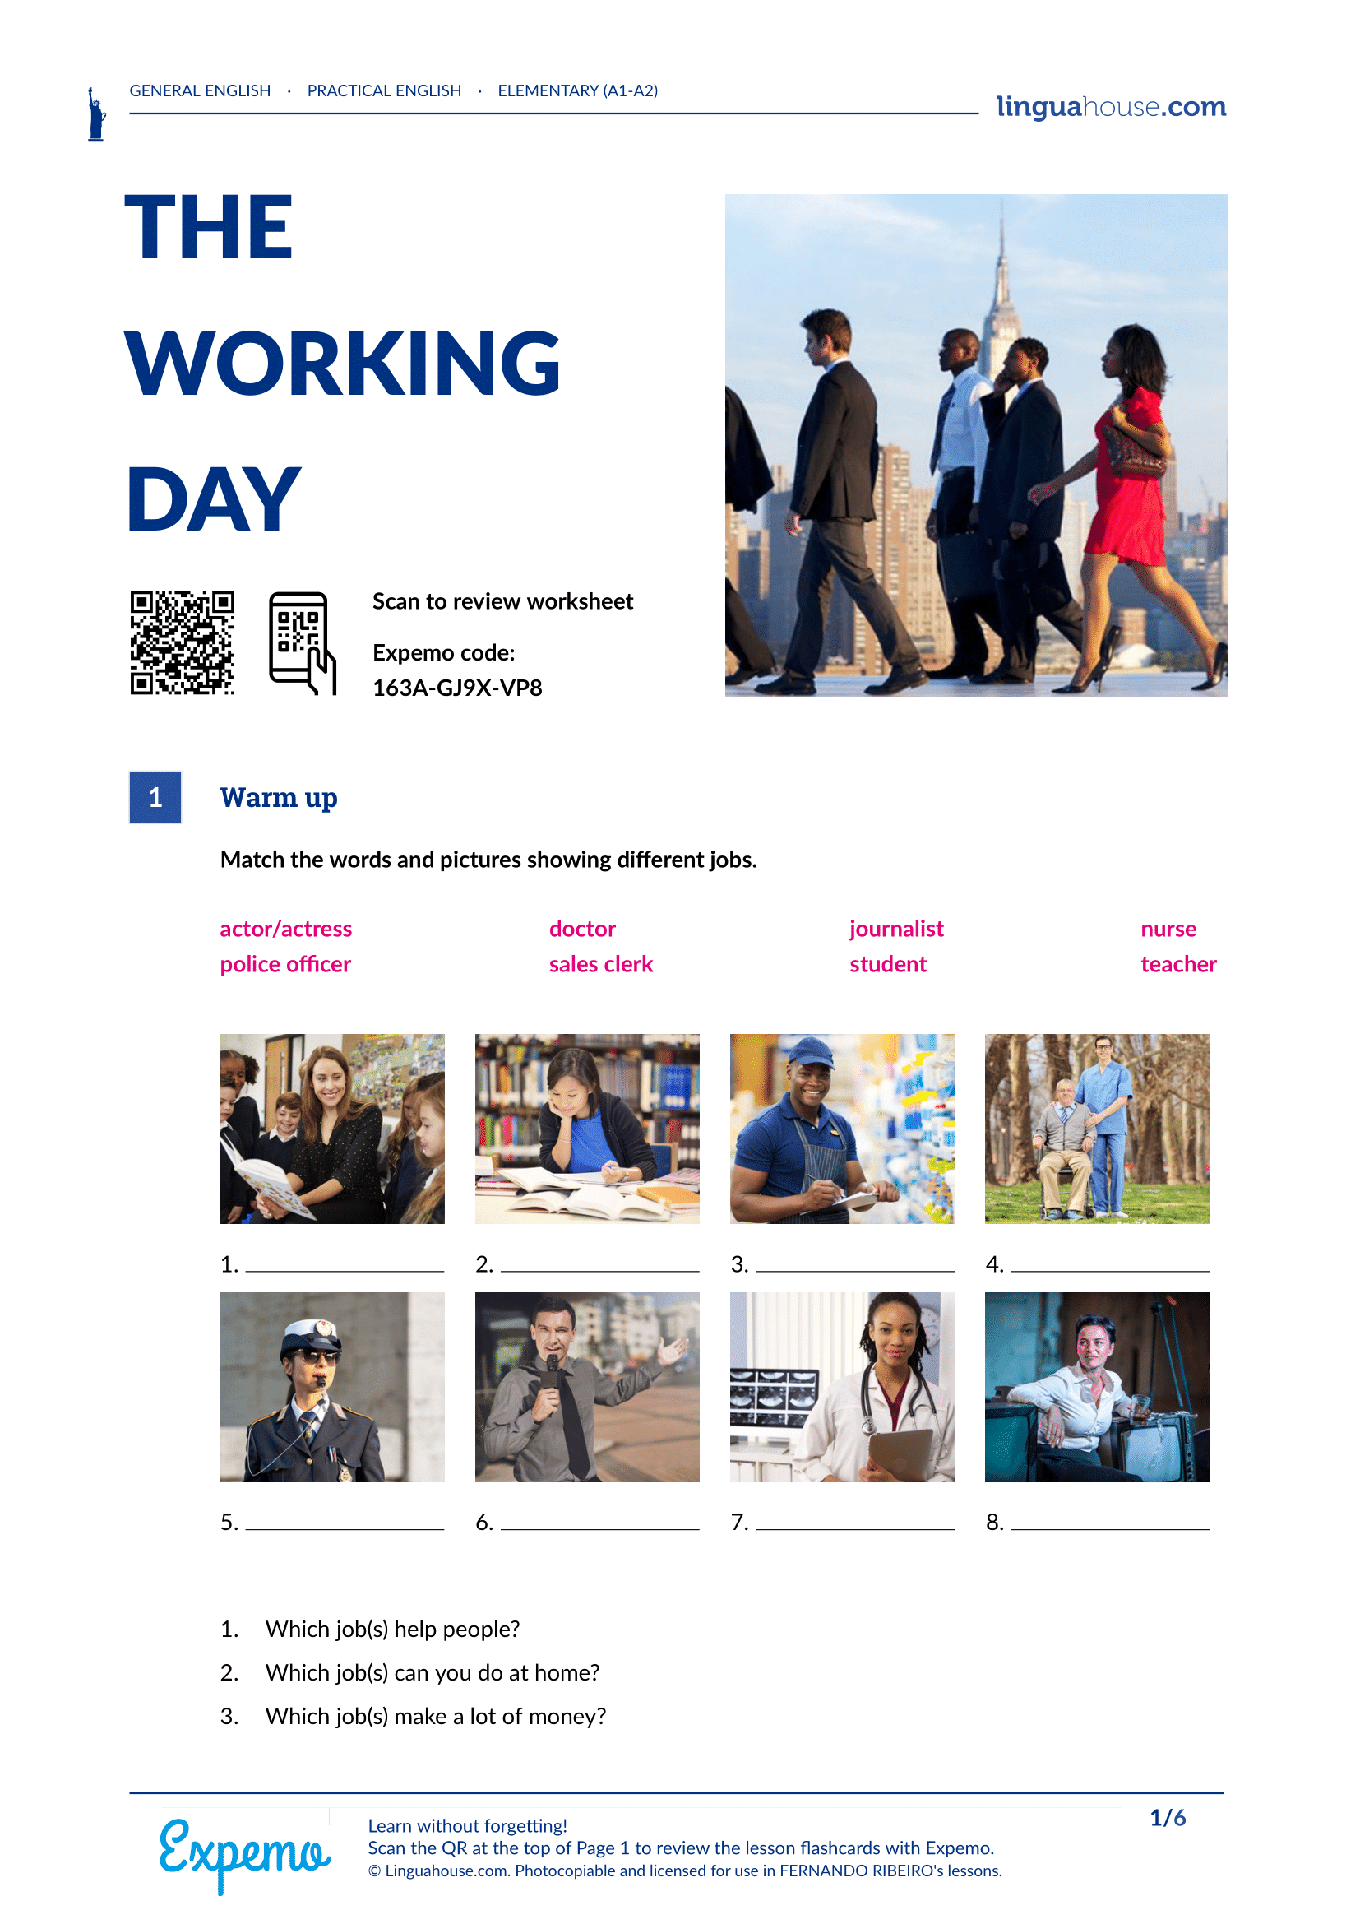

Slide 8
