Slide 1

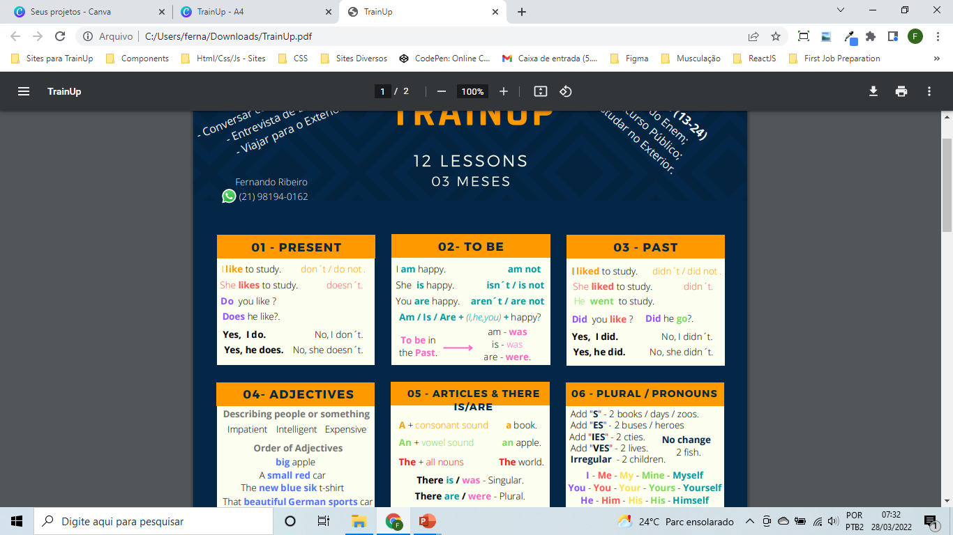
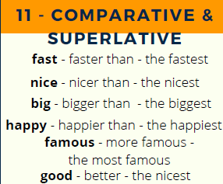
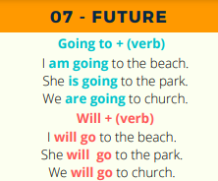

GRAMMAR
Lesson 11
Comparative & Superlative
QUESTIONS
Stopped
Finished
Washed
Woke up
Gave
Used
Needed
Lost
Wore
Took
Stopped
Finished
Washed
Woke up
Gave
Used
Needed
Lost
Wore
Took
Stopped
Finished
Washed
Woke up
Gave
Used
Needed
Lost
Wore
Took
Stopped
Finished
Washed
Woke up
Gave
Used
Needed
Lost
Wore
Took
Stopped
Finished
Washed
Woke up
Gave
Used
Needed
Lost
Wore
Took
Stopped
Finished
Washed
Woke up
Gave
Used
Needed
Lost
Wore
Took
Stopped
Finished
Washed
Woke up
Gave
Used
Needed
Lost
Wore
Took
Stopped
Finished
Washed
Woke up
Gave
Used
Needed
Lost
Wore
Took
Stopped
Finished
Washed
Woke up
Gave
Used
Needed
Lost
Wore
Took
Stopped
Finished
Washed
Woke up
Gave
Used
Needed
Lost
Wore
Took
Daily Activities
Transportation
Jobs
Sports
Fruits
Vegetables
Food & drinks
Appearance
Clothes
Nationality
Time and dates
Colors
Numbers
Giving
Airport
Family
Hobbies
Health
Medicine
Body
Seasons
Weathers
School
Money
Animals
Enviroment
Holidays
Christmas
House
Bathroom
Household
Kitchen
Places in a city
Tv Programmes
Cooking Verbs
Computer parts
Cars
Feeling Emotions
Friendship
Rooms in the house
Hotel
Money
Furniture
Music Instruments
Sports Outside
Fast Food
Hospital
Office
© www.trainup.com Page | 3 - 9

Slide 2
GRAMMAR
Lesson 11
Comparative & Superlative
QUESTIONS
Simple Present
I like to study.
don´t / do not .
She likes to study.
doesn´t.
Does he like?.
Do you like ?
Yes, he does.
Yes, I do.
No, I don´t.
No, she doesn´t.
Verb To Be
Am / Is / Are
am not
isn´t / is not
aren´t / are not
Was / Were
Was not / weren’t
Past Simple
Future
Modal
Present Perfect
100 Verbs
100 Verbs
100 Verbs
100 Verbs
100 Verbs
100 Verbs
100 Verbs
100 Verbs
100 Verbs
100 Verbs
Vocabulary
© www.trainup.com Page | 3 - 9

Slide 3
GRAMMAR
Lesson 11
Comparative & Superlative
QUESTIONS
100 Verbs
100 Verbs
100 Verbs
100 Verbs
100 Verbs
100 Verbs
100 Verbs
100 Verbs
100 Verbs
100 Verbs
Vocabulary
© www.trainup.com Page | 3 - 9

