Slide 1

GRAMMAR
Lesson 09
Progressive Tenses
VIDEOS
Estruturas?
Video Past Continuous
Positive
Sujeito + was / were + verbo com ING
Sujeito + was / were NOT + verbo com ING
Question word + was / were + sujeito + verbo com ING
What were you doing before you started watching
this vídeo?
I was working. / having lunch./ studying.
I was Writing na email.
My friends were waiting for me.
She was having breakfast.
Negative
I wasn’t watching tv.
They weren’t working.
She wasn’t talking to her boss.
Interrogative
What was he doing yesterday night?
What were they doing When you called?
Where you sleeping When I arrived?
Was it raining When you got up?
Video Present Continuous
Contração?
Negative
Interrogative
Isn’t / aren’t
You / they / we are not watching a vídeo
She is not watching a movie
She isn’t watching a movie
They are not playing
They aren’t playing
Positive
Are you watching a vídeo?
Are they playing?
You are watching a vídeo
She is watching a movie
They are playing
03 casos específicos
To Lie – lying ( mentir )
To dance – dancing
CVC – To sit – sitting (sentar)
Consoante Vogal Consoante
Video Future Continuous
Se é Futuro tem?
will
Positive
Interrogative
Se é contínuo tem?
ING
I will be sleeping at 7
You will be working tomorrow (tmrw)
Clarisvaldo will be calling you
I will be dancing
I will be studying
I will be talking
I will be buying /playing / working / meeting
Will you be sending...?
Dancing / playing / Writing ...
Verbo auxiliar?
will
Short Answer?
Yes, I will.
No, I won´t.
Obs1 :
will – to be going to
I am going to be studying.
You are going to be working on Saturday.
Are you going to be working?
Is he going to be eating? (Ele vai estar comendo?)
Yes, I am. / No, I am / Yes, He is / No, he isn’t.
Obs 2:
Praticar à EXAUSTÃO!
© www.trainup.com Page | 1 - 11

Slide 2
GRAMMAR
Lesson 09
Progressive Tenses
2) Escreva os verbos em Inglês:
- deixar, permitir to let - olhar; parecer to look - gostar to like
- Fazer to make - perder to lose - significar to mean
- encontrar (com alguém) to meet - mover; mudar (de residência) to move
- (possibilidade) poder may - (possibilidade) poder might
- (obrigação) ter que must
3) Ligue as palavras:
1
2
3
4
5
6
7
8
9
10
11
Christmas
Truth
Actually
Brother
Class
Smoke
Test
Europe
Once
Doctor
Phones
A
B
C
D
E
F
G
H
I
J
l
Verdade
Na realidade
Classe
Natal
Irmão
Doutor
Fumaça
Teste
Telefones
Uma vez
Europa
4) Complete as letras das palavras e crie frases no tempo progressivo:
CrYing
CHuRch
AcTuaLly
BRotHeR
ONce
SmOKe
EUroPE
PhOnES
DoCTor
CoRreCtLy
TesT
© www.trainup.com Page | 2 - 11

Slide 3

GRAMMAR
Lesson 09
Progressive Tenses
REPETITION
5) Risque o verbo INCORRETO: 6) Passe as frases para Negativa (azul):
1. I wasn’t talking to mom.
2. Your father was not telling a lie.
3. Actually we weren’t thinking of him.
4. We were not home when I met them.
5. It was not snowing when I got up.
6. I didn’t hurt my arm while I was working
in the garden.
7. I waved to Bob, but he was looking.
8. I am stopping for a drink.
9. My brother is studying at home.
10. The children are taking a their toys.
1. I were / was talking to Father Christmas. (mom)
2. Your father were / was telling the truth. (a lie)
3. Actually we were / was thinking of you. (him)
4. We were / was walking home when I met Jane. (them)
5. It were / was raining when I got up. (snowing)
6. I hurt my back while I were / was working in the garden.
7. I waved to Jane, but she weren´t / wasn’t looking. (Bob)
8. I am / is stopping for a smoke. (drink)
9. My brother is / are studying at Columbia. (at home)
10. The children am / are taking a test. (their toys)
7) Escreva as frases na ordem correta:
11. The / is / water / careful / boiling / Be!
12. getting / thirst. / Let’s / I´m / go / drink / and.
13. The / increasing / of / fast / the / population / world / is / very.
14. You / today / working / hard /are.
15. Don’t / eating / between / 10 / and / 11. / phone / We´ll be.
16. government / The / will / making / be / a / statement / the / crisis / about / later / today.
17. I / Europe / will / next / be / round / week /travelling.
18. He / pro / will / be / turning .
19. Well, / I’m / sure / they / hear / once / They / what / their /boy / did, / will be understanding.
20. And / her / the / will be / doctor / on / the 14th / visiting.
The water is boiling. Be careful!
I´m getting thirst. Let’s go and drink.
The population of the world is
increasing very fast.
You are working hard today.
Don’t phone between 10 and 11.
We´ll be eating.
The government will be making a statement about the crisis later today.
I will be travelling round Europe next week.
He will be turning pro.
Well, I'm sure once they hear what their boy did, They will be understanding.
And the doctor will be visiting her on the 14th.
© www.trainup.com Page | 3 - 11

Slide 4

GRAMMAR
Lesson 09
Progressive Tenses
QUESTIONS
8) Responda as perguntas:
1. Was she going to school?
2. Were they singing a song?
3. Was she working at home?
4. Was he teaching English?
5. Was she eating pizza?
6. Was I answering correctly?
7. Were they crying?
8. Is she going to church?
9. Is your son buying a new phone?
10. Are they playing soccer?
11. Are you enjoying the music?
12. Is it raining?
13. Are you really helping me?
14. Is she taking her medicines?
15. Will he be going to school?
16. Will she be waiting here?
17. Will they be helping us?
18. Will we be using our phones?
19. Will she be sleeping?
20. Will they be eating?
© www.trainup.com Page | 4 - 11

Slide 5
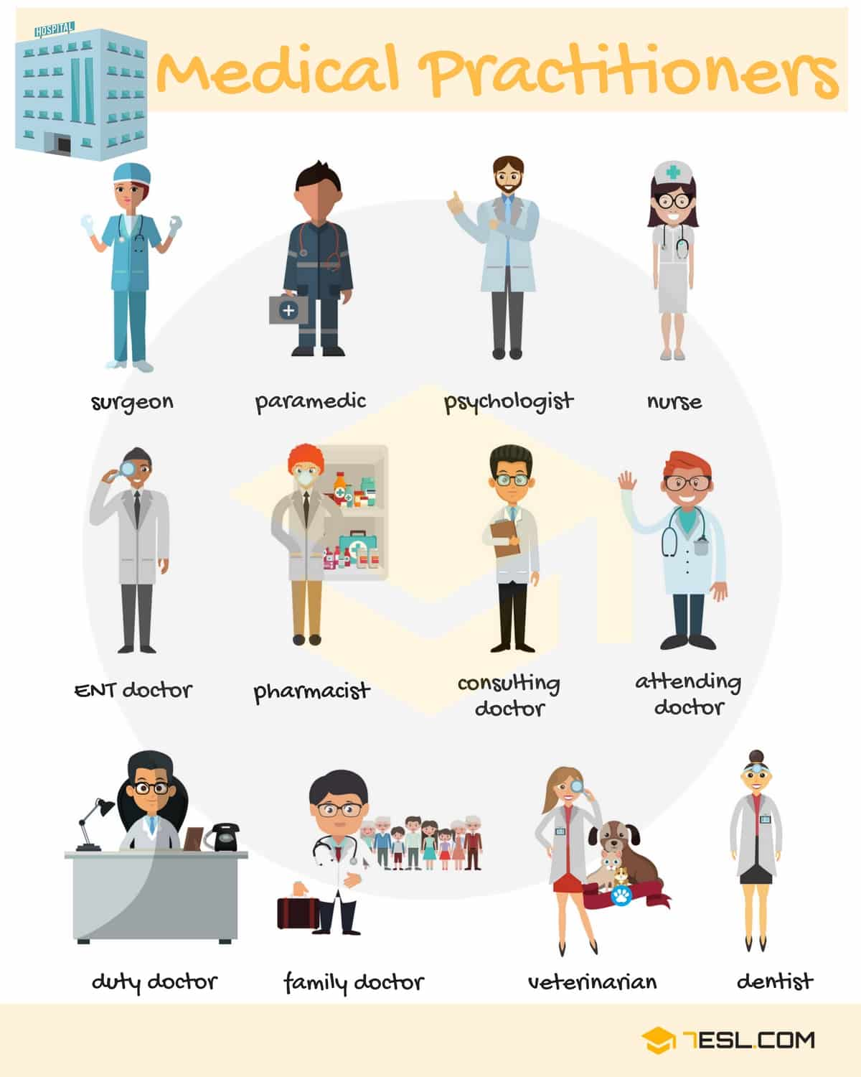

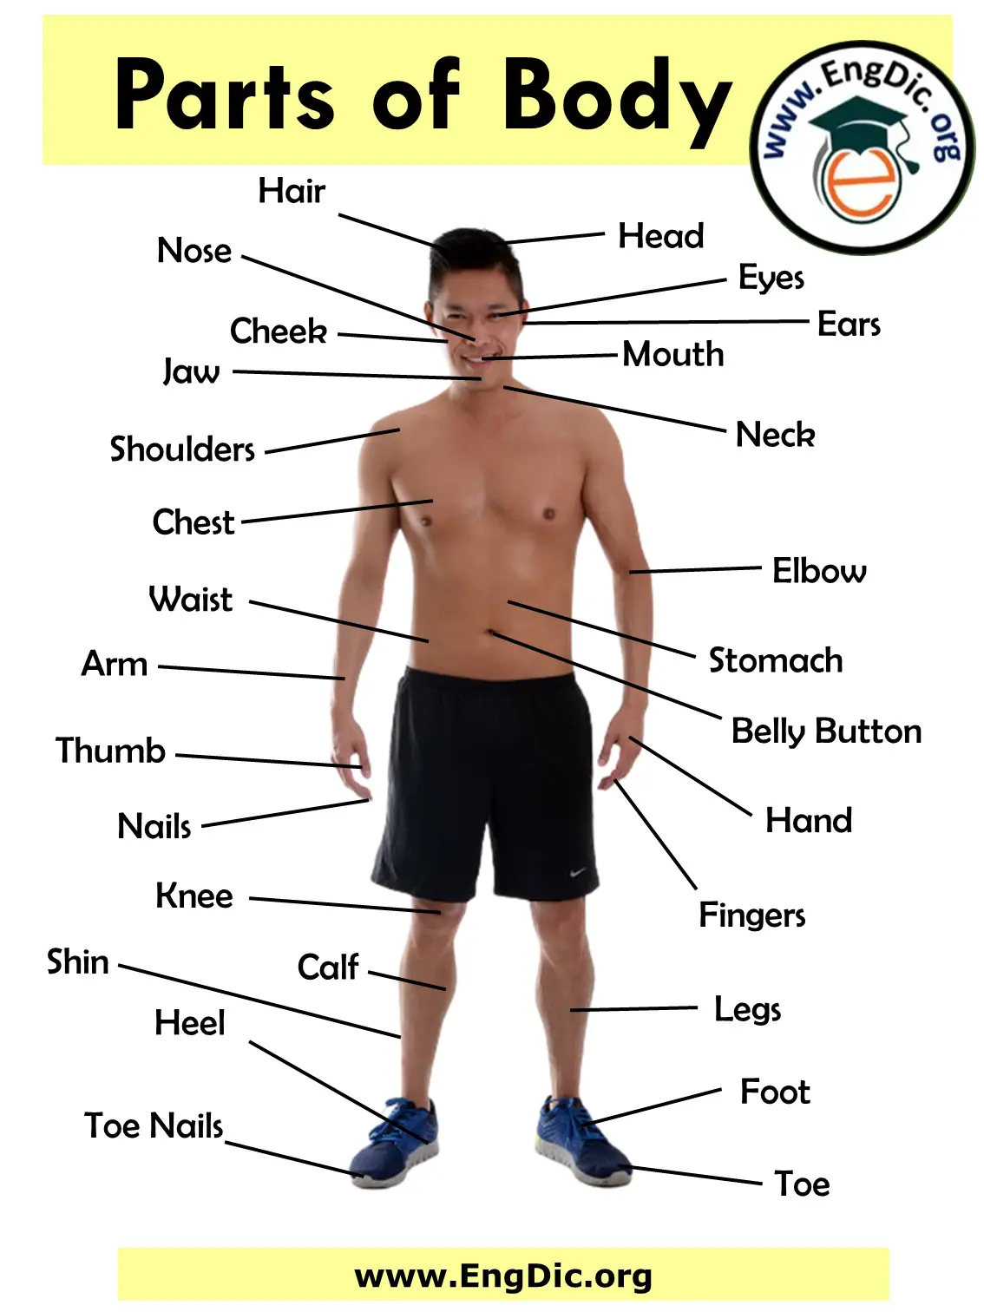
VOCABULARY
Lesson 09
Progressive Tenses
02 TOPICS
surgeon
psycologist
nurse
Consulting
doctor
9) Complete as palavras das imagens:
Duty
doctor
family
doctor
dentist
hair
mouth
ears
jaw
shoulders
elbow
arm
knee
hand
legs
foot
© www.trainup.com Page | 5 - 11

Slide 6

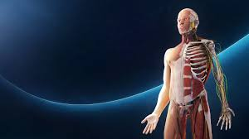
VOCABULARY
Lesson 09
Progressive Tenses
02 TOPICS
10) Responda as perguntas abaixo:
a) Do you worry about your health?
b) How often do you have a health check?
c) Where do you go to get information on health?
d) What are the best and worst jobs for your health?
e) How is the health of your computer / the economy / the planet?
HEALTH
a) Do you think our body is perfectly formed?
b) What part of your body would you like to change?
c) How is your body changing? Do you like these changes?
d) What’s the best and worst thing ever to happen to your body?
e) What do you do to look after your body?
BODY
© www.trainup.com Page | 6 - 11

Slide 7

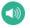
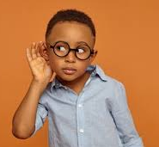




VOCABULARY
Lesson 09
Progressive Tenses
COMMON SENTENCES
11) Responda as perguntas:
I'm looking forward to meeting you. Why? I´m looking forward to meeting you because
2. She`s looking forward to talking with you. Why?
3. I'm looking forward to going to Paris. Why?
4. I'm looking forward to spending time with my friends. Who?
5. I'm looking forward to our future. Why?
6. I've decided to join the group.
7. I've decided to change my bad habits.
8. She’s decided to marry him.
9. He’s decided to apply for the job.
10. They've decided to stay at home.
11.1 Escute os audios no site e escreva:
11. I can not say _____________________
12. I can´t say ______________________ .
13. I can not say _____________________
14. I can’t say _______________________
15. I can’t say _______________________
11.2 Complete:
11.3 Enumere as imagens:
16. I can not wait to see that movie.
17. I can not wait to hear from her.
18. I can´t wait to visit my parentes this Holiday.
19. I can´t wait for my vacation.
20. I can´t wait open my present.
© www.trainup.com Page | 7 - 11

Slide 8


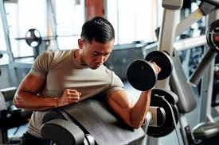
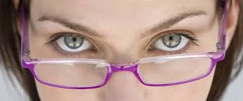
VOCABULARY
Lesson 09
Progressive Tenses
PHRASAL VERBS
12) Escreva mais frases com os Phrasal Verbs:
Think something over - (consider ) - ponderar, considerar Jane is thinking the suggestion over before her final decision.
Please think over what I've said.
Have a think over the weekend and tell me what you've decided.
We'll think over your proposal.
Think over and you'll find out that you are wrong.
Let me think over, please.
Work out - (exercise ) - exercitar-se Bob goes to the gym to work out every afternoon.
I usually work out after work.
I work out regulary to keep fit.
I'm sure it'll work out. (resolver-se)
My first job didn't work out. (dar certo)
Sometimes your plans don't work out because God has better ones.
Look at - (attention) - olhar, ter atenção Please, look at me.
Look at that man standing there.
The teacher told us to look at the blackboard.
Don't look at me like that.
I look at this problem from a different viewpoint.
Look at yourself in the mirror.
© www.trainup.com Page | 8 - 11

Slide 9
TEST
Lesson 09
Progressive Tenses
14) Fale em Inglês as frases do Site:
REPETITION
1. Eu estava conversando com o Papai Noel. (mãe)
2. Seu pai estava dizendo a verdade. (uma mentira)
3. Na verdade, estávamos pensando em você. (dele)
4. Estávamos voltando para casa quando conheci Jane. (eles)
5. Estava chovendo quando me levantei. (nevando)
6. Machuquei minhas costas enquanto trabalhava no jardim. (braço)
7. Acenei para Jane, mas ela não estava olhando. (Prumo)
8. Estou parando para fumar. (beber)
9. Meu irmão está estudando em Columbia. (em casa)
10. As crianças estão fazendo um teste. (seus brinquedos)
11. A água está fervendo. Tome cuidado! (Não toque nele)
12. Estou ficando com sede. Vamos beber. (com fome - para comer)
13. A população mundial está aumentando muito rapidamente. (na China)
14. Você está trabalhando duro hoje. (estude)
15. Não ligue entre 10 e 11. Estaremos comendo. (dormir)
16. O governo fará uma declaração sobre a crise ainda hoje. (O presidente)
17. Estarei viajando pela Europa na próxima semana. (mês)
18. Ele vai se tornar profissional. (mestre)
19. Bem, tenho certeza que uma vez que eles ouvirem o que seu filho fez, eles entenderão.
20. E o médico irá visitá-la no dia 14. (em 10 dias)
© www.trainup.com Page | 9 - 11

Slide 10
TEST
Lesson 09
Progressive Tenses
QUESTIONS
1. Ela estava indo para a escola?
2. Eles estavam cantando uma música?
3. Ela estava trabalhando em casa?
4. Ele estava ensinando inglês?
5. Ela estava comendo pizza?
6. Eu estava respondendo corretamente?
7. Eles estavam chorando?
8. Ela vai à igreja?
9. Seu filho está comprando um telefone novo?
10. Eles estão jogando futebol?
11. Você está gostando da música?
12. Está chovendo?
13. Você está realmente me ajudando?
14. Ela está tomando seus remédios?
15. Ele irá para a escola?
16. Ela estará esperando aqui?
17. Eles vão nos ajudar?
18. Vamos usar nossos telefones?
19. Ela vai dormir?
20. Eles vão comer?
HEALTH
a) Você se preocupa com sua saúde?
b) Com que frequência você faz um exame de saúde?
c) Onde você vai para obter informações sobre saúde?
d) Quais são os melhores e os piores empregos para sua saúde?
e) Como está a saúde do seu computador / da economia / do planeta?
BODY
a) Você acha que nosso corpo está perfeitamente formado?
b) Que parte do seu corpo você gostaria de mudar?
c) Como seu corpo está mudando? Você gosta dessas mudanças?
d) Qual é a melhor e a pior coisa que já aconteceu com seu corpo?
e) O que você faz para cuidar do seu corpo?
© www.trainup.com Page | 10 - 11

Slide 11
TEST
Lesson 09
Progressive Tenses
COMMON SENTENCES
1. Estou ansioso para conhecê-lo.
2. Ela está ansiosa para falar com você.
3. Estou ansioso para ir a Paris.
4. Estou ansioso para passar tempo com meus amigos.
5. Estou ansioso pelo nosso futuro.
6. Decidi aceitar o trabalho.
7. Decidi terminar minha graduação.
8. Decidi parar de trabalhar.
9. Decidi voltar ao ginásio.
10. Decidi estudar inglês novamente.
11. Não posso falar bem dela.
12. Não posso dizer que vou ajudá-lo esta noite.
13. Não posso dizer o quanto ela está feliz.
14. Não posso dizer que este carro é dele.
15. Não posso dizer uma palavra sobre isso.
16. Mal posso esperar para ver esse filme.
17. Mal posso esperar para ouvi-la.
18. Mal posso esperar para visitar meus pais neste feriado.
19. Mal posso esperar pelas minhas férias.
20. Mal posso esperar para abrir meu presente.
PHRASAL VERBS
1. Jane está pensando na sugestão antes de sua decisão final.
2. Bob vai à academia malhar todas as tardes.
3. Por favor, olhe para mim.
© www.trainup.com Page | 11 - 11

