Slide 1



GRAMMAR
Leitura Complementar
Lesson 12
100 Verbos
Present Perfect
VIDEOS
1) Assista ao Video:
0:10s Existe este tempo verbal em Português?
3:07
I have done many interviews.
I have seen many pictures of your country.
I have been to Japan once.
3:40 No Simple Past faço referência a um tempo
Especícifo. Diferente quando eu digo “I have been to Japan” eu estou focando na experência. Não importa quando eu fui.
04:30 Formação
Sujeito + have / has + Verbo Particípio
She has done many interviews.
05:40 Verbos no Inglês, 02 formas:
- Regular / Irregular
06:30 Forma Negativa
Have not - haven’t
Has not - hasn’t
07:50 NEVER (Usado p/ dar Ênfase)
She has never heard of Instagram before.
I’ve never had a walman.
06:30 Forma Interrogativa (Basta Inverter)
Have you been to Japan?
Has Maruilyn been to Japan?
11:00 EVER (Alguma vez)
Have you ever tried Japanese food?
Resposta (Already)
Yes, I have already tried Japanese food.
12:10 Short Answer:
Yes, I have.
No, She hasn’t.
VERBS & WORDS
2) Escreva os verbos em Inglês:
Pegar To take - Falar To talk - Dizer To tell - Tentar To try
Virar To turn - Entender To understand - Esperar To wait - Caminhar
Querer To want - Assistir To watch - Indica Futuro will
Vencer To win - Indica Possibilidade would
3) Ligue os verbos no Particípio Passado:
4) Complete as letras dos verbos:
1
2
3
4
5
6
7
8
9
10
Taken
Gone
Worked
Done
Eaten
Opened
loved
Lived
Cut
Bought
A
B
C
D
E
F
G
H
I
J
Levou
Fiz
Trabalhei
Fui
Abri
Cortei
Amei
Comprei
Comi
Vivi
Studied listened
Broken Chosen
Given Felt
Known Made
Fineshed Been
Wanted Just
Already Never
Ever Yet
For Since
© www.trainup.com Page | 1 - 7

Slide 2

GRAMMAR
Lesson 12
Present Perfect
REPETITION
5) Risque a opção INCORRETA:
6) Passe as frases para Negativa OU Positiva:
He has / have lost his wallet.
I have / has just finished my project.
She has lived / lives in Paris for 5 years.
I have sen / seen David several times.
Have / Has you ever eaten sushi before?
Man has / hadi walked on the moon.
I have become / became more interested in medicine.
Have you ever been / be to England?
Nobody have / has ever said that to me.
We have / has never seen it before.
1. He hasn’t lost his wallet.
2. I have not just finished my project.
3. She hasn’t lived in Paris for 5 years.
4. I haven’t seen David several times.
5. I have eaten sushi before.
6. Man has not walked on the moon.
7. I haven’t become more interested in medicine.
8. I haven’t been to England?
9. Anybody hasn’t said that to me.
10. We haven’t seen it before.
11. The / has / series / never been / television / shown on.
12. I have / done / just / it.
13. have / just / You / arrived.
14. already / She / everything / knows.
15. He / already arrived / has / at home.
16. I / haven't seen / Gallary / the Central Park / yet.
17. met / Have / Bob / you / yet?
18. I / for / have lived /10 years / here.
19. She / taught / has / univerity / for / at this / a long / time.
20. I / here / have lived / 1990 / since.
21. has taught / at / since / She / this univerity / 1983.
7) Escreva as frases na ordem correta:
11. The series has never been shown on television.
12. I have just done it.
13. You have just arrived.
14. She already knows everything.
15. He has already arrived at home.
16. I haven't seen the Central Park Gallary yet.
17. Have you met Bob yet?
18. I have lived here for 10 years.
19. She has taught at this univerity for a long time.
20. I have lived here since 1990.
21. She has taught at this univerity since 1983.
© www.trainup.com Page | 2 - 7

Slide 3

GRAMMAR
Lesson 12
Present Perfect
QUESTIONS
8) Responda as perguntas:
1. Have you ever met a famous person?
2. What have you done today?
3. Have you tried computer programming?
4. Have you sung in public before?
5. Who in your family has helped you a lot?
6. Which countries have been in the news this week?
7. How long have you studied English?
8. Where have you traveled?
9. Have you ever shot a gun?
10. Have you ever screamed at someone in public?
11. What is the best and worst restaurant you have eaten at?
12. Have you ever forgotten an important birthday?
13. Have you ever fallen asleep while talking on the phone?
14. Have you ever worked a job you hated?
15. Have you ever hunted and killed an animal?
16. Have you ever sold something you own?
17. Have you ever hurt yourself in the kitchen?
18. How long have they lived in Japan?
19. Where has he been?
20. What is the longest time away from home you have ever spent?
© www.trainup.com Page | 3 - 7

Slide 4

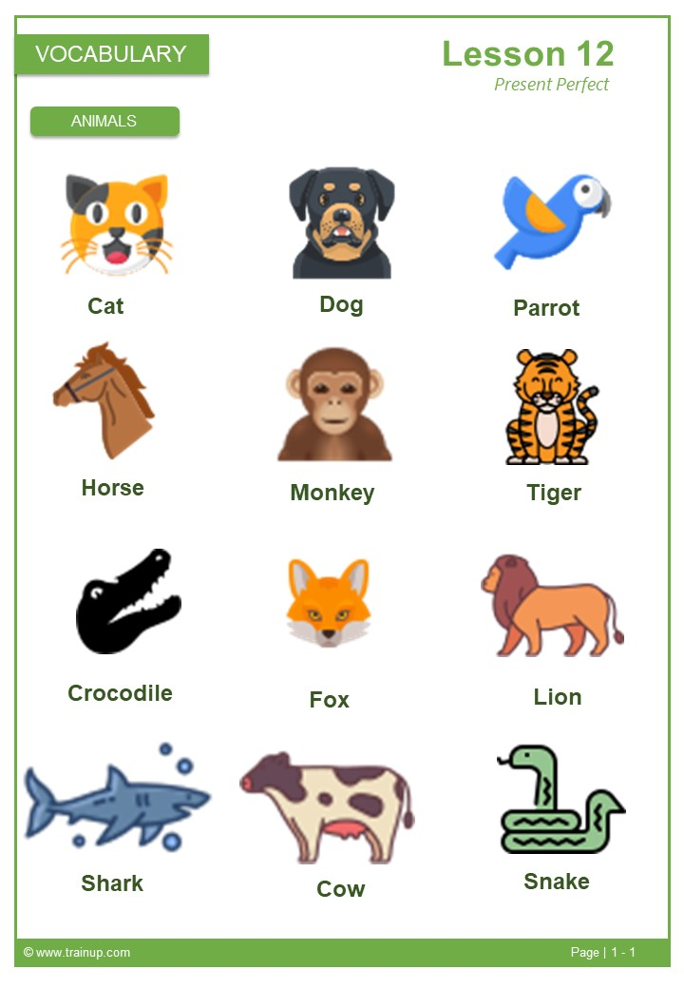
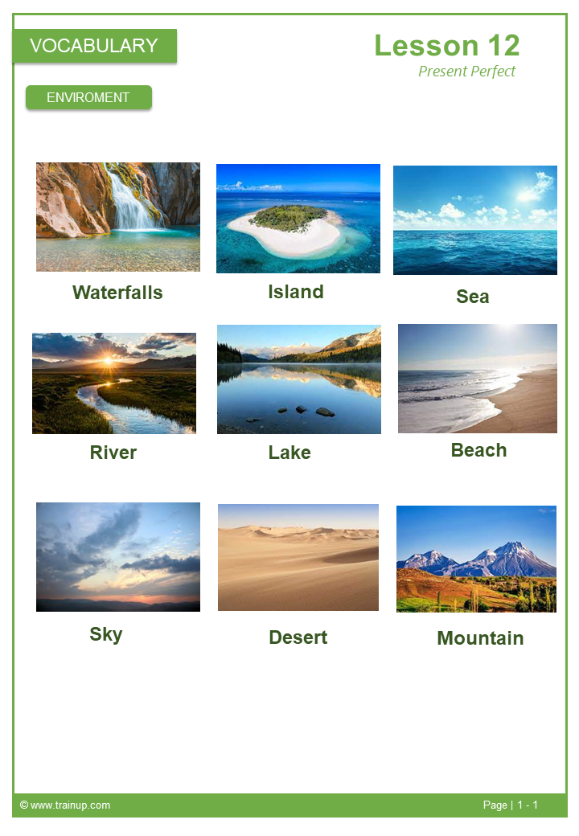
VOCABULARY
Lesson 12
Present Perfect
02 TOPICS
9) Complete as palavras das imagens:
ANIMALS
ENVIROMENT
1) How long do cats live? 2) Do dogs dream? 3) How difficult is horse riding? 4) How much can lions eat in a single meal? 5) How fast can cows run?
1) How do you feel when you see polluted rivers? 2) What do you think of living by the sea? 3) Do you prefer the mountains or the beach? 4) Is Antartica considered a desert? 5) Would you like to live in an island?
© www.trainup.com Page | 4 - 7

Slide 5

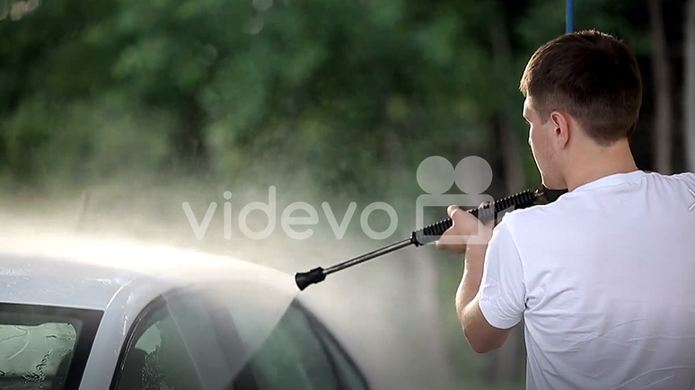
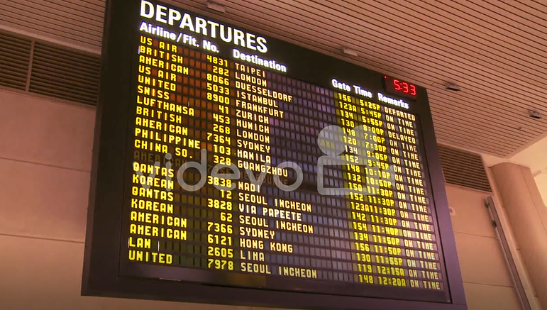
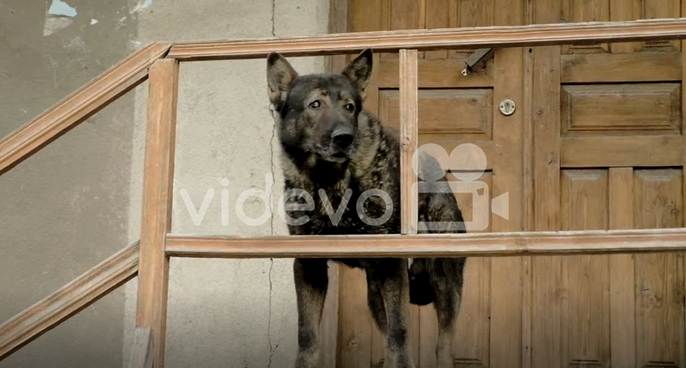
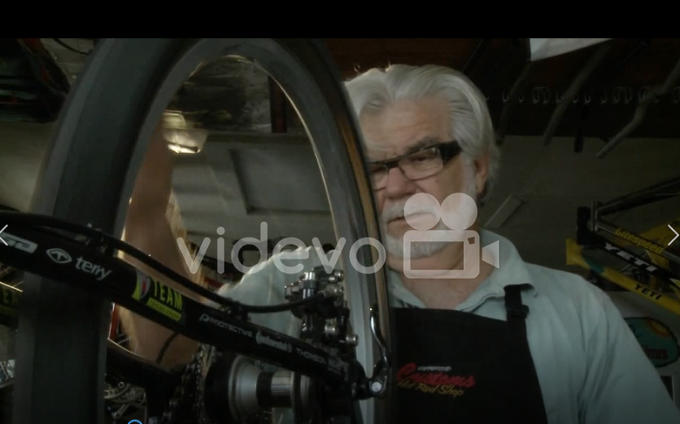
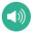

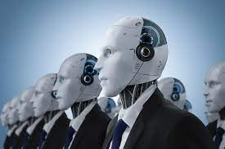
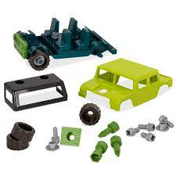

VOCABULARY
Lesson 12
Present Perfect
COMMON SENTENCES
11. Crie frases para os vídeos com
Are you trying to - You are supposed to - Shouldn’t - I’m afraid
1
2
3
4
11. 1 Crie novas as frases com:
She are supposed to
Are you trying to
He’s afraid
Shouldn’t
11.2 Escute os áudios no site e escreva:
You shouldn't smoke so much.
I'm afraid that I can't accept this job.
You are supposed to encourage your sister.
Is she trying to manage her money?
VOCABULARY
PHRASAL VERBS
.
Take over - (assume) - tornar-se algo, assumir um cargo
Take apart - (disassemble) - desmontar alguma coisa
Turn down - (reject) - rejeitar algo, reduzir
12) Complete as frases
com os Phrasal Verbs:
Why did she turn down your invitation?
Who will take over the leadership of the club?
I needed to take apart my computer.
Just before the milk comes to the boil, turn down the heat.
You know how to take apart a gun and put it back together?
It's time for someone new to take over.
Take apart the pieces before putting the toys away.
Turn down the music
Would you like me to take over for a while?
© www.trainup.com Page | 5 – 7

Slide 6
TEST
Lesson 12
13) Fale em Inglês as frases do Site:
Present Perfect
SUMMARY
Ele perdeu sua carteira.
Acabei meu projeto.
Ela mora em Paris há 5 anos.
Eu vi David várias vezes.
Você já comeu sushi antes?
O homem andou na lua.
Fiquei mais interessado em medicina.
Você já esteve na Inglaterra?
Ninguém nunca disse isso para mim.
Nós nunca o vimos antes.
A série nunca foi exibida na televisão.
Acabei de fazer isso.
Você acabou de chegar.
Ela já sabe de tudo.
Ele já chegou em casa.
Ainda não vi o Central Park Gallary ainda.
Você já conheceu Bob ?
Eu moro aqui há 10 anos.
Ela ensina nesta universidade há muito tempo.
Moro aqui desde 1990.
Ela ensina nesta universidade desde 1983.
© www.trainup.com Page | 6 – 7

Slide 7
TEST
13) Fale em Inglês as frases do Site:
Lesson 12
Present Perfect
QUESTIONS
1. Você já conheceu uma pessoa famosa?
2. O que você fez hoje?
3. Você já tentou programar computadores?
4. Você já cantou em público antes?
5. Quem na sua família o ajudou muito?
6. Quais países foram notícia esta semana?
7. Há quanto tempo você estuda inglês?
8. Onde você viajou?
9. Você já atirou com uma arma?
10. Você já gritou com alguém em público?
11. Qual é o melhor e o pior restaurante em que você comeu?
Você já esqueceu um aniversário importante?
Você já adormeceu enquanto falava ao telefone?
Você já trabalhou em um emprego que odiava?
Você já caçou e matou um animal?
Você já vendeu algo que possui?
Você já se machucou na cozinha?
Há quanto tempo eles moram no Japão?
Onde ele esteve?
Qual é o maior tempo longe de casa que você já passou?
ANIMALS
Quanto tempo os gatos vivem?
Os cães sonham?
Qual é a dificuldade de andar a cavalo?
Quanto os leões podem comer em uma única refeição?
Quão rápido as vacas podem correr?
ENVIROMENT
Como você se sente quando vê rios poluídos?
O que você acha de morar à beira-mar?
Você prefere as montanhas ou a praia?
A Antártica é considerada um deserto?
Gostaria de morar em uma ilha?
COMMON SENTECES
Você deve permanecer em silêncio.
Você está tentando imaginar uma nova imagem?
Receio que vamos nos atrasar.
Não deveríamos estar aqui cedo?
PHRASAL VERBS
Bob assumiu o cargo de diretor depois que Jane ficou doente.
Quando a máquina de café parou, Bob a desmontou e descobriu o que estava errado.
Por favor, abaixe a música. Eu preciso dormir.
© www.trainup.com Page | 7 – 7

