Slide 1
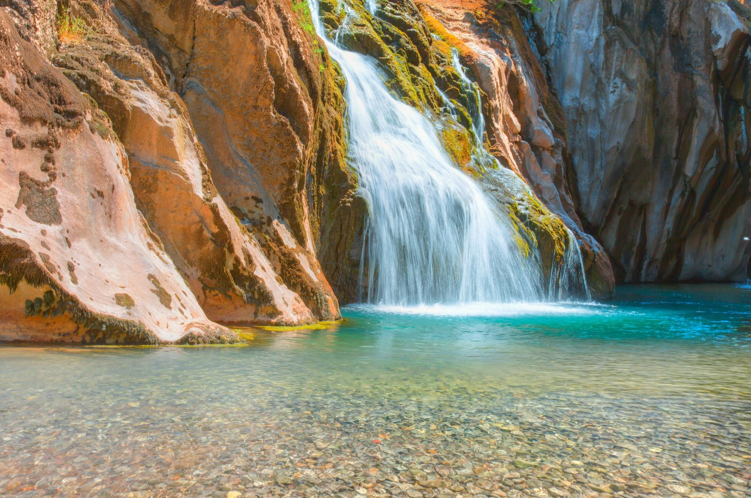
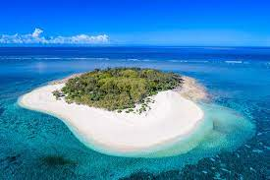
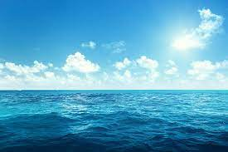
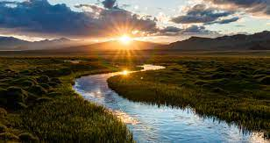
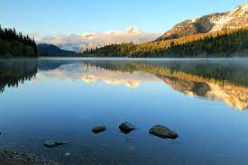
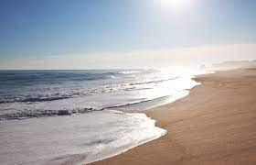
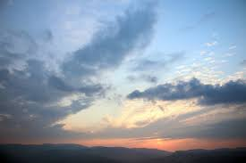
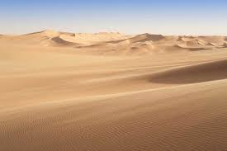
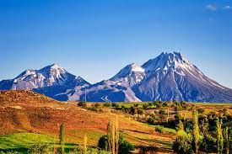
VOCABULARY
Lesson 12
Present Perfect
ENVIROMENT
Waterfalls
Island
Sea
River
Lake
Beach
Sky
Desert
Mountain
© www.trainup.com Page | 1 - 1

Slide 2












VOCABULARY
Lesson 12
Present Perfect
ANIMALS
Cat
Dog
Parrot
Horse
Monkey
Tiger
Crocodile
Fox
Lion
Shark
Cow
Snake
© www.trainup.com Page | 1 - 1

