Slide 1



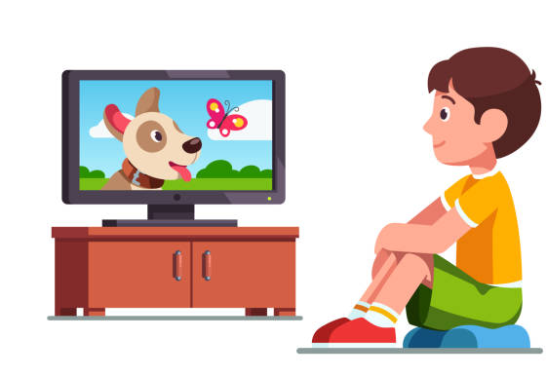



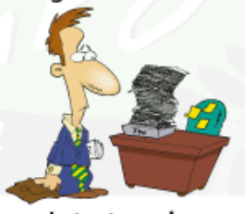
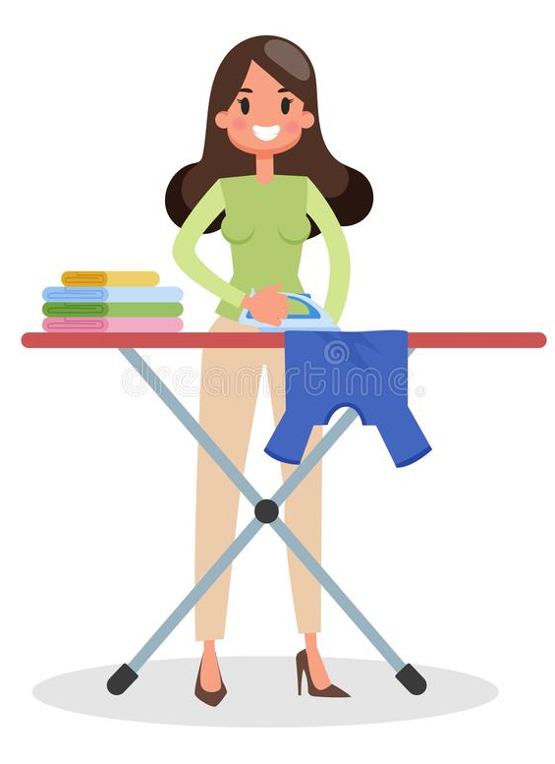


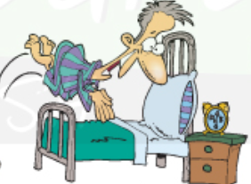



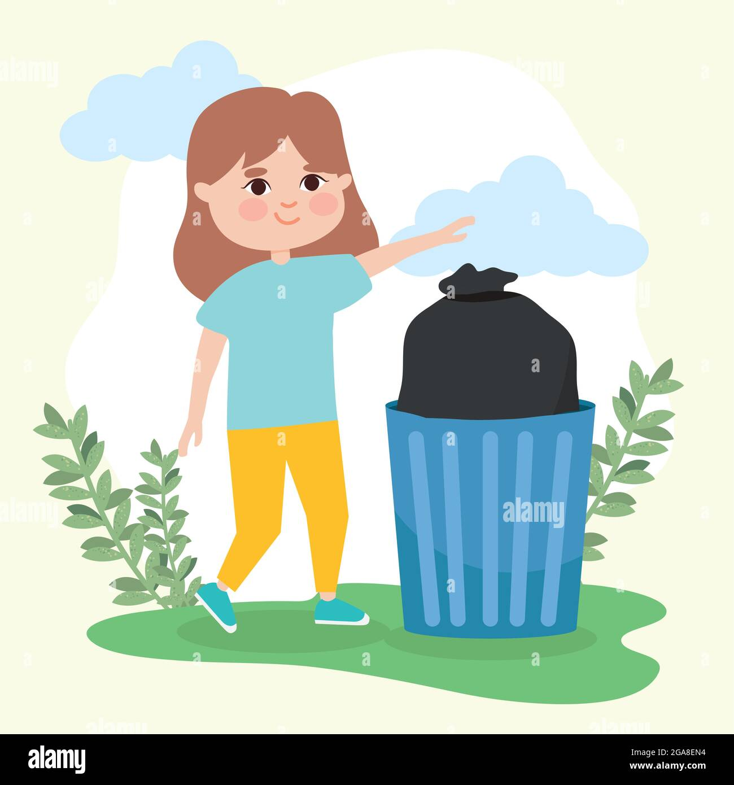
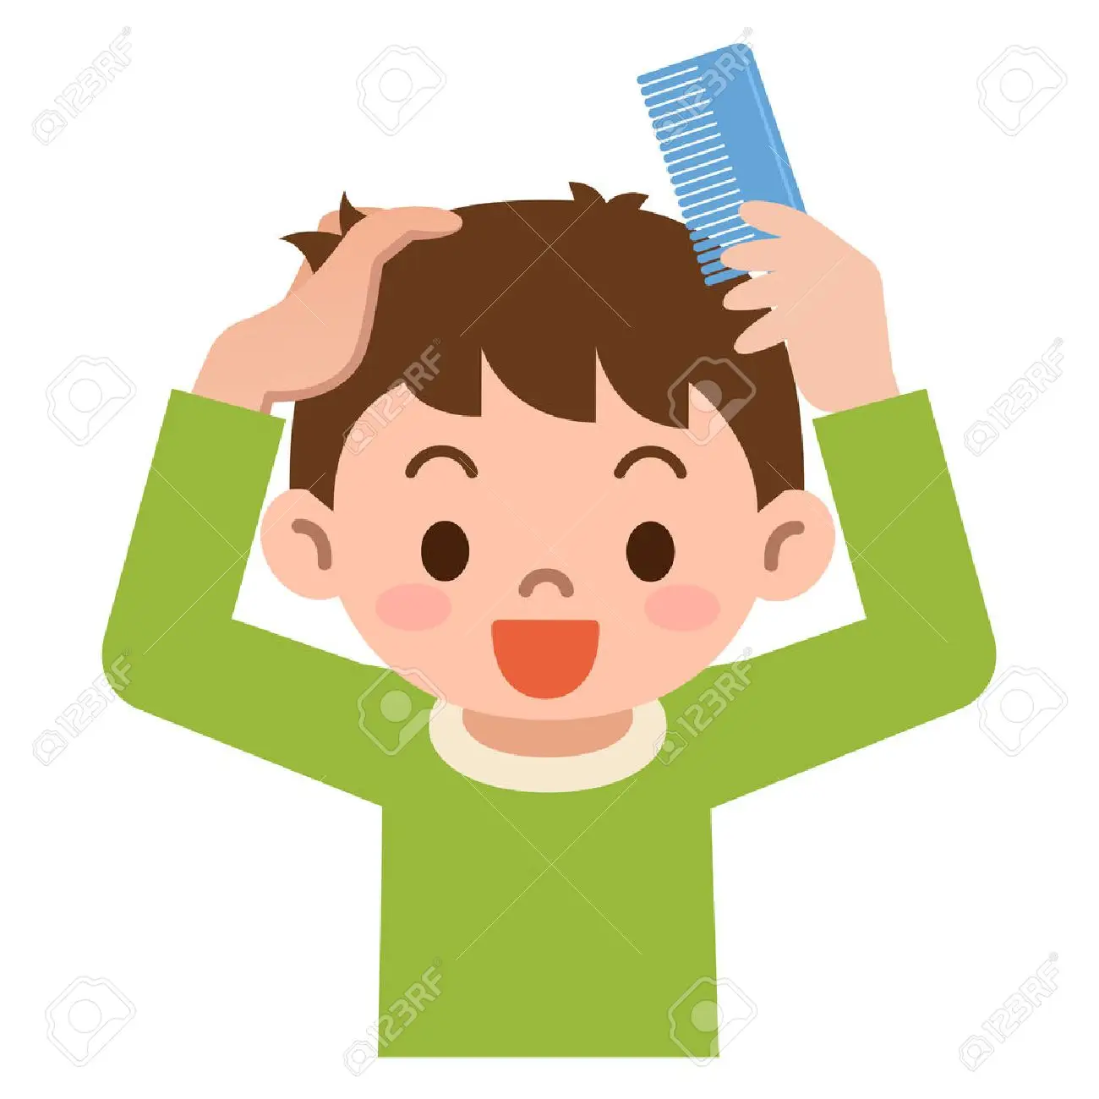
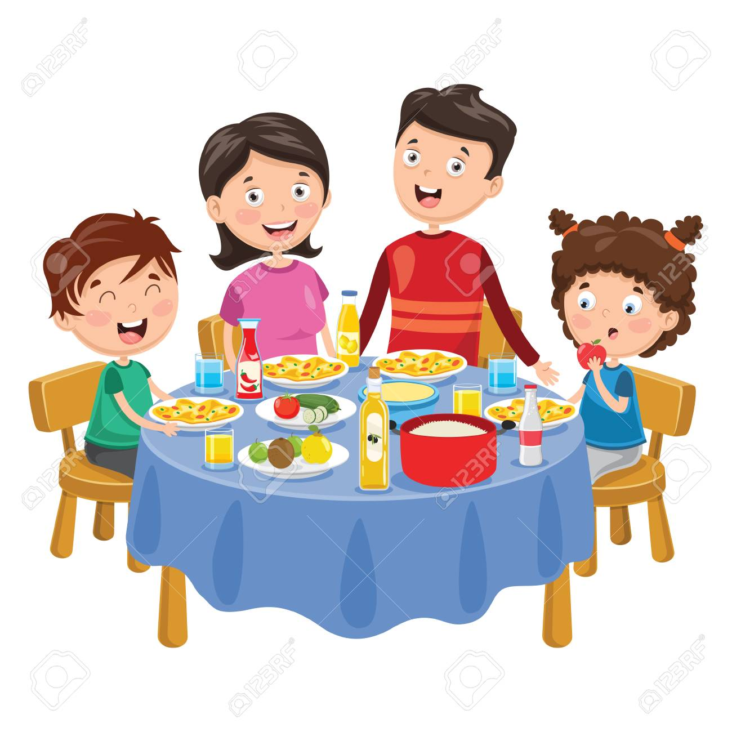

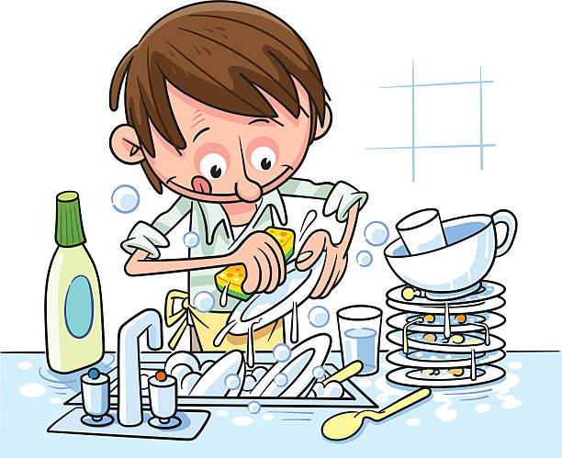
VOCABULARY
Daily Routine
Lesson 01
Get up
Have breakfast
Arrive at school
Watch tv
Be online
Do exercise
Take shower
Start work
Go to bed
Iron the clothes
Drive to work
Get dressed
go out with
friends
Take pictures
Feed the dog
Take out the
rubbish
Read the news
Do the dishes
Comb hair
Have dinner
© www.trainup.com Page | 1

