Slide 1


GRAMMAR
Lesson 04
VIDEO 1
Adjectives
VIDEOS
2 / 7 (5:45s)
... 2 or more usually
separate them with commas
A short, fair, pretty girl.
3 / 7 (6:20s)
Adjectives of color separates
by end
A black and white cow.
4 / 7 (7:00s)
After verb to be, use and between
the last two
The boy was handsome, smart
and polite
5 / 7 (8:10s)
and After the noun to emphasis
- an old man Strong and wicked
a Strong, wicked and old man
6 / 7 (9:40s)
... Comes after the noun
- God almighty, thank you!.
VIDEO 2
1) Assista ao Video:
MAIS IMPORTANTE (2:50s)
Primeiro você pôe a opinião
depois o fato e acabou.
A beautiful tall girl.
A beautiful blond girl.
- A nice yound man.
A big round ball.
Opinião – fato (substantivo) (5:25s)
a small paper book.
A long wide road.
A boring adventure movie.
A good tv game.
A Strong wet rain.
Último exemplo (6:00s)
two-story house
A comfortable two-story house.
Em 1:35s, Adjectives
... modify ________:
What it looks like...
- White house
How many ...
- Three boys
Which one it is ...
- The last one
But, DO NOT modify
VERBS or other ADJECTIVES
ADJECTIVES ORDER:
1 / 7 (3:40s)
Before Nouns
- The city has beautiful beaches.
After Verb To Be
- The water is too hot.
Usually
VERBS & WORDS
2) Escreva os verbos em Inglês:
Dirigir - To drive - Dirigir - To lead - Esquecer - To forget
Levantar - To get up - Crescer - To grow - Ouvir - To hear
Ajudar - To help - Ter esperança - To hope
3) Ligue as palavras:
4) Complete as letras das palavras:
1
2
3
4
5
6
7
8
9
10
Adorable
Beautiful
Important
Clever
Better
Embarrassed
Kind
Obedient
Faithful
Chubby
A
B
C
D
E
F
G
H
I
J
Adorável
Importante
Lindo
Obediente
Esperto
Melhor
Envergonhado
Fofinho
Fiel
Amável
Large Delicious
Small Fresh
Tiny Bitter
Quiet Yummy
Whispering Empty
Ancient Heavy
Modern Few
Rapid Delightful
Early Clumsy
© www.trainup.com Page | 1 - 7

Slide 2

GRAMMAR
Lesson 04
Adjectives
REPETITION
5) Risque a opção INCORRETA:
6) Passe as frases para Negativa OU Positiva (verde):
I had red / redi books. (cars)
You need to buy 2 big / bigi houses. (tables)
He drank coldi / cold water. (juice)
She lost her expensivi / expensive keys all the time.
It had several/ severall beautiful colors. (bright)
We took two old / olde boxes. (tickets)
You wore nice / nici shirts. (rings)
They watched wonderfull / wonderful films at night. (movies)
I didn’t have two empty / empti bags. (black)
You didn’t need different / differenti models. (actors)
1. I didn’t have red cars.
2. You didn’t need to buy 2 big tables.
3. He didn’t drink cold juice.
4. She didn’t lose her expensive voice all the time.
5. It didn’t have several bright colors.
6. We didn’t take two old tickets.
7. You didn’t wear nice rings.
8. They didn’t watch wonderful movies at night.
9. I had two black bags.
10. You needed different actors.
7) Escreva as frases na ordem correta:
11. He / juice / drink / my / didn´t / great .
12. She / document / didn´t / important …
. 13. didn´t / It / have / colors / bright.
14. difficult / didn´t / take / that / We / test.
15. You / wear /didn´t / shirts / cheap .
16. They / watch / didn’t / appropriate ….
17. He / a good / is /lawyer.
18. sea / sun / is blue / The / and the / is hot.
19. I / car /to have / a fast / want.
20. Don´t / heavy / that / take / bag.
11. He didn´t drink my great juice. (orange juice)
12. She didn´t lose her important document. (keys)
13. It didn´t have bright colors. (nice)
14. We didn´t take that difficult test. (easy)
15. You didn´t wear cheap shirts. (expensive)
16. They didn´t watch appropriate series at night. (movies)
17. He is a good lawyer. (doctor)
18. The sea is blue and the sun is hot. (yellow)
19. I want to have a fast car. (plane)
20. Don´t take that heavy bag. (tv)
© www.trainup.com Page | 2 - 7

Slide 3

GRAMMAR
Lesson 04
Adjectives
QUESTIONS
8) Responda as perguntas:
What are you interested in?
What school subject is interesting?
What do you do when you are bored?
What things in life are confusing?
Do you usually eat well at breakfast?
Did I read excellent books?
Did you talk to that aggressive boy?
Did he help his busy mother?
Did she find the best price?
Did it have basic colors?
Did we wear cool pants?
Did you prepare those delicious cakes?
Did they make you fell embarrassed?
Where is your new cell phone?
Do you have a handsome boyfriend?
What does your intelligent dad do?
Do you wear good socks?
Do you sleep in an old bad?
Do you know someone very intelligent?
Do you prefer cold or hot days?
© www.trainup.com Page | 3 - 7

Slide 4

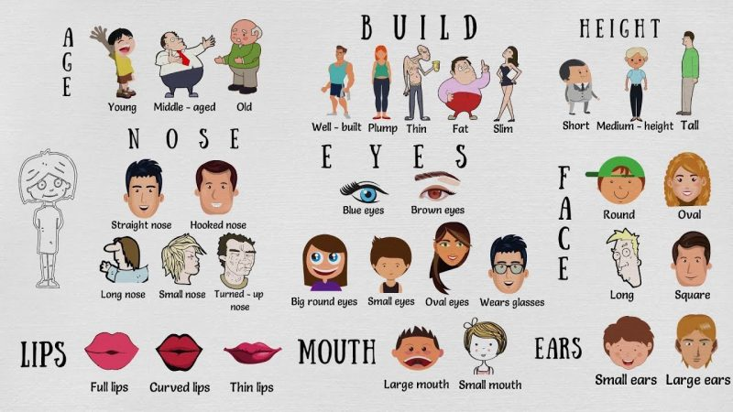
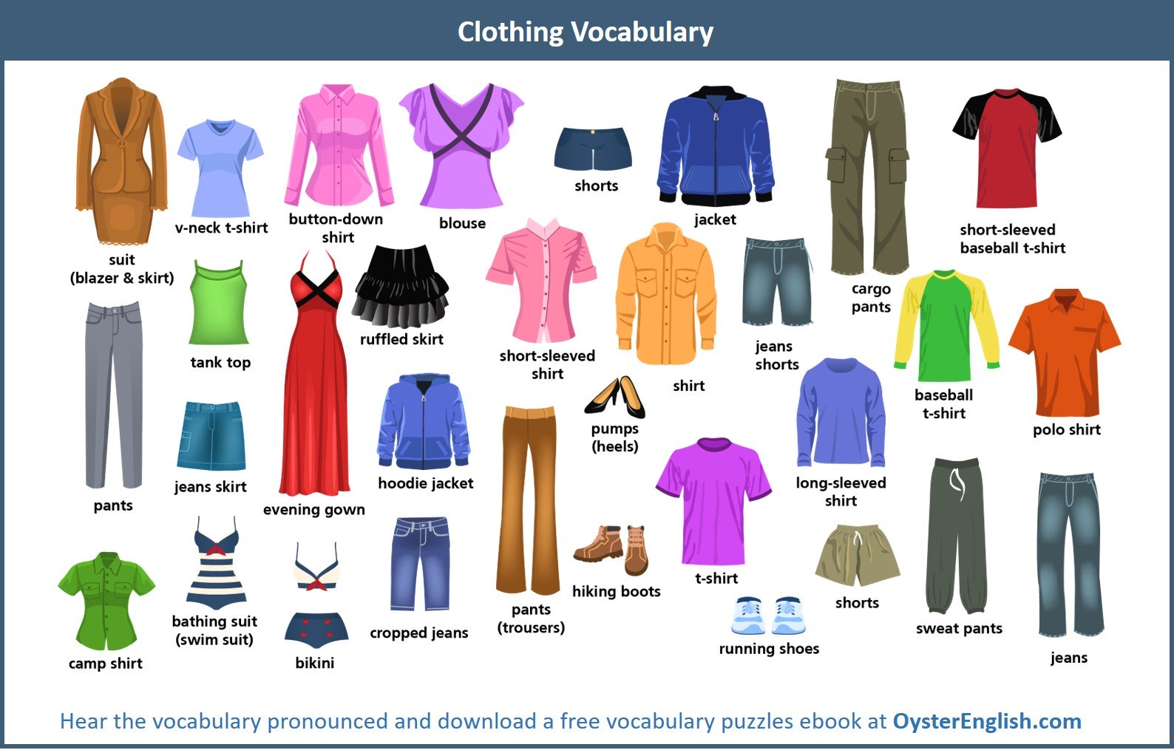
VOCABULARY
Lesson 04
Adjectives
02 TOPICS
9) Complete as palavras das imagens:
PEOPLE’S APPEARANCE
1) How often do you check your appearance in the mirror?
2) What things do you first notice about someone's appearance?
3) How do you think you look today?
4) Describe yourself based on Age, Build, Height and etc.
5) What would you like to have?
young
old
short
tall
Blue eyes
long
Large ears
1) How long does it take you to decide which clothes to wear?
2) Do you buy clothes on magazines?
3) What are you wearing now?
4) Do you ever buy used clothes?
5) What new clothes would you like to buy if you had lots of money?
blouse
jacket
T-shirt
bikini
jeans
© www.trainup.com Page | 4 - 7

Slide 5

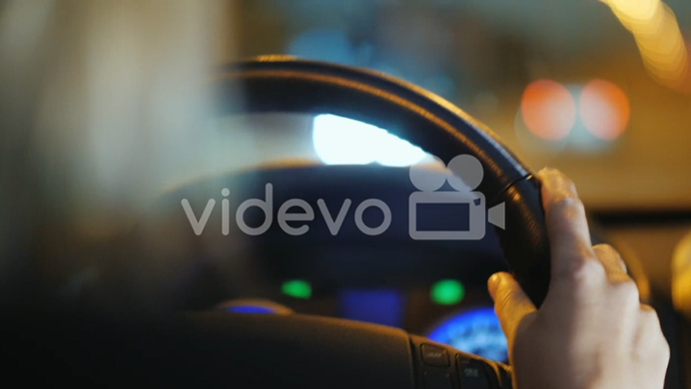
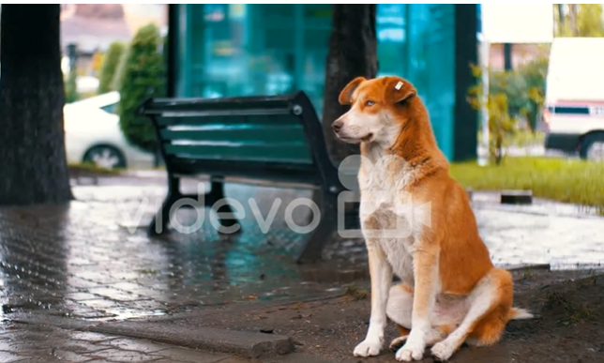
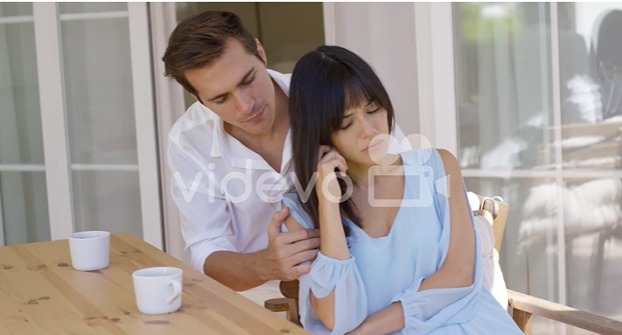
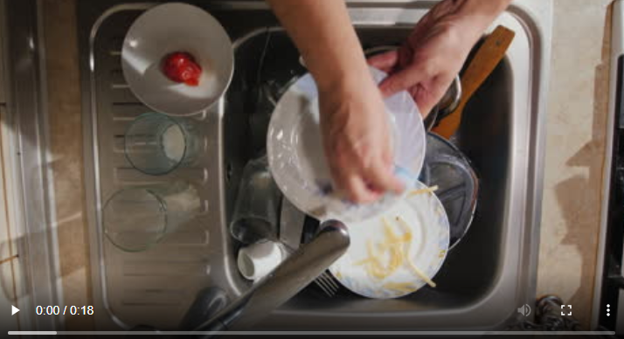
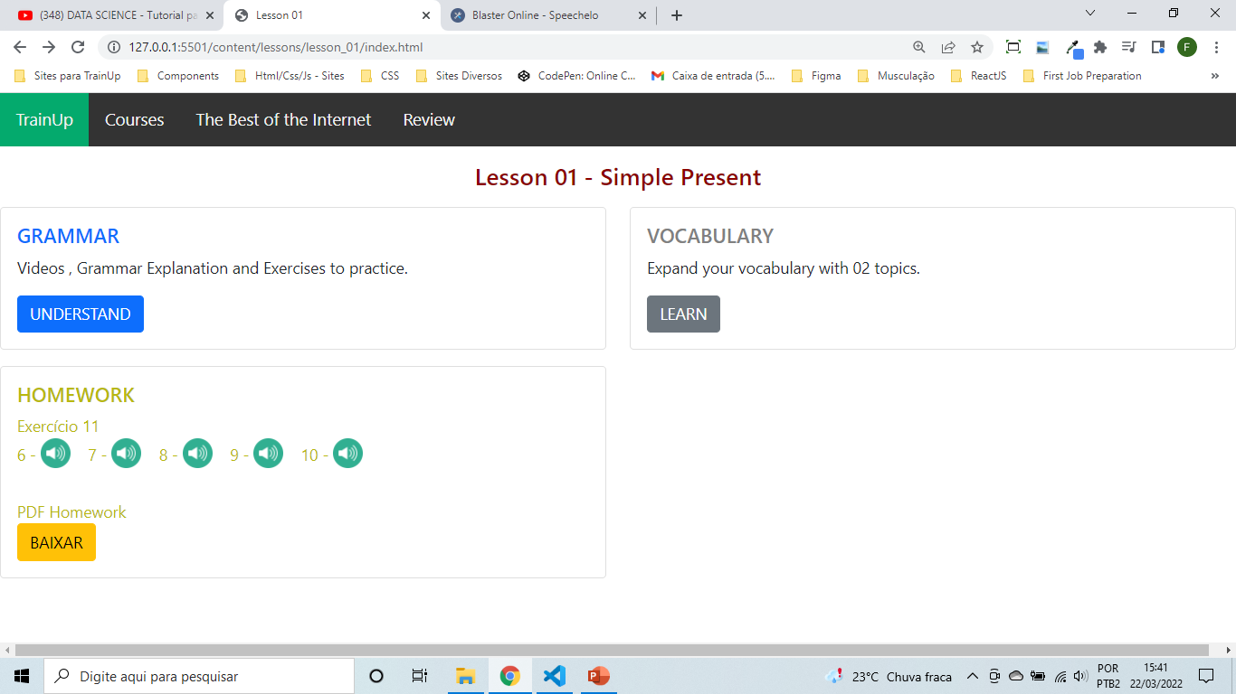

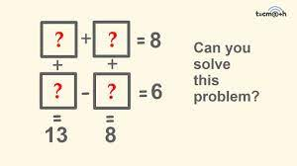
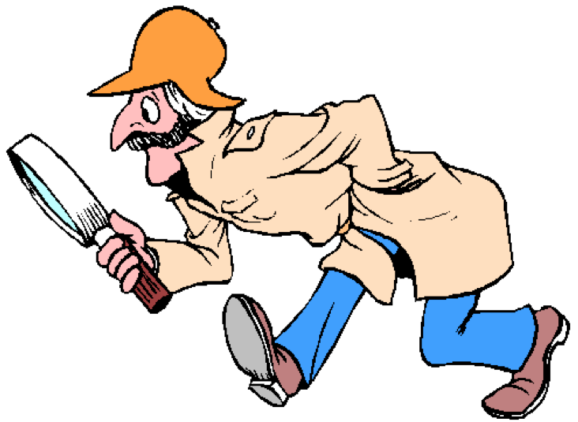
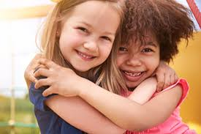
VOCABULARY
Lesson 04
Adjectives
COMMON SENTENCES
11. Crie frases para os vídeos com It's too bad that - I feel like - Help yourself - I’m not really happy ...
1
2
3
4
11. 1 Crie novas as frases com
It's too bad that
I feel like
Help yourself
I’m not really happy with
11.2 Escute os audios no site e escreva:
It's too bad that She has to go now.
I feel like drinking all night.
Help yourself to some fruit.
He’s not really happy with them.
VOCABULARY
PHRASAL VERBS
.
12) Complete as frases com os Phrasal Verbs:
Figure out - (find the answer) - entender, encontrar a resposta
Find out - (discover ) - descobrir
Get along - (like each other) - gostar ou dar-se bem um com o outro
Love will find out the way.
Please figure out the total cost.
We don't get along anymore.
I get along well with him.
Figure out what you like. Try to become the best in the world of it.
How did you find out about the party?
I don't get along well with her.
Father is trying to figure out his tax.
I'll find out her secret.
© www.trainup.com Page | 5 – 7

Slide 6
TEST
Lesson 04
13) Fale em Inglês as frases do Site:
Adjectives
REPETITION
Eu tinha livros vermelhos. (carros)
Você precisa comprar 2 casas grandes. (tabelas)
Ele bebeu água fria. (sumo)
Ela perdia suas chaves caras o tempo todo. (voz)
Tinha várias cores lindas. (brilhante)
Pegamos duas caixas velhas. (ingressos)
Você usava camisa bonitas. (argolas)
Eles assistiram filmes maravilhosos à noite. (filmes)
Eu não tinha duas sacolas vazias. (Preto)
Você não precisava de modelos diferentes. (atores)
Ele não bebeu meu grande suco. (suco de laranja)
Ela não perdeu seu importante documento. (chaves)
Não tinha cores vivas. (legais)
Não fizemos essa prova difícil. (fácil)
Você não usava camisas baratas. (caro)
Não assistiam a séries apropriadas à noite. (filmes)
Ele é um bom advogado. (doutor)
O mar é azul e o sol é quente. (amarelo)
Quero ter um carro rápido. (plano)
Não leve esse saco pesado.
© www.trainup.com Page | 6 – 7

Slide 7
TEST
Lesson 04
QUESTIONS
No que você está interessado?
Qual matéria escolar é interessante?
O que você faz quando está entediado?
Que coisas na vida são confusas?
Você costuma comer bem no café da manhã?
Li livros excelentes?
Você conversou com aquele garoto agressivo?
Ele ajudou sua mãe ocupada?
Ela encontrou o melhor preço?
Tinha cores básicas?
Adjectives
QUESTIONS
Usamos calças legais?
Você preparou aqueles bolos deliciosos?
Eles fizeram você se sentir envergonhado?
Onde está seu novo celular?
Você tem um namorado bonito?
O que seu pai inteligente faz?
Você usa meias boas?
Você dorme em um velho mal?
Você conhece alguém muito inteligente?
Você prefere dias frios ou quentes?
PEOPLE’S APPEARANCE
Com que frequência você verifica sua aparência no espelho?
Que coisas você percebe pela primeira vez sobre a aparência de alguém?
Como você acha que está hoje?
Descreva-se com base na idade, construção, altura e etc.
O que você gostaria de ter?
CLOTHES
Quanto tempo você leva para decidir qual roupa usar?
Você compra roupas em revistas?
O que você está vestindo agora?
Você costuma comprar roupas usadas?
Que roupas novas você gostaria de comprar se tivesse muito dinheiro?
COMMON SENTENCES
1. É uma pena que ele tenha perdido a mãe / tenha que trabalhar agora / perdido minha carteira / você não possa vir.
6. Tenho vontade de conversar com ela sobre o problema / dançar a noite toda / ir para a cama.
11. Sirva-se de alguns peixes / comer aquela pizza / um bolo.
16. Não estou muito feliz com o trabalho dele / esta situação / esta situação.
PHRASAL VERBS
É difícil entender este problema.
Você pode descobrir o sobrenome dela olhando no livro.
Eles se dão bem desde crianças.
© www.trainup.com Page | 7 – 7

