Slide 1

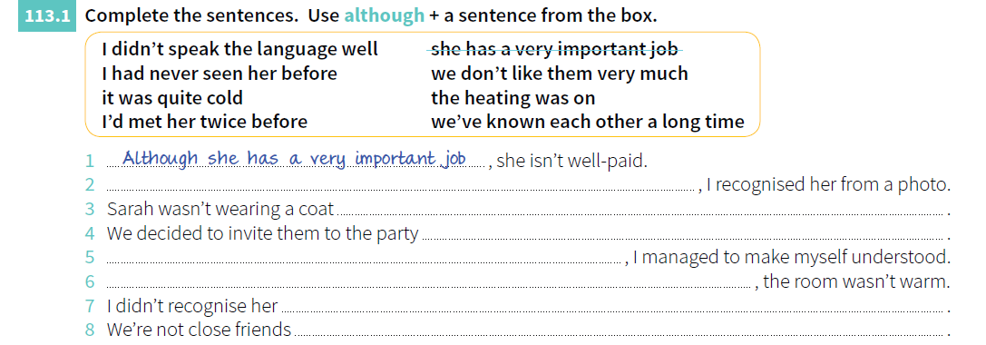
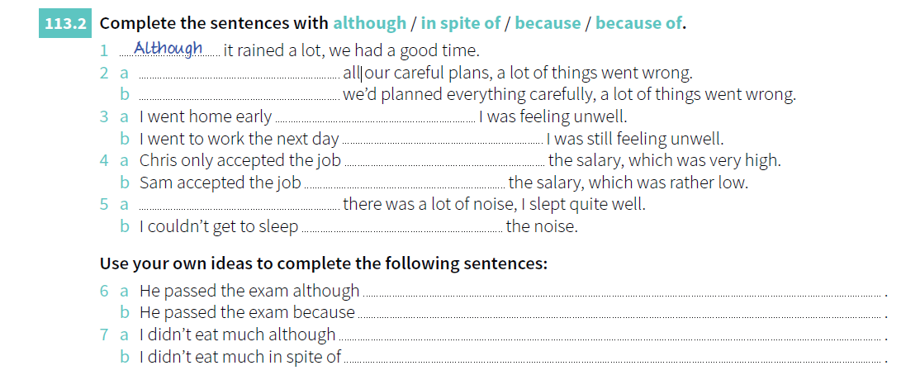
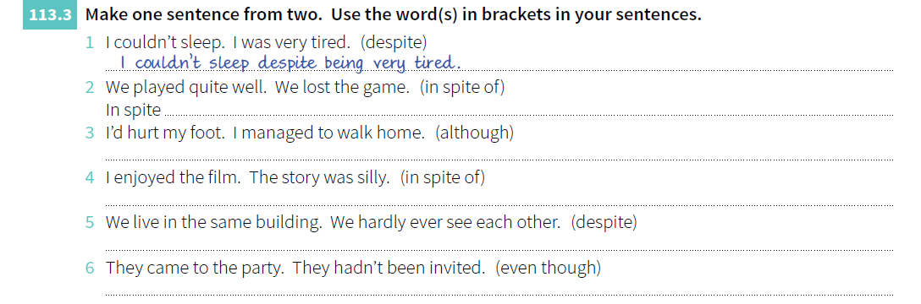
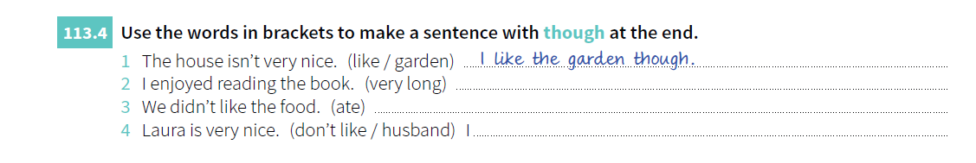
GRAMMAR
Lesson 14
Although, though, even though
Despite, In spite of
EXERCISES
© www.trainup.com Page | 3 - 9

Slide 2

GRAMMAR
Lesson 14
Although, though, even though
Despite, In spite of
EXEMPLES
Complete as frases abaixo (site):
I didn’t apply for the job although _____________________________________.
I got up early this morning although __________________________________.
Although I had a street map, __________________________________________.
He was handsome, though she_________________________________________.
Though he tried hard, __________________________________________________.
The phone woke me up, even though __________________________________.
Even though he apologized, ___________________________________________.
He went to work even though __________________________________________.
I respect her even though ______________________________________________.
In spite of the rain, we _________________________________________________.
She wasn’t well, but in spite of this ____________________________________.
In spite of what I said yesterday, _______________________________________.
Despite her fear, she ____________________________________________________.
I passed all of my exams despite ________________________________________.
I love him despite _______________________________________________________.
VOCABULARY
Baseado nas Wh Questions (Where, How, When, What, Where, Which, Why):
- responda, comente, faça uma pergunta ou desenvolva um pensamento :
COMMON SENTENCES
It’s gonna be delicious.
It’s gonna be hard to do it.
It looks like Bob´s dog.
It looks like it is going to rain.
It’s my fault you missed the taxi.
It’s my fault she didn't get paid.
It’s said that she lives abroud now.
It’s said that the woman is a thief.
© www.trainup.com Page | 2 - 9

Slide 3

GRAMMAR
Lesson 14
VERBS & TENSES
ORAL EXERCISE
Student A reads the sentence;
Student B listens to it and change into negative.
09. Can – poder
She can speak Chinese. (capacidade)
It can happen with anyone. (possibilidade)
You can play outside. (Permissão)
Can I talk to the director? (Pedido)
Exercise can help reduce stress. (verdade geral)
If you want, we can drink something. (sugestão)
10. Choose – escolher
She chose an academic career.
I need to choose now.
Is he going to choose right?
I hope you will choose a different path.
She has chosen this color for the party.
I cannot choose but wait.
11. Clean – limpar
He cleaned the car with a rag.
You need to clean your hands.
I'm going to clean the windows this morning.
Tomorrow is Sunday. I will clean my dorm thoroughly.
I have just cleaned the house.
The city should clean the streets more often.
12. Close – fechar
I closed my eyes against the bright light.
She always closes the book.
I'm going to close the window, if you don't mind.
This office will close at 5 o'clock until further notice.
Police have closed the area off to traffic.
To draw, you must close your eyes and sing.
13. Come – vir
All good things came to an end.
Good things come to those who wait.
'Are you going to come?
It is unlikely that she will come.
I have come to apologize to you.
I could come next week, or the week after.
14. Cook – cozinhar
I cooked lunch. And I made a cake.
She cooks everyday.
Who's going to cook tonight?
I'll cook if you do the dishes. Deal? -Deal.
I haven't cooked the dinner.
We could cook something easy, like pasta.
15. Cry – chorar, gritar
He cried because he hurt his knee.
Some babies cry during the night.
She is certainly not going to cry on her honeymoon.
A strong woman will cry, but will not admit defeat.
I have cried for him, yes, but I can not cry today.
The baby can cry as soon as he is born.
16. Cut – cortar
She cut the meat into small pieces.
Score twice before you cut once.
I'm just going to cut the grass.
I will cut a long story short.
They have cut the price of their products by almost 30 per cent.
You must cut expenses this month.
© www.trainup.com Page | 3 - 9

Slide 4



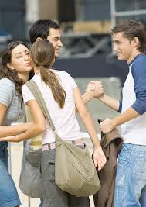
VOCABULARY
Lesson 14
Although, though, even though
Despite, In spite of
PHRASAL VERBS
Complete as frases com os Phrasal Verbs:
Bring about - (cause) - causar, provocar
Catch up - (reach a standard ) - alcançar um padrão ou nível Come across - (meet by chance) - encontrar por acaso
They felt the need to _____________ a renewal of society.
This is the worst place I've _____________.
This will _____________ both inner and social conflicts.
Several causes operated to _____________ the war.
I have to _____________ on my sleep.
You walk on and I'll _____________ with you later.
Why don't you _____________ to our house this evening?
I want to _____________ with all your news.
Your speech didn't _____________; nobody understood your opinion.
© www.trainup.com Page | 7 - 9

Slide 5

VOCABULARY
Lesson 14
Although, though, even though
Despite, In spite of
MOTIVATIONAL QUOTES
Simple Present 2. Verb To Be 3. Past Tense 4. Adjectives
5. Articles / There is 6. Plural / Pronouns 7. Future 8. Adverbs / Prepositions
9. Progressive Tense 10. Modal 11. Comparative / Superlative
12. Present Perfect 13.Had Better/ Would rather 14. Although/ Though/ Even though
Instruções:
SUBLINHE o que você já estudou.
ESCREVA o número da Lição.
You’ve gotta dance like there’s nobody watching, love like you’ll never be hurt, sing like there’s nobody listening, and live like it’s heaven on earth.”
“Fairy tales are more than true: not because they tell us that dragons exist, but because they tell us that dragons can be beaten.
“Everything you can imagine is real.“
“When one door of happiness closes, another opens; but often we look so long at the closed door that we do not see the one which has been opened for us.”
“Do one thing every day that scares you.”
“It’s no use going back to yesterday, because I was a different person then.
“Smart people learn from everything and everyone, average people from their experiences, stupid people already have all the answers.”
“Do what you feel in your heart to be right – for you’ll be criticized anyway.”
“Happiness is not something ready made. It comes from your own actions.”
“Whatever you are, be a good one.”
What is “heaven on heart” to you?
What are the dragons of your life?
How do you imagine a good world?
What does “door of happiness” mean?
What scares you?
How different are you from some years ago?
What do you like to learn?
Tell me something you have been criticized?
Tell me two exemple of happiness to you.
What are you good at?
© www.trainup.com Page | 6 - 9

