Slide 1

GRAMMAR
Lesson 14
Although, though, even though
Despite, In spite of
RESUMO
“although“, “though” e “even though” significam a mesma coisa: “
embora, apesar de“.
Although - contextos formais
Though - informais
Even though - dar mais ênfase ao que está sendo dito ou escrito.
ESTRUTURA:
Depois de Although, usamos: subject + verb:
Although it rained a lot, they had a good time.
Apesar de ter chovido muito, eles se divertiram.
No inglês falado, muitas vezes usamos though no final de uma frase, contrastando duas frases.
Her words are happy. Look at her face though.
Suas palavras são felizes. Mas olhe para o rosto dela.
But + Though = ênfase extra
English is tough, BUT Learning with TrainUp is easy though.
Inglês é difícil, MAS aprender com TrainUp é fácil.
I hate onions, But this onion snack is pretty good though.
Eu odeio cebolas, mas esse lanche de cebola é muito bom.
Although x Because
We went out although it was raining heavily.
Saímos embora estivesse chovendo muito.
In spite of = apesar de
Despite = apesar
Usado para expressar um contraste entre duas coisas.
Depois de apesar de (in spite of) ou apesar (despite), usamos um substantivo, um pronome (isto/aquilo/o que etc.) ou -ing:
© www.trainup.com Page | 1 - 9

Slide 2

GRAMMAR
Lesson 14
Although, though, even though
Despite, In spite of
EXEMPLES
Although, though, even though
I didn’t apply for the job although I had the necessary qualifications.
Não me candidatei ao emprego, embora tivesse as qualificações necessárias.
I got up early this morning although it’s the weekend.
Acordei cedo esta manhã, embora seja o fim de semana.
Although I had a street map, I got lost.
Embora eu tivesse um mapa de ruas, me perdi.
John didn’t pass the test although he studied hard.
John não passou no teste, embora tenha estudado muito.
My house was not empty though I was gone.
Minha casa não estava vazia embora eu tivesse ido embora.
He was handsome, though she wouldn't go so far as to call him gorgeous.
Ele era bonito, embora ela não fosse tão longe a ponto de chamá-lo de lindo.
Though he tried hard, nothing changed.
Embora ele se esforçasse, nada mudou.
The phone woke me up, even though it wasn't very loud.
O telefone me acordou, embora não fosse muito alto.
Even though he apologized, I'm still furious.
Mesmo que ele tenha se desculpado, eu ainda estou furiosa.
He went to work even though he was unwell.
Ele foi trabalhar mesmo estando doente.
Though no final de uma frase
Her words are happy. Look at her face though.
Suas palavras são felizes. Mas olhe para o rosto dela.
English is tough. Learning with TrainUp is easy though.
Inglês é difícil. Mas aprender com TrainUp é fácil.
Learning online is great. My time is limited though.
Aprender online é ótimo. Mas meu tempo é limitado.
© www.trainup.com Page | 2 - 9

Slide 3
GRAMMAR
Lesson 14
Although, though, even though
Despite, In spite of
EXEMPLES
In spite of = Despite of
I didn’t apply for the job in spite of the fact (that) I had the necessary qualifications.
despite the fact (that)
Não me candidatei ao emprego apesar de ter as qualificações necessárias.
In spite of = apesar de
In spite of the rain, we had a good time.
Apesar da chuva, nos divertimos.
She wasn’t well, but in spite of this she continued working.
Ela não estava bem, mas apesar disso continuou trabalhando.
In spite of what I said yesterday, I still love you.
Apesar do que eu disse ontem, eu ainda te amo.
They went out in spite of the rain.
Eles saíram apesar da chuva.
The house will certainly sell in spite of the fact that it’s overpriced.
A casa certamente venderá, apesar do fato de estar superfaturada.
In spite of the fack that Mark helps to the poor, he isn’t rich.
Apesar do fato de que Mark ajuda os pobres, ele não é rico
In spite of the fog, planes are still landing.
Apesar da neblina, os aviões ainda estão pousando.
They helped them in spite of the difficulties.
Eles os ajudaram apesar das dificuldades.
In spite of all the cooking shows I’ve watched, I’m still no good in the kitchen.
Apesar de todos os programas de culinária que assisti, ainda não sou bom na cozinha.
© www.trainup.com Page | 2 - 9

Slide 4
GRAMMAR
Lesson 14
Although, though, even though
Despite, In spite of
EXEMPLES
Despite = apesar
Despite her fear, she wrapped her arms around him.
Apesar de seu medo, ela colocou os braços ao redor dele.
I passed all of my exams despite the fact that I never studied.
Passei em todos os meus exames, apesar de nunca ter estudado.
I love him despite his faults.
Eu o amo apesar de seus defeitos.
The young men said that they would do it despite all of the difficulties.
Os jovens disseram que o fariam apesar de todas as dificuldades.
Despite being a millionaire, she lives in a very small ﬂat.
Apesar de ser milionária, ela mora em um apartamento muito pequeno.
Despite her exhaustion, she tries to help us.
Apesar de sua exaustão, ela tenta nos ajudar.
Despite her young age, she did a very good job.
Apesar de sua pouca idade, ela fez um trabalho muito bom.
Despite the cool day, he don’t want to go out.
Apesar do dia frio, ele não quer sair.
© www.trainup.com Page | 2 - 9

Slide 5

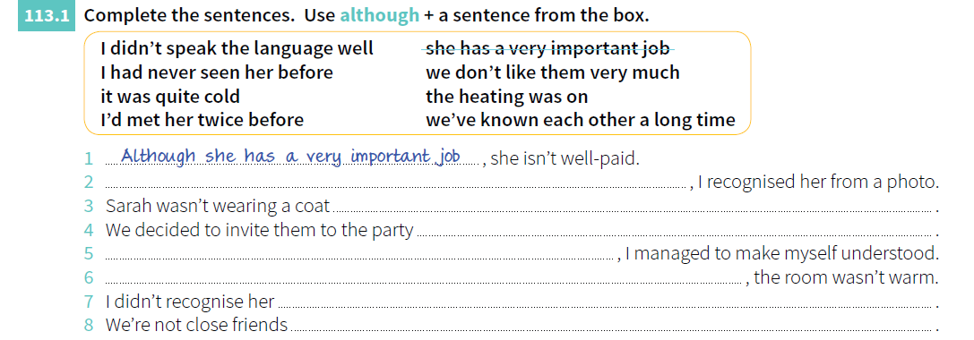
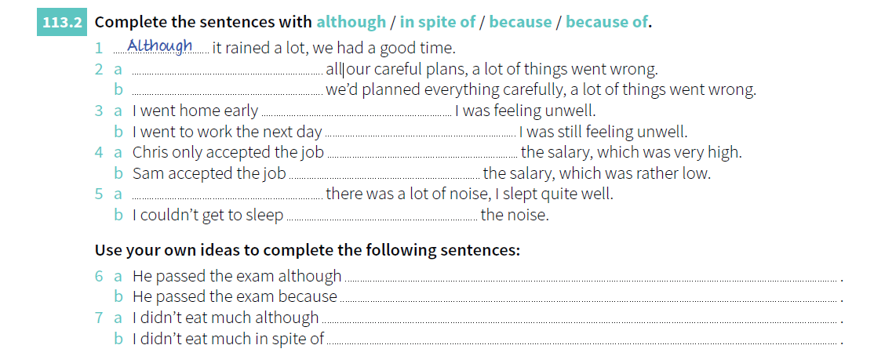
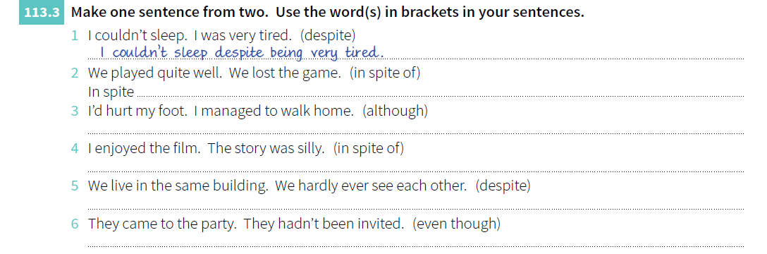
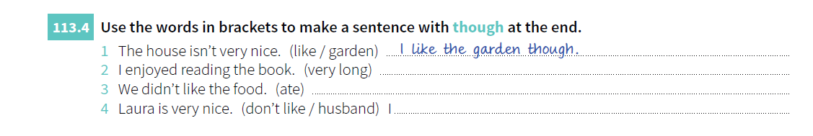
GRAMMAR
Lesson 14
Although, though, even though
Despite, In spite of
EXERCISES
© www.trainup.com Page | 3 - 9

Slide 6

GRAMMAR
Lesson 14
Although, though, even though
Despite, In spite of
100 VERBS
09. Can – poder
She can speak Chinese. (capacidade)
It can happen with anyone. (possibilidade)
You can play outside. (Permissão)
Can I talk to the director? (Pedido)
Exercise can help reduce stress. (verdade geral)
If you want, we can drink something. (sugestão)
10. Choose – escolher
She chose an academic career.
I need to choose now.
Is he going to choose right?
I hope you will choose a different path.
She has chosen this color for the party.
I cannot choose but wait.
11. Clean – limpar
He cleaned the car with a rag.
You need to clean your hands.
I'm going to clean the windows this morning.
Tomorrow is Sunday. I will clean my dorm thoroughly.
I have just cleaned the house.
The city should clean the streets more often.
12. Close – fechar
I closed my eyes against the bright light.
She always closes the book.
I'm going to close the window, if you don't mind.
This office will close at 5 o'clock until further notice.
Police have closed the area off to traffic.
To draw, you must close your eyes and sing.
13. Come – vir
All good things came to an end.
Good things come to those who wait.
'Are you going to come?
It is unlikely that she will come.
I have come to apologize to you.
I could come next week, or the week after.
14. Cook – cozinhar
I cooked lunch. And I made a cake.
She cooks everyday.
Who's going to cook tonight?
I'll cook if you do the dishes. Deal? -Deal.
I haven't cooked the dinner.
We could cook something easy, like pasta.
15. Cry – chorar, gritar
He cried because he hurt his knee.
Some babies cry during the night.
She is certainly not going to cry on her honeymoon.
A strong woman will cry, but will not admit defeat.
I have cried for him, yes, but I can not cry today.
The baby can cry as soon as he is born.
16. Cut – cortar
She cut the meat into small pieces.
Score twice before you cut once.
I'm just going to cut the grass.
I will cut a long story short.
They have cut the price of their products by almost 30 per cent.
You must cut expenses this month.
© www.trainup.com Page | 3 - 9

Slide 7

VOCABULARY
Lesson 14
Although, though, even though
Despite, In spite of
COMMON SENTENCES
It’s going to be = Vai ser
It’s gonna be delicious.
It’s gonna be easy.
It’s gonna be nice.
It’s gonna be exciting.
It’s gonna be great.
It’s said that = É dito que
It’s said that
It’s said that
It’s said that
It’s said that
It’s said that
It looks like = Parece (que)
It looks like a balloon.
It looks like it's going to rain.
It looks like it's going to be fun.
It looks like we'll have to stand.
It looks like you are late.
It’s my fault = É minha culpa
It’s my fault we missed the taxi.
It’s my fault she didn’t get paid
It’s my fault they lost the game.
It’s my fault we’re lost.
It’s my fault the service is canceled.
© www.trainup.com Page | 6 - 9

Slide 8



VOCABULARY
Lesson 14
Although, though, even though
Despite, In spite of
PHRASAL VERBS
Come across - (find by chance) - encontrar por acaso Perhaps I shall come across him in France.
Talvez eu o encontre na França.
Come into - (obtain from someone after their death) - obter de alguém após sua morte My father has just come into a fortune in diamonds.
Meu pai acaba de ganhar uma fortuna em diamantes.
Come round - (change one's position or opinion) - mudar de posição ou opinião Come round tonight and we'll watch a video.
Venha hoje à noite e vamos assistir a um vídeo.
Come up with - (think of and suggest an idea) - pensar e sugerir uma ideia
We're having a meeting to try to come up with ideas for fund-raising.
Estamos fazendo uma reunião para tentarmos ter ideias para angariar fundos.
© www.trainup.com Page | 7 - 9

Slide 9
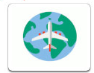
VOCABULARY
Lesson 14
Although, though, even though
Despite, In spite of
MOTIVATIONAL QUOTES
Simple Present 2. Verb To Be 3. Past Tense 4. Adjectives
5. Articles / There is 6. Plural / Pronouns 7. Future 8. Adverbs / Prepositions
9. Progressive Tense 10. Modal 11. Comparative / Superlative
12. Present Perfect 13.Had Better/ Would rather 14. Although/ Though/ Even though
15. Passive Voice 16. Used to/ Be used to / Get used to 17. Unless / As long as
18. So do I / Neither do I 19. If clauses / Tag Questions 20. Past Perfect
21. Past Perfect Continuous 22. Future Continuous 23. If and Wish 24. Reported Speech
Simple Present 2. Verb To Be 3. Past Tense 4. Adjectives
5. Articles / There is 6. Plural / Pronouns 7. Future 8. Adverbs / Prepositions
9. Progressive Tense 10. Modal 11. Comparative / Superlative
12. Present Perfect 13.Had Better/ Would rather 14. Although/ Though/ Even though
Instruções:
Identifique o que você já estudou.
Sublinhe e coloque o número da Lição.
You’ve gotta dance like there’s nobody watching, love like you’ll never be hurt, sing like there’s nobody listening, and live like it’s heaven on earth.”
“Fairy tales are more than true: not because they tell us that dragons exist, but because they tell us that dragons can be beaten.
“Everything you can imagine is real.“
“When one door of happiness closes, another opens; but often we look so long at the closed door that we do not see the one which has been opened for us.”
“Do one thing every day that scares you.”
“It’s no use going back to yesterday, because I was a different person then.
“Smart people learn from everything and everyone, average people from their experiences, stupid people already have all the answers.”
“Do what you feel in your heart to be right – for you’ll be criticized anyway.”
“Happiness is not something ready made. It comes from your own actions.”
“Whatever you are, be a good one.”
What is heaven on heart to you?
What are the dragons of your life?
How do you imagine a good world?
© www.trainup.com Page | 6 - 9

