Slide 1

GRAMMAR
Lesson 14
Although, though, even though
Despite, In spite of
RESUMO
“although“, “though” e “even though” significam a mesma coisa: “
embora, apesar de“.
Although - contextos formais
Though - informais
Even though - dar mais ênfase ao que está sendo dito ou escrito.
ESTRUTURA:
Depois de Although, usamos: subject + verb:
Although it rained a lot, they had a good time.
Apesar de ter chovido muito, eles se divertiram.
No inglês falado, muitas vezes usamos though no final de uma frase, contrastando duas frases.
Her words are happy. Look at her face though.
Suas palavras são felizes. Mas olhe para o rosto dela.
But + Though = ênfase extra
English is tough, BUT Learning with TrainUp is easy though.
Inglês é difícil, MAS aprender com TrainUp é fácil.
I hate onions, But this onion snack is pretty good though.
Eu odeio cebolas, mas esse lanche de cebola é muito bom.
Although x Because
We went out although it was raining heavily.
Saímos embora estivesse chovendo muito.
In spite of = apesar de
Despite = apesar
Usado para expressar um contraste entre duas coisas.
Depois de apesar de (in spite of) ou apesar (despite), usamos um substantivo, um pronome (isto/aquilo/o que etc.) ou -ing:
© www.trainup.com Page | 1 - 9

Slide 2

GRAMMAR
Lesson 14
Although, though, even though
Despite, In spite of
EXEMPLES
Although, though, even though
I didn’t apply for the job although I had the necessary qualifications.
Não me candidatei ao emprego, embora tivesse as qualificações necessárias.
I got up early this morning although it’s the weekend.
Acordei cedo esta manhã, embora seja o fim de semana.
Although I had a street map, I got lost.
Embora eu tivesse um mapa de ruas, me perdi.
John didn’t pass the test although he studied hard.
John não passou no teste, embora tenha estudado muito.
My house was not empty though I was gone.
Minha casa não estava vazia embora eu tivesse ido embora.
He was handsome, though she wouldn't go so far as to call him gorgeous.
Ele era bonito, embora ela não fosse tão longe a ponto de chamá-lo de lindo.
Though he tried hard, nothing changed.
Embora ele se esforçasse, nada mudou.
The phone woke me up, even though it wasn't very loud.
O telefone me acordou, embora não fosse muito alto.
Even though he apologized, I'm still furious.
Mesmo que ele tenha se desculpado, eu ainda estou furiosa.
Even though he apologized, I'm still furious.
Mesmo que ele tenha se desculpado, eu ainda estou furiosa.
Though no final de uma frase
Her words are happy. Look at her face though.
Suas palavras são felizes. Mas olhe para o rosto dela.
English is tough. Learning with TrainUp is easy though.
Inglês é difícil. Aprender com TrainUp é fácil.
Learning online is great. My time is limited though.
Aprender online é ótimo. Mas meu tempo é limitado.
© www.trainup.com Page | 2 - 9

Slide 3
GRAMMAR
Lesson 14
Although, though, even though
Despite, In spite of
EXEMPLES
In spite of = Despite of
I didn’t apply for the job in spite of the fact (that) I had the necessary qualifications.
despite the fact (that)
Não me candidatei ao emprego apesar de ter as qualificações necessárias.
In spite of = apesar de
In spite of the rain, we had a good time.
Apesar da chuva, nos divertimos.
She wasn’t well, but in spite of this she continued working.
Ela não estava bem, mas apesar disso continuou trabalhando.
In spite of what I said yesterday, I still love you.
Apesar do que eu disse ontem, eu ainda te amo.
They went out in spite of the rain.
Eles saíram apesar da chuva.
The house will certainly sell in spite of the fact that it’s overpriced.
A casa certamente venderá, apesar do fato de estar superfaturada.
In spite of the fack that Mark helps to the poor, he isn’t rich.
Apesar do fato de que Mark ajuda os pobres, ele não é rico
In spite of the fog, planes are still landing.
Apesar da neblina, os aviões ainda estão pousando.
They helped them in spite of the difficulties.
Eles os ajudaram apesar das dificuldades.
In spite of all the cooking shows I’ve watched, I’m still no good in the kitchen.
Apesar de todos os programas de culinária que assisti, ainda não sou bom na cozinha.
© www.trainup.com Page | 2 - 9

Slide 4
GRAMMAR
Lesson 14
Although, though, even though
Despite, In spite of
EXEMPLES
Despite = apesar
Despite her fear, she wrapped her arms around him.
Passei em todos os meus exames, apesar de nunca ter estudado.
I passed all of my exams despite the fact that I never studied.
Apesar de seu medo, ela colocou os braços ao redor dele.
I love him despite his faults.
Eu o amo apesar de seus defeitos.
The young men said that they would do it despite all of the difficulties.
Os jovens disseram que o fariam apesar de todas as dificuldades.
Despite being a millionaire, she lives in a very small ﬂat.
Apesar de ser milionária, ela mora em um apartamento muito pequeno.
Despite her exhaustion, she tries to help us.
Apesar de sua exaustão, ela tenta nos ajudar.
Despite her young age, she did a very good job.
Apesar de sua pouca idade, ela fez um trabalho muito bom.
Despite the cool day, he don’t want to go out.
Apesar do dia frio, ele não quer sair.
© www.trainup.com Page | 2 - 9

Slide 5

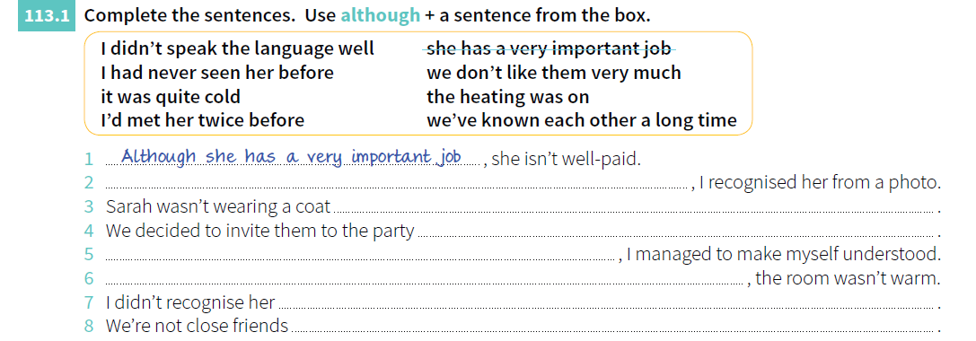
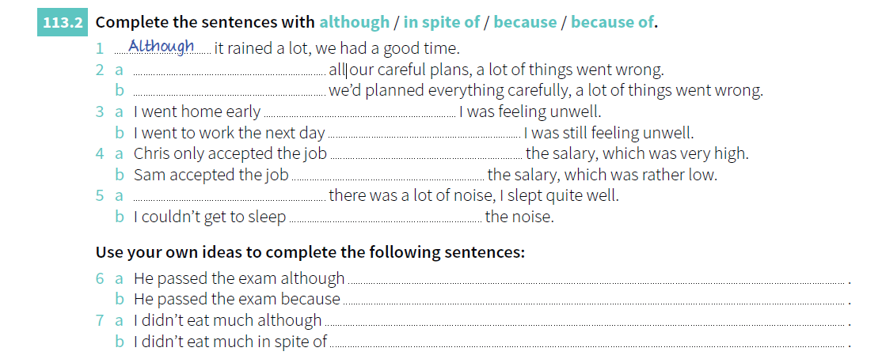
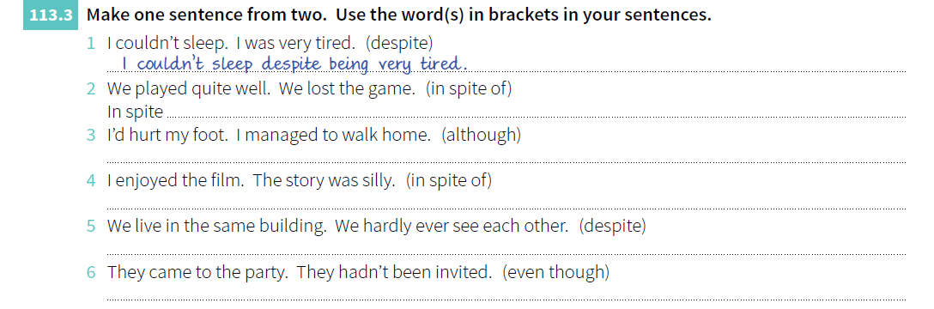
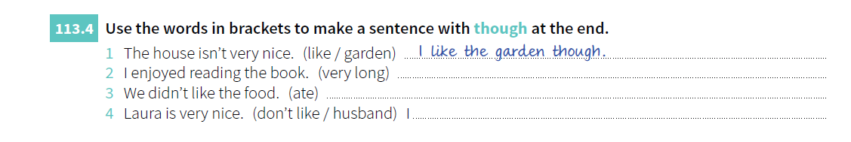
GRAMMAR
Lesson 14
Although, though, even though
Despite, In spite of
EXERCISES
© www.trainup.com Page | 3 - 9

Slide 6

GRAMMAR
Lesson 14
Although, though, even though
Despite, In spite of
QUESTIONS
1. Where do you work?
2. What does he do?
3. How do they come here?
4. When do we start?
5. Why do they play football so late?
6. What does she like doing at the weekend?
7. Where do you go to the cinema?
8. When do we leave?
9. Do you study a lot?
10. Do you have kids?
11. Do you have the time?
12. Does she drink beer?
13. Do you like to be late?
14. Does she study Italian?
15. Why do you come here?
16. Do you read books?
17. Do you see the stars?
18. Do they speak Chinese?
19. Does he swim?
20. Does she listen to jazz?
© www.trainup.com Page | 3 - 9

Slide 7

GRAMMAR
Lesson 14
Although, though, even though
Despite, In spite of
100 VERBS
09. Can – poder
She can speak Chinese. (capacidade)
It can happen with anyone. (possibilidade)
You can play outside. (Permissão)
Can I talk to the director? (Pedido)
Exercise can help reduce stress. (verdade geral)
If you want, we can drink something. (sugestão)
10. Choose – escolher
She chose an academic career.
I need to choose now.
Is he going to choose right?
I hope you will choose a different path.
She has chosen this color for the party.
I cannot choose but wait.
11. Clean – limpar
I arrived yesterday.
I arrive late all the time.
I am going to arrive on time.
I will arrive soon.
I have just arrived.
You can arrive whenever you want.
12. Close – fechar
I arrived yesterday.
I arrive late all the time.
I am going to arrive on time.
I will arrive soon.
I have just arrived.
You can arrive whenever you want.
13. Come – vir
14. Cook – cozinhar
She chose an academic career.
I need to choose now.
Is he going to choose right?
I hope you will choose a different path.
She has chosen this color for the party.
I cannot choose but wait.
15. Cry – chorar, gritar
I arrived yesterday.
I arrive late all the time.
I am going to arrive on time.
I will arrive soon.
I have just arrived.
You can arrive whenever you want.
16. Cut – cortar
I arrived yesterday.
I arrive late all the time.
I am going to arrive on time.
I will arrive soon.
I have just arrived.
You can arrive whenever you want.
© www.trainup.com Page | 3 - 9

Slide 8

VOCABULARY
Lesson 14
Although, though, even though
Despite, In spite of
COMMON SENTENCES
1. I plan to find a new apartment. When? I plan to find a new apartment next month.
2. I plan to relax on vacation. Where?
3. I plan to surprise my parents. How?
4. I plan to wash my car. When?
5. I plan to adopt a child. Do you ...?
6. It's my turn to ________________________
7. It’s his turn to ________________________
8. It’s her turn to ________________________
9. It’s not my turn to ____________________
10. It’s not their turn to ____________________
OBS: Crie novas frases:
11. Are you sure?
12. Are you sure about that?
13. Are you sure of what you said?
14. Are you sure that he is not coming?
15. I am sure about my faith.
16. By the way, is there a bathroom in the apartment?
17. By the way, do you have any change on you?
18. By the way, he is a difficult person. Who?
19. By the way, get out of here. Why?
20. By the way, I loved your shirt. Which one?
© www.trainup.com Page | 6 - 9

Slide 9



VOCABULARY
Lesson 14
Although, though, even though
Despite, In spite of
PHRASAL VERBS
Come across - (find by chance) - encontrar por acaso Perhaps I shall come across him in France.
Talvez eu o encontre na França.
Come into - (obtain from someone after their death) - obter de alguém após sua morte My father has just come into a fortune in diamonds.
Meu pai acaba de ganhar uma fortuna em diamantes.
Come round - (change one's position or opinion) - mudar de posição ou opinião Come round tonight and we'll watch a video.
Venha hoje à noite e vamos assistir a um vídeo.
Come up with - (think of and suggest an idea) - pensar e sugerir uma ideia
We're having a meeting to try to come up with ideas for fund-raising.
Estamos fazendo uma reunião para tentarmos ter ideias para angariar fundos.
© www.trainup.com Page | 7 - 9

Slide 10
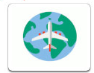
VOCABULARY
Lesson 14
Although, though, even though
Despite, In spite of
MOTIVATIONAL QUOTES
© www.trainup.com Page | 6 - 9

