Slide 1
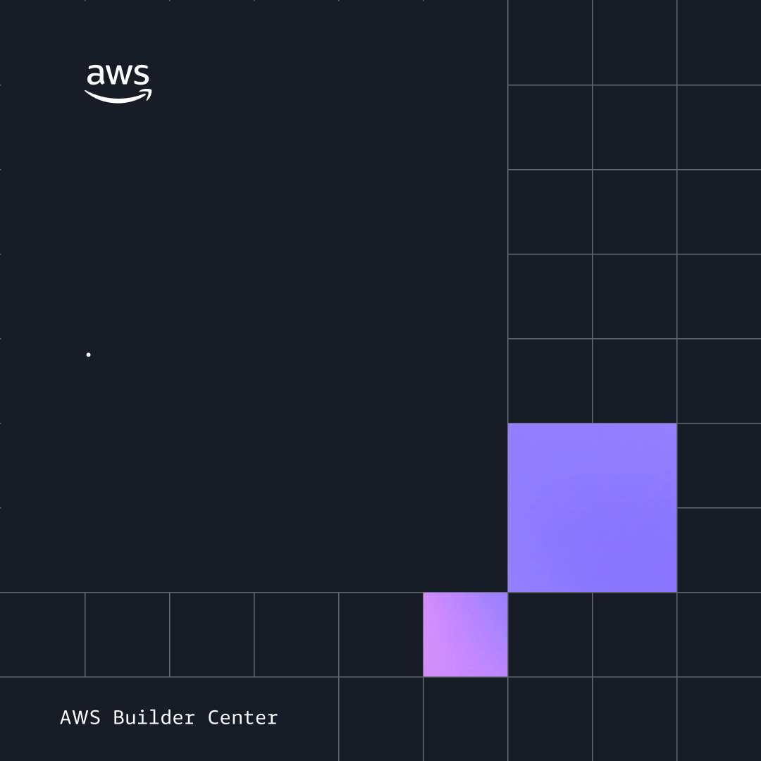
DevChat Title
Speaker Name
Nerdearla Chile

