Slide 1
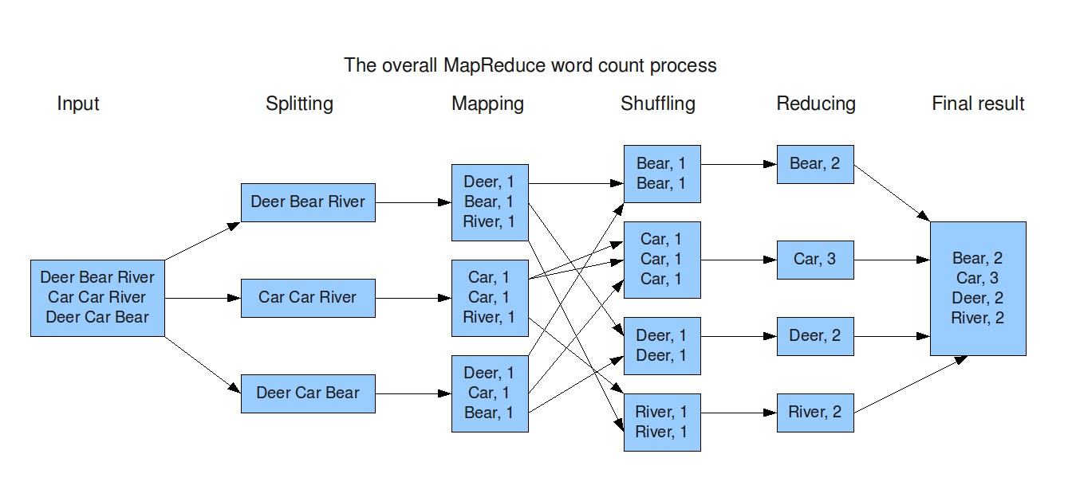
https://todaysoftmag.com/article/1358/hadoop-mapreduce-deep-diving-and-tuning

Slide 2
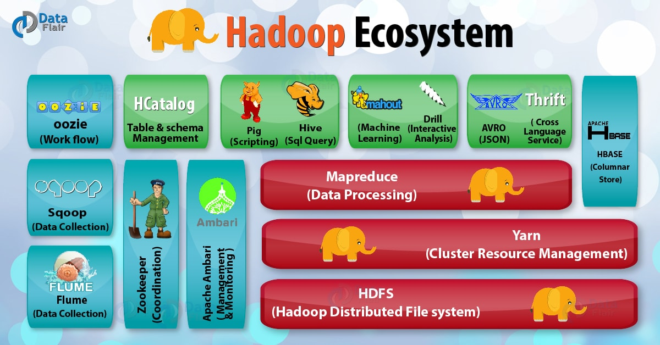
https://data-flair.training/blogs/hadoop-ecosystem-components/

Slide 3
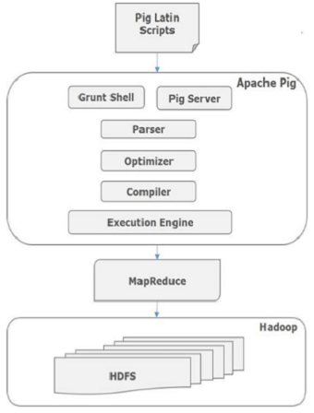
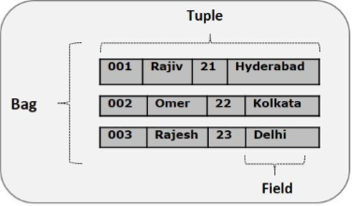
https://www.tutorialspoint.com/apache_pig/apache_pig_architecture.htm

Slide 4
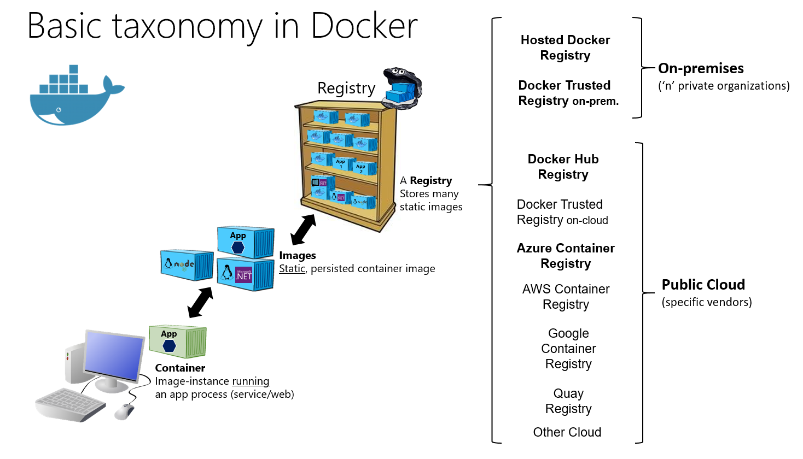
https://docs.microsoft.com/es-es/dotnet/architecture/microservices/docker-application-development-process/docker-app-development-workflow

Slide 5
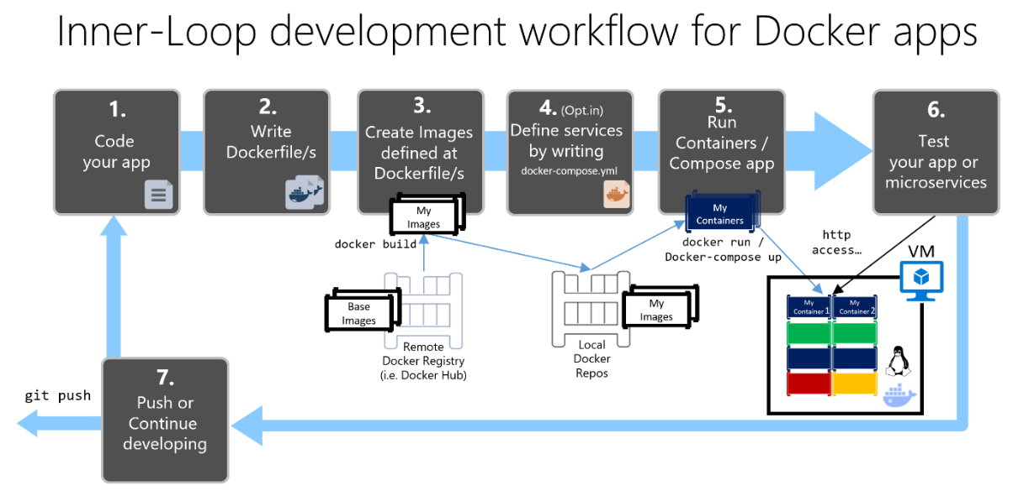
https://docs.microsoft.com/es-es/dotnet/architecture/microservices/container-docker-introduction/docker-containers-images-registries

Slide 6
