Slide 1
BANWR data exploration

Slide 2
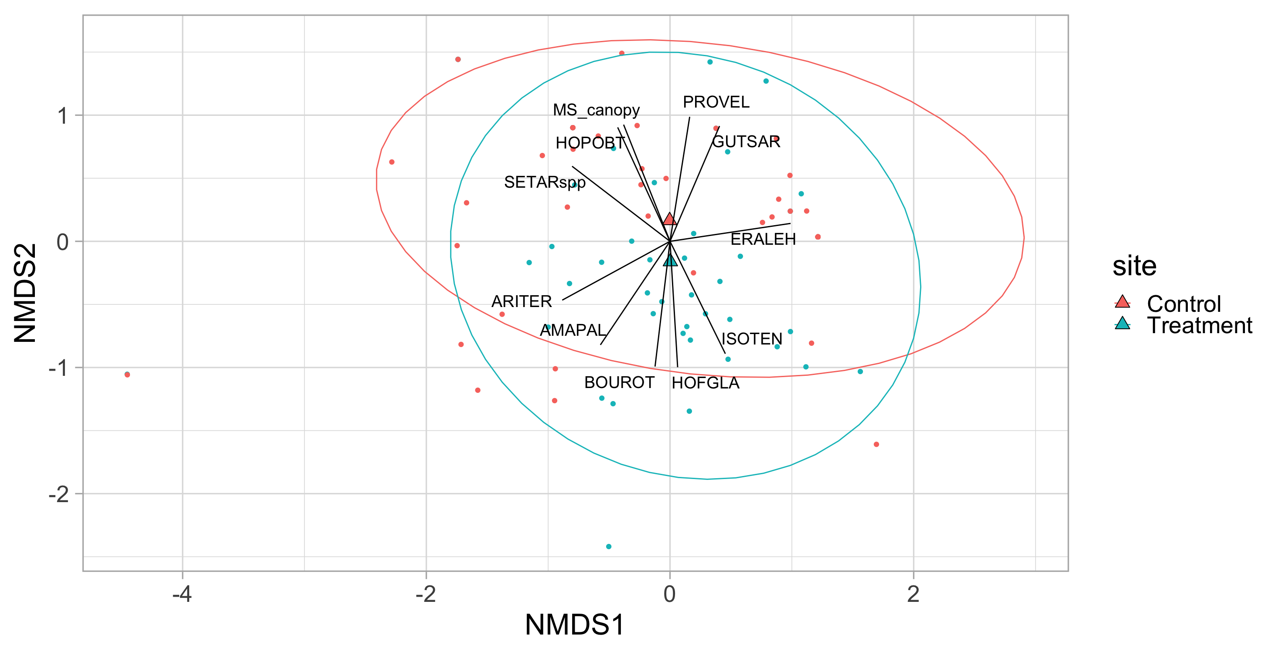
stress = 0.12

Slide 3
