Slide 1
Accounting for spatial dependence in multivariate analysis of plant communities
Fern Bromley
Independent Research Project
STAT 574E
October 2025

Slide 2
First we have to answer
How do we measure plant communities?
What ways do we have of quantifying plant community structure?
Univariate
Plant species richness
Species evenness
Total vegetation cover
Multivariate
Plant communities are usually described by ordinations that take into account species presence and abundance
Cover values for each species are treated as a variable/dimension of the dataset
Each sampled area can be described in terms of vegetation cover from a larger species pool

Slide 3



Univariate
Plant species richness
Total vegetation cover
Cover of individual species/groups
Multivariate
Plant communities are usually described by ordinations that take into account species presence and abundance
Cover values for each species are treated as a variable/dimension of the dataset
Each sampled area can be described in terms of vegetation cover from a larger species pool
Plot | Species richness
Plot 1 | 2
Plot 2 | 1
Plot 3 | 2

Slide 4
Univariate
Plant species richness
Species evenness
Total vegetation cover
Multivariate
Plant communities are usually described by ordinations that take into account species presence and abundance
Cover values for each species are treated as a variable/dimension of the dataset
Each sampled area can be described in terms of vegetation cover from a larger species pool
Plot | Palm tree | Tulip | Cactus
Plot 1 | 20 | 20 | 0
Plot 2 | 0 | 0 | 60
Plot 3 | 10 | 0 | 25

Slide 5
Univariate
Plant species richness
Species evenness
Total vegetation cover
Multivariate
Plant communities are usually described by ordinations that take into account species presence and abundance
Cover values for each species are treated as a variable/dimension of the dataset
Each sampled area can be described in terms of vegetation cover from a larger species pool
Plot | Palm tree | Tulip | Cactus
Plot 1 | 20 | 20 | 0
Plot 2 | 0 | 0 | 60
Plot 3 | 10 | 0 | 25
Community matrix

Slide 6
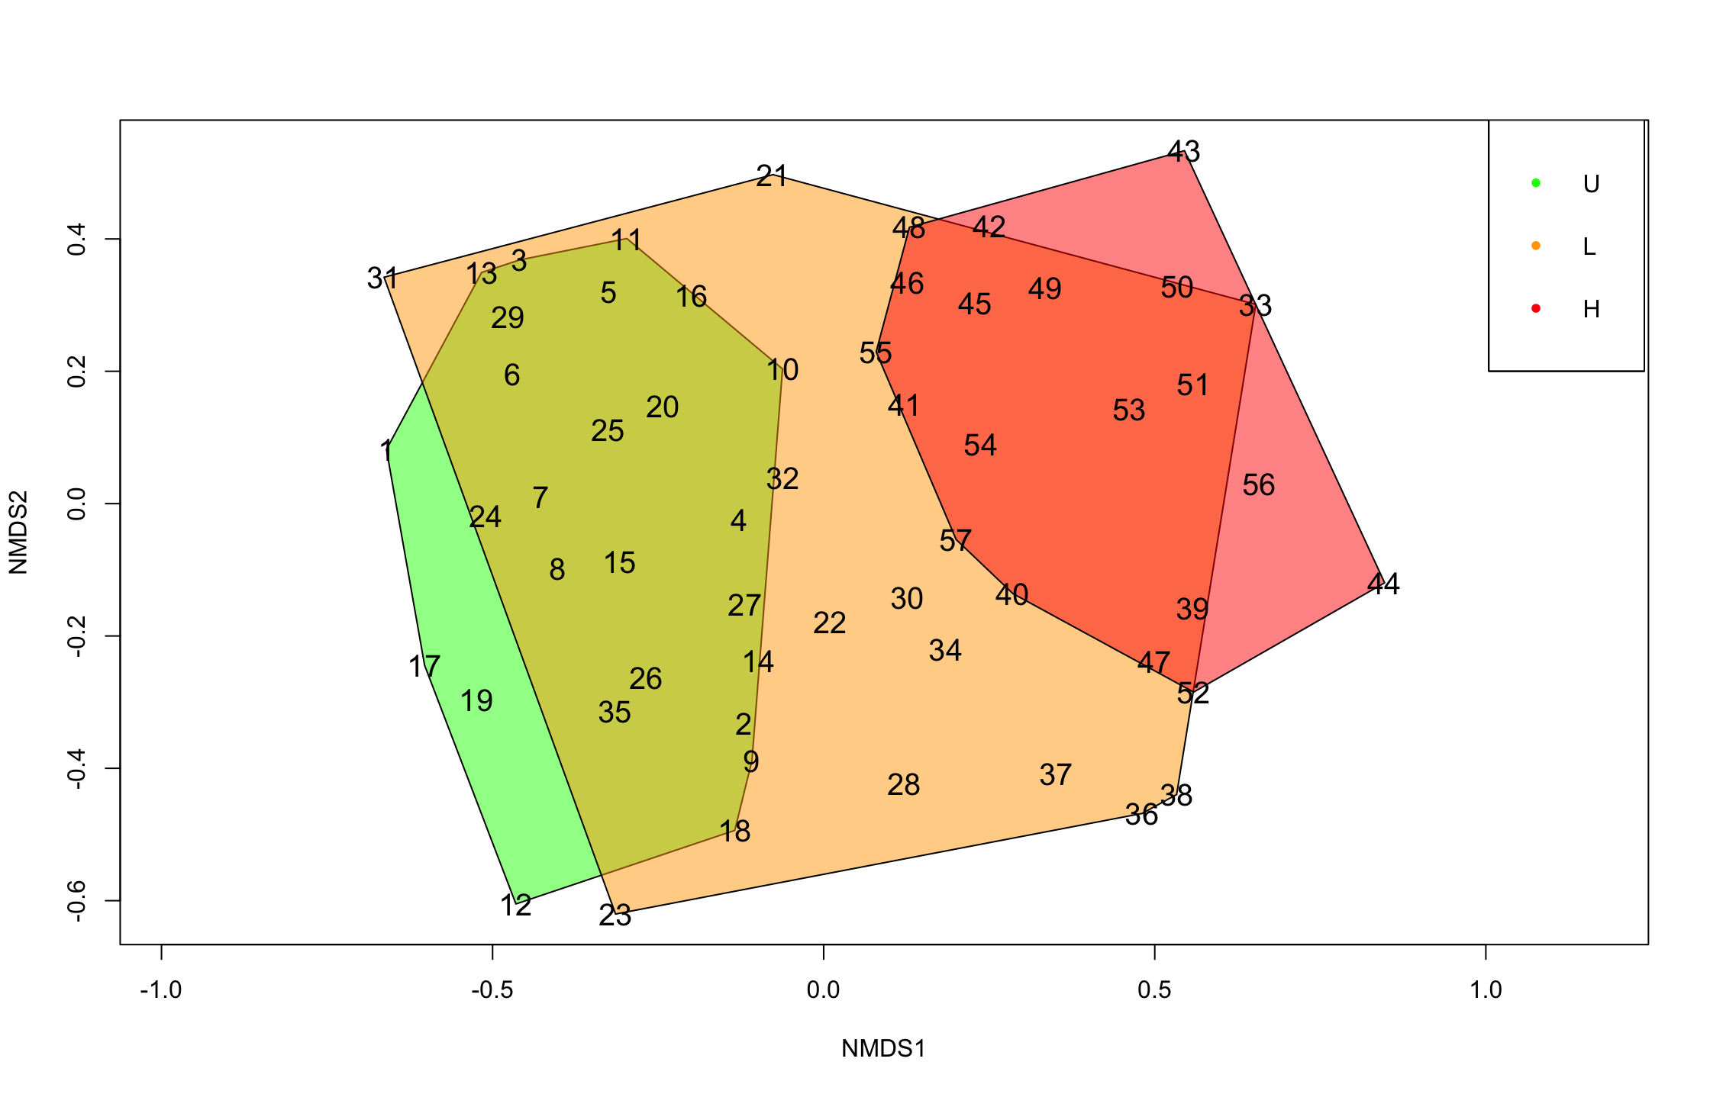
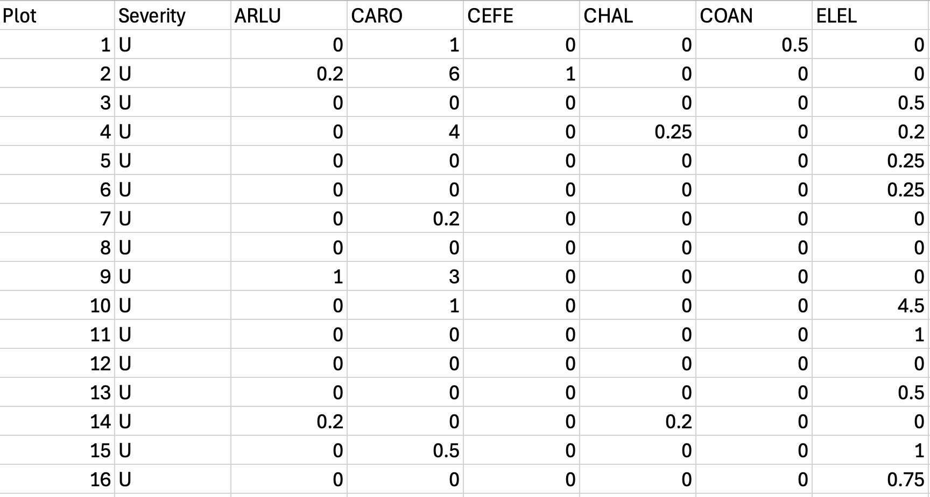
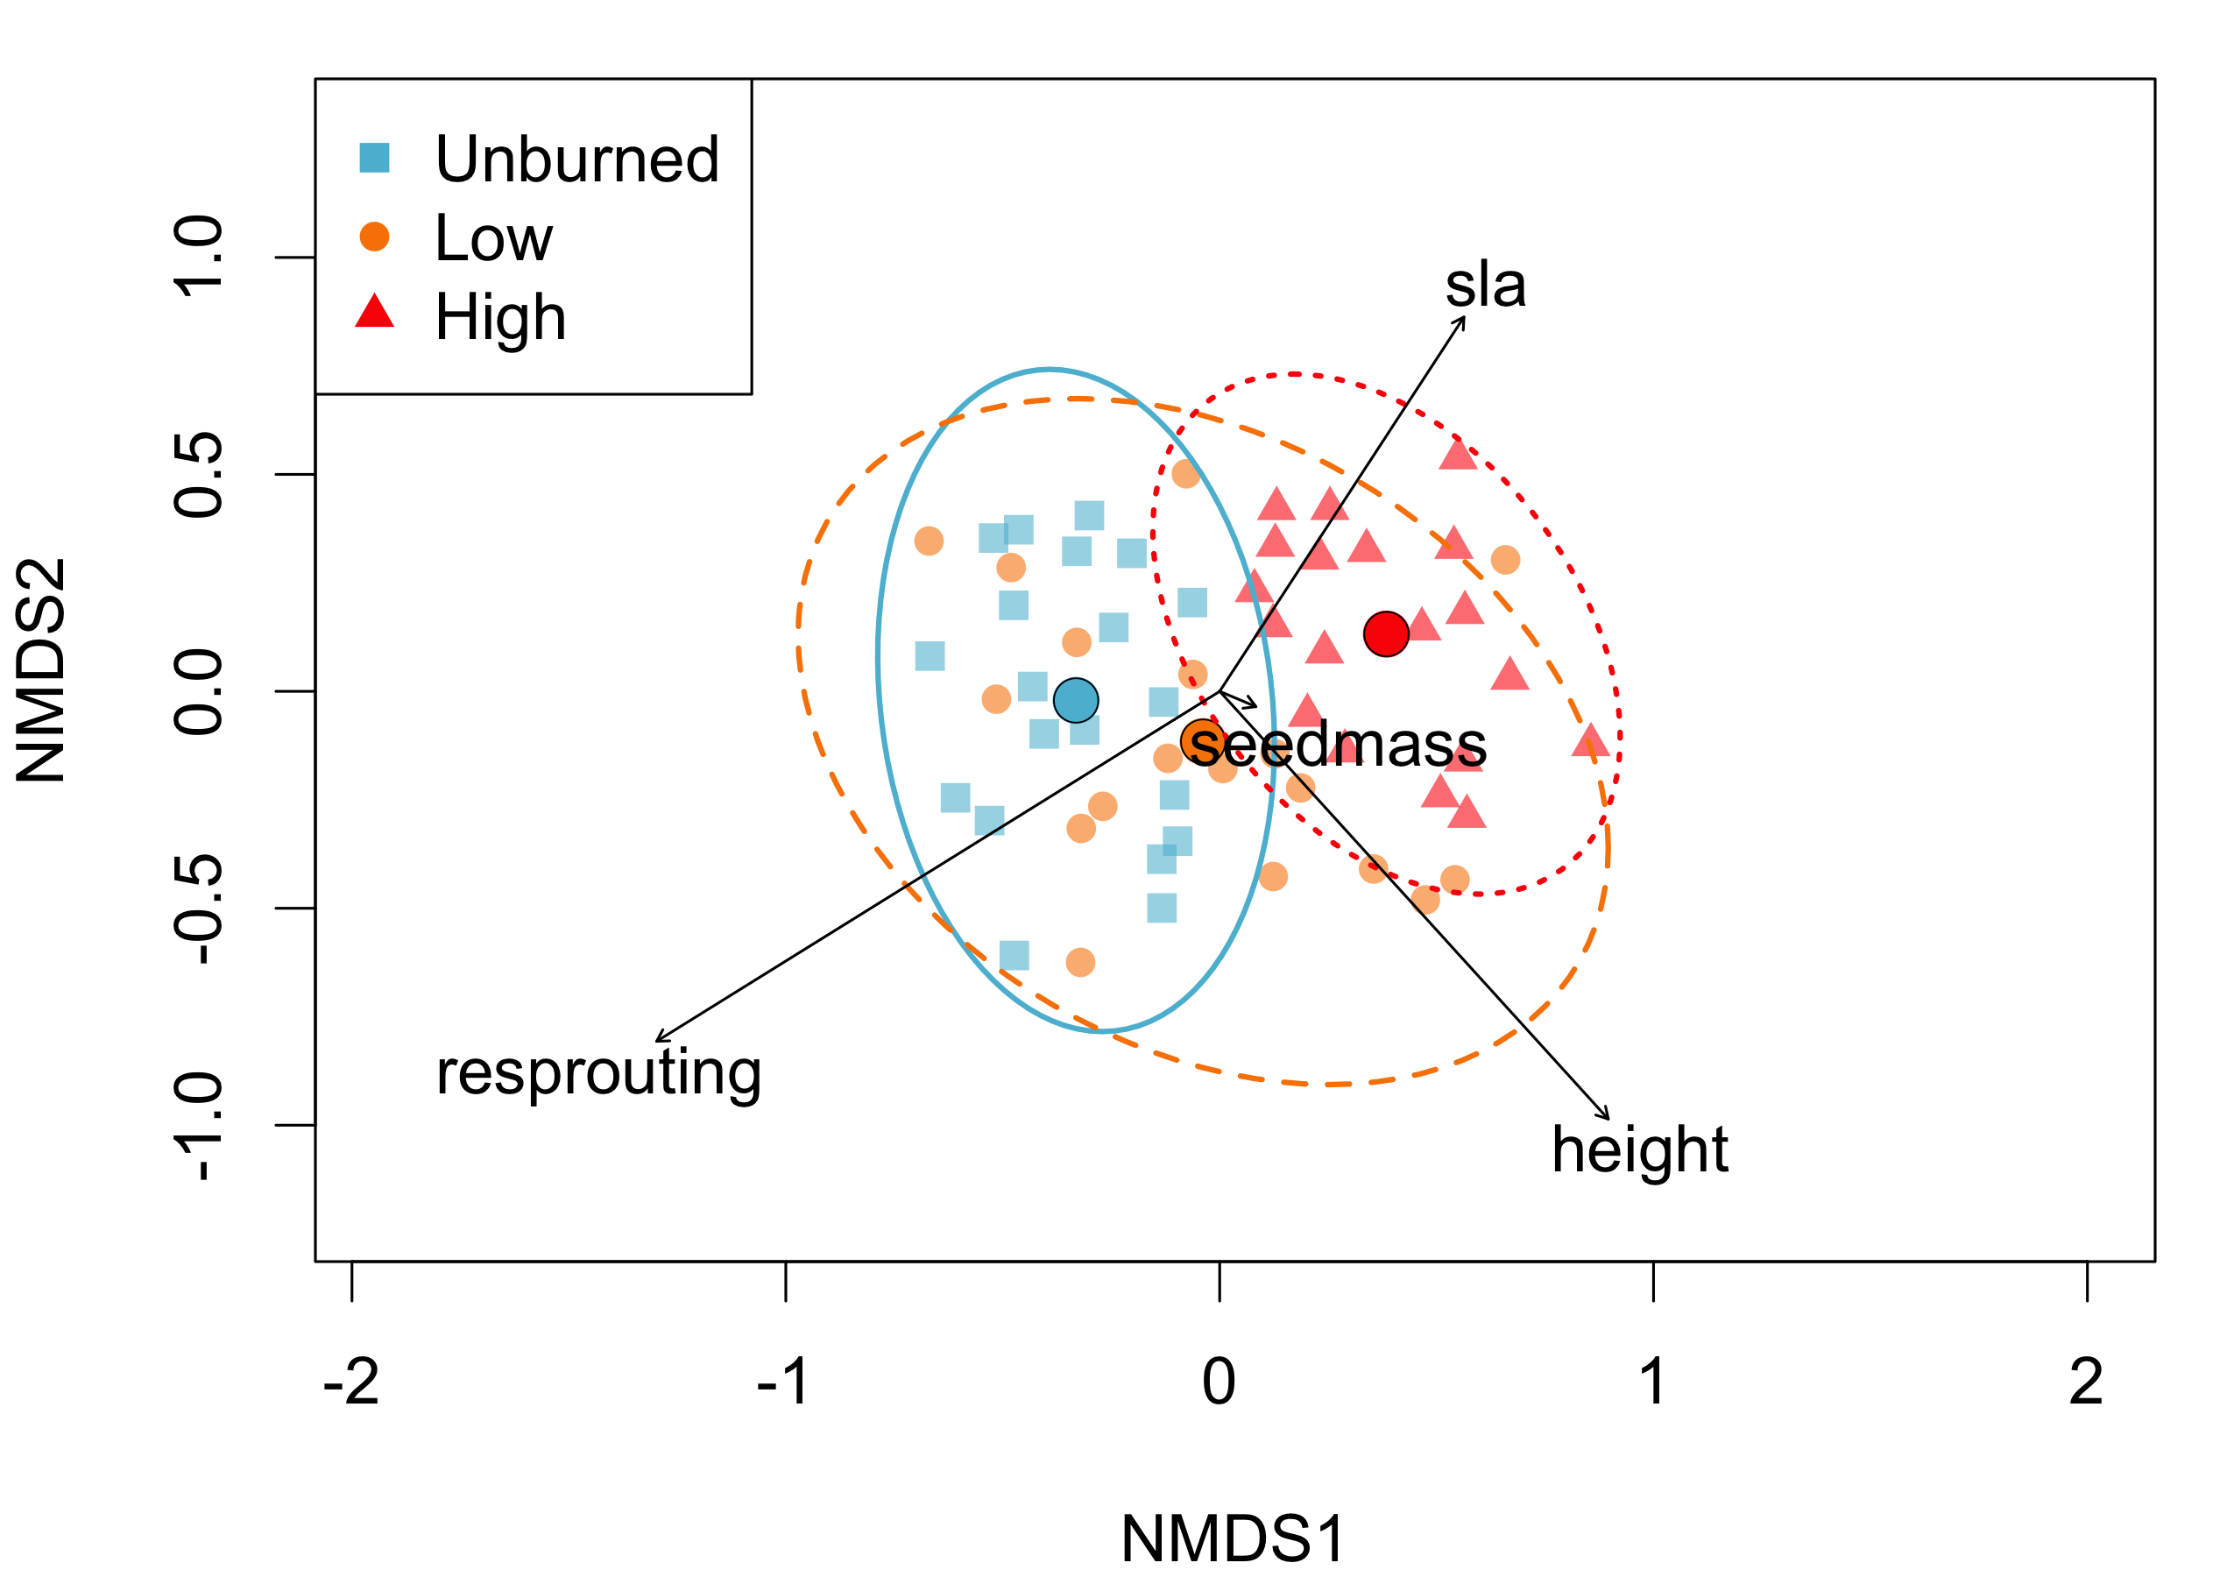
Plant communities Dissimilarity and distance
With many more rows and columns…

Slide 7
Accounting for multivariate spatial dependence
Plant community data “occur in a geographic context”
Acknowledging this, Wartenberg (1985) extends spatial autocorrelation to multiple variables: simultaneously accounts for autocorrelation and covariance (how the cover of one species covaries with another, but also how the cover of one species depends on spatial location/proximity to other sites with that species)

Slide 8
Multivariate spatial correlation
Let m = number of variables (species), n = number of locations
Derived from Moran’s I, we can define:
M = Z^{T}WZ
M: m x m spatial correlation matrix
Z: n x m (location by variable) data matrix
Z^{T}: transpose of Z (m x n; variable by location)
W: n x n spatial weight matrix
The diagonal values of M are Moran’s I values (autocorrelations)
Notes:
“Each off-diagonal element is, by analogy, a bivariate crosscorrelation coefficient,the spatial correlation of one variable with another variable calculated by summing the values over all pairs of localities, and weighted as in the autocorrelations. One such coefficient exists for each pair of variables.”

Slide 9
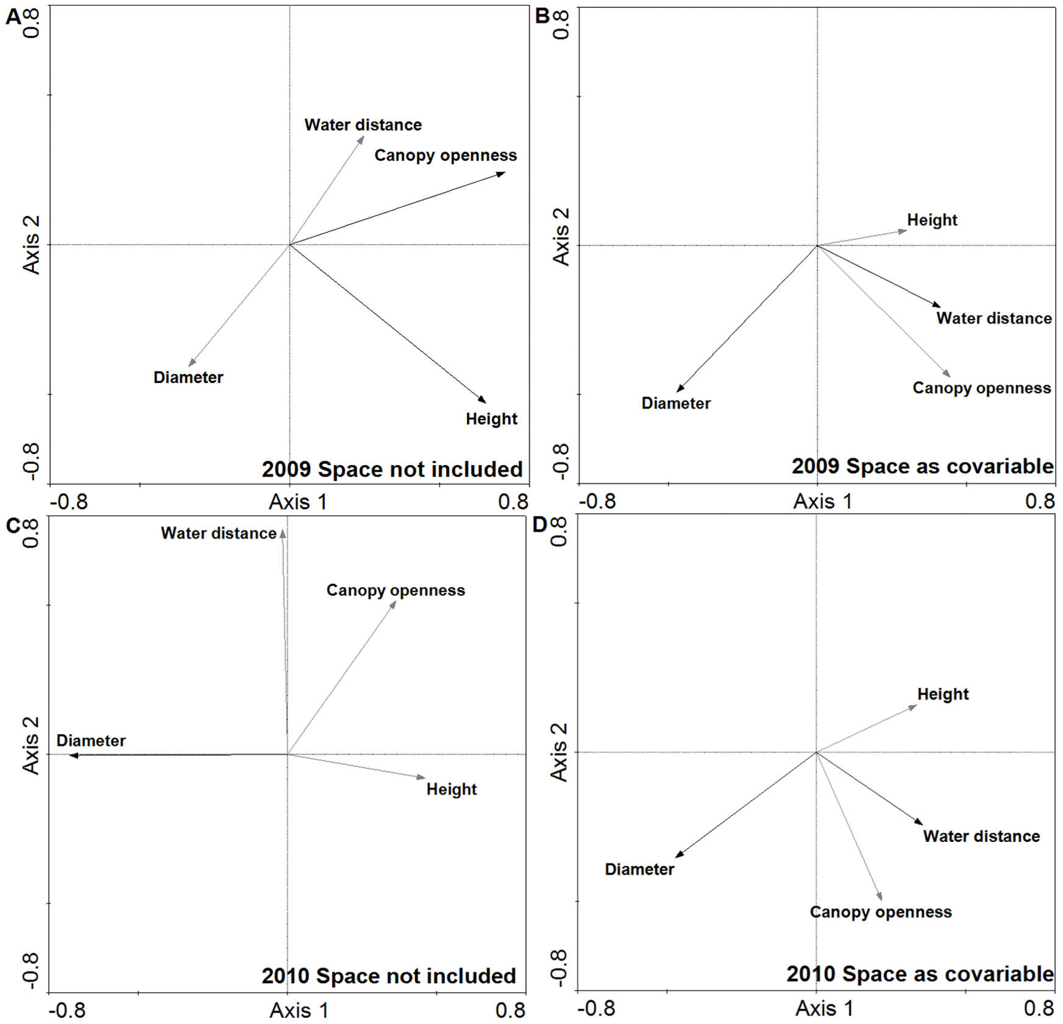
Including spatial factors can change results
Results from redundancy analysis (RDA)
Notes:
Horak, J. (2013). Effect of Site Level Environmental Variables, Spatial Autocorrelation and Sampling Intensity on Arthropod Communities in an Ancient Temperate Lowland Woodland Area. PLOS ONE, 8(12), e81541. https://doi.org/10.1371/journal.pone.0081541

Slide 10
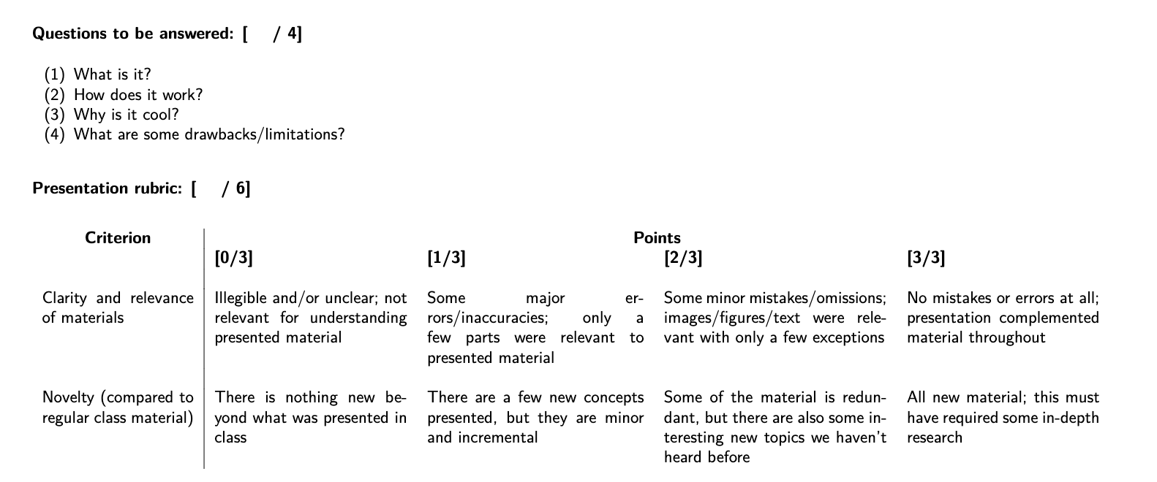

Slide 11
How can we use spatial models to assess environmental impacts on vegetation communities as a whole?
Most vegetation data collected in plots or quadrats are inherently areal, but the individual attributes of each (i.e., perfect cover of a particular grass) are essentially geostatistical.

Slide 12
When modeling vegetation spatial dependencies, how should we treat these data?
Spatial interpolation of vegetation attributes is extremely common
Utilizes a geostatistical framing
For instance, you can measure cover of shrubs in a number of 1-m2 quadrats distributed across a study area of interest; each quadrat is basically treated as a point and shrub cover is interpolated across a grid
REM RegKrigging paper
Can also predict distributions for particular species
May require treating populations differently
https://www.fs.usda.gov/ne/rsb/nant.html

Slide 13
Looking at interactions between plants and their environment
https://www.jstor.org/stable/2261666?seq=1

