Slide 1
EDTH TAIPEI 2026 | CHALLENGE 2
TAIPEI
DRIFT
GNSS jammed. Still on target.

Slide 2

THE PROBLEM
GNSS/LOCALISATION IS LOST WHEN JAMMING
$$
LOCALISATION
GETS EXPENSIVE FAST

Slide 3




OUR SOLUTION
RF
+
+
+
=
CAMERA
IMU
SUN
FREE MAP
POSITION
WE ARE THE FIRST COMBINING THESE SENSORS TO ONE POSITION

Slide 4
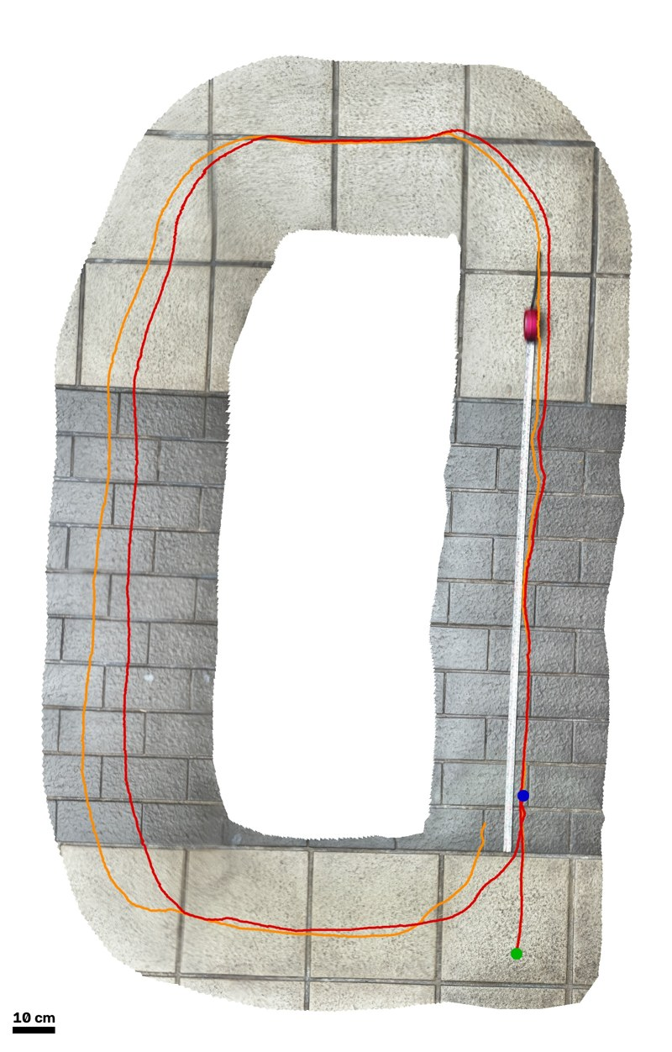
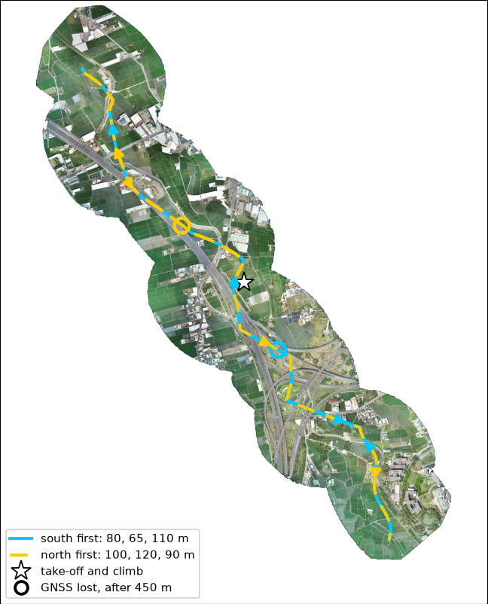

DEMO
VIDEO LINK
First Testing on Campus
Simulating in Taitung
Notes:
[2:35-2:48] Play the video or point at it: GNSS cut mid-flight over Taichung, the estimate stays on the track. Right: a real camera on a cart finds its own path from the floor alone; the loop closes to 0.1 mm. [Replace the VIDEO LINK hyperlink with the real video URL before upload.]

Slide 5
DOES IT WORK?
3 km
↓
18 m
median error, 4.3 km without GNSS
Notes:
[0:55-1:15] Each source we add cuts the error: IMU alone 3 km; the sun fixes the heading; the camera fixes the speed; the map fixes bring it to 18 m. Simulated 100 m flight over real Wufeng aerial imagery, with a map two years older than the ground. On sealed flights we never tuned on: 16 to 36 m, no wrong fix.

Slide 6



WHAT OTHERS MISSED
change
1.3°
$0
0
heading from the sun
maps: free, 2 years old
wrong fixes accepted
UNJAMMABLE
NO VENDOR LOCK-IN
KNOWS WHEN IT'S WRONG
Notes:
[1:35-1:55] Three insights. The sun is a compass nobody can jam: heading error drops from 55 to 1.3 degrees. A free photo two years old is enough: no vendor 3D data. And it knows when it is wrong: zero wrong fixes accepted, the stated error bound held 100 % on sealed flights. Night: a thermal camera against the same maps, same filter; that is our next step.

Slide 7
THE MARKET
48,750
4 M
$22.8 B
drones, Taiwan, 2026–27
drones a year, Ukraine
military drones, 2030
$200
licence per drone,
sold to drone makers
Sources: Taiwan MND 2025; Kyiv Post / Bloomberg 2025; MarketsandMarkets 2025
Notes:
[1:55-2:20] Taiwan buys 48,750 drones in 2026-27, a 1.56-billion-dollar programme, built in Taiwan with no Chinese parts: open maps and local software fit that rule. Ukraine builds millions a year. Military drones: 22.8 billion dollars by 2030. We license per drone to the makers, about 200 dollars, plus map packs. One million drones is 200 million dollars a year.

Slide 8
OUR PRICE
💵
💵
💵
$10-45
$100-110
$6-12
$116-167
+
+
+
+
+
=
MAP
CAMERA
IMU
SUN
BAROMETER
RF
FINAL PRICE
BAROMETER
Lidar exportkontroll 2000 bis 8000
$400-8000
Sensor (final version) | Specification in our simulator | Matching part | List price | Added cost per drone
Down + forward camera | 2 × 1024×1024 px, 90° FOV, 25 Hz | Platform camera; reference: Raspberry Pi Global Shutter Camera | $50 each [36]; Camera Module 3 wide $35 [14] | $0 if on the drone; else ≈ $70–100
IMU | 100 Hz, consumer MEMS (Mid-Air noise model) | ICM-42688-P on Pixhawk 6C | flight controller $211.99 [20][21] | $0 (on the flight controller)
Barometer | 50 Hz, 10 Pa noise (≈ 0.8 m), drift 0.65 Pa/√s | MS5611 on Pixhawk 6C | chip $5.78–12.32 [15] | $0 (on the flight controller)
Sun sensor | 0.1°, ±65° FOV (Fan et al. 2016) | Self-built: linear array behind a V-slit + RP2040 | parts $6–9 + mechanics (estimate) [9][10][12] | ≈ $10–20
Downward range finder (optional, metric flow) | 1 beam, 0.2–100 m, σ 0.02 m, 25 Hz | LightWare LW20/C (0.2–100 m, ±5 cm, 19 g) | $279 [23][24] | ≈ $250–300
RF direction finder (over water) | AIS receiver; 4 × 17 cm VHF stubs, RF switch at 1 kHz, one radio, −110 dBm | Low-cost: RTL-SDR V4 + ADG904 switch + 4 whips. Reference: HackRF One + Opera Cake | ≈ $110–210 low-cost; ≈ €558 (≈ $615) reference [37–44] | ≈ $110–210
Notes:
Sensor
Requirement from our simulations
Recommended part
Unit price (list)
Added cost per drone
Barometer
≈ 10 Pa white noise (≈ 0.8 m), drift 0.65 Pa/√s
MS5611 (already on Pixhawk 6C); alt. DPS310, BMP390
$5.60–12.32 per chip [15][18][19]
$0 if the flight controller has one; else ≈ $6–12
Sun sensor
0.1°, ±65° field of view, 25 Hz (Fan et al. model)
Self-built: linear array + slit + MCU, or pinhole + small CMOS sensor
$5.49–8.06 linear array; ≈ $0.70–1 MCU; ≈ $32 CMOS module [9][10][12][13]
≈ $10–45 (estimate incl. unsourced mechanics)
LiDAR (optional)
Range ≥ 180 m for 65–120 m flights; km-class for laser TRN
LightWare GRF-500 (500 m, 10.7 g) or SF30/D (200 m)
$399–€525 [22][25]
≈ $400–580
Scanning LiDAR (alternative)
Not used in our simulations
Livox Avia + Jetson Orin Nano Super
$2,079 + $399 [29][32]
≈ $2,500; up to ≈ $8,400 with Ouster OS1

Slide 9
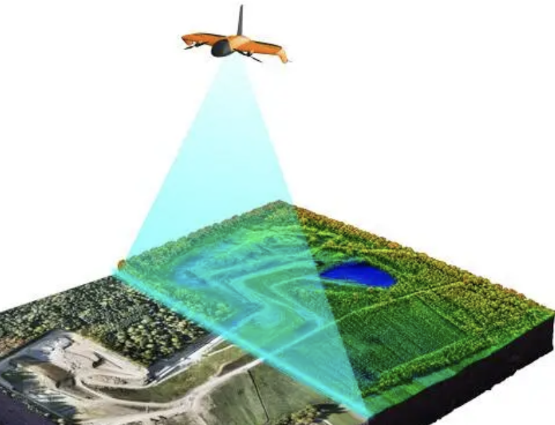
OUR PRICE
$116-167
FINAL PRICE
vs
💸💸
$400-8000
‼️
Exportcontrol
Sensor (final version) | Specification in our simulator | Matching part | List price | Added cost per drone
Down + forward camera | 2 × 1024×1024 px, 90° FOV, 25 Hz | Platform camera; reference: Raspberry Pi Global Shutter Camera | $50 each [36]; Camera Module 3 wide $35 [14] | $0 if on the drone; else ≈ $70–100
IMU | 100 Hz, consumer MEMS (Mid-Air noise model) | ICM-42688-P on Pixhawk 6C | flight controller $211.99 [20][21] | $0 (on the flight controller)
Barometer | 50 Hz, 10 Pa noise (≈ 0.8 m), drift 0.65 Pa/√s | MS5611 on Pixhawk 6C | chip $5.78–12.32 [15] | $0 (on the flight controller)
Sun sensor | 0.1°, ±65° FOV (Fan et al. 2016) | Self-built: linear array behind a V-slit + RP2040 | parts $6–9 + mechanics (estimate) [9][10][12] | ≈ $10–20
Downward range finder (optional, metric flow) | 1 beam, 0.2–100 m, σ 0.02 m, 25 Hz | LightWare LW20/C (0.2–100 m, ±5 cm, 19 g) | $279 [23][24] | ≈ $250–300
RF direction finder (over water) | AIS receiver; 4 × 17 cm VHF stubs, RF switch at 1 kHz, one radio, −110 dBm | Low-cost: RTL-SDR V4 + ADG904 switch + 4 whips. Reference: HackRF One + Opera Cake | ≈ $110–210 low-cost; ≈ €558 (≈ $615) reference [37–44] | ≈ $110–210
Notes:
Sensor
Requirement from our simulations
Recommended part
Unit price (list)
Added cost per drone
Barometer
≈ 10 Pa white noise (≈ 0.8 m), drift 0.65 Pa/√s
MS5611 (already on Pixhawk 6C); alt. DPS310, BMP390
$5.60–12.32 per chip [15][18][19]
$0 if the flight controller has one; else ≈ $6–12
Sun sensor
0.1°, ±65° field of view, 25 Hz (Fan et al. model)
Self-built: linear array + slit + MCU, or pinhole + small CMOS sensor
$5.49–8.06 linear array; ≈ $0.70–1 MCU; ≈ $32 CMOS module [9][10][12][13]
≈ $10–45 (estimate incl. unsourced mechanics)
LiDAR (optional)
Range ≥ 180 m for 65–120 m flights; km-class for laser TRN
LightWare GRF-500 (500 m, 10.7 g) or SF30/D (200 m)
$399–€525 [22][25]
≈ $400–580
Scanning LiDAR (alternative)
Not used in our simulations
Livox Avia + Jetson Orin Nano Super
$2,079 + $399 [29][32]
≈ $2,500; up to ≈ $8,400 with Ouster OS1

