Slide 1

The vagrantfile

Slide 2
The vagrantfile

Slide 3
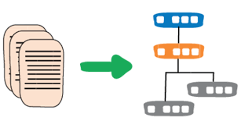
The infrastructure manager
In the last section of the intro here we went deeply into the advantages of keeping your infrastructure as code…so let’s take a quick look at how to do that practically:
The Vagrantfile is the first and best example of how code can create and maintain infrastructure in a development environment.
The syntax of the Vagrantfile is written in RUBY but fear not! You do not need to know Ruby in order to utilize the Vagrantfile.
This section will be dedicated to going over several sections of the Vagrantfile in order to make everyone here Vagrant-provisioning machines!

Slide 4

Vagrant in your file directory
So- when we begin a Vagrant project the first thing we do is create a directory from which we want to run all things vagrant. USUALLY this is a directory with application code already in it and ready to go.
Go ahead and do that now… create a directory called C:\Users\Administrators\vagrantmodone
(Bonus points if you do this from the git bash command line with the mkdir command)

Slide 5

Vagrantfile intro (continued)
The second step is to run the command vagrant init from our command line from within that directory. This will make a Vagrantfile appear (as if by magic!) in your chosen directory. That Vagrantfile will be the primary target of your editing and will have a long list of default settings for you to update in order to create your machine effectively
vagrant init

Slide 6

So what just happened?
So basically you should have seen two things appear in your directory when you typed in vagrant init:
A Vagrantfile appeared and
A .vagrant/ directory appeared (hidden because of the “.” in front
When we want to create or destroy a Vagrant directory we should delete both of these entries

Slide 7

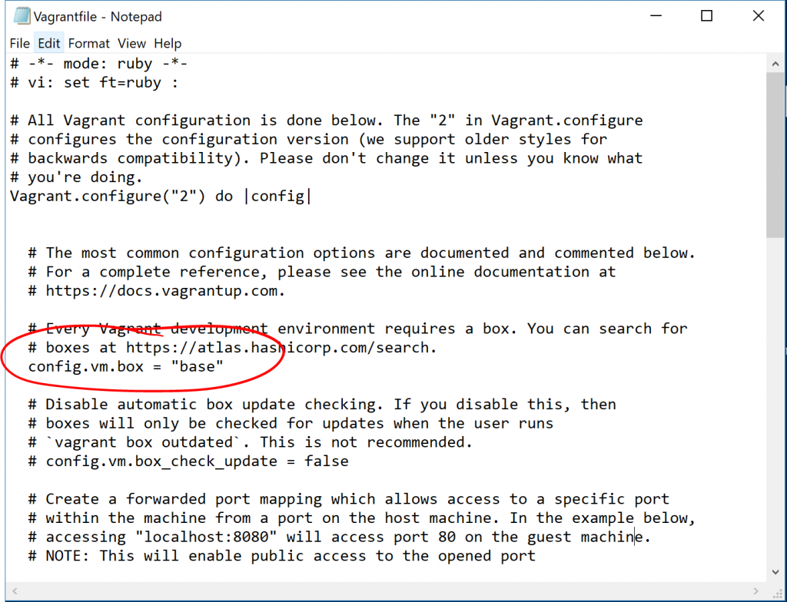
Vagrantfile intro (continued)
The third step is to go INTO your Vagrantfile and edit it to what you would like
This means:
Open up the file finder
Navigate to your new directory
Highlight the Vagrantfile and
OPEN WITH Notepad

Slide 8
Vagrantfile intro (continued)
SO- in this Vagrantfile the first thing that we notice is that it starts with THIS line:
Vagrant.configure("2") do |config|
# ...
end
So what does this mean? Basically
“2” is the version
and the |do| is a bit like starting a loop…in other words “please DO everything that follows!”

Slide 9

Vagrantfile commands (continued)
Now- we can see that there is a large section of text commented out that follows the configure line. This is useful for helping beginners to understand what is happening in the Vagrantfile but is not strictly necessary.
Read through the comments and then delete them IF YOU WISH (personally…I find less cluttered code easier but this is a 100% personal preference!)

Slide 10

Vagrantfile: Config.vm.box
There are numerous settings that we can put in this section. If you have a default Vagrantfile right now it should just say config.vm.box=“base”
This is where you will identify the image of the machine that you want to use to create your VM….
SO- as we will be seeing in the upcoming lab- THIS is where you will be putting things like “CentOS” or “Ubuntu” or “Windows” depending on which box you want to use.
THIS entry forms the base Operating system of our virtual machine.

Slide 11
Config.vm.box (continued)
config.vm.box is basically where we would POINT TO the image we want to use.
By default it is set to point to the Hashicorp Vagrant Cloud images found at https://app.vagrantup.com/boxes/search
BUT- if you have a box located somewhere else you can change this to config.vm.box_url
This means that if you have an .iso image in, say, a DROPBOX or GIT repo you can drop that link in here and Vagrant will download THAT image
99% of the time I’d recommend just using the hashicorp site though…

Slide 12
Config.vm.box (continued)
There are a bunch of other variants of config.vm.box that we can go through, including but not limited to:
config.vm.box_download_checksum
config.vm.box_download_checksum_type
config.vm.box_download_ca_cert
etc,etc
That is really advanced stuff though and basically all deals with HOW Vagrant will get the image to load up (should it check the ssl encryption? That sort of stuff).
Basically the big takeaway here is that config.vm.box is all about pointing Vagrant to which image it should use to make your virtual machine

Slide 13
config.vm.box_check_update
The next commented out section is config.vm.box_check_update.
Basically- when you run the vagrant up command the first thing that Vagrant will do (in the background) is check to see if there is an update to your box available. NOW- it is possible to adjust this setting to NEVER download and use that update if you want to maintain your machine at it’s current state.
There might be some situations when you want to do this (though I can’t think of any!) so the option is there…but I highly recommend that you leave this part commented out unless you understand the implications of never updating your current virtual machine.
By default “check_update” is set to TRUE

Slide 14
config.vm.network "forwarded_port", guest: 80, host: 8080
This next section deals with how you want Vagrant to treat the relationship between the ports on your virtual machine with the ports on your host machine.
Basically…let’s say you have a Windows web server running a Vagrant CENTOS machine.
You put a bunch of your code onto the Vagrant CENTOS machine that will display pictures of the GOLANG GOPHER on the web
The issue is that there is no BROWSER in your CENTOS machine….but BY GOLLY you want to see your gopher. So what do you do?
You can direct Vagrant to override your PORT 8080 on your HOST machine with whatever is being sent through port 80 on your VAGRANT machine
Now you can open up localhost:8080 on your HOST machine and voila! Pics of GOPHERS galore!

Slide 15
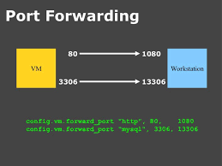
Vagrant port forwarding

Slide 16

Vagrant port forwarding (continued)
The important takeaway here is that Vagrantfile Port forwarding allows your Vagrant machine to essentially “take over” the port of the host in order to do anything from allowing MYSQL commands to be run inside the vagrant machine (via port 3306) to showing web content through port 80.
This is a way to give you direct access to programs INSIDE the vagrant machines FROM your host machine (which, if we’re honest, is probably the machine that actually has most of your CODE GUIs and key programs).

Slide 17

Vagrant port forwarding (continued)
Another important thing to note is the difference between the PRIVATE NETWORKING port forwarding and the PUBLIC NETWORK port forwarding.
ESSENTIALLY here’s the situation:
You have a webserver in the cloud that is currently serving web content to the internets
On this webserver you are running a Vagrant machine that is doing most of the heavy lifting

Slide 18
Port forwarding (continued)
There are three types of port forwarding that you can do from this web server to your Vagrant machine:
Straight up forwarded port mapping (the first option in the Vagrantfile) which gives the outside world access to your vagrant machine
Host only port mapping (second option in the Vagrantfile) which basically says “only IP address 127.0.0.1 (or “localhost”) is allowed to access the Vagrant machine through port 80/3306/5432/443…whatever
Host only port mapping through designated IP address- So maybe you want to designate an IP address OTHER than 127.0.0.1 (like a ”10.” or “192.” or “172”)
Open to the entire world: Basically like a 7-11: Open 24/7/365 and allow anyone and everything through all ports into the virtual machine; in essence treat it the same as the host machine

Slide 19
Confused?? Good…ask questions!

