Slide 1
Do robots dream of electric sheep?
Bridging the gap between data and creative marketing
Fernando Pombeiro
Manager, BI Engineering, Fandango

Slide 2
Learning objectives
Big data 101
Understanding KPIs and their inherent shortcomings
Understanding your customer
Notes:
Learning objectives will frame the class and give students reference points

Slide 3
Introduction
Creative analytics
Notes:
15m

Slide 4
The story behind big data
“We are looking to bridge this gap not via marketing knowledge. That we know and we are ahead of the pack at Circus; what we are seeking is to pioneer the gap between Data and Creative for a broader audience and not coders. “
--Chris Roberts

Slide 5
How do we measure?
The story behind big data
Please take a minute to think about one of the biggest issues in modern business: the Key Performance Indicator
KPIs – as understood in the modern business context– are measures of whether something is “good” or not.
Across most parts of the business our KPIs are industry standard.
Please take a minute and write down three of the KPIs most applicable to your job

Slide 6
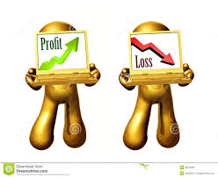
The story behind big data
Most of us probably utilized industry standard KPIs. If we think of them visually (on a pyramid) they would all spring from two basic measurements (in any business): Cost vs Revenue
…or as we say in Marketing:
Cost per Acquisition vs Lifetime Value
…or as we say in Operations (at Amazon):
Variable Cost per Unit vs Revenue per unit
…or as we say in finance:
Liabilities vs Assets

Slide 7
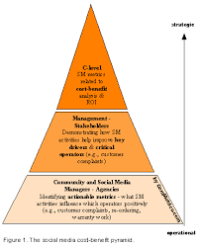
The story behind big data
All of these KPIs are supported by numerous other KPIs, including:
Cost per Click
Cost per mille (thousand page views)
Churn rate of a user
Bounce rate
And so many more…
If you imagine the whole KPI chain as a pyramid-
they all lead up to the fundamental question of Revenue vs Cost

Slide 8

The story behind big data
As we go into the realm of asking about creative measurements we are passing in to relatively uncharted territory- outside of items that have “standard” measurements.
The challenge in presenting here is around the question of what makes this a good ad vs a bad ad.
The old school KPI method would say “well if customers click on it and it makes money→ good. If not→ bad (Revenue vs cost again!)

Slide 9
The story behind big data
That is one way to look at things- but keeping in mind that bad ads are a cost center (artist time, production time, photography)- so our learning curve means that we must put out and test bad ads again and again and again and again in order to learn
The question becomes: how do we create good ads with the minimum investment (the fewest “bad” ads)?
This is where data science and machine learning are kind of changing the game across multiple industries and this is how I read Chris’ quote from the front:
How do we bridge the gap between creative people and analytical machines in order to give creative people the best guidance on how to create “good” art?
Can a machine know “good” art and provide this guidance? How?
Do Robots dream of Electric Sheep? (can an artificial intelligence tell what is good “art”?)

Slide 10

The view from the binary
Here is the tension: computers can only think in binary terms: something is True or something is not True
This is not a limitation that humans have- we can make value judgments and decide if a thing is “good” based on our past experiences- which is something computers do not have (or do they)?
Computers are fundamentally literal machines that can learn- this process is known as machine learning.
It is inside this framework- of teaching a machine to appreciate art– that we will run the rest of this class. We will give our theoretical machine (that we are teaching) and cute and cuddly name– Skynet.
This will be used to teach the class the fundamental concepts surrounding modern Data Science

Slide 11

Back to KPIs
So let’s come back to our KPIs. Ask yourself how these came about?
The truth is probably this: trial and error- a lot of it- painfully and over time- using techniques like “A/B” testing.
Think of all of this “trial and error” as “building a model”--- what you (and your industry) were doing was taking in data (at relatively slow rates compared to a computer) and processing it and finding trends.
Once you found those trends you created “rules” (example: maybe people prefer blue to green or orange to red or whatever)
Once you had those rules you began to set up concrete KPIs around them

Slide 12
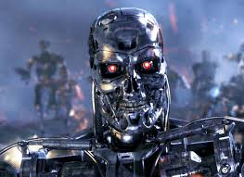
Machine learning
Machine learning is fundamentally about creating these rules at a much faster rate using an extremely high velocity and enormous (or “big”) data set.
Imagine if you could speed up the trial and error of a project by 10x, 100x, or 1000x by running 200 A/B tests a second and constantly iterating on the results with incremental improvements every time based on new knowledge gained by the machine.
Imagine you were doing this with an image for an ad campaign.
The computer would take in a result, analyze it instantly, and improve the output based on whatever metrics you asked for it to (usually “clicks”) and instantly spit out a new image and test that, seek improvements on other variables, and spit them out.
This is the machine learning model

Slide 13
Machine learning
Fundamentally- modern data science is broken down into the following steps:
Create your hypothesis:
“A bit of “good” advertising art is art that is clicked on by more people than not clicked on.
Gather your data:
“Here are 100 images I have that I am going to release and see if they are clicked”
Set up your variables:
“Here are some aspects of each piece of art that I am going to present as variables”:
Number of colors (number: 1-1,000)
Background Color (Tropical, Desert, Plain White) (later!)
(Animal, Vegetable, Mineral, Celestial) (later!)
Red circle or no red circle (later!)
*Please note: these variables should be binary and apply across the spectrum. As much as possible we want them to be numbers
Set up your categories: Supervised or unsupervised

Slide 14
hypothesis
Our hypothesis:
MORE COLORS means MORE CLICKS!
We are going to run ONE of our ads 1,000 times to find out!
The input or data in is going to be something that looks like this:
[1 color, 100 clicks]
[2 colors, 200 clicks]
[3 colors, 300 clicks]
[4 colors, 400 clicks]
…and so on (obviously these are not the *actual* clicks. We’ll come to that in a bit!)

Slide 15
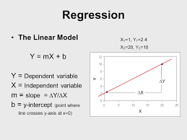
A quick note on terminology
We have a hypothesis now: we have run our ads 1000 times to determine one variable: do more colors correlate with higher clicks.
We are not teaching the machine (yet). At this point we are merely testing a hypothesis.
We are going to test this hypothesis using a technique called Ordinary Least Squares (or as it is more commonly referred to): REGRESSION analysis.

Slide 16
Dependent and independent variables
Our next step in the process is to design a visual representation of our hypothesis.
We have two variables-
An independent variable- which is, in short hand- the thing we can control (think of it like the lever). This is usually plotted on the “x-axis”.
A dependent variable – which is the thing that is effected by the independent variable (so for every increase in ‘x’ we get this much increase in “y”)
IF we start with the idea that “if we have 0 colors we will get 0 clicks” and then say that for every color we add we will add 1,000 clicks our graph might look something like this:

Slide 17
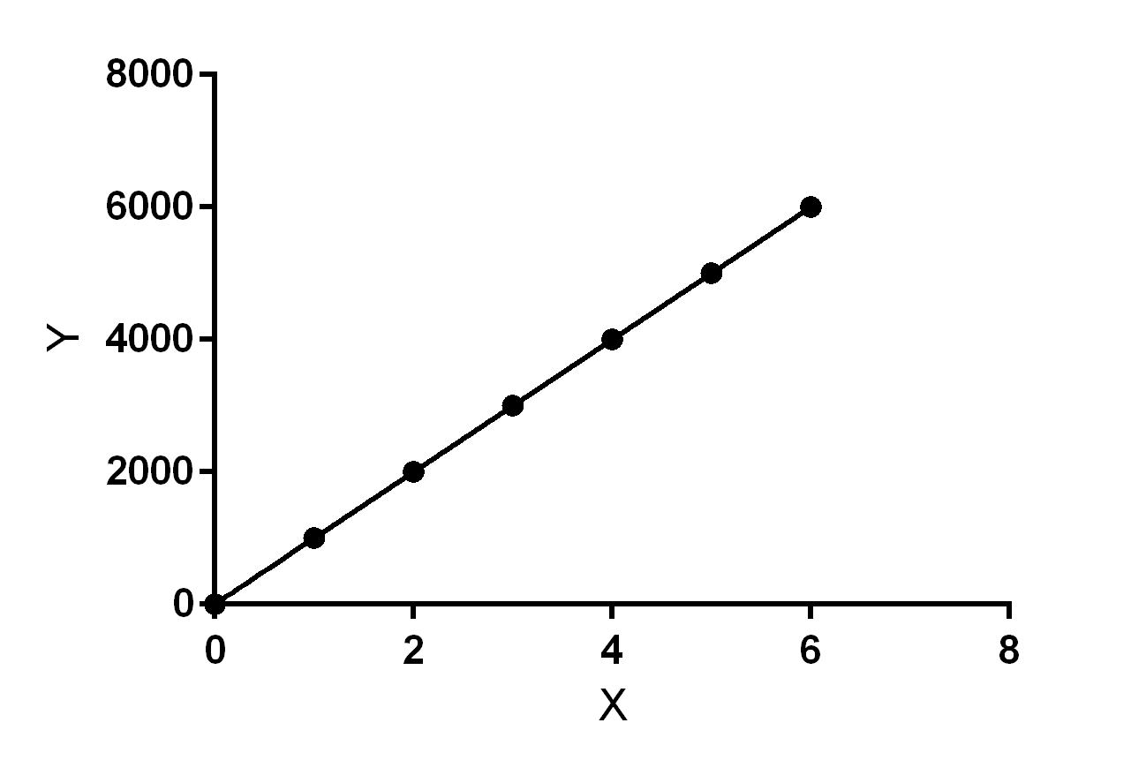
Let’s see what this looks like visually

Slide 18
But the real world doesn’t work that way
As everyone knows- the real world almost never works out along the ideal.
In reality we have our hypothesis but what ends up happening is actually that the data never aligns perfectly with what we expect… so instead of that perfect alignment we will end up seeing something like this:

Slide 19
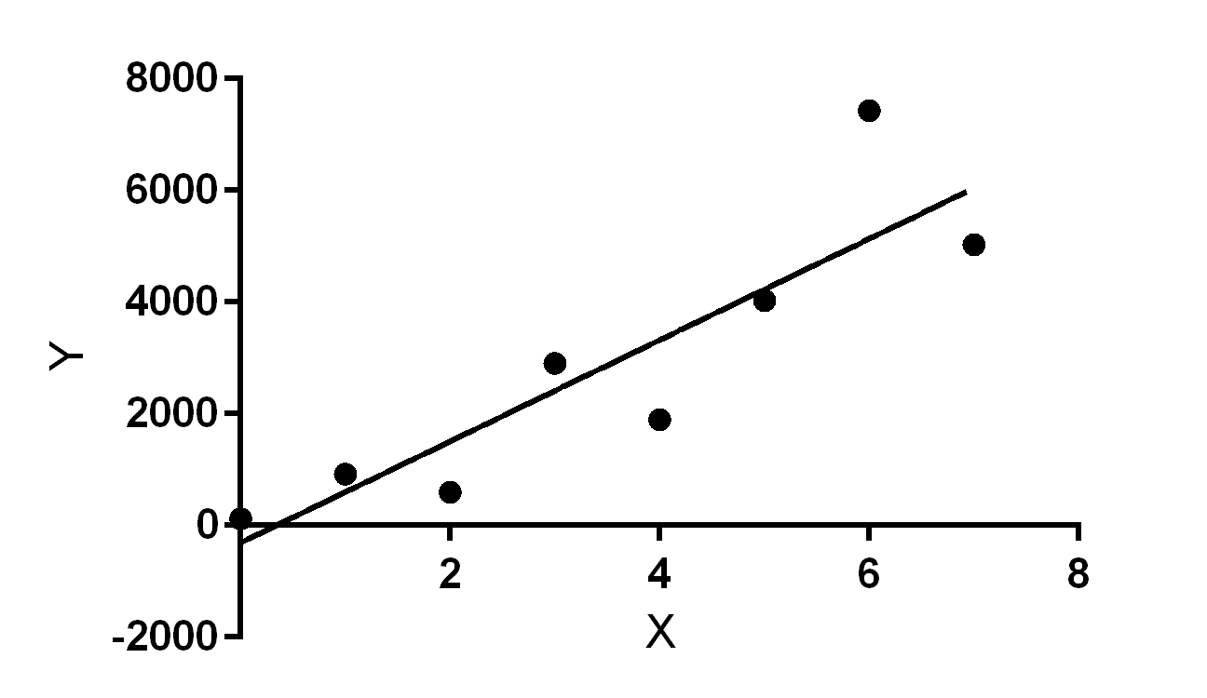
But the real world doesn’t work that way

Slide 20
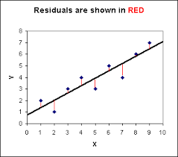
Regression
So now we need to measure our error, right? We want to see how “close” we came to our hypothesis without actually hitting it dead on.
One way to do it would be to measure the differences, along the ‘y’ axis of our “line” and see how far off they were. So it might look something like this:

Slide 21
The Coefficient of determination
So now we have this way of measuring the “error” in our calculations.
I will be sending out a separate powerpoint to talk about the math around this (not written by me- but it is simple to understand)- but without knowing the math the coefficient of determination or r-squared value is basically a way to measure the error between what we think things should look like and what they actually do look like.
R squared is a ratio- so it is a number between 0 and 1- usually mentioned as a percentage of a whole. Think of it like your grades in school (90% + is an “A”, 80%+ is a “B”, and so on…). A perfect fit would be a 1 (or 100%) whereas no correlation between the two variables would be a 0.

Slide 22
The Coefficient of determination
The r squared value (or coefficient of determination if you want to impress your friends!) measures how strongly two sets of numbers correlate to each other.
This is fundamentally how we determine the strength of a model- we look at two separate variables- one an independent variable (the thing we can control…in our case: the number of colors in an ad) and one a dependent variable- a thing that is effected by the thing we control (in our case: the number of clicks per ad).
The R squared value gives us this number. You can go to this website (and I will send it out over the slack channel) to practice with some values…
http://www.graphpad.com/quickcalcs/linear1/

Slide 23
Practical exercise
Arguably the best part of all this is that these days computers do all of the hard work for you.
We are going to do a quick practical exercise, in excel, where we are going to plug in a couple of sets of numbers and simply look at whether they correlate.
I will send out the excel spreadsheet over slack for everyone to use and follow along.
What we are looking for here is an answer to the question- do these two items correlate?

Slide 24
Practical exercise
The first data set that I have provided has the following data:
X = fires per 1000 housing units
Y = thefts per 1000 population
within the same Zip code in the Chicago metro area
So tell me- is there a correlation between the number of fires in a neighborhood and the number of thefts?
Let’s start teaching our machines to spit out some numbers!
The second data set hast he following:
X = List price (in $1000) for a GMC pickup truck
Y = Best price (in $1000) for a GMC pickup truck

Slide 25
Practical exercise
There are several more data sets on here for you to play with. Here’s what you should do:
Highlight the appropriate data set
Choose chart->scatterplot
Once the chart pops up go over to “chart layout” in the upper banner.
Choose “trendline”-> “linear”
Once the trendline appears highlight it and choose “format trendline”
Choose the “options” button
Choose “display r squared value”
Voila! You are doing ordinary least squares correlation!

Slide 26
Back to the big picture
So what is happening here?
Basically excel is looking at your data points and calculating a line through them that gives the “best” correlation. It is doing this mathematically (computers are super fast at math like this!)
The takeaway here is that when looking at the data presented the excel sheet can cay “this is the best r-squared value I can find”– it then plots that as your “hypothesis” and calculates the error (it does all this in milliseconds).
Now imagine doing this at a large scale!

Slide 27
Back to the big picture
To come back to our machine learning problem- imagine if a machine can find these correlations in milliseconds, calculate the “best” one (that gets the most clicks) and say “this particular variable gets you more clicks”.
Now imagine that we run through every color in the spectrum by running ads with that color in it (a “blue background” ad, a “red background” ad, a “yellow background” ad).
Imagine that with each of these we looked at different variables and decided which variables had the “best effect” on clicks (i.e: which variables correlated the most with clicks!)
So, for example, we decided: “six colors with a yellow background has the highest r squared value with higher clicks!”
This is machine learning– which we will be discussing further next week.

Slide 28

Homework (of course there’s homework!)
Please go out and find a correlation in your regular work
It just needs to be two sets of numbers. Find something where you have two sets of numbers to line up. It can be “coffee breaks taken vs. hours of sleep” or “soccer scores vs stock market” (side note- a friend just wrote his PhD on this!)
Run a correlation analysis on it and be prepared to present whether or not you found a mathematical correlation in the next class

Slide 29
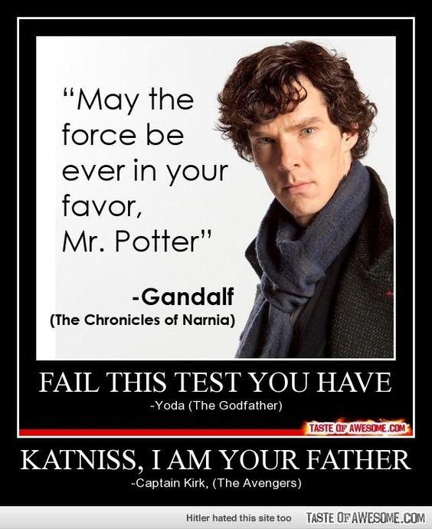
Summary
CONFUSED?
Good- ASK QUESTIONS!
Notes:
5m
Last time you interviewed each other about {prompt from Lesson 1}, and we ended with you deciding what the problem actually was after your research interviews.
Now we’re going to take that problem and work through some solutions.

