Slide 1
Introduction to php
Fernando Pombeiro
Manager, BI Engineering, Fandango

Slide 2

SO WHAT BRINGS YOU HERE TONIGHT?
Introductions!
Notes:
learning objectives will frame the class and give students reference points

Slide 3
Intro to php
What is php?

Slide 4

So what is php?
Intro to Php
PHP stands for “PHP Hypertext Preprocessor” (I know, I know- you can’t use the acronym like that!)
PHP is a server side scripting language.
PHP allows for dynamic html- meaning that the user can utilize different websites based on server inputs.
PHP can be
Object Oriented
OR Procedural
Notes:
learning objectives will frame the class and give students reference points

Slide 5
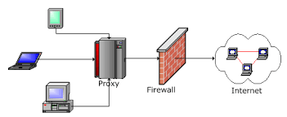
Server side vs client
Intro to Php
When you go to a website on your browser what you are doing is asking for another computer to serve you some information
Your computer receives that information and it looks like:go to a website in a browser of your choice, right click it, and select “view page source”.
Notes:
learning objectives will frame the class and give students reference points

Slide 6

Server side vs client
Intro to Php
The server returns HTML (HyperText Meta Language”) which is then interpreted by your browser or client.
So this breaks the whole system into two haves- servers (send data) and clients (interpret data to pictures pleasing to the human eye).
Notes:
learning objectives will frame the class and give students reference points

Slide 7

Server side vs client
Intro to Php
PHP talks to the server and can alter the html sent to the client by choosing what the client should see.
Some sites utilizing PHP include:
Facebook
Wordpress
Wikipedia
Yahoo
Tumblr
Notes:
learning objectives will frame the class and give students reference points

Slide 8
Embedded in html
Intro to Php
PHP is often directly embedded into html.
You can’t see php when you try to look at it from “view page source”- but that’s because it’s server side (your client/browser isn’t interpreting it).
That being said- the fact that it embeds with HTML makes is SUPER awesome.
<? echo “Hello I am PHP!”; ?>
Notes:
learning objectives will frame the class and give students reference points

Slide 9

So what do we need to run a php app?
Intro to Php
We need a “stack”. PHP is usually run on the “LAMP stack”.
LAMP stands for
Linux
Apache
MySql
PHP
Notes:
learning objectives will frame the class and give students reference points

Slide 10
So what do we need to run a php app?
Intro to Php
BI_SBOX_DB
Notes:
learning objectives will frame the class and give students reference points

Slide 11

LAMP stack
Intro to Php
Linux: The preferred operating system of most developers (command line based…generally). By operating system- think WINDOWS/MAC
Apache: the server that is used to make php work
MySQL: The databse that PHP talks to in order to retrieve/change (CRUD) data
PHP: Obviously
Notes:
learning objectives will frame the class and give students reference points

Slide 12
Intro to php
Setting up your environment

Slide 13

Assuming no one has linux
Setting up your environment
To set up a stack we need some elements- an apache server, a MySQL database, and a PHP interpreter (PHP is an interpreted language).
Fortunately all of these come pre-packaged in a couple of available packages-
For Windows there’s WAMP
For Mac there’s MAMP
Notes:
learning objectives will frame the class and give students reference points

Slide 14

Assuming no one has linux
Setting up your environment
Please go to each of the sites in your handouts and download the appropriate package and install them.
Once installed you will need to start up your servers. Click on the installer and start it up.
Notes:
learning objectives will frame the class and give students reference points

Slide 15
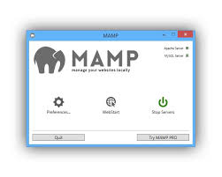
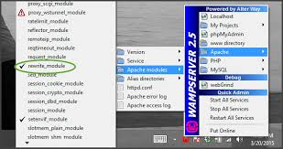
Assuming no one has linux
Setting up your environment
A successful server start looks like this on MAC and WINDOWS
:
Notes:
learning objectives will frame the class and give students reference points

Slide 16

Checking final setup
Setting up your environment
Now open up a browser (a real browser, not internet explorer) and type this into your browser address bar:
“http://localhost:8000
or (MAC)- “http://localhost:8080
Notes:
learning objectives will frame the class and give students reference points

Slide 17
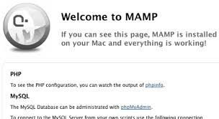
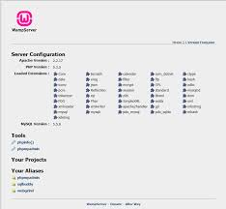
Checking final setup
Setting up your environment
If you see a page like this then you are doing well so far!
Notes:
learning objectives will frame the class and give students reference points

Slide 18
Intro to php
Editing your landing page

Slide 19

You have a webserver!
Editing your landing page
Keep in mind that this server is not actually attached to the interwebs!!
No one else can see this page (unless you upload it).
Basically you have a server
feeding directly into your web
browser.
Notes:
learning objectives will frame the class and give students reference points

Slide 20

Navigate to your landing
Editing your landing page
First thing to notice- web pages are actually DOCUMENTS
These documents- in this stack, end with the ‘.php’ extension.
Right now your web page “looks for” a document called “index.php” and displays it. We’re going to short circuit that process.
Notes:
learning objectives will frame the class and give students reference points

Slide 21
Navigate to your landing
Editing your landing page
Navigate to what is known as your “document root”
For those of you using macs that is found in:
/Applications/MAMP/htdocs
For windows:
C:\wamp\www
Notes:
learning objectives will frame the class and give students reference points

Slide 22

Navigate to your landing
Editing your landing page
Once there you should see a file called “index.php”. I want you to change the name of that to “mainindex.php”
Now open up SUBLIME or TEXT EDITOR and call it “index.php” and save it to the same place.
We are ready to go! Put some html into your doc!
Notes:
learning objectives will frame the class and give students reference points

Slide 23
Intro to php
Basic php stuff to know

Slide 24
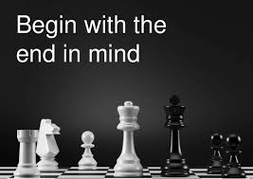
structures
Basic php stuff
Before we start writing php we must tell the server that we are planning on writing some php here- so utilize this symbol to start:
<?php
…and when we’re done we denote that with:
?>
Notes:
learning objectives will frame the class and give students reference points

Slide 25
variables
Basic php
PHP uses variables to hold data
A variable is denoted with the “$” symbol before it and can hole one thing (for example):
$name = ‘Fern’;
It can also hold many things in a data structure known as an array:
$names = [ ‘Fern’, ‘Wookie’, ‘Vicki’];
Notes:
learning objectives will frame the class and give students reference points

Slide 26

Php is not strongly typed
Basic php stuff to know
So you see all that line stuff we’re doing? That looks like:
This {
Is
my
code
}
Totally not actually necessary
Notes:
learning objectives will frame the class and give students reference points

Slide 27
Intro to php
Structures in php

Slide 28
structures
Data structures in php
These arrays can also be “key-> value” stores…for example:
$teams = [ “awesome” => “phillies”,
“sucks” => “mets”,
“sucks_super_hard” => “yankees” ]
Notice how we are using this “=>” in the “key”=>”value” store and…watch those commas!
Notes:
learning objectives will frame the class and give students reference points

Slide 29

structures
Data structures in php
Notice how each command ends with a “;”?
This is how we tell php that we have come to the end of a command. Do not forget these after each command.
PHP contains several data types including:
strings, floats, ints, bytes (and so much more)
Notes:
learning objectives will frame the class and give students reference points

Slide 30
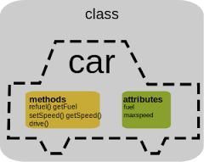
structures
Data structures in php
PHP also contains OBJECTS (remember it can also be OBJECT ORIENTED). These are denoted with “class” before them, so: <?php
class foo
{
function do_foo()
{
echo "Doing foo.";
}
}$bar = new foo;
$bar->do_foo();
Notes:
learning objectives will frame the class and give students reference points

Slide 31
Intro to php
Traversing data structures (and more)

Slide 32

To traverse:
Traversing data structures
The most common method of data traversal is the “foreach” loop
Everyone create an array of numbers as such:
$some_numbers = array(1,2,3,4,5,6)
Now let’s multiply them all by 2:
foreach ($some_numbers as &$value) {
$value = $value * 2;
}
var_dump($some_numbers);
Notes:
learning objectives will frame the class and give students reference points

Slide 33
To traverse:
Traversing data structures
You can also do “while” loops, as in “while x < 10 do y;”.
The syntax for this is:
$i = 1;
while ($i <= 10) {
echo $i++; /* the printed value would be
$i before the increment
(post-increment) */
}
Notes:
learning objectives will frame the class and give students reference points

Slide 34

Do…while
Traversing data structures
This is PHP for “DO a thing WHILE this condition is TRUE”
The syntax for this is:
do {
echo “The yankees suck!”
}
while ($phillies_win_record < .500);
Notes:
learning objectives will frame the class and give students reference points

Slide 35
Array tricks
Traversing data structures
A quick note on anything that involves counting/looping: In PHP (and in all computer programming)- the first index of a list or array is the “0” portion….
So to return “fern” in this array:
$myarray = array(“fern”, “vicki”, “wookie”)
You would do $myarray[0]
Notes:
learning objectives will frame the class and give students reference points

Slide 36

Libraries
Traversing data structures
In PHP you can import someone else’s code at will by putting “REQUIRE <library name> at the top of your code.
A library is a bunch of PHP code that some kind soul has already written for you. By requiring (or including) it you can steal it and use it in your own code in order to, for example, connect to a database (or read a csv).
Notes:
learning objectives will frame the class and give students reference points

Slide 37
frameworks
Traversing data structures
PHP has hundreds of frameworks which is just a fancy way of saying: pre-built packages with lots of useful things for organizing my code.
These frameworks include:
ZEND, Symfony, CakePHP, CodeIgnitor, magento
Basically they get you lots of cool stuff that you can then REQUIRE in your code and organizes your code in a nice, readable way.
Notes:
learning objectives will frame the class and give students reference points

Slide 38
Intro to php
LAB TIME!!

Slide 39

Summary
CONFUSED?
Good- ASK QUESTIONS!
Notes:
5m
Last time you interviewed each other about {prompt from Lesson 1}, and we ended with you deciding what the problem actually was after your research interviews.
Now we’re going to take that problem and work through some solutions.

