Slide 1
Hadoop for beginniners

Slide 2

History Of Hadoop
Hadoop was created by Doug Cutting and named after his child’s stuffed elephant (hence the logo):

Slide 3
What is Hadoop?
Hadoop is a distributed file system that works across multiple nodes (read computers).
Influenced by Google’s Map Reduce algo which breaks up data into small chunks and re-assembles it.
Think of the transporter in Star Trek- data is broken apart and re-assembled (mapped by the name node).

Slide 4
So what does a database DO?
Two things, basically:
Takes Data IN
Stores Data
Gives Data OUT
Let’s see how Hadoop tackles each of these
*Spoiler alert- it’s NOT actually a database but a distributed file system!

Slide 5
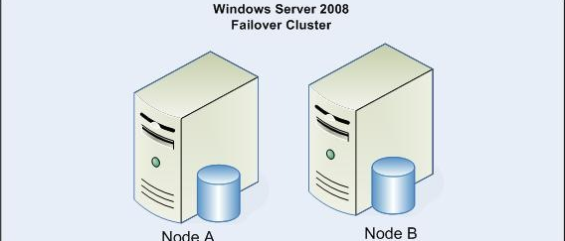
Compared to SQL

Slide 6
SQL is single master/slave focused
Most databases in the SQL family work in a table structure.
Data structure, being tabular, usually needs to stay on one node to maintain relationships.
As the size of the data grows it becomes more and more difficult to maintain table structures and relationships.
Most of the “work” is done on a single node at a time.

Slide 7
Hadoop File System
Hadoop is a file system- it utilizes multiple nodes to do most of the “work” of storing and finding items and returning them to the client.
Hadoop is like a tank- indestructible, large, and capable of working very hard BUT…
Not very fast

Slide 8

Breaking up data

Slide 9
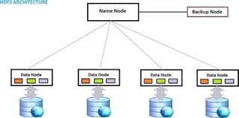
How Hadoop Distributes

Slide 10
How Hadoop stores data
Hadoop takes input from the client and breaks it up into 64k chunks (this is negotiable in settings).
Those chunks of data are then copied in triplicate (three copies- also negotiable in settings) and distributed among a cluster of nodes
The NAME NODE maps the locations of this data- it is the metadata
The NAMENODE now knows the location of each of the ripped pieces of paper

Slide 11
So let’s talk about how each part works
YARN (Yet Another Resource Negotiator): this is the resource negotiator for Hadoop. Automates resource management of workers. This is the mother brain that allocates workers. It is really a collection that owns an entire hierarchy of different processes that are happening in Hadoop.

Slide 12
Let’s look at the hierarchy
Yet Another Resource Negotiator
APPLICATIONMANAGER-> The process that kicks off the ResourceManager (known as JOBTRACKER in v2) and manages multiple applications from the client. RESOURCEMANAGER/JobTracker-> A master daemon that communicates with the client, tracks resources on the cluster, and assigns work to the NODEMANAGERS
NODEMANAGERS -> A worker daemon that launches and tracks processes spawned on worker hosts TASKMANAGERS-> These do work on each of the nodes

Slide 13
Behind the scenes…
hadoop dfs command first contacts the Namenode with the given files's details.The Namenode computes the number of blocks that the file has and splits it up.
The Namenode returns the list of chosen Datanodes for every computed block of the given file. This count of Datanodes in every list is equal to the replication factor configured in the hdfs-site.xml (it is three by default- hence three copies of everything)
Then the hadoop client starts storing every blocks of the file to the given Datanode through Hadoop Streaming.
For each block, the hadoop client just prepares the data pipe line in which all chosen Datanodes chosen to store the block are formed as a Data queue.
The hadoop client just copies the current block only to the first Datanode in the queue.
Upon completion of the copy, the first Datanode cascades the block to second Datanode in the Queue and so on.
All the block details of the files and the details of Datanodes which have the copy of them are maintained in Namenode's metadata.

Slide 14
Containers and Memory Management
So the Application Manager launches the Resourcemanager which asks for an allocates memory on each node to run tasks.
A container is basically a request to hold resources on a YARN cluster (request 8GB of RAM from client -> Node)
Once the memory is allocated the NODEMANAGER launches a task within the container

Slide 15
So think of it as an assembly line
Each portion of the file is sent to a node which assigns a key to the 64k (default) section of the file and reports back to the Job Tracker which records the key in the NameNode
Now we have a file stored in small chunks where work can be done on each chunk when we query!

Slide 16
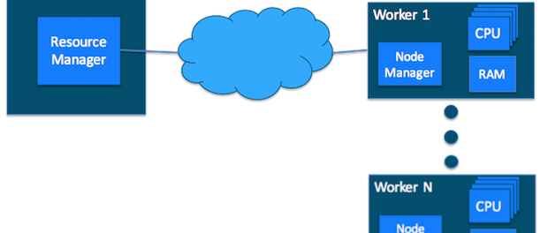
Resource Manager managing

Slide 17
Architecture
With this architecture the scalability of Hadoop is (almost) infinite. Advantages include:
When you begin to run out of space- add more nodes!
Processing large pieces of data is spread out across multiple nodes- no single worker
Horizontally scalable and because of making triple replication across nodes- very difficult to lose data (even if a node dies).
*this is a setting and can be changed

Slide 18
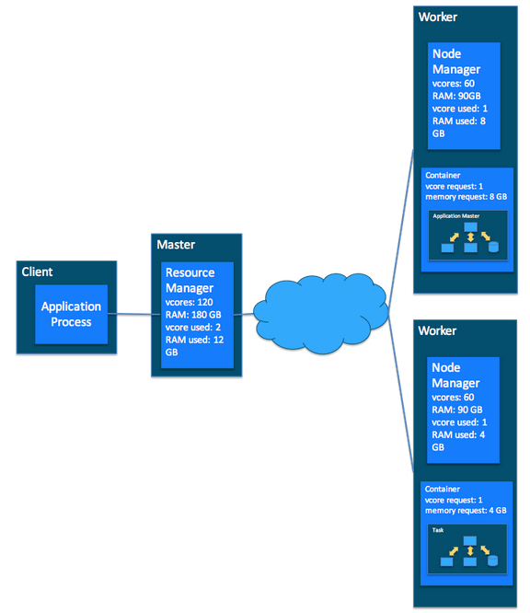
How everything ties

Slide 19
MapReduce
Mapping: The process of sending out mappers to separate nodes as unique applications to search through data to find what you are looking for. This is an application launched by YARN
*NOTE: YARN works with any application system- does NOT have to be MapReduce!
Reduction: Work done on the data found by the mappers (sum, min, max, count, upper, lower, etc)

Slide 20
MapReduce and Yarn
MapReduce and YARN work together because YARN can negotiate for each of these processes to allow the Map applications to run.
When we talk about Distributed files this is what we mean- several workers are launched and each does a tiny bit of the work across multiple nodes.
There is a “big brain” that controls these resources- this is YARN and the various managers (and the job tracker- which is a daemon run on it’s own node to track everything).

Slide 21
The Star Trek Example
Okay- so the enterprise has to explore a planet.
Captain Kirk (Client): “Spock- launch an away team!”
Spock: (JobTracker)
Scotty: ResourceManager
Sulu: ApplicationManager
Ensigns (those who live): TaskTrackers

Slide 22
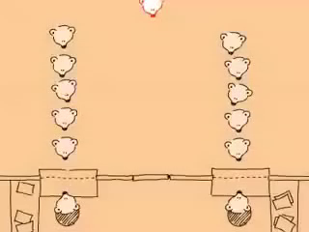

Slide 23
Let’s talk Querying
Now that we have an understanding of MapReduce let’s talk about the practical side- how do we query this stuff?
Hadoop is written in JAVA.
Querying can come in multiple forms. Most common are:
JAVA
PIG
HIVE
All of the data (pieces of notebook paper) are in key/value stores with the NameNode mapping the location of each key
Results are written to an output (or multiple output) file in a directory on the HDFS home system

Slide 24
When you query it is in HDFS
To date there isn’t really a great GUI for Hadoop…so as a result we are pretty CLI intensive.
The first thing to understand is the meaning of hdfs (HaDoop File System). This is a file structure that you access on command line by typing “hdfs -<command>”
So if you want to load a large file into Hadoop for processing it’s as simple as “hdfs –copyFromLocal <filename>.txt”
Once the file is loaded into HDFS it can be queried.

Slide 25
Java
The most basic way to query is to write a .jar file and then execute it against the Hadoop HDFS system.
Basically you inherit the “Main()” class from Hadoop and then write your mappers in a standard crawl algorithm
The Reducers are then deployed from there and usually work in a FOREACH loop
*Usually pretty impractical but great for writing UDFs. The average JAVA query usually runs around 140 lines of code.

Slide 26
HIVE
HIVE is a SQL overlay that allows Hadoop to present itself in a table format.
HQL (HIVE-SQL) are files that you can write and execute simply by typing “hive –f hive.hql” or on an interactive shell. They are basically SQL files. Utilizing command line allows us to build pretty awesome etls because we can output directly to a file and scp to wherever we want.

Slide 27
PIG
“Pig Latin”- utilizes “bags” and joins to analyze data.
Accessed by typing “PIG” into the command line with hadoop running.
Deploys map reduce jobs in the background to gather data

Slide 28
SPARK
Utilizes structures similar to dataframes that we see in “R” and Python Pandas
Creates Spark tables and context to do high level analysis (predictive, grouping, etc) on large data sets.

