Slide 1
Intro to modern analytics (and tools)
Fernando Pombeiro
Manager, BI Engineering, Fandango

Slide 2

SO WHAT BRINGS YOU HERE TONIGHT?
Introductions!
Notes:
learning objectives will frame the class and give students reference points

Slide 3
Agenda
Intro to analytics
Understand how analytics is utilized in modern business communities
Understand some of the technological tools utilized to gather data
How machine learning is taking hold
Where do we go from here
Notes:
learning objectives will frame the class and give students reference points

Slide 4
Intro to analytics
Analytics intro

Slide 5
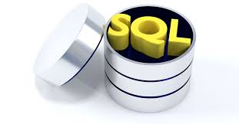
Intro to analytics
Obviously these days there are more opportunities than ever to gather data from multiple sources:
Computers/web logs
Application Program Interfaces
Web scraping
Database to database connections
Surveys
Notes:
5m
Last time you interviewed each other about {prompt from Lesson 1}, and we ended with you deciding what the problem actually was after your research interviews.
Now we’re going to take that problem and work through some solutions.

Slide 6

History of analytics
There are two types of analytics (obviously):
Statistical (“Here’s how many people visited our Facebook page!”)
Anecdotal: (“Dude! Everyone in our Facebook page is FURIOUS!”)
Generally speaking the business world is moving away from the anecdotal model and seeking to react to statistical movements in their customer bases
Notes:
5m
Last time you interviewed each other about {prompt from Lesson 1}, and we ended with you deciding what the problem actually was after your research interviews.
Now we’re going to take that problem and work through some solutions.

Slide 7

History of analytics
Anecdotal measures tend to be taken by surveys/feedback…however there are NUMEROUS shortcomings to this model:
Data arrives slowly, in small batches
Customer must be engaged
Hawthorne effect
Skewed data points from small sample sizes
Extrapolation is difficult
Notes:
5m
Last time you interviewed each other about {prompt from Lesson 1}, and we ended with you deciding what the problem actually was after your research interviews.
Now we’re going to take that problem and work through some solutions.

Slide 8
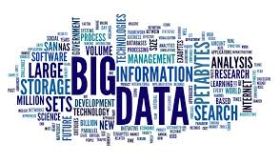
History of analytics
Statistical: We are having much more luck with this one because instead of following what the customer says we follow what the customer does….and this is a much better indicator of their true intentions (as anyone who has ever been in the dating pool knows).
The term “Big Data” is becoming very vogue out there when mentioning analytics- and this deals mostly with the statistical side of things.
Notes:
5m
Last time you interviewed each other about {prompt from Lesson 1}, and we ended with you deciding what the problem actually was after your research interviews.
Now we’re going to take that problem and work through some solutions.

Slide 9
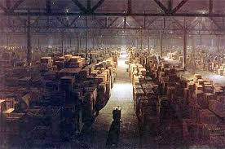
BIG DATA
BIG DATA tends to refer to high volume, high velocity data (like web logs) that we store in a giant, virtual warehouse.
Understanding BIG DATA can be broken down into the three parts that make up the entire structure:
Gathering data
Storing data
Parsing data
Notes:
5m
Last time you interviewed each other about {prompt from Lesson 1}, and we ended with you deciding what the problem actually was after your research interviews.
Now we’re going to take that problem and work through some solutions.

Slide 10
Big data
Gathering big data

Slide 11

Gathering big data
So we’ve talked about ways of gathering anecdotal data- but what are some of the ways that we gather statistical data?
Application Program Interfaces
Web Scrapers
Database searches
File Transfer Protocols
Third party vendors
Cookies
Notes:
5m
Last time you interviewed each other about {prompt from Lesson 1}, and we ended with you deciding what the problem actually was after your research interviews.
Now we’re going to take that problem and work through some solutions.

Slide 12

Application program interfaces
So an Application Program Interface is basically a way for one computer to query another for information.
Any time you go on any website, anywhere, in the entire world this is basically what is happening- your computer reaches out to the server and says “HEY! Give me some data! I want cute cat videos NOW!!” and the server does what it’s name implies- it serves them to you.
API calls are exactly the same
The server replies with exactly the data that you asked for- in a very stripped down form.
Notes:
5m
Last time you interviewed each other about {prompt from Lesson 1}, and we ended with you deciding what the problem actually was after your research interviews.
Now we’re going to take that problem and work through some solutions.

Slide 13

Web Scrapers
In the less sophisticated “the website I am curious about doesn’t have an API” world there are “web scrapers”
These pretty much do the same thing as an API but make you sift through a ton of HTML to get where you’re going.
This is obviously a far from ideal solution- but a lot of websites that offer, for example, sports scores, don’t have an API that we can hit- so programmers:
Write a program
Grab all of the HTML from the page
Throw out everything but the key metrics.
Notes:
5m
Last time you interviewed each other about {prompt from Lesson 1}, and we ended with you deciding what the problem actually was after your research interviews.
Now we’re going to take that problem and work through some solutions.

Slide 14

Database searches
Another possible way to gather data is via direct Database Searches
My company might have direct access to another company database (what they want us to see) via a login/password.
My company logs into the databse, takes what we need, and stores the data in our own database.
Notes:
5m
Last time you interviewed each other about {prompt from Lesson 1}, and we ended with you deciding what the problem actually was after your research interviews.
Now we’re going to take that problem and work through some solutions.

Slide 15

File transfer protocols
Imagine if a company just wrote down a bunch of data on a note and left it wrapped in a newspaper on a park bench at noon every third Sunday
This is basically what happens with File Transfer Protocols- where a company puts it’s data into a drop box and we pick it up and put it into our database
Think of Dropbox
Notes:
5m
Last time you interviewed each other about {prompt from Lesson 1}, and we ended with you deciding what the problem actually was after your research interviews.
Now we’re going to take that problem and work through some solutions.

Slide 16

Third party vendors
Another great source of data is Third Party Vendors who make a living selling customer data
There are several of these out there and, well- if you want to be off the grid- don’t utilize credit cards
The third party vendors frequently communicate demographic information with private companies to allow us targeted marketing
They frequently send information via either API or FTP server
Notes:
5m
Last time you interviewed each other about {prompt from Lesson 1}, and we ended with you deciding what the problem actually was after your research interviews.
Now we’re going to take that problem and work through some solutions.

Slide 17

Cookies!
Ever wonder how if you glance at a web page one minute, within three minutes you’ll see advertisements for that item on separate web pages?
Your browser most likely collects cookies which track what websites you visited
These are not always evil (cookies never are!)- they are intended for numerous other things like making sure that the website you utilize loads faster from a cache and so forth.
That being said- companies can totally see what websites you’ve been visiting which is how we can advertise to you.
Notes:
5m
Last time you interviewed each other about {prompt from Lesson 1}, and we ended with you deciding what the problem actually was after your research interviews.
Now we’re going to take that problem and work through some solutions.

Slide 18
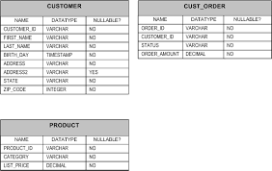
Database Structures and RANks
FOURTH in command: TABLES
FOURTH in our rank structure we get to TABLES.
SQL tables are JUST EXCEL SPREADSHEETS- think of them that way!
A SCHEMA can have multiple TABLES in it.
(Think excel WORKBOOK with several SHEETS)
Notes:
5m
Last time you interviewed each other about {prompt from Lesson 1}, and we ended with you deciding what the problem actually was after your research interviews.
Now we’re going to take that problem and work through some solutions.

Slide 19
Big data
Storing data

Slide 20

Options for storing data
So at a broad level we have numerous options for storing all of this great data that we just pulled down from numerous sources:
Excel spreadsheets
Table based Databases:
Amazon Web Services
SQL
Unstructured solutions:
Hadoop
Elastic Map Reduce
MongoDB
Notes:
5m
Last time you interviewed each other about {prompt from Lesson 1}, and we ended with you deciding what the problem actually was after your research interviews.
Now we’re going to take that problem and work through some solutions.

Slide 21

Excel spreadsheets
Advantages:
Very common industry standard
Relatively short training time
Can be customized
Disadvantages:
Holds, like, NO real amount data (~ 1 million rows)
VERY slow and cumbersome
Crashes often
Notes:
5m
Last time you interviewed each other about {prompt from Lesson 1}, and we ended with you deciding what the problem actually was after your research interviews.
Now we’re going to take that problem and work through some solutions.

Slide 22

MYSQL/MSSQL/Oracle/Vertica
Advantages:
Some (MYSQL) are cheap
Scalable and easy to manage
Excellent way to retrieve data
Disadvantages:
No visualization layer
Expensive- you need DBAs, analysts with skillz
Only good up to ~ 10 million rows
Notes:
5m
Last time you interviewed each other about {prompt from Lesson 1}, and we ended with you deciding what the problem actually was after your research interviews.
Now we’re going to take that problem and work through some solutions.

Slide 23

Types of sql databases
SQL is table based- think of excel but much more powerful!
A Relational Database Management System is just a series of excel spreadsheets that all connect to each other.
MYSQL: Open source, free, efficient to ~ 10 million rows
MSSQL: Windows based so- not open source but exceptionally flexible and good to ~ 30 million rows
POSTGRESQL: Object based- similar to the others- good to ~200 million rows.
REDSHIFT: POSTGRES based tables that really work well above 25 million rows
Notes:
5m
Last time you interviewed each other about {prompt from Lesson 1}, and we ended with you deciding what the problem actually was after your research interviews.
Now we’re going to take that problem and work through some solutions.

Slide 24
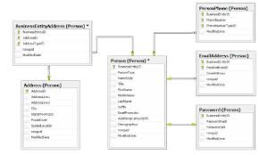
Table organization
Most companies that utilize SQL use some kind of basic and easy to understand SQL table structure
Think of excel spreadsheets that you use- one might have transactions by day and another has data about customers…
Notes:
5m
Last time you interviewed each other about {prompt from Lesson 1}, and we ended with you deciding what the problem actually was after your research interviews.
Now we’re going to take that problem and work through some solutions.

Slide 25

NOSQL solutions
Advantages:
Horizontally scalable (in theory to infinity)
AWESOME at maintaining data through a catastrophe
Need more space? Just add nodes…
Disadvantages:
Very difficult to program/traverse
Highly skilled operators so VERY expensive
Slow (at times)- can’t be used for production
Notes:
5m
Last time you interviewed each other about {prompt from Lesson 1}, and we ended with you deciding what the problem actually was after your research interviews.
Now we’re going to take that problem and work through some solutions.

Slide 26

Types of NOSQL solutions
Hadoop:
Utilizes MapReduce to traverse key-value stores
Schema-less
Made up of connected nodes
Spreads data across multiple computers- 3 times!
MongoDB:
Document based- so instead of excel sheets imagine old fashioned library cards
On each card there is data that describes objects- so you don’t have to have empty columns
Notes:
5m
Last time you interviewed each other about {prompt from Lesson 1}, and we ended with you deciding what the problem actually was after your research interviews.
Now we’re going to take that problem and work through some solutions.

Slide 27

AWS
Lately most companies have been opting for Amazon Web services- which offer both Hadoop and SQL type data storage in the cloud.
The AWS SQL solution is known as REDSHIFT- and it is based on POSTGRESQL
The AWS Unstructured (NOSQL) data solution is commonly referred to as EMR or Elastic Map Reduce
Either one of these offer cloud storage that promises security, versatility, and very low chances of lost data.
But they cost significant amounts of $$
Notes:
5m
Last time you interviewed each other about {prompt from Lesson 1}, and we ended with you deciding what the problem actually was after your research interviews.
Now we’re going to take that problem and work through some solutions.

Slide 28
Big data
Getting data out of storage

Slide 29
Understanding and aggregating data
Lately there have been numerous programs to try to help with this part of the process. Basically these act as data visualization layers:
Tableau
Periscope
Microstrategy
And there are some coding languages that help to traverse large data sets and get insights such as:
Spark
Python Pandas
R
Notes:
5m
Last time you interviewed each other about {prompt from Lesson 1}, and we ended with you deciding what the problem actually was after your research interviews.
Now we’re going to take that problem and work through some solutions.

Slide 30
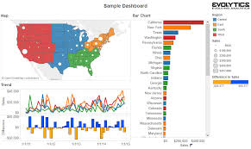
Tableau
Tableau is the most popular visualization layer
It allows users to do data aggregation on the Tableau level by loading data into POSTGRES tables (called extracts) and then visualizing them.
It also allows reports to be quickly published and users to filter for their own data. This means that data is disseminated quickly and efficiently in an organization without a ton of front e nd work.
Downside: It’s very expensive.
Notes:
5m
Last time you interviewed each other about {prompt from Lesson 1}, and we ended with you deciding what the problem actually was after your research interviews.
Now we’re going to take that problem and work through some solutions.

Slide 31
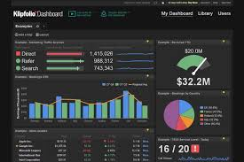
periscope
Periscope is a relatively new kid on the block
It basically takes SQL and creates visualizations in real time for the user
The user can then publish these visualizations to allow them to be disseminated throughout an organization.
Disadvantages: New and unproven and expensive
Notes:
5m
Last time you interviewed each other about {prompt from Lesson 1}, and we ended with you deciding what the problem actually was after your research interviews.
Now we’re going to take that problem and work through some solutions.

Slide 32
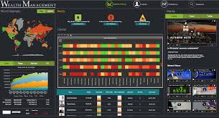
microstrategy
Microstrategy adds a visualization layer that does not require the user to know SQL
It’s a drag and drop system for reporting that can email reports, publish them, and help develop them quickly.
Disadvantages: Expensive and difficult to administer (you have to be careful how you set it up on your data warehouse)
Notes:
5m
Last time you interviewed each other about {prompt from Lesson 1}, and we ended with you deciding what the problem actually was after your research interviews.
Now we’re going to take that problem and work through some solutions.

Slide 33
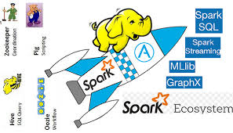
spark
Spark is primarily used for a distributed data system like HADOOP- where you have data spread out across nodes (computers)
Spark is a language that can be accessed interactively – it speeds up mapreduce by doing more in-memory computing.
Basically- the issue with Hadoop has always been that it’s slow. SPARK can work in real time.
Downside: It requires advanced (expensive) coders
Notes:
5m
Last time you interviewed each other about {prompt from Lesson 1}, and we ended with you deciding what the problem actually was after your research interviews.
Now we’re going to take that problem and work through some solutions.

Slide 34

R
R is a coding language that takes large data sets in and utilizes dataframes and series to do calculations on that data.
R allows the user to parse large amounts of streaming data to look for insights- including cohort analysis, advanced statistics, and data modeling.
Drawback: Highly skilled coders
Notes:
5m
Last time you interviewed each other about {prompt from Lesson 1}, and we ended with you deciding what the problem actually was after your research interviews.
Now we’re going to take that problem and work through some solutions.

Slide 35

Python pandas
Pandas is basically “R” for python ☺ It allows you to stream large amounts of data to a python application and then works out the data extremely quickly
It allows for advanced statistical analysis on the fly
Notes:
5m
Last time you interviewed each other about {prompt from Lesson 1}, and we ended with you deciding what the problem actually was after your research interviews.
Now we’re going to take that problem and work through some solutions.

Slide 36
Big data
Practical exercise (small scale)

Slide 37
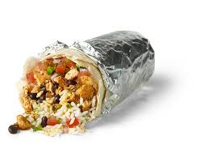
Practical exercise time
Now that we understand a lot of the modern terminology that is floating around out there (at a very broad level) we can start looking at how we can practically apply some analytics
It’s awesome and it involves Chipotle
Notes:
5m
Last time you interviewed each other about {prompt from Lesson 1}, and we ended with you deciding what the problem actually was after your research interviews.
Now we’re going to take that problem and work through some solutions.

Slide 38

Summary
CONFUSED?
Good- ASK QUESTIONS!
Notes:
5m
Last time you interviewed each other about {prompt from Lesson 1}, and we ended with you deciding what the problem actually was after your research interviews.
Now we’re going to take that problem and work through some solutions.

