Slide 1
Python for data science part 1 (and some statistics)
Fernando Pombeiro
Manager, BI Engineering, Fandango

Slide 2
Traversing data types
Review
Lists and lists of lists
Dictionaries and dictionaries of lists, dictionaries
Strings & String manipulations
Numbers and numerical manipulations
Libraries and importing modules
Hitting apis and getting information
Classes
Functional programming
Notes:
learning objectives will frame the class and give students reference points

Slide 3
Agenda
Intro to analytics
Database Overview (storing data)
Getting data from a database (practical exercise)
Introduction to a few statistical concepts (linear regression, pair plotting, training)
Notes:
learning objectives will frame the class and give students reference points

Slide 4
Python for data science
Storing data

Slide 5

Options for storing data
So at a broad level we have numerous options for storing all of this great data that we just pulled down from numerous sources:
Excel spreadsheets
Table based Databases:
Amazon Web Services
SQL
Unstructured solutions:
Hadoop
Elastic Map Reduce
MongoDB
Notes:
5m
Last time you interviewed each other about {prompt from Lesson 1}, and we ended with you deciding what the problem actually was after your research interviews.
Now we’re going to take that problem and work through some solutions.

Slide 6

Excel spreadsheets
Advantages:
Very common industry standard
Relatively short training time
Can be customized
Disadvantages:
Holds, like, NO real amount data (~ 1 million rows)
VERY slow and cumbersome
Crashes often
Notes:
5m
Last time you interviewed each other about {prompt from Lesson 1}, and we ended with you deciding what the problem actually was after your research interviews.
Now we’re going to take that problem and work through some solutions.

Slide 7

MYSQL/MSSQL/Oracle/Vertica
Advantages:
Some (MYSQL) are cheap
Scalable and easy to manage
Excellent way to retrieve data
Disadvantages:
No visualization layer
Expensive- you need DBAs, analysts with skillz
Only good up to ~ 10 million rows
Notes:
5m
Last time you interviewed each other about {prompt from Lesson 1}, and we ended with you deciding what the problem actually was after your research interviews.
Now we’re going to take that problem and work through some solutions.

Slide 8

Types of sql databases
SQL is table based- think of excel but much more powerful!
A Relational Database Management System is just a series of excel spreadsheets that all connect to each other.
MYSQL: Open source, free, efficient to ~ 10 million rows
MSSQL: Windows based so- not open source but exceptionally flexible and good to ~ 30 million rows
POSTGRESQL: Object based- similar to the others- good to ~200 million rows.
REDSHIFT: POSTGRES based tables that really work well above 25 million rows
Notes:
5m
Last time you interviewed each other about {prompt from Lesson 1}, and we ended with you deciding what the problem actually was after your research interviews.
Now we’re going to take that problem and work through some solutions.

Slide 9
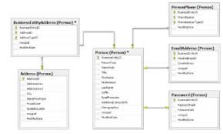
Table organization
Most companies that utilize SQL use some kind of basic and easy to understand SQL table structure
Think of excel spreadsheets that you use- one might have transactions by day and another has data about customers…
Notes:
5m
Last time you interviewed each other about {prompt from Lesson 1}, and we ended with you deciding what the problem actually was after your research interviews.
Now we’re going to take that problem and work through some solutions.

Slide 10

NOSQL solutions
Advantages:
Horizontally scalable (in theory to infinity)
AWESOME at maintaining data through a catastrophe
Need more space? Just add nodes…
Disadvantages:
Very difficult to program/traverse
Highly skilled operators so VERY expensive
Slow (at times)- can’t be used for production
Notes:
5m
Last time you interviewed each other about {prompt from Lesson 1}, and we ended with you deciding what the problem actually was after your research interviews.
Now we’re going to take that problem and work through some solutions.

Slide 11

Types of NOSQL solutions
Hadoop:
Utilizes MapReduce to traverse key-value stores
Schema-less
Made up of connected nodes
Spreads data across multiple computers- 3 times!
MongoDB:
Document based- so instead of excel sheets imagine old fashioned library cards
On each card there is data that describes objects- so you don’t have to have empty columns
Notes:
5m
Last time you interviewed each other about {prompt from Lesson 1}, and we ended with you deciding what the problem actually was after your research interviews.
Now we’re going to take that problem and work through some solutions.

Slide 12

AWS
Lately most companies have been opting for Amazon Web services- which offer both Hadoop and SQL type data storage in the cloud.
The AWS SQL solution is known as REDSHIFT- and it is based on POSTGRESQL
The AWS Unstructured (NOSQL) data solution is commonly referred to as EMR or Elastic Map Reduce
Either one of these offer cloud storage that promises security, versatility, and very low chances of lost data.
But they cost significant amounts of $$
Notes:
5m
Last time you interviewed each other about {prompt from Lesson 1}, and we ended with you deciding what the problem actually was after your research interviews.
Now we’re going to take that problem and work through some solutions.

Slide 13
Takeaways
Mostly the takeaway that I want you to have from this is that the vast majority of the data you will be dealing with is in table format.
In Python we will have dataframes, arrays, matrices, vectors- but essentially you need to keep in mind the table format.
Notes:
5m
Last time you interviewed each other about {prompt from Lesson 1}, and we ended with you deciding what the problem actually was after your research interviews.
Now we’re going to take that problem and work through some solutions.

Slide 14
Python for data science
Practical exercise: connecting to a database

Slide 15
Practical exercise.
Please refer to exercise “Connecting to a Database” as we will be connecting to a database to get data into a python dictionary.
Notes:
5m
Last time you interviewed each other about {prompt from Lesson 1}, and we ended with you deciding what the problem actually was after your research interviews.
Now we’re going to take that problem and work through some solutions.

Slide 16
Python for data science
Basic statistics for data science

Slide 17
Supervised vs unsupervised learning
A large part of data science is centered around predictive analytics.
Netflix one million dollar prize story: http://www.netflixprize.com/community/topic_1537.html
At the basic level what we’re looking to do, to start, with most data science is to build things into categories.
How do we teach a machine what makes for classical music vs punk?
At the highest level there are two basic types of categorization:
Supervised learning
Unsupervised learning
Notes:
5m
Last time you interviewed each other about {prompt from Lesson 1}, and we ended with you deciding what the problem actually was after your research interviews.
Now we’re going to take that problem and work through some solutions.

Slide 18

Supervised learning
We already know the categories
Just a matter of putting each new piece of information into the correct category:
Music can be:
Classical
Punk
Rockabilly
Reggae
…and that’s it!
Is the new information going into a known output? Then it’s supervised.
Notes:
5m
Last time you interviewed each other about {prompt from Lesson 1}, and we ended with you deciding what the problem actually was after your research interviews.
Now we’re going to take that problem and work through some solutions.

Slide 19
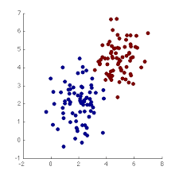

UnSupervised learning
Basically: “I have all of this data. I think it might group together somehow but I’m not really sure how…..”
Imagine taking data points and throwing them onto a scatterplot. Do they group into larger “groups”? Let’s find out!
We are not sure of outcome but we think these items will group together.
Notes:
5m
Last time you interviewed each other about {prompt from Lesson 1}, and we ended with you deciding what the problem actually was after your research interviews.
Now we’re going to take that problem and work through some solutions.

Slide 20
Overfitting and underfitting data
Data science modeling relies on getting inputs and then making generalizations about those inputs.
Imagine you had some input data that looked like this:
Age | Married | Income | Children | Nationality | Occupation | Clicked on ad?
60 | Yes | 100000 | 2 | Indian | Engineer | Yes
66 | Yes | 900000 | 1 | British | Chef | No
35 | No | 78000 | 0 | German | Travel agent | No
26 | Yes | 45000 | 0 | Kenyan | Clerk | No
81 | Yes | 100000 | 5 | Scottish | Engineer | Yes
43 | Yes | 110000 | 2 | Japanese | Teacher | Yes
Notes:
5m
Last time you interviewed each other about {prompt from Lesson 1}, and we ended with you deciding what the problem actually was after your research interviews.
Now we’re going to take that problem and work through some solutions.

Slide 21
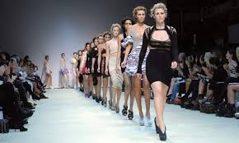
Modeling your data
The majority of data science centers around building models that, with a given input, will produce an expected output.
So this could be predictive
If I add in the last six months data then the model tells me what the next two months will look like
They could be categorical:
If I put in a movie it moves it to the correct CATEGORY based on certain aspects of that movie. So if we consider a song and the patterns of sounds we can categorize it.
This is how we get recommendation engines like Pandora.
Notes:
5m
Last time you interviewed each other about {prompt from Lesson 1}, and we ended with you deciding what the problem actually was after your research interviews.
Now we’re going to take that problem and work through some solutions.

Slide 22
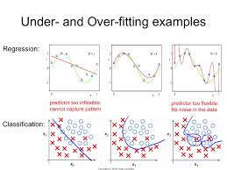
Overfitting and underfitting data
Overfitting would be to say “Only teachers over 80 with at least 100k in income and three children who are engineers click on our ads!”
Underfitting would be “everyone between 20 and 100 clicks on our ads!
Data science is about finding the sweet spot
Notes:
5m
Last time you interviewed each other about {prompt from Lesson 1}, and we ended with you deciding what the problem actually was after your research interviews.
Now we’re going to take that problem and work through some solutions.

Slide 23
regression
The data science course will teach you a lot of this but the most common form of regression is the ordinary least squares analysis.
OLS is the prevailing method; minimizes sum of squared errors
Since actual values are either above or below the “fitted” or predicted values, positive errors will cancel out negative errors.
Summing your squared errors instead gives you a better sense of the total amount of error.
Points on the line that are not present in observed data can be “inferred” to be valid
Notes:
5m
Last time you interviewed each other about {prompt from Lesson 1}, and we ended with you deciding what the problem actually was after your research interviews.
Now we’re going to take that problem and work through some solutions.

Slide 24
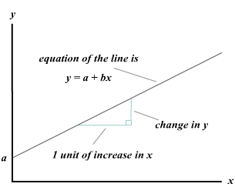
The math behind OLS Regression
y = a + bx
Calculate a and b
Notes:
5m
Last time you interviewed each other about {prompt from Lesson 1}, and we ended with you deciding what the problem actually was after your research interviews.
Now we’re going to take that problem and work through some solutions.

Slide 25
Pearson Correlation coefficient
r ranges from -1 (perfectly negative) to 1 (perfectly positive)
R^2 ranges from 0 (no relationship) to 1 (perfect relationship)
A statistical measure of model fit:
0% indicates that your model explains none of the variation in your sample
100% that it explains all of the variation.
Notes:
5m
Last time you interviewed each other about {prompt from Lesson 1}, and we ended with you deciding what the problem actually was after your research interviews.
Now we’re going to take that problem and work through some solutions.

Slide 26
Pearson Correlation coefficient
r ranges from -1 (perfectly negative) to 1 (perfectly positive)
R^2 ranges from 0 (no relationship) to 1 (perfect relationship)
A statistical measure of model fit:
0% indicates that your model explains none of the variation in your sample
100% that it explains all of the variation.
Notes:
5m
Last time you interviewed each other about {prompt from Lesson 1}, and we ended with you deciding what the problem actually was after your research interviews.
Now we’re going to take that problem and work through some solutions.

Slide 27

Pearson Correlation coefficient
Here, SS indicates “sum of squared errors”, reg is the errors predicted by your model, and tot is the total amount of error in your sample.
Read: “R-squared is the ratio of explained variance to total variance.”
Notes:
5m
Last time you interviewed each other about {prompt from Lesson 1}, and we ended with you deciding what the problem actually was after your research interviews.
Now we’re going to take that problem and work through some solutions.

Slide 28
R^2 as a measure of accuracy
“Chasing a high r-squared” is a common fallacy in model development; if you change your model to account for 100% of the variation in your sample, you are likely accounting for random error that does not exist in the larger population
As a result, it’s much more important to have a constant conversation between what makes intuitive sense and what seems mathematically significant.
Notes:
5m
Last time you interviewed each other about {prompt from Lesson 1}, and we ended with you deciding what the problem actually was after your research interviews.
Now we’re going to take that problem and work through some solutions.

Slide 29
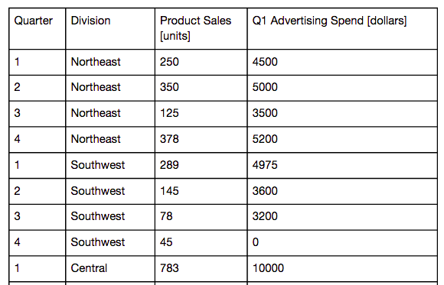
Quick demo and exercise
Take a look at the data here. Our theory is (obviously) more marketing spend = more product sales, right?
What would a “perfect” model for this look like?
Notes:
5m
Last time you interviewed each other about {prompt from Lesson 1}, and we ended with you deciding what the problem actually was after your research interviews.
Now we’re going to take that problem and work through some solutions.

Slide 30
Dependent variables
How do you choose which is your dependent variable?
Think about what variable affects the other - intuitively, advertising will result in sales - so those would respectively be x (independent) and y (dependent) axes
Often, your independent variable is something you can control, while your dependent you cannot. (This is not always the case)
Notes:
5m
Last time you interviewed each other about {prompt from Lesson 1}, and we ended with you deciding what the problem actually was after your research interviews.
Now we’re going to take that problem and work through some solutions.

Slide 31
Coefficients
What do these coefficients mean?
a - .05 in this example - For every additional dollar spent in advertising, we can expect .05 units more sold.
This can be better expressed as “for every additional 100 dollars spent, we can expect 5 more units sold”
x - 30.31 in this example - When zero dollars are spend in advertising, we can expect to sell ~30 units.
sales = .05 * ads + 30.31
Notes:
5m
Last time you interviewed each other about {prompt from Lesson 1}, and we ended with you deciding what the problem actually was after your research interviews.
Now we’re going to take that problem and work through some solutions.

Slide 32
Outliers
It’s important to have intuitive reasoning when performing an analysis of model results
Let’s brainstorm what happened in the following situations:
What happened in Southwest district in Q4? Sales with no advertising spend?
What about Central district in Q4? High advertising spend but unremarkable sales?
Notes:
5m
Last time you interviewed each other about {prompt from Lesson 1}, and we ended with you deciding what the problem actually was after your research interviews.
Now we’re going to take that problem and work through some solutions.

Slide 33
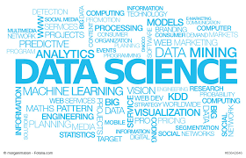
Data science methodology
You will probably notice- once you begin the data science program, that there is a method used over and over again.
The job (in DS) is generally: Build a model.
This model must be able to do a few things: 1. Guess at something based on new data (called generalization)
2. Have a portion of the data set held aside for testing (train on time example).
3. Be trained, with new data, to make predictions.
Notes:
5m
Last time you interviewed each other about {prompt from Lesson 1}, and we ended with you deciding what the problem actually was after your research interviews.
Now we’re going to take that problem and work through some solutions.

Slide 34

Summary
CONFUSED?
Good- ASK QUESTIONS!
Notes:
5m
Last time you interviewed each other about {prompt from Lesson 1}, and we ended with you deciding what the problem actually was after your research interviews.
Now we’re going to take that problem and work through some solutions.

