Slide 1
Python for data science part 2
Fernando Pombeiro
Manager, BI Engineering, Fandango

Slide 2
traversing data
Review
Lists and lists of lists
Dictionaries and dictionaries of lists, dictionaries
Strings & String manipulations
Numbers and numerical manipulations
Libraries and importing modules
Hitting apis and getting information
Classes
Functional programming
Notes:
learning objectives will frame the class and give students reference points

Slide 3
Agenda
Python for Data science 2
Introduction to numPy arrays
Introduction to Pandas DataFrames and lab
Introduction to matplotlib
A brief foray into the Data Science methodology
Notes:
learning objectives will frame the class and give students reference points

Slide 4
Python for data science
numPy

Slide 5

Numpy arrays
Python for data science 2
The basic formulation for a numPy array should look familiar (like a list of lists with “array” in front of it)
array([[ 0, 1, 2, 3, 4],
[ 5, 6, 7, 8, 9],
[10, 11, 12, 13, 14]])
Notes:
learning objectives will frame the class and give students reference points

Slide 6
Numpy arrays
Python for data science 2
NumPY arrays all have to be the same data type
They have a shape that can be accessed by calling “a.shape” which will return (in our previous example)- (3,5)- 0r “3 lists of 5 elements each”
The other thing to understand is dimensions…
Notes:
learning objectives will frame the class and give students reference points

Slide 7
Numpy arrays- Dimensions
Python for data science 2
The second (slightly confusing) thing about numPy arrays is the nDim function- which is the minimum # of dimensions to access an element.
So our example has two dimensions- one down, one across- so nDim=2
Notes:
learning objectives will frame the class and give students reference points

Slide 8
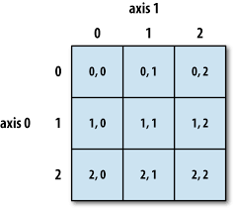
Numpy arrays- Dimensions
Python for data science 2
The second (slightly confusing) thing about numPy arrays is the nDim function- which is the minimum # of dimensions to access an element.
So our example has two dimensions- one down, one across- so nDim=2
Notes:
learning objectives will frame the class and give students reference points

Slide 9
Numpy arrays- Dimensions
Python for data science 2
Some other useful functions:
a.shape (length, width)
a.arange(10) #all numbers from 0 to 9
a.reshape(4,3) #re-arranges to 4 x 3 lists
Notes:
learning objectives will frame the class and give students reference points

Slide 10
Working with arrays
Python for data science 2
Arrays can be added to, multiplied, etc- for example if we create another array (‘b’) by doing b = np.array([1,2,3,4] then do b* a…well you’ll see what happens!
Keep this in mind as a new container (we will be working with it in the lab!)
Notes:
learning objectives will frame the class and give students reference points

Slide 11
Python for data science
dataframes

Slide 12
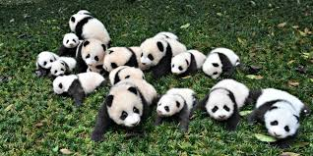
Pandas dataframes
Python for data science 2
Pandas is basically a great method for putting your data into easy-to-understand tables and rows.
The standard is to import pandas as pd and then create easy-to-use tables from which you can plot, calculate min(), max(), mean(), get stdev of each row and so much more!
Notes:
learning objectives will frame the class and give students reference points

Slide 13

Dataframes (con’t)
Python for data science 2
If you have multiple columns in Pandas you have a Dataframe. If you have one column it’s a Series.
Please open the attached ‘cheat sheet’ in this folder and keep it in your Documents folder…you will be referring to it quite a bit.
In Jupyter dataframes are printed nicely.
Notes:
learning objectives will frame the class and give students reference points

Slide 14
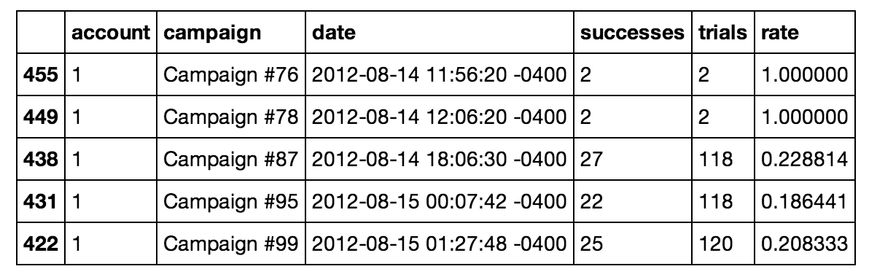
Pandas dataframe
Python for data science 2
Notes:
learning objectives will frame the class and give students reference points

Slide 15

Dataframe indexing
Python for data science 2
If you were paying close attention to the last slide you probably noticed that the first column doesn’t have a title. That is because it is the Dataframe index
The index is just a shorthand way of calling up a specific row (like list[9] calls the 10th element in a python list).
Notes:
learning objectives will frame the class and give students reference points

Slide 16

Traversing dataframes
Python for data science 2
Similar to the way that we traverse a list- if we want to get a specific column it’s: Dataframe[‘columnname’]
To get specific data you can traverse with Dataframe.iteritems OR you can call the index.
To create a dataframe you can use a list (for a series) and then a second list as an index.
Notes:
learning objectives will frame the class and give students reference points

Slide 17
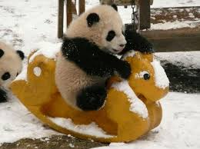
Traversing dataframes
Python for data science 2
So to create a dataframe your code would look something like this:
import pandas as pd
x_df = pd.Dataframe([100,99,188,77,888], index=[a,b,c,d,e])
So the resulting table would have the first column as a,b,c… and the data would be the second.
Notes:
learning objectives will frame the class and give students reference points

Slide 18
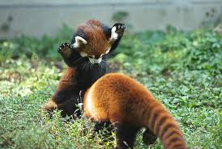
Data science dataframes
Python for data science 2
Dataframes are central to data science as they allow an easy way for us to feed data into our models.
The vast majority of data science algorithms in python are in the pandas library.
Notes:
learning objectives will frame the class and give students reference points

Slide 19
Python for data science
Matplotlib

Slide 20
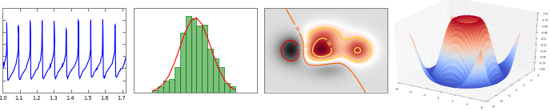
Matplotlib
Python for data science 2
Matplotlib is the python library for data visualization.
It takes python input and can be called directly from the command line.
Notes:
learning objectives will frame the class and give students reference points

Slide 21
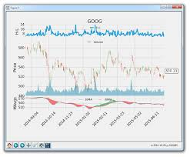
Matplotlib
Python for data science 2
We import matplotlib by saying import matplotlib as plt
There is an example of a basic chart included in this folder.
I’ve also included some others- let’s go through them.
Notes:
learning objectives will frame the class and give students reference points

Slide 22
Matplotlib
Python for data science 2
Matplotlib can also do animations and make interactive charts for the user to play with.
Both of these features are extremely advanced but figured that I’d mention.
Notes:
learning objectives will frame the class and give students reference points

Slide 23
Python for data science
Data science methodology

Slide 24

Data science
Python for data science 2
So when it comes to Data Science there is a methodology to it.
Basically most of your time will be spent building models
Some of these models will classify things (classification models). Others will predict along a timeline (regression models).
Notes:
learning objectives will frame the class and give students reference points

Slide 25

modeling
Python for data science 2
From day ONE of Data Science we will be discussing various algorithms that are build into the Pandas library that we use to build these models
These algorithms come in the form of objects.
Notes:
learning objectives will frame the class and give students reference points

Slide 26
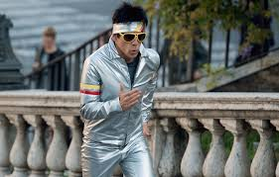
modeling
Python for data science 2
Basically what these models do is threefold:
We take an existing dataset (say…historical film performance)
We break off 25% of it and throw it aside as testing data.
The other 75% of it is kept as training data.
Notes:
learning objectives will frame the class and give students reference points

Slide 27
modeling
Python for data science 2
From here we need to train our model by teaching it with the training data
We throw that data into the model and try to build some sort of ability to predict the future based on this historic data.
If the problem is one of categorization then we build a model with a scatter plot
If it’s regression then we will usually model based on linear comparisons.
Notes:
learning objectives will frame the class and give students reference points

Slide 28
modeling
Python for data science 2
The goal of training your model is to build an idea of what you think will happen and then throw in your testing data and see if your model correctly predicts it.
We will do a quick example with iris in this lab.
Notes:
learning objectives will frame the class and give students reference points

Slide 29

Summary
CONFUSED?
Good- ASK QUESTIONS!
Notes:
5m

