Slide 1


Introduction to GoLang VMWare 20 November 2018 by Fernando Pombeiro

Slide 2
About DI
Founded in 2003; headquartered in Boulder, Colorado
Founder and CEO, Kelby Zorgdrager, has 20 years’ experience in Technical Learning and Development
More than 40,000 developers trained in 30 countries since 2003
Managed and delivered learning solutions to more than 4,000 developers globally in 2014
Over 200 different course offerings available in Open Source, Java development, web and mobile application development, cloud computing, and more

Slide 3






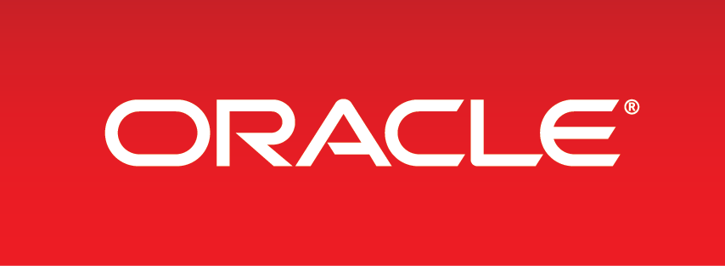









Our Customers Include

Slide 4


About the Instructor
Background: Six years military (two tours in Iraq) defusing mines followed by four years at Amazon.com in operations. Transitioned to the gaming world in 2009 as a coder.
Been coding for ~ 10 years:
LAMP stack initially
Transitioned to Python, MongoDB, ELK and GOLANG!
Introductions!

Slide 5
About the GoLang Course
In this course we will be covering Golang and how it is used in modern development/ops for large scale application environments.
We will primarily focus on the practical side of golang through six lab sessions along with some lecture portions.
At the end of the course we will have built out a containerized application using golang concepts and configurations.

Slide 6

About the GoLang Course
The course will be broken up into 5 modules. My goal is to do 2 modules a day for day one and day 2 and then for the last day- Module 5 is pretty much ALL practical.
At the end of the course we will walk through creating a web application and how to deploy it with docker.

Slide 7
Class Schedule
Class schedule:
Pretty simple: Around 2.5 hours then 20 minute break broken into three parts:
Meet n’ greet: 9 – 9:30am
Lab Setup: 9:30 to 10:30am
Break: 10:30am to 10:45am
Lecture 1: 10:45am to 12:15pm
Lunch: 12:15 to 1:15pm
Lab 1: 1:15pm to 3:45pm
Break: 3:45pm – 4pm
Lecture 2: 4pm to 5:30pm
Questions & whatnot: after 5:30pm
Breaks:
As needed. Nothing formal (we’re all adults!) but one rule: PLEASE do not return to your workstations and start “doing email” or I will NEVER SEE YOU AGAIN!

Slide 8

Lab Setup (Please see LAB SETUP in Github)

Slide 9
Module One: The Philosophy and History behind GoLang Basic structure

Slide 10

Introduction to GoLang (History)
GoLang is a programming language designed by three Google engineers named
Robert Griesemer
Rob Pike
Ken Thompson

Slide 11

Introduction to GoLang (History)
GOLANG is…
Statically typed- meaning that type checking is done at compile time (this is to perform bugs). So you have to declare type (string, float, decimal, int, etc) when you declare a variable. This is different from Python, PHP, etc
Compiled: As oppose to interpreted- meaning that compilers take the data that you put in to the program and make binaries out of it.

Slide 12
Introduction to Golang (Philosophy)
Go was born out of a frustration (at Google) with existing languages
It came about at a time when C++, C, or Java were the primary languages available.
When dealing with things like concurrency programmers were forced to choose either:
Efficient compilation (close enough to bare metal to compile efficiently)
Efficient execution (fast)
Ease of programming (easily typed
Go is designed to address all of these

Slide 13

Introduction to Golang (Philosophy)
Go is designed to give you the ease of python with the type safety and efficiency of languages like C and C++.
The primary concern of the design is to reduce clutter and complexity in the design:
No header files (no need to create a file containing function definitions before you…define the function)
No forward declarations (no need to define the function before, well….defining the function)

Slide 14
Introduction to Golang (Philosophy)
The philosophy here is several fold:
Quick Builds: There is an apocryphal story that GO was conceived of during a 45 minute build
Dependency Control: We’ll get into this later- but at Google, thanks to a lack of dependency control, builds were taking 45 minutes
Duplication of effort
Cost of updates
Concurrency and multi-processing must be built in

Slide 15
Introduction to Golang (Philosophy)
The syntax of Golang seeks to reduce typing.
Very light on restricted terms and keywords.
No “stuttering”…so none of this garbage:
foo.Foo* myFoo = new(foo.Foo)
Everything is declared exactly once (so no .h files)

Slide 16

Introduction to Golang (Philosophy)
Final rule: There is no type hierarchy.
Types just “are”- they don’t have to announce their relationships…so parent objects and “type Honda INHERETS FROM object Car…” isn’t a thing.
No more superclasses (Kind of no classes at all, actually!)

Slide 17

Introduction to Golang (Philosophy)
Golang has an extensive library called runtime that does stuff like:
Garbage Collection (clean up unused objects and anything taking up memory)
Concurrency (GoRoutines- which we’ll get in to later)
Stack management
Much more…
For Java folks out there- there is no Golang Virtual Machine

Slide 18
What does go NOT have? (and why)
Assertions: To be honest- I find these super useful too…but the makers of GO felt that they can be used as an error handling crutch so when we want to say “assert a = type int” it frequently becomes a way for programmers to avoid proper error handling.
Generics: This one will drive you crazy!!! And it’s the number one issue that I hear coders complain about with regards to Golang! But again- the philosophy of Go at it’s conception was scalability, readability, and concurrency. Polymorphic programming is not included in there…though they are talking about adding it.

Slide 19

What does go NOT have? (and why)
Exceptions: So no try-catch-finally here. Why? The designers felt that it leads to convoluted code. You’ll see this again and again (as with assertions)- Go wants you to DEAL with your exceptions- not breeze past them. Instead Go uses several different methods to handle exception cases, including Defer, Panic and Recover.
Atomic Map operations: So this one is fairly scary (it was for me) when doing complex multi-threaded operations. Basically- if you are hitting a map to auto-increment with multiple threads you *might* crash the program– or decrement when you mean to increment- but the designers decided on speed over safety in this case.

Slide 20
What does go NOT have? (and why)
Object Orientation (or Objects at ALL….sort of): So as stated before- Go has no type hierarchy in which a child inherits from a parent object.. Go uses something called structs which we will address shortly. That being said (and remember this): INTERFACES DO exist in Go!! We’ll also be discussing that shortly.
Method Overloading: Because seriously- method overloading is a stupid, confusing, and utterly unnecessary way to code. Fight me.

Slide 21

What does go NOT have? (and why)
Implicit numeric conversions: This one can be a PITA- int64 is distinct from int in Go and mixing these up will not result in implicit conversions…it’ll just break your stuff. Again, though- SPEED is the concern here and keeping tight static control of types is paramount in Go. That being said- constants in Go go a long way towards ameliorating this issue.
Variant types: Basically this would provide a way to say “a variable may be any of these three types but ONLY these three types”. Nope. Speed.

Slide 22
So what does Go ACTUALLY HAVE?
DEPENDENCY CONTROL:
Let’s take a quick look at how we import a package:
import “encoding/json”
Here’s the thing with Go: If you don’t use that dependency in the package that you are importing it in to you get an error at compile time.
Not a warning…an error. This is to force you to manage your dependencies and keep your compile time low.
Here’s a sample:
package A imports package B;
package B imports package C;
package A does not import package C
Files are read only once! So first C is compiled, then B is compiled, then A is compiled…then linked.
Package A will read the file for B EXACTLY ONCE.

Slide 23
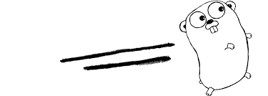
So what does Go ACTUALLY HAVE?
Packages:
These are designed for simplicity and ease of understanding!
Every file starts with a package clause, for example:
package json
…will be at the top of the file. Keep these simple and straightforward!
Packages can be imported by their path (as in python, javascript, etc)
Package import/export is decided within the name of the package depending on whether or not the first letter is capitalized…so:
struct Fernisawesome will be exported (public) while
struct fernisawesome will only be used within the package

Slide 24
So what does Go ACTUALLY HAVE?
Scope:
SIMPLICITY is the name of the game here…so as with everything else- scoping in Golang is built for simplicity:
universe (predeclared identifiers such as int and string)
package (all the source files of a package live at the same scope)
file (for package import renames only; not very important in practice)
function (the usual)
block (the usual)
There is no implicit or EXPLICIT this…so if you have a struct called “luke” as a receiver of output from a function it is always written as: “luke.ReceivesFromTheForce”
Again- because Satan designed method overloading and he has not accessed Go- “x.M” always refers to a single function “M” in ”x”

Slide 25

So what does Go ACTUALLY HAVE?
Concurrency:
This is a big one in the Go world- at the language level Java and C lack in-built concurrency…which hurts them in the modern multi-core processing world. GO embodies a variant of Communicating Sequential Processes (CSP) with first class channels.
Go is not memory-safe in the presence of concurrency- sharing is legal and you can pass a pointer over a channel. This can lead to some bad practices BUT the philosophy here is "Don't communicate by sharing memory, share memory by communicating."
GOROUTINES- are how Go handles concurrency- it multiplexes independently executing functions into a set of threads.
We’ll go much deeper into this later ☺

Slide 26
So what does Go ACTUALLY HAVE?
Garbage collection
Obviously this is a vast improvement of C/C++ where managing garbage collection can hinder the speed at which you can program.
Go DOES do automatic garbage collection but for the purposes of this program we will not be messing with memory allocation.
That being said- if you want to mess with memory management (and garbage collection yourself) GO does allow you to, to some degree, go “under the hood” to mess with that stuff.

Slide 27
So what does Go ACTUALLY HAVE?
Composition…. NOT Inheritance
As addressed earlier- GOLANG doesn’t have a “type hierarchy”…i.e: there are no “super” objects and children.
Inheritance? Not so much a thing here.
Types just “are”
This is going to be tough for my Object Oriented programmers out there to adapt to!
The philosophical ideal behind this decision has to do with the need for object-oriented programs to over-design during the initial design phase…. Due to the tight inheritance relationships between objects programmers must design high level objects sufficiently abstract to handle any case that the code might be used for.

Slide 28

So what does Go ACTUALLY HAVE?
Composition…. NOT Inheritance (continued)
The creators of Go felt (and I agree) that polymorphism created more problems than it helped with and that it would be nicer to have a statically defined interface that enforces a uniformity of behavior of a method.
This is part of the “define once” philosophy (and keep it simple).

Slide 29

So what does Go ACTUALLY HAVE?
Composition…. NOT Inheritance (continued)
To get around the loss of ability to use inheritance, Go instead utilizes interfaces (we’ll get more into this later).
Interfaces in GO do not use the “implements” name but “implementing” methods is what they do! They allow us a level of abstraction to implement methods.

Slide 30
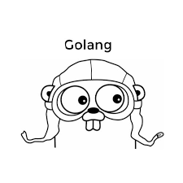
So what does Go ACTUALLY HAVE?
Error handling:
No control structure when handling errors: an error IS or it isn’t.
If an error IS- GO does NOT allow you to pass it up the stack; it uses a very basic “if-return” syntax…
So no JAVA/Python/Javascript “try-catch-finally” here!
Basically- if you go to open a file and it isn’t there- here is Go’s error construct:
f, err := os.Open(fileName)
if err != nil {
return err
}

Slide 31

SUMMARY OF Philosophy
To summarize: GOLANG is designed to do the following:
Clear dependencies
Clear syntax
Clear semantics
Composition over inheritance
Simplicity provided by the programming model (garbage collection, concurrency)
Easy tooling (the go tool, gofmt, godoc, gofix)

Slide 32

Questions on Philosophy?

Slide 33
Module One: The Philosophy and History behind GoLang

Slide 34
Golang Setup (follow along)
Workspaces
At it’s most fundamental and basic a Go workspace is made up of two folders:
bin/ - this will contain the binary versions of the files you build in Go
src/ - this will contain your source code.
For most GO coders- they will only utilize a single workspace for all of their GO projects. Most of the code that YOU touch will go into the src directory.
The bin directory will contain the binary files you compile and deploy- which makes your code blazingly fast. These are the executable files.

Slide 35

Golang Setup (follow along)
Structure within the workspace
/go/src/github.com/
One level down from the top-level src folder will be a github.com folder. This is going to be the root level directory for your repositories (make it in the vm)
So the “github.com” folder we want to initialize the metadata for the git repo…so here is where we’ll run our git init command.
So this folder will have a series of sub-folders and (and this is essential)- if you manage this folder correctly then each of the sub-folders in the github.com folder will represent it’s own repository.
So when you want to push data to a repo- from here.

Slide 36
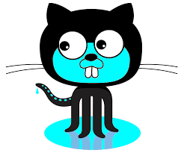
Golang Setup (follow along)
Structure within the workspace
/go/src/github.com/golang_practice
So now we have created our first repository (golang practice). If you want to push this repo there’s a BUNCH of stuff you need to do (but feel free to do it- there’s a link in the lab section)
So if you wanted to create multiple repositories for different projects and upload each of them as a different repository to your github account- now you can just add them…so for this we have golang_practice….but you might also want /go/src/github.com/fern_is_awesome and go there and do a git init…and a /go/src/github.com/here_is_another_one

Slide 37
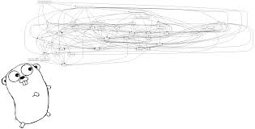
Golang Setup (follow along)
Structure within the workspace
/go/src/github.com/golang_practice/cmd
So from here I’m doing personal recommendations but this is what I’ve found works well.
The cmd folder is going to, basically, contain the “main” files (main.go) for our repo. It’s kind of the highest level of the repository and will house where we put the “MAIN” file that kicks off everything else.
Very little code should actually live here!!!
The code in here should import other packages that end up doing the majority of the work of the application (we’ll talk more about the MAIN file later).
So MAIN basically calls each of the other packages and puts them in order.

Slide 38

Golang Setup (follow along)
Structure within the workspace
/go/src/github.com/golang_practice/internal/
This is where we are going to put the packages we are going to use internally (duh!).
This is where 90% of our *actual* coding will be done.
Basically the idea is that this is where you keep your private application code – the packages that you want to keep for your application to use. These are not, generally, understood as being “open to the public” for export.
So if I create a package that, for example, reverses the letters in word, and wanted to use that in another package within the application this is where I’d put it.

Slide 39
Golang Setup (follow along)
Structure within the workspace
/go/src/github.com/golang_practice/pkg/
This is where we will stick our public packages (notice that we no longer have an “internal” directory in there.
These are the packages that others can download with go get (which we’ll talk about shortly).
This is also where you will put any code that you are happy for the public to use so please make sure that it works!

Slide 40

Golang Setup (follow along)
Structure within the workspace
/go/src/github.com/golang_practice/vendor/
A lot of us are used to using package dependency programs like requirements.txt (python) or package.lock and then running a simple npm init or pip install –r requirements.txt to load our dependencies.
Golang is relatively new and package management hasn’t been completely figured out yet…but right now the leader in package management is, by far, dep.
Anyways- WHEN you get dependencies- you’ll stick them in vendor. The dependency manager dep knows to look in this folder and load those dependencies for the program to work.

Slide 41

Golang Setup (follow along)
Structure within the workspace
/go/src/github.com/golang_practice/vendor/
A lot of us are used to using package dependency programs like requirements.txt (python) or package.lock and then running a simple npm init or pip install –r requirements.txt to load our dependencies.
Golang is relatively new and package management hasn’t been completely figured out yet…but right now the leader in package management is, by far, dep.
Anyways- WHEN you get dependencies- you’ll stick them in vendor. The dependency manager dep knows to look in this folder and load those dependencies for the program to work.
So you’ll basically, with dep, and the package list in vendor, be able to load dependencies looking at this folder.

Slide 42

Golang Setup (follow along)
Other possible directories:
/go/src/github.com/golang_practice/api/
If you have an API you can put rules here (NA for this project)
/go/src/github.com/golang_practice/web
If we want to make a website server in goLang we’ll put things like our static web assets, templates, etc in here.
/go/src/github.com/golang_practice/configs
Config files go here- so passwords, json files, vault files, etc
/go/src/github.com/golang_practice/init
Your init scripts- like supervisord or runit
/go/src/github.com/golang_practice/scripts
Basically- Makefile scripts and the like
/go/src/github.com/golang_practice/build
Docker, AMI, OS (deb, rpm, pkg) and ci scripts (in a ci subdirectory)
/go/src/github.com/golang_practice/deployments
Docker-compose.yml, kubernetes, helm, etc…

Slide 43
Golang Setup (follow along)
Other possible directories:
/go/src/github.com/golang_practice/test
Tests (duh)
/go/src/github.com/golang_practice/docs
Design and user docs (READMEs)
/go/src/github.com/golang_practice/tools
Supporting tools (can import from /pkg and internal)
/go/src/github.com/golang_practice/examples
HOW Tos
/go/src/github.com/golang_practice/assets
Images, logos, etc

Slide 44
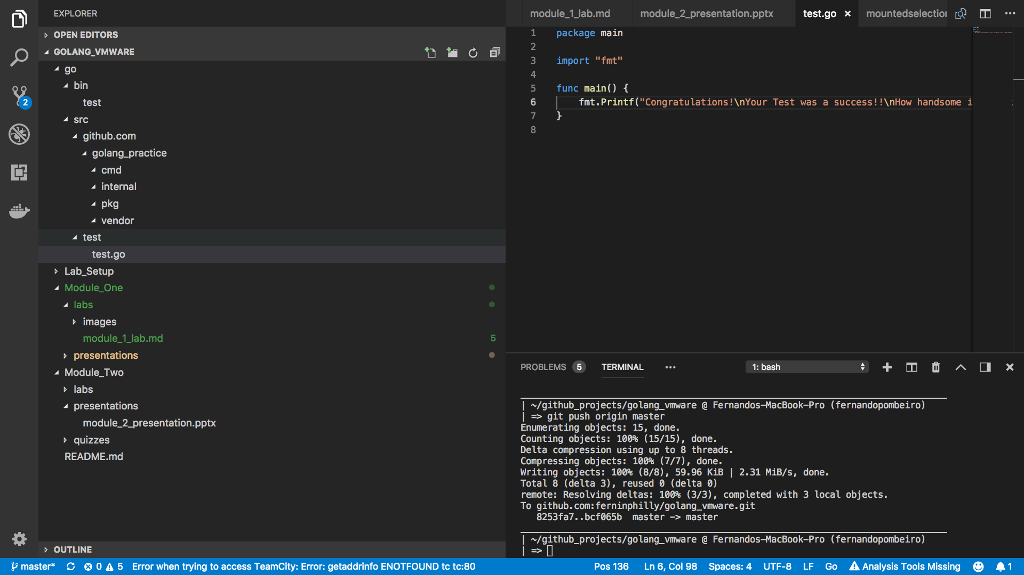
Golang Setup
Congratulations! We now have our setup done! If you have followed the instructions your directory structure within your vm should look something like this:

Slide 45

Golang Playground
So now that we have created our directory structure let’s put it aside for a moment. Why?
Well- as many of you probably realize- coding is painful without some sort of CLI (Command Line Interface) to work with.
In Python we have great programs like typing “python” into your command line (or pip install ipython and then typing “ipython” into your CLI).
In Node.js we have great programs like node or nesh which give us awesome command line interfaces to test our code before we push it.
So how do we do this in GOLANG?

Slide 46
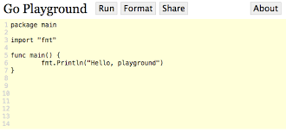
Golang Playground
Before we dive deep into creating GO projects we need a fun environment in which to test our code before we drive it! Usually CLIs fill this role (and there are golang CLIs out there!)
With GO- navigate here: https://play.golang.org/
Usually, as a coder, when I need to test something this is the first location I head to. It’s a nice little testing area and because of the easy “share” feature at the top- I can instantly create a link

Slide 47

Golang Playground
Now- there ARE huge drawbacks to the GO playground in it’s current implementation. They include the following:
The big one is no third party package imports which REALLY cripples it (it’s nice in Python that I can simply run pip install whatever then go into my command line and import whatever).
There are time and memory limits set up on it.
The time begins at 2009-11-10 23:00:00 UTC…which is just really weird.
That being said- it’s nice to be an instructor and know that all of my students (for the practical portion) are on the same gui (basically).

Slide 48

Golang Playground
All of this being said- this is what we’re going to use going forward for most of our intro coding!
We are now set up and ready to ”go!”
ANY QUESTIONS?!?

Slide 49

REVIEW
GO is a statically typed, compiled language developed at GOOGLE
GO depends on type safety so no generics
GO has No Type Hierarchy
GO uses structs instead of objects and interfaces to fake a type hierarchy
GO uses a workspace that contains multiple packages

Slide 50

REVIEW
A GO workspace has two main folders:
src/ - where we keep uncompiled code and
bin/ - where we keep our binaries
We have set up a directory structure under the main workspace that includes things like internal, cmd, pkg, github.com
The GOPATH variable will determine where you put packages from go get

Slide 51

QUIZ
Where should I put the main.go package?
How do I set up a new package within my workspace with git?
How can I manipulate where my go get command line sends my packages?
How do I run basic code?
How do I build a binary?

