Slide 1


Introduction to GoLang VMWare 20 November – 22 November 2018 by Fernando Pombeiro

Slide 2
Module TWO: Primitive types, Data Structures, and functions

Slide 3

Welcome to Coding!
package main
So, obviously the MAIN package- which is where we will start our code from (goes in the cmd folder).
When we want to run our package we will go to the cli and run go run main.go.
IF we want to run a different package THIS is the namespace
packages reduces the chance of having overlapping names. This keeps our function names short and succinct
packages organize code so that its easier to find code you want to reuse
packages speed up the compiler by only requiring recompilation of smaller chunks of a program. Although we use the package fmt, we don't have to recompile it every time we change our program.

Slide 4
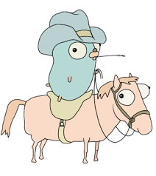
Welcome to Coding!
import ( “fmt” )
This is the way we import all packages- whether they be local or downloaded- so a namespace could also be brought in this way.
Note the DOUBLE QUOTES
In this case we are importing a package called “fmt”- which is short for “format” (I might be making that up).
It is basically similar to C’s printf and scanf
We will be playing with this a lot in string manipulation.

Slide 5
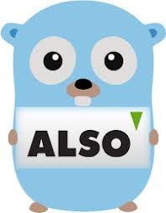
Welcome to Coding!
func main () {}
Function structure- uses brackets to bracket the function.
The main function is special (you don’t have to name the return data type- though normally you would).
This is where, when you are done with your application, you will kick it off from. go run main.go tests your entire application.

Slide 6
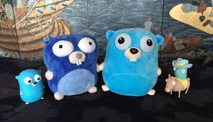
Welcome to Coding!
fmt.Println(“Hello, playground”)
Obviously this is using the “fmt” package an running a function called “Println”.
How can I find out more about “Println”?

Slide 7
Welcome to Coding!
Go to your command line and run the following:
godoc fmt Println
How amazing is that?
godoc is a way for you to double check how a function works!

Slide 8
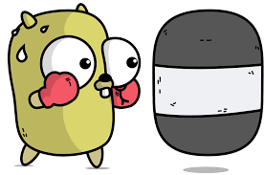
Golang Setup (command line commands)
Now that we’re set up let’s go over some of the command line commands with go. Let’s go over the most important ones to start with:
go get
This is the package manager- basically the equivalent of pip install or npm install. Let’s “go get” a package.
Note that “go get” is using your $GOPATH to place the file in it’s correct location (notice how the “src/github.com/” lined up?)
Now let’s try importing it! To do that we need to create a “main.go” file somewhere.
WHERE should we put that main.go file??

Slide 9
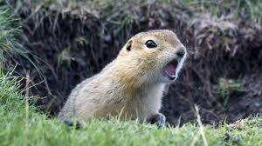
Golang Setup (command line commands)
“But what if I don’t like the current setup of my Go development environment?!?
So everything that go get uses to decide where to put the packages that it downloads is based on your $GOPATH variable.
SO- if you are unhappy with where the packages are being put- simply update the variable for your current session using the export GOPATH=$HOME/src/<myNewPath> and then you should be good to go!
Under our current setup, however, all packages that we download will go into go/src/github.com folder.

Slide 10

Golang Primitive types
Primitive Types
Go has three primitive types that are going to be familiar to anyone with other coding experience:
Boolean types
Numeric types
int int8 int16 int32 int64 uint uint8 uint16 uint32 uint64 uintptr
Bytes, runes (int32), float32/64 complex64/128
Strings
Creating these is as simple as declaring a variable. Let’s create one of each in the go playground (see the lab)
Pay attention to the SCOPE of the variables here!

Slide 11

Golang Variable scope
Variables can be declared with initializers- which is when we use the var keyword to declare the variable. We can also initialize empty variables (think of let in node.js)- which will default to minimum vals dependent on type.
Variables can also have their types implicitly declared with var variable = (“” for string, 0 for int, etc…) OR you can explicitly declare the type at definition (i.e:
var notanint string = "0)"

Slide 12

Golang Variable scope
Finally- within functions only we can use the “:=“ symbol as a short variable declaration. It implicitly declares var type, so:
func main() {
myname := “Fernando”
fmt.Println(myname)
}
will work but:
myname := “Fernando”
func main() {
fmt.Println(myname)
}
will fail

Slide 13
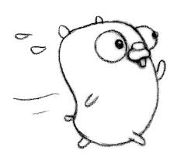
Golang String replacement
Golang uses similar string replacement to most bash or old python methods (with some slight differences). Follow along in step 5 of the lab to see how this works.
The next slide will run through each of the replacement values in a golang fmt.Println

Slide 14
Golang String Replacements
General
%v is the value in a default format when printing structs, the plus flag (%+v) adds field names %#v a Go-syntax representation of the value
%T a Go-syntax representation of the type of the value
%% a literal percent sign; consumes no value
Integer
%b base 2
%c the character represented by the corresponding Unicode code point
%d base 10
%o base 8
%q a single-quoted character literal safely escaped with Go syntax.
%x base 16, with lower-case letters for a-f
%X base 16, with upper-case letters for A-F
%U Unicode format: U+1234; same as "U+%04X"

Slide 15

Golang String Replacements
String
%s the uninterpreted bytes of the string or slice
%q a double-quoted string safely escaped with Go syntax
%x base 16, lower-case, two characters per byte
%X base 16, upper-case, two characters per byte
There are more of these but realistically- you will use %v and %T MOST of the time (especially when you want to print out structs)

Slide 16

Casting in Golang
Casting in Golang follows the same pattern as most other languages- where T is the type that you want to cast the variable to:
T(v) will convert value “v” to type “T”. SO:
str(0) becomes “0”
int(3.1415) evaluates to 3
…and so on. You can use float, integer, Boolean, etc

Slide 17

Constants
Just as in other languages that you (probably) have used- constants are just what the name implies. They are declared with the const keyword.
You cannot change constants (obviously) and you cannot declare them implicitly for obvious reasons…so
const a := “WillNotWork” will not work.

Slide 18
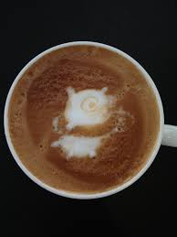
The REFLECT package
Before we continue on it’s worth going into the REFLECT package a bit since every go program that I have ever written (or seen) that is more than 100 lines usually needs to use REFLECTION.
Why? NO GENERICS (told you this kind of sucks!)
So the easiest way around this is the reflect package which we will sample in the lab

Slide 19

Golang: Functions
Functions in Go take ZERO or more arguments.
For the inputs you must declare the type
You must also declare a type for the outputs (like in Java)
The layout is
func <function name> (<input> <inputtype>) <return type if any> {
var := something
return var
}

Slide 20

Golang: Functions
Functions can return as many values as you’d like (similar to Python)- which you can then return
func swap(x, y string) (string, string) {
return y, x
}
func main() {
a, b := swap("hello", "world")
fmt.Println(a, b)
}

Slide 21
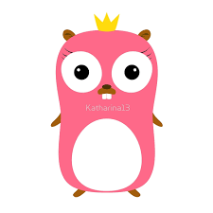
Golang: Functions- Naked returns
Golang has a weird feature called “naked returns”- which is when a return statement is run without arguments.
Do not use this
…but you should know that it exists ☺

Slide 22
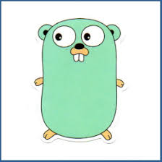
Golang: Functions- Variadic functions
Golang supports variadic inputs to the functions (like the **args or **kwargs keywords in python)
You still need to declare the type (remember that Golang is strictly typed).
In Go a variadic function is declared with the … declared before the type declaration in the function input

Slide 23

Golang: Functions- a few more notes
Similar to one of the best things about Node/Javascript- Functions in go can be passed around just like any other value. This means that we can return anonymous functions which can form closures
When you return a function you use the keywords for both the function and the return from that function
package main
import "fmt"
func intSeq() func() int {
i := 0
return func() int {
i++
return i
}
}

Slide 24

Golang: Functions- The INIT() function
Like the python __init__ function that can be used to initialize an object, the golang init() function can be utilized to do things like inititalize variables, set up some form of state for the package, initialize database connections, etc.
UNLIKE the python __init__ function, the golang init is called only once. This is nice if you have, say, a database connection that is needed in multiple packages in a complex production environment. You can import the database package multiple times but only connect to the DB once.

Slide 25
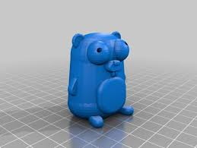
Golang functions: Recursion
Recursion in Golang works just like in other languages- functions *can* call themselves.
If anyone does tech interviews- there is always a recursion function in the questions somewhere!
Pretty straightforward on this one…

Slide 26

Built in Functions
Golang comes with a series of built in functions that can be called without the need for importing them at the top of the function.
We’re going to go through quite a few of the most common built-in functions that will come in handy for you.

Slide 27

Golang Functions: Defer, panic, Recover
defer(): basically schedules a function call to be run after the first one. Usually this one is used for things like opening and closing files (i.e: “Open the file, defer closing until after we DOATHING”)
panic(): This is basically an error handler to return exit code 1. It should be called in two situations only:
An unrecoverable error where the program cannot continue it’s execution (i.e: Failure to bind to a required port by a webserver)
A programmer error
Important note about a panic: execution is stopped BUT- any deferred functions are executed and then the call returns to the caller.

Slide 28

Golang Functions: Recover()
recover(): A built-in function used to regain control of a panicking goroutine. It is only useful when called inside a deferred function. This is how you stop a panicking function by returning to normal execution and retrieving the error value that was passed that called the panic().

Slide 29

Golang functions: Error Handling
error() is another built in function that you’ll be using a lot. The two common methods for handling errors in GO are:
multiple return values
f, err := os.Open("filename.ext")
if err != nil {
log.fatal(err)
}
panic()- which we just went over.
Notice that with the error the order of multiple returns that is standard is value, ERROR- which is stupid- but a convention.

Slide 30
Error Handling- making our own
So- GO is not as advanced as a lot of languages on the error handling front. This means that you might have to create your own error handling methods.
For most standard go functions look like this:
func f1(arg int) (int, error) {
if arg == 42 {
return -1, errors.New("can't work with 42")
}
return arg + 3, nil
}

Slide 31
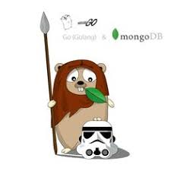
Golang: Error handling
So again- in error handling in Golang the error is passed FIRST. In a function where there is no default return value (a void in Java) you pass just the error, i.e: err := json.Unmarshal(jsonData, &basket)
(if you are curious- that json function unmarshal’s data into a basket type via pointer)

Slide 32
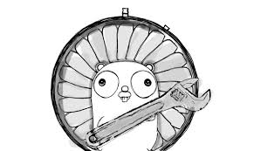
Go Error Handling
Finally- there is a standard way to ignore errors- though I would strongly recommend against using it (or using it sparingly)
In GO the “_” variable is basically the equivalent of sending the output from a function to dev/null… into the ether. SO, to ignore an error:
var whatIwant, _ := fnthatreturnsathing()

Slide 33
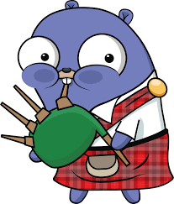
Calling Golang Functions
Remember that Golang doesn’t have type hierarchy. Just as we can declare var in the outer scope of a go package (outside a function) we can also declare functions with the type keyword.
In the lab please note how the type is being called. You can pass functions around just like anything else!

Slide 34
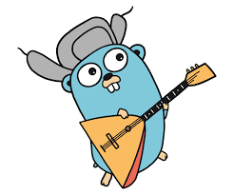
BREAK TIME!!
Take fifteen! We have completed a sub-section!

Slide 35

GO Data Structures
There are Five basic data structures that every Go developer needs:
Array
Slice
Map
Struct
Interface

Slide 36

Arrays in GO
Generally the *right* way to do arrays is to declare the number of indexes that you’ll need:
var newArr [4]int will make a 4 index empty array
newArr[0] = 2 will assign the number “2” to the front of the array

Slide 37

Arrays in GO (continued)
First off- yes- you need to declare the length of arrays
That being said- they can be of ANY data type- so:
var BestMoviesEver = []string{“Troll 2”, “Samurai Cop”, “Manos: Hands of Fate”, “Ballistic: Ecks vs Sever”}

Slide 38

Arrays in GO: A couple more things…
Arrays can only be of a single data type
Yes- Arrays have to have an index range declared when they are initialized. You can’t have a dynamically sized array.
You can have a dynamically sized slice- which we’ll get to in a minute.

Slide 39

Slices In GO
At a first look- SLICES look the same as they do in most languages (Java, javascript, python)- you can pull a range from an array:
chars := []string{ “Torgo”, “Master”, “Debbie”, “Michael”, “Margaret”}
family := chars[2:5]

Slide 40
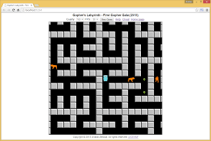
Slices- a couple more notes
So- something else to know about slices:
When they come from Pre- created arrays you cannot extend the length of the array. They are reference types- they refer to an underlying array so modifying the elements of a slice will modify the corresponding elements in the referenced array.
IF you modify in a slice then other slices that refer to that same array will see those changes.

Slide 41

Slices as Dynamic Arrays
You can use the make built-in function to create a slice that will generate whatever length you like-– so, for example, if you have an api hit that returns a various length JSON list you can use the MAKE to create the proper size GO array:
a := len(someJSONlist)
b := make([]string, a)
// THIS creates an array of “a” size…so the last element will be b[a]

Slide 42

Maps in GO
Dictionaries in python. OBJECTS in node. Maps in GO.
Maps are hash table implementations
map[KeyType]ValueType
Use the “make” built in function to create maps. Remember- the original initialization is ”nil”

Slide 43

Maps in GO (continued)
As with other data types, maps can be sub maps, sub-sub maps, and maps of lists.
Again- you can *make* maps with the make built-in function so: make(map[string]map[int]bool)

Slide 44

Structs in GO
There are no OBJECTS in GO…
Instead we have STRUCTS (structures)
GO are typed collections of fields. They are useful for grouping data together to form records. SO- whereas where you might use an object in python- in GO we do:
type person struct {
name string
age int
}

Slide 45

Structs in Go
Think of structs are like the abstract object definition
To instantiate we just use struct_name(inputs)…so:
person{ “name”: ”Mark”, ”age”: 20 }
or
person{“name”: “Lisa”, 23 } //Note that we don’t need the index
or
a := person{“name”: “Johnny”, age: “Unknown” }
fmt.Println(”How old is Johnny?”, a.age)

Slide 46
Structs in Go (continued)
As with other items- structs can contain other structs and any data type. They can even contain functions (as you will see in your lab)

Slide 47

Go Structs (continued some more)
So you might be thinking “Yeah- well if structs are basically OBJECTS- how do I run FUNCTIONS against them?!?”
Glad you asked! Let’s take a quick look at how to reference a struct!

Slide 48
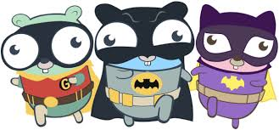
Go Structs some more
We have functions work on structs using receiver functions that point back to our structs
Consider a “rect” struct with a width and height:
type rect struct {
width, height int
}
Now we want to be able to get the area of that rectangle:
func (r rect) perim() int {
return 2*r.width + 2*r.height
}

Slide 49

Consider this function:
func (r rect) perim() int {
return 2*r.width + 2*r.height
}
Then to call it:
//first define:
r := rect{width: 10, height: 5}
//then call
fmt.Println(r.perim())

Slide 50

Structs and functions
So as you can see- we altered the function method and we are pointing back at our struct as the receiver of the output of the function.
You then call the function the same way you would normally (in most languages) call a function within the object- with structName.functionName()

Slide 51

Interfaces In GO
In coding the term “interface” comes with a lot of baggage. For GO you can think of it a lot like how we use it in Java.
An interface is primarily used to achieve polymorphism by creating a collection of methods that can act on any struct.
We are encapsulating behavior and not an object.

Slide 52

How to create Interfaces
Instantiating interfaces looks a lot like structs.
They have the function call as the name and the return type as the value:
type geometry interface {
area() float64
perim() float64
}

Slide 53

Interfaces
There are two primary ways to use Interfaces in GO:
As a set of methods to achieve polymorphism and
As a type that is dynamic.
We’ve been over the first one of these so let’s talk about the second one here: the empty interface

Slide 54

Interfaces and Generic
From lesson one we must remember that ther are no generics in GO!
BUT….
EMPTY INTERFACES (interfaces that are not pre-defined and have NO methods)--> all types satisfy an empty interface!

Slide 55

Empty interfaces (continued)
So what does this mean? Basically it means that when you have an interface as an input to a function it will accept any parameter but (and this is important): That parameter will then be of interface TYPE…
So you haven’t really created generics here- all you’ve done is delayed them (as we can see in the labs).

Slide 56

Interfaces (again)
Fun fact- the vast majority of inputs for built-in functions in GO are of type interface.
If you really aren’t sure of the type of input coming in (if you are parsing JSON from an API or something) then use a combination of “interface{}” and “switch” statements to unmarshal into a struct.

Slide 57
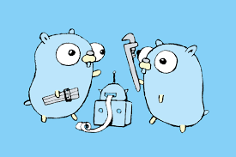
Interface Type assertions
A type assertion provides access to an interface value's underlying concrete value.
So you can easily take an interface {} with various values and assert them as strings (check out the lab).

Slide 58
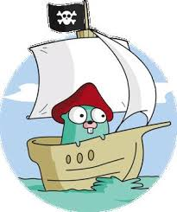
DATA TYPES!!
AND WE’RE DONE!
ANY QUESTIONS?!?

