Slide 1


Introduction to GoLang VMWare 19 November – 21 November 2018 by Fernando Pombeiro

Slide 2
Module Five: Deployment and DevOps in GO

Slide 3
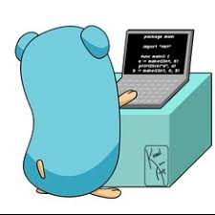
Why GO to build Command line apps?
So one of the most powerful things about golang is that it’s super easy to create binary files.
This offers several huge advantages- for example- if you need to deploy an application you simply run the built in go command line command “go build <my app name>” and, assuming no compling errors- you get a binary fine in your home directory of that application!!

Slide 4

Why is the binary file so powerful?
Ever try to deploy an especially large directory structure for a complex application? Especially one that needs to be compiled down? It’s painful- and you can see the difference immediately when deploying, for example, docker containers.
The simple go build command is all you need to create the binary. After that, to deploy (assuming you are doing it with docker)- simply wrap the binary file.

Slide 5

Go install
GO also comes with a simple command line application that will install into a binary folder that you can set with the $GOBIN environment variable.
If there is no $GOBIN environment variable set then the binary file will go to $GOPATH/bin
You can also create a similar system using go build –o /somepath/to/yourbinary

Slide 6
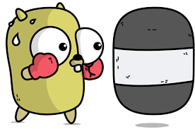
Creating Web applications
So in this next section we’re going to go through creating two applications in GOLANG. A large part of this will hearken back to the first module!
Sign into your virtual machine (whatever that virtual machine is- if you want to use Docker then by all means go with docker!)
Let’s START by creating a command line application for our host!

Slide 7

Create a command line application
So a big part of GO’s advantages are it’s ability to create command line applications. We can code out in GO (using the os library) and then install the application to the $PATH variable (yes- I’m speaking in Linux terms!) which allow it to be used anywhere.
So head over to the lab and we’ll try that now!

Slide 8
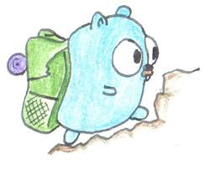
Command Line application
So we’re going to create a simple and (hopefully useful) application that resets our local docker registry at the touch of a button!
We’re going to call it nbrCount and it’s going to count all of the files in a directory. This is one of those mildly useful things that can tell us if we’ve added a file.

Slide 9
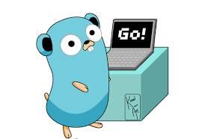
GODOC
We should review godoc applications as well here- which we do in the lab…but first a few rules:
To make it easier on your goDoc all of your functions should have comments one line above them. GODOC is the equivalent of JavaDocs
Start the comment with the name of the package (every package should have a comment. Start all of the functions that you export (meaning- they have a capital first letter) with the name of the function.

Slide 10

Web application
Now let’s expand and create a web application on docker. Our web application will be split up among multiple packages and will do the following:
It will have, as an input, the name of a film
It will then take the name of that film and send it to an API that will return the location of a movie poster and
It will then show the movie poster to the user.
We will use the OMDB api

Slide 11

Deploying a multi-stage application
So one of the most powerful aspects of GO, as we saw in our command line builds, is the fact that we can use a command line command to build a binary.
As you can imagine this becomes incredibly useful when deploying go applications- especially using things like containers.

Slide 12
Multi-stage deployments
We’re going to use Docker for this next section as it provides an excellent deployment methodology and method tools. Recently Docker has introduced Multi-stage deployments with Docker containers which provide an excellent example of how building the binaries of an application can shrink the size of the deployment significantly.

Slide 13
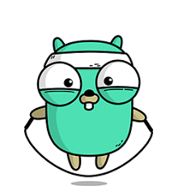
Multi-stage deployments
So let’s start with a simple application. Check out the lab for the deployme app. It’s a simple webserver application that doesn’t do much (except quote the most amazing movie of 2015!!).
Our goal, however, is to take that application and shrink it in size to a binary on a minimal docker container- then *just* run the binary!

Slide 14
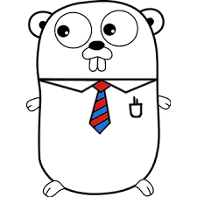
One last thing to speed us up even more
memorization: this is another one of those things that help speed up programs.
Basically- think caching.
If we have a function that always takes the same immutable value types (parameters) and always returns the same immutable return values then we can cache the answer…so that way as long as we get a value that we’ve returned before it is stored in memory and it speeds up the process
We do this by wrapping the function in a cache… which we’ll go over in the lab!

Slide 15
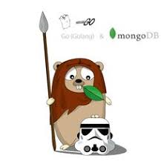
Final lab
So let’s create an in-memory cache for a fake application that takes a long time to run and see if we can get the speed done.
Doing this will require us to use reflection to check the inputs and then return those values (gotta watch those types!)
Hop over to the lab and we’ll get started!

Slide 16
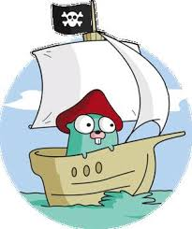
IT’S ALL DONE!!!
AND WE’RE DONE!
ANY QUESTIONS?!?

