Slide 1
The software development life cycle
Fernando Pombeiro
Ben Sewell

Slide 2
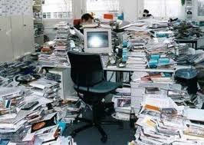
So you wanna start a tech company?

Slide 3
What we’ll be talking about
This will be a series of talks discussing the SDLC and each step, including the tools used, to create and maintain software effectively.
We will break it down into each of the steps of the SDLC and do around 30 minutes on each section.
The following slide will go into each of the steps of the SDLC

Slide 4
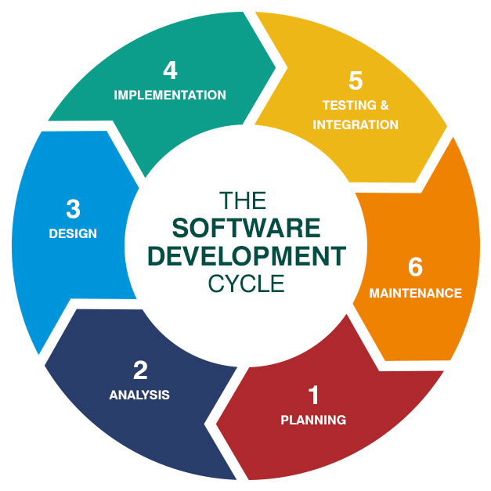
The software development life cycle
Planning
Analysis
Design
Implementation
Testing & Integration
Maintenance

Slide 5
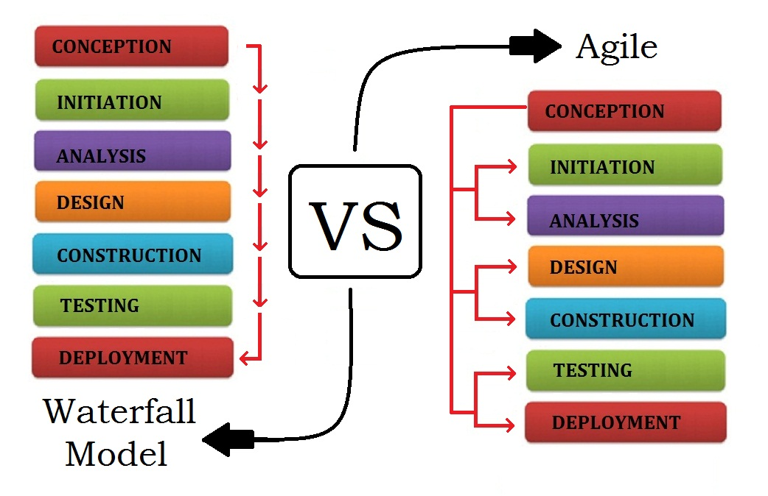
Models of the Software Deployment Life cycle
Waterfall Life Cycle
V-shaped Life Cycle
Incremental Life Cycle
Spiral Life Cycle
Rapid Application Development
Agile
Prototyping

Slide 6
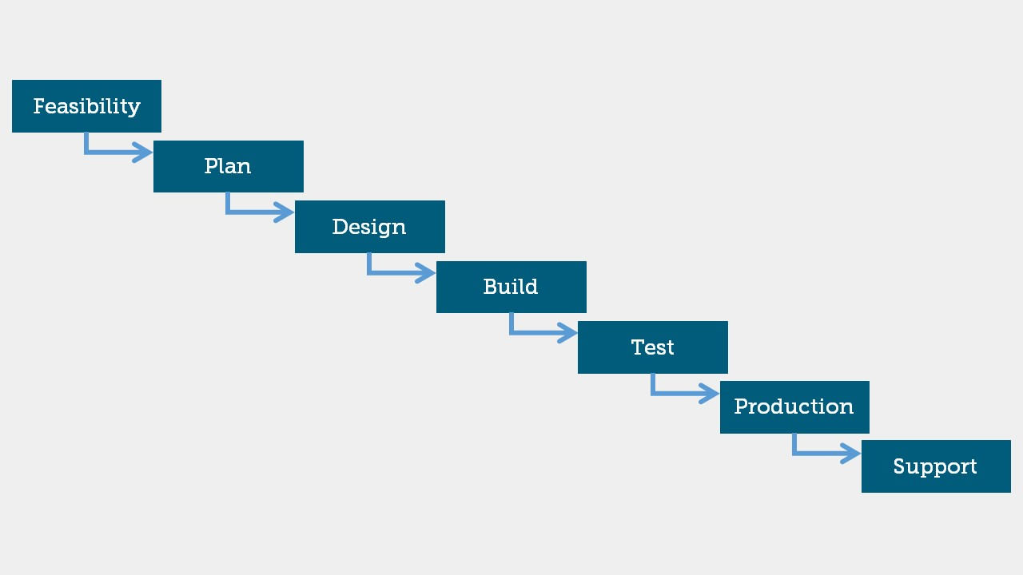
Models of sldc: Waterfall
High level: finish one task and then move on to another.
Pros:
Less room for error: foundations completed and tested before moving on
Very well documented
Stable
Cons:
Not flexible- can’t react to changing market forces
Can’t foresee every problem
Can’t react to changes well

Slide 7

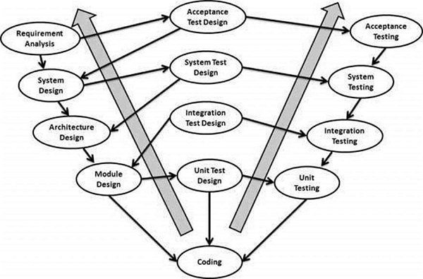
Models of sldc: V model
High level: tasks are done in parallel with testing happening at each phase. Similar to waterfall but with more testing.
Pros:
Almost no room for error
Extremely stable
Well documented tests
Cons:
Not flexible- can’t react to changing market forces
Can’t foresee every problem
Can’t react to changes well

Slide 8

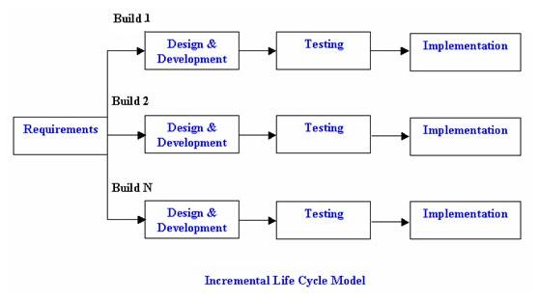
Models of sldc: incremental model
High level: Break the project down into small tasks. Complete planning, testing, researching for each piece. Several teams work together. Bring together finished product.
Pros:
Reasonably fast- can have several teams working simultaneously
Low initial investment (working on small bits)
Problems in increments easier to handle
Cons:
Requires insane amount of planning
Integration testing not done until the end
Teams need to be working at same speed

Slide 9

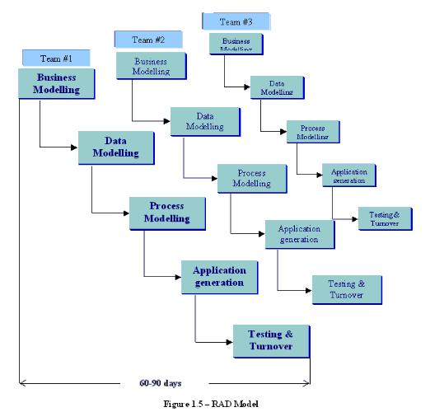
Models of sldc: RAD (rapid application dev)
High level: Similar to Incremental model but more emphasis on front end modelling- from data to businesses to process.
Pros:
Really fast development
Reusability of components due to fast modeling
Faster integration than incremental
Cons:
Depends on very capable people capable of working independently
Can only work with modular design systems
Expensive

Slide 10
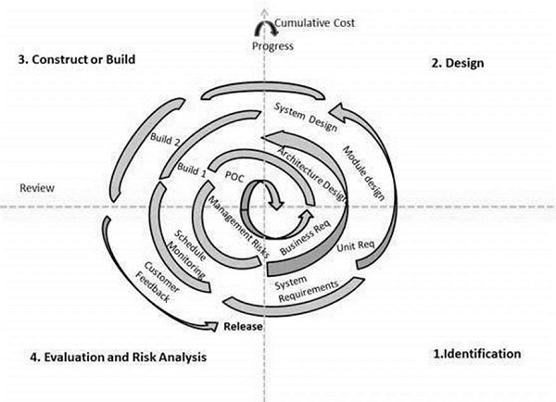
Models of sldc: spiral development
High level: Cyclical nature of spiral design runs through iterations again and again as you get closer to your final product- asking for feedback at each phase.
Pros:
Risk analysis is at forefront- so stable
Constant feedback ensures quality product at the end
Customer feedback embedded in the entire process
Cons:
Management of the project is incredibly difficult
Expensive to keep iterating
No fixed end

Slide 11

Models of sldc: agile development
High level: Combines the best aspects of each of the other steps- from constant feedback through iteration through testing. Testing & development merge together.
Pros:
PRODUCT focused- not project focused
Incremental and empowering for individuals
Pushes responsibility down to developer
Cons:
It can easily turn chaotic
Changing last second requirements can cause problems
VERY difficult to implement

Slide 12
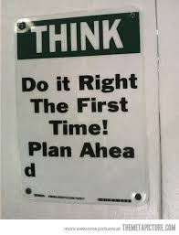
Planning

Slide 13
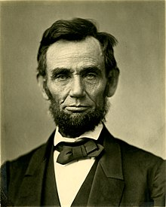
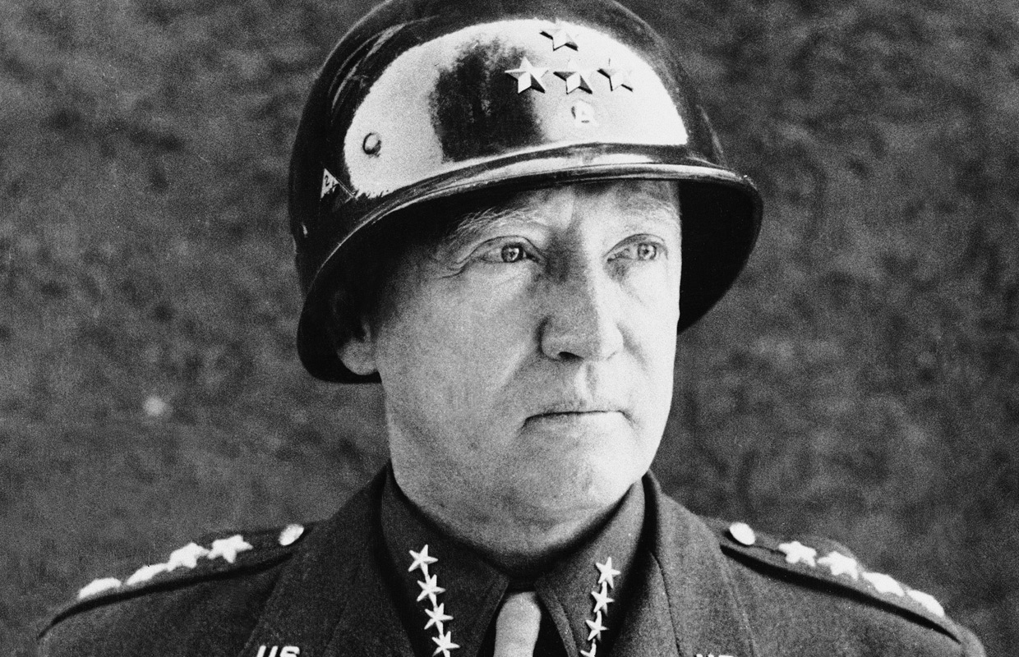
How to think about planning
Some basic rules to understand about software:
“It does not do to leave a live dragon out of your calculations if you live near him”
“A good plan violently executed now is better than a perfect plan executed next week” (Gen. George Patton)
“Give me six hours to chop down a tree and I will spend the first four sharpening the axe” (Abraham Lincoln)
“Want to hear God laugh? Make a plan“

Slide 14

How to think about planning
Planning has two sides: it does have costs and it does have benefits
Planning has a credibility measurement:
Consistent failure to achieve goals = wild optimism
Over-shooting goals consistently = wild pessimism
Planning has an administrative cost (meetings)
Over-planning makes you too rigid and you end up with Duke Nuke ‘em 3D (or 3D televisions)

Slide 15
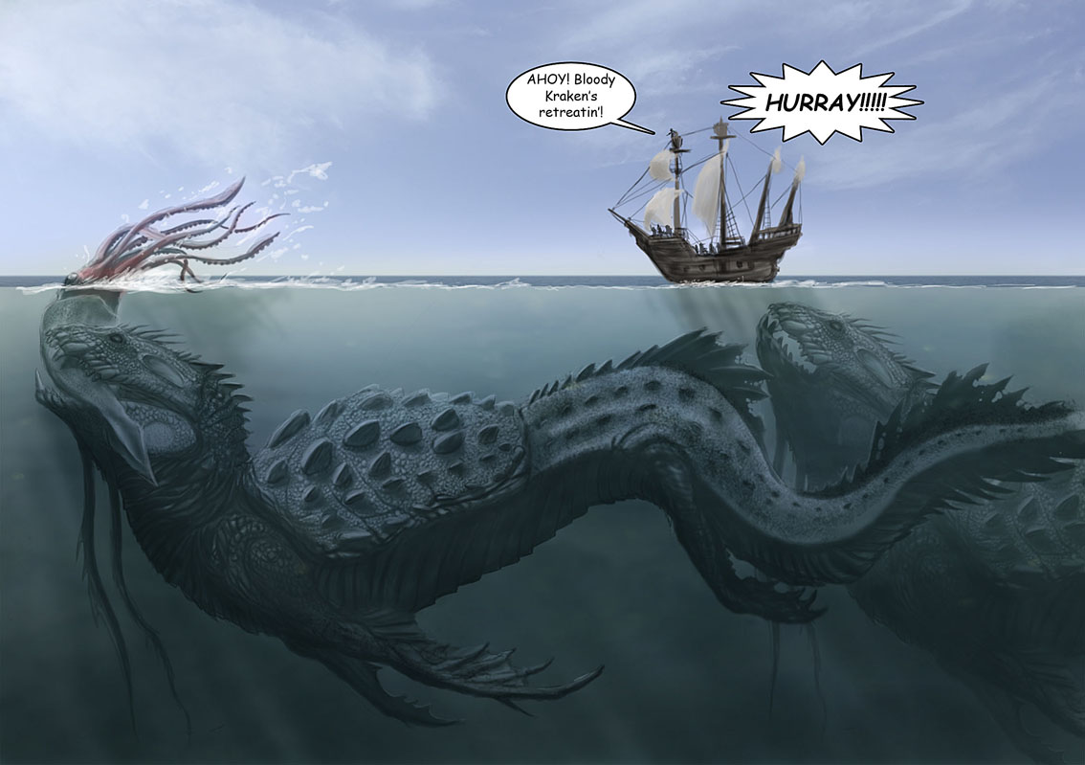
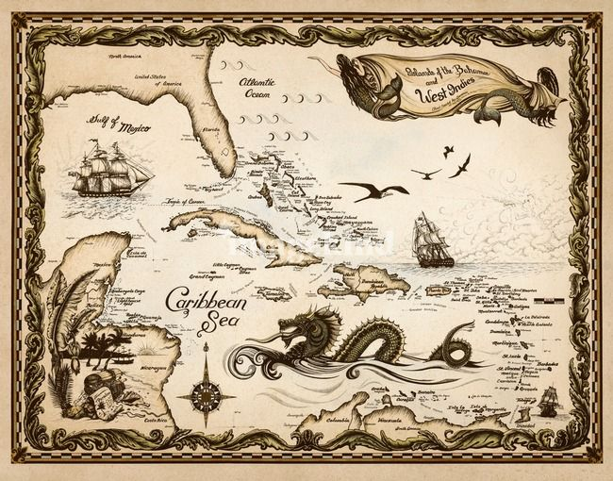
The pivot
Software development comes with large, scary variables. It’s not unlike taking a trans-oceanic voyage. You can plan your ideal route. You can map out every step….but things happen that are outside of your control (weather, monsters, etc).
The question becomes: How do you, as captains, decide when to alter your route?

Slide 16
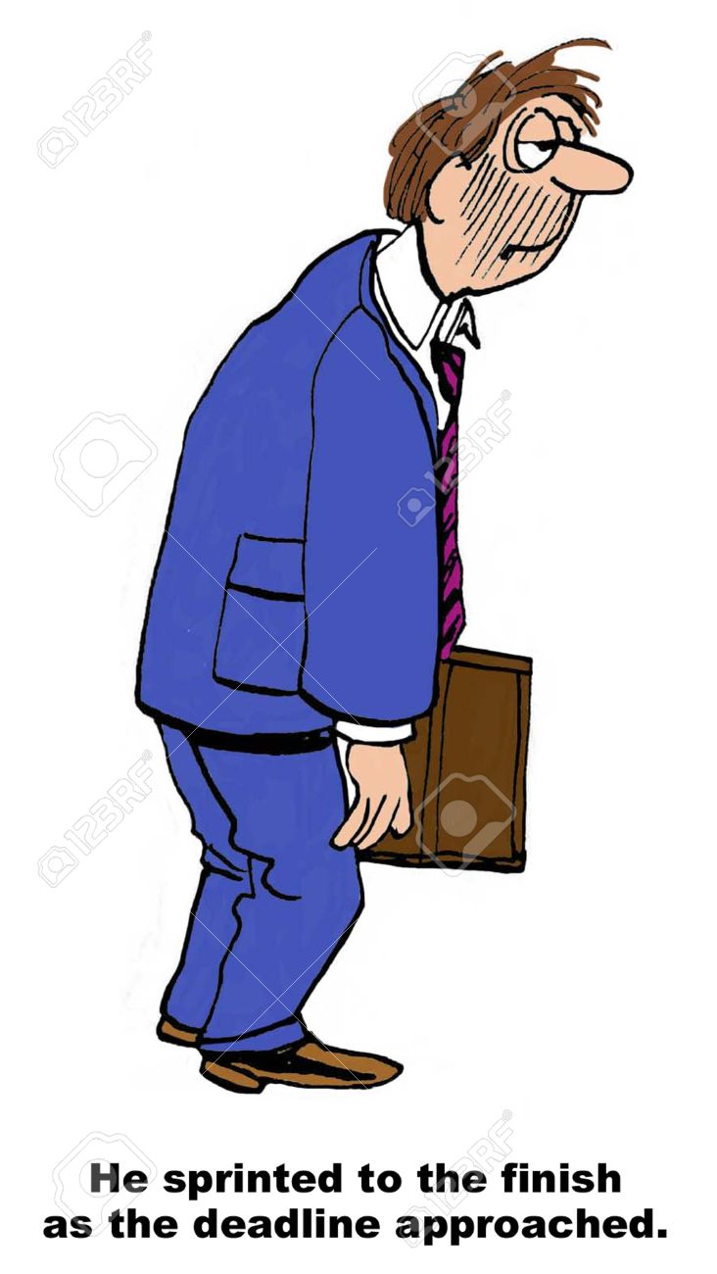
Planning: the tools
Considering all of these aspects of planning (the tension between flexibility and rigidity, the pivot question, the administrative costs) the industry has come up with a standard called “sprinting”.
A “Sprint” is a small chunk of planning. It can be done in various sizes: sometimes a sprint takes a week. Sometimes two weeks. Sometimes three weeks. Sometimes a month.
A “Sprint” is a collection of tasks that can be completed in ‘n’ time.

Slide 17
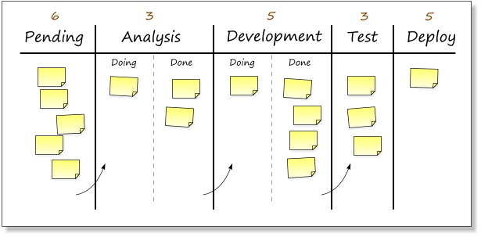
Planning: Flow
The best way to track these items is to visualize them. As marketers would tell you: deliver a complex message in a few seconds.
To do this we use “Kanban” boards.
Kanban boards allow us to visualize our workflow and look for bottlenecks.

Slide 18

planning: tickets
Tickets (tasks) come with an administrative overhead
Sprint planning takes time.
Writing tickets takes time.
Commenting on tickets takes time.
Ticket descriptions always need to be binary:
IF A is done then this ticket can be closed, otherwise leave open

Slide 19
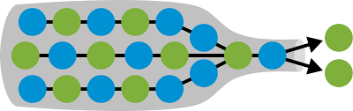
planning: Flow
Your entire process cannot move any faster than your smallest bottleneck
RESIST THE URGE to keep pushing on other aspects of the business until that bottleneck is cleared.
Adding more work just causes traffic jams
Kanban boards are designed to help identify these jams

Slide 20
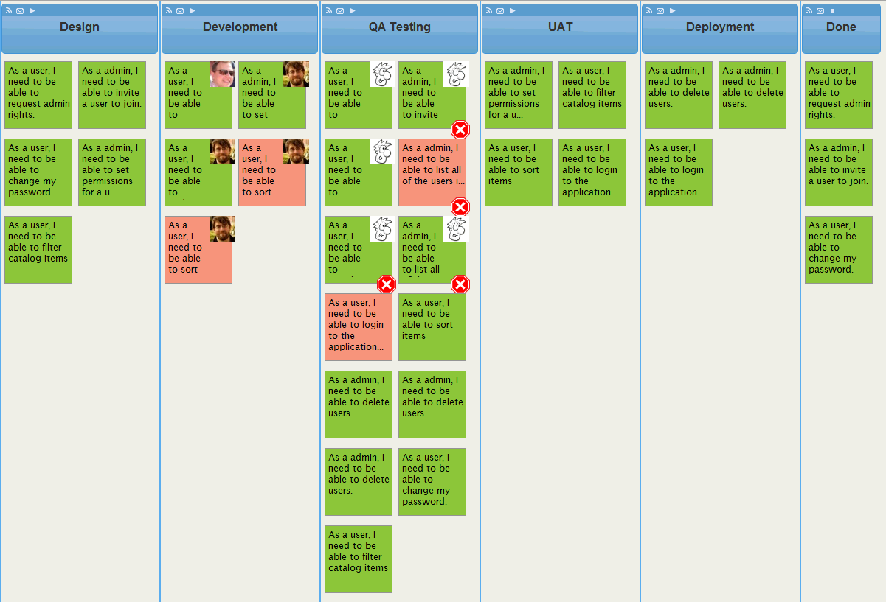
planning: Flow
Find the bottleneck here
Note the ticket descriptions

Slide 21
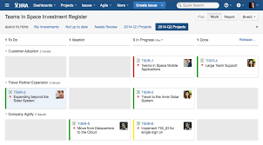
planning: tickets
Youtrack is the system we use here. It delivers a virtual kanban board.
Other tools that do similar work:
Jira
Mingle
Youtrack
Atlassian
Mastering these tools is a hugepart of developing effective software as a project manager
You do NOT need to be super technically competent to manage a project using these tools

Slide 22
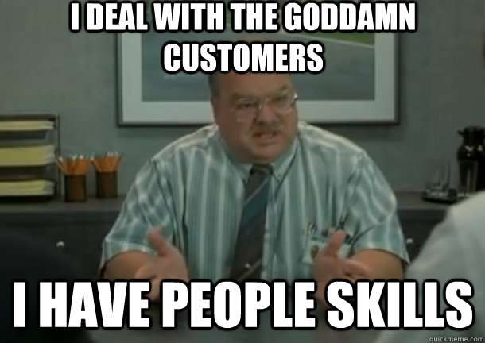
planning: tickets
In most private software businesses there is a project manager who is responsible for the JIRA boards.
This project manager interacts with the business managers, gathers requirements, then writes them out in the form of
Epic tickets
Stories
Tasks
The software engineer then works on the tasks.
Ideally EVERYONE is always aware of how the work is flowing.

Slide 23
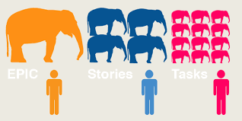
Planning: the breakdown
Project
Epic Ticket
Story1
Story2
Story3
Epic Ticket 2
Task1
Task2
Task3
S2 Task1
S2 Task2
S2 Task3
S3 Task1
S3 Task2
S3 Task3

Slide 24

Planning: the process
Daily Standups: (10 minutes)
10 minute meeting for each team member to talk about what they are up to. Three sentences each. Keep it short. 2 minutes per person:
What I did yesterday.
What I plan to do today
Where I am with tickets

Slide 25
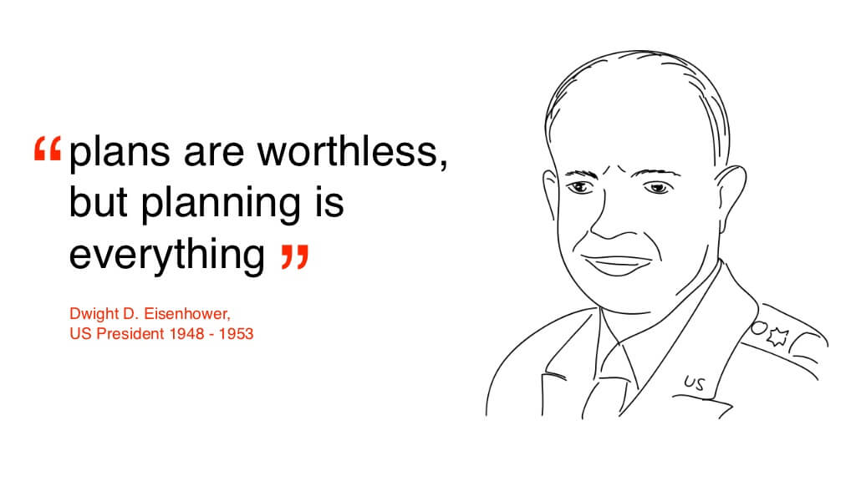
Planning: the process
Weekly/Bi weekly/Monthly sprint planning: (up to an hour)
Write out most of the tickets for the sprint
Expect changes mid-sprint and leave room for this
Organize priorities for the sprint
Set up the board so that every engineer knows exactly what they will be doing tomorrow, the next day, etc.
Make sure you line up tasks with available hours of work/story points

Slide 26
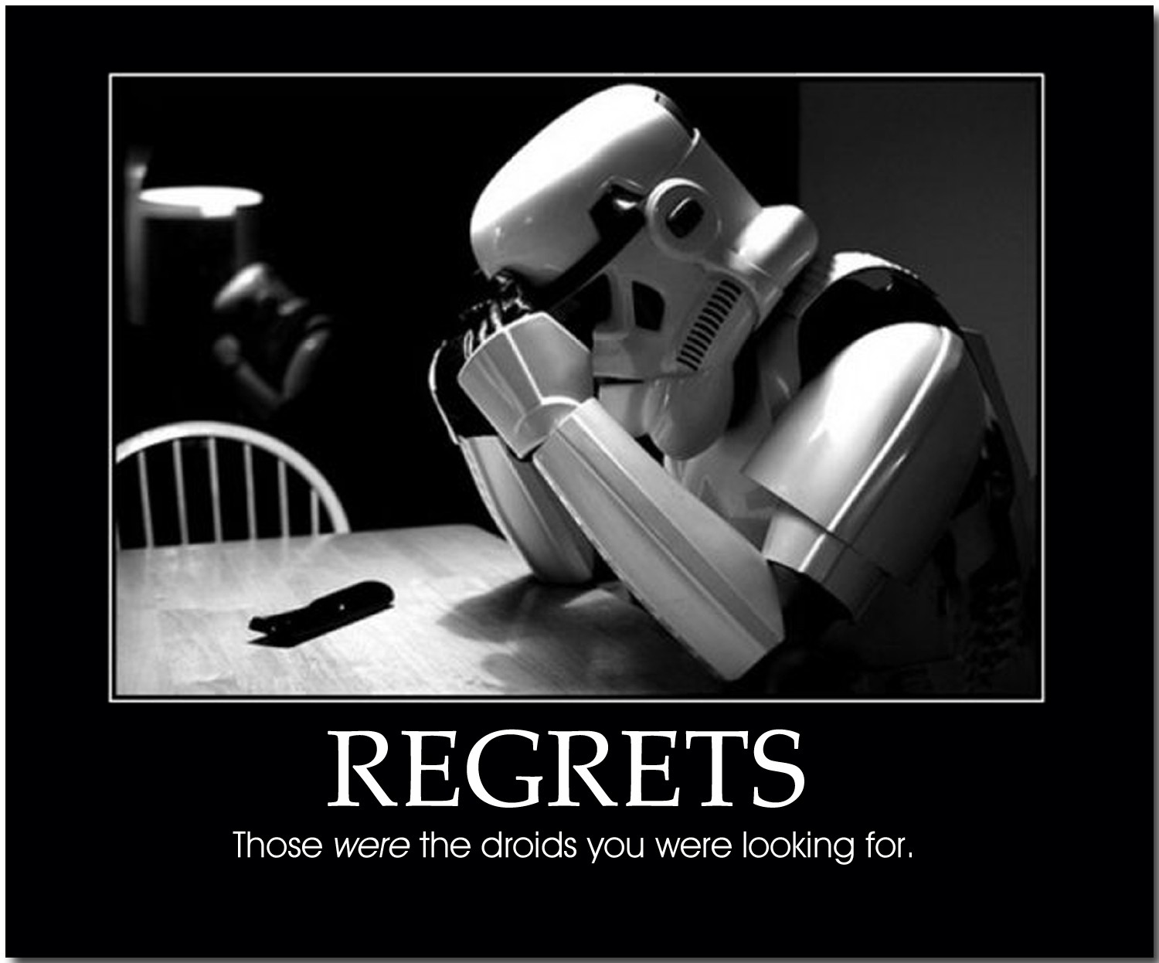
Planning: the process
Bi/Weekly/monthly sprint retrospectives: (up to an hour)
Review of last sprint:
What did we do well?
What did we do poorly?
How can we improve for the next sprint?
How are we going to apply these lessons?
Should occur before following sprint planning

Slide 27
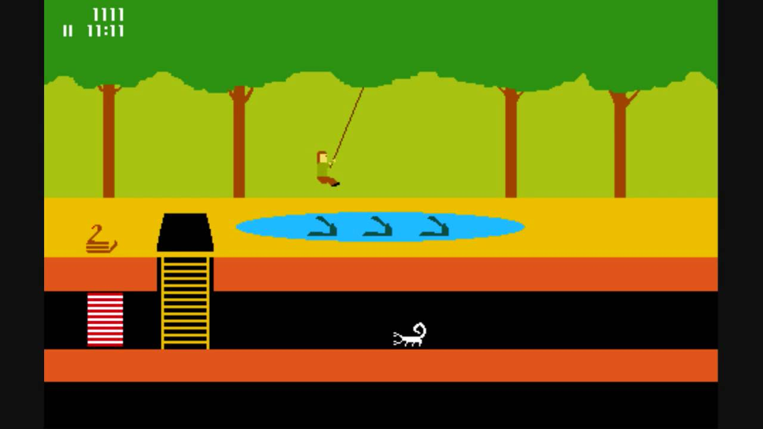
Planning: pitfalls
Poorly written tickets
Not keeping up your JIRA boards
SCOPE CREEP
Changing priorities mid-sprint
Fight inertia
Not doing standups
Analysis Paralysis
Lack of retrospectives

Slide 28
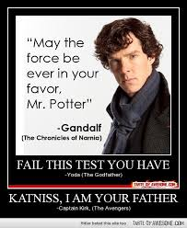
Confused? Good…..ask questions!

Slide 29
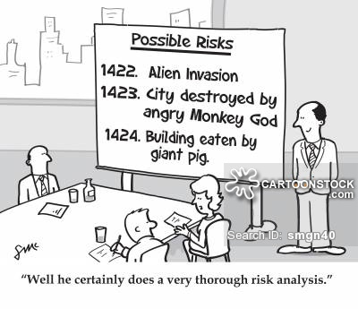
Avoid mistaked: anilize ur werk

Slide 30

analysis
Analysis- in the context of the SDLC- is the gathering of business requirements.
A lot of the time the Planning and Analysis sections are merged into one; you use your market analysis to plan out your SDLC.
Analysis is shorthand for “gather business requirements”
This is the first part of the course: find your market gaps, analyze them, and create your plan.

