Slide 1
Computer Organization and Architecture
Ferosh Jacob
Kennesaw State University

Slide 2
Chapter 2 Objectives
Understand the fundamentals of numerical data representation and manipulation in digital computers.
Master the skill of converting between various radix systems.
Understand how errors can occur in computations because of overflow and truncation.

Slide 3
Chapter 2 Objectives
Understand the fundamental concepts of floating-point representation.
Gain familiarity with the most popular character codes.
Understand the concepts of error detecting and correcting codes.

Slide 4
2.1 Introduction
A bit is the most basic unit of information in a computer.
  It is a state of “on” or “off” in a digital circuit.
  Sometimes these states are “high” or “low” voltage instead of “on” or “off..”
A byte is a group of eight bits.
  A byte is the smallest possible addressable unit of computer storage.
  The term, “addressable,” means that a particular byte can be retrieved according to its location in memory.

Slide 5
2.1 Introduction
A word is a contiguous group of bytes.
  Words can be any number of bits or bytes.
  Word sizes of 16, 32, or 64 bits are most common.
  In a word-addressable system, a word is the smallest addressable unit of storage.
A group of four bits is called a nibble (or nybble).
  Bytes, therefore, consist of two nibbles: a “high-order nibble,” and a “low-order” nibble.

Slide 6
2.2 Positional Numbering Systems
Bytes store numbers using the position of each bit to represent a power of 2.
  The binary system is also called the base-2 system.
  Our decimal system is the base-10 system. It uses powers of 10 for each position in a number.
  Any integer quantity can be represented exactly using any base (or radix).

Slide 7
2.2 Positional Numbering Systems
The decimal number 947 in powers of 10 is:
The decimal number 5836.47 in powers of 10 is:
  9 × 10 ² + 4 × 10 ¹ + 7 × 10 ⁰
  5 × 10 ³ + 8 × 10 ² + 3 × 10 ¹ + 6 × 10 ⁰
  + 4 × 10 ⁻¹ + 7 × 10 ⁻²

Slide 8
2.2 Positional Numbering Systems
The binary number 11001 in powers of 2 is:
When the radix of a number is something other than 10, the base is denoted by a subscript.
  Sometimes, the subscript 10 is added for emphasis:
  11001₂ = 25₁₀
  1 × 2 ⁴ + 1 × 2 ³ + 0 × 2 ² + 0 × 2 ¹ + 1 × 2 ⁰
  = 16 + 8 + 0 + 0 + 1 = 25

Slide 9
2.3 Decimal to Binary Conversions
Because binary numbers are the basis for all data representation in digital computer systems, it is important that you become proficient with this radix system.
Your knowledge of the binary numbering system will enable you to understand the operation of all computer components as well as the design of instruction set architectures.

Slide 10
2.3 Decimal to Binary Conversions
In an earlier slide, we said that every integer value can be represented exactly using any radix system.
You can use either of two methods for radix conversion: the subtraction method and the division remainder method.
The subtraction method is more intuitive, but cumbersome. It does, however reinforce the ideas behind radix mathematics.

Slide 11
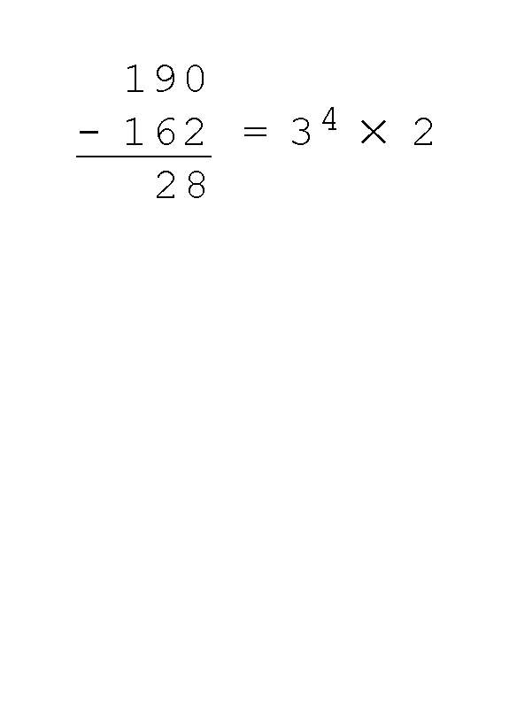
2.3 Decimal to Binary Conversions
Suppose we want to convert the decimal number 190 to base 3.
  We know that 3 ⁵ = 243 so our result will be less than six digits wide. The largest power of 3 that we need is therefore 3 ⁴ = 81, and 81 × 2 = 162.
  Write down the 2 and subtract 162 from 190, giving 28.

Slide 12
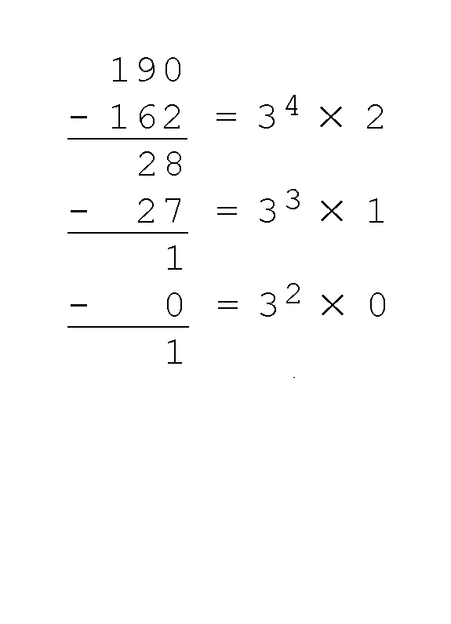
2.3 Decimal to Binary Conversions
Converting 190 to base 3...
  The next power of 3 is 3 ³ = 27. We’ll need one of these, so we subtract 27 and write down the numeral 1 in our result.
  The next power of 3, 3 ² = 9, is too large, but we have to assign a placeholder of zero and carry down the 1.

Slide 13
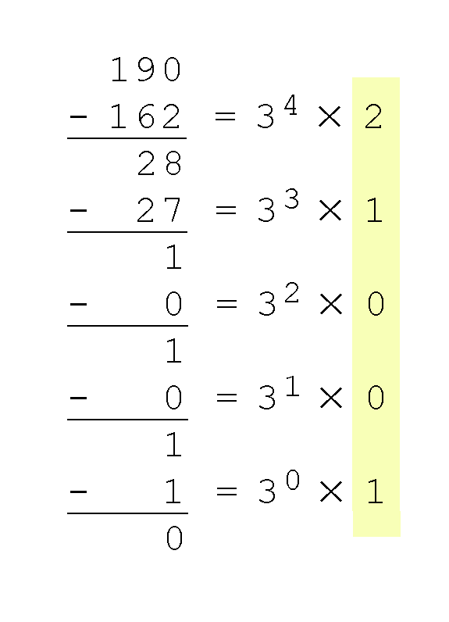
2.3 Decimal to Binary Conversions
Converting 190 to base 3...
  3 ¹ = 3 is again too large, so we assign a zero placeholder.
  The last power of 3, 3 ⁰ = 1, is our last choice, and it gives us a difference of zero.
  Our result, reading from top to bottom is:
  190₁₀ = 21001₃

Slide 14
2.3 Decimal to Binary Conversions
Another method of converting integers from decimal to some other radix uses division.
This method is mechanical and easy.
It employs the idea that successive division by a base is equivalent to successive subtraction by powers of the base.
Let’s use the division remainder method to again convert 190 in decimal to base 3.

Slide 15
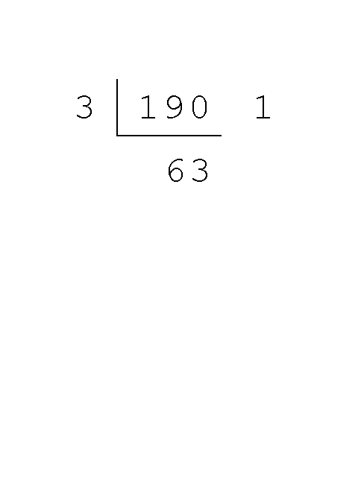
2.3 Decimal to Binary Conversions
Converting 190 to base 3...
  First we take the number that we wish to convert and divide it by the radix in which we want to express our result.
  In this case, 3 divides 190 63 times, with a remainder of 1.
  Record the quotient and the remainder.

Slide 16
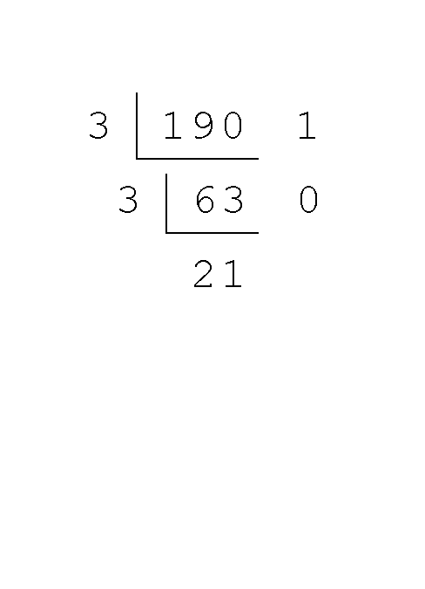
2.3 Decimal to Binary Conversions
Converting 190 to base 3...
  63 is evenly divisible by 3.
  Our remainder is zero, and the quotient is 21.

Slide 17
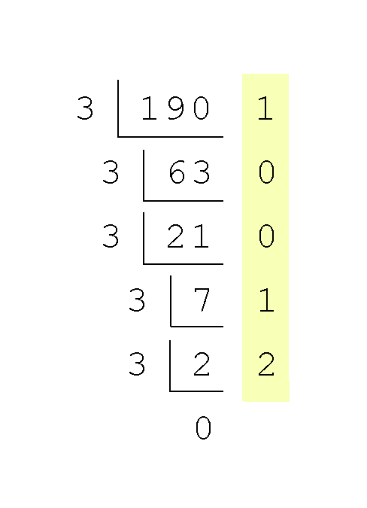
2.3 Decimal to Binary Conversions
Converting 190 to base 3...
  Continue in this way until the quotient is zero.
  In the final calculation, we note that 3 divides 2 zero times with a remainder of 2.
  Our result, reading from bottom to top is:
  190₁₀ = 21001₃

Slide 18
2.3 Decimal to Binary Conversions
Fractional values can be approximated in all base systems.
Unlike integer values, fractions do not necessarily have exact representations under all radices.
The quantity ½ is exactly representable in the binary and decimal systems, but is not in the ternary (base 3) numbering system.

Slide 19
2.3 Decimal to Binary Conversions
Fractional decimal values have nonzero digits to the right of the decimal point.
Fractional values of other radix systems have nonzero digits to the right of the radix point.
Numerals to the right of a radix point represent negative powers of the radix:
  0.47₁₀ = 4 × 10 ⁻¹ + 7 × 10 ⁻²
  0.11₂ = 1 × 2 ⁻¹ + 1 × 2 ⁻²
  = ½ + ¼
  = 0.5 + 0.25 = 0.75

Slide 20
2.3 Decimal to Binary Conversions
As with whole-number conversions, you can use either of two methods: a subtraction method and an easy multiplication method.
The subtraction method for fractions is identical to the subtraction method for whole numbers. Instead of subtracting positive powers of the target radix, we subtract negative powers of the radix.
We always start with the largest value first, n ⁻¹, where n is our radix, and work our way along using larger negative exponents.

Slide 21
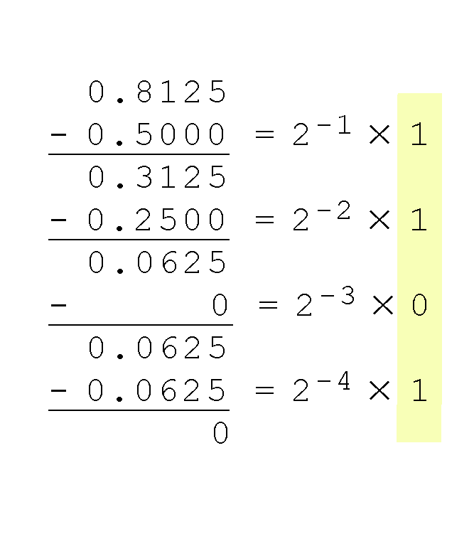
2.3 Decimal to Binary Conversions
The calculation to the right is an example of using the subtraction method to convert the decimal 0.8125 to binary.
  Our result, reading from top to bottom is:
  0.8125₁₀ = 0.1101₂
  Of course, this method works with any base, not just binary.

Slide 22
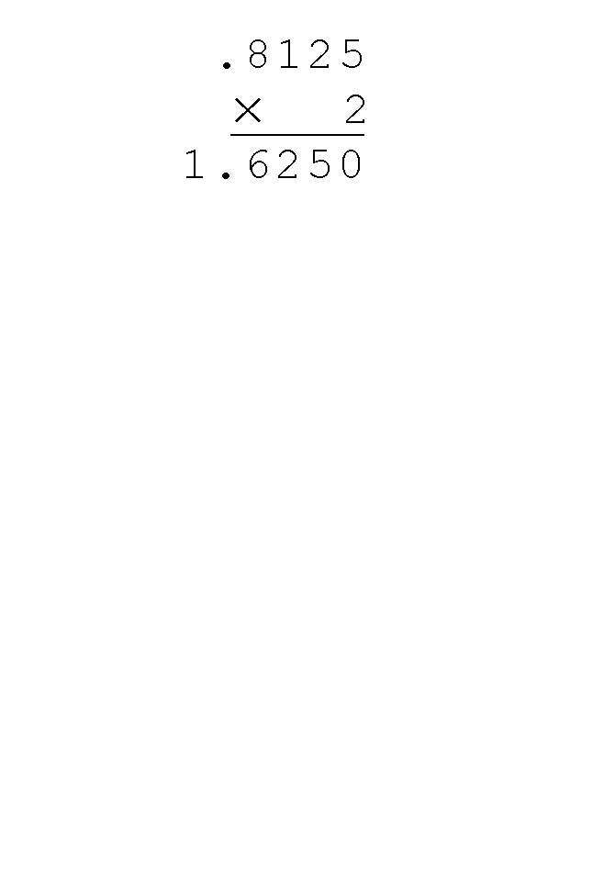
2.3 Decimal to Binary Conversions
Using the multiplication method to convert the decimal 0.8125 to binary, we multiply by the radix 2.
  The first product carries into the units place.

Slide 23
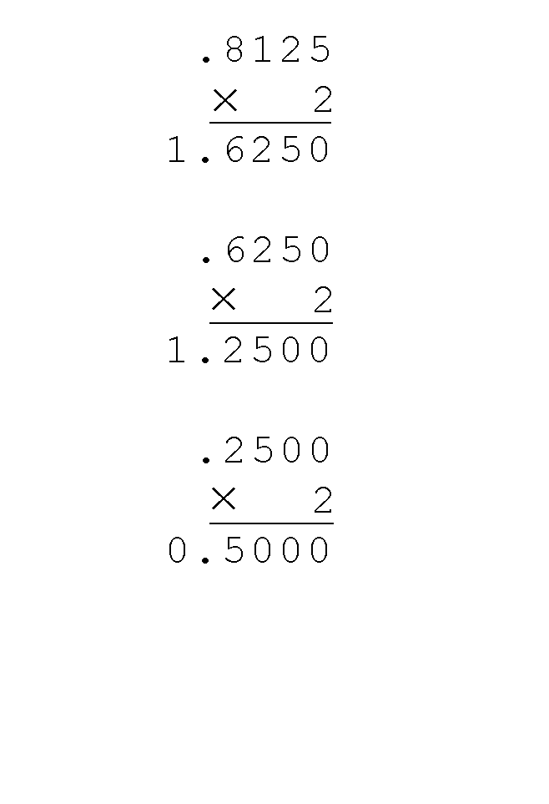
2.3 Decimal to Binary Conversions
Converting 0.8125 to binary . . .
  Ignoring the value in the units place at each step, continue multiplying each fractional part by the radix.

Slide 24
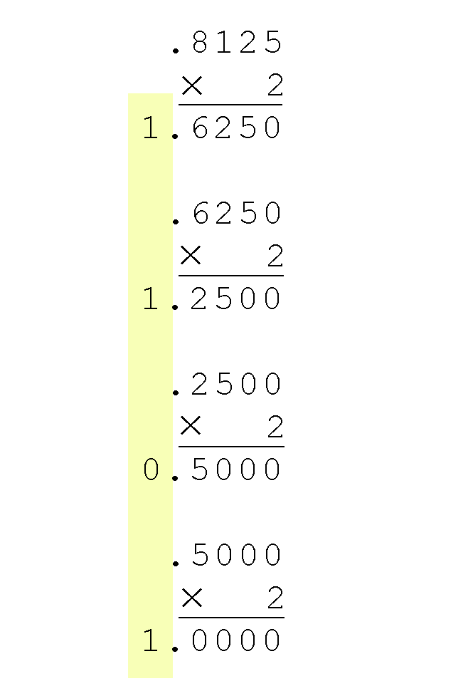
2.3 Decimal to Binary Conversions
Converting 0.8125 to binary . . .
  You are finished when the product is zero, or until you have reached the desired number of binary places.
  Our result, reading from top to bottom is:
  0.8125₁₀ = 0.1101₂
  This method also works with any base. Just use the target radix as the multiplier.

Slide 25
2.3 Decimal to Binary Conversions
The binary numbering system is the most important radix system for digital computers.
However, it is difficult to read long strings of binary numbers-- and even a modestly-sized decimal number becomes a very long binary number.
  For example: 11010100011011₂ = 13595₁₀
For compactness and ease of reading, binary values are usually expressed using the hexadecimal, or base-16, numbering system.

Slide 26
2.3 Decimal to Binary Conversions
The hexadecimal numbering system uses the numerals 0 through 9 and the letters A through F.
  The decimal number 12 is C₁₆.
  The decimal number 26 is 1A₁₆.
It is easy to convert between base 16 and base 2, because 16 = 2⁴.
Thus, to convert from binary to hexadecimal, all we need to do is group the binary digits into groups of four.
A group of four binary digits is called a hextet

Slide 27
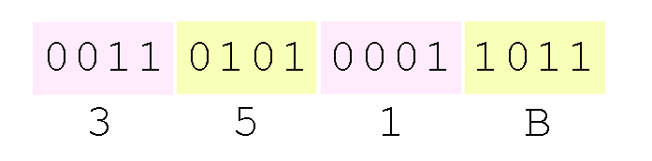
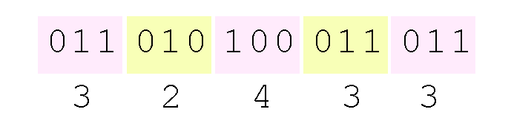
2.3 Decimal to Binary Conversions
Using groups of hextets, the binary number 11010100011011₂ (= 13595₁₀) in hexadecimal is:
Octal (base 8) values are derived from binary by using groups of three bits (8 = 2³):
Octal was very useful when computers used six-bit words.

Slide 28
2.4 Signed Integer Representation
The conversions we have so far presented have involved only positive numbers.
To represent negative values, computer systems allocate the high-order bit to indicate the sign of a value.
  The high-order bit is the leftmost bit in a byte. It is also called the most significant bit.
The remaining bits contain the value of the number.

Slide 29
2.4 Signed Integer Representation
There are three ways in which signed binary numbers may be expressed:
  Signed magnitude,
  One’s complement and
  Two’s complement.
In an 8-bit word, signed magnitude representation places the absolute value of the number in the 7 bits to the right of the sign bit.

Slide 30
2.4 Signed Integer Representation
For example, in 8-bit signed magnitude, positive 3 is: 00000011
Negative 3 is: 10000011
Computers perform arithmetic operations on signed magnitude numbers in much the same way as humans carry out pencil and paper arithmetic.
  Humans often ignore the signs of the operands while performing a calculation, applying the appropriate sign after the calculation is complete.

Slide 31
2.4 Signed Integer Representation
Binary addition is as easy as it gets. You need to know only four rules:
  0 + 0 = 0 0 + 1 = 1
  1 + 0 = 1 1 + 1 = 10
The simplicity of this system makes it possible for digital circuits to carry out arithmetic operations.
  We will describe these circuits in Chapter 3.
Let’s see how the addition rules work with signed magnitude numbers . . .

Slide 32
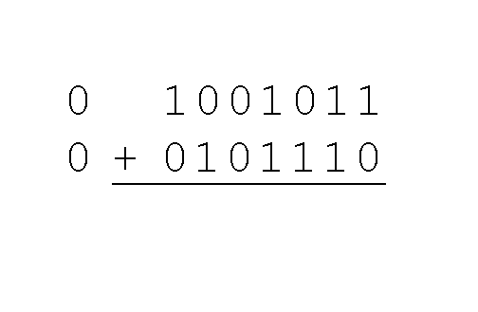
2.4 Signed Integer Representation
Example:
  Using signed magnitude binary arithmetic, find the sum of 75 and 46.
First, convert 75 and 46 to binary, and arrange as a sum, but separate the (positive) sign bits from the magnitude bits.

Slide 33
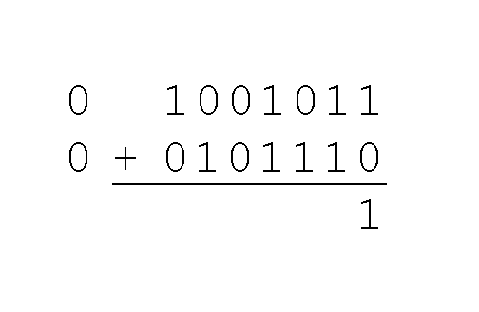
2.4 Signed Integer Representation
Example:
  Using signed magnitude binary arithmetic, find the sum of 75 and 46.
Just as in decimal arithmetic, we find the sum starting with the rightmost bit and work left.

Slide 34
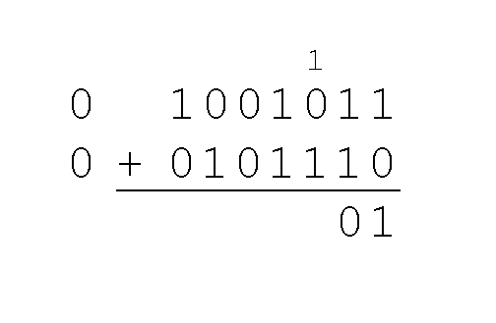
2.4 Signed Integer Representation
Example:
  Using signed magnitude binary arithmetic, find the sum of 75 and 46.
In the second bit, we have a carry, so we note it above the third bit.

Slide 35
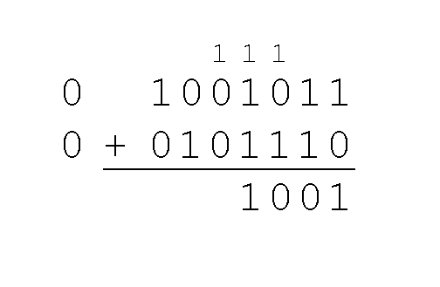
2.4 Signed Integer Representation
Example:
  Using signed magnitude binary arithmetic, find the sum of 75 and 46.
The third and fourth bits also give us carries.

Slide 36
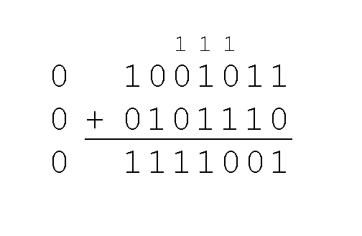
2.4 Signed Integer Representation
Example:
  Using signed magnitude binary arithmetic, find the sum of 75 and 46.
Once we have worked our way through all eight bits, we are done.
In this example, we were careful careful to pick two values whose sum would fit into seven bits. If that is not the case, we have a problem.

Slide 37
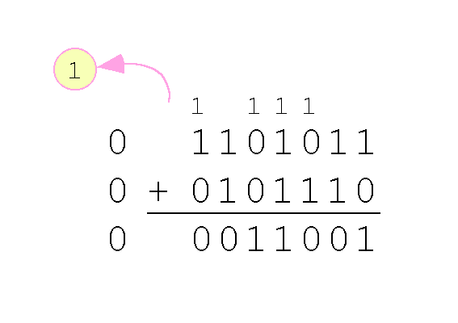
2.4 Signed Integer Representation
Example:
  Using signed magnitude binary arithmetic, find the sum of 107 and 46.
We see that the carry from the seventh bit overflows and is discarded, giving us the erroneous result: 107 + 46 = 25.

Slide 38
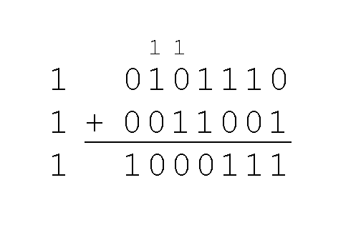
2.4 Signed Integer Representation
The signs in signed magnitude representation work just like the signs in pencil and paper arithmetic.
  Example: Using signed magnitude binary arithmetic, find the sum of - 46 and - 25.
Because the signs are the same, all we do is add the numbers and supply the negative sign when we are done.

Slide 39
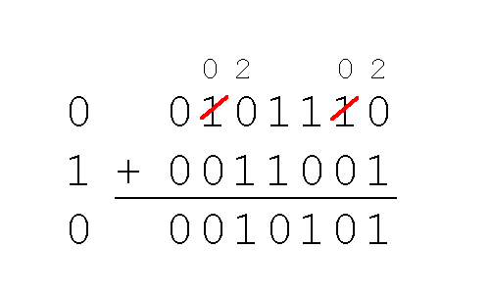
2.4 Signed Integer Representation
Mixed sign addition (or subtraction) is done the same way.
  Example: Using signed magnitude binary arithmetic, find the sum of 46 and - 25.
The sign of the result gets the sign of the number that is larger.
  Note the “borrows” from the second and sixth bits.

Slide 40
2.4 Signed Integer Representation
Signed magnitude representation is easy for people to understand, but it requires complicated computer hardware.
Another disadvantage of signed magnitude is that it allows two different representations for zero: positive zero and negative zero.
For these reasons (among others) computers systems employ complement systems for numeric value representation.

Slide 41
2.4 Signed Integer Representation
In complement systems, negative values are represented by some difference between a number and its base.
In diminished radix complement systems, a negative value is given by the difference between the absolute value of a number and one less than its base.
In the binary system, this gives us one’s complement. It amounts to little more than flipping the bits of a binary number.

Slide 42
2.4 Signed Integer Representation
For example, in 8-bit one’s complement, positive 3 is: 00000011
Negative 3 is: 11111100
In one’s complement, as with signed magnitude, negative values are indicated by a 1 in the high order bit.
Complement systems are useful because they eliminate the need for subtraction. The difference of two values is found by adding the minuend to the complement of the subtrahend.

Slide 43
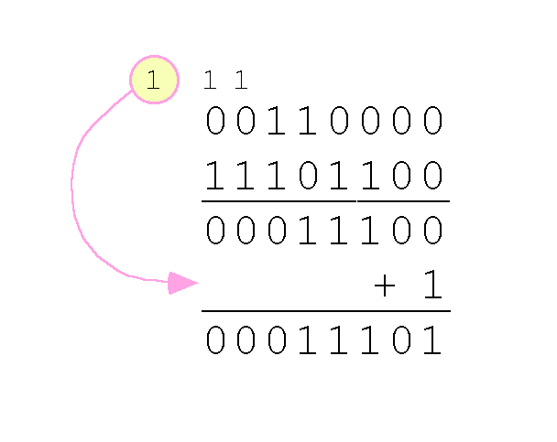
2.4 Signed Integer Representation
With one’s complement addition, the carry bit is “carried around” and added to the sum.
  Example: Using one’s complement binary arithmetic, find the sum of 48 and - 19
  We note that 19 in one’s complement is 00010011, so -19 in one’s complement is: 11101100.

Slide 44
2.4 Signed Integer Representation
Although the “end carry around” adds some complexity, one’s complement is simpler to implement than signed magnitude.
But it still has the disadvantage of having two different representations for zero: positive zero and negative zero.
Two’s complement solves this problem.
Two’s complement is the radix complement of the binary numbering system.

Slide 45
2.4 Signed Integer Representation
To express a value in two’s complement:
  If the number is positive, just convert it to binary and you’re done.
  If the number is negative, find the one’s complement of the number and then add 1.
Example:
  In 8-bit one’s complement, positive 3 is: 00000011
  Negative 3 in one’s complement is: 11111100
  Adding 1 gives us -3 in two’s complement form: 11111101.

Slide 46
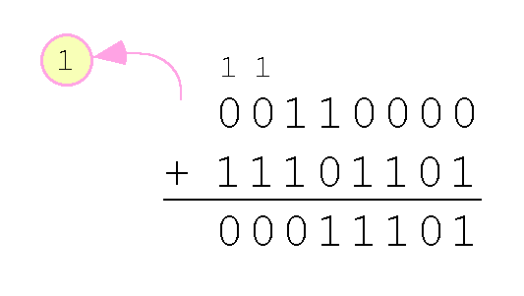
2.4 Signed Integer Representation
With two’s complement arithmetic, all we do is add our two binary numbers. Just discard any carries emitting from the high order bit.
Example: Using one’s complement binary arithmetic, find the sum of 48 and - 19.
  We note that 19 in one’s complement is: 00010011, so -19 in one’s complement is: 11101100,
  and -19 in two’s complement is: 11101101.

Slide 47
2.4 Signed Integer Representation
When we use any finite number of bits to represent a number, we always run the risk of the result of our calculations becoming too large to be stored in the computer.
While we can’t always prevent overflow, we can always detect overflow.
In complement arithmetic, an overflow condition is easy to detect.

Slide 48
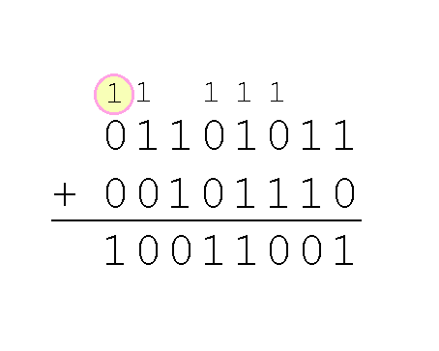
2.4 Signed Integer Representation
Example:
  Using two’s complement binary arithmetic, find the sum of 107 and 46.
We see that the nonzero carry from the seventh bit overflows into the sign bit, giving us the erroneous result: 107 + 46 = -103.
Rule for detecting signed two’s complement overflow: When the “carry in” and the “carry out” of the sign bit differ, overflow has occurred.

Slide 49
2.4 Signed Integer Representation
Signed and unsigned numbers are both useful.
  For example, memory addresses are always unsigned.
Using the same number of bits, unsigned integers can express twice as many values as signed numbers.
Trouble arises if an unsigned value “wraps around.”
  In four bits: 1111 + 1 = 0000.
Good programmers stay alert for this kind of problem.

Slide 50
2.4 Signed Integer Representation
Research into finding better arithmetic algorithms has continued apace for over 50 years.
One of the many interesting products of this work is Booth’s algorithm.
In most cases, Booth’s algorithm carries out multiplication faster and more accurately than naïve pencil-and-paper methods.
The general idea is to replace arithmetic operations with bit shifting to the extent possible.

Slide 51
Thanks
Slides adapted from
  http://users.dickinson.edu/~jmac/courses/previous/fall-2008-comp251/book-powerpoints/

