Slide 1
Computer Organization and Architecture
A Closer Look at Instruction Set Architectures
Ferosh Jacob
Kennesaw State University

Slide 2
Chapter 5 Objectives
Understand the factors involved in instruction set architecture design.
Gain familiarity with memory addressing modes.
Understand the concepts of instruction-level pipelining and its affect upon execution performance.

Slide 3
5.1 Introduction
This chapter builds upon the ideas in Chapter 4.
We present a detailed look at different instruction formats, operand types, and memory access methods.
We will see the interrelation between machine organization and instruction formats.
This leads to a deeper understanding of computer architecture in general.

Slide 4
5.2 Instruction Formats
Instruction sets are differentiated by the following:
  Number of bits per instruction.
  Stack-based or register-based.
  Number of explicit operands per instruction.
  Operand location.
  Types of operations.
  Type and size of operands.

Slide 5
5.2 Instruction Formats
Instruction set architectures are measured according to:
  Main memory space occupied by a program.
  Instruction complexity.
  Instruction length (in bits).
  Total number of instructions in the instruction set.

Slide 6
5.2 Instruction Formats
In designing an instruction set, consideration is given to:
  Instruction length.
    Whether short, long, or variable.
  Number of operands.
  Number of addressable registers.
  Memory organization.
    Whether byte- or word addressable.
  Addressing modes.
    Choose any or all: direct, indirect or indexed.

Slide 7
5.2 Instruction Formats
Byte ordering, or endianness, is another major architectural consideration.
If we have a two-byte integer, the integer may be stored so that the least significant byte is followed by the most significant byte or vice versa.
  In little endian machines, the least significant byte is followed by the most significant byte.
  Big endian machines store the most significant byte first (at the lower address).

Slide 8
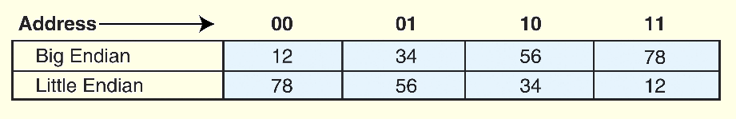
5.2 Instruction Formats
As an example, suppose we have the hexadecimal number 12345678.
The big endian and small endian arrangements of the bytes are shown below.

Slide 9
5.2 Instruction Formats
Big endian:
  Is more natural.
  The sign of the number can be determined by looking at the byte at address offset 0.
  Strings and integers are stored in the same order.
Little endian:
  Makes it easier to place values on non-word boundaries.
  Conversion from a 16-bit integer address to a 32-bit integer address does not require any arithmetic.

Slide 10
5.2 Instruction Formats
The next consideration for architecture design concerns how the CPU will store data.
We have three choices:
  1. A stack architecture
  2. An accumulator architecture
  3. A general purpose register architecture.
In choosing one over the other, the tradeoffs are simplicity (and cost) of hardware design with execution speed and ease of use.

Slide 11
5.2 Instruction Formats
In a stack architecture, instructions and operands are implicitly taken from the stack.
  A stack cannot be accessed randomly.
In an accumulator architecture, one operand of a binary operation is implicitly in the accumulator.
  One operand is in memory, creating lots of bus traffic.
In a general purpose register (GPR) architecture, registers can be used instead of memory.
  Faster than accumulator architecture.
  Efficient implementation for compilers.
  Results in longer instructions.

Slide 12
5.2 Instruction Formats
Most systems today are GPR systems.
There are three types:
  Memory-memory where two or three operands may be in memory.
  Register-memory where at least one operand must be in a register.
  Load-store where no operands may be in memory.
The number of operands and the number of available registers has a direct affect on instruction length.

Slide 13
5.2 Instruction Formats
Stack machines use one - and zero-operand instructions.
LOAD and STORE instructions require a single memory address operand.
Other instructions use operands from the stack implicitly.
PUSH and POP operations involve only the stack’s top element.
Binary instructions (e.g., ADD, MULT) use the top two items on the stack.

Slide 14
5.2 Instruction Formats
Stack architectures require us to think about arithmetic expressions a little differently.
We are accustomed to writing expressions using infix notation, such as: Z = X + Y.
Stack arithmetic requires that we use postfix notation: Z = XY+.
  This is also called reverse Polish notation, (somewhat) in honor of its Polish inventor, Jan Lukasiewicz (1878 - 1956).

Slide 15
5.2 Instruction Formats
The principal advantage of postfix notation is that parentheses are not used.
For example, the infix expression,
Z = (X × Y) + (W × U),
becomes:
Z = X Y × W U × +
in postfix notation.

Slide 16
5.2 Instruction Formats
In a stack ISA, the postfix expression,
Z = X Y × W U × +
might look like this:
PUSH X
PUSH Y
MULT
PUSH W
PUSH U
MULT
ADD
PUSH Z
Note: The result of a binary operation is implicitly stored on the top of the stack!

Slide 17
5.2 Instruction Formats
In a one-address ISA, like MARIE, the infix expression,
Z = X × Y + W × U
looks like this:
LOAD X
MULT Y
STORE TEMP
LOAD W
MULT U
ADD TEMP
STORE Z

Slide 18
5.2 Instruction Formats
In a two-address ISA, (e.g.,Intel, Motorola), the infix expression,
Z = X × Y + W × U
might look like this:
LOAD R1,X
MULT R1,Y
LOAD R2,W
MULT R2,U
ADD R1,R2
STORE Z,R1
Note: One-address ISAs usually require one operand to be a register.

Slide 19
5.2 Instruction Formats
With a three-address ISA, (e.g.,mainframes), the infix expression,
Z = X × Y + W × U
might look like this:
MULT R1,X,Y
MULT R2,W,U
ADD Z,R1,R2
Would this program execute faster than the corresponding (longer) program that we saw in the stack-based ISA?

Slide 20
5.2 Instruction Formats
We have seen how instruction length is affected by the number of operands supported by the ISA.
In any instruction set, not all instructions require the same number of operands.
Operations that require no operands, such as HALT, necessarily waste some space when fixed-length instructions are used.
One way to recover some of this space is to use expanding opcodes.

Slide 21
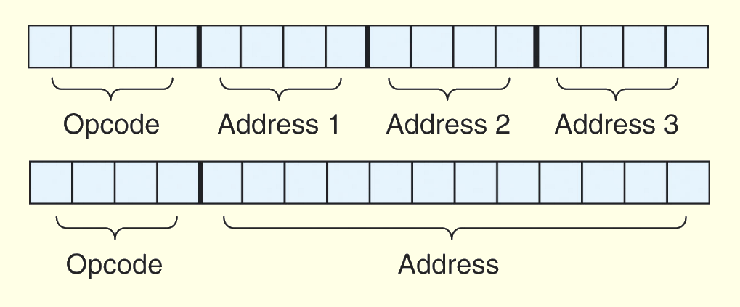
5.2 Instruction Formats
A system has 16 registers and 4K of memory.
We need 4 bits to access one of the registers. We also need 12 bits for a memory address.
If the system is to have 16-bit instructions, we have two choices for our instructions:

Slide 22
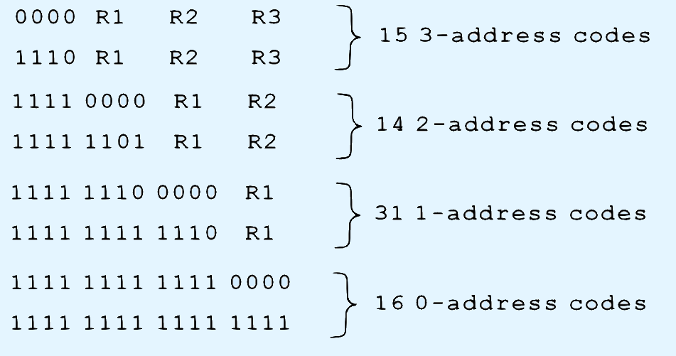
5.2 Instruction Formats
If we allow the length of the opcode to vary, we could create a very rich instruction set:
Is there something missing from this instruction set?

Slide 23
5.3 Instruction types
Instructions fall into several broad categories that you should be familiar with:
  Data movement.
  Arithmetic.
  Boolean.
  Bit manipulation.
  I/O.
  Control transfer.
  Special purpose.
Can you think of some examples of each of these?

Slide 24
5.4 Addressing
Addressing modes specify where an operand is located.
They can specify a constant, a register, or a memory location.
The actual location of an operand is its effective address.
Certain addressing modes allow us to determine the address of an operand dynamically.

Slide 25
5.4 Addressing
Immediate addressing is where the data is part of the instruction.
Direct addressing is where the address of the data is given in the instruction.
Register addressing is where the data is located in a register.
Indirect addressing gives the address of the address of the data in the instruction.
Register indirect addressing uses a register to store the address of the address of the data.

Slide 26
5.4 Addressing
Indexed addressing uses a register (implicitly or explicitly) as an offset, which is added to the address in the operand to determine the effective address of the data.
Based addressing is similar except that a base register is used instead of an index register.
The difference between these two is that an index register holds an offset relative to the address given in the instruction, a base register holds a base address where the address field represents a displacement from this base.

Slide 27
5.4 Addressing
In stack addressing the operand is assumed to be on top of the stack.
There are many variations to these addressing modes including:
  Indirect indexed.
  Base/offset.
  Self-relative
  Auto increment - decrement.
We won’t cover these in detail.
Let’s look at an example of the principal addressing modes.

Slide 28
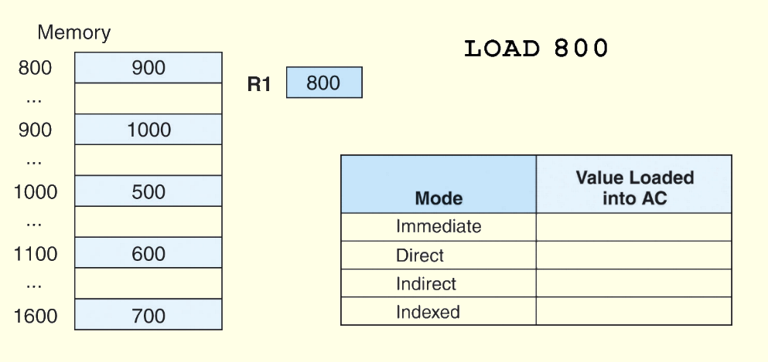
5.4 Addressing
For the instruction shown, what value is loaded into the accumulator for each addressing mode?

Slide 29
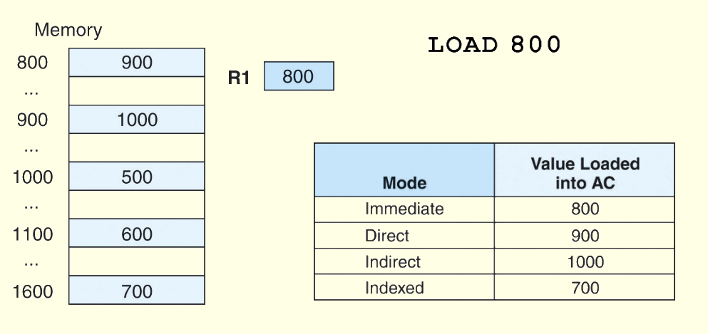
5.4 Addressing
These are the values loaded into the accumulator for each addressing mode.

Slide 30
5.5 Instruction-Level Pipelining
Some CPUs divide the fetch-decode-execute cycle into smaller steps.
These smaller steps can often be executed in parallel to increase throughput.
Such parallel execution is called instruction-level pipelining.
This term is sometimes abbreviated ILP in the literature.
The next slide shows an example of instruction-level pipelining.

Slide 31
5.5 Instruction-Level Pipelining
Suppose a fetch-decode-execute cycle were broken into the following smaller steps:
Suppose we have a six-stage pipeline. S1 fetches the instruction, S2 decodes it, S3 determines the address of the operands, S4 fetches them, S5 executes the instruction, and S6 stores the result.
1. Fetch instruction. 4. Fetch operands.
2. Decode opcode. 5. Execute instruction.
3. Calculate effective 6. Store result.
address of operands.

Slide 32
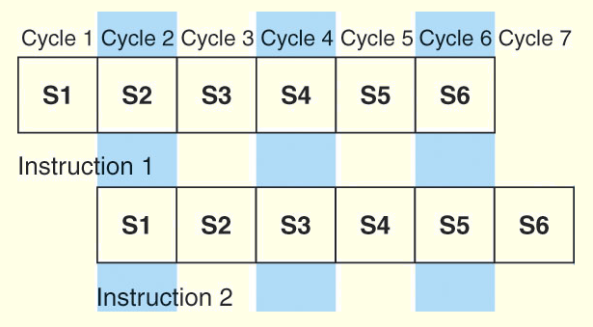
5.5 Instruction-Level Pipelining
For every clock cycle, one small step is carried out, and the stages are overlapped.
S1. Fetch instruction. S4. Fetch operands.
S2. Decode opcode. S5. Execute.
S3. Calculate effective S6. Store result.
address of operands.

Slide 33
5.5 Instruction-Level Pipelining
The theoretical speedup offered by a pipeline can be determined as follows:
  Let t_{p} be the time per stage. Each instruction represents a task, T, in the pipeline.
  The first task (instruction) requires k × t_{p} time to complete in a k-stage pipeline. The remaining (n - 1) tasks emerge from the pipeline one per cycle. So the total time to complete the remaining tasks is (n - 1)t_{p}.
  Thus, to complete n tasks using a k-stage pipeline requires:
  (k × t_{p}) + (n - 1)t_{p} = (k + n - 1)t_{p}.

Slide 34

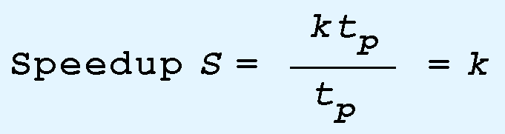
5.5 Instruction-Level Pipelining
If we take the time required to complete n tasks without a pipeline and divide it by the time it takes to complete n tasks using a pipeline, we find:
If we take the limit as n approaches infinity, (k + n - 1) approaches n, which results in a theoretical speedup of:

Slide 35
5.5 Instruction-Level Pipelining
Our neat equations take a number of things for granted.
First, we have to assume that the architecture supports fetching instructions and data in parallel.
Second, we assume that the pipeline can be kept filled at all times. This is not always the case. Pipeline hazards arise that cause pipeline conflicts and stalls.

Slide 36
5.5 Instruction-Level Pipelining
An instruction pipeline may stall, or be flushed for any of the following reasons:
  Resource conflicts.
  Data dependencies.
  Conditional branching.
Measures can be taken at the software level as well as at the hardware level to reduce the effects of these hazards, but they cannot be totally eliminated.

Slide 37
5.6 Real-World Examples of ISAs
We return briefly to the Intel and MIPS architectures from the last chapter, using some of the ideas introduced in this chapter.
Intel introduced pipelining to their processor line with its Pentium chip.
The first Pentium had two five-stage pipelines. Each subsequent Pentium processor had a longer pipeline than its predecessor with the Pentium IV having a 24-stage pipeline.
The Itanium (IA-64) has only a 10-stage pipeline.

Slide 38
5.6 Real-World Examples of ISAs
Intel processors support a wide array of addressing modes.
The original 8086 provided 17 ways to address memory, most of them variants on the methods presented in this chapter.
Owing to their need for backward compatibility, the Pentium chips also support these 17 addressing modes.
The Itanium, having a RISC core, supports only one: register indirect addressing with optional post increment.

Slide 39
5.6 Real-World Examples of ISAs
MIPS was an acronym for Microprocessor Without Interlocked Pipeline Stages.
The architecture is little endian and word-addressable with three-address, fixed-length instructions.
Like Intel, the pipeline size of the MIPS processors has grown: The R2000 and R3000 have five-stage pipelines.; the R4000 and R4400 have 8-stage pipelines.

Slide 40
5.6 Real-World Examples of ISAs
The R10000 has three pipelines: A five-stage pipeline for integer instructions, a seven-stage pipeline for floating-point instructions, and a six-state pipeline for LOAD/STORE instructions.
In all MIPS ISAs, only the LOAD and STORE instructions can access memory.
The ISA uses only base addressing mode.
The assembler accommodates programmers who need to use immediate, register, direct, indirect register, base, or indexed addressing modes.

Slide 41
5.6 Real-World Examples of ISAs
The Java programming language is an interpreted language that runs in a software machine called the Java Virtual Machine (JVM).
A JVM is written in a native language for a wide array of processors, including MIPS and Intel.
Like a real machine, the JVM has an ISA all of its own, called bytecode. This ISA was designed to be compatible with the architecture of any machine on which the JVM is running.
The next slide shows how the pieces fit together.

Slide 42
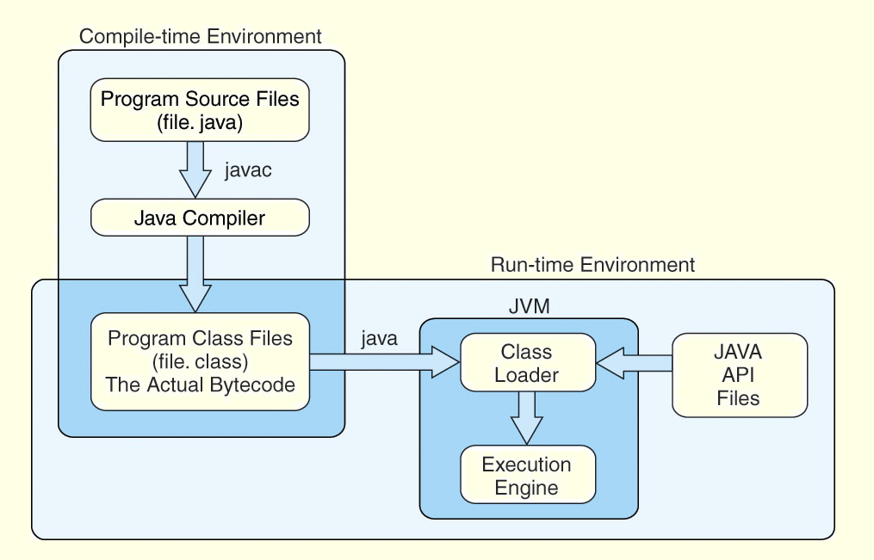
5.6 Real-World Examples of ISAs

Slide 43
5.6 Real-World Examples of ISAs
Java bytecode is a stack-based language.
Most instructions are zero address instructions.
The JVM has four registers that provide access to five regions of main memory.
All references to memory are offsets from these registers. Java uses no pointers or absolute memory references.
Java was designed for platform interoperability, not performance!

Slide 44
Chapter 5 Conclusion
ISAs are distinguished according to their bits per instruction, number of operands per instruction, operand location and types and sizes of operands.
Endianness as another major architectural consideration.
CPU can store store data based on
  1. A stack architecture
  2. An accumulator architecture
  3. A general purpose register architecture.

Slide 45
Chapter 5 Conclusion
Instructions can be fixed length or variable length.
To enrich the instruction set for a fixed length instruction set, expanding opcodes can be used.
The addressing mode of an ISA is also another important factor. We looked at:
  Immediate – Direct
  Register – Register Indirect
  Indirect – Indexed
  Based – Stack

Slide 46
Chapter 5 Conclusion
A k-stage pipeline can theoretically produce execution speedup of k as compared to a non-pipelined machine.
Pipeline hazards such as resource conflicts and conditional branching prevents this speedup from being achieved in practice.
The Intel, MIPS, and JVM architectures provide good examples of the concepts presented in this chapter.

Slide 47
Thanks
Slides adapted from
  http://users.dickinson.edu/~jmac/courses/previous/fall-2008-comp251/book-powerpoints/

