Slide 1
Computer Organization and Architecture
Memory
Ferosh Jacob
Kennesaw State University

Slide 2
Chapter 6 Objectives
Master the concepts of hierarchical memory organization.
Understand how each level of memory contributes to system performance, and how the performance is measured.
Master the concepts behind cache memory, virtual memory, memory segmentation, paging and address translation.

Slide 3
6.1 Introduction
Memory lies at the heart of the stored-program computer.
In previous chapters, we studied the components from which memory is built and the ways in which memory is accessed by various ISAs.
In this chapter, we focus on memory organization. A clear understanding of these ideas is essential for the analysis of system performance.

Slide 4
6.2 Types of Memory
There are two kinds of main memory: random access memory, RAM, and read-only-memory, ROM.
There are two types of RAM, dynamic RAM (DRAM) and static RAM (SRAM).
Dynamic RAM consists of capacitors that slowly leak their charge over time. Thus they must be refreshed every few milliseconds to prevent data loss.
DRAM is “cheap” memory owing to its simple design.

Slide 5
6.2 Types of Memory
SRAM consists of circuits similar to the D flip-flop that we studied in Chapter 3.
SRAM is very fast memory and it doesn’t need to be refreshed like DRAM does. It is used to build cache memory, which we will discuss in detail later.
ROM also does not need to be refreshed, either. In fact, it needs very little charge to retain its memory.
ROM is used to store permanent, or semi-permanent data that persists even while the system is turned off.

Slide 6
6.3 The Memory Hierarchy
Generally speaking, faster memory is more expensive than slower memory.
To provide the best performance at the lowest cost, memory is organized in a hierarchical fashion.
Small, fast storage elements are kept in the CPU, larger, slower main memory is accessed through the data bus.
Larger, (almost) permanent storage in the form of disk and tape drives is still further from the CPU.

Slide 7
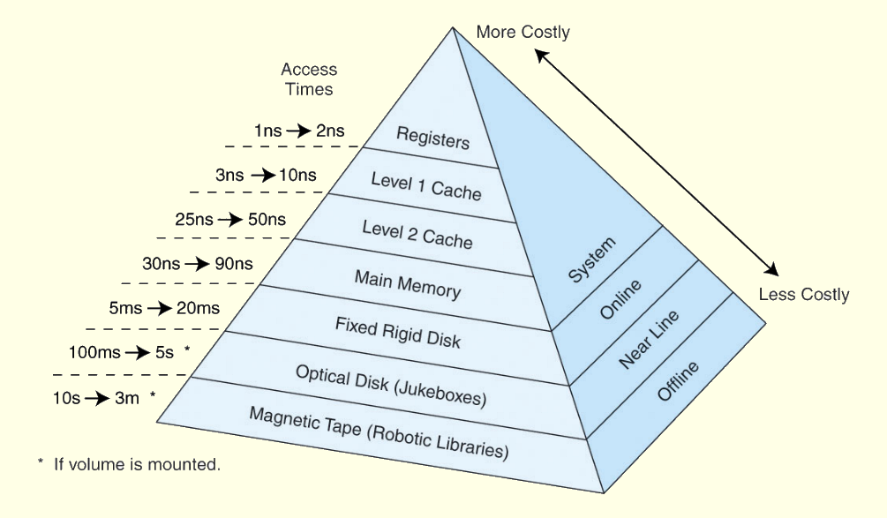
6.3 The Memory Hierarchy
This storage organization can be thought of as a pyramid:

Slide 8
6.3 The Memory Hierarchy
To access a particular piece of data, the CPU first sends a request to its nearest memory, usually cache.
If the data is not in cache, then main memory is queried. If the data is not in main memory, then the request goes to disk.
Once the data is located, then the data, and a number of its nearby data elements are fetched into cache memory.

Slide 9
6.3 The Memory Hierarchy
This leads us to some definitions.
  A hit is when data is found at a given memory level.
  A miss is when it is not found.
  The hit rate is the percentage of time data is found at a given memory level.
  The miss rate is the percentage of time it is not.
  Miss rate = 1 - hit rate.
  The hit time is the time required to access data at a given memory level.
  The miss penalty is the time required to process a miss, including the time that it takes to replace a block of memory plus the time it takes to deliver the data to the processor.

Slide 10
6.3 The Memory Hierarchy
An entire blocks of data is copied after a hit because the principle of locality tells us that once a byte is accessed, it is likely that a nearby data element will be needed soon.
There are three forms of locality:
  Temporal locality- Recently-accessed data elements tend to be accessed again.
  Spatial locality - Accesses tend to cluster.
  Sequential locality - Instructions tend to be accessed sequentially.

Slide 11
6.4 Cache Memory
The purpose of cache memory is to speed up accesses by storing recently used data closer to the CPU, instead of storing it in main memory.
Although cache is much smaller than main memory, its access time is a fraction of that of main memory.
Unlike main memory, which is accessed by address, cache is typically accessed by content; hence, it is often called content addressable memory.
Because of this, a single large cache memory isn’t always desirable-- it takes longer to search.

Slide 12
6.4 Cache Memory
The “content” that is addressed in content addressable cache memory is a subset of the bits of a main memory address called a field.
The fields into which a memory address is divided provide a many-to-one mapping between larger main memory and the smaller cache memory.
Many blocks of main memory map to a single block of cache. A tag field in the cache block distinguishes one cached memory block from another.

Slide 13
6.4 Cache Memory
The simplest cache mapping scheme is direct mapped cache.
In a direct mapped cache consisting of N blocks of cache, block X of main memory maps to cache block Y = X mod N.
Thus, if we have 10 blocks of cache, block 7 of cache may hold blocks 7, 17, 27, 37, . . . of main memory.
Once a block of memory is copied into its slot in cache, a valid bit is set for the cache block to let the system know that the block contains valid data.
What could happen if there were no valid bit?

Slide 14
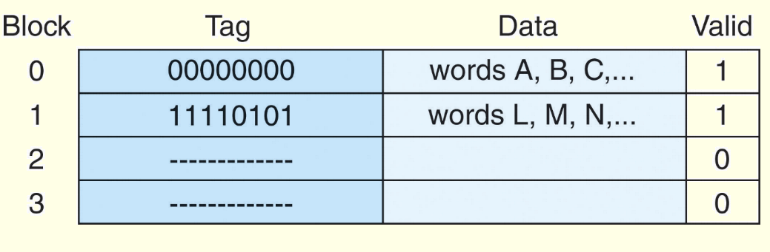
6.4 Cache Memory
The diagram below is a schematic of what cache looks like.
Block 0 contains multiple words from main memory, identified with the tag 00000000. Block 1 contains words identified with the tag 11110101.
The other two blocks are not valid.

Slide 15
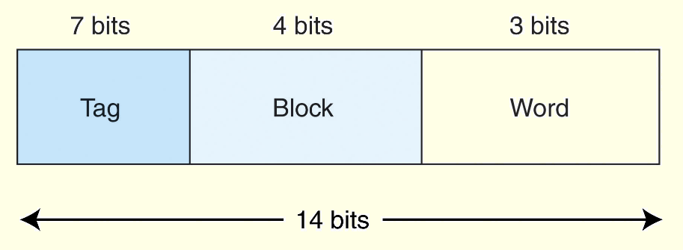
6.4 Cache Memory
The size of each field into which a memory address is divided depends on the size of the cache.
Suppose our memory consists of 2¹⁴ words, cache has 16 = 2⁴ blocks, and each block holds 8 words.
  Thus memory is divided into 2¹⁴ / 2 ⁸ = 2¹¹ blocks.
For our field sizes, we know we need 4 bits for the block, 3 bits for the word, and the tag is what’s left over:

Slide 16
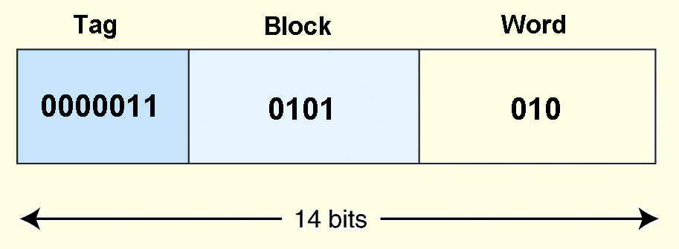
6.4 Cache Memory
As an example, suppose a program generates the address 1AA. In 14-bit binary, this number is: 00000110101010.
The first 7 bits of this address go in the tag field, the next 4 bits go in the block field, and the final 3 bits indicate the word within the block.

Slide 17
6.4 Cache Memory
If subsequently the program generates the address 1AB, it will find the data it is looking for in block 0101, word 011.
However, if the program generates the address, 3AB, instead, the block loaded for address 1AA would be evicted from the cache, and replaced by the blocks associated with the 3AB reference.

Slide 18
6.4 Cache Memory
Suppose a program generates a series of memory references such as: 1AB, 3AB, 1AB, 3AB, . . . The cache will continually evict and replace blocks.
The theoretical advantage offered by the cache is lost in this extreme case.
This is the main disadvantage of direct mapped cache.
Other cache mapping schemes are designed to prevent this kind of thrashing.

Slide 19
6.4 Cache Memory
Instead of placing memory blocks in specific cache locations based on memory address, we could allow a block to go anywhere in cache.
In this way, cache would have to fill up before any blocks are evicted.
This is how fully associative cache works.
A memory address is partitioned into only two fields: the tag and the word.

Slide 20
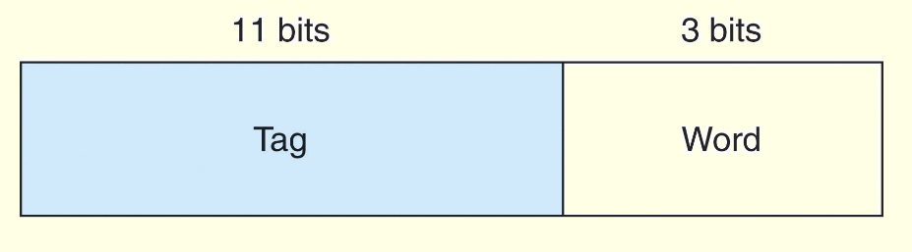
6.4 Cache Memory
Suppose, as before, we have 14-bit memory addresses and a cache with 16 blocks, each block of size 8. The field format of a memory reference is:
When the cache is searched, all tags are searched in parallel to retrieve the data quickly.
This requires special, costly hardware.

Slide 21
6.4 Cache Memory
You will recall that direct mapped cache evicts a block whenever another memory reference needs that block.
With fully associative cache, we have no such mapping, thus we must devise an algorithm to determine which block to evict from the cache.
The block that is evicted is the victim block.
There are a number of ways to pick a victim, we will discuss them shortly.

Slide 22
6.4 Cache Memory
Set associative cache combines the ideas of direct mapped cache and fully associative cache.
An N-way set associative cache mapping is like direct mapped cache in that a memory reference maps to a particular location in cache.
Unlike direct mapped cache, a memory reference maps to a set of several cache blocks, similar to the way in which fully associative cache works.
Instead of mapping anywhere in the entire cache, a memory reference can map only to the subset of cache slots.

Slide 23
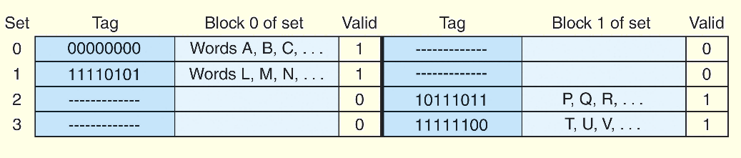
6.4 Cache Memory
The number of cache blocks per set in set associative cache varies according to overall system design.
For example, a 2-way set associative cache can be conceptualized as shown in the schematic below.
Each set contains two different memory blocks.

Slide 24
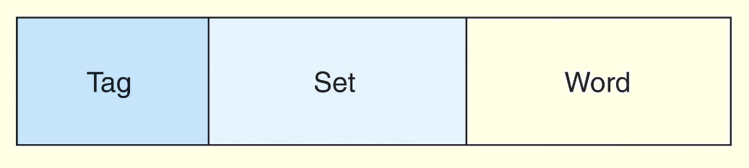
6.4 Cache Memory
In set associative cache mapping, a memory reference is divided into three fields: tag, set, and word, as shown below.
As with direct-mapped cache, the word field chooses the word within the cache block, and the tag field uniquely identifies the memory address.
The set field determines the set to which the memory block maps.

Slide 25
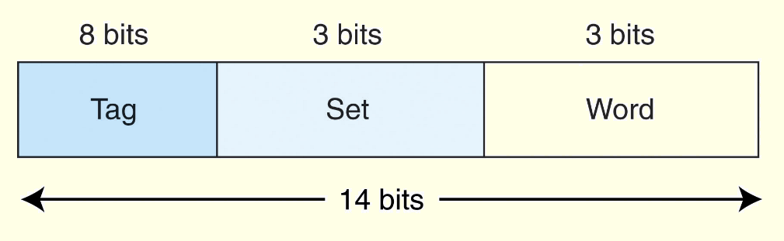
6.4 Cache Memory
Suppose we have a main memory of 2¹⁴ bytes.
This memory is mapped to a 2-way set associative cache having 16 blocks where each block contains 8 words.
Since this is a 2-way cache, each set consists of 2 blocks, and there are 8 sets.
Thus, we need 3 bits for the set, 3 bits for the word, giving 8 leftover bits for the tag:

Slide 26
6.4 Cache Memory
With fully associative and set associative cache, a replacement policy is invoked when it becomes necessary to evict a block from cache.
An optimal replacement policy would be able to look into the future to see which blocks won’t be needed for the longest period of time.
Although it is impossible to implement an optimal replacement algorithm, it is instructive to use it as a benchmark for assessing the efficiency of any other scheme we come up with.

Slide 27
6.4 Cache Memory
The replacement policy that we choose depends upon the locality that we are trying to optimize-- usually, we are interested in temporal locality.
A least recently used (LRU) algorithm keeps track of the last time that a block was assessed and evicts the block that has been unused for the longest period of time.
The disadvantage of this approach is its complexity: LRU has to maintain an access history for each block, which ultimately slows down the cache.

Slide 28
6.4 Cache Memory
First-in, first-out (FIFO) is a popular cache replacement policy.
In FIFO, the block that has been in the cache the longest, regardless of when it was last used.
A random replacement policy does what its name implies: It picks a block at random and replaces it with a new block.
Random replacement can certainly evict a block that will be needed often or needed soon, but it never thrashes.

Slide 29
6.4 Cache Memory
The performance of hierarchical memory is measured by its effective access time (EAT).
EAT is a weighted average that takes into account the hit ratio and relative access times of successive levels of memory.
The EAT for a two-level memory is given by:
EAT = H × Access_{C} + (1-H) × Access_{MM}.
  where H is the cache hit rate and Access_{C} and Access_{MM} are the access times for cache and main memory, respectively.

Slide 30
6.4 Cache Memory
For example, consider a system with a main memory access time of 200ns supported by a cache having a 10ns access time and a hit rate of 99%.
The EAT is:
0.99(10ns) + 0.01(200ns) = 9.9ns + 2ns = 11ns.
This equation for determining the effective access time can be extended to any number of memory levels, as we will see in later sections.

Slide 31
6.4 Cache Memory
Cache replacement policies must also take into account dirty blocks, those blocks that have been updated while they were in the cache.
Dirty blocks must be written back to memory. A write policy determines how this will be done.
There are two types of write policies,write through and write back.
Write through updates cache and main memory simultaneously on every write.

Slide 32
6.4 Cache Memory
Write back (also called copyback) updates memory only when the block is selected for replacement.
The disadvantage of write through is that memory must be updated with each cache write, which slows down the access time on updates. This slowdown is usually negligible, because the majority of accesses tend to be reads, not writes.
The advantage of write back is that memory traffic is minimized, but its disadvantage is that memory does not always agree with the value in cache, causing problems in systems with many concurrent users.

Slide 33
6.4 Cache Memory
The cache we have been discussing is called a unified or integrated cache where both instructions and data are cached.
Many modern systems employ separate caches for data and instructions.
  This is called a Harvard cache.
The separation of data from instructions provides better locality, at the cost of greater complexity.
  Simply making the cache larger provides about the same performance improvement without the complexity.

Slide 34
6.4 Cache Memory
Cache performance can also be improved by adding a small associative cache to hold blocks that have been evicted recently.
  This is called a victim cache.
A trace cache is a variant of an instruction cache that holds decoded instructions for program branches, giving the illusion that noncontiguous instructions are really contiguous.

Slide 35
6.4 Cache Memory
Most of today’s small systems employ multilevel cache hierarchies.
The levels of cache form their own small memory hierarchy.
Level1 cache (8KB to 64KB) is situated on the processor itself.
  Access time is typically about 4ns.
Level 2 cache (64KB to 2MB) may be on the motherboard, or on an expansion card.
  Access time is usually around 15 - 20ns.

Slide 36
6.4 Cache Memory
In systems that employ three levels of cache, the Level 2 cache is placed on the same die as the CPU (reducing access time to about 10ns)
Accordingly, the Level 3 cache (2MB to 256MB) refers to cache that is situated between the processor and main memory.
Once the number of cache levels is determined, the next thing to consider is whether data (or instructions) can exist in more than one cache level.

Slide 37
6.4 Cache Memory
If the cache system used an inclusive cache, the same data may be present at multiple levels of cache.
Strictly inclusive caches guarantee that all data in a smaller cache also exists at the next higher level.
Exclusive caches permit only one copy of the data.
The tradeoffs in choosing one over the other involve weighing the variables of access time, memory size, and circuit complexity.

Slide 38
6.5 Virtual Memory
Cache memory enhances performance by providing faster memory access speed.
Virtual memory enhances performance by providing greater memory capacity, without the expense of adding main memory.
Instead, a portion of a disk drive serves as an extension of main memory.
If a system uses paging, virtual memory partitions main memory into individually managed page frames, that are written (or paged) to disk when they are not immediately needed.

Slide 39
6.5 Virtual Memory
A physical address is the actual memory address of physical memory.
Programs create virtual addresses that are mapped to physical addresses by the memory manager.
Page faults occur when a logical address requires that a page be brought in from disk.
Memory fragmentation occurs when the paging process results in the creation of small, unusable clusters of memory addresses.

Slide 40
6.5 Virtual Memory
Main memory and virtual memory are divided into equal sized pages.
The entire address space required by a process need not be in memory at once. Some parts can be on disk, while others are in main memory.
Further, the pages allocated to a process do not need to be stored contiguously-- either on disk or in memory.
In this way, only the needed pages are in memory at any time, the unnecessary pages are in slower disk storage.

Slide 41
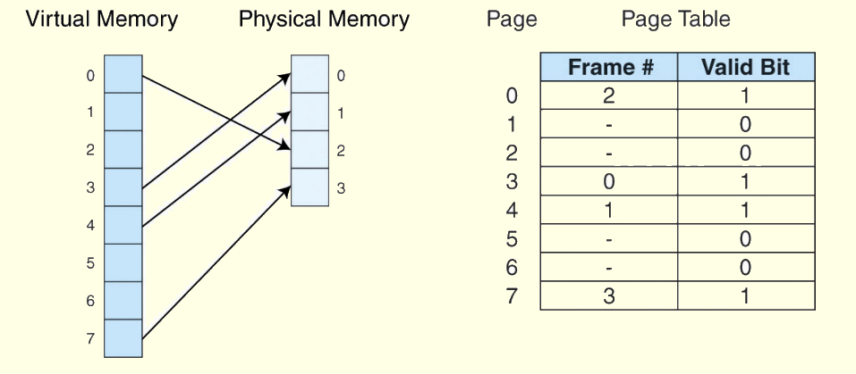
6.5 Virtual Memory
Information concerning the location of each page, whether on disk or in memory, is maintained in a data structure called a page table (shown below).
There is one page table for each active process.

Slide 42
6.5 Virtual Memory
When a process generates a virtual address, the operating system translates it into a physical memory address.
To accomplish this, the virtual address is divided into two fields: A page field, and an offset field.
The page field determines the page location of the address, and the offset indicates the location of the address within the page.
The logical page number is translated into a physical page frame through a lookup in the page table.

Slide 43
6.5 Virtual Memory
If the valid bit is zero in the page table entry for the logical address, this means that the page is not in memory and must be fetched from disk.
  This is a page fault.
  If necessary, a page is evicted from memory and is replaced by the page retrieved from disk, and the valid bit is set to 1.
If the valid bit is 1, the virtual page number is replaced by the physical frame number.
The data is then accessed by adding the offset to the physical frame number.

Slide 44
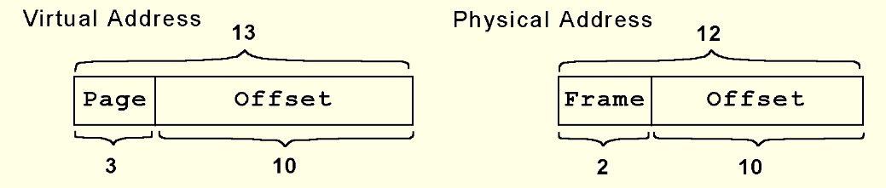
6.5 Virtual Memory
As an example, suppose a system has a virtual address space of 8K and a physical address space of 4K, and the system uses byte addressing.
  We have 2¹³/2¹⁰ = 2³ virtual pages.
A virtual address has 13 bits (8K = 2¹³) with 3 bits for the page field and 10 for the offset, because the page size is 1024.
A physical memory address requires 12 bits, the first two bits for the page frame and the trailing 10 bits the offset.

Slide 45
6.5 Virtual Memory
We said earlier that effective access time (EAT) takes all levels of memory into consideration.
Thus, virtual memory is also a factor in the calculation, and we also have to consider page table access time.
Suppose a main memory access takes 200ns, the page fault rate is 1%, and it takes 10ms to load a page from disk. We have:
  EAT = 0.99(200ns + 200ns) 0.01(10ms) = 100, 396ns.

Slide 46
6.5 Virtual Memory
Even if we had no page faults, the EAT would be 400ns because memory is always read twice: First to access the page table, and second to load the page from memory.
Because page tables are read constantly, it makes sense to keep them in a special cache called a translation look-aside buffer (TLB).
TLBs are a special associative cache that stores the mapping of virtual pages to physical pages.
The next slide shows how all the pieces fit together.

Slide 47
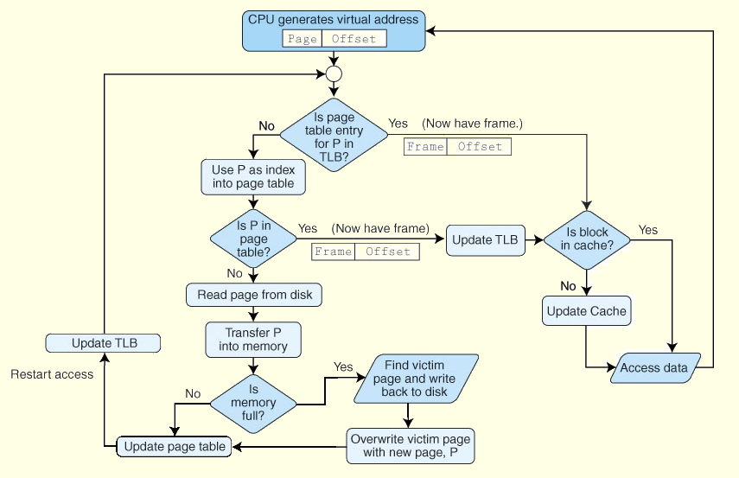
6.5 Virtual Memory

Slide 48
6.5 Virtual Memory
Another approach to virtual memory is the use of segmentation.
Instead of dividing memory into equal-sized pages, virtual address space is divided into variable-length segments, often under the control of the programmer.
A segment is located through its entry in a segment table, which contains the segment’s memory location and a bounds limit that indicates its size.
After a page fault, the operating system searches for a location in memory large enough to hold the segment that is retrieved from disk.

Slide 49
6.5 Virtual Memory
Both paging and segmentation can cause fragmentation.
Paging is subject to internal fragmentation because a process may not need the entire range of addresses contained within the page. Thus, there may be many pages containing unused fragments of memory.
Segmentation is subject to external fragmentation, which occurs when contiguous chunks of memory become broken up as segments are allocated and deallocated over time.

Slide 50
6.5 Virtual Memory
Large page tables are cumbersome and slow, but with its uniform memory mapping, page operations are fast. Segmentation allows fast access to the segment table, but segment loading is labor-intensive.
Paging and segmentation can be combined to take advantage of the best features of both by assigning fixed-size pages within variable-sized segments.
Each segment has a page table. This means that a memory address will have three fields, one for the segment, another for the page, and a third for the offset.

Slide 51
6.6 A Real-World Example
The Pentium architecture supports both paging and segmentation, and they can be used in various combinations including unpaged unsegmented, segmented unpaged, and unsegmented paged.
The processor supports two levels of cache (L1 and L2), both having a block size of 32 bytes.
The L1 cache is next to the processor, and the L2 cache sits between the processor and memory.
The L1 cache is in two parts: and instruction cache (I-cache) and a data cache (D-cache).
The next slide shows this organization schematically.

Slide 52
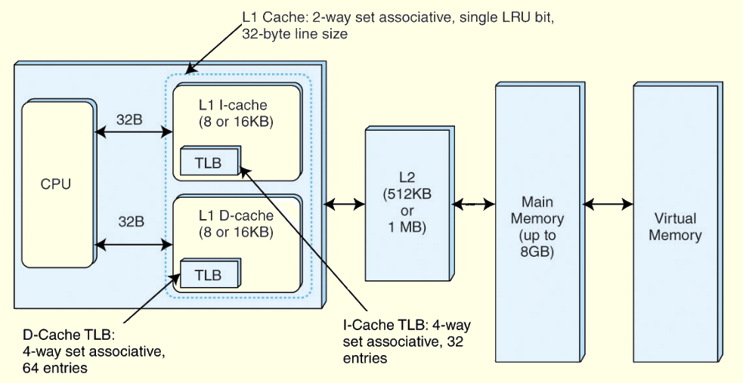
6.6 A Real-World Example

Slide 53
Chapter 6 Conclusion
Computer memory is organized in a hierarchy, with the smallest, fastest memory at the top and the largest, slowest memory at the bottom.
Cache memory gives faster access to main memory, while virtual memory uses disk storage to give the illusion of having a large main memory.
Cache maps blocks of main memory to blocks of cache memory. Virtual memory maps page frames to virtual pages.
There are three general types of cache: Direct mapped, fully associative and set associative.

Slide 54
Chapter 6 Conclusion
With fully associative and set associative cache, as well as with virtual memory, replacement policies must be established.
Replacement policies include LRU, FIFO, or LFU. These policies must also take into account what to do with dirty blocks.
All virtual memory must deal with fragmentation, internal for paged memory, external for segmented memory.

Slide 55
Thanks
Slides adapted from
  http://users.dickinson.edu/~jmac/courses/previous/fall-2008-comp251/book-powerpoints/

