Slide 1

Chapter 7 Special Section
Focus on Data Compression

Slide 2

7A Objectives
Understand the essential ideas underlying data compression.
Become familiar with the different types of compression algorithm.
Be able to describe the most popular data compression algorithms in use today and know the applications for which each is suitable.

Slide 3
7A.1 Introduction
Data compression is important to storage systems because it allows more bytes to be packed into a given storage medium than when the data is uncompressed.
Some storage devices (notably tape) compress data automatically as it is written, resulting in less tape consumption and significantly faster backup operations.
Compression also reduces file transfer time, saving time and communications bandwidth.

Slide 4
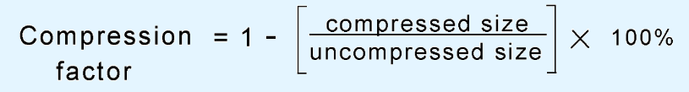
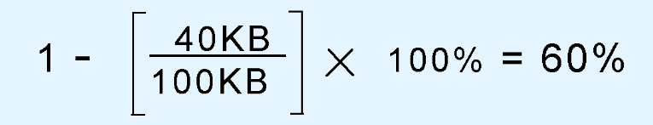
7A.1 Introduction
A good metric for compression is the compression factor (or compression ratio) given by:
If we have a 100KB file that we compress to 40KB, we have a compression factor of:

Slide 5
7A.1 Introduction
Compression is achieved by removing data redundancy while preserving information content.
The information content of a group of bytes (a message) is its entropy.
  Data with low entropy permit a larger compression ratio than data with high entropy.
Entropy, H, is a function of symbol frequency. It is the weighted average of the number of bits required to encode the symbols of a message:
  H= -P(x) × log₂P(x_{i})

Slide 6
7A.1 Introduction
The entropy of the entire message is the sum of the individual symbol entropies.
  ∑ -P(x) × log₂P(x_{i})
The average redundancy for each character in a message of length l is given by:
∑ P(x) × l_{i} - ∑ -P(x) × log₂P(x_{i})

Slide 7
7A.2 Statistical Coding
Consider the message: HELLO WORLD!
  The letter L has a probability of 3/12 = 1/4 of appearing in this message. The number of bits required to encode this symbol is -log₂(1/4) = 2.
Using our formula, ∑ -P(x) × log₂P(x_{i}), the average entropy of the entire message is 3.022.
  This means that the theoretical minimum number of bits per character is 3.022.
Theoretically, the message could be sent using only 37 bits. (3.022 ×12 = 36.26)

Slide 8
7A.2 Statistical Coding
The entropy metric just described forms the basis for statistical data compression.
Two widely-used statistical coding algorithms are Huffman coding and arithmetic coding.
Huffman coding builds a binary tree from the letter frequencies in the message.
  The binary symbols for each character are read directly from the tree.
Symbols with the highest frequencies end up at the top of the tree, and result in the shortest codes.

Slide 9
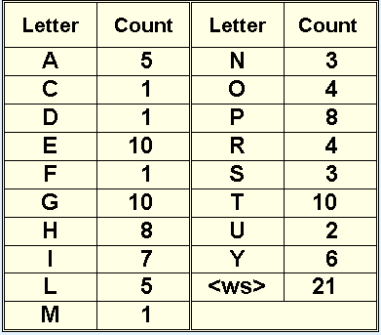
7A.2 Statistical Coding
The process of building the tree begins by counting the occurrences of each symbol in the text to be encoded.
HIGGLETY PIGGLTY POP
THE DOG HAS EATEN THE MOP
THE PIGS IN A HURRY
THE CATS IN A FLURRY
HIGGLETY PIGGLTY POP

Slide 10
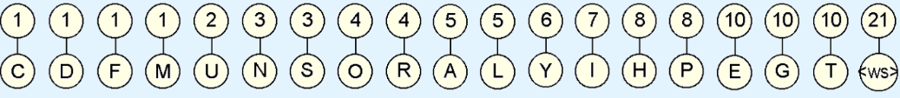
7A.2 Statistical Coding
Next, place the letters and their frequencies into a forest of trees that each have two nodes: one for the letter, and one for its frequency.

Slide 11
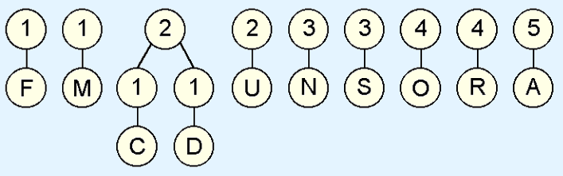
7A.2 Statistical Coding
We start building the tree by joining the nodes having the two lowest frequencies.

Slide 12
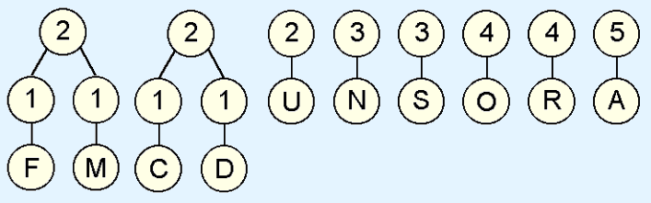
7A.2 Statistical Coding
And then we again join the nodes with two lowest frequencies.

Slide 13
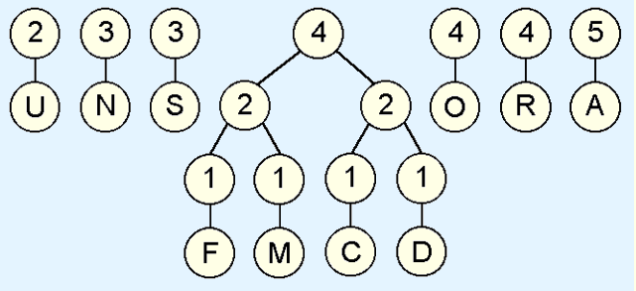
7A.2 Statistical Coding
And again ....

Slide 14
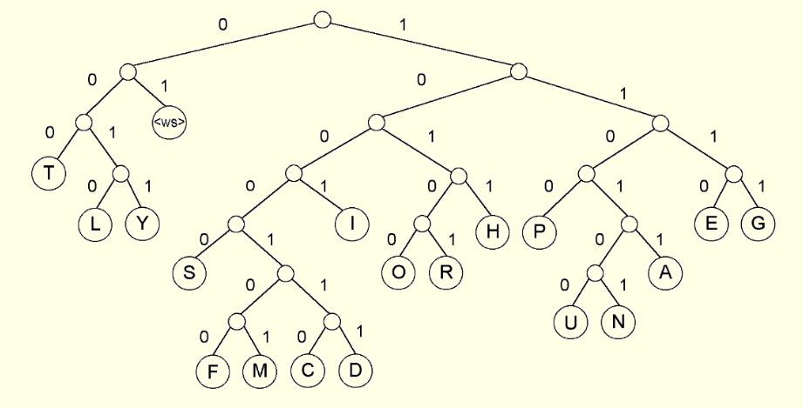
7A.2 Statistical Coding
Here is our finished tree.

Slide 15
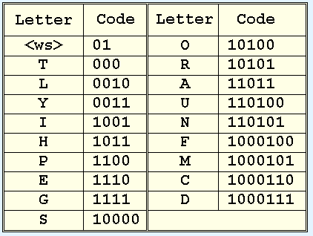
7A.2 Statistical Coding
This is the code derived from this tree.

Slide 16
7A.2 Statistical Coding
The second type of statistical coding, arithmetic coding, partitions the real number interval between 0 and 1 into segments according to symbol probabilities.
  An abbreviated algorithm for this process is given in the text.
Arithmetic coding is computationally intensive and it runs the risk of causing divide underflow.
Variations in floating-point representation among various systems can also cause the terminal condition (a zero value) to be missed.

Slide 17
7A.2 Statistical Coding
For most data, statistical coding methods offer excellent compression ratios.
Their main disadvantage is that they require two passes over the data to be encoded.
  The first pass calculates probabilities, the second encodes the message.
This approach is unacceptably slow for storage systems, where data must be read, written, and compressed within one pass over a file.

Slide 18
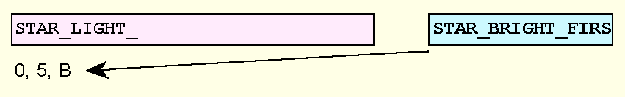
7A.3 LZ Dictionary Systems
Ziv-Lempel (LZ) dictionary systems solve the two-pass problem by using values in the data as a dictionary to encode itself.
The LZ77 compression algorithm employs a text window in conjunction with a lookahead buffer.
  The text window serves as the dictionary. If text is found in the lookahead buffer that matches text in the dictionary, the location and length of the text in the window is output.

Slide 19
7A.3 LZ Dictionary Systems
The LZ77 implementations include PKZIP and IBM’s RAMAC RVA 2 Turbo disk array.
  The simplicity of LZ77 lends itself well to a hardware implementation.
LZ78 is another dictionary coding system.
It removes the LZ77 constraint of a fixed-size window. Instead, it creates a trie as the data is read.
Where LZ77 uses pointers to locations in a dictionary, LZ78 uses pointers to nodes in the trie.

Slide 20
7A.4 GIF and PNG Compression
GIF compression is a variant of LZ78, called LZW, for Lempel-Ziv-Welsh.
It improves upon LZ78 through its efficient management of the size of the trie.
Terry Welsh, the designer of LZW, was employed by the Unisys Corporation when he created the algorithm, and Unisys subsequently patented it.
Owing to royalty disputes, development of another algorithm PNG, was hastened.

Slide 21
7A.4 GIF and PNG Compression
PNG employs two types of compression, first a Huffman algorithm is applied, which is followed by LZ77 compression.
The advantage that GIF holds over PNG, is that GIF supports multiple images in one file.
MNG is an extension of PNG that supports multiple images in one file.
GIF, PNG, and MNG are primarily used for graphics compression. To compress larger, photographic images, JEPG is often more suitable.

Slide 22
7A.5 JPEG Compression
Photographic images incorporate a great deal of information. However, much of that information can be lost without objectionable deterioration in image quality.
With this in mind, JPEG allows user-selectable image quality, but even at the “best” quality levels, JPEG makes an image file smaller owing to its multiple-step compression algorithm.
It’s important to remember that JPEG is lossy, even at the highest quality setting. It should be used only when the loss can be tolerated.
The JPEG algorithm is illustrated on the next slide.

Slide 23
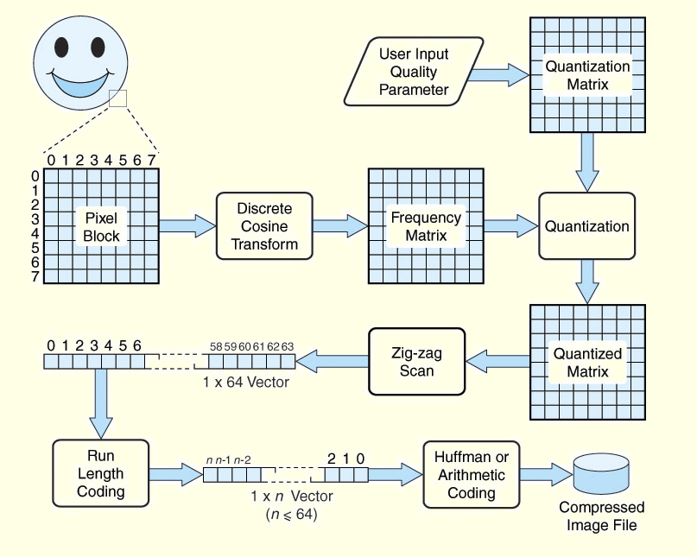
7A.5 JPEG Compression

Slide 24
Section 7A Conclusion
Two approaches to data compression are statistical data compression and dictionary systems.
Statistical coding requires two passes over the input, dictionary systems require only one.
LZ77 and LZ78 are two popular dictionary systems.
GIF, PNG, MNG, and JPEG are used for image compression.
JPEG is lossy, so its use is not suited for all types of images.

Slide 25
End of Section 7A

