Slide 1
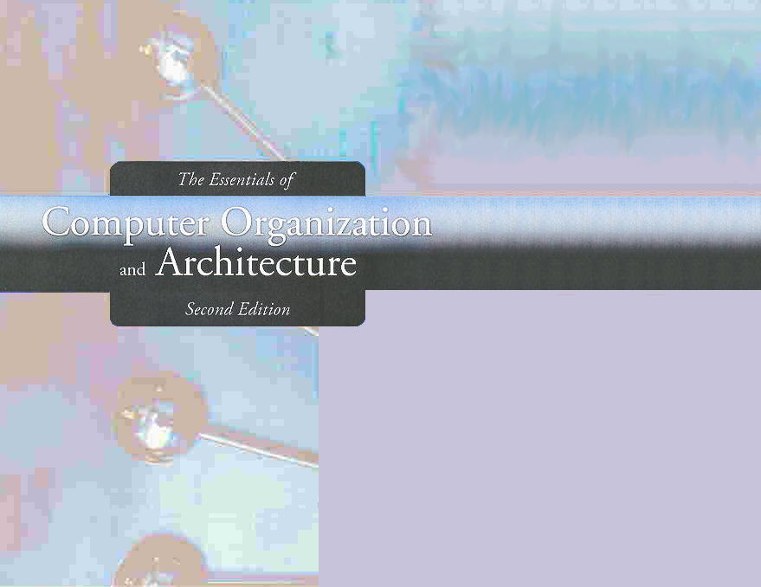
Chapter 12
Network Organization and Architecture

Slide 2

Chapter 12Objectives
Become familiar with the fundamentals of network architectures.
Learn the basic components of a local area network.
Become familiar with the general architecture of the Internet.

Slide 3
12.1 Introduction
The network is a crucial component of today’s computing systems.
Resource sharing across networks has taken the form of multitier architectures having numerous disparate servers, sometimes far removed from the users of the system.
If you think of a computing system as collection of workstations and servers, then surely the network is the system bus of this configuration.

Slide 4
12.2 Early Business Computer Networks
The first computer networks consisted of a mainframe host that was connected to one or more front end processors.
Front end processors received input over dedicated lines from remote communications controllers connected to several dumb terminals.
The protocols employed by this configuration were proprietary to each vendor’s system.
One of these, IBM’s SNA became the model for an international communications standard, the ISO/OSI Reference Model.

Slide 5
12.3 Early Academic and Scientific Networks
In the 1960s, the Advanced Research Projects Agency funded research under the auspices of the U.S. Department of Defense.
Computers at that time were few and costly. In 1968, the Defense Department funded an interconnecting network to make the most of these precious resources.
The network, DARPANet, designed by Bolt, Beranek, and Newman, had sufficient redundancy to withstand the loss of a good portion of the network.
DARPANet, later turned over to the public domain, eventually evolved to become today’s Internet.

Slide 6
12.4 Network Protocols I ISO/OSI Reference Model
To address the growing tangle of incompatible proprietary network protocols, in 1984 the ISO formed a committee to devise a unified protocol standard.
The result of this effort is the ISO Open Systems Interconnect Reference Model (ISO/OSI RM).
The ISO’s work is called a reference model because virtually no commercial system uses all of the features precisely as specified in the model.
The ISO/OSI model does, however, lend itself to understanding the concept of a unified communications architecture.

Slide 7
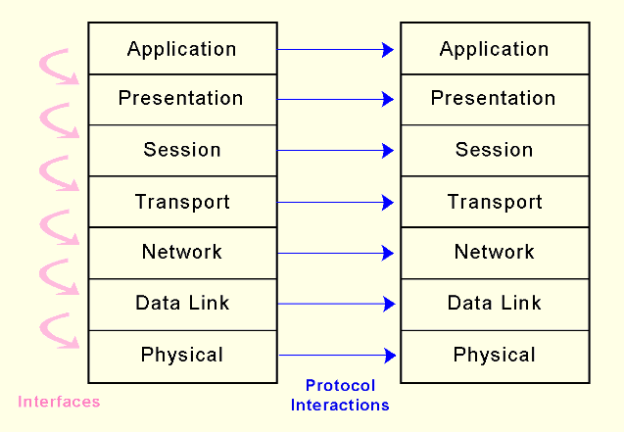
12.4 Network Protocols I ISO/OSI Reference Model
The OSI RM contains seven protocol layers, starting with physical media interconnections at Layer 1, through applications at Layer 7.

Slide 8
12.4 Network Protocols I ISO/OSI Reference Model
OSI model defines only the functions of each of the seven layers and the interfaces between them.
Implementation details are not part of the model.

Slide 9
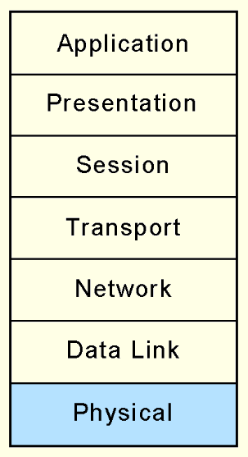
12.4 Network Protocols I ISO/OSI Reference Model
The Physical layer receives a stream of bits from the Data Link layer above it, encodes them and places them on the communications medium.
The Physical layer conveys transmission frames, called Physical Protocol Data Units, or Physical PDUs. Each physical PDU carries an address and has delimiter signal patterns that surround the payload, or contents, of the PDU.

Slide 10
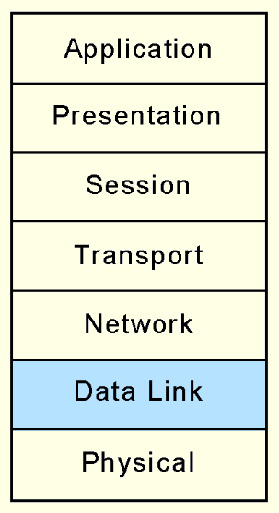
12.4 Network Protocols I ISO/OSI Reference Model
The Data Link layer negotiates frame sizes and the speed at which they are sent with the Data Link layer at the other end.
  The timing of frame transmission is called flow control.
Data Link layers at both ends acknowledge packets as they are exchanged. The sender retransmits the packet if no acknowledgement is received within a given time interval.

Slide 11
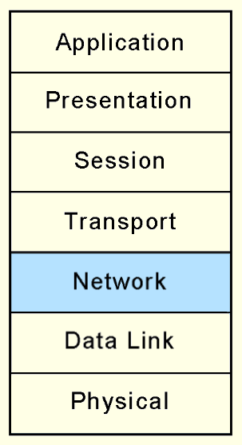
12.4 Network Protocols I ISO/OSI Reference Model
At the originating computers, the Network layer adds addressing information to the Transport layer PDUs.
The Network layer establishes the route and ensures that the PDU size is compatible with all of the equipment between the source and the destination.
Its most important job is in moving PDUs across intermediate nodes.

Slide 12
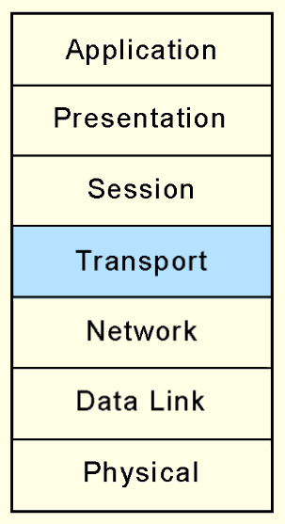
12.4 Network Protocols I ISO/OSI Reference Model
the OSI Transport layer provides end-to-end acknowledgement and error correction through its handshaking with the Transport layer at the other end of the conversation.
  The Transport layer is the lowest layer of the OSI model at which there is any awareness of the network or its protocols.
Transport layer assures the Session layer that there are no network-induced errors in the PDU.

Slide 13
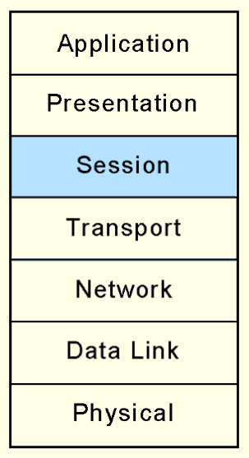
12.4 Network Protocols I ISO/OSI Reference Model
The Session layer arbitrates the dialogue between two communicating nodes, opening and closing that dialogue as necessary.
It controls the direction and mode (half -duplex or full-duplex).
It also supplies recovery checkpoints during file transfers.
Checkpoints are issued each time a block of data is acknowledged as being received in good condition.

Slide 14
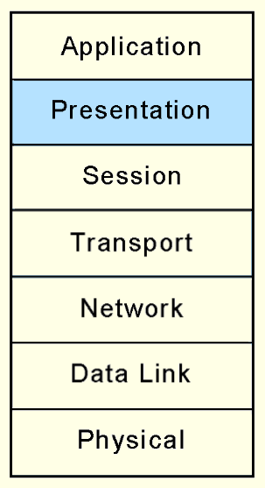
12.4 Network Protocols I ISO/OSI Reference Model
The Presentation layer provides high-level data interpretation services for the Application layer above it, such as EBCDIC-to-ASCII translation.
Presentation layer services are also called into play if we use encryption or certain types of data compression.

Slide 15
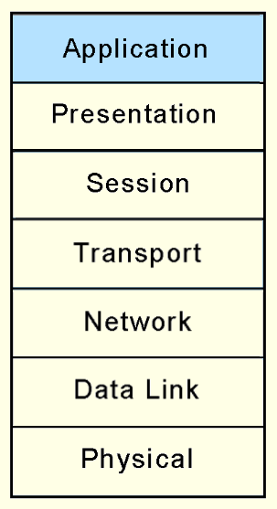
12.4 Network Protocols I ISO/OSI Reference Model
The Application layer supplies meaningful information and services to users at one end of the communication and interfaces with system resources (programs and data files) at the other end of the communication.
All that applications need to do is to send messages to the Presentation layer, and the lower layers take care of the hard part.

Slide 16
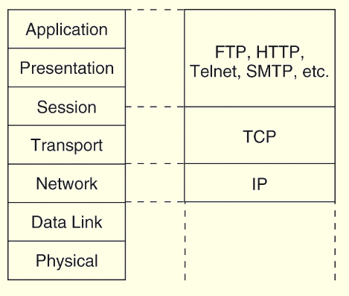
12.4 Network Protocols II TCP/IP Architecture
TCP/IP is the de facto global data communications standard.
It has a lean 3-layer protocol stack that can be mapped to five of the seven in the OSI model.
TCP/IP can be used with any type of network, even different types of networks within a single session.

Slide 17
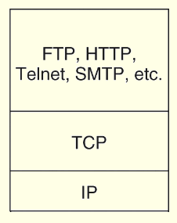
12.4 Network Protocols II TCP/IP Architecture
The IP Layer of the TCP/IP protocol stack provides essentially the same services as the Network and Data Link layers of the OSI Reference Model.
It divides TCP packets into protocol data units called datagrams, and then attaches routing information.

Slide 18
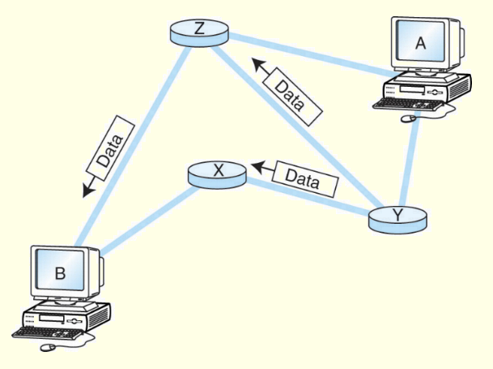
12.4 Network Protocols II TCP/IP Architecture
The concept of the datagram was fundamental to the robustness of ARPAnet, and now, the Internet.
Datagrams can take any route available to them without human intervention.

Slide 19
12.4 Network Protocols II TCP/IP Architecture
The current version of IP, IPv4, was never designed to serve millions of network components scattered across the globe.
It limitations include 32-bit addresses, a packet length limited to 65,635 bytes, and that all security measures are optional.
Furthermore, network addresses have been assigned with little planning which has resulted in slow and cumbersome routing hardware and software.
We will see later how these problems have been addressed by IPv6.

Slide 20
12.4 Network Protocols II TCP/IP Architecture
Transmission Control Protocol (TCP) is the consumer of IP services.
It engages in a conversation-- a connection-- with the TCP process running on the remote system.
A TCP connection is analogous to a telephone conversation, with its own protocol "etiquette."

Slide 21
12.4 Network Protocols II TCP/IP Architecture
As part of initiating a connection, TCP also opens a service access point (SAP) in the application running above it.
In TCP, this SAP is a numerical value called a port.
The combination of the port number, the host ID, and the protocol designation becomes a socket, which is logically equivalent to a file name (or handle) to the application running above TCP.
Port numbers 0 through 1023 are called “well-known” port numbers because they are reserved for particular TCP applications.

Slide 22
12.4 Network Protocols II TCP/IP Architecture
TCP makes sure that the stream of data it provides to the application is complete, in its proper sequence and that no data is duplicated.
TCP also makes sure that its segments aren’t sent so fast that they overwhelm intermediate nodes or the receiver.
A TCP segment requires at least 20 bytes for its header. The data payload is optional.
A segment can be at most 65,656 bytes long, including the header, so that the entire segment fits into an IP payload.

Slide 23
12.4 Network Protocols II TCP/IP Architecture
In 1994, the Internet Engineering Task Force began work on what is now IP Version 6.
The IETF's primary motivation in designing a successor to IPv4 was, of course, to extend IP's address space beyond its current 32-bit limit to 128 bits for both the source and destination host addresses.
  This is a seemingly inexhaustible address space, giving 2¹²⁸ possible host addresses.
The IETF also devised the Aggregatable Global Unicast Address Format to manage this huge address space.

Slide 24
12.4 Network Protocols II TCP/IP Architecture
In 1994, the Internet Engineering Task Force began work on what is now IP Version 6.
The IETF's primary motivation in designing a successor to IPv4 was, of course, to extend IP's address space beyond its current 32-bit limit to 128 bits for both the source and destination host addresses.
  This is a seemingly inexhaustible address space, giving 2¹²⁸ possible host addresses.
The IETF also devised the Aggregatable Global Unicast Address Format to manage this huge address space.

Slide 25
12.6 Network Organization
Computer networks are often classified according to their geographic service areas.
The smallest networks are local area networks (LANs). LANs are typically used in a single building, or a group of buildings that are near each other.
Metropolitan area networks (MANs) are networks that cover a city and its environs.
  LANs are becoming faster and more easily integrated with WAN technology, it is conceivable that someday the concept of a MAN may disappear entirely.
Wide area networks (WANs) can cover multiple cities, or span the entire world.

Slide 26
12.6 Network Organization
In this section, we examine the physical network components common to LANs, MANs and WANs.
We start at the lowest level of network organization, the physical medium level, Layer 1.
There are two general types of communications media: Guided transmission media and unguided transmission media.
Unguided media broadcast data over the airwaves using infrared, microwave, satellite, or broadcast radio carrier signals.

Slide 27
12.6 Network Organization
Guided media are physical connectors such as copper wire or fiber optic cable that directly connect to each network node.
The electrical phenomena that work against the accurate transmission of signals are called noise.
Signal and noise strengths are both measured in decibels (dB).
Cables are rated according to how well they convey signals at different frequencies in the presence of noise.

Slide 28
12.6 Network Organization
The signal-to-noise rating, measured in decibels, quantifies the quality of the communications channel.
The bandwidth of a medium is technically the range of frequencies that it can carry, measured in Hertz.
In digital communications, bandwidth is the general term for the information-carrying capacity of a medium, measured in bits per second (bps).
Another important measure is bit error rate (BER), which is the ratio of the number of bits received in error to the total number of bits received.

Slide 29
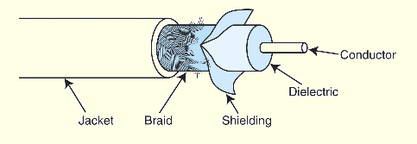
12.6 Network Organization
Coaxial cable was once the medium of choice for data communications.
It can carry signals up to trillions of cycles per second with low attenuation.
  Today, it is used mostly for broadcast and closed circuit television applications.
_
Coaxial cable also carries signals for residential Internet services that piggyback on cable television lines.

Slide 30
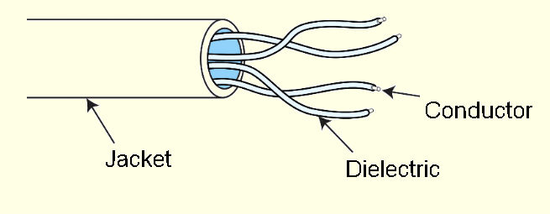
12.6 Network Organization
Twisted pair cabling, containing two twisted wire pairs, is found in most local area network installations today.
It comes in two varieties: shielded and unshielded. Unshielded twisted pair is the most popular.
_
The twists in the cable reduce inductance while the shielding protects the cable from outside interference..

Slide 31
12.6 Network Organization
Electronic Industries Alliance (EIA), along with the Telecommunications Industry Association (TIA) established a rating system called EIA/TIA-568B.
The EIA/TIA category ratings specify the maximum frequency that the cable can support without excessive attenuation.
The ISO rating system refers to these wire grades as classes.
Most local area networks installed today are equipped with Category 5 or better cabling. Some are installing fiber optic cable.

Slide 32
12.6 Network Organization
Optical fiber network media can carry signals faster and farther than either or twisted pair or coaxial cable.
Fiber optic cable is theoretically able to support frequencies in the terahertz range, but transmission speeds are more commonly in the range of about two gigahertz, carried over runs of 10 to 100 Km (without repeaters).
Optical cable consists of bundles of thin (1.5 to 125 μm) glass or plastic strands surrounded by a protective plastic sheath.

Slide 33


12.6 Network Organization
Optical fiber supports three different transmission modes depending on the type of fiber used.
Single-mode fiber provides the fastest data rates over the longest distances. It passes light at only one wavelength, typically, 850, 1300 or 1500 nanometers.
Multimode fiber can carry several different light wavelengths simultaneously through a larger fiber core.

Slide 34

12.6 Network Organization
Multimode graded index fiber also supports multiple wavelengths concurrently, but it does so in a more controlled manner than regular multimode fiber
Unlike regular multimode fiber, light waves are confined to the area of the optical fiber that is suitable to propagating its particular wavelength.
Thus, different wavelengths concurrently transmitted through the fiber do not interfere with each other.

Slide 35
12.6 Network Organization
Fiber optic media offer many advantages over copper, the most obvious being its enormous signal-carrying capacity.
It is also immune to EMI and RFI, making it ideal for deployment in industrial facilities.
Fiber optic is small and lightweight, one fiber being capable of replacing hundreds of pairs of copper wires.
But optical cable is fragile and costly to purchase and install. Because of this, fiber is most often used as network backbone cable, which bears the traffic of hundreds or thousands of users.

Slide 36
12.6 Network Organization
Unguided data communications media transmit byes over carrier waves such as those provided by cellular telephone networks, Bluetooth, and 802.11x.
  There are others, including free space optical lasers, microwaves, and satellite communications, to name a few.
Cellular wireless networks use a cellular telephone network to transmit data.
First generation technology allowed a maximum transmission rate of around 1Mbps.

Slide 37
12.6 Network Organization
Cell network data technology is now in its third generation (3G).
Transmission rates up to 2.048Mbps are supported.
3G also supports a wide array of equipment, including the seamless integration of low-Earth-orbiting (LEO) satellites.
This technology makes it possible for the entire world to finally have access to the World Wide Web!

Slide 38
12.6 Network Organization
Bluetooth, also known as IEEE 802.15.1-2002 was first conceived by Ericsson in 1994.
Bluetooth’s purpose is to connect small peripheral devices with a nearby host.
  Examples include mice, keyboards, printers, and cameras.
The collection of these devices forms a personal area network, or piconet.
Transmission at 720Kbps occurs over an unregulated 2.45GHz frequency using power no greater than 100 milliwatts.

Slide 39
12.6 Network Organization
Wireless local area networks (WLANs) are slower than their wired counterparts, but they make up for this in their versatility.
  A WLAN can be set up just about anywhere.
Three WLAN specifications are dominant in the US:
  802.11a: 54Mbps
  802.11b: up to 1Mbps
  802.11g: up to 54Mbps
Completion of 802.11n (100Mbps) is expected in 2007.

Slide 40
12.6 Network Organization
WLANs consist of a collection of wireless access points (WAPs) that broadcast to nearby computer nodes.
Distances are limited by ambient interference and obstructions such as walls.
Connection speeds decrease as distance and obstructions increase.
Security continues to be a concern even when wired equivalent protocol (WEP) is employed.
  Some security experts believe that it is impossible to make a WLAN as secure as a wired LAN.

Slide 41
12.6 Network Organization
Transmission media are connected to clients, hosts and other network devices through network interfaces.
Because these interfaces are often implemented on removable circuit boards, they are commonly called network interface cards, or simply NICs.
A NIC usually embodies the lowest three layers of the OSI protocol stack.
NICs attach directly to a system’s main bus or dedicated I/O bus.

Slide 42
12.6 Network Organization
Every network card has a unique 6-byte MAC (Media Access Control ) address burned into its circuits.
  The first three bytes are the manufacturer's identification number, which is designated by the IEEE. The last three bytes are a unique identifier assigned to the NIC by the manufacturer.
Network protocol layers map this physical MAC address to at least one logical address.
It is possible for one computer (logical address) to have two or more NICs, but each NIC will have a distinct MAC address.

Slide 43
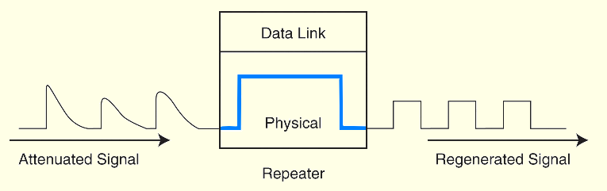
12.6 Network Organization
Signal attenuation is corrected by repeaters that amplify signals in physical cabling.
Repeaters are part of the network medium (Layer 1).
  In theory, they are dumb devices functioning entirely without human intervention. However, some repeaters now offer higher-level services to assist with network management and troubleshooting.

Slide 44
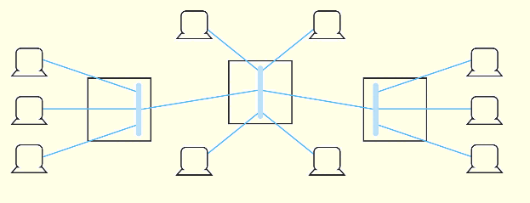
12.6 Network Organization
Hubs are also Physical layer devices, but they can have many ports for input and output.
They receive incoming packets from one or more locations and broadcast the packets to one or more devices on the network.
Hubs allow computers to be joined to form network segments.

Slide 45
12.6 Network Organization
A switch is a Layer 2 device that creates a point-to-point connection between one of its input ports and one of its output ports.
Switches contain buffered input ports, an equal number of output ports, a switching fabric and digital hardware that interprets address information encoded on network frames as they arrive in the input buffers.
Because all switching functions are carried out in hardware, switches are the preferred devices for interconnecting high-performance network components.

Slide 46
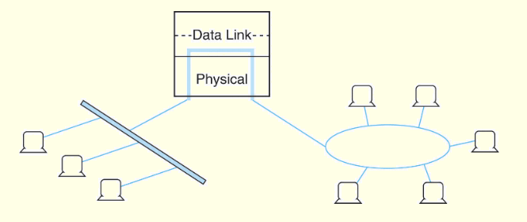
12.6 Network Organization
Bridges are Layer 2 devices that join two similar types of networks so they look like one network.
Bridges can connect different media having different media access control protocols, but the protocol from the MAC layer through all higher layers in the OSI stack must be identical in both segments.

Slide 47
12.6 Network Organization
A router is a device connected to at least two networks that determines the destination to which a packet should be forwarded.
Routers are designed specifically to connect two networks together, typically a LAN to a WAN.
Routers are by definition Layer 3 devices, they can bridge different network media types and connect different network protocols running at Layer 3 and below.
Routers are sometimes referred to as “intermediate systems” or “gateways” in Internet standards literature.

Slide 48
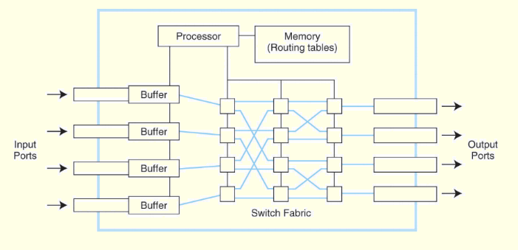
12.6 Network Organization
Routers are complex devices because they contain buffers, switching logic, memory, and processing power to calculate the best way to send a packet to its destination.

Slide 49
12.6 Network Organization
Dynamic routers automatically set up routes and respond to the changes in the network.
They explore their networks through information exchanges with other routers on the network.
The information packets exchanged by the routers reveal their addresses and costs of getting from one point to another.
Using this information, each router assembles a table of values in memory.
Typically, each destination node is listed along with the neighboring, or next-hop, router to which it is connected.

Slide 50
12.6 Network Organization
When creating their tables, dynamic routers consider one of two metrics. They can use either the distance to travel between two nodes, or they can use the condition of the network in terms of measured latency.
The algorithms using the first metric are distance vector routing algorithms. Link state routing algorithms use the second metric.
Distance vector routing is easy to implement, but it suffers from high traffic and the count-to-infinity problem where an infinite loop finds its way into the routing tables.

Slide 51
12.6 Network Organization
In link state routing, router discovers the speed of the lines between itself and its neighboring routers by periodically sending out Hello packets.
After the Hello replies are received, the router assembles the timings into a table of link state values.
This table is then broadcast to all other routers, except its adjacent neighbors.
Eventually, all routers within the routing domain end up with identical routing tables.
All routers then use this information to calculate the optimal path to every destination in its routing table.

Slide 52
12.7 High Capacity Digital Links
Long distance telephone communication relies on digital lines.
Because the human voice analog, it must be digitized before being sent over a digital carrier. The technique used for this conversion is called pulse-code modulation, or PCM.
PCM relies on the fact that the highest frequency produced by a normal human voice is around 4000Hz.
Therefore, if the voices of a telephone conversation are sampled 8,000 times per second, the amplitude and frequency can be accurately rendered in digital form.

Slide 53
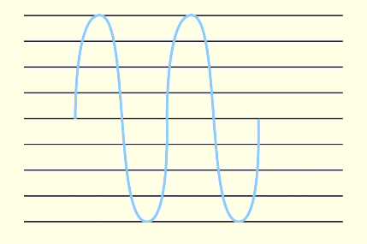
12.7 High Capacity Digital Links
The figure below shows pulse amplitude modulation with evenly spaced (horizontal) quantization levels.
Each quantization level can be encoded with a binary value.
This configuration conveys as much information by each bit at the high end as the low end of the 4000Hz bandwidth.
•

Slide 54
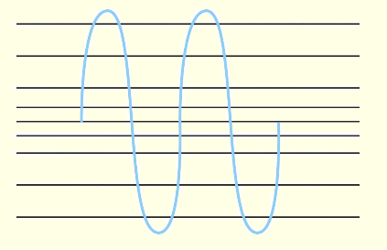
12.7 High Capacity Digital Links
However, a higher fidelity rendering of the human voice is produced when the quantization levels of PCM are bunched around the middle of the band, as shown below.
•
Thus, PCM carries information in a manner that reflects how it is produced and interpreted.

Slide 55
12.7 High Capacity Digital Links
Using127 quantization levels pulse-code modulation signal is distinguishable from a pure analog signal.
So, the amplitude of the signal could be conveyed using only 7 bits for each sample.
  In the earliest PCM deployments, an eighth bit was added to the PCM sample for signaling and control purposes within the Bell System.
  Today, all 8 bits are used.
A single stream of PCM signals produced by one voice connection requires a bandwidth of 64Kbps (8 bits × 8,000 samples/sec.). Digital Signal 0 (DS-0) is the signal rate of the 64Kbps PCM bit stream.

Slide 56
12.7 High Capacity Digital Links
To form a transmission frame, a series of PCM signals from 24 different voice connections is placed on the line, with a control channel and framing bit forming a 125μs frame.
This process is called time division multiplexing (TDM) because each connection gets roughly 1/24th of the 125μs frame.
At 8,000 samples per second per connection, the combination of the voice channels, signaling channel and framing bit requires a total bandwidth of 1.544Mbps.

Slide 57
12.7 High Capacity Digital Links
Europe and Japan use a larger frame size than the one that is used in North America.
  The European standard uses 32 channels, two of which are used for signaling and synchronization and 30 which are used for voice signals.
  The total frame size is 256 bits and requires a bandwidth of 2.048Mbps.
The 1.544Mbps and 2.048Mbps line speeds are called T-1 and E-1, respectively, and they carry DS-1 signals.

Slide 58
12.7 High Capacity Digital Links
DS-1 frames can be multiplexed onto high-speed trunk lines.
The set of carrier speeds that results from these multiplexing levels is called the Plesiochronous Digital Hierarchy (PDH).
As timing exchange signals propagate through the hierarchy, errors are introduced.
The deeper the hierarchy, the more likely it is that the signals will drift or slip before reaching the bottom.

Slide 59
12.7 High Capacity Digital Links
During the 1980s, BellCore and ANSI formulated standards for a synchronous optical network, SONET.
The Europeans adapted SONET to the E-carrier system, calling it the synchronous digital hierarchy, or SDH.
Just as the basic signal of the T-carrier system is DS-1 at 1.544Mbps, the basic SONET signal is STS-1 (Synchronous Transport System 1) at 51.84Mbps.

Slide 60
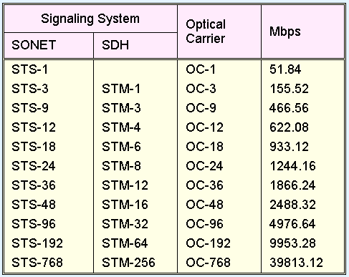
12.7 High Capacity Digital Links
When an STS signal is passed over an optical carrier network, the signal is called OCx, where x is the carrier speed.
•
The fundamental SDH signal is STM-1, which conveys signals at a rate of 155.52Mbps.
The SONET hierarchy along with SDH is shown in the table.
•

Slide 61
12.7 High Capacity Digital Links
In 1982 the ITU-T completed a series of recommendations for the Integrated, Services Digital Network (ISDN), an all-digital network that would carry voice, video and data directly to the consumer.
ISDN was designed in strict compliance with the ISO/OSI Reference Model.
The ISDN recommendations focus on various network terminations and interfaces located at specific reference points in the ISDN model.
The organization of this system is shown on the next slide.

Slide 62
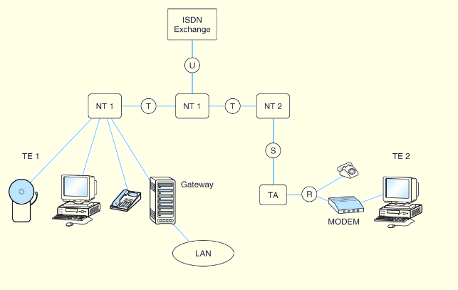
12.7 High Capacity Digital Links

Slide 63
12.7 High Capacity Digital Links
ISDN supports two signaling rate structures, Basic and Primary.
A Basic Rate Interface consists of two 64Kbps B-Channels and one 16Kbps D-Channel.
  These channels completely occupy two channels of a T-1 frame plus one-quarter of a third one.
  ISDN Primary Rate Interfaces occupy the entire T-1 frame, providing 23 64Kbps B-Channels and the entire 64Kbps D-Channel.
B-Channels can be multiplexed to provide higher data rates, such as 128Kbps residential Internet service.

Slide 64
12.7 High Capacity Digital Links
Unfortunately, the ISDN committees were neither sufficiently farsighted nor fast enough in completing the recommendations.
ISDN provides too much bandwidth for voice, and far too little for data.
Except for a relatively small number of home Internet users, ISDN has become a technological orphan.
The importance of ISDN is that it forms a bridge to a more advanced and versatile digital system, Asynchronous Transfer Mode (ATM).

Slide 65
12.7 High Capacity Digital Links
ATM does away with the idea of time-division multiplexing.
Instead, conversation and each data transmission consists of a sequence of discrete 53-byte cells that can be managed and routed individually to make optimal use of whatever bandwidth is available.
Moreover, ATM is designed to be an efficient bearer service for digital voice, data, and video streams.
In years since, ATM has been adapted to also be a bearer service for LAN and MAN services.

Slide 66
12.7 High Capacity Digital Links
The CCITT called this next generation of digital services broadband ISDN, or B-ISDN, to emphasize its architectural connection with (narrowband) ISDN.
ATM supports three transmission services: full-duplex 155.52Mbps, full-duplex 622.08Mbps and an asymmetrical mode with an upstream data rate of 155.52Mbps and a downstream data rate of 622.08Mbps.
B-ISDN is downwardly compatible with ISDN. It uses virtually the same reference model, as shown on the next slide.

Slide 67
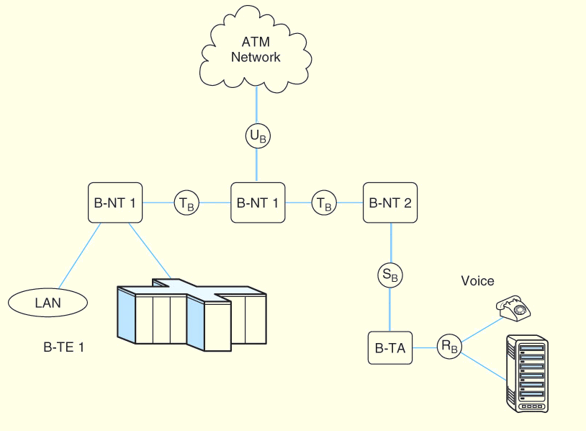
12.7 High Capacity Digital Links

Slide 68
12.8 A Look at the Internet
We have described how the Internet went from its beginnings as a closed military research network to the open worldwide communications infrastructure of today.
However, gaining access to the Internet is not quite as simple as gaining access to a dial tone.
Most individuals and businesses connect to the Internet through privately operated Internet service providers (ISPs).

Slide 69
12.8 A Look at the Internet
Each ISP maintains a switching center called a point-of-presence (POP).
Some POPs are connected through high-speed lines (T-1 or higher) to regional POPs or other major intermediary POPs.
Local ISPs are connected to regional ISPs, which are connected to national and international ISPs (often called National Backbone Providers, or NBPs).
The NBPs are interconnected through network access points (NAPs).
The ISP-POP-NAP hierarchy is shown on the next slide.

Slide 70
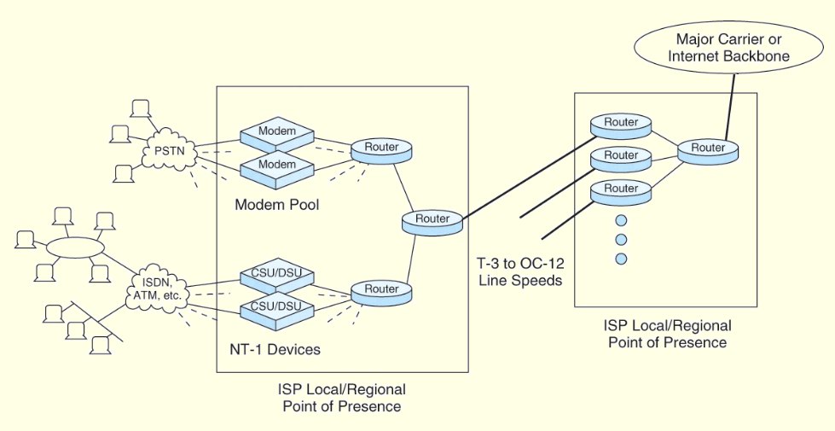
12.8 A Look at the Internet

Slide 71
12.8 A Look at the Internet
Major Internet users, such as large corporations and government and academic institutions, are able to justify the cost of leasing direct high-capacity digital lines between their premises and their ISP.
The cost of these leased lines is far beyond the reach of private individuals and small businesses.
Consequently, Internet users with modest bandwidth requirements typically use standard telephone lines to serve their telecommunications needs.

Slide 72
12.8 A Look at the Internet
Because standard telephone lines are built to carry analog (voice) signals, digital signals produced by a computer must first be converted, or modulated, from digital to analog form, before they are transmitted over the phone line.
At the receiving end, they must be demodulated from analog to digital. A device called a modulator/ demodulator, or modem, converts the signal.
Most home computers come equipped with built-in modems that connect directly to the system's I/O bus.

Slide 73
12.8 A Look at the Internet
Modulating a digital signal onto an analog carrier means that some characteristic of the analog carrier signal is changed so that signal can convey digital information.
Varying the amplitude, varying the frequency, or varying the phase of the signal can produce analog modulation of a digital signal.
These forms of modulation are shown on the next slide.

Slide 74
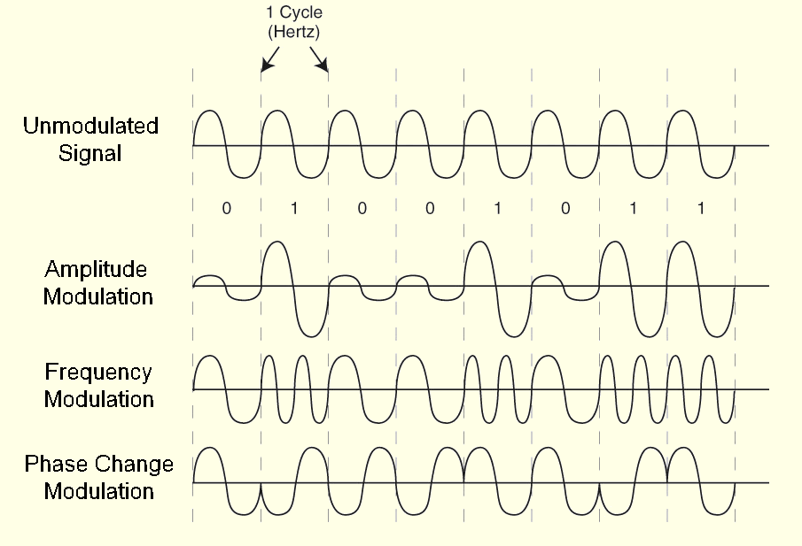
12.8 A Look at the Internet

Slide 75
12.8 A Look at the Internet
Using simple amplitude, frequency or 180° phase-change modulation, limits modem throughput to about 2400bps.
Varying two characteristics at a time instead of just one increases the number of bits that can be transmitted.
Quadrature amplitude modulation (QAM), changes both the phase and the amplitude of the carrier signal. QAM uses two carrier signals that are 180° out of phase with each other.

Slide 76
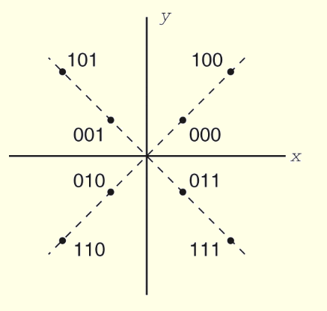
12.8 A Look at the Internet
Two waves can be modulated to create a set of Cartesian coordinates.
The X,Y coordinates in this plane describe a signal constellation or signal lattice that encodes specified bit patterns.
•
A sine wave could be modulated for the Y-coordinate and the cosine wave for the X-coordinate.

Slide 77
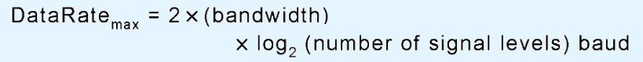
12.8 A Look at the Internet
Voice grade telephone lines are designed to carry a total bandwidth of 3000Hz.
In 1924, information theorist Henry Nyquist showed that no signal can convey information at a rate faster than twice its frequency. Symbolically:
  where baud is the signaling speed of the line.
A 3000Hz signal can transmit two-level (binary) data at a rate no faster than 6,000 baud.

Slide 78
12.8 A Look at the Internet
In 1948, Claude Shannon extended Nyquist's work to consider the presence of noise on the line, using the line's signal-to-noise ratio. Symbolically:
The public switched telephone network (PSTN) typically has a signal-to-noise ratio of 30dB.
It follows that the maximum data rate of voice grade telephone lines is approximately 30,000bps, regardless of the number of signal levels used.

Slide 79
12.8 A Look at the Internet
The 30Kbps limit that Shannon's Law imposes on analog telephone modems is a formidable barrier to the promise of a boundless and open Internet.
While long-distance telephone links have been fast and digital for decades, the local loop wires running from the telephone switching center to the consumer continues to use hundred-year-old analog technology.
The "last mile" local loop, can in fact span many miles, making it extremely expensive to bring the analog telephone service of yesterday into the digital world of the present.

Slide 80
12.8 A Look at the Internet
The physical conductors in telephone wire are thick enough to support moderate-speed digital traffic for several miles without severe attenuation.
Digital Subscriber Line (DSL) is a technology that can coexist with plain old telephone service (POTS) on the same wire pair that carries the digital traffic.
At present, most DSL services are available only to those customers whose premises connect with the central telephone switching office (CO) using less than 18,000 feet (5,460 m) of copper cable.

Slide 81
12.8 A Look at the Internet
At the customer's premises, some DSLs require a splitter to separate voice from digital traffic. The digital signals terminate at a coder/decoder device often called a DSL modem.
There are two different—and incompatible— modulation methods used by DSL: Carrierless Amplitude Phase (CAP) and Discrete MultiTone Service (DMT). CAP is the older and simpler of the two technologies, but DMT is the ANSI standard for DSL.

Slide 82
12.8 A Look at the Internet
CAP uses three frequency ranges, 0 to 4KHz for voice, 25KHz through 160KHz for "upstream" traffic (e.g., sending a command through a browser asking to see a particular Web page), and 240KHz to 1.5MHz for "downstream" traffic
This imbalanced access method is called Asymmetric Digital Subscriber Line (ADSL).
The fixed channel sizes of CAP lock in an upstream bandwidth of 135KHz.
This may not be ideal for someone who does a great deal of uploading, or connects to a remote LAN.

Slide 83
12.8 A Look at the Internet
Where a symmetric connection is required, Discrete MultiTone DSL may offer better performance.
DMT splits a 1MHz frequency bandwidth into 256 4KHz channels, called tones.
These channels can be configured in any way that suits both the customer and the provider.
DMT can adapt to fluctuations in line quality.
When DMT equipment detects excessive crosstalk or excessive attenuation on one of its channels, it stops using that channel until the situation is remedied.

Slide 84
12.8 A Look at the Internet
Cable modems provide broadband Internet access to homes over the cable television infrastructure.
The idea is to take advantage of unused television channels for data transmission.
Users connect through a cable modem termination system (CMTS).
Ideally, the upstream data rate is 128Kbps and downstream is 35Mbps.
Because a single channel is shared by many users, the downstream data rate is usually about 1.5Mbps.

Slide 85
12.8 A Look at the Internet
Providing broadband access to everyone is only one of the problems facing the Internet today.
A more serious problem concerns backbone router congestion.
More than 50,000 routers serve various backbone networks in the United States alone.
Considerable time and bandwidth is consumed as the routers exchange routing information.
  Obsolete routes can persist long enough to impede traffic, causing even more congestion as the system tries to resolve the error.

Slide 86
12.8 A Look at the Internet
Greater problems develop when a router malfunctions, broadcasting erroneous routes (or good routes that it subsequently cancels) to the entire backbone system.
This is known as the router instability problem and it is an area of continuing research.
When IPv6 is adopted universally some of these problems will go away because the routing tables ought to get smaller.

Slide 87
12.8 A Look at the Internet
Even with improved addressing, there are limits to the speed with which tens of thousands of routing tables can be synchronized.
This problem is undergoing intense research, the outcome of which may give rise to a new generation of routing protocols.
One thing is certain, simply giving the Internet more bandwidth offers little promise for making it any faster in the long-term.
It has to get smarter.

Slide 88
Chapter 12 Conclusion
The ISO/OSI RM describes a theoretical network architecture. This architecture has to some extent been incorporated into digital telecommunication systems, including ISDN and ATM.
TCP/IP using IPv4 is the protocol supported by the Internet. IPv6 has been defined and implemented by numerous vendors, but its adoption is incomplete.

Slide 89
Chapter 12 Conclusion
Network organization consists of physical (or wireless) media, NICs, modems, CSU/DSUs, repeaters, hubs, switches, routers, and computers. Each has its place in the OSI RM.
Many people connect to the Internet through dial up lines using modems. Faster speeds are provided by DSL.
The Internet is a hierarchy of ISPs, POPs, NAPs, and various backbone systems.
The router instability problem is one of the largest challenges for the Internet.

Slide 90
End of Chapter 12

