Slide 1
TailorSwift: Tailored for Swift BigData access
Ferosh Jacob

Slide 2
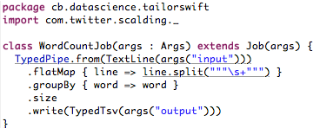
WordCount in Scalding

Slide 3
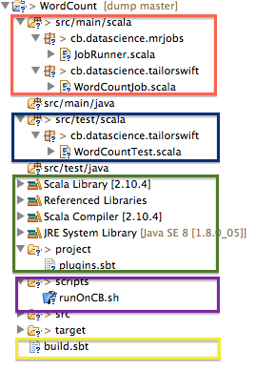
Wordcount project structure

Slide 4
Deploying the WordCount
Create the fatjar (~ 80 jar files has to be merged)
Using different merging strategies (e.g., rename, remove)
Exclude conflicting jars
Upload the jar to CB Hadoop cluster
Upload script files to CB Hadoop cluster
Submit the job.

Slide 5
What I want to do
Create a project with WebScalding nature
Write the WebScalding Job
Deploy the project

