Slide 1
TailorSwift: Tailored for Swift BigData access
Ferosh Jacob

Slide 2
HIVE is not enough!
Find me all germans jobs from our DB
Evaluate how carotene distribute all the Job titles to different SOC codes

Slide 3
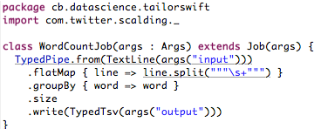
WordCount in Scalding

Slide 4
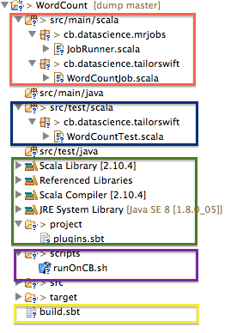
Wordcount project structure

Slide 5
Deploying the WordCount
Create the fatjar (~ 80 jar files has to be merged)
Using different merging strategies (e.g., rename, remove)
Exclude conflicting jars
Upload the jar to CB Hadoop cluster
Upload script files to CB Hadoop cluster
Submit the job.

Slide 6
What I want to do
Create a project with WebScalding nature
Write the WebScalding Job
Deploy the project

