Slide 1

Deep Learning with Python: from Theory to Application
Hamid Hassanzadeh, Priyanka Goyal, Ferosh Jacob, Mitchell Bowden, Pramod Salian, and Ravi Sambhu
HOMEDEPOT, Search, Online technology

Slide 2
Standing queries
The path from IR to text classification:
You have an information need to monitor, say:
Unrest in the Niger delta region
You want to rerun an appropriate query periodically to find new news items on this topic
You will be sent new documents that are found
I.e., it’s not ranking but classification (relevant vs. not relevant)
Such queries are called standing queries
Long used by “information professionals”
A modern mass instantiation is Google Alerts
Standing queries are (hand-written) text classifiers

Slide 3
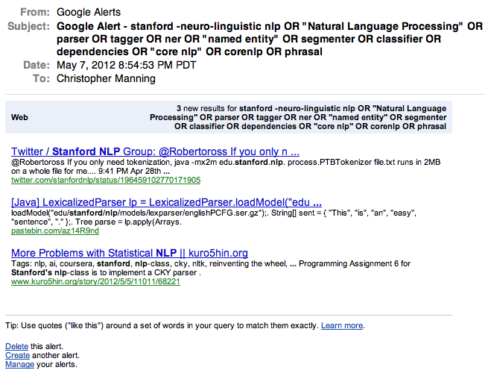
3

Slide 4
Spam filtering Another text classification task
From: "" <takworlld@hotmail.com>
Subject: real estate is the only way... gem oalvgkay
Anyone can buy real estate with no money down
Stop paying rent TODAY !
There is no need to spend hundreds or even thousands for similar courses
I am 22 years old and I have already purchased 6 properties using the
methods outlined in this truly INCREDIBLE ebook.
Change your life NOW !
=================================================
Click Below to order:
http://www.wholesaledaily.com/sales/nmd.htm
=================================================

Slide 5
Categorization/Classification
Given:
A representation of a document d
Issue: how to represent text documents.
Usually some type of high-dimensional space – bag of words
A fixed set of classes:
C = {c₁, c₂,…, c_{J}}
Determine:
The category of d: γ(d) ∈ C, where γ(d) is a classification function
We want to build classification functions (“classifiers”).

Slide 6
Document Classification
“planning
language
proof
intelligence”
Test
Data:
(AI)
(Programming)
(HCI)
Classes:
ML
Planning
Semantics
Garb.Coll.
Multimedia
GUI
Training
Data:
learning
intelligence
algorithm
reinforcement
network...
planning
temporal
reasoning
plan
language...
programming
semantics
language
proof...
garbage
collection
memory
optimization
region...
...
...

Slide 7
Classification Methods (1)
Manual classification
Used by the original Yahoo! Directory
Looksmart, about.com, ODP, PubMed
Accurate when job is done by experts
Consistent when the problem size and team is small
Difficult and expensive to scale
Means we need automatic classification methods for big problems

Slide 8
Classification Methods (2)
Hand-coded rule-based classifiers
One technique used by new agencies, intelligence agencies, etc.
Widely deployed in government and enterprise
Vendors provide “IDE” for writing such rules

Slide 9
Classification Methods (2)
Hand-coded rule-based classifiers
Commercial systems have complex query languages
Accuracy is can be high if a rule has been carefully refined over time by a subject expert
Building and maintaining these rules is expensive

Slide 10
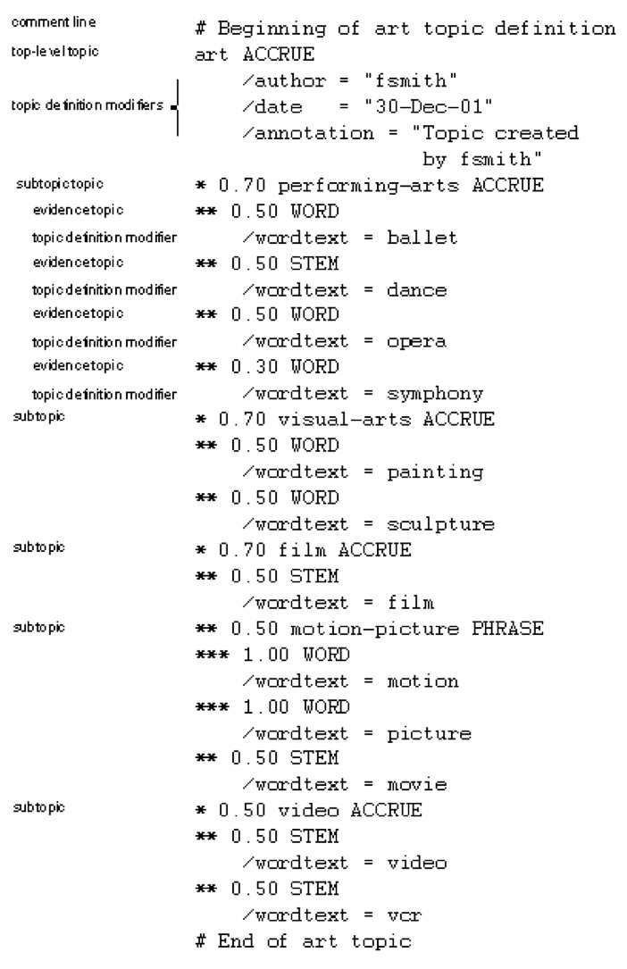
A Verity topic A complex classification rule
Note:
maintenance issues (author, etc.)
Hand-weighting of terms
[Verity was bought by Autonomy, which was bought by HP ...]

Slide 11
Classification Methods (3): Supervised learning
Given:
A document d
A fixed set of classes:
C = {c₁, c₂,…, c_{J}}
A training set D of documents each with a label in C
Determine:
A learning method or algorithm which will enable us to learn a classifier γ
For a test document d, we assign it the class
γ(d) ∈ C

Slide 12
Classification Methods (3)
Supervised learning
Naive Bayes (simple, common) – see video
k-Nearest Neighbors (simple, powerful)
Support-vector machines (new, generally more powerful)
… plus many other methods
No free lunch: requires hand-classified training data
But data can be built up (and refined) by amateurs
Many commercial systems use a mixture of methods

Slide 13
The bag of words representation
I love this movie! It's sweet, but with satirical humor. The dialogue is great and the adventure scenes are fun… It manages to be whimsical and romantic while laughing at the conventions of the fairy tale genre. I would recommend it to just about anyone. I've seen it several times, and I'm always happy to see it again whenever I have a friend who hasn't seen it yet.
γ(
)=c

Slide 14
The bag of words representation
great | 2
love | 2
recommend | 1
laugh | 1
happy | 1
... | ...
γ(
)=c

Slide 15
Features
Supervised learning classifiers can use any sort of feature
URL, email address, punctuation, capitalization, dictionaries, network features
In the bag of words view of documents
We use only word features
we use all of the words in the text (not a subset)

Slide 16
Feature Selection: Why?
Text collections have a large number of features
10,000 – 1,000,000 unique words … and more
Selection may make a particular classifier feasible
Some classifiers can’t deal with 1,000,000 features
Reduces training time
Training time for some methods is quadratic or worse in the number of features
Makes runtime models smaller and faster
Can improve generalization (performance)
Eliminates noise features
Avoids overfitting

Slide 17
Feature Selection: Frequency
The simplest feature selection method:
Just use the commonest terms
No particular foundation
But it make sense why this works
They’re the words that can be well-estimated and are most often available as evidence
In practice, this is often 90% as good as better methods
Smarter feature selection – future lecture

Slide 18
Evaluating Categorization
Evaluation must be done on test data that are independent of the training data
Sometimes use cross-validation (averaging results over multiple training and test splits of the overall data)
Easy to get good performance on a test set that was available to the learner during training (e.g., just memorize the test set)

Slide 19
Evaluating Categorization
Measures: precision, recall, F1, classification accuracy
Classification accuracy: r/n where n is the total number of test docs and r is the number of test docs correctly classified

Slide 20

WebKB Experiment (1998)
Classify webpages from CS departments into:
student, faculty, course, project
Train on ~5,000 hand-labeled web pages
Cornell, Washington, U.Texas, Wisconsin
Crawl and classify a new site (CMU) using Naïve Bayes

Slide 21
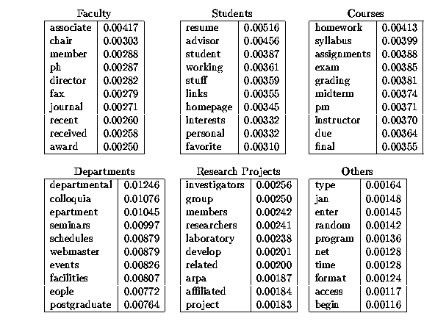
Introduction to Information Retrieval

Slide 22
SpamAssassin
Naïve Bayes has found a home in spam filtering
Paul Graham’s A Plan for Spam
Widely used in spam filters
But many features beyond words:
black hole lists, etc.
particular hand-crafted text patterns

Slide 23
SpamAssassin Features:
Basic (Naïve) Bayes spam probability
Mentions: Generic Viagra
Regex: millions of (dollar) ((dollar) NN,NNN,NNN.NN)
Phrase: impress ... girl
Phrase: ‘Prestigious Non-Accredited Universities’
From: starts with many numbers
Subject is all capitals
HTML has a low ratio of text to image area
Relay in RBL, http://www.mail-abuse.com/enduserinfo_rbl.html

Slide 24
Naive Bayes is Not So Naive
Very fast learning and testing (basically just count words)
Low storage requirements
Very good in domains with many equally important features
More robust to irrelevant features than many learning methods
Irrelevant features cancel each other without affecting results

Slide 25
Naive Bayes is Not So Naive
More robust to concept drift (changing class definition over time)
Naive Bayes won 1st and 2nd place in KDD-CUP 97 competition out of 16 systems
Goal: Financial services industry direct mail response prediction: Predict if the recipient of mail will actually respond to the advertisement – 750,000 records.
A good dependable baseline for text classification (but not the best)!

Slide 26
Classification Using Vector Spaces
In vector space classification, training set corresponds to a labeled set of points (equivalently, vectors)
Premise 1: Documents in the same class form a contiguous region of space
Premise 2: Documents from different classes don’t overlap (much)
Learning a classifier: build surfaces to delineate classes in the space

Slide 27
Documents in a Vector Space
Sec.14.1
Government
Science
Arts

Slide 28
Test Document of what class?
Sec.14.1
Government
Science
Arts

Slide 29
Test Document = Government
Sec.14.1
Is this
similarity
hypothesis
true in
general?
Government
Science
Arts
Our focus: how to find good separators

Slide 30
Definition of centroid
Sec.14.2
Where D_{c} is the set of all documents that belong to class c and v(d) is the vector space representation of d.
Note that centroid will in general not be a unit vector even when the inputs are unit vectors.

Slide 31
Rocchio classification
Sec.14.2
Rocchio forms a simple representative for each class: the centroid/prototype
Classification: nearest prototype/centroid
It does not guarantee that classifications are consistent with the given training data

Slide 32
Rocchio classification
Sec.14.2
Little used outside text classification
It has been used quite effectively for text classification
But in general worse than Naïve Bayes
Again, cheap to train and test documents

Slide 33
k Nearest Neighbor Classification
Sec.14.3
kNN = k Nearest Neighbor
To classify a document d:
Define k-neighborhood as the k nearest neighbors of d
Pick the majority class label in the k-neighborhood

Slide 34
Example: k=6 (6NN)
Sec.14.3
P(science| )?
Government
Science
Arts

Slide 35
Nearest-Neighbor Learning
Sec.14.3
Learning: just store the labeled training examples D
Testing instance x (under 1NN):
Compute similarity between x and all examples in D.
Assign x the category of the most similar example in D.
Does not compute anything beyond storing the examples
Also called:
Case-based learning
Memory-based learning
Lazy learning
Rationale of kNN: contiguity hypothesis

Slide 36
k Nearest Neighbor
Sec.14.3
Using only the closest example (1NN) subject to errors due to:
A single atypical example.
Noise (i.e., an error) in the category label of a single training example.
More robust: find the k examples and return the majority category of these k
k is typically odd to avoid ties; 3 and 5 are most common

Slide 37
kNN decision boundaries
Sec.14.3
Boundaries are in principle arbitrary surfaces – but usually polyhedra
Government
Science
Arts
kNN gives locally defined decision boundaries between
classes – far away points do not influence each classification decision (unlike in Naïve Bayes, Rocchio, etc.)

Slide 38
kNN: Discussion
Sec.14.3
No feature selection necessary
No training necessary
Scales well with large number of classes
Don’t need to train n classifiers for n classes
Classes can influence each other
Small changes to one class can have ripple effect
May be expensive at test time
In most cases it’s more accurate than NB or Rocchio

Slide 39
Let’s test our intuition
Can a bag of words always be viewed as a vector space?
What about a bag of features?
Can we always view a standing query as a region in a vector space?
What about Boolean queries on terms?
What do “rectangles” equate to?

Slide 40
Bias vs. capacity – notions and terminology
Sec.14.6
Consider asking a botanist: Is an object a tree?
Too much capacity, low bias
Botanist who memorizes
Will always say “no” to new object (e.g., different # of leaves)
Not enough capacity, high bias
Lazy botanist
Says “yes” if the object is green
You want the middle ground
Notes:
Bias/variance in terms of resulting classifier given randomly selected training set; why it is a tradeoff; when to choose low-bias method, when to choose low-variance method

Slide 41
kNN vs. Naive Bayes
Sec.14.6
Bias/Variance tradeoff
Variance ≈ Capacity
kNN has high variance and low bias.
Infinite memory
NB has low variance and high bias.
Linear decision surface (hyperplane – see later)
Notes:
Bias/variance in terms of resulting classifier given randomly selected training set; why it is a tradeoff; when to choose low-bias method, when to choose low-variance method

Slide 42
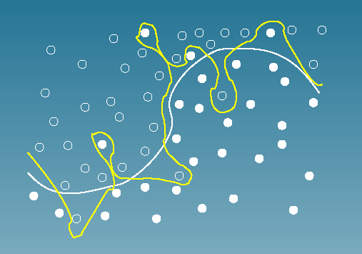
Bias vs. variance: Choosing the correct model capacity
Sec.14.6

Slide 43
Summary: Representation of Text Categorization Attributes
Representations of text are usually very high dimensional
High-bias algorithms that prevent overfitting should generally work best in high-dimensional space
For most text categorization tasks, there are many relevant features and many irrelevant ones
Notes:
Explain supervised learning

Slide 44
Which classifier do I use for a given text classification problem?
Is there a learning method that is optimal for all text classification problems?
No, because there is a tradeoff between bias and variance.
Factors to take into account:
How much training data is available?
How simple/complex is the problem? (linear vs. nonlinear decision boundary)
How noisy is the data?
How stable is the problem over time?
For an unstable problem, its better to use a simple and robust classifier.

Slide 45
Machine Learning Basics
Machine learning is a field of computer science that gives computers the ability to learn without being explicitly programmed
Labeled Data
Machine Learning algorithm
Training
Prediction
Labeled Data
Learned model
Prediction
Methods that can learn from and make predictions on data

Slide 46
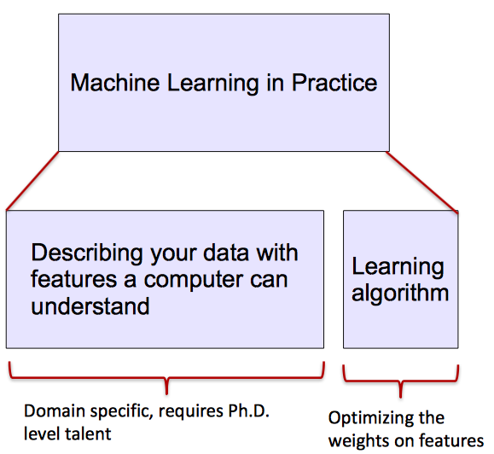
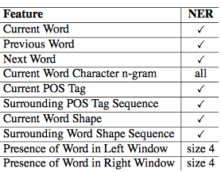
ML vs. Deep Learning
Most machine learning methods work well because of human-designed representations and input features
ML becomes just optimizing weights to best make a final prediction

Slide 47
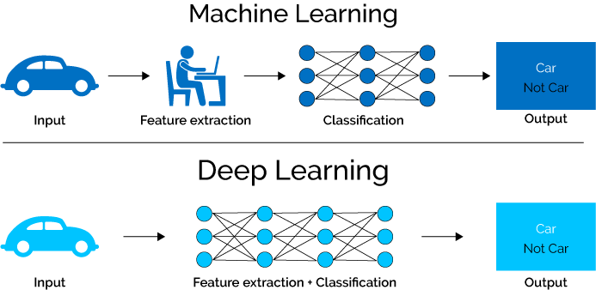
What is Deep Learning (DL) ?
A machine learning subfield of learning representations of data. Exceptional effective at learning patterns.
Deep learning algorithms attempt to learn (multiple levels of) representation by using a hierarchy of multiple layers
If you provide the system tons of information, it begins to understand it and respond in useful ways.
https://www.xenonstack.com/blog/static/public/uploads/media/machine-learning-vs-deep-learning.png

Slide 48
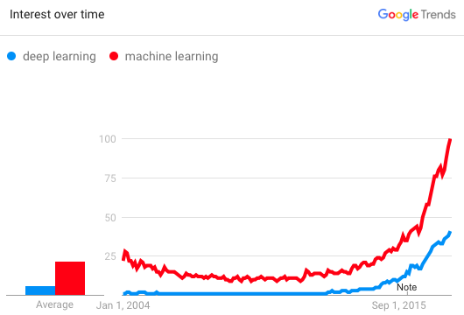
Why is DL useful?
Manually designed features are often over-specified, incomplete and take a long time to design and validate
Learned Features are easy to adapt, fast to learn
Deep learning provides a very flexible, (almost?) universal, learnable framework for representing world, visual and linguistic information.
Can learn both unsupervised and supervised
Effective end-to-end joint system learning
Utilize large amounts of training data
In ~2010 DL started outperforming other ML techniques
first in speech and vision, then NLP

Slide 49
Acknowledgement
Slides are adapted from
http://web.stanford.edu/class/cs276/
times.cs.uiuc.edu/course/510f17/ppt/deep-learning.pptx
https://www.cs.utexas.edu/~mooney/ir-course/

