Slide 1


AI/ML
Tue Sept 22 · 1:15 p.m.
[session # TBC]
Lightning Talk Session · Artificial Intelligence & Machine Learning
The Quality Ceiling Is the Task, Not the Model Size
A Reproducible CPU/GPU Benchmark of Search-Relevance Judges
Ferosh Jacob; Jiho Noh
Department of Computer Science, Kennesaw State University
Presenter / PI: Ferosh Jacob · fjacob1@kennesaw.edu
Notes:
[0:00–0:20] Good afternoon — I'm Ferosh Jacob, Department of Computer Science at Kennesaw State, with Jiho Noh. Our poster is “The Quality Ceiling Is the Task, Not the Model Size” — a reproducible CPU-GPU benchmark of search-relevance judges. Three minutes, one question.

Slide 2
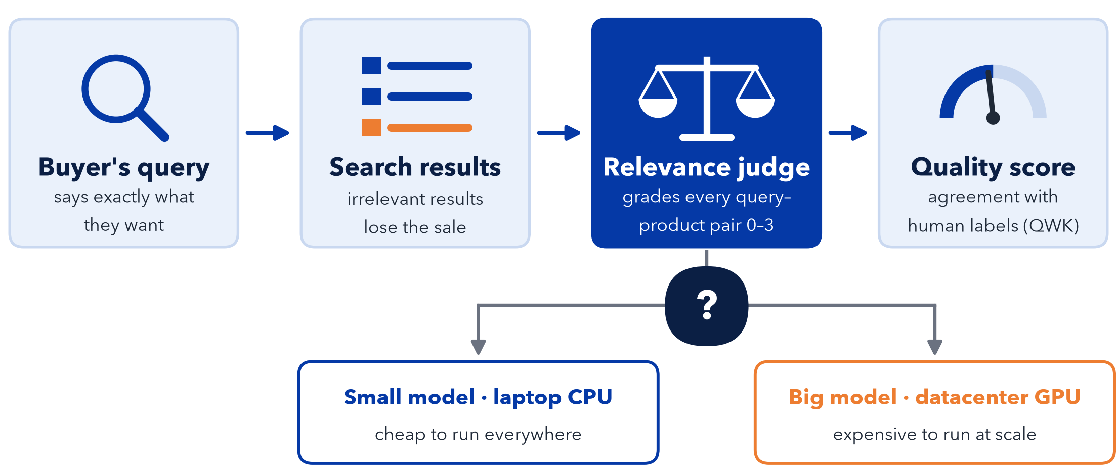
Bad search loses sales; judging it is costly
Does a bigger model on bigger hardware actually judge better?
Notes:
[0:20–0:45] Search is where a buyer tells a retailer exactly what they want. If the results are not relevant, that sale is lost. Measuring relevance at scale needs a judge — a model that grades every query-and-product pair on a zero-to-three scale. If that judge has to be a big model on a datacenter GPU, it gets expensive. So: does a bigger model on bigger hardware actually judge better?

Slide 3
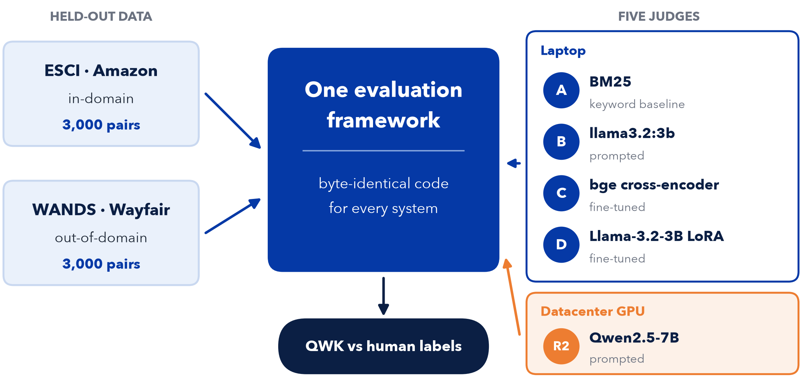
One framework, five judges, two datasets
Notes:
[0:45–1:15] The setup. One evaluation framework, byte-identical for every system, so any change in score is the model and the hardware, not the pipeline. Four judges on a laptop: A, BM25; B, the prompted llama-3.2-3b deployed today; C, a fine-tuned bge cross-encoder; D, a Llama-3.2-3B LoRA. One on a datacenter GPU: R2, prompted Qwen-2.5-7B. Two held-out sets with human labels — Amazon ESCI in-domain, Wayfair WANDS out-of-domain — three thousand pairs each, scored with Quadratic Weighted Kappa.

Slide 4
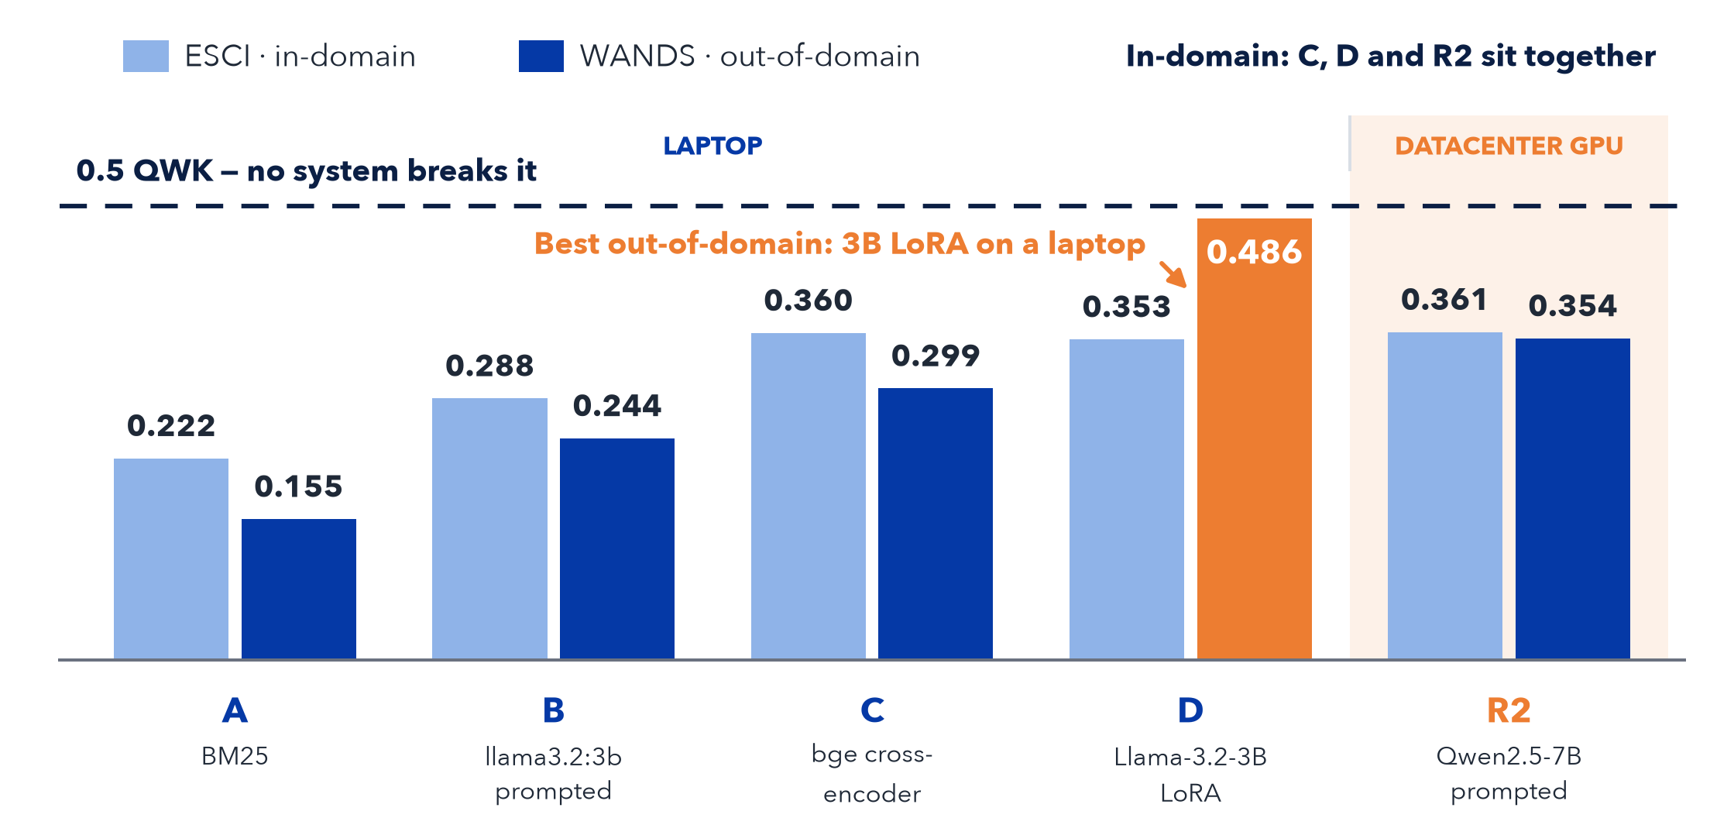
Nothing breaks 0.5 QWK, on a laptop or a GPU
Notes:
[1:15–2:00] Two things to read. First, the dashed line: nothing breaks zero-point-five. The best score anywhere is zero-point-four-eight-six, and its confidence interval just reaches past the line, so this is about point estimates. Second, in-domain on ESCI the learned arms and the GPU model sit together: bge at zero-point-three-six-zero, the LoRA at zero-point-three-five-three, R2 at zero-point-three-six-one. R2 is the controlled scale-up of B: same prompt, parser and scoring code; only the model, the hardware and the model family changed. That lifted QWK by zero-point-zero-seven-three on ESCI and zero-point-one-one-zero on WANDS — real, but in-domain it only reaches parity. Out-of-domain, the winner is not the datacenter model: it is the 3B LoRA, at zero-point-four-eight-six, on a laptop.

Slide 5
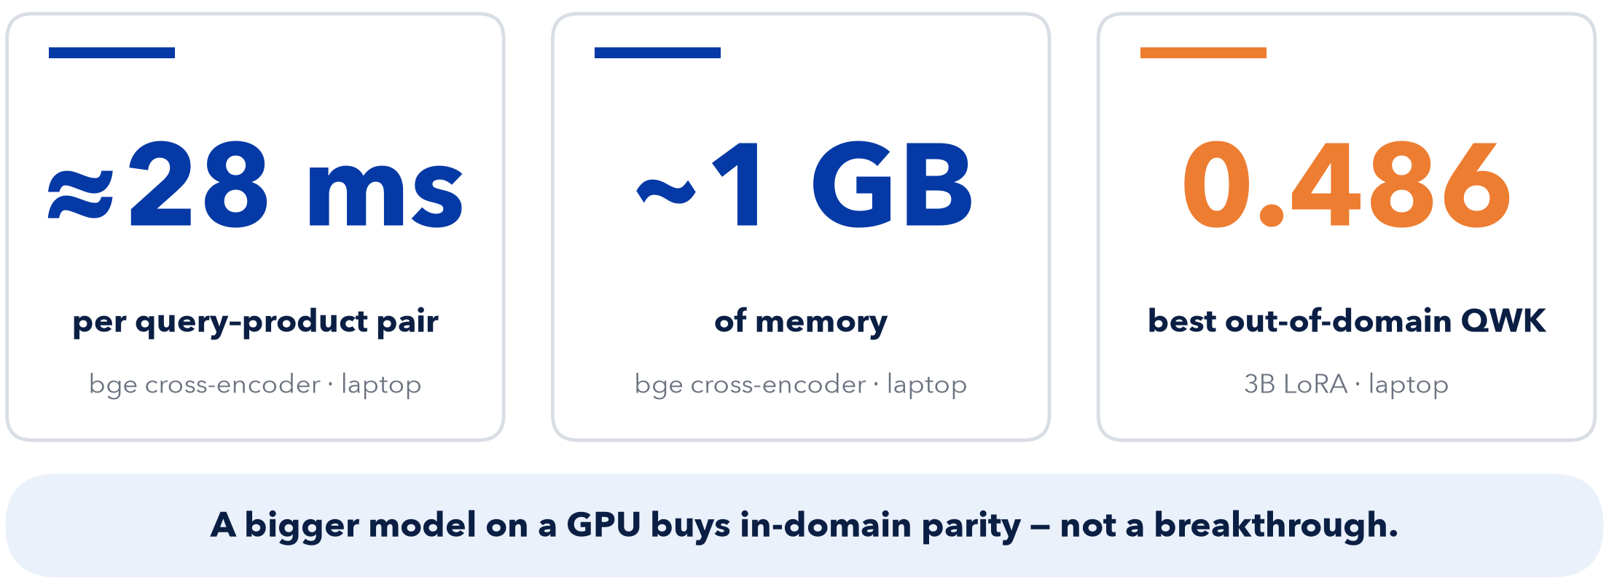
The ceiling is the task, not the model size
See the poster: The Quality Ceiling Is the Task, Not the Model Size
Notes:
[2:00–2:45] The takeaway. A small fine-tuned specialist gives the best accuracy per millisecond: the bge cross-encoder runs at about twenty-eight milliseconds a pair, in about a gigabyte of memory. A bigger model on a GPU buys in-domain parity, not a breakthrough. Since nothing broke zero-point-five, we read the ceiling as a property of the task, not the model size. Next: human-to-human agreement, and a clean same-family three-B to eight-B ablation. Come see the poster — thank you.
[IF CUT SHORT – 10s] Nothing we tested breaks zero-point-five QWK, and the best out-of-domain result is a 3B LoRA on a laptop. The ceiling is the task, not the model size.

