Slide 1
WebScalding: A Framework for Big Data Web Services
Ferosh Jacob, Aaron Johnson, Faizan Javed,
Meng Zhao, and Matt McNair

Slide 2
Webscalding overview
What?
Why?
Design, develop, and deploy Big Data solutions without delving into the accidental complexities of MapReduce or web services descriptions
Scalding Wrapper
Written in SCALA
Highly customized for CareerBuilder (CB) R&D projects
Write once, run anywhere
Production, test environments
Sequential and parallel environments
Parallel and parallel environments
Legacy solution (Python scripts)
Lack of abstraction
Local and BigData modes
Webservices orchestration

Slide 3
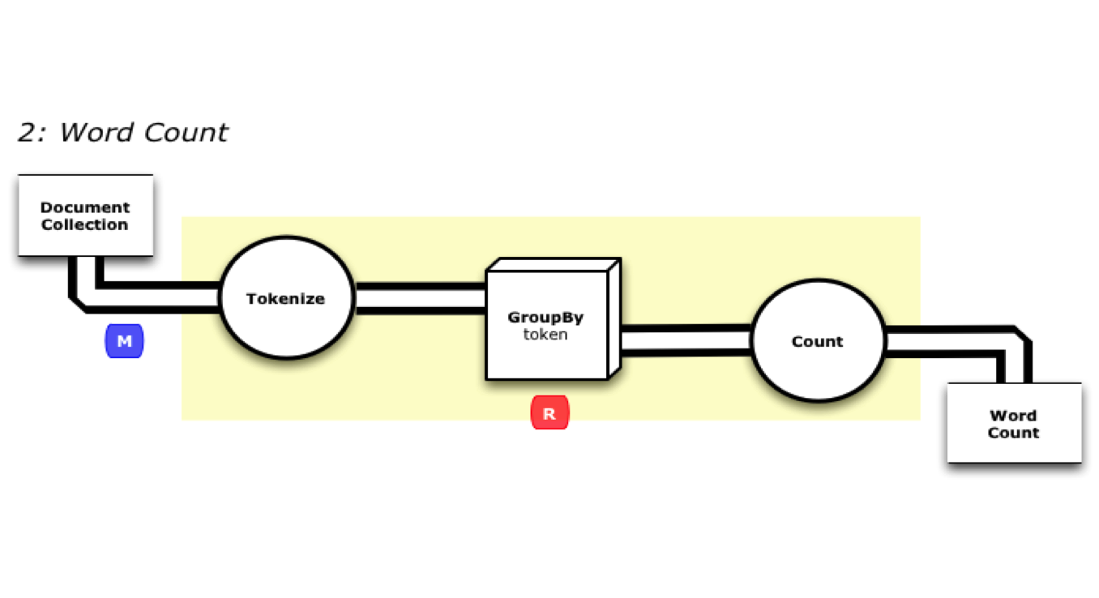
How cascading solves WORA?

Slide 4
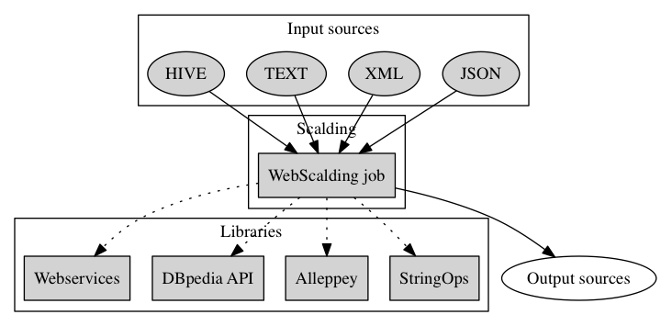
WebScalding overview

Slide 5
WebScalding libraries
Web Services Library
support for calling many internal web services
authentication/authorization
processing web service requests (e.g., GET/POST)
handling various error scenarios while processing web services.
Alleppey
Training and classifying data using several algorithms
Custom cross validation on any supported models
DBpedia API Wrappers
make the Dbpedia access thread-safe
Local and hadoop execution of Wikipedia
StringOps
Matching, Sorting, Stemming string algorithms
Language detection

Slide 6

CaseStudy: DSFSG Project

Slide 7
DSFSG Project: Tasks for CB DataScience team
Data cleaning
remove email addresses and phone numbers
names of the resume posters
Web service execution
Carotene (CB)
Autocoder (External)
Special processing for resumes
extract job title and the job description
limit to last3 jobs
Data
22M resumes 2.5M job postings
a total of 101 GB.

Slide 8
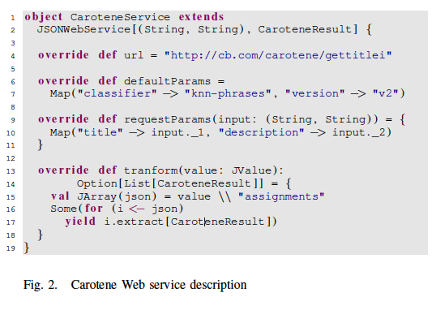
DSFSG Project: Defining a webservice using WebScalding

Slide 9
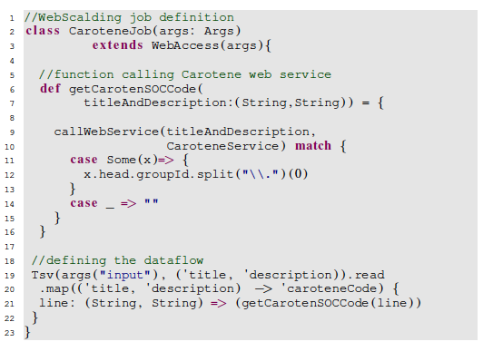
Case study 1: DSFSG Project: Defining a Webservice WebScalding execution job

Slide 10
DSFSG Project: Execution time Comparison

Slide 11
DSFSG Project Speedup: WebScalding Hadoop v/s Python Sequential

Slide 12
Case study 2: Accessing HIVE tables- German skills project
Goal: Identify all the German resumes and job postings in our database
Legacy approach: Determine the German data (resume or job posting) based on from where the data is uploaded
Challenge: Users can upload their data in English from a foreign language CB website and vice versa

Slide 13
German skills project- workflow overview
Extract job posting or resume from DB
Use a language translator
Filter based on the detected language

Slide 14
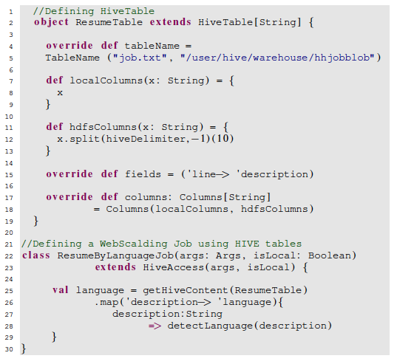
German skills project- Defining HIVE tables using WebScalding

Slide 15
German skills project- Hostsite and lang-detect comparison
Lang | Lang-detect | Hostsite
en | 46,204,969 | 42,364,522
de | 2,741,516 | 2,802,857
pl | 1,666,247 | 1,702,878
fr | 524,902 | 84,665
it | 274,305 | 305,636
Job postings
Lang | Lang-detect | Hostsite
en | 87,048,731 | 112,764,535
fr | 955,712 | 504,499
ro | 384,316 | 15,617
es | 301,511 | 448,943
it | 289,129 | 520,161
Resume

Slide 16
Case Study 3: Reading Large XML files- Wiki search
Goal: Read a large XML dataset (e.g., Wikipedia)
Approach: Split the large XML file into node of interest, so each node can be processed separately
Challenge: How to split the large XML based on the node of interest.

Slide 17
Wiki search: Summary of Wiki templates and Wiki Categories
Wiki Category | Count
Living people | 666,299
Archived files for deletion discussions | 89,118
Year of birth missing (living people) | 51,482
Pending DYK nominations | 37,794
English-language films | 28,835
American films | 20,558
Year of birth unknown | 19,610
Year of birth missing | 18,546
The Football League players | 17,808
Main Belt asteroids | 17,323
Wiki Template | Count
flagicon | 3,251,438
reflist | 3,020,151
convert | 1,356,797
persondata | 1,149,443
coord | 731,265
fb r | 707,343
sortname | 578,434
sort | 541,871
flag | 508,315
sfn | 422,362

Slide 18
Conclusion
WebScalding was developed to enable data scientists and analysts to:
design, develop, and deploy Big Data solutions without delving into the accidental complexities of MapReduce or web services descriptions
At CareerBuilder, WebScalding has successfully delivered high performing Big Data solutions involving web services in a very time-efficient manner

Slide 19
Questions?

