Slide 1

Deep Learning with Python: from Theory to Application(2/3)
Hamid Hassanzadeh, Priyanka Goyal, Ferosh Jacob, Mitchell Bowden, Pramod Salian, and Ravi Sambhu
HOMEDEPOT, Search, Online technology

Slide 2
Agenda
Overview of TensorFlow
Graphs and Sessions
Basic Operations, Tensor Types, Importing Data
Introduction to RNNs

Slide 3
What’s TensorFlow™?
“Open source software library for numerical computation using data flow graphs”
Notes:
TensorFlow was originally created by Google as an internal machine learning tool, but an implementation of it was open sourced under the Apache 2.0 License in November 2015. Notice that we say an implementation and not TensorFlow was open sourced. Google still maintains its own internal implementation of it. For the rest of this course, when we say TensorFlow, we are referring to the open source implementation.

Slide 4
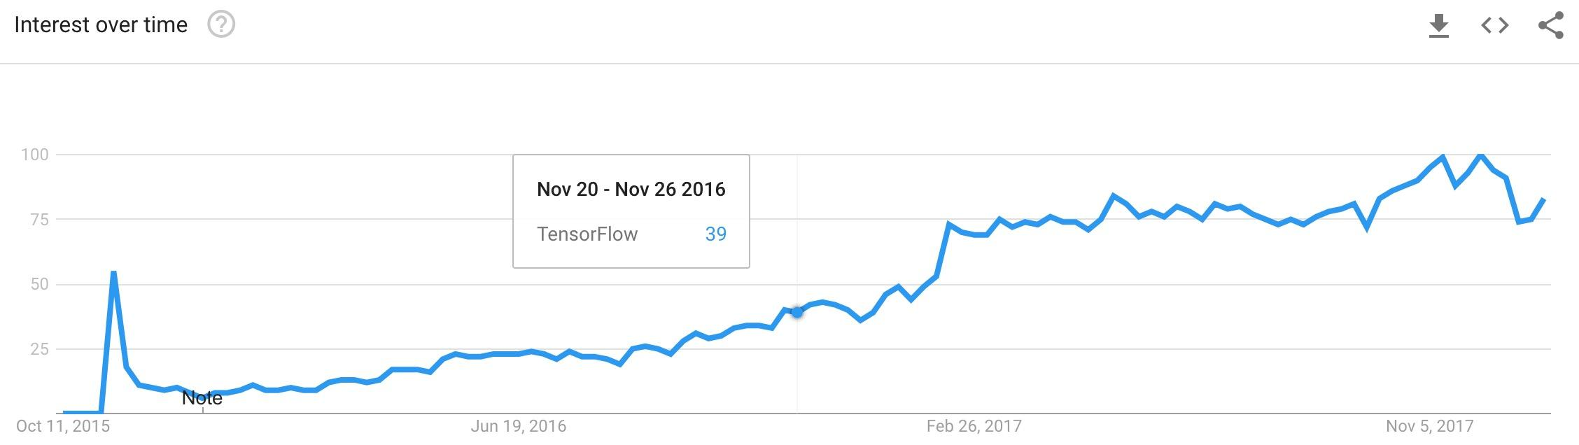
Launched Nov 2015

Slide 5
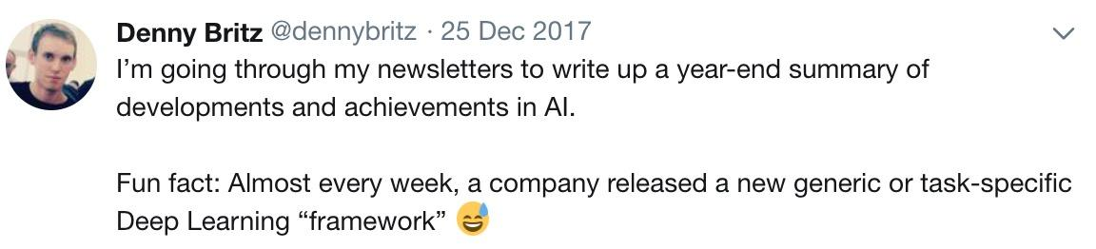
Why TensorFlow?
Many machine learning libraries

Slide 6
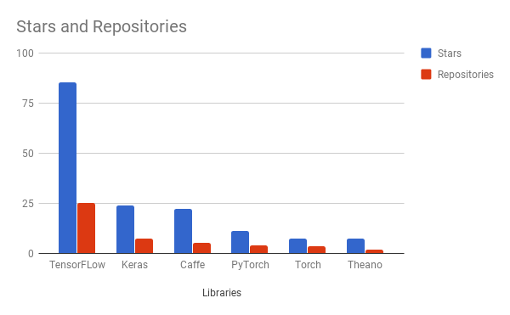
Why TensorFlow?
Popularity Originally developed by Google as a single infrastructure for machine learning in both production and research
Responsive Construct – easily visualizing each and every part of the graph
Visualizer and Event Logger
Flexibility + Scalability
Notes:
For a framework to be useful in production, it needs to be efficient, scalable, and maintainable. For research, the framework needs to have flexible operations that can be combined in novel ways. Alternative frameworks are either flexible enough for research but less scalable, such as Chainer and PyTorch, or scalable but less flexible, such as Caffe and MXNet. TensorFlow are both flexible and scalable, allowing users to streamline from research into production.

Slide 7

Companies using TensorFlow

Slide 8
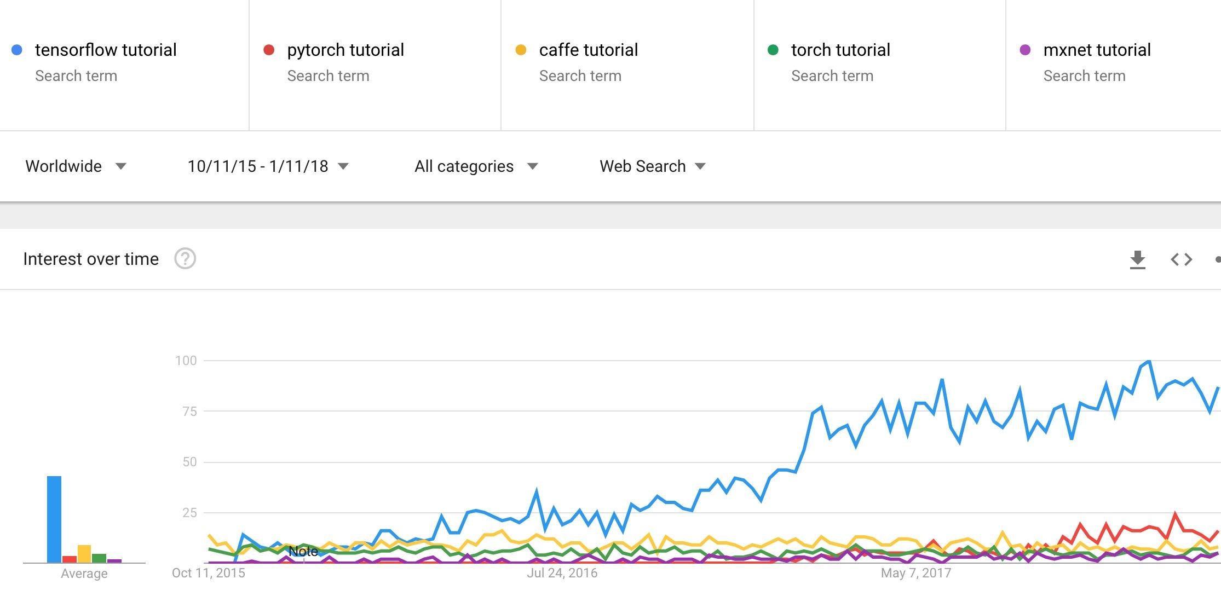
Demand for tutorials on TensorFlow

Slide 9
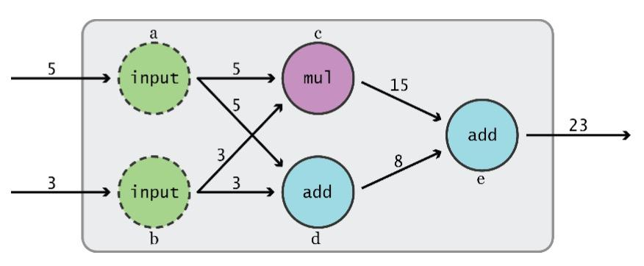
Data Flow Graphs
TensorFlow separates definition of computations from their execution
Graph from TensorFlow for Machine Intelligence
Notes:
How does it do so? By using graphs and sessions

Slide 10
Data Flow Graphs
Phase 1: build a computational graph (tf.Graph)
Phase 2: use a session to execute operations in the graph. (tf.Session)
Graph from TensorFlow for Machine Intelligence

Slide 11
What’s a tensor?
[
An n-dimensional array – central unit of data
0-d tensor: scalar (number)
1-d tensor: vector
2-d tensor: matrix
and so on
Eg, [[1.,2.,3.],[4.,5.,6.]] # a rank(number of dimensions) 2 tensor and a matrix with shape [2,3] (tuple of integers specifying the array's length along each dimension values )
Uses numpy arrays to represent tensor

Slide 12
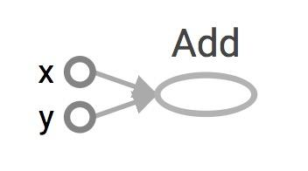
Data Flow Graphs
import tensorflow as tf a = tf.add(3, 5)
Visualized by TensorBoard
Notes:
More about naming them in the next module

Slide 13
Data Flow Graphs
import tensorflow as tf a = tf.add(3, 5)
Visualized by TensorBoard
Why x, y?
TF automatically names the nodes when you don’t explicitly name them.
x = 3
y = 5
Notes:
More about naming them in the next module

Slide 14
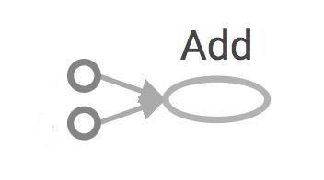
Data Flow Graphs
import tensorflow as tf a = tf.add(3, 5)
Interpreted?
3
Nodes: operators, variables, and constants
Edges: tensors
a
5
Notes:
Different from graphs we might be familiar in which nodes are values, edges are functions

Slide 15
Data Flow Graphs
import tensorflow as tf a = tf.add(3, 5) print(a)
3
5
a
>> Tensor("Add:0", shape=(), dtype=int32)
(Not 8)

Slide 16
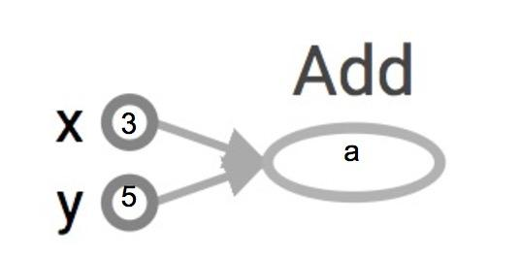
How to get the value of a?
Create a session, assign it to variable sess so we can call it later
Within the session, evaluate the graph to fetch the value of a
import tensorflow as tf a = tf.add(3, 5) sess = tf.Session() print(sess.run(a)) sess.close()
or
import tensorflow as tf a = tf.add(3, 5) with tf.Session() as sess: print(sess.run(a))
8
>> 8
The session will look at the graph, trying to think: hmm, how can I get the value of a,
then it computes all the nodes that leads to a.

Slide 17
tf.Session()
A Session object encapsulates the environment in which Operation objects are executed, and Tensor objects are evaluated.
Session will also allocate memory to store the current values of variables.
Notes:
Note that sessions deal with memory allocation

Slide 18
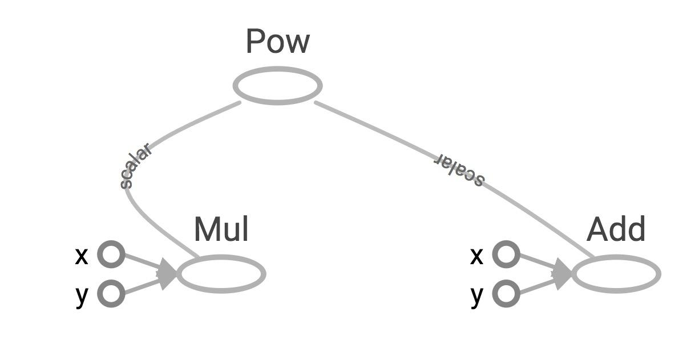
More graph
Visualized by TensorBoard
x = 2 y = 3 op1 = tf.add(x, y) op2 = tf.multiply(x, y) op3 = tf.pow(op2, op1) with tf.Session() as sess: op3 = sess.run(op3)

Slide 19
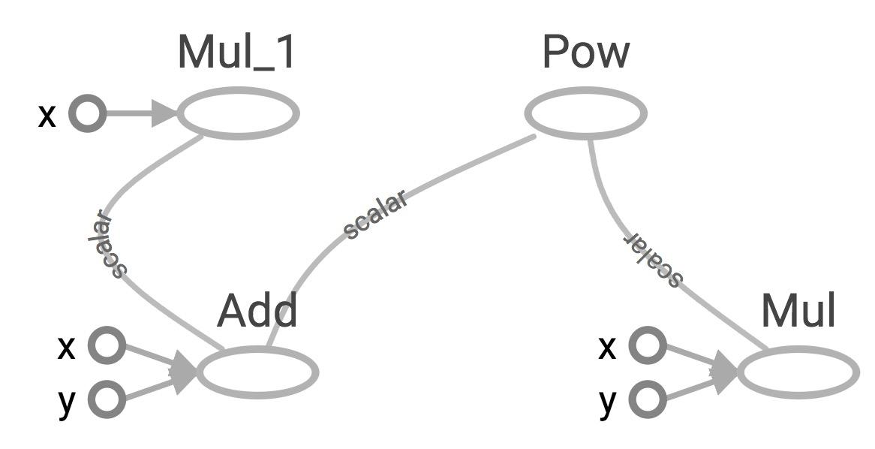
Subgraphs
x = 2 y = 3 add_op = tf.add(x, y) mul_op = tf.multiply(x, y) useless = tf.multiply(x, add_op) pow_op = tf.pow(add_op, mul_op) with tf.Session() as sess: z = sess.run(pow_op)
useless
pow_op
add_op
mul_op
Because we only want the value of pow_op and pow_op doesn’t depend on useless, session won’t compute value of useless
→ save computation

Slide 20
Distributed Computation
To put part of a graph on a specific CPU or GPU:
# Creates a graph.
with tf.device('/gpu:2'):
a = tf.constant([1.0, 2.0, 3.0, 4.0, 5.0, 6.0], name='a')
b = tf.constant([1.0, 2.0, 3.0, 4.0, 5.0, 6.0], name='b')
c = tf.multiply(a, b)
# Creates a session with log_device_placement set to True.
sess = tf.Session(config=tf.ConfigProto(log_device_placement=True))
# Runs the op.
print(sess.run(c))

Slide 21
tf.Graph()
to add operators to a graph, set it as default:
g = tf.Graph() with g.as_default(): x = tf.add(3, 5) sess = tf.Session(graph=g) with tf.Session() as sess: sess.run(x)

Slide 22
tf.Graph()
To handle the default graph:
g = tf.get_default_graph()

Slide 23
tf.Graph()
Do not mix default graph and user created graphs
g = tf.Graph()
# add ops to the default graph a = tf.constant(3)
# add ops to the user created graph with g.as_default(): b = tf.constant(5)
Prone to errors

Slide 24
tf.Graph()
Do not mix default graph and user created graphs
g1 = tf.get_default_graph() g2 = tf.Graph()
# add ops to the default graph with g1.as_default(): a = tf.Constant(3)
# add ops to the user created graph with g2.as_default(): b = tf.Constant(5)
Better
But still not good enough because no more than one graph!

Slide 25
Why graphs
Save computation. Only run subgraphs that lead to the values you want to fetch.
Break computation into small, differential pieces to facilitate auto-differentiation
Facilitate distributed computation, spread the work across multiple CPUs, GPUs, TPUs, or other devices
Many common machine learning models are taught and visualized as directed graphs
Notes:
Many common machine learning models, such as neural networks, are commonly taught and visualized as directed graphs already, which makes their implementation more natural for machine learning practitioners.
By splitting up computation into small, easily differentiable pieces, TF is able to automatically compute the derivative of any node (or “Operation”, as they’re called in TensorFlow) with respect to any other node that can affect the first node’s output. Being able to compute the derivative/gradient of nodes, especially output nodes, is crucial for setting up machine learning models.
Third having the computation separated, it makes it much easier to distribute work across multiple CPUs, GPUs, and other computational devices. Simply split the whole, larger graph into several smaller graphs and give each device a separate part of the graph to work on (with a touch of logic to coordinate sharing information across devices)

Slide 26
Your first TensorFlow program
import tensorflow as tf
a = tf.constant(2) b = tf.constant(3) x = tf.add(a, b)
with tf.Session() as sess: print(sess.run(x))
Notes:
Style choice:
sess = tf.Session() instead of with tf.Session()

Slide 27
Visualize it with TensorBoard
import tensorflow as tf
a = tf.constant(2) b = tf.constant(3) x = tf.add(a, b)
writer = tf.summary.FileWriter('./graphs', tf.get_default_graph()) with tf.Session() as sess: # writer = tf.summary.FileWriter('./graphs', sess.graph) print(sess.run(x)) writer.close() # close the writer when you’re done using it
Create the summary writer after graph definition and before running your session
‘graphs’ or any location where you want to keep your event files
Notes:
You can choose where to put your files. I find it easier

Slide 28
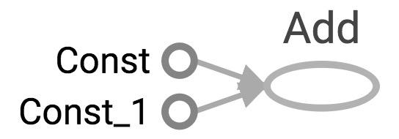
Visualize it with TensorBoard
import tensorflow as tf
a = tf.constant(2) b = tf.constant(3) x = tf.add(a, b) writer = tf.summary.FileWriter('./graphs', tf.get_default_graph()) writer.close()

Slide 29
Visualize it with TensorBoard
import tensorflow as tf
a = tf.constant(2) b = tf.constant(3) x = tf.add(a, b) writer = tf.summary.FileWriter('./graphs', tf.get_default_graph()) writer.close()
Question:
How to change Const, Const_1 to the names we give the variables?

Slide 30
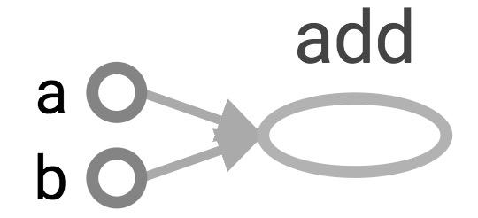
Explicitly name them
import tensorflow as tf
a = tf.constant(2, name='a') b = tf.constant(3, name='b') x = tf.add(a, b, name='add')
writer = tf.summary.FileWriter('./graphs', tf.get_default_graph()) with tf.Session() as sess: print(sess.run(x)) # >> 5

Slide 31
TensorBoard can do much more than just visualizing your graphs.
Learn to use TensorBoard
well and often!

Slide 32
Constants, Sequences, Variables, Ops

Slide 33
Constants
import tensorflow as tf
a = tf.constant([2, 2], name='a') b = tf.constant([[0, 1], [2, 3]], name='b')
tf.constant(value,dtype=None,shape=None,name='Const',verify_shape=False)

Slide 34
Constants
import tensorflow as tf
a = tf.constant([2, 2], name='a') b = tf.constant([[0, 1], [2, 3]], name='b') x = tf.multiply(a, b, name='mul')
with tf.Session() as sess: print(sess.run(x))
# >> [[0 2] # [4 6]]

Slide 35
Tensors filled with a specific value
tf.zeros(shape, dtype=tf.float32, name=None)
creates a tensor of shape and all elements will be zeros
tf.zeros([2, 3], tf.int32) ==> [[0, 0, 0], [0, 0, 0]]
Notes:
These are more compact than constants in the graph def, resulting in faster startup (especially in distributed where the graph must be send to all workers)

Slide 36
Tensors filled with a specific value
tf.ones(shape, dtype=tf.float32, name=None)
tf.ones_like(input_tensor, dtype=None, name=None, optimize=True)

Slide 37
Tensors filled with a specific value
tf.fill(dims, value, name=None)
creates a tensor filled with a scalar value.
tf.fill([2, 3], 8) ==> [[8, 8, 8], [8, 8, 8]]

Slide 38
Constants as sequences
tf.lin_space(start, stop, num, name=None) tf.lin_space(10.0, 13.0, 4) ==> [10. 11. 12. 13.]
tf.range(start, limit=None, delta=1, dtype=None, name='range') tf.range(3, 18, 3) ==> [3 6 9 12 15] tf.range(5) ==> [0 1 2 3 4]
Notes:
# create a sequence of num evenly-spaced values are generated beginning at start. If num > 1, the values in the sequence increase by stop - start / num - 1, so that the last one is exactly stop.
create a sequence of numbers that begins at start and extends by increments of delta up to but not including limit

Slide 39
Randomly Generated Constants
tf.set_random_seed(seed)

Slide 40
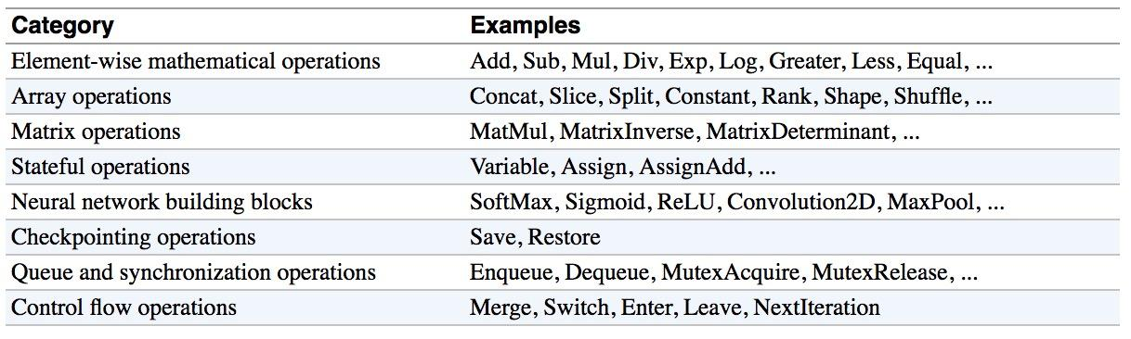
Operations
Buduma. Fundamentals of Deep Learning. O’Reilly, 2017
Notes:
Should i keep this or nah?
Not sure it adds much that isn’t already in the slides -straka

Slide 41
TensorFlow Data Types
TensorFlow takes Python natives types: boolean, numeric (int, float), strings
t_0 = 19 # scalars are treated like 0-d tensors
tf.zeros_like(t_0) # ==> 0
tf.ones_like(t_0) # ==> 1
Notes:
Single values will be converted to 0-d tensors (or scalars), lists of values will be converted to 1-d tensors (vectors), lists of lists of values will be converted to 2-d
tensors (matrices), and so on.

Slide 42
TensorFlow Data Types
TensorFlow takes Python natives types: boolean, numeric (int, float), strings
t_0 = 19 # scalars are treated like 0-d tensors
tf.zeros_like(t_0) # ==> 0
tf.ones_like(t_0) # ==> 1
Notes:
Single values will be converted to 0-d tensors (or scalars), lists of values will be converted to 1-d tensors (vectors), lists of lists of values will be converted to 2-d
tensors (matrices), and so on.

Slide 43
TensorFlow Data Types
TensorFlow takes Python natives types: boolean, numeric (int, float), strings
t_0 = 19 # scalars are treated like 0-d tensors
tf.zeros_like(t_0) # ==> 0
tf.ones_like(t_0) # ==> 1
t_1 = [b"apple", b"peach", b"grape"] # 1-d arrays are treated like 1-d tensors
tf.zeros_like(t_1) # ==> ?????
Notes:
Single values will be converted to 0-d tensors (or scalars), lists of values will be converted to 1-d tensors (vectors), lists of lists of values will be converted to 2-d
tensors (matrices), and so on.

Slide 44
TensorFlow Data Types
TensorFlow takes Python natives types: boolean, numeric (int, float), strings
t_0 = 19 # scalars are treated like 0-d tensors
tf.zeros_like(t_0) # ==> 0
tf.ones_like(t_0) # ==> 1
t_1 = [b"apple", b"peach", b"grape"] # 1-d arrays are treated like 1-d tensors
tf.zeros_like(t_1) # ==> [b'' b'' b'']
Notes:
Single values will be converted to 0-d tensors (or scalars), lists of values will be converted to 1-d tensors (vectors), lists of lists of values will be converted to 2-d
tensors (matrices), and so on.

Slide 45
TensorFlow Data Types
TensorFlow takes Python natives types: boolean, numeric (int, float), strings
t_0 = 19 # scalars are treated like 0-d tensors
tf.zeros_like(t_0) # ==> 0
tf.ones_like(t_0) # ==> 1
t_1 = [b"apple", b"peach", b"grape"] # 1-d arrays are treated like 1-d tensors
tf.zeros_like(t_1) # ==> [b'' b'' b'']
tf.ones_like(t_1) # ==> ?????
Notes:
Single values will be converted to 0-d tensors (or scalars), lists of values will be converted to 1-d tensors (vectors), lists of lists of values will be converted to 2-d
tensors (matrices), and so on.

Slide 46
TensorFlow Data Types
TensorFlow takes Python natives types: boolean, numeric (int, float), strings
t_0 = 19 # scalars are treated like 0-d tensors
tf.zeros_like(t_0) # ==> 0
tf.ones_like(t_0) # ==> 1
t_1 = [b"apple", b"peach", b"grape"] # 1-d arrays are treated like 1-d tensors
tf.zeros_like(t_1) # ==> [b'' b'' b'']
tf.ones_like(t_1) # ==> TypeError: Expected string, got 1 of type 'int' instead.
Notes:
Single values will be converted to 0-d tensors (or scalars), lists of values will be converted to 1-d tensors (vectors), lists of lists of values will be converted to 2-d
tensors (matrices), and so on.

Slide 47
TensorFlow Data Types
TensorFlow takes Python natives types: boolean, numeric (int, float), strings
t_0 = 19 # scalars are treated like 0-d tensors
tf.zeros_like(t_0) # ==> 0
tf.ones_like(t_0) # ==> 1
t_1 = [b"apple", b"peach", b"grape"] # 1-d arrays are treated like 1-d tensors
tf.zeros_like(t_1) # ==> [b'' b'' b'']
tf.ones_like(t_1) # ==> TypeError: Expected string, got 1 of type 'int' instead.
t_2 = [[True, False, False],
[False, False, True],
[False, True, False]] # 2-d arrays are treated like 2-d tensors
tf.zeros_like(t_2) # ==> ?????
tf.ones_like(t_2) # ==> ?????
Notes:
Single values will be converted to 0-d tensors (or scalars), lists of values will be converted to 1-d tensors (vectors), lists of lists of values will be converted to 2-d
tensors (matrices), and so on.

Slide 48
TensorFlow Data Types
TensorFlow takes Python natives types: boolean, numeric (int, float), strings
t_0 = 19 # scalars are treated like 0-d tensors
tf.zeros_like(t_0) # ==> 0
tf.ones_like(t_0) # ==> 1
t_1 = [[True, False, False],
[False, False, True],
[False, True, False]] # 2-d arrays are treated like 2-d tensors
tf.zeros_like(t_1) # ==> 3x3 tensor, all elements are False
tf.ones_like(t_1) # ==> 3x3 tensor, all elements are True
Notes:
Single values will be converted to 0-d tensors (or scalars), lists of values will be converted to 1-d tensors (vectors), lists of lists of values will be converted to 2-d
tensors (matrices), and so on.

Slide 49
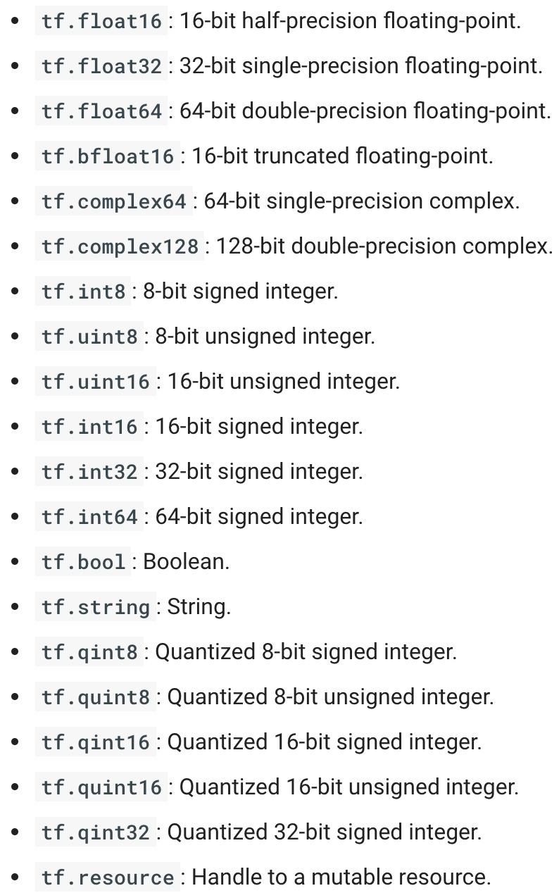
TensorFlow Data Types
Notes:
https://www.tensorflow.org/api_docs/python/tf/DType

Slide 50
What’s wrong with constants?
Constants are stored in the graph definition

Slide 51
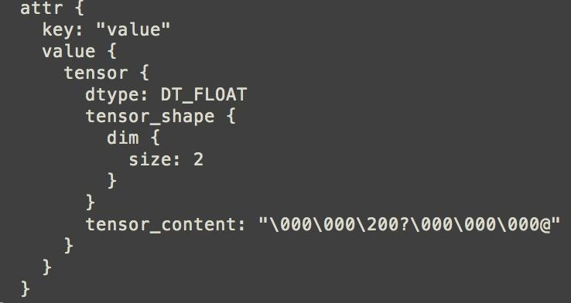
Print out the graph def
my_const = tf.constant([1.0, 2.0], name="my_const")
with tf.Session() as sess: print(sess.graph.as_graph_def())
Notes:
The graph definition is stored in a protobuf (protocol buffers, Google's language-neutral, platform-neutral, extensible mechanism for serializing structured data – think XML, but smaller, faster, and simpler.)

Slide 52
What’s wrong with constants?
This makes loading graphs expensive when constants are big

Slide 53
What’s wrong with constants?
This makes loading graphs expensive when constants are big
Only use constants for primitive types.
Use variables or readers for more data that requires more memory

Slide 54
Variables
# create variables with tf.Variable
s = tf.Variable(2, name="scalar")
m = tf.Variable([[0, 1], [2, 3]], name="matrix")
W = tf.Variable(tf.zeros([784,10]))
# create variables with tf.get_variable
s = tf.get_variable("scalar", initializer=tf.constant(2))
m = tf.get_variable("matrix", initializer=tf.constant([[0, 1], [2, 3]]))
W = tf.get_variable("big_matrix", shape=(784, 10), initializer=tf.zeros_initializer())

Slide 55


Variables
# create variables with tf.Variable
s = tf.Variable(2, name="scalar")
m = tf.Variable([[0, 1], [2, 3]], name="matrix")
W = tf.Variable(tf.zeros([784,10]))
# create variables with tf.get_variable
s = tf.get_variable("scalar", initializer=tf.constant(2))
m = tf.get_variable("matrix", initializer=tf.constant([[0, 1], [2, 3]]))
W = tf.get_variable("big_matrix", shape=(784, 10), initializer=tf.zeros_initializer())

Slide 56
Variables
# create variables with tf.Variable
s = tf.Variable(2, name="scalar")
m = tf.Variable([[0, 1], [2, 3]], name="matrix")
W = tf.Variable(tf.zeros([784,10]))
# create variables with tf.get_variable
s = tf.get_variable("scalar", initializer=tf.constant(2))
m = tf.get_variable("matrix", initializer=tf.constant([[0, 1], [2, 3]]))
W = tf.get_variable("big_matrix", shape=(784, 10), initializer=tf.zeros_initializer())
Why tf.constant but tf.Variable?

Slide 57
Variables
# create variables with tf.Variable
s = tf.Variable(2, name="scalar")
m = tf.Variable([[0, 1], [2, 3]], name="matrix")
W = tf.Variable(tf.zeros([784,10]))
# create variables with tf.get_variable
s = tf.get_variable("scalar", initializer=tf.constant(2))
m = tf.get_variable("matrix", initializer=tf.constant([[0, 1], [2, 3]]))
W = tf.get_variable("big_matrix", shape=(784, 10), initializer=tf.zeros_initializer())
tf.constant is an op
tf.Variable is a class with many ops

Slide 58
tf.Variable class
# create variables with tf.get_variable
s = tf.get_variable("scalar", initializer=tf.constant(2))
m = tf.get_variable("matrix", initializer=tf.constant([[0, 1], [2, 3]]))
W = tf.get_variable("big_matrix", shape=(784, 10), initializer=tf.zeros_initializer())
tf.Variable holds several ops:
x = tf.Variable(...)
x.initializer # init op
x.value() # read op
x.assign(...) # write op
x.assign_add(...) # and more
Notes:
As a shortcut, TF allows you to omit the `.value` in many cases, so you can pass values of vars to other ops as tf.add(x, ...) rather than tf.add(x.value, ...).

Slide 59
tf.Variable class
# create variables with tf.get_variable
s = tf.get_variable("scalar", initializer=tf.constant(2))
m = tf.get_variable("matrix", initializer=tf.constant([[0, 1], [2, 3]]))
W = tf.get_variable("big_matrix", shape=(784, 10), initializer=tf.zeros_initializer())
with tf.Session() as sess: print(sess.run(W)) >> FailedPreconditionError: Attempting to use uninitialized value Variable

Slide 60
You have to initialize your variables
The easiest way is initializing all variables at once:
with tf.Session() as sess:
sess.run(tf.global_variables_initializer())
Initializer is an op. You need to execute it within the context of a session

Slide 61
You have to initialize your variables
The easiest way is initializing all variables at once:
with tf.Session() as sess:
sess.run(tf.global_variables_initializer())
Initialize only a subset of variables:
with tf.Session() as sess:
sess.run(tf.variables_initializer([a, b]))
Initialize a single variable
W = tf.Variable(tf.zeros([784,10]))
with tf.Session() as sess:
sess.run(W.initializer)

Slide 62
Eval() a variable
# W is a random 700 x 100 variable object
W = tf.Variable(tf.truncated_normal([700, 10]))
with tf.Session() as sess:
sess.run(W.initializer)
print(W)
>> Tensor("Variable/read:0", shape=(700, 10), dtype=float32)

Slide 63
Eval() a variable
# W is a random 700 x 100 variable object
W = tf.Variable(tf.truncated_normal([700, 10]))
with tf.Session() as sess:
sess.run(W.initializer)
print(W.eval()) # Similar to print(sess.run(W))
>> [[-0.76781619 -0.67020458 1.15333688 ..., -0.98434633 -1.25692499
-0.90904623]
[-0.36763489 -0.65037876 -1.52936983 ..., 0.19320194 -0.38379928
0.44387451]
[ 0.12510735 -0.82649058 0.4321366 ..., -0.3816964 0.70466036
1.33211911]
...,
[ 0.9203397 -0.99590844 0.76853162 ..., -0.74290705 0.37568584
0.64072722]
[-0.12753558 0.52571583 1.03265858 ..., 0.59978199 -0.91293705
-0.02646019]
[ 0.19076447 -0.62968266 -1.97970271 ..., -1.48389161 0.68170643
1.46369624]]
Notes:
You have to

Slide 64
tf.Variable.assign()
W = tf.Variable(10)
W.assign(100)
with tf.Session() as sess:
sess.run(W.initializer)
print(W.eval()) # >> ????

Slide 65
tf.Variable.assign()
W = tf.Variable(10)
W.assign(100)
with tf.Session() as sess:
sess.run(W.initializer)
print(W.eval()) # >> 10
Ugh, why?

Slide 66
tf.Variable.assign()
W = tf.Variable(10)
W.assign(100)
with tf.Session() as sess:
sess.run(W.initializer)
print(W.eval()) # >> 10
W.assign(100) creates an assign op.
That op needs to be executed in a session to take effect.

Slide 67
tf.Variable.assign()
W = tf.Variable(10)
W.assign(100)
with tf.Session() as sess:
sess.run(W.initializer)
print(W.eval()) # >> 10
--------
W = tf.Variable(10)
assign_op = W.assign(100)
with tf.Session() as sess:
sess.run(W.initializer)
sess.run(assign_op)
print(W.eval()) # >> 100
Notes:
You don’t need to initialize variable because assign_op does it for you. In fact, initializer op is the assign op that assigns the variable’s initial value to the variable itself.

Slide 68
tf.Variable.assign()
# create a variable whose original value is 2
my_var = tf.Variable(2, name="my_var")
# assign a * 2 to a and call that op a_times_two
my_var_times_two = my_var.assign(2 * my_var)
with tf.Session() as sess:
sess.run(my_var.initializer)
sess.run(my_var_times_two) # >> what’s the value of my_var now?

Slide 69
tf.Variable.assign()
# create a variable whose original value is 2
my_var = tf.Variable(2, name="my_var")
# assign a * 2 to a and call that op a_times_two
my_var_times_two = my_var.assign(2 * my_var)
with tf.Session() as sess:
sess.run(my_var.initializer)
sess.run(my_var_times_two) # >> the value of my_var now is 4
sess.run(my_var_times_two) # >> the value of my_var now is

Slide 70
tf.Variable.assign()
# create a variable whose original value is 2
my_var = tf.Variable(2, name="my_var")
# assign a * 2 to a and call that op a_times_two
my_var_times_two = my_var.assign(2 * my_var)
with tf.Session() as sess:
sess.run(my_var.initializer)
sess.run(my_var_times_two) # >> the value of my_var now is 4
sess.run(my_var_times_two) # >> the value of my_var now is 8
sess.run(my_var_times_two) # >> the value of my_var now is 16
It assign 2 * my_var to my_var every time my_var_times_two op is executed.

Slide 71
assign_add() and assign_sub()
my_var = tf.Variable(10)
With tf.Session() as sess: sess.run(my_var.initializer) # increment by 10 sess.run(my_var.assign_add(10)) # >> 20
# decrement by 2 sess.run(my_var.assign_sub(2)) # >> 18
Notes:
assign_add() and assign_sub() can’t initialize the variable my_var for you because these ops need the original value of my_var

Slide 72
Each session maintains its own copy of variables
W = tf.Variable(10)
sess1 = tf.Session()
sess2 = tf.Session()
sess1.run(W.initializer)
sess2.run(W.initializer)
print(sess1.run(W.assign_add(10))) # >> 20
print(sess2.run(W.assign_sub(2))) # >> ?

Slide 73
Each session maintains its own copy of variables
W = tf.Variable(10)
sess1 = tf.Session()
sess2 = tf.Session()
sess1.run(W.initializer)
sess2.run(W.initializer)
print(sess1.run(W.assign_add(10))) # >> 20
print(sess2.run(W.assign_sub(2))) # >> 8

Slide 74
Each session maintains its own copy of variables
W = tf.Variable(10)
sess1 = tf.Session()
sess2 = tf.Session()
sess1.run(W.initializer)
sess2.run(W.initializer)
print(sess1.run(W.assign_add(10))) # >> 20
print(sess2.run(W.assign_sub(2))) # >> 8
print(sess1.run(W.assign_add(100))) # >> 120
print(sess2.run(W.assign_sub(50))) # >> -42
sess1.close()
sess2.close()

Slide 75
Placeholder

Slide 76
A quick reminder
A TF program often has 2 phases:
Assemble a graph
Use a session to execute operations in the graph.

Slide 77
Placeholders
A TF program often has 2 phases:
Assemble a graph
Use a session to execute operations in the graph.
⇒ Assemble the graph first without knowing the values needed for computation

Slide 78
Placeholders
A TF program often has 2 phases:
Assemble a graph
Use a session to execute operations in the graph.
⇒ Assemble the graph first without knowing the values needed for computation
Analogy:
Define the function f(x, y) = 2 * x + y without knowing value of x or y.
x, y are placeholders for the actual values.

Slide 79
Why placeholders?
We, or our clients, can later supply their own data when they need to execute the computation.

Slide 80
Placeholders
tf.placeholder(dtype, shape=None, name=None)
# create a placeholder for a vector of 3 elements, type tf.float32
a = tf.placeholder(tf.float32, shape=[3])
b = tf.constant([5, 5, 5], tf.float32)
# use the placeholder as you would use a constant or a variable
c = a + b # short for tf.add(a, b)
with tf.Session() as sess:
print(sess.run(c)) # >> ???

Slide 81
Placeholders
tf.placeholder(dtype, shape=None, name=None)
# create a placeholder for a vector of 3 elements, type tf.float32
a = tf.placeholder(tf.float32, shape=[3])
b = tf.constant([5, 5, 5], tf.float32)
# use the placeholder as you would a constant or a variable
c = a + b # short for tf.add(a, b)
with tf.Session() as sess:
print(sess.run(c)) # >> InvalidArgumentError: a doesn’t an actual value

Slide 82
Supplement the values to placeholders using a dictionary

Slide 83
Placeholders
tf.placeholder(dtype, shape=None, name=None)
# create a placeholder for a vector of 3 elements, type tf.float32
a = tf.placeholder(tf.float32, shape=[3])
b = tf.constant([5, 5, 5], tf.float32)
# use the placeholder as you would a constant or a variable
c = a + b # short for tf.add(a, b)
with tf.Session() as sess:
print(sess.run(c, feed_dict={a: [1, 2, 3]})) # the tensor a is the key, not the string ‘a’
# >> [6, 7, 8]

Slide 84
Placeholders
tf.placeholder(dtype, shape=None, name=None)
# create a placeholder for a vector of 3 elements, type tf.float32
a = tf.placeholder(tf.float32, shape=[3])
b = tf.constant([5, 5, 5], tf.float32)
# use the placeholder as you would a constant or a variable
c = a + b # short for tf.add(a, b)
with tf.Session() as sess:
print(sess.run(c, feed_dict={a: [1, 2, 3]}))
# >> [6, 7, 8]
Quirk:
shape=None means that tensor of any shape will be accepted as value for placeholder.
shape=None is easy to construct graphs, but nightmarish for debugging

Slide 85
Placeholders
tf.placeholder(dtype, shape=None, name=None)
# create a placeholder of type float 32-bit, shape is a vector of 3 elements
a = tf.placeholder(tf.float32, shape=[3])
# create a constant of type float 32-bit, shape is a vector of 3 elements
b = tf.constant([5, 5, 5], tf.float32)
# use the placeholder as you would a constant or a variable
c = a + b # Short for tf.add(a, b)
with tf.Session() as sess:
print(sess.run(c, {a: [1, 2, 3]}))
# >> [6, 7, 8]
Quirk:
shape=None also breaks all following shape inference, which makes many ops not work because they expect certain rank.
Notes:
The session will look at the graph, trying to think: hmm, how can I get the value of a, then it computes all the nodes that leads to a.

Slide 86
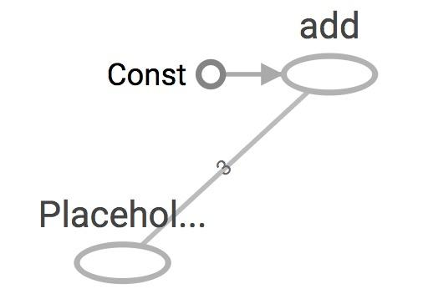
Placeholders are valid ops
tf.placeholder(dtype, shape=None, name=None)
# create a placeholder of type float 32-bit, shape is a vector of 3 elements
a = tf.placeholder(tf.float32, shape=[3])
# create a constant of type float 32-bit, shape is a vector of 3 elements
b = tf.constant([5, 5, 5], tf.float32)
# use the placeholder as you would a constant or a variable
c = a + b # Short for tf.add(a, b)
with tf.Session() as sess:
print(sess.run(c, {a: [1, 2, 3]}))
# >> [6, 7, 8]
Notes:
we can feed_dict any tensors. placeholders are just a way to indicate that sth must be fed

Slide 87
What if want to feed multiple data points in?
You have to do it one at a time
with tf.Session() as sess:
for a_value in list_of_values_for_a:
print(sess.run(c, {a: a_value}))

Slide 88
You can feed_dict any feedable tensor.
Placeholder is just a way to indicate that something must be fed

Slide 89
tf.Graph.is_feedable(tensor)
# True if and only if tensor is feedable.
Notes:
Example from GitHub

Slide 90
Feeding values to TF ops
# create operations, tensors, etc (using the default graph)
a = tf.add(2, 5)
b = tf.multiply(a, 3)
with tf.Session() as sess:
# compute the value of b given a is 15
sess.run(b, feed_dict={a: 15}) # >> 45
Notes:
The session will look at the graph, trying to think: hmm, how can I get the value of a, then it computes all the nodes that leads to a.

Slide 91
Extremely helpful for testing
Feed in dummy values to test parts of a large graph
Notes:
When you have a large graph and just want to test out certain parts, you can provide dummy values so TensorFlow won’t waste time doing unnecessary computations.

Slide 92
What’s lazy loading?

Slide 93
Defer creating/initializing an object
until it is needed

Slide 94
Lazy loading Example
Normal loading
x = tf.Variable(10, name='x')
y = tf.Variable(20, name='y')
z = tf.add(x, y) # create the node before executing the graph
writer = tf.summary.FileWriter('./graphs/normal_loading', tf.get_default_graph())
with tf.Session() as sess:
sess.run(tf.global_variables_initializer())
for _ in range(10):
sess.run(z)
writer.close()

Slide 95
Lazy loading Example
Lazy loading
x = tf.Variable(10, name='x')
y = tf.Variable(20, name='y')
writer = tf.summary.FileWriter('./graphs/normal_loading', tf.get_default_graph())
with tf.Session() as sess:
sess.run(tf.global_variables_initializer())
for _ in range(10):
sess.run(tf.add(x, y)) # someone decides to be clever to save one line of code
writer.close()

Slide 96
Both give the same value of z
What’s the problem?

Slide 97
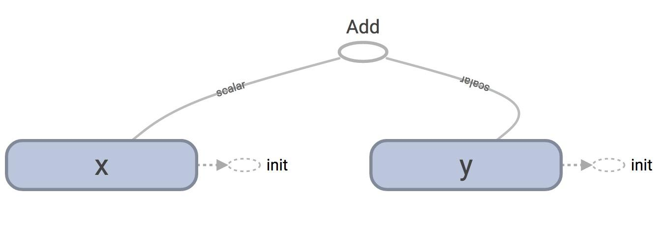
TensorBoard
Normal loading
Notes:
Looks normal

Slide 98
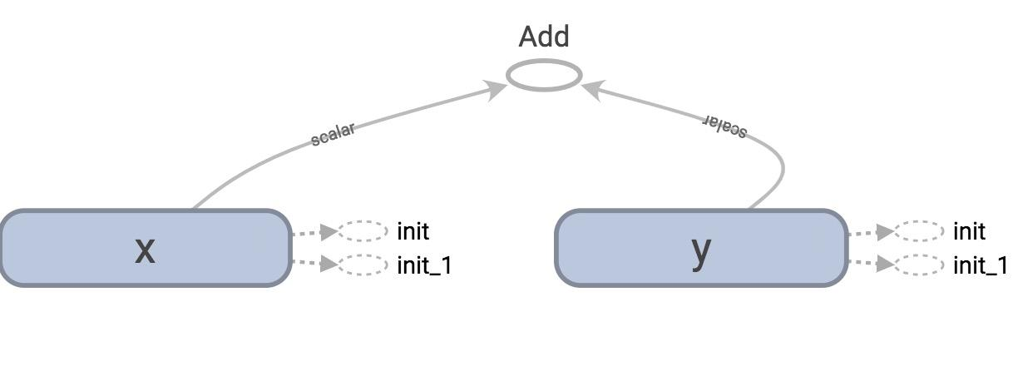
TensorBoard
Lazy loading

Slide 99
tf.get_default_graph().as_graph_def()
Normal loading
node {
name: "Add"
op: "Add"
input: "x/read"
input: "y/read"
attr {
key: "T"
value {
type: DT_INT32
}
}
}
Node “Add” added once to the graph definition
Notes:
tensorflow.python.framework.errors_impl.FailedPreconditionError: Attempting to use uninitialized value

Slide 100
tf.get_default_graph().as_graph_def()
Lazy loading
node {
name: "Add_1"
op: "Add"
...
}
...
node {
name: "Add_10"
op: "Add"
...
}
Node “Add” added 10 times to the graph definition
Or as many times as you want to compute z

Slide 101
Imagine you want to compute an op
thousands, or millions of times!
Notes:
Example from GitHub

Slide 102
Your graph gets bloated
Slow to load
Expensive to pass around
Notes:
Example from GitHub

Slide 103
Acknowledgement
Slides are adapted from
http://web.stanford.edu/class/cs20si/
Resources
The official documentations
TensorFlow’s official sample models
StackOverflow should be your first port of call in case of bug
Books
Aurélien Géron’s Hands-On Machine Learning with Scikit-Learn and TensorFlow (O’Reilly, March 2017)
François Chollet’s Deep Learning with Python (Manning Publications, November 2017)
Nishant Shukla’s Machine Learning with TensorFlow (Manning Publications, January 2018)
Lieder et al.’s Learning TensorFlow A Guide to Building Deep Learning Systems (O’Reilly, August 2017)

Slide 104
Introduction to RNN
Notes:
Example from GitHub

Slide 105
Need of RNN
the idea behind RNNs is to make use of sequential information.
a traditional neural network we assume that all inputs (and outputs) are independent of each other but for many tasks that’s a very bad idea.
to predict the next word in a sentence you better know which words came before it. RNNs are called recurrent because they perform the same task for every element of a sequence, with the output being depended on the previous computations.
Another way to think about RNNs is that they have a “memory” which captures information about what has been calculated so far. In theory RNNs can make use of information in arbitrarily long sequences, but in practice they are limited to looking back only a few steps
Notes:
The session will look at the graph, trying to think: hmm, how can I get the value of a, then it computes all the nodes that leads to a.

Slide 106
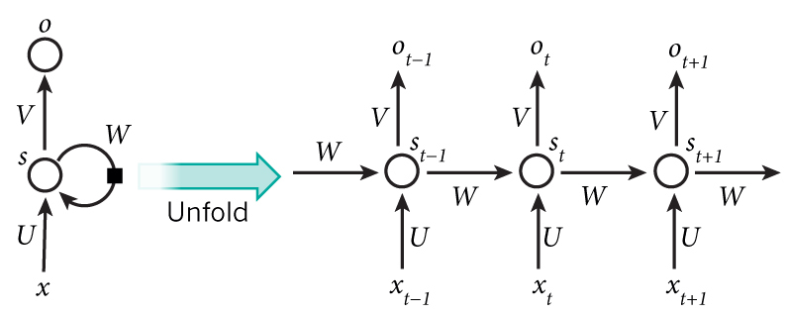
How RNN works
A recurrent neural network and the unfolding in time of the computation involved in its forward computation. Source: Nature
Notes:
The session will look at the graph, trying to think: hmm, how can I get the value of a, then it computes all the nodes that leads to a.

Slide 107
What can rnn do ?
Language Modelling and Generating text
Machine Translations
Speech recognition
Generating Image descriptions
Notes:
The session will look at the graph, trying to think: hmm, how can I get the value of a, then it computes all the nodes that leads to a.

