Slide 1


Domain-Specific Languages for Composing Signature Discovery Workflows
Ferosh Jacob*, Adam Wynne+, Yan Liu+, Nathan Baker+, and Jeff Gray*
*Department of Computer Science, University of Alabama, AL
+Pacific Northwest National Laboratory, Richland, WA

Slide 2

Signature Discovery Intiative (SDI)
The most widely understood signature is the human fingerprint
Biomarkers can be used to indicate the presence of disease or identify a drug resistance
A signature is a unique or distinguishing measurement, pattern or collection of data that identifies a phenomenon (object, action or behavior) of interest
Combinations of line overloads that may lead to a cascading power failure
Anomalous network traffic is often an indicator of a computer virus or malware

Slide 3
SDI high-level goals
Anticipate future events by detecting precursor signatures, such as combinations of line overloads that may lead to a cascading power failure
Characterize current conditions by matching observations against known signatures, such as the characterization of chemical processes via comparisons against known emission spectra
Analyze past events by examining signatures left behind, such as the identity of cyber hackers whose techniques conform to known strategies and patterns

Slide 4
SDI Analytic Framework (AF)
Challenge:
An approach that can be applied across a broad spectrum to efficiently and robustly construct candidate signatures, validate their reliability, measure their quality and overcome the challenge of detection
Solution: Analytic Framework (AF)
Legacy code in a remote machine is wrapped and exposed as web services,
Web services are orchestrated to create re-usable tasks that can be retrieved and executed by users

Slide 5
Challenges for scientists in using AF
Accidental complexity of creating service wrappers
In our system, manually wrapping a simple script that has a single input and output file requires 121 lines of Java code (in five Java classes) and 35 lines of XML code (in two files).
Lack of end-user environment support
Many scientists are not familiar with service-oriented software technologies, which force them to seek the help of software developers to make Web services available in a workflow workbench.

Slide 6
A domain-specific modeling approach
We applied Domain-Specific Modeling (DSM) techniques to
Model the process of wrapping remote executables.
The executables are wrapped inside AF web services using a Domain-Specific Language (DSL) called the Service Description Language (SDL).
Model the SDL-created web services
The SDL-created web services can then be used to compose workflows using another DSL, called the Workflow Description Language (WDL).

Slide 7
Example application: BLAST execution
Submit BLAST job in a cluster
Check the status of the job
Download the output files upon completion of the job.

Slide 8
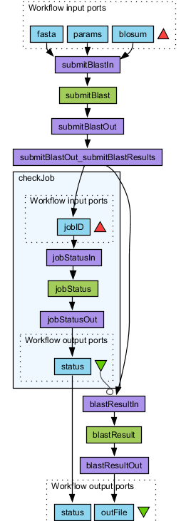
Output generated as Taverna workflow executable
Submit job
2. Check status
3. Download files

Slide 9
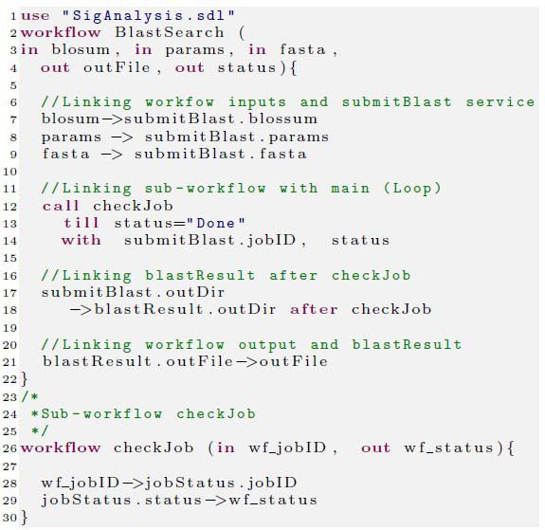
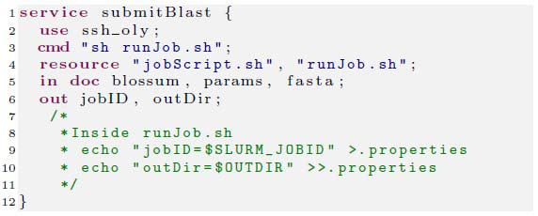
Example application: BLAST execution
Service description (SDL) for BLAST submission
Workflow description (WDL) for BLAST

Slide 10
Implementation
Script metadata
(e.g., name, inputs)
Workflow
Web services
(Taverna engine)
Retrieve documents
(AF framework)
Apply templates
(Template engine)
Execution
SDL
(e.g., blast.sdl)
WDL
(e.g., blast.wdl)
Inputs
Outputs
Web services
(e.g., checkJob)
Taverna workflow
(e.g., blast.t2flow)
@Runtime

Slide 11
Related works
Compared to domain-independent workflows like JBPM and Taverna, our framework has the advantage that it is configured only for scientific signature discovery workflows.
Most of these tools assume that the web services are available. Our framework configures the workflow definition file that declares how to compose services wrappers created by our framework.

Slide 12
Questions ?

Slide 13
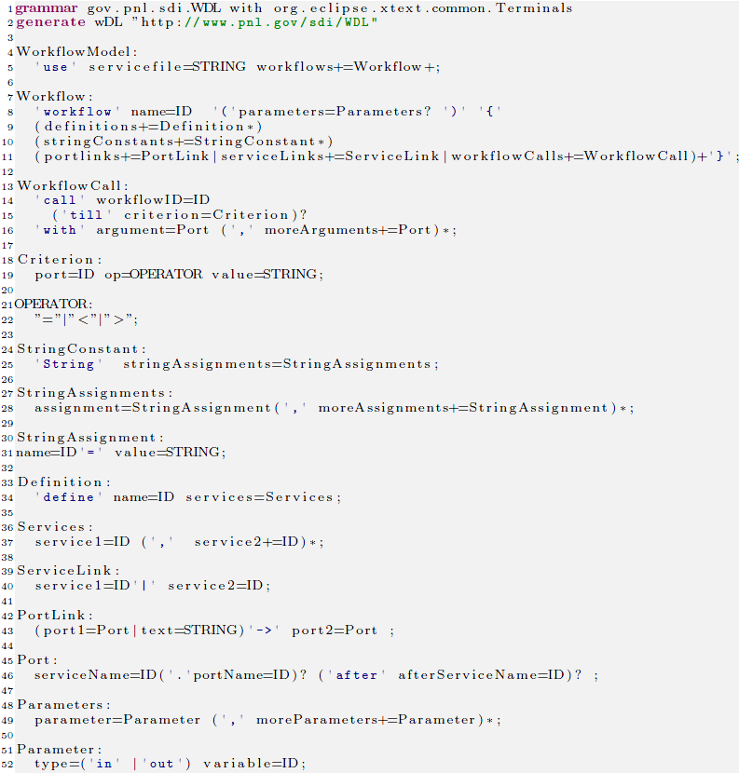
Xtext grammar for WDL

Slide 14
An overview of SDL code generation
No | Service | Utils/Script | {Inputs (type)] [Outputs(type)] | LOC | Total LOC (files)
1 | echoString | echo | [0][1 (doc)] | 10+13+1+6 | 30(4)
2 | echoFile | echo | [1 (String)] [1 (doc) ] | 10+14+1+6 | 31(4)
3 | aggregate | cat | [1(List doc) ] [1 (doc) ] | 10+20+1+7 | 38(4)
4 | classifier_Training | R | [2 (doc), 1 (String) ] [1 (doc) ] | 11+24+2+8 | 45(4)
5 | classifier_Testing | R | [3 (doc), 1 (String) ] [1 (doc) ] | 12+29+2+8 | 51(4)
6 | accuracy | R | [1 (doc) ] [1 (doc) ] | 11+19+1+6 | 37(4)
7 | submitBlast | SLURM, sh | [3 (doc) ] [2 (String) ] | 17+27+2+8+18 | 72(5)
8 | jobStatus | SLURM, sh | [1 (String) ] [1 (String) ] | 10+14+1+6 | 31(4)
9 | blastResult | cp | [1 (String) ] [1 (doc) ] | 10+14+1+6 | 31(4)
10 | mafft | mafft | [1 (doc) ] [1 (doc) ] | 10+18+1+6 | 35(4)

Slide 15
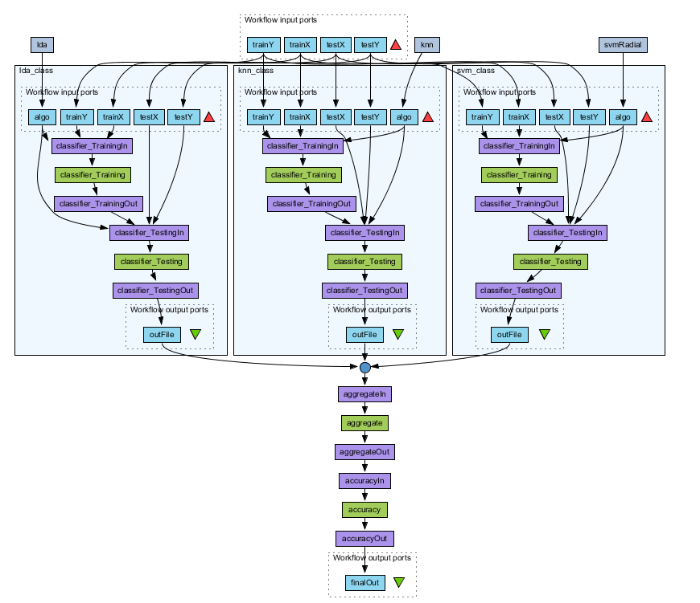
Taverna classification workflow

