Slide 1
Full-time software engineer and Part-time Instructor
Ferosh Jacob, SPACE 2019 (June 22nd), Kennesaw

Slide 2
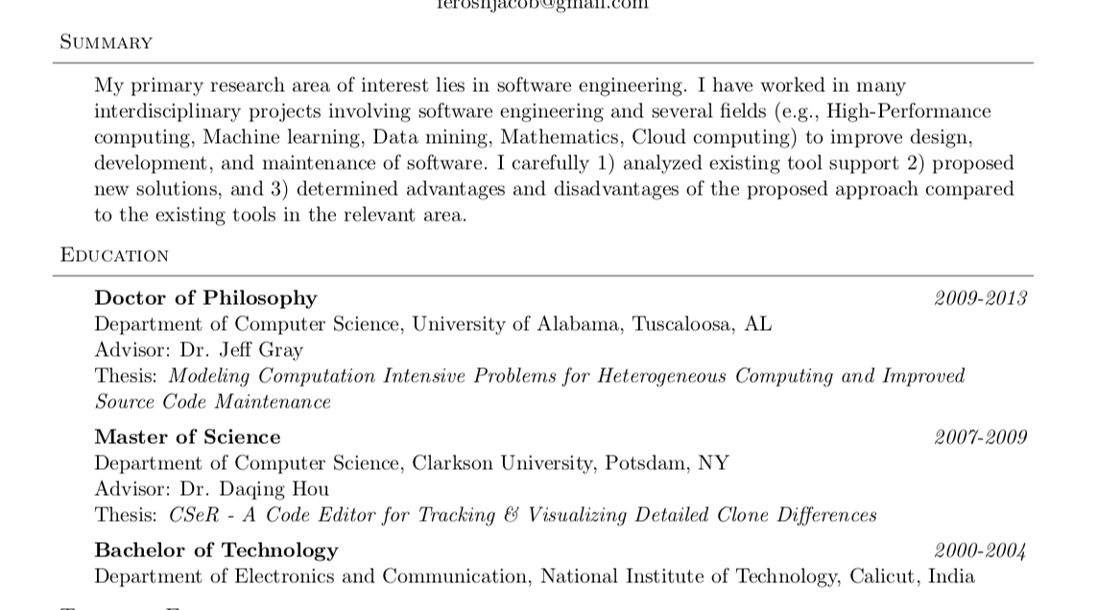
About me

Slide 3
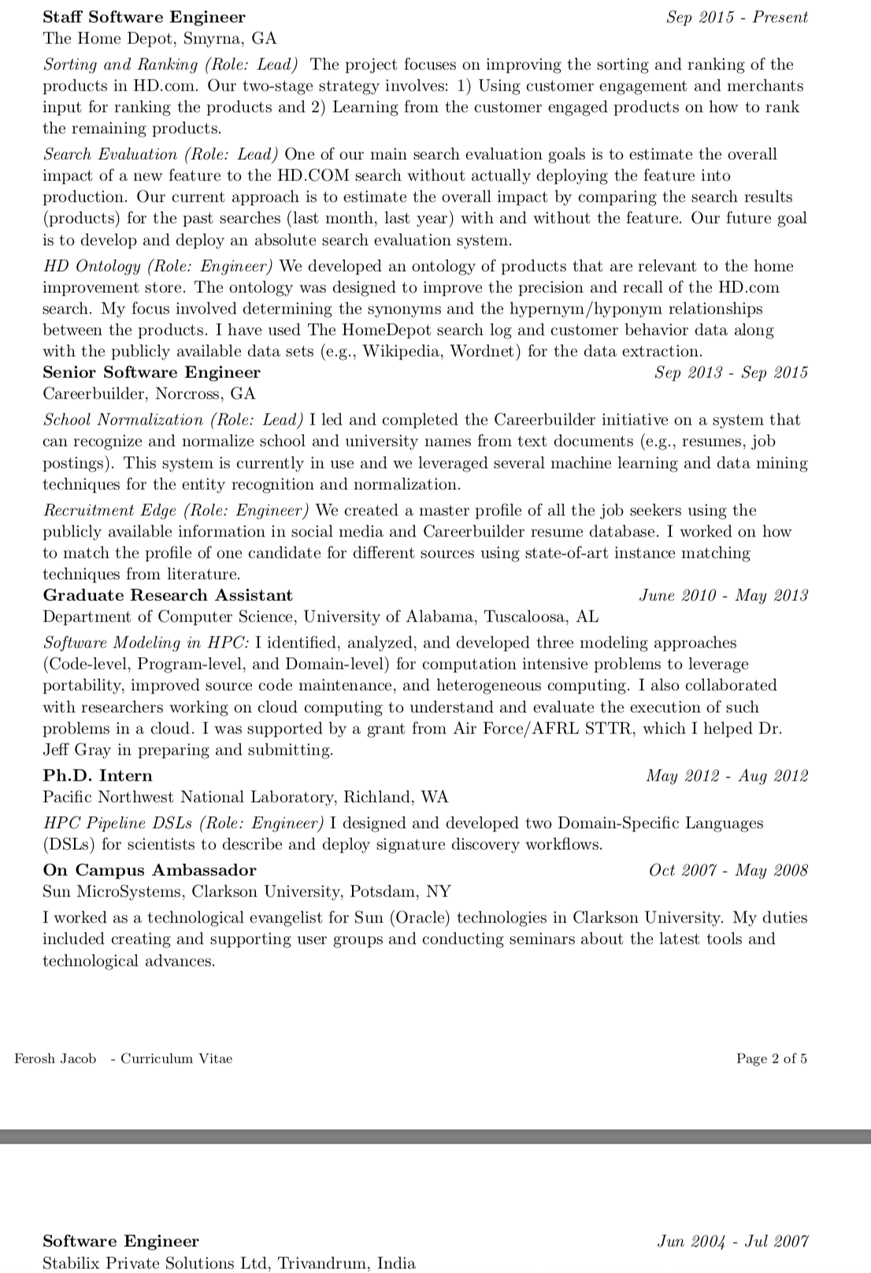
Full-time Software Engineer

Slide 4
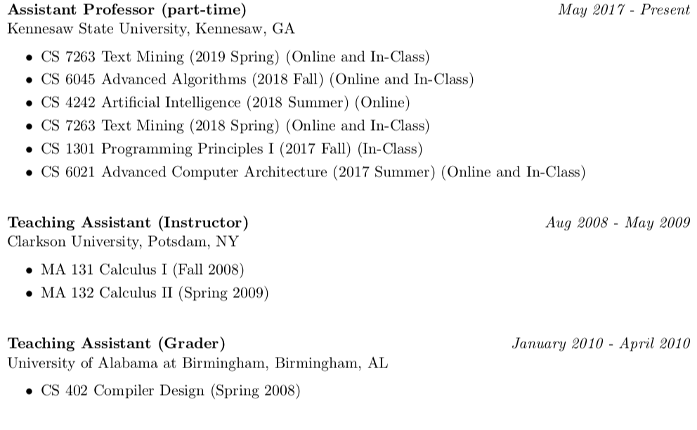
Part-time Software Engineer

Slide 5
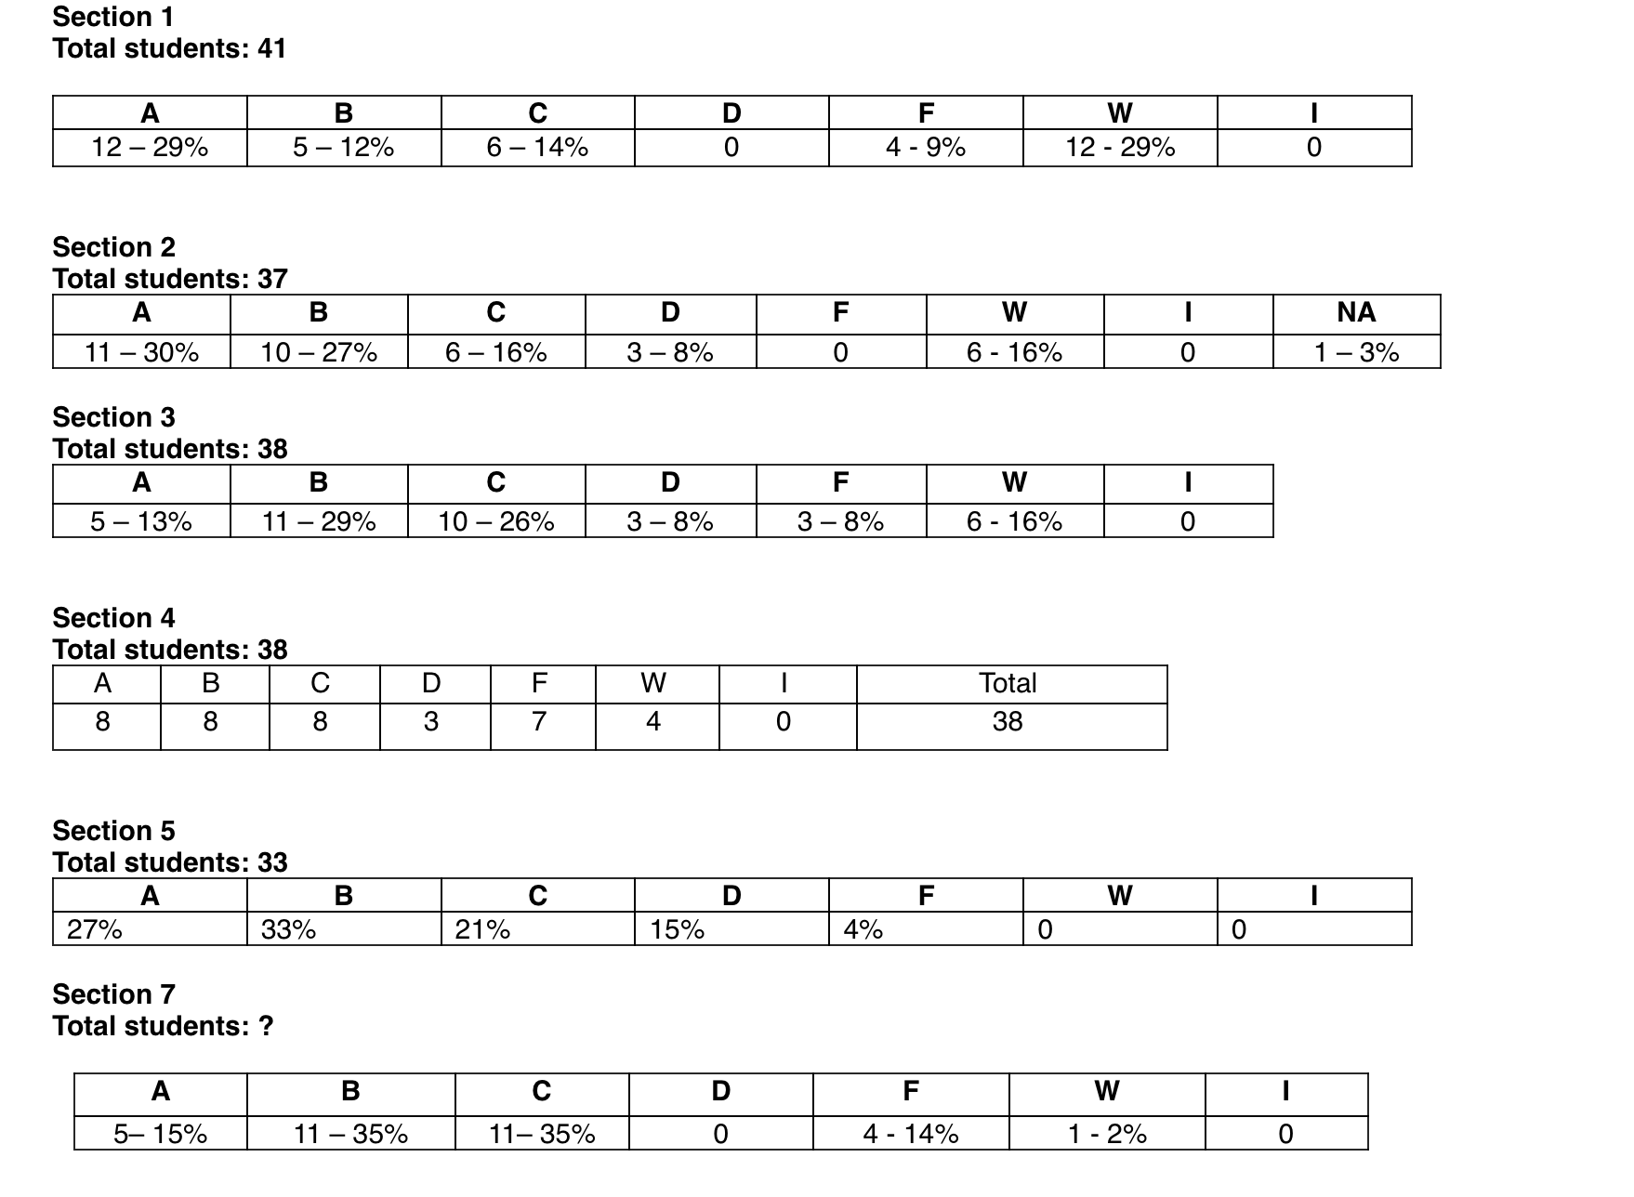
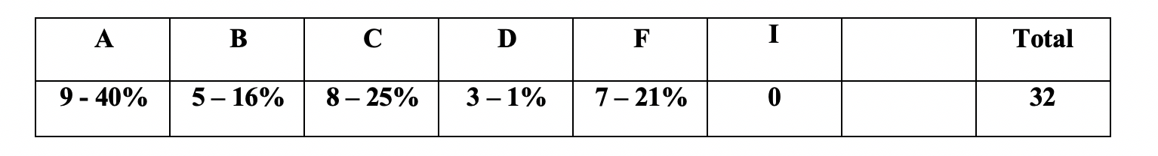
CS 1301 Programming Principles I Section 12 Fall 2017

Slide 6
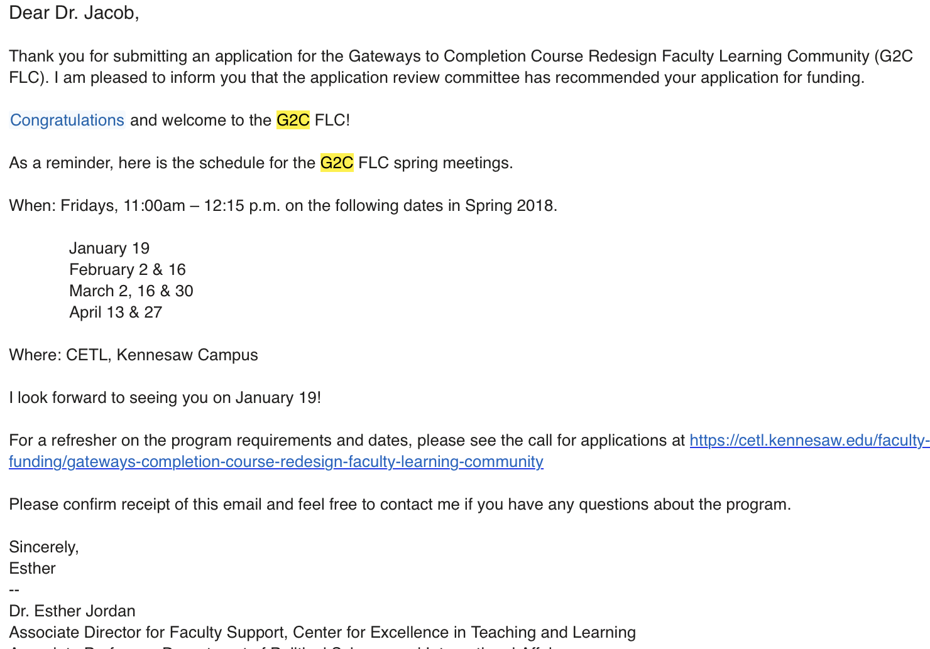
CS 1301 Programming Principles I Section 12 Fall 2017

Slide 7
Three strategies
All three strategies were based on experience on JAVA or industry in general
Feed back appreciated!

Slide 8
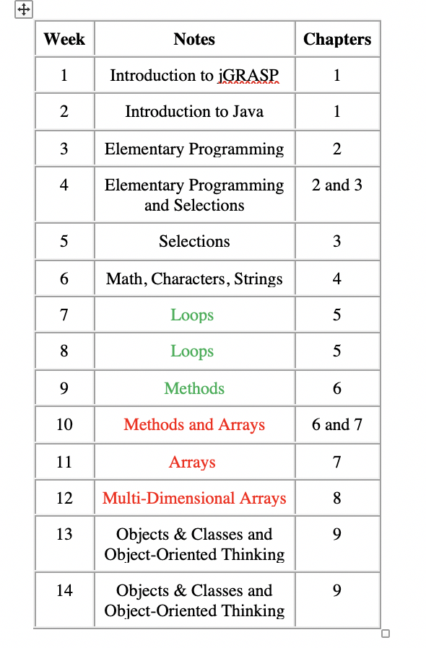
Strategy 1.1
Some topics are important than the other

Slide 9

Strategy 1.1 -Discussion
This Photo by Unknown Author is licensed under CC BY-SA

Slide 10
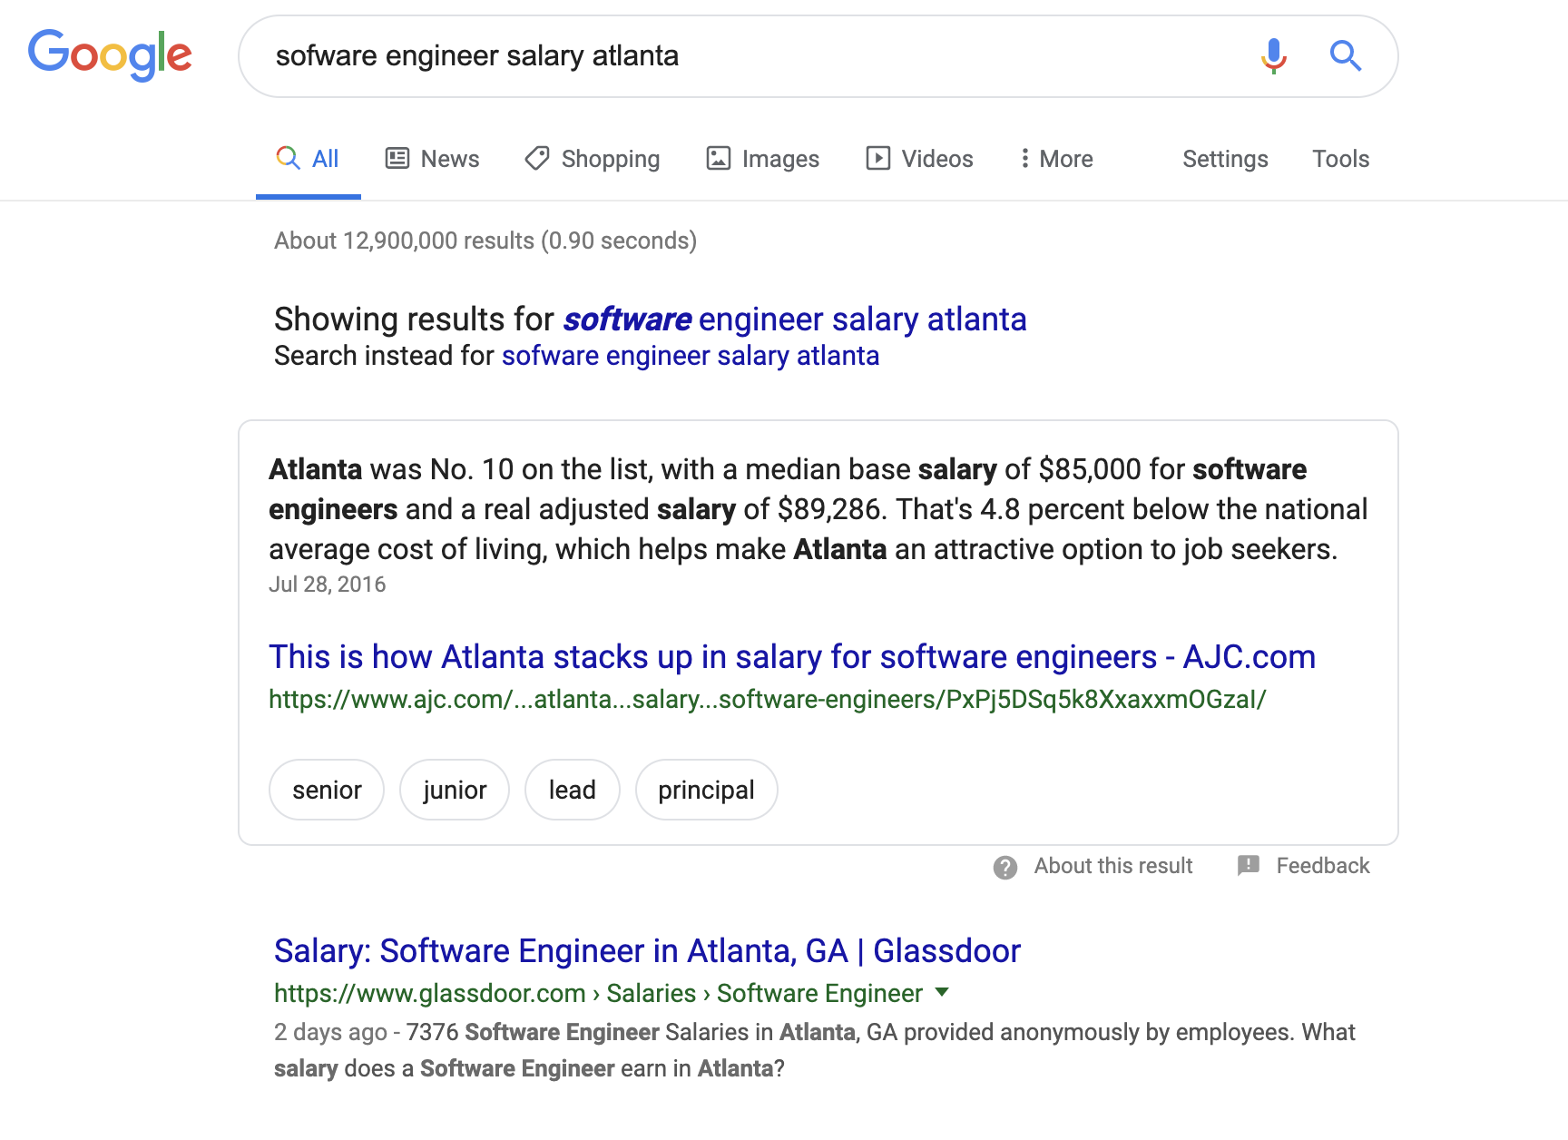
Strategy 1.2 This course can change your career

Slide 11
Strategy 1.2 -Discussion
This Photo by Unknown Author is licensed under CC BY-SA

Slide 12
Strategy 1.3 It is all about the job!

Slide 13
Strategy 1.3 -Discussion
This Photo by Unknown Author is licensed under CC BY-SA

Slide 14
Thanks

