Slide 1


Slide 2

PREFACE
ABOUT THE BOOK
Part I - This book contains 250 very important .NET interview questions.
Part II - Next part of this book contains 250 more interview questions.
ABOUT THE AUTHOR
Happy Rawat has around 15 years of experience in software development. He helps candidates in clearing technical interview in tech companies.

Slide 3

Chapters
1. OOPS/ C#
1. Basics
2. Inheritance, Abstraction, Encap…
3. Abstract Class & Interface
4. Access Specifiers, Boxing, Unboxing...
5. Loops, Conditions, Exception Hand…
6. Generics & Collections
7. Constructors
8. Method, Parameters, Delegates…
9. Important Keywords
10. LINQ
2. .NET FRAMEWORK
3. SQL
4. ASP.NET MVC
5. ASP.NET WEBFORMS
6. ADO.NET & EF
7. WEB API
8. .NET CORE
9. SOLID PRINCIPLES
10. DESIGN PATTERNS
11. CODING PROBLEMS

Slide 4
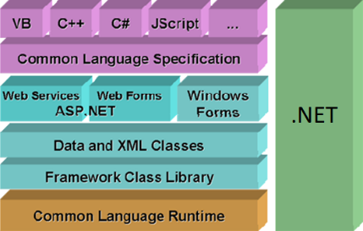
Chapter 1 : OOPS & C# - Basics
Q1. What is C#? What Is the difference between C# and .NET?
Q2. What is OOPS? What are the main concepts of OOPS?
Q3. What are the advantages of OOPS?
Q4. What are the limitations of OOPS?
Q5. What are Classes and Objects?
Q6. What are the types of classes in C#?
Q7. Is it possible to prevent object creation of a class in C#?
Q8. What is Property?
Q9. What is the difference between Property and Function?
Q10. What are Namespaces?
V Imp
V Imp
Back to main index

Slide 5

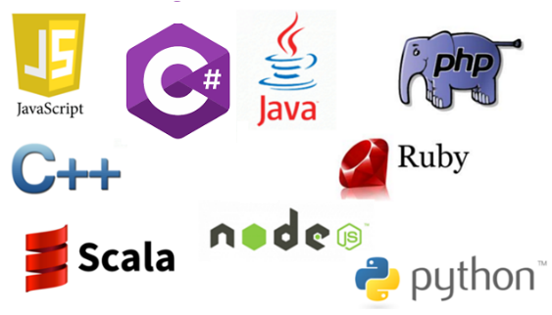

Q1. What is C#? What is the difference between C# and .NET?
Q1
What is C#? What is the difference between C# and .NET?
C# is an object-oriented programming language which runs on the .NET framework.
.NET is a framework for building and running software's and applications.
back to chapter index

Slide 6

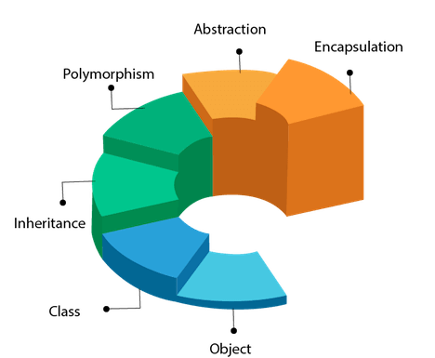
Q2. What is OOPS? What are the main concepts of OOPS?
Q2
What is OOPS? What are the main concepts of OOPS?
OOP stands for Object-Oriented Programming, which means it is a way to create software around objects.
OOPs provide a clear structure for the software's and web applications.
back to chapter index

Slide 7
Q3. What are the advantages of OOPS?
Q3
What are the advantages of OOPS?
Advantages of OOPS:
Reuse of code using inheritance.
Flexibility of code using polymorphism.
Secure application by using Encapsulation.
Easily scalable from small to large applications.
Easier troubleshooting of code because of modularity.
back to chapter index

Slide 8
Q4. What are the limitations of OOPS?
Q4
What are the limitations of OOPS?
Disadvantage of OOPS:
It is not suitable for small applications.
back to chapter index

Slide 9
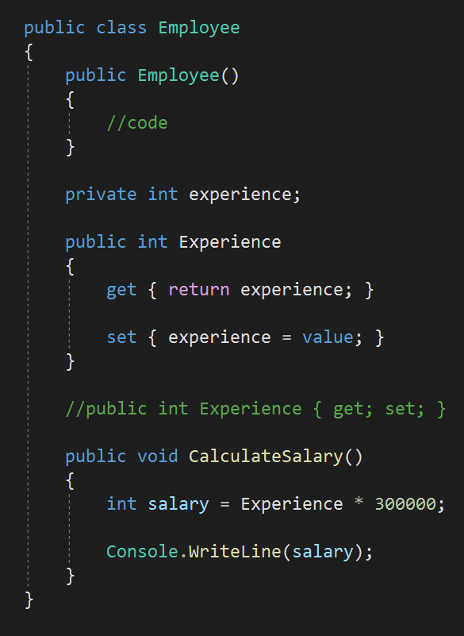
Q5. What are Classes and Objects?
Q5
What are Classes and Objects?
A class is a LOGICAL UNIT or BLUEPRINT. It contains fields, methods and properties.
Constructor
Class members are:
Field
1. A constructor is a method in the class which gets executed when a class object is created.
Property
2. A field is a variable of any type. It is basically the data.
3. A property is a member that provides helps in read and write of private field.
Method
4. A method is a code block that contains a series of statements.
back to chapter index

Slide 10
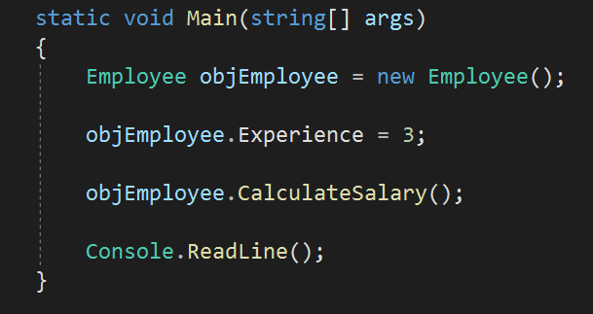
Q5
What are Classes and Objects?
Object - An object is an INSTANCE of a class.
Object
back to chapter index

Slide 11
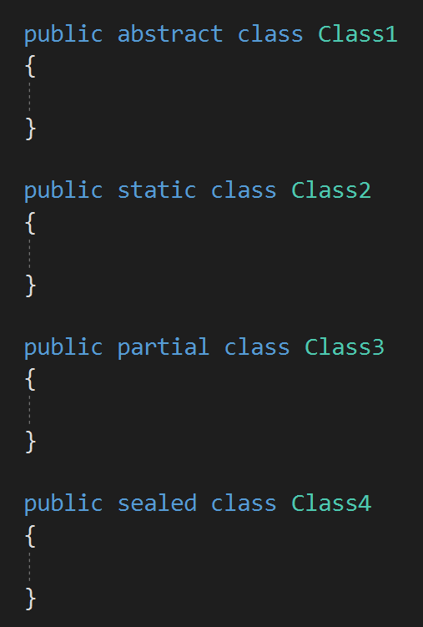
Q6. What are the types of classes in C#?
Q6
What are the types of classes in C#?
Types of Classes
Abstract Class
Static Class
Partial Class
Sealed Class
back to chapter index

Slide 12
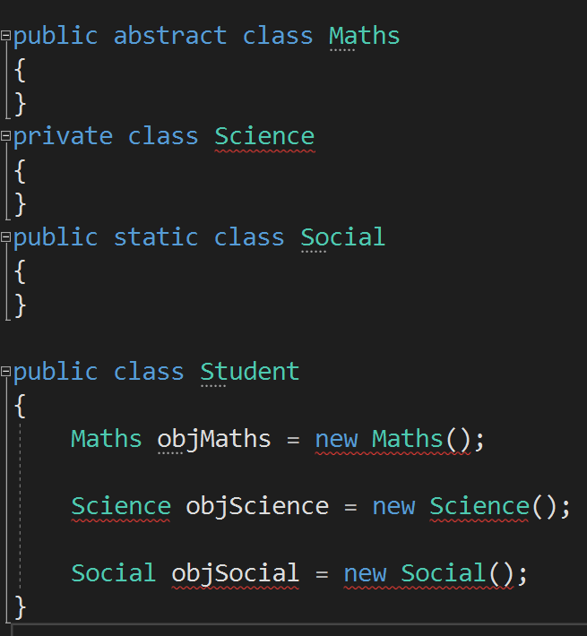
Q7. Is it possible to prevent object creation of a class in C#?
Q7
Is it possible to prevent object creation of a class in C#?
Object creation of a class can be prevented by:
Abstract Class
Private Class
Static Class
back to chapter index

Slide 13
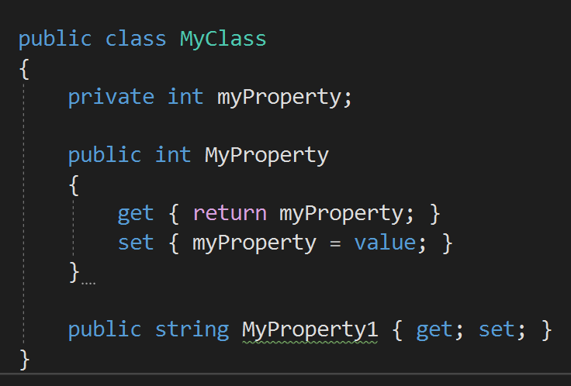
Q8. What is Property?
Q8
What is Property?
A property is a class member that provides a flexible mechanism to read and write private field.
back to chapter index

Slide 14
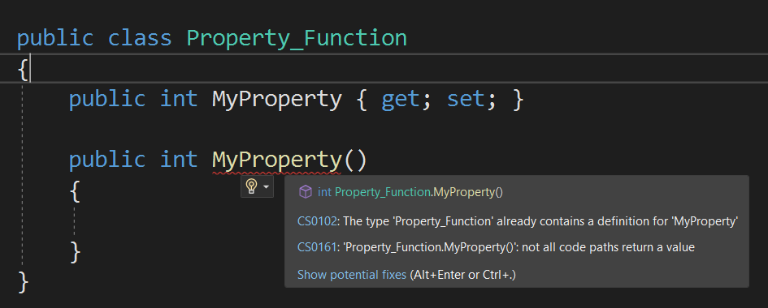
Q9. What is the difference between Property and Function?
Q9
What is the difference between Property and Function?
Property is a specialized function only.
Specialized means properties are used only to get and set field values.
back to chapter index

Slide 15
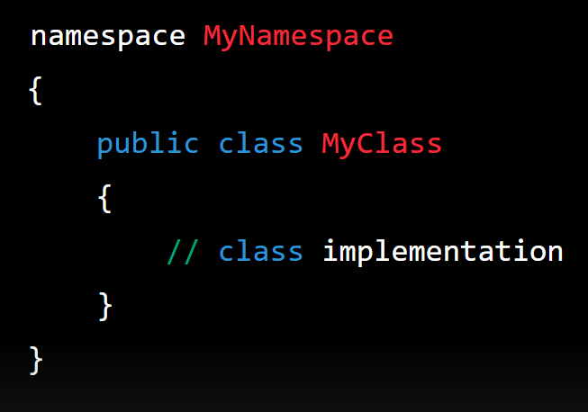
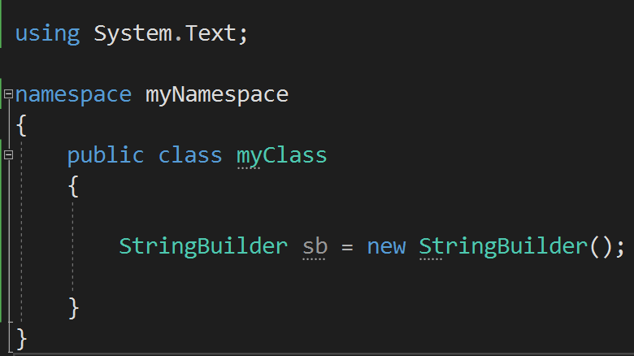
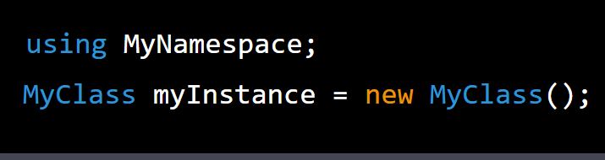
Q10. What are Namespaces?
Q10
What are Namespaces?
A namespace is a container for a set of related classes and other types.
back to chapter index

Slide 16
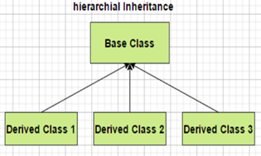
Chapter 2 : OOPS & C# - Inheritance, Abstraction, Encapsulation & Polymorphism
Q11. What is Inheritance? When to use Inheritance?
Q12. What are the different types of Inheritance?
Q13. Does C# support Multiple Inheritance?
Q14. How to prevent a class from being Inherited?
Q15. Are private class members inherited to the derived class?
Q16. What is Abstraction? How to implement abstraction?
Q17. What is Encapsulation? How to implement encapsulation?
Q18. What is the difference between Abstraction and Encapsulation?
Q19. What is Polymorphism and what are its types? When to use polymorphism?
Q20. What is Method Overloading? In how many ways a method can be overloaded?
Q21. When should you use method overloading in real applications?
Q22. If two methods are same except return type, then methods are overloaded or what willl happen?
Q23. What is the difference between Overloading and Overriding?
Q24. What is the use of Overriding?
Q25. If a method is marked as virtual, do we must have to "override" it from the child class?
Q26. What is the difference between Method Overriding and Method Hiding?
V Imp
V Imp
V Imp
V Imp
Back to main index

Slide 17
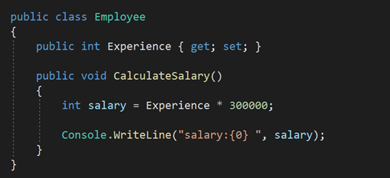

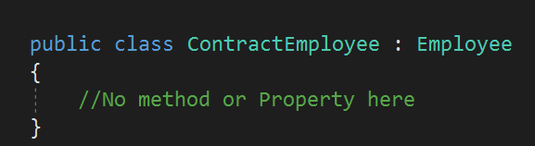
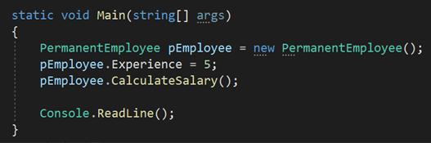
Q11. What is Inheritance? When to use Inheritance?
Q11
What is Inheritance? When to use Inheritance?
Inheritance is creating a PARENT-CHILD relationship between two classes, where child class will automatically get the properties and methods of the parent.
Base/ Parent/ Super class
Inheritance is good for: REUSABILITY and ABSTRACTION of code
Derived/ Child/ Sub class
CalculateSalary() method is not present in PermanentEmployee class, but it will get it automatically from it’s parent
back to chapter index

Slide 18

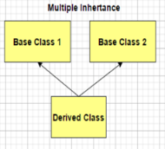
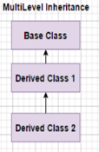
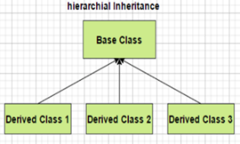
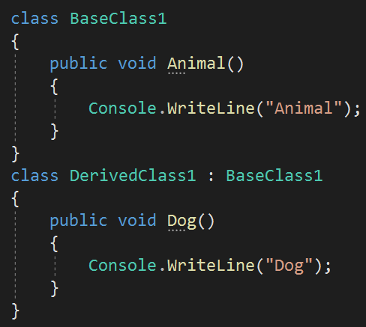
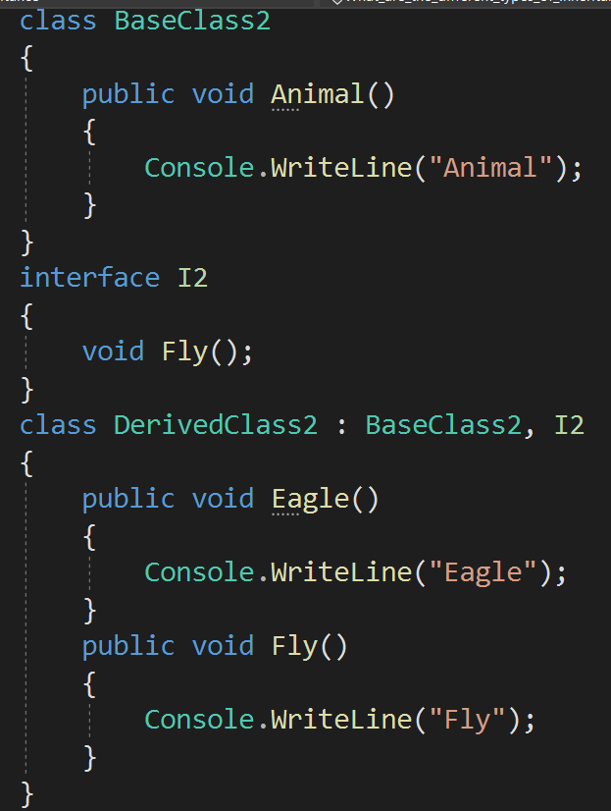
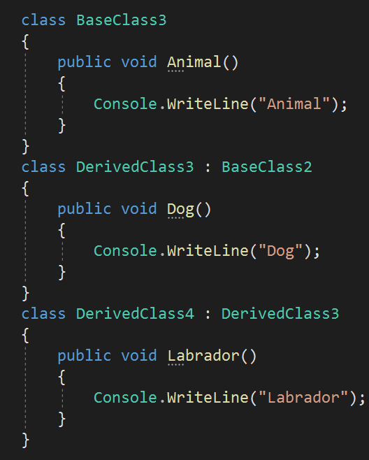
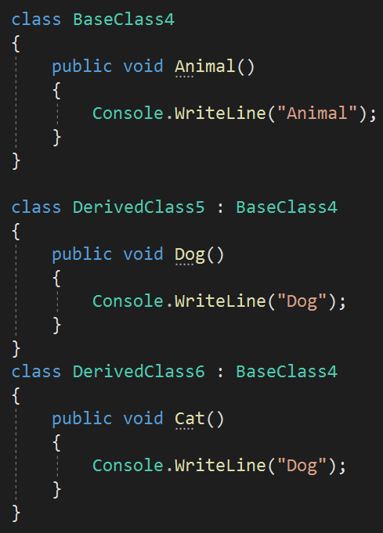
Q12
What are the different types of Inheritance?
back to chapter index

Slide 19
Q13. Does C# support Multiple Inheritance?
Q13
Does C# support Multiple Inheritance? How can you implement multiple inheritance in C#?
NO
C# support inheritance by using multiple Interfaces. This is an alternative way of multiple inheritance.
back to chapter index

Slide 20
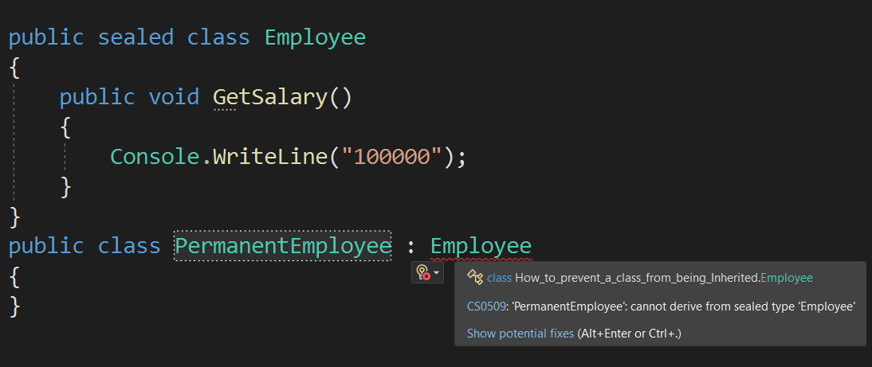
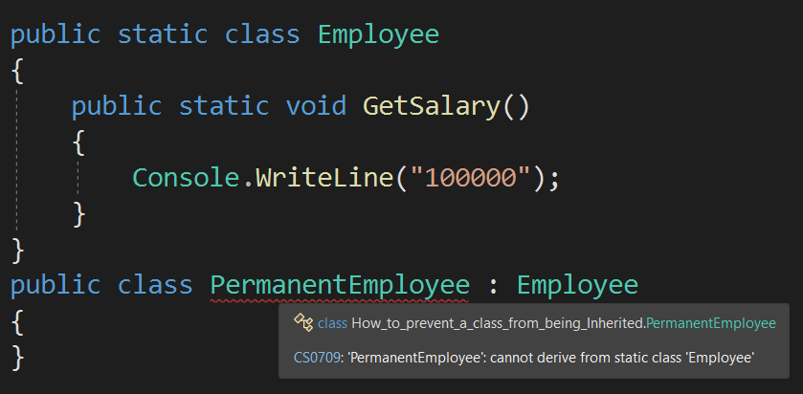
Q14. How to prevent a class from being Inherited?
Q14
How to prevent a class from being Inherited?
By using SEALED keyword in class
By using STATIC keyword in base class
Difference between sealed & static is, you can create the object of sealed class, but you cannot create the object of static class.
back to chapter index

Slide 21

Q15. Are private class members inherited to the derived class?
Q15
Are private class members inherited to the derived class?
No, the private members cannot be inherited to derived class.
Only public and protected class members can be inherited.
back to chapter index

Slide 22
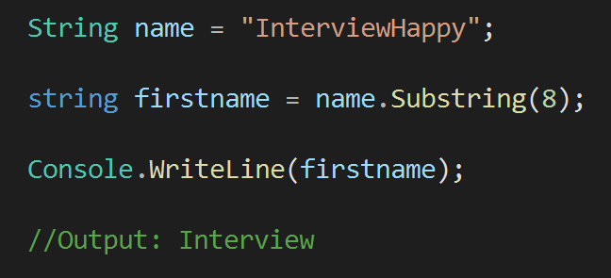
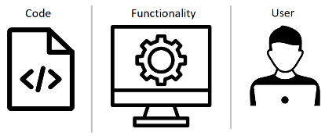
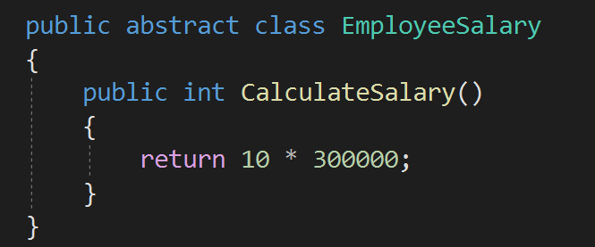
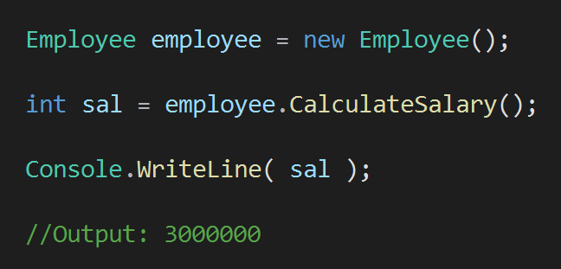
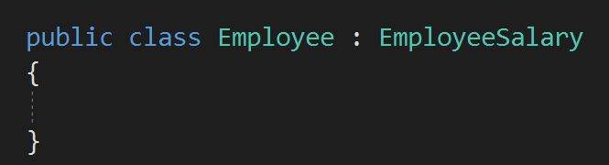
Q16. What is Abstraction? How to implement abstraction?
Q16
What is Abstraction? How to implement abstraction in real applications?
Abstraction means showing only required things and hide the BACKGROUND details.
Background/Hidden method.
Mostly we use abstract classes and interfaces for implementing abstraction.
back to chapter index

Slide 23
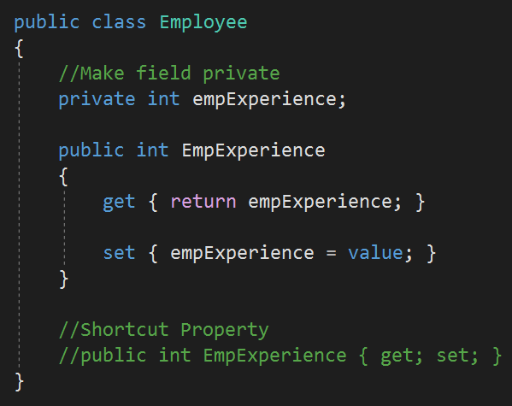
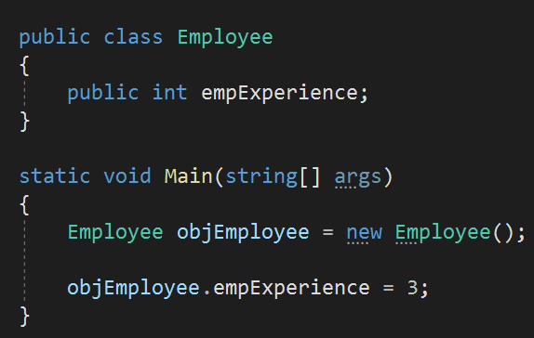

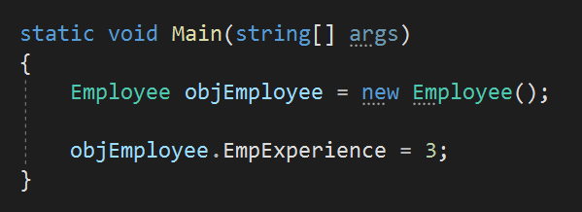
Q17. What is Encapsulation? How to implement encapsulation?
Q17
What is Encapsulation? How to implement encapsulation in real applications?
Encapsulation means WRAPPING of data and methods into a single unit.
This field cannot be accessed from outside without the property
Field/Data is accessed without property or function. It will work but it violating encapsulation
back to chapter index

Slide 24
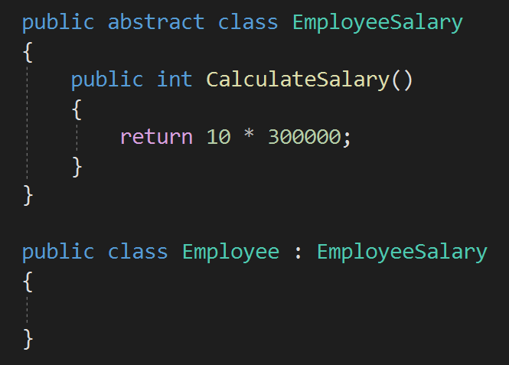
Q18. What is the difference between Abstraction and Encapsulation?
Q18
What is the difference between Abstraction and Encapsulation?
Abstraction means showing only required things and hide the BACKGROUND details.
Encapsulation means WRAPPING of data and methods into a single unit.
back to chapter index

Slide 25
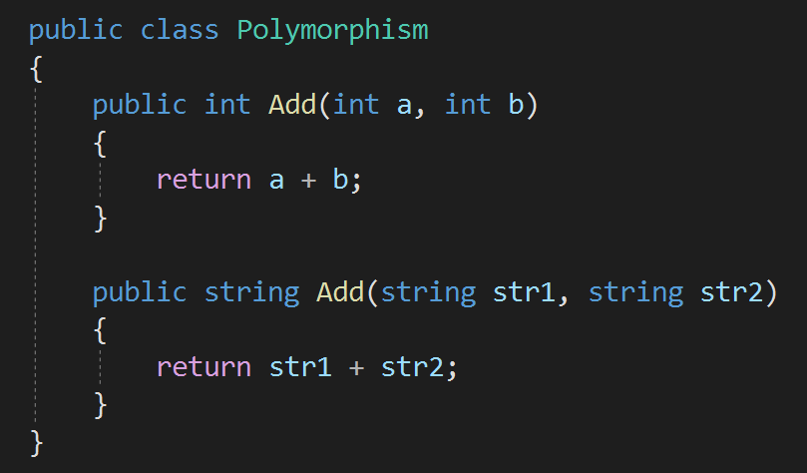
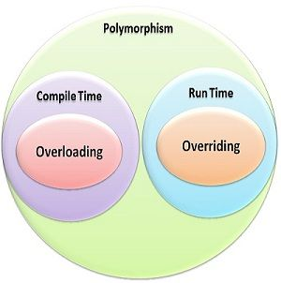
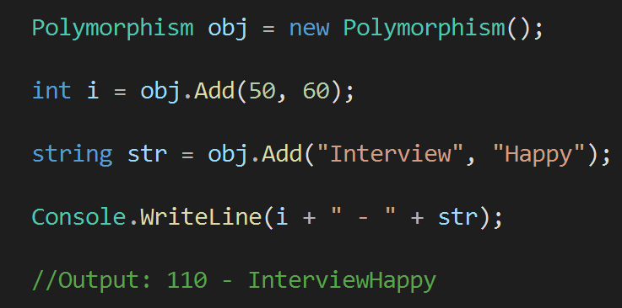
Q19. What is Polymorphism and what are its types? When to use polymorphism?
Q19
What is Polymorphism and what are its types? When to use polymorphism?
Polymorphism is the ability of a variable, object, or function to take on MULTIPLE FORMS.
Function with same name but have multiple forms
back to chapter index

Slide 26
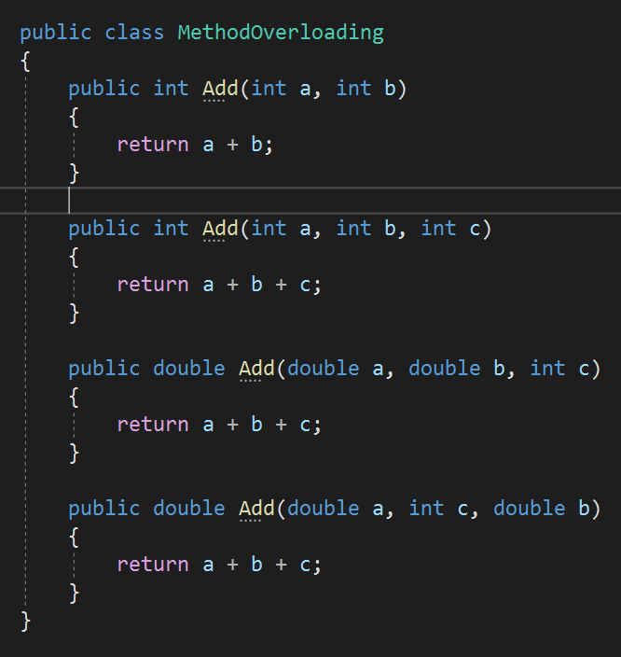
Q20. What is Method Overloading? In how many ways a method can be overloaded?
Q20
What is Method Overloading? In how many ways a method can be overloaded?
Method overloading is a type of polymorphism in which we can create multiple methods of the same name in the same class, and all methods work in different ways.
1. Number of parameters are different
2. Type of parameters are different
3. Order of parameters is different
back to chapter index

Slide 27
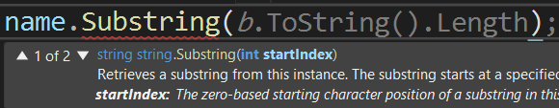
Q21. When should you use method overloading in real applications?
Q21
When should you use method overloading in real applications?
back to chapter index

Slide 28
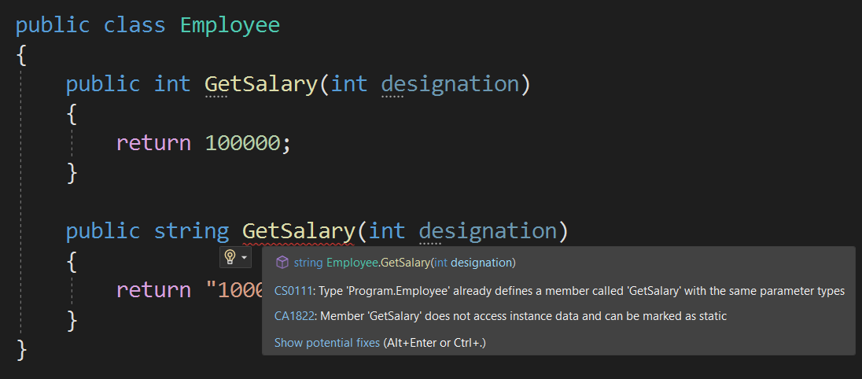
Q22. If two methods are same except return type, then methods are overloaded or what willl happen?
Q22
If two methods are same except return type, then methods are overloaded or what will happen?
No, this will show compile time error.
back to chapter index

Slide 29
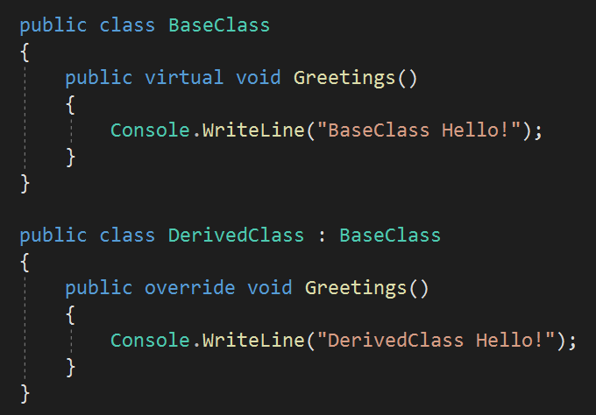
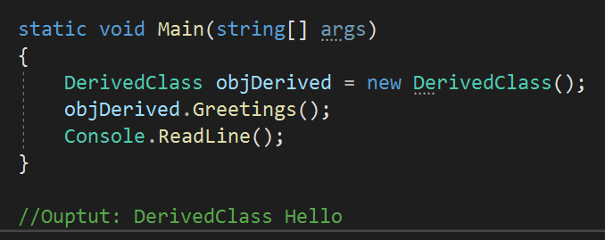
Q23. What is the difference between Overloading and Overriding?
Q23
What is the difference between Overloading and Overriding?
Method Overriding
Multiple methods of same name are in different class.
Inheritance is used, as it is in different class.
Both methods have same signature.
It’s a run time polymorphism.
Virtual & override keywords.
back to chapter index

Slide 30
Q23
What is the difference between Overloading and Overriding?
Method Overloading
Multiple methods of same name in single class.
No need of inheritance, as it is in single class.
All methods have different signature.
It’s a compile time polymorphism.
No special keyword used.
Method Overriding
Multiple methods of same name in different class.
Inheritance is used, as it is in different class.
All methods have same signature.
It’s a run time polymorphism.
Virtual & override keywords.
back to chapter index

Slide 31
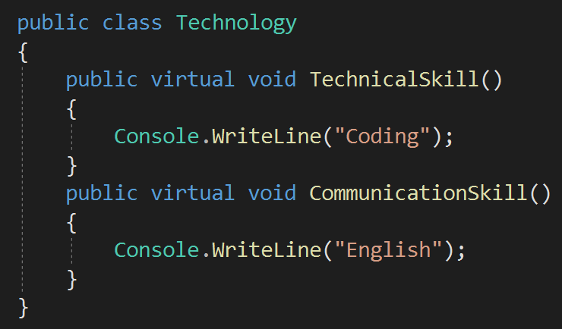
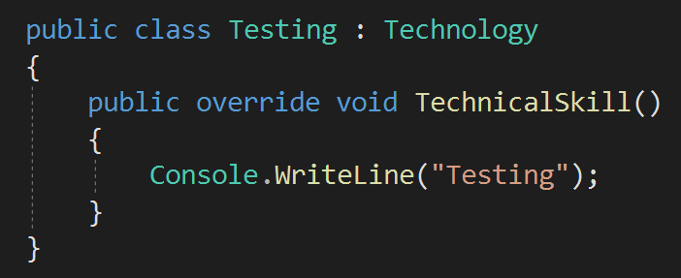
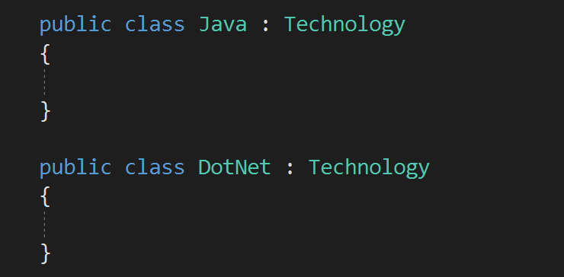
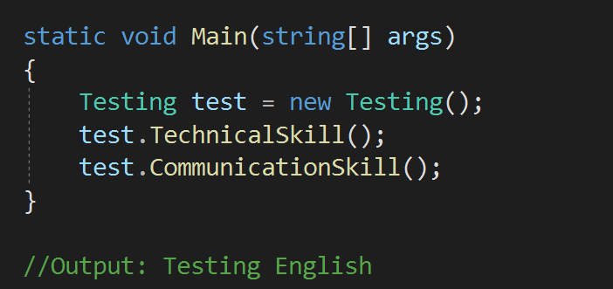
Q24. What is the use of Overriding?
Q24
What is the use of Overriding? When should I override the method in real applications?
Overriding is used to modify and provide a new implementation of the method inherited from a base class.
back to chapter index

Slide 32
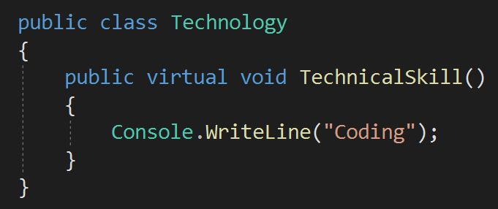
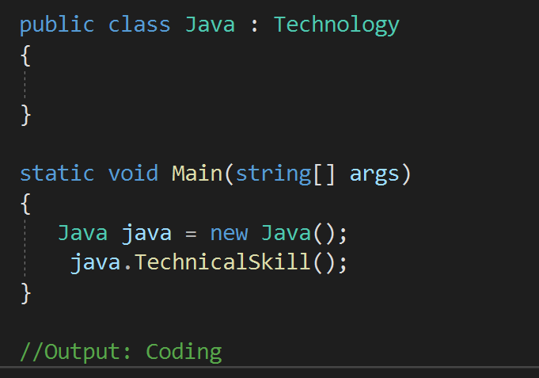
Q25. If a method is marked as virtual, do we must have to "override" it from the child class?
Q25
If a method is marked as virtual, do we must have to "override" it from the child class?
NO. Overriding virtual method is optional.
back to chapter index

Slide 33
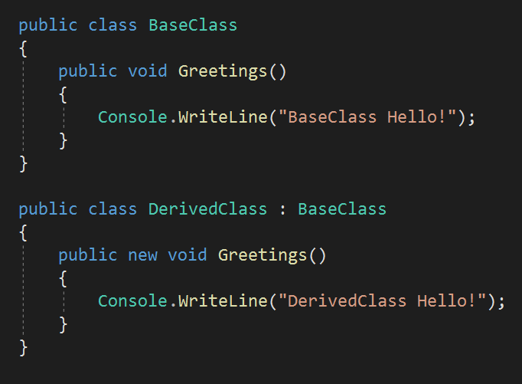
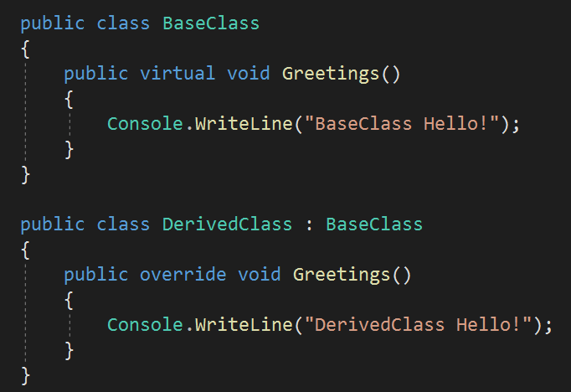


Q26. What is the difference between Method Overriding and Method Hiding?
Q26
What is the difference between Method Overriding and Method Hiding?
In Method Hiding, you can completely hide the implementation of the methods of a base class from the derived class using the new keyword.
back to chapter index

Slide 34

Chapter 3 : OOPS & C# - Abstract Class & Interface
V Imp
Q27. What is the difference between Abstract class and an Interface?
Q28. When to use Interface and when Abstract class in real applications?
Q29. Why to create Interfaces in real applications?
Q30. Can we define body of Interfaces methods? When to define methods in Interfaces?
Q31. Can you create an instance of an Abstract class or an Interface?
Q32. Do Interface can have a Constructor?
Q33. Do abstract class have Constructors in C#?
Q34. What is the difference between abstraction and abstract class?
Q35. Can Abstract class be Sealed or Static in C#?
Q36. Can you declare abstract methods as private in C#?
Q37. Does Abstract class support multiple Inheritance?
V Imp
V Imp
Back to main index

Slide 35


Q27. What is the difference between Abstract class and an Interface?
Q27
What is the difference between an Abstract class and an Interface (atleast 4)?
Abstract class contains both DECLARATION & DEFINITION of methods.
Interface should contain DECLARATION of methods.
With C# 8.0, you can now have default implementations/ definition of methods in an interface. But that is recommended in special case*.
Only method Declaration is allowed
Method Declared
Method Defined
2. Abstract class keyword: ABSTRACT
2. Interface keyword: INTERFACE
back to chapter index

Slide 36


Q27
What is the difference between an Abstract class and an Interface (atleast 4)?
3. Abstract class does not support multiple inheritance
3. Interface supports multiple inheritance.
back to chapter index

Slide 37


Q27
What is the difference between an Abstract class and an Interface (atleast 4)?
4. Abstract class can have constructors.
4. Interface do not have constructors.
back to chapter index

Slide 38
Q27
What is the difference between an Abstract class and an Interface (atleast 4)?
Abstract Class | Interface
1. Abstract class contains both DECLARATION & DEFINITION of methods. | Mostly Interfaces contain DECLARATION of methods. From C# 8.0 definition is also possible.
2. Abstract class keyword: ABSTRACT | 2. Interface keyword: INTERFACE
3. Abstract class does not support multiple inheritance | 3. Interface supports multiple inheritance.
4. Abstract class can have constructors. | 4. Interface do not have constructors.
back to chapter index

Slide 39


Q28. When to use Interface and when Abstract class in real applications?
Q28
When to use Interface and when Abstract class in real applications?
When to use Interface?
An interface is a good choice when you know a method has to be there, but it can be implemented DIFFERENTLY by independent derived classes.
back to chapter index

Slide 40

Q28
When to use Interface and when Abstract class in real applications?
When to use Abstract class?
Abstract class is a good choice when you are sure some methods are concrete/defined and must be implemented in the SAME WAY in all derived classes.
Normally we prefer Interface because it gives us the flexibility to modify the behavior at later stage.
back to chapter index

Slide 41


Q29. Why to create Interfaces in real applications?
Q29
Why to create Interfaces in real applications?
Benefits of Interfaces:
Help in defining the contract of the system.
Unit testing is easy in application having interfaces.
Used for implementing dependency injection.
back to chapter index

Slide 42

Q30. Can we define body of Interfaces methods? When to define methods in Interfaces?
Q30
Can we define body of Interfaces methods? When to define methods in Interfaces?
Yes. From C# 8.0 it is possible to put method bodies in Interfaces.
back to chapter index

Slide 43



Q31. Can you create an instance of an Abstract class or an Interface?
Q31
Can you create an instance of an Abstract class or an Interface?
No. Abstract class and interface purpose is to act as base class via inheritance. There object creation is not possible.
back to chapter index

Slide 44

Q32. Do Interface can have a Constructor?
Q32
Do Interface can have a constructor?
NO. Interface can only be used for inheritance, so constructor is not required.
back to chapter index

Slide 45



Q33. Do abstract class have Constructors in C#?
Q35
Do abstract class have Constructors in C#?
YES, Abstract class can have constructors.
The reason is, when the abstract class is inherited in the derived class, and whenever the object of the derived class is created then FIRST the constructor of the abstract/ base class will be called and then only the constructor of derived class will be called.
back to chapter index

Slide 46
Q34. What is the difference between abstraction and abstract class?
Q33
What is the difference between abstraction and abstract class?
Abstraction means showing only required things and hide the BACKGROUND details.
Abstract class is one of the ways to implement abstraction.
back to chapter index

Slide 47

Q35. Can Abstract class be Sealed or Static in C#?
Q34
Can Abstract class be Sealed or Static in C#?
NO. Abstract class are used for inheritance, but sealed and static both will not allow the class to be inherited.
back to chapter index

Slide 48

Q36. Can you declare abstract methods as private in C#?
Q36
Can you declare abstract methods as private in C#?
NO. Abstract methods are only declaration, and they must be implemented in the derive class, therefore they can not be private.
back to chapter index

Slide 49

Q37. Does Abstract class support multiple Inheritance?
Q37
Does Abstract class support multiple Inheritance?
NO. Only at maximum one abstract class can be used for inheritance.
But multiple interfaces can be used.
back to chapter index

Slide 50

Chapter 4 : OOPS & C# - Access Specifiers, Boxing, Unboxing, String & StringBuilder
V Imp
Q38. What are Access Specifiers?
Q39. What is internal access modifier? Show example?
Q40. What is the default access modifier in a class?
Q41. What is Boxing and Unboxing?
Q42. Which one is explicit Boxing or Unboxing?
Q43. Is Boxing and Unboxing good for performance?
Q44. What are the basic string operations in C#?
Q45. What is the difference between “String” and “StringBuilder”?
Q46. When to use String and when StringBuilder in real applications?
Q47. What is String Interpolation in C#?
V Imp
V Imp
Back to main index

Slide 51

Q38. What are Access Specifiers?
Q38
What are Access Specifiers?
Access specifiers are keywords to specify the accessibility of a class, method, property, field.
The keywords are – Public, Private, Protected, Internal, Protected Internal.
back to chapter index

Slide 52




Q39. What is internal access modifier? Show example.
Q39
What is internal access modifier? Show example.
Internal modifier is used to tell that access is limited to the current assembly.
back to chapter index

Slide 53

Q40. What is the default access modifier in a class?
Q40
What is the default access modifier in a class?
Internal is the default access modifier of a class.
back to chapter index

Slide 54


Q41. What is Boxing and Unboxing?
Q41
What is Boxing and Unboxing? Where to use Boxing and Unboxing in real applications?
Boxing - Boxing is the process of converting from value type to reference type.
Unboxing - Unboxing is the process of converting reference type to value type.
back to chapter index

Slide 55


Q41
What is Boxing and Unboxing? Where to use Boxing and Unboxing in real applications?
We internally use boxing when item is added to Arraylist. And we use unboxing when item is extracted from Arraylist.
back to chapter index

Slide 56

Q42. Which one is explicit Boxing or Unboxing?
Q42
Which one is explicit Boxing or Unboxing?
Unboxing is explicit conversion process.
back to chapter index

Slide 57

Q43. Is Boxing and Unboxing good for performance?
Q43
Is Boxing and Unboxing good for performance?
No, it is recommended to use boxing and unboxing when it is necessary only.
Converting from one type to another type is not good from performance point of view.
back to chapter index

Slide 58
Q44. What are the basic string operations in C#?
Q44
What are the basic string operations in C#?
Concatenate: Two strings can be concatenated either by using a System.String.Concat or by using + operator.
string str1 = "This is one";
string str2 = "This is two";
string str2 = str1 + str2;
//Output: This is one This is two
Replace: Replace(a,b) is used to replace a string with another string.
string str1 = "This is one";
string str2 = str1.Replace(“one”, “two”);
//Output: This is two
Trim: Trim() is used to trim the white spaces in a string at the end.
string str1 = "This is one ";
str1.Trim();
//Output: "This is one“
Contains: Check if a string contains a pattern of substring or not.
string str = "This is test";
bool result = str.Contains("test");
//Output: true
back to chapter index

Slide 59


Q45. What is the difference between “String” and “StringBuilder”?
Q45
What is the difference between “String” and “StringBuilder”?
String is IMMUTABLE in C#.
StringBuilder is MUTABLE in C#.
It means if you defined one string then you couldn’t modify it. Every time you will assign some value to it, it will create a new string.
This means if any manipulation will be done on string, then it will not create a new instance every time.
Both these strings are different and occupy different memory in process
Only one string in memory.
back to chapter index

Slide 60
Q46. When to use String and when StringBuilder in real applications?
Q46
When to use String and when StringBuilder in real applications?
If you want to change a string multiple times, then StringBuilder is a better option from performance point of view because it will not require new memory every time.
back to chapter index

Slide 61


Q47. What is String Interpolation in C#?
Q47
What is String Interpolation in C#?
String interpolation is a technique that enables you to insert expression values into strings.
back to chapter index

Slide 62
Chapter 5 : OOPS & C# - Loops, Conditions, Exception Handling
Q48. What are the Loop types in C#? When to use what in real applications?
Q49. What is the difference between “continue” and “break” statement?
Q50. What are the alternative ways of writing if-else conditions? When to use what?
Q51. How to implement Exception Handling in C#?
Q52. Can we execute multiple Catch blocks?
Q53. When to use Finally in real applications?
Q54. Can we have only “Try” block without “Catch” block in real applications?
Q55. What is the difference between Finally and Finalize?
Q56. What is the difference between “throw ex” and “throw”? Which one to use in real applications?
V Imp
V Imp
V Imp
Back to main index

Slide 63




Q48. What are the Loop types in C#? When to use what in real applications?
Q48
What are the Loop types in C#? When to use what in real applications?
Initialize
Condition
Whether condition true or false, this statement will run at least first time.
Increment
back to chapter index

Slide 64


Q49. What is the difference between “continue” and “break” statement?
Q49
What is the difference between “continue” and “break” statement?
Continue statement end the loop iteration and transfer the control to the beginning of the loop.
Break statement end the loop iteration and exit the loop.
//Output:
Print: 0
Print: 1
Print: 2
Print: 4
//Output:
Print: 0
Print: 1
Print: 2
back to chapter index

Slide 65



Q50. What are the alternative ways of writing if-else conditions? When to use what?
Q50
What are the alternative ways of writing if-else conditions? When to use what?
Switch statement
If-else if-else statement
Ternary Operator ?:
back to chapter index

Slide 66

Q51. How to implement Exception Handling in C#?
Q51
How to implement Exception Handling in C#?
Exception handling in Object-Oriented Programming is used to MANAGE ERRORS.
TRY − A try block is a block of code inside which any error can occur.
CATCH − When any error occur in TRY block then it is passed to catch block to handle it.
FINALLY − The finally block is used to execute a given set of statements, whether an exception occur or not.
back to chapter index

Slide 67

Q52. Can we execute multiple Catch blocks?
Q52
Can we execute multiple Catch blocks?
NO
We can write multiple catch blocks but when we will run the application and if any error occur, only one out of them will execute based on the type of error.
back to chapter index

Slide 68

Q53. When to use Finally in real applications?
Q53
When to use Finally in real applications?
Finally block is mostly used to dispose the unwanted objects when they are no more required. This is good for performance, otherwise you have to wait for garbage collector to dispose them.
back to chapter index

Slide 69

Q54. Can we have only “Try” block without “Catch” block in real applications?
Q54
Can we have only “Try” block without “Catch” block in real applications?
YES - We can have only try block without catch block, but then we must have finally block with try block.
back to chapter index

Slide 70
Q55. What is the difference between Finally and Finalize?
Q55
What is the difference between Finally and Finalize?
Finally, is used in exception handling.
Finalize is a method which is automatically called by the garbage collector to dispose the no longer needed objects.
back to chapter index

Slide 71

Q56. What is the difference between “throw ex” and “throw”? Which one to use in real applications?
Q56
What is the difference between “throw ex” and “throw”? Which one to use in real applications?
Throw ex will change the stack trace, where as throw will preserve the whole stack trace.
Error:
at Throw_ex__and__throw.Program.DivideZerobyZero() in D:\InterviewHappy\_InterviewHappy-Hindi\31-Oct-2022\OOP_CSharp_Code\Throw_ex_Throw\Program.cs:line 32
at Throw_ex__and__throw.Program.Main(String[] args) in D:\InterviewHappy\_InterviewHappy-Hindi\31-Oct-2022\OOP_CSharp_Code\Throw_ex_Throw\Program.cs:line 15
back to chapter index

Slide 72

Q56
What is the difference between “throw ex” and “throw”? Which one to use in real applications?
Throw ex will change the stack trace, where as throw will preserve the whole stack trace.
Error:
at Throw_ex__and__throw.Program.DivideZerobyZero() in D:\InterviewHappy\_InterviewHappy-Hindi\31-Oct-2022\OOP_CSharp_Code\Throw_ex_Throw\Program.cs:line 28
at Throw_ex__and__throw.Program.Main(String[] args) in D:\InterviewHappy\_InterviewHappy-Hindi\31-Oct-2022\OOP_CSharp_Code\Throw_ex_Throw\Program.cs:line 15
Its a best practice to use throw as it preserve the whole stack trace.
back to chapter index

Slide 73

Chapter 6 : OOPS & C# - Generics & Collections
V Imp
Q57. Explain Generics in C#? When and why to use?
Q58. What are Collections in C# and what are their types?
Q59. What is the difference between Array and ArrayList (atleast 2)?
Q60. What is the difference between Arraylist and Hashtable?
Q61. What is the difference between List and Dictionary Collections?
Q62. What is IEnumerable in C#?
Q63. What is the difference between IEnumerable and IEnumerator in C#?
Q64. What is the difference between IEnumerable and IQueryable in C#?
V Imp
V Imp
V Imp
Back to main index

Slide 74



Q57. Explain Generics in C#? When and why to use?
Q57
Explain Generics in C#? When and why to use them in real applications?
Generics allows us to make classes and methods - type independent or type safe.
The problem is, it involves Boxing from converting string (value) to object (reference) type. This will impact the performance.
back to chapter index

Slide 75


Q57
Explain Generics in C#? When and why to use them in real applications?
Generics allows us to make classes and methods - type independent or type safe.
Generic Method
back to chapter index

Slide 76


Q57
Explain Generics in C#? When and why to use them in real applications?
Generics allows us to make classes and methods - type independent or type safe.
Generic Class
back to chapter index

Slide 77

Q58. What are Collections in C# and what are their types?
Q58
What are Collections in C# and what are their types?
C# collection are used to store, manage and manipulate data.
For example ArrayList, Dictionary, List, Hashtable etc.
back to chapter index

Slide 78


Q59. What is the difference between Array and ArrayList (atleast 2)?
Q59
What is the difference between Array and ArrayList (atleast 2)?
Array
ArrayList
1. Array is STRONGLY typed.
This means that an array can store only specific type of items/ elements.
1. ArrayList can store ANY type of items\elements.
2. Array can contain FIXED number of items.
2. ArrayList can store ANY number of items.
back to chapter index

Slide 79


Q60. What is the difference between Arraylist and Hashtable?
Q60
What is the difference between Arraylist and Hashtable?
In Arraylist we can only add Items/ Values to the list.
In Hashtable we can add Items/Values with the Keys.
Value
Key
Value
back to chapter index

Slide 80


Q61. What is the difference between List and Dictionary Collections?
Q61
What is the difference between List and Dictionary Collections?
List is a collection of items.
It is the generic version of Arraylist.
Dictionary is a collection of key value pair.
It is the generic version of Hashtable.
back to chapter index

Slide 81



Q62. What is IEnumerable in C#?
Q62
What is IEnumerable in C#?
IEnumerable interface is used when we want to ITERATE among our collection classes using a FOREACH loop.
back to chapter index

Slide 82

Q62
What is IEnumerable in C#?
back to chapter index

Slide 83



Q63. What is the difference between IEnumerable and IEnumerator in C#?
Q63
What is the difference between IEnumerable and IEnumerator in C#?
IEnumerable internally uses IEnumerator only to iterate the collection via forach loop.
IEnumerable simplifies the use of IEnumerator.
back to chapter index

Slide 84


Q63
What is the difference between IEnumerable and IEnumerator in C#?
back to chapter index

Slide 85

Q64. What is the difference between IEnumerable and IQueryable in C#?
Q64
What is the difference between IEnumerable and IQueryable in C#?
Why to use IQueryable for sql queries?
IQueryable inherited from IEnumerable interface only, so anything you can do with a IEnumerable, you can also do with an IQueryable also.
For example, iterating the collection can be done by both IEnumerable and IQueryable.
back to chapter index

Slide 86


Q64
What is the difference between IEnumerable and IQueryable in C#?
Why to use IQueryable for sql queries?
back to chapter index

Slide 87


Q64
What is the difference between IEnumerable and IQueryable in C#?
Why to use IQueryable for sql queries?
IEnumerable is used with in-memory collection.
IQueryable is better in getting result from database.
back to chapter index

Slide 88

Q64
What is the difference between IEnumerable and IQueryable in C#?
Why to use IQueryable for sql queries?
IQueryable inherited from IEnumerable interface only, so anything you can do with a IEnumerable, you can also do with an IQueryable also.
IEnumerable bring all result from database and then filter it at code side, which is a network load and performance issue.
IQueryable filter the result at database only and then get only filtered result, therefore less network load and better performance.
IQueryable is under SYSTEM.LINQ namespace. IEnuberable is under System.Collections namespace.
back to chapter index

Slide 89
Chapter 7 : OOPS & C# - Constructors
Q65. What is a Constructor? When to use constructor in real applications?
Q66. What are the types of constructor?
Q67. What is Default constructor?
Q68. What is Parameterized constructor?
Q69. What is Static constructor? What is the use in real applications?
Q70. Can we have parameters or access modifier in static constructor?
Q71. What is Copy constructor?
Q72. What is Private constructor? What is the use?
Q73. What is Constructor overloading?
Q74. What is Destructor?
Q75. Can you create object of class with private constructor in C#?
Q76. If base class and child class both have constructor which one will be called first, when derived class object is created?
Types of Constructors
Default Constructor
Parameterized Constructor
Copy Constructor
Private Constructor
Static Constructor
V Imp
Back to main index

Slide 90


Q65. What is a Constructor? When to use constructor in real applications?
Q65
What is a Constructor? When to use constructor in real applications?
A constructor is a specialized method in the class which gets executed when a class object is created.
Constructor name will same as of Class name.
A constructor is used to set default values for the class.
back to chapter index

Slide 91
Q66. What are the types of constructor?
Q66
What are the types of constructor?
Types of Constructors
Default Constructor
Parameterized Constructor
Copy Constructor
Private Constructor
Static Constructor
back to chapter index

Slide 92


Q67. What is Default constructor?
Q67
What is Default constructor?
A default constructor is a constructor that is automatically created by the compiler, if no other constructors are defined in the class.
back to chapter index

Slide 93


Q68. What is Parameterized constructor?
Q68
What is Parameterized constructor?
A constructor with at least one parameter is a parameterized constructor.
back to chapter index

Slide 94


Q69. What is Static constructor? What is the use in real applications?
Q69
What is Static constructor? What is the use of it in real applications?
Static constructor is used to be called before any static member of a class is called.
back to chapter index

Slide 95
Q70. Can we have parameters or access modifier in static constructor?
Q70
Can we have parameters or access modifier in static constructor?
No, static constructor can not have parameters or access modifier.
back to chapter index

Slide 96



Q71. What is Copy constructor?
Q71
What is Copy constructor?
The constructor which creates an object by copying variables from another object is called a copy constructor.
back to chapter index

Slide 97


Q72. What is Private constructor? What is the use?
Q72
What is Private constructor? What is the use?
When a constructor is created with a private specifier, it is not possible for other classes to derive from this class, neither is it possible to create an instance of this class.
back to chapter index

Slide 98


Q73. What is Constructor overloading?
Q73
What is Constructor overloading?
Constructor Overloading is a technique to define multiple constructors within a class with different sets of parameters.
back to chapter index

Slide 99

Q74. What is Destructor?
Q74
What is Destructor?
Destructors in C# are methods inside the class used to destroy instances of that class when they are no longer needed.
The Destructor is called implicitly by the .NET Framework’s Garbage collector
back to chapter index

Slide 100


Q75. Can you create object of class with private constructor in C#?
Q75
Can you create object of class with private constructor in C#?
No
back to chapter index

Slide 101


Q76. If base class and child class both have constructor which one will be called first, when derived class object is created?
Q76
If base class and child class both have constructor which one will be called first,
when derived class object is created?
Base class
back to chapter index

Slide 102
Chapter 8 : OOPS & C# - Method Parameters, Delegates & Events
Q77. What is a Method in C#?
Q78. What is the difference between Pass by Value and Pass by Reference Parameters?
Q79. How to return more than one value from a method in C#?
Q80. What is the difference between “out” and “ref” parameters?
Q81. What is “params” keyword? When to use params keyword in real applications?
Q82. What are optional parameters in a method?
Q83. What are named parameters in a method?
Q84. What are Extension Methods in C#? When to use extension methods?
Q85. What are Delegates in C#? When to use delegates in real applications?
Q86. What are Multicast Delegates?
Q87. What are Anonymous Delegates in C#?
Q88. What are the differences between Events and Delegates?
V Imp
V Imp
Functions
Delegate
Event
V Imp
V Imp
V Imp
Back to main index

Slide 103
Q77. What is a Method in C#?
Q77
What is a Method in C#?
A method is a code block that contains a series of statements.
Method
back to chapter index

Slide 104





Q78. What is the difference between Pass by Value and Pass by Reference Parameters?
Q78
What is the difference between Pass by Value and Pass by Reference Parameters?
back to chapter index

Slide 105
Q79. How to return more than one value from a method in C#?
Q79
How to return more than one value from a method in C#?
By using ref and out keywords.
By using a List, Arraylist(any collection) in the return type.
back to chapter index

Slide 106


Q80. What is the difference between “out” and “ref” parameters?
Q80
What is the difference between “out” and “ref” parameters?
When to use out and when to use ref?
Use out parameter to return a new and fresh value and use ref to modify an existing value.
1. No need to initialize out parameter before passing it.
1. Must initialize ref parameter else error.
2. Out parameter must be initialized before returning.
2. For Ref parameter, Initialization is not necessary before returning.
back to chapter index

Slide 107


Q81. What is “params” keyword? When to use params keyword in real applications?
Q81
What is “params” keyword? When to use params keyword in real applications?
Params keyword is used as a parameter which can take the VARIABLE number of parameters.
You can pass any number of parameters here.
It is useful when programmer don’t have any prior knowledge about the number of parameters to be used.
back to chapter index

Slide 108


Q82. What are optional parameters in a method?
Q82
What are optional parameters in a method?
Optional parameters allow some arguments which are not mandatory to pass, and their default value is set.
back to chapter index

Slide 109


Q83. What are named parameters in a method?
Q83
What are named parameters in a method?
Named parameters are used to specify an argument based on the name of the argument and not the position
back to chapter index

Slide 110



Q84. What are Extension Methods in C#? When to use extension methods?
Q84
What are Extension Methods in C#? When to use extension methods in real applications?
Extension method allows you to add new methods in the existing class without modifying the source code of the original class.
Extension method must be static because this will be directly called from the class name, not by the object creation.
this keyword is used for binding this method with the main class.
USE - Use them when you want to add a method in a class which code you don’t have.
back to chapter index

Slide 111



Q85. What are Delegates in C#? When to use delegates in real applications?
Q85
What are Delegates in C#? When to use delegates in real applications?
A Delegate is a variable that holds the reference to a method or Pointer to a method.
A delegate can refer to more than one methods of same return type and parameters.
When to use delegate?
When we need to pass a method as a parameter.
back to chapter index

Slide 112

Q86. What are Multicast Delegates?
Q86
What are Multicast Delegates?
A Multicast Delegate in C# is a delegate that holds the references of more than one function.
back to chapter index

Slide 113

Q87. What are Anonymous Delegates in C#?
Q87
What are Anonymous Delegates in C#?
Delegates pointing methods without name are called anonymous delegates.
back to chapter index

Slide 114

Q88. What are the differences between Events and Delegates?
Q88
What are the differences between Events and Delegates?
The event is a notification mechanism that depends on delegates
Functions
Delegate
Event
An event is dependent on a delegate and cannot be created without delegates.
Event is like a wrapper over the delegate to improve its security.
back to chapter index

Slide 115

Chapter 9: OOPS & C# - Important Keywords
Q89. What is ‘this’ keyword in C#? When to use it in real applications?
Q90. What is the purpose of “using” keyword in C#?
Q91. Can we use Using keyword with other classes apart from DBConnection?
Q92. What is the difference between “is” and “as” operators?
Q93. What is the difference between “Readonly” and “Constant” variables?
Q94. What is “Static" class? When to use static class in real application?
Q95. What is the difference between “var” and “dynamic” in C#?
Q96. What is Enum keyword used for?
Q97. Is it possible to inherit Enum in C#?
Q98. What is the use of Yield keyword in C#?
V Imp
V Imp
Back to main index

Slide 116



Q89. What is ‘this’ keyword in C#? When to use it in real applications?
Q89
What is “this” keyword in C#? When to use it in real applications?
this keyword is used to refer to the CURRENT INSTANCE of the class.
this keyword avoids the name confusion between class fields and constructor parameters.
back to chapter index

Slide 117


Q90. What is the purpose of “using” keyword in C#?
Q90
What is the purpose of “using” keyword in C#?
There are two purpose of using keyword in C#:
1. USING DIRECTIVE
2. USING STATEMENT - The using statement ensures that DISPOSE() method of the class object is called even if an exception occurs.
back to chapter index

Slide 118
Q91. Can we use Using keyword with other classes apart from DBConnection?
Q91
Can we use Using keyword with other classes apart from DBConnection?
Yes, using keyword can be used with any class which is inherited from IDisposable class. For example, with StreamReader class.
back to chapter index

Slide 119


Q92. What is the difference between “is” and “as” operators?
Q92
What is the difference between “is” and “as” operators?
The IS operator is USED TO CHECK the type of an object.
AS operator is used to PERFORM CONVERSION between compatible reference type.
The IS operator will return boolean type.
The AS operator is not of boolean type.
back to chapter index

Slide 120


Q93. What is the difference between “Read-only” and “Constant” variables?
Q93
What is the difference between “Readonly” and “Constant” variables (atleast 3)?
Constant
Readonly
Using constant, we must assign values with declaration itself. But readonly fields can be assigned in declaration as well as in the constructor part.
Constant field value cannot be changed, but Readonly field value can be changed.
“const” keyword for Constant and “readonly” keyword is used for Readonly.
Constant is a COMPILE time constant, and ReadOnly is a RUNTIME constant.
back to chapter index

Slide 121

Q94. What is “Static" class? When to use static class in real application?
Q94
What is “Static" class? When to use static class in real application?
A static class is a class which object can not be created, and which can not be inherited.
Use of static class:
Static classes are used as containers for static members like methods, constructors and others.
back to chapter index

Slide 122



Q95. What is the difference between “var” and “dynamic” in C#?
Q95
What is the difference between “var” and “dynamic” in C#?
VAR - The type of the variable is decided by the compiler at compile time.
DYNAMIC - The type of the variable is decided at run time.
back to chapter index

Slide 123




Q96. What is Enum keyword used for?
Q96
What is Enum keyword used for?
An enum is a special "class" that represents a group of constants.
back to chapter index

Slide 124

Q97. Is it possible to inherit Enum in C#?
Q97
Is it possible to inherit Enum in C#?
Enum is a sealed class type, so it cannot be inherited.
back to chapter index

Slide 125




Q98. What is the use of Yield keyword in C#?
Q98
What is the use of Yield keyword in C#?
back to chapter index

Slide 126


Q98
What is the use of Yield keyword in C#?
The yield keyword will act as an iterator blocker and generate or return values.
back to chapter index

Slide 127

Chapter 10 : OOPS & C# - LINQ
Q99. What is LINQ? When to use LINQ in real applications?
Q100. What are the advantages & disadvantages of LINQ?
Q101. What is Lambda Expressions? What is the use in real applications?
Q102. What is the difference between First and FirstOrDefault methods in LINQ?
V Imp
Back to main index

Slide 128



Q99. What is LINQ? When to use LINQ in real applications?
Q99
What is LINQ? When to use LINQ in real applications?
LINQ (Language Integrated Query) is uniform query syntax in C# to retrieve data from different sources.
back to chapter index

Slide 129

Q100. What are the advantages & disadvantages of LINQ?
Q100
What are the advantages & disadvantages of LINQ?
Advantages of LINQ
Easy and simple syntax to Learn
Improved code readability
Improved performance
Type safety
Disadvantages of LINQ
Limited support for some data sources
Difficult to maintain and debug
back to chapter index

Slide 130




Q101. What is Lambda Expressions? What is the use in real applications?
Q101
What is Lambda Expressions? What is the use in real applications?
A lambda expression is used to simplify the syntax of anonymous methods.
back to chapter index

Slide 131


Q102. What is the difference between First and FirstOrDefault methods in LINQ?
Q102
What is the difference between First and FirstOrDefault methods in LINQ?
First method will return the first value, but it is not able to handle null values.
FirstOrDefault will return the first value, and it is able to handle null values also.
back to chapter index

Slide 132

Chapter 11 : .NET Framework - Basics
V Imp
Q103. What are the important components of .NET framework?
Q104. What is an Assembly? What are the different types of assembly?
Q105. What is GAC?
Q106. What is Reflection?
Q107. What are Serialization and Deserialization?
Q108. What is meant by Globalization and Localization?
Q109. What are Window Services?
V Imp
Back to main index

Slide 133

Q103. What are the important components of .NET framework?
Q103
What are the important components of .NET framework?
CLR (Common Language Runtime)
CLR manages the execution of programs for example operations like memory management, security checks etc.
CLR provides execution of managed code only (Code written in any .NET-supported language such as C#, Visual Basic .NET, or F#).
CTS(Common Type System)
CTS is a set of rules that define how types are declared, used, and managed in the .NET Framework. Types like int, string, double.
CLS(Common Language Specification)
CLS is a subset of CTS. It defines a set of rules that every language must follow which runs under .NET framework.
The benefit is, if you create same program logic in different languages of .NET, then the compiler will generate same dll.
FCL(Framework Class Library)
FCL is the collection of classes, namespaces, interfaces and value types that are used for .NET applications.
For example, String, Arraylist, List classes are provided by FCL only.
back to chapter index

Slide 134


Q104. What is an Assembly? What are the different types of assembly?
Q104
What is an Assembly? What are the different types of assembly in .NET?
Assembly is unit of deployment like EXE or a DLL.
When you create a code and build the solution, then the .NET Framework convert your code into Intermediate Language and that is placed inside the assembly(dll), which you can find inside bin folder.
There are 3 types of assemblies:
Private assembly - A private assembly can be used by a single application only. It is not accessible outside. So, all the projects you create will by default create private assembly only.
Public/ shared assembly - Shared assemblies are usually libraries of code, which multiple applications can use. It is registered in the global assembly cache(GAC).
Satellite assembly - A satellite Assembly is defined as an assembly with resources only, no executable code.
back to chapter index

Slide 135
Q105. What is GAC?
Q105
What is GAC?
GAC stands for Global Assembly Cache.
GAC is the place where public assemblies are stored.
Private assembly can be converted into public assembly by adding them in GAC using gacutil tool.
back to chapter index

Slide 136



Q106. What is Reflection?
Q106
What is Reflection?
Reflection is the ability of a code to access the metadata of the assembly during runtime.
Suppose you have to check the version of the assembly at runtime, then you can use reflection.
Metadata is information about data.
back to chapter index

Slide 137

Q107. What are Serialization and Deserialization?
Q107
What are Serialization and Deserialization? What are the types of serialization?
Serialization is the process of converting an object into a format that can be stored, transmitted, or reconstructed later.
Types of Serialization
Binary
Serialization
XML
Serialization
JSON
Serialization
Application 1
Application 2
Serialization
Deserialization
Object
json
json
Object
Deserialization is the process of converting serialized data, such as binary/ XML/ json data, back into an object.
back to chapter index

Slide 138

Q107
What are Serialization and Deserialization? What are the types of serialization?
Serialization is the process of converting an object into a format that can be stored, transmitted, or reconstructed later.
When to use serialization??
It is mostly used in Web API to convert class objects into JSON string.
Deserialization is the process of converting serialized data, such as binary/ XML/ json data, back into an object.
back to chapter index

Slide 139


Q108. What is meant by Globalization and Localization?
Q108
What is meant by Globalization and Localization?
Globalization is the process of designing and developing a software product that can support different cultures and regions of the world.
Localization is the process of adapting a globalized application, to a particular culture/locale.
back to chapter index

Slide 140


Q109. What are Window Services?
Q109
What are Window Services?
Windows service is a computer program that runs in the BACKGROUND to execute some tasks.
Windows services can be started AUTOMATICALLY or manually.
You can also manually pause, stop and restart Windows services.
back to chapter index

Slide 141


Chapter 12 : .NET Framework - Garbage Collection
V Imp
Q110. What is Garbage Collection(GC)?
Q111. What are Generations in garbage collection?
Q112. What is the difference between “Dispose” and “Finalize”?
Q113. What is the difference between “Finalize” and “Finally” methods?
Q114. Can we force Garbage Collector to run?
V Imp
Back to main index

Slide 142



Q110. What is Garbage Collection(GC)?
Q110
What is Garbage Collection(GC)?
The garbage collector (GC) manages the allocation and release of memory in .NET framework.
Garbage collection is one of the responsibilities of CLR only.
Garbage collector will dispose this employee object automatically when it is no longer needed.
back to chapter index

Slide 143

Q111. What are Generations in garbage collection?
Q111
What are Generations in garbage collection?
Garbage collection release the objects which are no longer needed.
.NET framework has a mechanism to decide which objects are no longer needed and that mechanism we call generations.
Generation is a mechanism to collect the short-lived objects more frequently than the longer-lived object.
back to chapter index

Slide 144



Q112. What is the difference between “Dispose” and “Finalize”?
Q112
What is the difference between “Dispose” and “Finalize”?
Both Dispose and Finalize methods are used to release the unmanaged objects which are no longer required.
Finalize method is called automatically by the garbage collector.
But the Dispose method is called explicitly by the code to release any unmanaged object.
back to chapter index

Slide 145

Q113. What is the difference between “Finalize” and “Finally” methods?
Q113
What is the difference between “Finalize” and “Finally”?
Finalize method is used for garbage collection. So before destroying an object this method is called as part of clean up activity by GC.
Finally block is used in exception handling for executing the code irrespective of exception occurred or not.
back to chapter index

Slide 146

Q114. Can we force Garbage Collector to run?
Q114
Can we force Garbage Collector to run?
Yes, by calling GC.COLLECT() method we can force garbage collector to run, but this is not recommended, instead use Dispose method.
back to chapter index

Slide 147

Chapter 13 : .NET Framework - Threading
Q115. What is the difference between Process and Thread?
Q116. Explain Multithreading?
Q117. What is the difference between synchronous and asynchronous programming? What is the role of Task?
Q118. What is the difference between Threads and Tasks? What are the advantages of Tasks over Threads?
Q119. What is the role of Async and Await?
V Imp
V Imp
V Imp
Back to main index

Slide 148
Q115. What is the difference between Process and Thread?
Q115
What is the difference between Process and Thread?
A process is an instance of a program with its own memory space and system resources.
A thread is the smallest unit of process, that shares memory and resources with other threads within the same process.
back to chapter index

Slide 149


Q116. Explain Multithreading?
Q116
Explain Multithreading?
Multithreading refers to the ability to execute multiple threads of code concurrently within a single process.
Multithreading allows you to perform multiple tasks simultaneously, such as downloading data while displaying a progress bar.
To create multithreaded application in C#, we need to use SYSTEM.THREADING namespace.
back to chapter index

Slide 150



Q117. What is the difference between synchronous and asynchronous programming? What is the role of Task?
Q117
What is the difference between synchronous and asynchronous programming? OR
What is the role of Task?
In synchronous programming, task is executed in a sequential manner.
Synchronous Programming
In asynchronous programming, tasks can be executed independently of each other.
Asynchronous Programming
back to chapter index

Slide 151

Q118. What is the difference between Threads and Tasks? What are the advantages of Tasks over Threads?
What is the difference between Threads and Tasks?
What are the advantages of Tasks over Threads?
Q118
In .NET, threads and tasks are two different ways for doing multithreading.
Thread is a general programming concept. On the other hand, Microsoft created Task in .NET to simplify the use of Threads.
Tasks are like a wrapper over Threads.
Tasks internally uses threads only.
back to chapter index

Slide 152


Q118
What is the difference between Threads and Tasks?
What are the advantages of Tasks over Threads?
back to chapter index

Slide 153
Q118
What is the difference between Threads and Tasks?
What are the advantages of Tasks over Threads?
In .NET, threads and tasks are two different ways for doing multithreading.
Thread is a general programming concept. On the other hand, Microsoft created Task in .NET to simplify the used of Threads.
Tasks are like a wrapper over Threads.
Tasks internally uses threads only.
Advantages of Tasks over Threads:
Simplified Code.
Exception handling.
A Task can return a result, but there is no proper way to return a result from Thread.
We can apply chaining and parent/ child on multiple tasks, but it can be very difficult in threads.
back to chapter index

Slide 154
Q119. What is the role of Async and Await?
Q119
What is the role of Async and Await?
In synchronous programming, task is executed in a sequential manner.
In asynchronous programming, tasks can be executed independently of each other.
Synchronous Programming
Async and Await are keywords used to enable asynchronous programming.
Asynchronous Programming
back to chapter index

Slide 155



Q119
What is the role of Async and Await?
The async keyword is used to mark a method as an asynchronous method.
The await keyword is used to pause the execution of an asynchronous method until a specified operation completes.
back to chapter index

Slide 156

Chapter 14 : SQL - Basics
Q120. What is the difference between DBMS and RDBMS?
Q121. What is a Constraint in SQL? What are the types of constraints?
Q122. What is the difference between Primary key and Unique key?
Q123. What are Triggers and types of triggers?
Q124. What is a View?
Q125. What is the difference between Having clause and Where clause?
Q126. What is Sub query or Nested query or Inner query in SQL?
Q127. What is Auto Increment/ Identity column in SQL Server?
V Imp
V Imp
V Imp
Back to main index

Slide 157



Q120. What is the difference between DBMS and RDBMS?
Q120
What is the difference between DBMS and RDBMS?
back to chapter index

Slide 158
Q120
What is the difference between DBMS and RDBMS?
DBMS | RDBMS
1. DBMS stores data as file. | RDBMS stores data in TABULAR form.
2. No relationship between data. | Data is stored in the form of tables which are RELATED to each other. Eg: Foreign key relationship.
3. Normalization is not present. | NORMALIZATION is present.
4. It deals with small quantity of data. | It deals with LARGE amount of data.
5. Examples: XML | Examples: MySQL, PostgreSQL, SQL Server, Oracle, Microsoft Access etc.
back to chapter index

Slide 159

Q121. What is a Constraint in SQL? What are the types of constraints?
Q121
What is a Constraint in SQL? What are the types of constraints?
SQL constraints are used to specify rules for the data in a table.
1. A PRIMARY KEY is a field which can uniquely identify each row in a table.
2. NOT NULL constraint tells that we cannot store a null value in a column.
3. A FOREIGN KEY is a field which can uniquely identify each row in another table.
5. DEFAULT constraint specifies a default value for the column when no value is specified by the user.
4. CHECK constraint helps to validate the values of a column to meet a particular condition.
6. UNIQUE constraint tells that all the values in the column must be unique.
back to chapter index

Slide 160
Q122. What is the difference between Primary key and Unique key?
Q122
What is the difference between Primary key and Unique key?
Primary Key | Unique Key
1. Primay key can’t accept null values | Unique key can accept only one null value
2. Automatically create clustered index. | Create non clustered index.
3. Only one primary key can be present in a table. | More than one unique key can be present in a table.
back to chapter index

Slide 161


Q123. What are Triggers and types of triggers?
Q123
What are Triggers and types of triggers?
Triggers are stored programs, which are AUTOMATICALLY executed or fired when some events (insert, delete and update) occur.
Locations -> LocationHist
Example of After(DML) Trigger
In after trigger, update on the table executed first and then after trigger will be fired.
back to chapter index

Slide 162

Q123
What are Triggers and types of triggers?
Triggers are stored programs, which are AUTOMATICALLY executed or fired when some events (insert, delete and update) occur.
Example of Instead of(DML) Trigger
An INSTEAD OF trigger is a trigger that allows you to skip an INSERT , DELETE , or UPDATE statement to a table or a view and execute other statements defined in the trigger.
back to chapter index

Slide 163

Q124. What is a View?
Q124
What is a View?
A view is a VIRTUAL table which consists of a subset of data contained in single table or more than one table.
CREATE VIEW [India-Customers] AS
SELECT CustomerName, ContactName
FROM Customers
WHERE Country = ’India’;
Advantages of Views
Indexed Views to improve the performance.
Extra security – DBA can hide the actual table names and expose views for Read operations only.
Remember, in case of view, only query is stored but the actual data is never stored like a table.
back to chapter index

Slide 164

Q125. What is the difference between Having clause and Where clause?
Q125
What is the difference between Having clause and Where clause?
1. WHERE Clause is used before GROUP BY Clause.
HAVING Clause is used after GROUP BY Clause.
2. WHERE Clause cannot contain AGGREGATE function.
HAVING Clause can contain aggregate function.
SELECT EmpName FROM Employee
GROUP BY EmpName
HAVING SUM(EmpSalary) <30000
back to chapter index

Slide 165

Q126. What is Sub query or Nested query or Inner query in SQL?
Q126
What is Sub query or Nested query or Inner query in SQL?
A Subquery/ Inner query/ Nested query is a query within another SQL outer query and embedded within the WHERE clause.
back to chapter index

Slide 166

Q127. What is Auto Increment/ Identity column in SQL Server?
Q127
What is Auto Increment/ Identity column in SQL Server?
Auto-increment allows a unique number to be generated automatically when a new record is inserted into a table.
Mostly auto increment is set on the primary key only.
CREATE TABLE Employee (
ID int IDENTITY(1,1) PRIMARY KEY,
EmpName varchar(255) NOT NULL
);
back to chapter index

Slide 167

Chapter 15: SQL - Joins & Indexes
Q128. What are Joins in SQL?
Q129. What are the types of Joins in SQL Server?
Q130. What is Self-Join?
Q131. What are Indexes in SQL Server?
Q132. What is Clustered index?
Q133. What is Non-Clustered index?
Q134. What is the difference between Clustered and Non-Clustered index?
Q135. How to create Clustered and Non-Clustered index in a table?
Q136. In which column you will apply the indexing to optimize this query?
V Imp
V Imp
Back to main index

Slide 168


Q128. What are Joins in SQL?
Q128
What are Joins in SQL?
A join clause is used to combine rows from two or more tables, based on a related column between them.
back to chapter index

Slide 169



Q129. What are the types of Joins in SQL Server?
Q129
What are the types of Joins in SQL Server?
Left outer join - A left join returns all the rows from the left table, along with any matching rows from the right table.
Right outer join - A right join returns all the rows from the right table, along with any matching rows from the left table.
Full outer join - A full outer join returns all the rows from both the left and right tables in the join.
Inner join - An inner join returns only the common rows from both tables that meet the join condition.
back to chapter index

Slide 170



Q130. What is Self-Join?
Q130
What is Self-Join?
A self join is a join of a table to itself.
When to use Self Join??
This manager id is employee id of the manager of an employee
Now your task is to get the employees name with their manager names??
back to chapter index

Slide 171



Q131. What are Indexes in SQL Server?
Q131
What are Indexes in SQL Server?
SQL Indexes are used in relational databases to retrieve data VERY FAST.
They are similar to indexes at the start of the BOOKS, which purpose is to find a topic quickly.
back to chapter index

Slide 172

Q132. What is Clustered index?
Q132
What is Clustered index?
A clustered index is a type of index that determines the physical order of data in a table.
Dictionary
Table data can be sorted in only way, therefore, there can be only one clustered index per table.
In SQL Server, if you set a primary key on a column, then it will automatically create a clustered index on that particular column.
back to chapter index

Slide 173

Q133. What is Non-Clustered index?
Q133
What is Non-Clustered index?
A non-clustered index is stored at one place and table data is stored in another place.
Book Index
A table can have multiple non-clustered index in a table.
back to chapter index

Slide 174


Q134. What is the difference between Clustered and Non-Clustered index?
Q134
What is the difference between Clustered and Non-Clustered index?
1. A clustered index is a type of index that determines the physical order of data in a table.
A non-clustered index is stored at one place and table data is stored in another place. For example, Book Index.
2. A table can have only one clustered index.
A table can have multiple non-clustered index.
3. Clustered index is faster.
Non-clustered index is slower.
back to chapter index

Slide 175


Q135. How to create Clustered and Non-Clustered index in a table?
Q135
How to create Clustered and Non-Clustered index in a table?
Clustered Index
Non-clustered Index
When you create a PRIMARY KEY constraint, a clustered index on the column is automatically created.
back to chapter index

Slide 176
Q136. In which column you will apply the indexing to optimize this query?
In which column you will apply the indexing to optimize this query.
“select id, class from student where name=”happy””?
Q136
select id, class from student where name=”happy”
The column after WHERE condition, which is “NAME” here.
back to chapter index

Slide 177
Chapter 16 : SQL - Stored Procedure, Functions & Others
V Imp
Q137. What is the difference between Stored Procedure and Functions?
Q138. How to optimize a Stored Procedure or SQL Query?
Q139. What is a Cursor? Why to avoid them?
Q140. What is the difference between scope_identity and @@identity?
Q141. What is CTE in SQL Server?
Q142. What is the difference between Delete, Truncate and Drop commands?
Q143. How to get the Nth highest salary of an employee?
Q144. What are ACID properties?
Q145. What are Magic Tables in SQL Server?
CREATE PROCEDURE proc_name
(@Ename varchar(50),
@EId int output)
AS
BEGIN
INSERT INTO Employee (EmpName)
VALUES (@Ename)
SELECT @EId= SCOPE_IDENTITY()
END
V Imp
Back to main index

Slide 178
Q137. What is the difference between Stored Procedure and Functions?
Q137
What is the difference between Stored Procedure and Functions (at least 3)?
CREATE PROCEDURE proc_name
(@Ename varchar(50),
@EId int output)
AS
BEGIN
INSERT INTO Employee (EmpName)
VALUES (@Ename)
SELECT @EId= SCOPE_IDENTITY()
END
Stored Procedure | Function
1. SP may or may not return a value | Function must return a value
2. Can have input/output parameters | Only has input parameters
3. We can call function inside SP | Cannot call SP insied a function
4. We cannot use SP in SQL statements like SELECT, INSERT, UPDATE, DELETE, MERGE, etc. | We can use them with function. SELECT *, dbo.fnCountry(city.long) FROM city;
5. We can use try-catch exception handling in SP | We can not use try-catch in functions
6. We can use transactions inside SP. | We can not use transactions inside functions.
CREATE FUNCTION function_name
(parameters) --only input parameter
RETURNS data_type AS
BEGIN
-- SQL statements
RETURN value
END;
back to chapter index

Slide 179
Q138. How to optimize a Stored Procedure or SQL Query?
Q138
How to optimize a Stored Procedure or SQL Query?
1. Use SET NOCOUNT ON
2. Specify column names instead of using * .
SELECT * FROM table1
SELECT col1, col2 FROM table1
3. Use schema name before objects or table names.
SELECT EmpID, Name FROM Employee
SELECT EmpID, Name FROM dbo.Employee
4. Use EXISTS () instead of COUNT ().
SELECT Count(1) FROM dbo.Employee
IF( EXISTS (SELECT 1 FROM db.Employees))
5. Use TRANSACTION when required only.
6. Do not use DYNAMIC QUERIES. They are vulnerable to SQL Injections.
back to chapter index

Slide 180



Q139. What is a Cursor? Why to avoid them?
Q139
What is a Cursor? Why to avoid them?
A database Cursor is a control which enables traversal/ iteration over the rows or records in the table.
5 step process:
Declare
Open
Fetch using while loop
Close
Deallocate
LIMITATION
A cursor is a MEMORY resident set of pointers. Meaning it occupies lots of memory from your system which is not good for performance.
back to chapter index

Slide 181
Q140. What is the difference between scope_identity and @@identity?
Q140
What is the difference between scope_identity and @@identity?
Both are used to get the last value generated in the identity column of the table.
@@IDENTITY function returns the last identity value generated within the current session, regardless of the scope.
This will return a value generated by an INSERT statement in a trigger, stored procedure or batch of T-SQL statements.
The scope_identity() function returns the last identity created in the same session and the same scope.
Mostly we use scope_identity() function inside stored procedures.
back to chapter index

Slide 182


Q141. What is CTE in SQL Server?
Q141
What is CTE in SQL Server?
A Common Table Expression, is a TEMPORARY named result set, that you can reference within a SELECT, INSERT, UPDATE, or DELETE statement.
back to chapter index

Slide 183



Q142. What is the difference between Delete, Truncate and Drop commands?
Q142
What is the difference between Delete, Truncate and Drop commands?
DELETE | TRUNCATE | DROP
It is a DML. | It is a DDL. | 1. It is a DDL.
2. It is used to delete one or all rows from the table based on where condition, but it will not delete schema. | 2. It is used to delete all rows from the table, but it will not delete schema. | 2. It is used to delete all rows from the table with structure/schema.
3. It can be rollback. | 3. It can not be rollback. | 3. It can not be rollback.
back to chapter index

Slide 184
Q143. How to get the Nth highest salary of an employee?
Q143
How to get the Nth highest salary of an employee?
1. The logic is first select TOP 3 salaries in descending order.
2. Put the result in “Result”
and then do order by asc
3. Select top 1 salary from result set
SELECT SALARY
FROM (
SELECT DISTINCT TOP 3 SALARY
FROM tbl_Employees
ORDER BY SALARY DESC
) RESULT
ORDER BY SALARY
SELECT TOP 1 SALARY
FROM (
SELECT DISTINCT TOP 3 SALARY
FROM tbl_Employees
ORDER BY SALARY DESC
) RESULT
ORDER BY SALARY
SELECT DISTINCT TOP 3 SALARY
FROM tbl_Employees
ORDER BY SALARY DESC
Salary
5000
10000
6000
4000
2000
7000
Result
6000
7000
10000
10000
7000
6000
Result
6000
back to chapter index

Slide 185




Q144. What are ACID properties?
Q144
What are ACID properties?
ACID properties are used when you are handling transactions in SQL.
For example, multiple inserts in a table are happening at the same point of time.
back to chapter index

Slide 186
Q145. What are Magic Tables in SQL Server?
Q145
What are Magic Tables in SQL Server?
Magic tables are the temporary logical tables that are created by the SQL server, whenever there are insertion or deletion or update( D.M.L) operations.
Types of magic tables
INSERTED – When any insert query executed, then the recently inserted row gets added to the INSERTED magic table.
DELETED – When any delete query executed, then the recently deleted row gets added to the DELETED magic table.
In update case, the updated row gets stored in INSERTED magic table and the old row or previous row gets stored in the DELETED magic table.
The use of magic tables are TRIGGERS.
back to chapter index

Slide 187

Chapter 17 : ASP.NET – MVC - Part 1
Q146. What is MVC? Explain MVC Life cycle.
Q147. What are the advantages of MVC over Web Forms?
Q148. What are the different return types of a controller Action method?
Q149. What are Filters and their types in MVC?
Q150. What is Authentication and Authorization in ASP.NET MVC?
Q151. What are the types of Authentication in ASP.NET MVC?
Q152. What is Output Caching in MVC? How to implement it?
Q153. What is Routing in MVC?
Q154. Explain Attribute Based Routing in MVC?
V Imp
V Imp
V Imp
V Imp
V Imp
Back to main index

Slide 188





Q146. What is MVC? Explain MVC Life cycle.
Q146
What is MVC? Explain MVC Life cycle.
MVC is a framework for building web applications using MVC (Model View Controller) architecture.
The Model represents the data.
The View displays the data.
The Controllers act as an interface between Model and View components to process all the business logic.
Request
Response
back to chapter index

Slide 189

Q147. What are the advantages of MVC over Web Forms?
Q147
What are the advantages of MVC over Web Forms?
In web forms one aspx file will have one aspx.cs file, which means UI(aspx) is tightly coupled with logic in code-behind (.aspx.cs).
.aspx
.aspx.cs
In MVC, one controller can interact with multiple views and one view can interact with multiple controllers and therefore they are loosely coupled.
back to chapter index

Slide 190
Q147
What are the advantages of MVC over Web forms?
Advantage of MVC over Web-Forms:
Separation of concerns - The MVC framework provides a clean separation of the UI, business logic and data with the help of MVC architecture.
Multiple view support - Due to the separation of the model from the view, the user interface can display multiple views of the same data at the same time.
Change accommodation - UI change more frequently than business rules. Now because the model does not depend on the views, modifying view will not affect the model.
Testability - ASP.NET MVC provides better support for test driven development.
Light-weight – In MVC framework, the request and response are bit lighter than webforms.
Full features of Asp.Net – Almost all the features of web-forms are present in ASP.NET MVC.
back to chapter index

Slide 191

Q148. What are the different return types of a controller Action method?
Q148
What are the different return types of action method in controller?
Types of Action Result
View
PartialView
Json
Content
File
RedirectToRoute
Redirect
HttpNotFoundResult
Empty
HttpStatusCodeResult
ViewResult: It returns a view that renders HTML to be sent to the client.
PartialViewResult: It returns a partial view that is rendered within another view.
JsonResult: It returns JSON data that can be consumed by client-side JavaScript code.
back to chapter index

Slide 192
Q148
What are the different return types of a controller Action method?
Types of Action Result
View
PartialView
Json
Content
File
RedirectToRoute
Redirect
HttpNotFoundResult
Empty
HttpStatusCodeResult
ContentResult: It returns a string of content that is directly written to the response stream. This is useful for returning plain text, XML, or other non-HTML content.
FileResult: It returns a file to the client for download, such as a PDF, image, or video.
RedirectToRouteResult: It redirects the client to another action method based on a specified route.
RedirectResult: It redirects the client to a specified URL.
HttpNotFoundResult: It returns a 404 Not Found status code to the client.
HttpStatusCodeResult: It returns an HTTP status code to the client, such as 401 Unauthorized or 500 Internal Server Error.
EmptyResult: It returns an empty response to the client without any content.
back to chapter index

Slide 193

Q149
What are Filters and their types in MVC?
Filters in ASP.NET MVC are used to inject logic that runs before or after an action method is executed.
Types of Filter
Authorization Filter
Action Filter
Result Filter
Exception Filter
back to chapter index

Slide 194
Q149. What are Filters and their types in MVC?
Q149
What are Filters and their types in MVC?
Authorization Filters: Authorization filters are used to enforce authentication and authorization rules.
They run before the action method is executed and can be used to verify whether the user is authenticated and authorized to perform the requested action.
Types of Filter
Authorization Filter
Action Filter
Result Filter
Exception Filter
back to chapter index

Slide 195



Q149
What are Filters and their types in MVC?
2. Action Filters: Action filters run before and after an action method is executed. They can be used to modify the behavior of the action method or perform pre-processing or post-processing tasks.
back to chapter index

Slide 196




Q149
What are Filters and their types in MVC?
3. Result Filters: Result filters run before and after the result of an action method is executed. They can be used to modify the behavior of the result or perform post-processing tasks.
back to chapter index

Slide 197


Q149
What are Filters and their types in MVC?
4. Exception Filters: Exception filters are used to handle exceptions that occur during the execution of an action method. They run only when an unhandled exception occurs.
back to chapter index

Slide 198
Q149
What are Filters and their types in MVC?
Filters in ASP.NET MVC are used to inject logic that runs before or after an action method is executed.
Types of Filter
Authorization Filter
Action Filter
Result Filter
Exception Filter
back to chapter index

Slide 199


Q150. What is Authentication and Authorization in ASP.NET MVC?
Q150
What is Authentication and Authorization in ASP.NET MVC?
Authentication is the process of verifying the identity of a user by validating their credentials such as username and password.
Authorization is the process of allowing an authenticated user ACCESS to resources. Authentication is always precedes to Authorization.
back to chapter index

Slide 200



Q151. What are the types of Authentication in ASP.NET MVC?
Q151
What are the types of Authentication in ASP.NET MVC?
Form Authentication - Forms authentication is a cookie-based authentication mechanism that uses user credentials stored in a database to authenticate users.
Passport Authentication - Passport authentication is a centralized authentication service provided by Microsoft.
Token Authentication: Token authentication is a mechanism that uses JSON Web Tokens (JWT) to authenticate users. It is commonly used in Single Page Applications (SPA) or APIs where the user's credentials are not stored on the server.
Windows Authentication - Windows authentication is a mechanism that uses the user's Windows credentials to authenticate users. It is typically used in intranet scenarios where all users are part of the same Windows domain.
back to chapter index

Slide 201




Q152. What is Output Caching in MVC? How to implement it?
Q152
What is Output Caching in MVC? How to implement it?
Output caching in MVC is a technique used to improve the performance of web applications by storing the output of an action method in cache.
Client
Request
Response
Cache
Server
Request
Response
Outputcache is one of the type of ResultFilter only
Database
back to chapter index

Slide 202

Q153. What is Routing in MVC?
Q153
What is Routing in MVC?
Routing in MVC is the process of mapping a URL request to a specific controller action in a web application.
The routing system is responsible for directing incoming requests to the appropriate controller, based on the URL.
The routing system is typically configured using a routing table, which maps URLs to controller actions.
back to chapter index

Slide 203

Q154. Explain Attribute Based Routing in MVC?
Q154
Explain Attribute Based Routing in MVC?
Attribute based routing is used to manipulate the default behavior of routing in ASP.NET MVC.
http://localhost:1234/home/about
back to chapter index

Slide 204

Chapter 18 : ASP.NET – MVC - Part 2
V Imp
Q155. What is the difference between ViewData, ViewBag & TempData?
Q156. How can we pass the data from controller to view in MVC?
Q157. What is Partial View?
Q158. What are Areas in MVC?
Q159. How Validation works in MVC? What is Data Annotation?
Q160. Explain the concept of MVC Scaffolding?
Q161. What is Bundling and Minification in MVC?
Q162. How to implement Security in web applications in MVC?
V Imp
Back to main index

Slide 205


Q155. What is the difference between ViewData, ViewBag & TempData?
Q155
What is the difference between ViewData, ViewBag & TempData?
ViewData, ViewBag, and TempData are all ways to pass data between a controller and a view.
ViewData and ViewBag are used to transfer data from controller to view.
TempData is used to pass data from controller to controller(pass data between two action methods).
ViewBag doesn’t require typecasting, whereas ViewData require the typecasting.
back to chapter index

Slide 206
Q156. How can we pass the data from controller to view in MVC?
Q156
How can we pass the data from controller to view in MVC?
By using ViewData and ViewBag
back to chapter index

Slide 207

Q157. What is Partial View?
Q157
What is Partial View?
A partial view is a reusable view component that can be rendered within other views or shared across multiple pages in a web application.
It helps us to reduce code duplication.
View 1
Partial View 1
Partial View 2
View 2
Partial View 1
Partial View 3
back to chapter index

Slide 208

Q158. What are Areas in MVC?
Q158
What are Areas in MVC?
Areas are just a way to divide the modules of large applications in multiple or separated MVC.
back to chapter index

Slide 209

Q159. How Validation works in MVC? What is Data Annotation?
Q159
How Validation works in MVC? What is Data Annotation?
Validation can be done in MVC using DATA ANNOTATION Attributes.
back to chapter index

Slide 210
Q159
How Validation works in MVC? What is Data Annotation?
[Required]: Specifies that a property is required and cannot be null or empty.
[StringLength]: Specifies the minimum and maximum length of a string property.
[RegularExpression]: Specifies a regular expression pattern that a string property must match.
[EmailAddress]: Specifies that a string property must be a valid email address format.
[Range]: Specifies the minimum and maximum allowed values for a numeric property.
[Compare]: Compares the value of a property with the value of another property in the same model.
[DataType]: Specifies the data type of a property, which can be used for formatting and validation purposes.
back to chapter index

Slide 211
Q159
How Validation works in MVC? What is Data Annotation?
[Display]: Provides metadata for displaying the property, such as the name and order of the property in a view.
[Editable]: Specifies whether a property can be edited or displayed in a view.
[ReadOnly]: Specifies that a property can be displayed in a view but cannot be edited.
[HiddenInput]: Specifies that a property should be hidden in a view.
[DisplayName]: Provides a friendly name for a property that can be used in a view.
[DisplayFormat]: Specifies a format string for displaying the value of a property.
[RequiredIf]: Specifies that a property is required if another property in the model has a specific value.
[CreditCard]: Specifies that a string property must be a valid credit card number format.
back to chapter index

Slide 212

Q160. Explain the concept of MVC Scaffolding?
Q160
Explain the concept of MVC Scaffolding?
In ASP.NET MVC, scaffolding is a technique that generates code for common web application.
The scaffolding code can include controllers, views, and data access code automatically generated that can help developers to create web applications more quickly and with less manual coding.
back to chapter index

Slide 213



Q161. What is Bundling and Minification in MVC?
Q161
What is Bundling and Minification in MVC?
BUNDLING - It lets us combine multiple JavaScript (.js) files or multiple cascading style sheet (.css) files, so that they can be downloaded as a unit, rather than making individual HTTP requests for different js and css files.
MINIFICATION - It squeezes out whitespace and performs other types of compression to make the downloaded files as small as possible.
back to chapter index

Slide 214



Q162. How to implement Security in web applications in MVC?
Q162
How to implement Security in web applications in MVC?
Error handling - Must setup custom error page.
Cross-Site-Request-Forgery (CSRF) – Antiforgery token
Cross-Site-Scripting (XSS) attacks – Must validate input controls
Mallicious file upload – Must validate the extension of files.
SQL injection attack - Validate inputs, use parameterized queries, use ORM (e.g. dapper , entity framework ), use stored procedures and avoid dynamic queries.
Save the password in encrypted form so that even developer can’t access it.
Use https
back to chapter index

Slide 215

Chapter 19 : ASP.NET - Web Forms
V Imp
Q163. What are the events in Page Life Cycle?
Q164. What is the difference between Server.Transfer() and Response.Redirect()?
Q165. What are the different types of Caching?
Q166. What are the types of state management?
Q167. Where the ViewState is stored after the page postback?
Q168. What are the different ways to store session state in asp.net?
Q169. What is cookie less session?
Q170. How to force all the validation controls to run in a page in web forms?
V Imp
Back to main index

Slide 216


Q163. What are the events in Page Life Cycle?
Q163
What are the events in Page Life Cycle? In which event are the controls fully loaded?
Init - This event fires after each control has been initialized.
Preload – Set properties or default values of the control.
Load – All the controls are ready at this event.
PreRender - Allows final changes to the page or its control.
Render - The Render event generates the client-side HTML
Unload - This event is used for cleanup code.
In PAGE LOAD event controls are fully loaded.
back to chapter index

Slide 217


Q164. What is the difference between Server.Transfer() and Response.Redirect()?
Q164
What is the difference between Server.Transfer() and Response.Redirect()?
Both Response.Redirect() and Server.Transfer() methods are used to redirect the user's browser from one page to another page.
Response.Redirect uses round trip back to the client for redirecting the page.
It is a slow technique, but it maintains the URL history in the client browser for all pages.
In Server.Transfer page processing transfers from one page to the other page without making a round-trip back to the client's browser.
It is a faster technique, but it does not maintain the URL history in the client browser for all pages.
back to chapter index

Slide 218
Q165. What are the different types of Caching?
Q165
What are the different types of Caching?
Page 1
Page 2
Database
Client
Request
Response
Page Output Caching
Fragment Caching
Data Caching
Cache
Page Output Caching: Page output caching allows you to cache the output of an entire page. This is useful when a page contains all static content.
Fragment Caching: Fragment caching allows you to cache a portion or fragment of a page. This is useful when a page contains dynamic content that can be separated from the rest of the page.
Data Caching: Data caching allows you to cache data retrieved from a database or other data source. This can improve performance by reducing the number of database calls.
Server
Request
Response
Database
back to chapter index

Slide 219
Q166. What are the types of state management?
Q166
What are the types of state management?
State management refer to storing data that is required by a web application to track information between user requests and server responses.
Cookies: Cookies is a mechanism for storing small amounts of data on the client's machine. For example, it is used to save usernames.
Hidden Fields: Hidden fields are HTML form elements that can be used to store data on the client side. They are often used to pass data between pages.
ViewState: ViewState is a mechanism that stores the data on the client side as a hidden field. ViewState is useful for persisting data between postbacks in a WebForms application.
QueryString: QueryString is a mechanism for passing data from one page to another through the URL. But it is not secure as it is visible to all.
State Management in ASP.NET
Client Side
Server Side
Cookies
Hidden Field
ViewState
Query String
Session State
Application State
Caching
back to chapter index

Slide 220
Q166
What are the types of state management?
Server-side state management techniques:
Session State: Session state is a server-side mechanism that allows you to store user-specific data on the server. Session state uses a session ID to associate data with a specific user and can be used to persist data between page requests.
Application State: Application state is a server-side mechanism that allows you to store data that is shared by all users of an application.
Caching: Cache is a server-side mechanism that allows you to store frequently accessed data in memory.
State Management in ASP.NET
Client Side
Server Side
Cookies
Hidden Field
ViewState
Query String
Session State
Application State
Caching
back to chapter index

Slide 221
Q167. Where the ViewState is stored after the page postback?
Q167
Where the ViewState is stored after the page postback?
ViewState is stored in a HIDDEN FIELD on the page at client side.
back to chapter index

Slide 222



Q168. What are the different ways to store session state in asp.net?
Q168
What are the different ways to store session state in asp.net?
Types of storage for session state
In-Process Session State
State Server Session State
SQL Server Session State
Session state is a mechanism that enables you to store data on server side for multiple requests. It allows you to persist data between pages.
In-Process Session State: This is the default session state management mode in ASP.NET, where session data is stored in memory on the same web server.
State Server Session State: This mode stores session data in a separate process called the ASP.NET State Service, which runs outside the web server process.
SQL Server Session State: This mode stores session data in a SQL Server database, which provides the highest level of reliability and scalability.
back to chapter index

Slide 223

Q169. What is cookie less session?
Q169
What is cookie less session?
By default, a session uses a browser cookie in the background.
In cookie less, the session is passed via url instead of cookie.
back to chapter index

Slide 224
Q170. How to force all the validation controls to run in a page in web forms?
Q170
How to force all the validation controls to run in a page in web forms?
Page.Validate()
back to chapter index

Slide 225

Chapter 20 : ADO.NET & EF
V Imp
Q171. What are the main components of ADO.NET?
Q172. What is Connected architecture and Disconnected architecture?
Q173. What are the different Execute Methods of ADO.NET?
Q174. What are the Authentication techniques used to connect to SQL Server?
Q175. What is ORM? What are the different types of ORM?
Q176. What is Entity Framework?
Q177. How will you differentiate ADO.NET from Entity Framework?
Q178. How Entity Framework works? OR How to setup EF?
Q179. What is meant by DBContext and DBSet?
Q180. What are the different types of application development approaches used with EF?
Q181. What is the difference between LINQ to SQL and Entity Framework?
V Imp
V Imp
Back to main index

Slide 226


Q171. What are the main components of ADO.NET?
Q171
What are the main components of ADO.NET?
DataSet class - A DataSet is basically a container which gets the data from one or more tables from the database. It follows disconnected architecture.
DataAdapter class - A DataAdapter bridges the gap between the disconnected DataSet/ DataTable objects and the physical database.
DataReader Class - The DataReader allows you to read the data returned by a SELECT command.
It is read only.
Unlike dataset we cannot update the database via this.
It follows connected architecture.
back to chapter index

Slide 227

Q172. What is Connected architecture and Disconnected architecture?
Q172
What is Connected architecture and Disconnected architecture?
Disconnected Architecture - Disconnected architecture means, you don’t need to connect always to get data from the database.
Get data into DataAdapter.
Manipulate the DataAdapter
Resubmit the data.
It is fast and robust(data will not lose in case of any power failure).
Connected Architecture - Connected architecture means you are directly interacting with database, but it is less secure and not robust.
back to chapter index

Slide 228

Q173. What are the different Execute Methods of ADO.NET?
Q173
What are the different Execute Methods of ADO.NET?
EXECUTESCALAR() - It is used to return SINGLE value from the database.
EXECUTENONQUERY() – It returns a RESULTSET from databse and it has multiple values. It can be used for insert, update and delete.
EXECUTEREADER() - It only retrieves data from database. No update, insert. It is readonly.
back to chapter index

Slide 229
Q174. What are the Authentication techniques used to connect to SQL Server?
Q174
What are the Authentication techniques used to connect to SQL Server?
Types of Authentications to connect to SQL Server
Windows Authentication
SQL Server Authentication
Azure AD Authentication
back to chapter index

Slide 230


Q174
What are the Authentication techniques used to connect to SQL Server?
The main authentication techniques are:
Windows Authentication: This technique uses the current Windows user account to authenticate to SQL Server. It is the most secure and recommended technique for applications running on a Windows domain.
SQL Server Authentication: This technique uses a SQL Server user account and password to authenticate to SQL Server.
Azure Active Directory Authentication: This technique allows for authentication using Azure Active Directory (AAD) identities.
back to chapter index

Slide 231

Q175. What is ORM? What are the different types of ORM?
Q175
What is ORM? What are the different types of ORM?
ORM (Object-Relational Mapper) is for mapping objects in your application with database tables.
It is like a wrapper to make database calls simple and easy.
Types of ORM’s
Entity Framework
N Hibernate
Dapper
back to chapter index

Slide 232

Q176. What is Entity Framework?
Q176
What is Entity Framework?
An Entity Framework (EF) is an open-source ORM (Object-Relational Mapper) from Microsoft.
It’s like a wrapper on ADO.NET.
Entity Framework minimizes the coding effort.
back to chapter index

Slide 233
Q177. How will you differentiate ADO.NET from Entity Framework?
Q177
How will you differentiate ADO.NET from Entity Framework?
ADO.NET
EF
public class UserRepository
{
public DataSet GetAllUsersList()
{
DataSet ds = new DataSet(); // Initializes disconnected dataset to fetch results
//Create and initialize the connection using connection string
using (SqlConnection sqlConn = SqlConnection ("DataSource=localhost;
Initial Catalog=TestDB; User ID=sa;Password=admin;"))
{
sqlConn.Open(); //Open connection
string sql = "select * from tblusers"; // sql query to access user from table
SqlCommand sqlCmd = new SqlCommand(sql, sqlConn);
sqlCmd.CommandType = CommandType.Text; // Define Command Type
SqlDataAdapter sqlAdapter = new SqlDataAdapter(sqlCmd);
sqlAdapter.Fill(ds); //Get the data in disconnected mode
}
return ds; // return dataset result
}
}
public class UserRepository
{
public static void Main(string[] args)
{
// Initializes the dbContext class User Entity
using (var userContextDB = new UserContext())
{
// Create a new user object
var user = new User() { UserID = "USER-01" };
// Call Add Command
userContextDB.User.Add(user);
// Execute the save command to make changes
userContextDB.SaveChanges();
}
}
}
back to chapter index

Slide 234
Q177
How will you differentiate ADO.NET from Entity Framework?
Entity Framework | ADO.NET
1. In EF, code is simpler and short. | In ADO.NET, same code is bigger.
2. EF can generate SQL statements automatically based on LINQ queries. | ADO.NET requires developers to write SQL statements themselves.
3. EF is designed to be database independent, which means same code can work with different databases. | ADO.NET, is tightly coupled to SQL Server and requires different code for different database systems.
4. EF is slightly slower than ADO.NET because internally EF use ADO.NET only | ADO.NET is slightly faster than EF.
back to chapter index

Slide 235
Q178. How Entity Framework works? OR How to setup EF?
Q178
How Entity Framework works? OR How to setup EF?
How to add records to Student table in database using EF?
1. Install-Package EntityFramework
In the Models folder, create a class file named Student.cs
public class Student
{
public int ID { get; set; }
public string Name { get; set; }
}
2. Create the data model for the student entity
3. Create the database context
public class SchoolContext : DbContext
{
public DbSet<Student> Students { get; set; }
}
back to chapter index

Slide 236
Q178
How Entity Framework works? OR How to setup EF?
3. Add data to student table
protected void AddStudents(SchoolContext context)
{
var students = new List<Student>
{
new Student{Name=“Happy"},
new Student{Name=“John"},
new Student{Name=“Amit"},
};
students.ForEach(s => context.Students.Add(s));
context.SaveChanges()
}
back to chapter index

Slide 237


Q179. What is meant by DBContext and DBSet?
Q179
What is meant by DBContext and DBSet?
DbContext is a class in the Entity Framework that helps in creating the communication between the database and the domain/entity class.
The DbSet class represents an entity set that can be used for create, read, update, and delete operations.
back to chapter index

Slide 238

Q180. What are the different types of application development approaches used with EF?
Q180
What are the different types of application development approaches used with EF?
Database First – In Database First approach first the database is created and then the entity model is generated from it.
Code First - The Code First approach involves creating the data model using C# or VB.NET classes. Developers can define entities, relationships, and other schema elements using code, and then generate the database schema from the code.
Model First - The Model First approach involves creating the data model using visual tools such as Entity Data Model Designer in Visual Studio. Developers can create entities, relationships, and other schema elements visually, and then generate the database schema from the model.
back to chapter index

Slide 239
Q181. What is the difference between LINQ to SQL and Entity Framework?
Q181
What is the difference between LINQ to SQL and Entity Framework?
Application
Entity Framework
Database
Linq to SQL
LINQ to SQL and Entity Framework are both Object-Relational Mapping (ORM) frameworks that allow developers to interact with relational databases using object-oriented programming techniques.
Differences between LINQ to SQL and EF:
LINQ to SQL is a lightweight ORM that supports only SQL Server databases.
Entity Framework is a more robust ORM that supports multiple database providers, including SQL Server, Oracle, MySQL etc.
LINQ to SQL is suitable for small to medium-sized applications.
Entity Framework is suitable for large and complex applications.
back to chapter index

Slide 240

Chapter 21 : Web API - Basics
Q182. What is Web API? What is the purpose of Web API?
Q183. What are Web API advantages over WCF and web serivces?
Q184. What are HTTP verbs or HTTP methods?
Q185. What is the difference Rest API and Web API?
Q186. What are REST guidelines? What is the difference between Rest and Restful?
Q187. Is it possible to use WCF as Restful services?
Q188. How to consume Web API from a .NET MVC application?
Q189. What is the difference between Web API and MVC Controller?
V Imp
Back to main index

Slide 241



Q182. What is Web API? What is the purpose of Web API?
Q182
What is Web API? What is the purpose of Web API?
Web API(Application Programming Interface) are HTTP based services that can be accessed from browser or mobile-apps.
Web API enables different software applications to communicate with each other through the internet.
Web API’s mostly use JSON and XML formats to transfer data between different applications.
back to chapter index

Slide 242

Q183. What are Web API advantages over WCF and web serivces?
Q183
What are Web API advantages over WCF and web serivces?
Web APIs are simpler to use and learn, and use familiar web technologies like HTTP, JSON and XML.
Web APIs are more flexible, can be hosted on a wide range of platforms, and are compatible with many devices including mobile devices, web browsers, and IoT devices.
Web APIs are more scalable and can handle a large number of requests without consuming too many resources.
Web APIs are faster than WCF because they use lightweight protocols like JSON and HTTP.
back to chapter index

Slide 243



Q184. What are HTTP verbs or HTTP methods?
Q184
What are HTTP verbs or HTTP methods?
back to chapter index

Slide 244

Q184
What are HTTP verbs or HTTP methods?
back to chapter index

Slide 245


Q184
What are HTTP verbs or HTTP methods?
back to chapter index

Slide 246

Q185. What is the difference Rest API and Web API?
Q185
What is the difference Rest API and Web API?
REST is a set of guidelines which helps in creating a system where applications can easily communicate with each other.
REST stands for Representational State Transfer.
back to chapter index

Slide 247

Q186. What are REST guidelines? What is the difference between Rest and Restful?
Q186
What are REST guidelines? What is the difference between Rest and Restful?
Separation of Client and Server - The implementation of the client and the server must be done independently.
Stateless - The server will not store anything about the latest HTTP request the client made. It will treat every request as new request.
Uniform interface – Identify the resources by URL www.abc.com/api/questions
Cacheable – The API response should be cacheable to improve the performance.
Layered system - The system should follow layered pattern. For example, MVC is a layered system.
RESTFUL Service: If a system written by applying REST guidelines, then it is also called REST service or RESTful services.
back to chapter index

Slide 248
Q187. Is it possible to use WCF as Restful services?
Q187
Is it possible to use WCF as Restful services?
Yes, we can develop RESTful services with WCF by following the REST guidelines in WCF service.
back to chapter index

Slide 249

Q188. How to consume Web API from a .NET MVC application?
Q188
How to consume Web API from a .NET MVC application?
Web API methods can be consumed with the help of HttpClient class.
1. Create the object of HttpClient class.
2. Set the BaseAddress property of client object.
3. Add media type, the request format of data. Here it is json.
4. GetAsync method will send request to find api resource GetAllEmployees. And then store the response in HttpResponseMessage class object.
5. Checking the response is successful or not.
6. If successful then result is saved in a variable
7. Then the variable will be deserialized from json format to Employee object.
back to chapter index

Slide 250



Q189. What is the difference between Web API and MVC Controller?
Q189
What is the difference between Web API and MVC Controller?
Web API Controller
Web API Controller | MVC Controller
1. Web api controller derives from SYSTEM.WEB.HTTP.APICONTROLLER class. | ASP.NET MVC controller derives from SYSTEM.WEB.MVC.CONTROLLER class.
2. Web API controller does not give view support. | ASP.NET MVC gives view support.
MVC Controller
back to chapter index

Slide 251
Chapter 22 : Web API – Authentication & JWT
Q190. What are the types of authentication techniques in web api?
Q191. What is Basic Authentication in Web API?
Q192. What is API Key Authentication in Web API?
Q193. What is Token based authentication?
Q194. What is JWT Authentication?
Q195. What are the parts of JWT token?
Q196. Where JWT token reside in the request?
V Imp
V Imp
Back to main index

Slide 252
Q190. What are the types of authentication techniques in web api?
Q190
What are the types of authentication techniques in web api?
Types of Authentication techniques
Basic Authentication
API Key Authentication
Token-based Authentication
Windows Authentication
Certificate-based Authentication
Multi-Factor Authentication
Authentication is the process of verifying the identity of a user by validating their credentials such as username and password.
back to chapter index

Slide 253


Q191. What is Basic Authentication in Web API?
Q191
What is Basic Authentication in Web API?
In Basic Authentication, the user passes their credentials on a post request. At the WebAPI end, credentials are verified, and response is sent back.
The disadvantage of it is, Basic Authentication sends credentials in plain text over the network, so it is not considered a secure method of authentication.
back to chapter index

Slide 254

Q192. What is API Key Authentication in Web API?
Q192
What is API Key Authentication in Web API?
API Key Authentication - In API Key Authentication, the API owner will share an API key with the users and this key will authenticate the users of that API.
The disadvantage of it is, API keys can be shared or stolen therefore it may not be suitable for all scenarios.
back to chapter index

Slide 255

Q193. What is Token based authentication?
Q193
What is Token based authentication?
Token-based authentication is a 4 step process:
Client application first sends a request to Authentication server with valid credentials.
The Authentication server/ Web API sends an Access token to the client as a response.
In next request, the client uses the same token to access the restricted resources until the token is valid or not expired.
If the Access token is expired, then the client application can request for a new access token by using Refresh token.
back to chapter index

Slide 256



Q194. What is JWT Authentication?
Q194
What is JWT Authentication?
JWT authentication is a token base authentication where JWT is a token format.
JWT stands for JSON Web Token.
back to chapter index

Slide 257

Q195. What are the parts of JWT token?
Q195
What are the parts of JWT token?
JWT token has 3 parts:
Header
Payload
Signature
Algorithm used to generate the token.
JWT Token
The type of the token, which is JWT here.
The payload contains the CLAIMS.
The signature is a string that is used to ensure the INTEGRITY of the token and verify that it has not been tampered with.
back to chapter index

Slide 258

Q196. Where JWT token reside in the request?
Q196
Where JWT token reside in the request?
In REQUEST HEADER.
KEY - Authorization
VALUE - Token
back to chapter index

Slide 259
Chapter 23 : Web API - More
Return Types in Web API
HttpResponseMessage
IHttpActionResult
JsonResult
XmlResult
FileStreamResult
EmptyResult
StatusCodeResult
RedirectResult
Q197. How to test Web API? What are the tools?
Q198. What are main Return Types supported in Web API?
Q199. What is the difference between HTTPResponseMessage and IHttpActionResult?
Q200. What is the difference between IActionResult and IHttpActionResult?
Q201. What is Content Negotiation in Web API?
Q202. What is MediaTypeFormatter class in Web API?
Q203. What are Response Codes in Web API?
V Imp
V Imp
Back to main index

Slide 260

Q197. How to test Web API? What are the tools?
Q197
How to test Web API? What are the tools?
Postman, Swagger and Fiddler tools
back to chapter index

Slide 261

Q198. What are main Return Types supported in Web API?
Q198
What are main return types supported in Web API?
Return Types in Web API
HttpResponseMessage
IHttpActionResult
JsonResult
XmlResult
FileStreamResult
EmptyResult
StatusCodeResult
RedirectResult
1. HttpResponseMessage: This class allows developers to create and return HTTP responses with a customized status code, headers, and content.
back to chapter index

Slide 262


Q198
What are main return types supported in Web API?
2. IHttpActionResult: This interface provides a level of abstraction between the controller and the HTTP response, allowing developers to return a variety of response types that implement the interface.
Return Types in Web API
HttpResponseMessage
IHttpActionResult
JsonResult
XmlResult
FileStreamResult
EmptyResult
StatusCodeResult
RedirectResult
3. JsonResult: This class is used to serialize an object to JSON format and return it as an HTTP response message.
back to chapter index

Slide 263
Q198
What are main return types supported in Web API?
Return Types in Web API
HttpResponseMessage
IHttpActionResult
JsonResult
XmlResult
FileStreamResult
EmptyResult
StatusCodeResult
RedirectResult
XmlResult: This class is used to serialize an object to XML format and return it as an HTTP response message.
FileStreamResult: This class is used to return a file as an HTTP response message by reading the file as a stream.
EmptyResult: This class is used to return an empty HTTP response message with a specified status code.
StatusCodeResult: This class is used to return an HTTP response message with a specified status code and no content.
RedirectResult: This class is used to redirect the client to a different URL by returning an HTTP response message with a redirect status code.
back to chapter index

Slide 264


Q199. What is the difference between HTTPResponseMessage and IHttpActionResult?
Q199
What is the difference between HTTPResponseMessage and IHttpActionResult?
In web API version 1.0, We have a response type class called HttpResponseMessage for returning Http response message from API.
In Web API version 2.0 IHttpActionResult/ IActionResult is introduced which is basically the replacement of HttpResponseMessage.
back to chapter index

Slide 265
Q199
What is the difference between HTTPResponseMessage and IHttpActionResult?
Benefits of IHttpActionResult:
Readability: The IHttpActionResult implementation is more readable as it uses simple NotFound() and Ok() methods.
Testability: The IHttpActionResult implementation is more testable, as it allows for easier mocking of the return values.
Flexibility: The IHttpActionResult implementation is more flexible, as it allows for easy customization of the HTTP response without needing to construct a HttpResponseMessage object manually.
In Web API version 2.0 IHttpActionResult/ IActionResult is introduced which is basically the replacement of HttpResponseMessage.
back to chapter index

Slide 266
Q200. What is the difference between IActionResult and IHttpActionResult?
Q200
What is the difference between IActionResult and IHttpActionResult?
IHttpActionResult is used in ASP.NET Web API, while IActionResult is used in ASP.NET Core.
back to chapter index

Slide 267



Q201. What is Content Negotiation in Web API?
Q201
What is Content Negotiation in Web API?
Content negotiation is a way for the client and server to agree on the format(json/ xml) of the data being exchanged.
Content negotiation can be implemented with the help of MediaTypeFormatter class.
back to chapter index

Slide 268

Q202. What is MediaTypeFormatter class in Web API?
Q202
What is MediaTypeFormatter class in Web API?
back to chapter index

Slide 269



Q202
What is MediaTypeFormatter class in Web API?
MediaTypeFormatter is a class in ASP.NET Web API that handles the conversion of objects into serialized formats(JSON, XML, and other media ) that can be transmitted over the web.
back to chapter index

Slide 270

Q203. What are Response Codes in Web API?
Q203
What are Response Codes in Web API?
1xx: Informational – Communicates transfer protocol-level information.
2xx: Success – Indicates that the client’s request was accepted successfully.
3xx: Redirection – This means request is not complete. The client must take some additional action in order to complete their request.
4xx: Client Error – This means there is some error in API code.
5xx: Server Error – This means the error is not due to web api code but due to some environment settings.
back to chapter index

Slide 271
Q203
What are Response Codes in Web API?
200 OK: The request was successful, and the server has returned the requested data in the response body.
204 No Content: The request was successful, but the server has no data to return in the response body.
400 Bad Request: The client's request was invalid or could not be understood by the server.
401 Unauthorized: The client is not authorized to access the requested resource. The client should include authentication credentials in the request header to authenticate itself.
403 Forbidden: The client is authenticated, but not authorized to access the requested resource.
404 Not Found: The requested resource could not be found on the server.
500 Internal Server Error: An error occurred on the server while processing the request.
back to chapter index

Slide 272

Chapter 24 : .NET Core - Basics
Q204. What is .NET Core?
Q205. What is .NET Standard?
Q206. What are the advantages of .NET Core over .NET framework?
Q207. What is the role of Program.cs file in ASP.NET Core?
Q208. What is the role of ConfigureServices method?
Q209. What is the role of Configure method?
Q210. Describe the complete Request Processing Pipeline for ASP.NET Core MVC?
Q211. What is the difference between .NET Core and .NET 5?
Q212. What is Metapackage? What is the name of Metapackage provided by ASP.NET Core?
V Imp
Back to main index

Slide 273


Q204. What is .NET Core?
Q204
What is .NET Core?
What is .NET Core?
.NET Core is completely a NEW framework.
It is FREE and OPEN-SOURCE platform.
It is developed by Microsoft.
back to chapter index

Slide 274

Q205. What is .NET Standard?
Q205
What is .NET Standard?
.NET Standard is a set of rules that is common across all .NET frameworks.
back to chapter index

Slide 275
Q206. What are the advantages of .NET Core over .NET framework?
Q206
What are the advantages of .NET Core over .NET framework?
CROSS PLATFORM
OPEN SOURCE
HOSTING
BUILT-IN DEPENDENCY INJECTION
SUPPORT MULTIPLE IDE
Windows
Linux
MacOS
.NET Framework only supports Windows
Free to use
Modify
Distribute
.NET Framework is paid
Kestrel
IIS
Nginx
.NET Framework only support IIS Hosting
Loosely Coupled Design
Reusability
Testability
.NET framework don’t have built in dependency injection
Visual Studio
Visual Studio for Mac
Visual Studio Code
.NET framework only support Visual Studio IDE
back to chapter index

Slide 276


Q207. What is the role of Program.cs file in ASP.NET Core?
Q207
What is the role of Program.cs file in ASP.NET Core?
Program.cs file contains the application startup code.
The main method of Program.cs file is the entry point of application.
back to chapter index

Slide 277

Q207
What is the role of Program.cs file in ASP.NET Core?
From .NET 6.0, the startup class code is merged in Program.cs file and therefore there is no separate Startup.cs class.
back to chapter index

Slide 278


Q208. What is the role of ConfigureServices method?
Q208
What is the role of ConfigureServices method?
ConfigureServices is used to add services to the application.
ConfigureServices method always execute before Configure method.
ConfigureServices is an optional method. It’s not necessary that all its methods will be execute.
back to chapter index

Slide 279



Q209. What is the role of Configure method?
Q209
What is the role of Configure method?
Configure method will configure the request pipeline.
Configure method executes after ConfigureServices method.
For each and every request, all the methods will execute inside the Configure method and in the same sequence.
back to chapter index

Slide 280

Q210. Describe the complete Request Processing Pipeline for ASP.NET Core MVC?
Q210
Describe the complete Request Processing Pipeline for ASP.NET Core MVC?
http://localhost:1234/home/about
back to chapter index

Slide 281
Q211. What is the difference between .NET Core and .NET 5?
Q211
What is the difference between .NET Core and .NET 5?
.NET 5 is the next major release after .NET Core 3.1.
The word ‘Core’ is dropped from the name to emphasize that .NET 5 is the future of all earlier versions of .NET Core.
Recently, Microsoft has introduced .NET 6.
back to chapter index

Slide 282


Q212. What is Metapackage? What is the name of Metapackage provided by ASP.NET Core?
Q212
What is Metapackage? What is the name of Metapackage provided by ASP.NET Core?
Metapackage is a consolidated package of many dependencies.
back to chapter index

Slide 283
Chapter 25 : .NET Core - Dependency Injection
V Imp
Q213. What is Dependency Injection?
Q214. How to implement Dependency injection in .NET Core?
Q215. What are the advantages of Dependency Injection in .NET Core?
Q216. How to use Dependency Injection in Views in ASP.NET Core?
V Imp
V Imp
Back to main index

Slide 284



Q213. What is Dependency Injection?
Q213
What is Dependency Injection?
Dependency Injection (DI) is a software design pattern in which we inject the dependency object of a class into another class.
back to chapter index

Slide 285






Q214. How to implement Dependency injection in .NET Core?
Q214
How to implement Dependency injection in .NET Core?
100 Controllers
(Big/Enterprise Level Application)
back to chapter index

Slide 286







Q214
How to implement Dependency injection in .NET Core?
back to chapter index

Slide 287

Q215. What are the advantages of Dependency Injection in .NET Core?
Q215
What are the advantages of Dependency Injection in .NET Core?
Flexibility: DI allows you to easily change the behavior of an application without modifying its code. By injecting dependencies, you can easily switch between different implementations of a service/ class.
Easier unit testing: DI makes it easy to unit test your code by allowing you to easily replace real dependencies with mock with the help of interfaces.
Independent modules: By separating dependencies, it becomes easier to make changes to your code without affecting the rest of the system.
Reusability: DI promotes reuse of components by making them independent of their environment. This allows you to reuse the same components in different applications without modification.
back to chapter index

Slide 288




Q216. How to use Dependency Injection in Views in ASP.NET Core?
Q216
How to use Dependency Injection in Views in ASP.NET Core?
A service can be injected into a view using the @inject directive.
back to chapter index

Slide 289

Chapter 26 : .NET Core - Service Lifetimes, Middleware & Hosting
Q217. What are the types of Service Lifetimes of an object in ASP.NET Core?
Q218. What is AddSingleton, AddScoped and AddTransient method?
Q219. What is Middleware in ASP.NET Core? What is custom middleware?
Q220. How ASP.NET Core Middleware is different from HttpModule?
Q221. What is Request Delegate in .NET Core?
Q222. What is Run(), Use() and Map() method?
Q223. What are the types of Hosting in ASP.NET Core? What is In process and Out of process hosting?
Q224. What is Kestrel? What is the difference between Kestrel and IIS?
V Imp
V Imp
V Imp
Back to main index

Slide 290



Q217. What are the types of Service Lifetimes of an object in ASP.NET Core?
Q217
What are the types of Service Lifetimes of an object/ instance in ASP.NET Core?
The Service Lifetime refers to the lifespan of a registered service. Or
The service lifetime controls how long a result object will live for after it has been created by the container.
back to chapter index

Slide 291


Q218. What is AddSingleton, AddScoped and AddTransient method?
Q218
What is AddSingleton, AddScoped and AddTransient method?
AddSingleton method create only one instance when the service is requested for first time. And then the same instance will be shared by all different http requests.
back to chapter index

Slide 292

Q218
What is AddSingleton, AddSoped and AddTransient method?
AddScoped method create single instance per request. For every individual request there will be a single instance or object.
Client1
Request 1
Payment Service
Client1
Request 2
Request 3
Client1
back to chapter index

Slide 293


Q218
What is AddSingleton, AddSoped and AddTransient method?
AddTransient instance will not be shared at all, even with in the same request. Every time a new instance will be created.
back to chapter index

Slide 294


Q219. What is Middleware in ASP.NET Core? What is custom middleware?
Q219
What is Middleware in ASP.NET Core? What is custom middleware?
A middleware is a component that is executed on every request in the ASP.NET Core application.
back to chapter index

Slide 295

Q219
What is Middleware in ASP.NET Core? What is custom middleware?
A middleware a component that is executed on EVERY REQUEST in the ASP.NET Core application.
We can set up the middleware in ASP.NET using the CONFIGURE method of our STARTUP class.
back to chapter index

Slide 296

Q220. How ASP.NET Core Middleware is different from HttpModule?
Q220
How ASP.NET Core Middleware is different from HttpModule?
HttpModules are nothing else, but they are very similar to Middlewares only.
HttpModules are registered in the web.config or global.asax file of the ASP.NET framework, while a Middleware is registered via Configure method of the startup.cs class.
back to chapter index

Slide 297

Q221. What is Request Delegate in .NET Core?
Q221
What is Request Delegate in .NET Core?
Request delegates are used to build the request pipeline.
Request delegates are configured using Run, Map, and Use extension methods.
Request Pipeline
back to chapter index

Slide 298



Q222. What is Run(), Use() and Map() method?
Q222
What is Run(), Use() and Map() method?
For any request, Use method will execute the middleware component and then pass the execution to the next middleware or component.
back to chapter index

Slide 299


Q222
What is Run(), Use() and Map() method?
Run method will execute the middleware component and then terminate the execution.
It should be placed at the end of any pipeline.
back to chapter index

Slide 300



Q222
What is Run(), Use() and Map() method?
The Map method is used to map a specific request url path to a middleware component.
back to chapter index

Slide 301



Q223. What are the types of Hosting in ASP.NET Core? What is In process and Out of process hosting?
Q223
What are the types of Hosting in ASP.NET Core? OR What is in process and out of process hosting?
In Process Hosting
In-Process | Out of Process
Process name is w3wp.exe | Process name is dotnet.exe
Only one web server (IIS) | Two web server (IIS/Nginx/Apache + Kestrel) One web server (Kestrel)
Out of Process Hosting
back to chapter index

Slide 302
Q224. What is Kestrel? What is the difference between Kestrel and IIS?
Q224
What is Kestrel? What is the difference between Kestrel and IIS?
Kestrel is a lightweight cross-platform web server for asp.net core.
It is a type of out of process hosting. It can be used alone, or it can be used with IIS or Nginx web servers.
Kestrel | IIS
1. Kestrel is a lightweight web server used for hosting. | IIS is a complete web server which is also used for hosting.
2. Kestrel is cross platform and can be used with other web servers like IIS, Nginx and Apache. | IIS is not cross platform and can only run-in windows.
3. Kestrel is open source like .NET Core | IIS is not open source
back to chapter index

Slide 303

Chapter 27 : .NET Core - Routing, Files, CORS & More…
V Imp
Q225. What is Routing? Explain attribute routing in ASP.NET Core?
Q226. Explain default project structure in ASP.NET Core application?
Q227. How ASP.NET Core serve static files?
Q228. What are the roles of Appsettings.Json and Launchsetting.Json file?
Q229. What are the various techniques to save configuration settings in .NET Core?
Q230. What is CORS? Why is CORS restriction is required? How to fix CORS error?
Q231. What is In-Memory caching & Distributed Caching?
Q232. How to handle errors in ASP.NET Core?
Q233. What are Razor pages in .NET Core?
V Imp
Back to main index

Slide 304
Q225. What is Routing? Explain attribute routing in ASP.NET Core?
Q225
What is Routing? Explain attribute routing in ASP.NET Core?
Routing in MVC is the process of mapping a URL request to a specific controller action in a web application.
The routing system is responsible for directing incoming requests to the appropriate controller, based on the URL.
The routing system is typically configured using a routing table, which maps URLs to controller actions.
back to chapter index

Slide 305
Q225
What is Routing? Explain attribute routing in ASP.NET Core?
Attribute based routing is used to manipulate the default behavior of routing in ASP.NET MVC.
http://localhost:1234/home/about
back to chapter index

Slide 306

Q226. Explain default project structure in ASP.NET Core application?
Q226
Explain default project structure in ASP.NET Core MVC application?
wwwroot - Store static files of the application like js/css/images.
Appsettings.json – Configuration settings like database connection strings and other things are saved here.
Program.cs – Entry point of the application.
back to chapter index

Slide 307


Q227. How ASP.NET Core serve static files?
Q227
How ASP.NET Core serve static files?
WWWROOT contains all the static files.
USESTATICFILES() enables the static files to be served to client.
back to chapter index

Slide 308


Q228. What are the roles of Appsettings.Json and Launchsetting.Json file?
Q228
What are the roles of Appsettings.Json and Launchsetting.Json file in ASP.NET Core?
The appsettings. json file is an application configuration file used to store configuration settings such as database connections strings etc.
back to chapter index

Slide 309


Q228
What are the roles of Appsettings.Json and Launchsetting.Json file in ASP.NET Core?
The launchSettings. json file is used to store the configuration information, which is used to start the ASP.NET Core application.
back to chapter index

Slide 310
Q229. What are the various techniques to save configuration settings in .NET Core?
Q229
What are the various techniques to save configuration settings in ASP.NET Core?
Appsettings.json (Default) (Mostly Used)
Azure Key Vault (Application is hosted on Azure)
Environment variables
In-memory .NET objects
Command Line Arguments
Custom Providers
back to chapter index

Slide 311



Q230. What is CORS? Why is CORS restriction is required? How to fix CORS error?
Q230
What is CORS in ASP.NET Core?
Why is CORS restriction required? How to fix CORS error?
http://interviewhappy.com/getdata
http://interviewhappy.com/senddata
http://xyz.com/senddata
http:// api.interviewhappy.com /senddata
https://interviewhappy.com/senddata
CORS stands for Cross-Origin Resource Sharing.
CORS is a security feature implemented in web browsers that restricts web pages or scripts from making requests to a different domain than the one that served the web page.
http://interviewhappy.com:12/senddata
back to chapter index

Slide 312

Q230
What is CORS in ASP.NET Core?
Why is CORS restriction required? How to fix CORS error?
CORS stands for Cross-Origin Resource Sharing.
CORS is a security feature implemented in web browsers that restricts web pages or scripts from making requests to a different domain than the one that served the web page.
Why CORS is required?
Because of security reason. So that you can make your api secure by default. Otherwise, any external website can try to access your data.
How to fix CORS error?
Add Microsoft.AspNetCore.Cors nuget package to your project.
In startup class, edit the Configure and ConfigureServices method.
back to chapter index

Slide 313
Q231. What is In-Memory caching & Distributed Caching?
Q231
What is In-Memory caching & Distributed Caching?
In-Memory Caching | Distributed Caching
1. It’s the normal way of caching. In this cache is stored in the memory of a single server which is hosting the application. | Distributed caching is when you want to handle caching outside of your application. A different server is used for store cached data.
2. It can be implemented with the IMemoryCache Interface in ASP.NET Core. | It can be implemented with the help of Redis Cache.
Redis is an open-source, highly replicated, performant, non-relational kind of database and caching server.
When to use which caching?
In normal cases where the application size is small, use in-memory cache.
But where application is very big or it’s a microservices based architecture, then use distributed caching.
back to chapter index

Slide 314


Q232. How to handle errors in ASP.NET Core?
Q232
How to handle errors in ASP.NET Core?
Error handling for development and other environments can be set in CONFIGURE method of Startup.cs class.
The IsDevelopment() method will check the ASPNETCORE_ENVIRONMENT value in LaunchSettings.json file.
back to chapter index

Slide 315
Q233. What are Razor pages in .NET Core?
Q233
What are Razor pages in .NET Core?
Razor pages follows a page-centric development model just like ASP.NET web forms.
back to chapter index

Slide 316

Chapter 28 : SOLID Principles
V Imp
Q234. What are SOLID Principles? What is the difference between SOLID Principles and Design Patterns?
Q235. What is Single Responsibility Principle?
Q236. What is Open-closed Principle?
Q237. What is Liskov Substitution Principle?
Q238. What is Interface Segregation Principle?
Q239. What is Dependency Inversion Principle?
Q240. What is DRY principle?
V Imp
V Imp
Back to main index

Slide 317



Q234. What are SOLID Principles? What is the difference between SOLID Principles and Design Patterns?
Q234
What are SOLID Principles? What is the difference between SOLID Principles and Design Patterns?
SOLID principles are a set of principles, which must be followed to develop flexible, maintainable, and scalable software systems.
Design patterns are concrete and solve a particular kind of problem in software's.
SOLID principles aren't concrete - rather abstract.
Design patterns are concrete and solve a particular kind of problem in a specific and fixed manner.
back to chapter index

Slide 318


Q235. What is Single Responsibility Principle?
Q235
What is Single Responsibility Principle?
Single Responsibility Principle (SRP) states that a class should have only one responsibility.
Or a class should have only one reason to change.
back to chapter index

Slide 319



Q235
What is Single Responsibility Principle?
Single Responsibility Principle (SRP) states that a class should have only one responsibility.
Or a class should have only one reason to change.
When a class has only one responsibility, it becomes easier to change and test. If a class has multiple responsibilities, changing one responsibility may impact others and more testing efforts will be required then.
back to chapter index

Slide 320


Q236. What is Open-closed Principle?
Q236
What is Open-closed Principle?
Open-Closed Principle (OCP) states that software entities(classes, modules) should be open for extension, but closed for modification.
Inserting one more else if{} will violate the open closed principle because you are modifying the class rather than extending it.
back to chapter index

Slide 321




Q236
What is Open-closed Principle?
Open-Closed Principle (OCP) states that software entities(classes, modules) should be open for extension, but closed for modification.
SRP is the prerequisite for OCP.
The benefit is simple testing is required to test individual classes, but if you will keep on adding and modifying in one class. Then even for the smallest modification, the whole class needs to be tested.
back to chapter index

Slide 322







Q237. What is Liskov Substitution Principle?
Q237
What is Liskov Substitution Principle?
The Liskov Substitution Principle (LSP) states that an object of a child class must be able to replace an object of the parent class without breaking the application.
All the base class methods must be applicable for the derived class.
back to chapter index

Slide 323



Q238. What is Interface Segregation Principle?
Q238
What is Interface Segregation Principle?
The Interface Segregation (ISP) states that a class should not be forced to implement interfaces that it does not use.
back to chapter index

Slide 324



Q238
What is Interface Segregation Principle?
The Interface Segregation (ISP) states that a class should not be forced to implement interfaces that it does not use.
It is better to have multiple smaller interfaces than larger interfaces.
back to chapter index

Slide 325


Q239. What is Dependency Inversion Principle?
Q239
What is Dependency Inversion Principle?
The Dependency Inversion Principle (DIP) states that a high-level class must not depend upon a lower level class.
Higher Level Class
Lower Level Class
back to chapter index

Slide 326



Q239
What is Dependency Inversion Principle?
The Dependency Inversion Principle (DIP) states that a high-level class must not depend upon a lower level class.
back to chapter index

Slide 327
Q240. What is DRY principle?
Q240
What is DRY principle?
DRY stands for DON’T REPEAT YOURSELF.
Don’t write the same functionality multiple time.
Instead write code once and then use it at multiple places using inheritance.
back to chapter index

Slide 328

Chapter 29 : Design Patterns
V Imp
Q241. What are Design Patterns and what problem they solve?
Q242. What are the types of Design Patterns?
Q243. What are Creational Design Patterns?
Q244. What are Structural Design Patterns?
Q245. What are Behavioral Design Patterns?
Q246. What is Singleton Design Pattern?
Q247. How to make singleton pattern thread safe?
Q248. What is Factory pattern? Why to use factory pattern?
Q249. How to implement Factory method pattern?
Q250. What is Abstract Factory pattern?
V Imp
V Imp
V Imp
Back to main index

Slide 329


Q241. What are Design Patterns and what problem they solve?
Q241
What are Design Patterns and what problem they solve?
Design patterns are reusable solutions for common problems in software design.
back to chapter index

Slide 330


Q242. What are the types of Design Patterns?
Q242
What are the types of Design Patterns?
back to chapter index

Slide 331


Q243. What are Creational Design Patterns?
Q243
What are Creational Design Patterns?
Creational design patterns are design patterns that deal with object creation mechanisms.
Why direct object creation is a problem?
The reason is in a large/enterprise application, if you want to change this Class from Cat to Dog, then you have to change it everywhere wherever you have used it and then it will be a testing issue. You have to retest all these classes like Pet class.
back to chapter index

Slide 332


Q244. What are Structural Design Patterns?
Q244
What are Structural Design Patterns?
Structural Design Pattern is used to manage the structure of classes and interfaces to manage the relationship between the classes.
Adapter pattern
back to chapter index

Slide 333

Q245. What are Behavioral Design Patterns?
Q245
What are Behavioral Design Patterns?
Behavioral design patterns defines the way to communicate between classes and object.
For example, in strategy pattern we can choose the best strategy at run time for doing any operation .
back to chapter index

Slide 334




Q246. What is Singleton Design Pattern?
Q246
What is Singleton Design Pattern?
The Singleton design pattern is a creational design pattern that ensures a class has only one instance of it.
1. Declare class as sealed to prevent any further inheritance
2. Declare a static instance of this class.
3. Create a private constructor so that no one can create the object of this class.
4. Create a method which will check whether the instance is null, if yes then it will create the new instance and if not null then it will return the same instance.
back to chapter index

Slide 335

Q247. How to make singleton pattern thread safe?
Q247
How to make Singleton pattern Thread safe?
Normal Singleton Pattern
T1
T2
back to chapter index

Slide 336


Q248. What is Factory pattern? Why to use factory pattern?
Q248
What is Factory pattern? Why to use factory pattern?
The Factory Pattern is a creational design pattern which manages object creation.
Factory Design Patterns
Simple Factory
Factory Method
Abstract Factory
1. Lots of new keywords
2. Client will know all the concrete classes name
back to chapter index

Slide 337



Q248
What is Factory pattern? Why to use factory pattern?
Factory Pattern provides an interface or abstract class for creating objects, but lets the subclasses decide which class to instantiate.
Or In simple factory pattern, one factory class is responsible for creating all the objects for its derived or sub class.
Factory Design Patterns
Simple Factory
Factory Method
Abstract Factory
back to chapter index

Slide 338
Q249. How to implement Factory method pattern?
Q249
How to implement Factory method pattern?
Simple Factory pattern provides a single factory class that creates objects, while the Factory Method pattern uses inheritance and polymorphism, so it provide more flexibility and extensibility.
back to chapter index

Slide 339



Q249
How to implement Factory method pattern?
Simple Factory pattern provides a single factory class that creates objects, while the Factory Method pattern uses inheritance and polymorphism, so it provide more flexibility and extensibility.
back to chapter index

Slide 340

Q249
How to implement Factory method pattern?
Things to remember about Factory(simple factory and factory method) design patterns.
The Factory Pattern is a creational design pattern which manages object creation.
Factory Pattern provides an interface or abstract class for creating objects, but lets the subclasses decide which class to instantiate.
Or In simple factory pattern, one factory class is responsible for creating all the objects for its derived or sub class.
Simple Factory pattern provides a single factory class that creates objects, while the Factory Method pattern uses inheritance and polymorphism, so it provide more flexibility and extensibility.
back to chapter index

Slide 341
Q250. What is Abstract Factory pattern?
Q250
What is Abstract Factory pattern?
The Abstract Factory pattern is a creational design pattern that provides an interface for creating related families of objects without specifying their concrete classes.
Abstract Factory pattern can be thought of as a "factory of factories".
Big IT Company Hiring
Direct
Java
Direct – DotNet
No factory pattern
Big IT Company Hiring
Big IT Company Hiring
Non-Tech Agency
Tech Agency
Agency
Account
Java
DotNet
Finance
Java
DotNet
Abstract Factory Pattern
Factory Method Pattern
back to chapter index

Slide 342


C# Coding Problems
Array Problems
String Problems
Number Problems
Notes:
First, I will explain in VS Code, you can use any editor.
First I will explain the algorithm or approach for solving the coding problem and then the code.
My recommendation is first listen to the algorithm, approach and then pause the video and try to code by yourself.
Then resume the video and check my code. Ok.
Because if you know how to code, requirements and algorithms, then that is all what interviewers and managers expect from software engineers.

Slide 343
Array Coding Problems
Q. What are the must-know pre-requisites for solving basic coding problems?
Q. What is the common approach for solving coding problems?
Q. Write a function to calculate the sum of all elements in an array.
Q. Write a function to calculate the average of an array of numbers.
Q. Write a function to find the smallest number in an array.
Q. Write a function to find the largest number in an array.
Q. Write a function to find the second largest number in an array.

Slide 344
Q. What are the must-know pre-requisites for solving basic coding problems?
1. Data types & Variables
int
2. Classes & Methods
Create class
4. Control statements
if-else
char
boolean
Main method
3. Operators
Functions
for loop
return
break & continue
5. Array & String methods
length
==, !=, >, <, >=, <=
&&, ||
+, -, *, /
indexOf
substring
sort
replace
trim
++, --
split
while loop
String
Array
foreach loop

Slide 345
Q. What are the steps or approach for solving coding problems?
1. Read and understand the problem
2. Set the input & imagine the output.
3. Define variable to receive the output from a function.
4. Print the output.
5. Write function logic and return result.
6. Test the code for success result.
7. At last check edge cases constraints.
// Find the length of the array
public class ArrayLength
{
public static void Main(string[] args)
{
int[] numbers = { 1, 2, 3, 4, 5}; // Input
int length = ArrayLengthMethod(numbers);
Console.WriteLine(length); // Output: 5
}
public static int ArrayLengthMethod(int[] array)
{
int length = array.Length;
return length;
}
}

Slide 346
Q. Write a function to calculate the sum of all elements in an array.
Tip: Break down the big problem into smaller problems and then solve them.
public class SumOfArrayElements
{
public static void Main(string[] args)
{
int[] numbers = { 1, 2, 3, 4, 5 }; // Input
int sum = CalculateSum(numbers);
Console.WriteLine(sum); // Output: 15
}
public static int CalculateSum(int[] array)
{
int sum = 0; // Assume 0 as initial sum value
// Iterate through the array to extract each element
for (int i = 0; i < array.Length; i++)
{
sum += array[i]; // Add each element to the sum
}
return sum;
}
}
0 | 1 | 2 | 3 | 4
1 | 2 | 3 | 4 | 5
numbers
sum
1+2=3 | 3+3=6 | 6+4=10 | 10+5=15
sum
15

Slide 347
Q. Write a function to calculate the average of an array of numbers.
0 | 1 | 2 | 3 | 4
1 | 2 | 3 | 4 | 5
public class AverageOfArrayElements
{
public static void Main(string[] args)
{
int[] numbers = { 1, 2, 3, 4, 5 }; // Input
double average = CalculateAverage(numbers);
Console.WriteLine(average); // Output: 3
}
public static double CalculateAverage(int[] array)
{
int sum = 0; // Assume 0 as initial sum value
// Iterate through the array to extract each element
for (int i = 0; i < array.Length; i++)
{
sum += array[i]; // Add each element to the sum
}
return (double)sum / array.Length;
}
}
numbers
sum
1+2=3 | 3+3=6 | 6+4=10 | 10+5=15
sum
15
average
15/5 = 3.0

Slide 348
Q. Write a function to find the smallest number in an array.
public class SmallestNumberFinder
{
public static void Main(string[] args)
{
int[] numbers = { 3, 5, 7, 2, 8 };
int smallest = FindSmallestNumber(numbers);
Console.WriteLine(smallest); // Output: 2
}
public static int FindSmallestNumber(int[] array)
{
// Assume the first element as the smallest
int smallest = array[0];
// Iterate through the array to extract each element
for (int i = 1; i < array.Length; i++)
{
// Compare smallest with current element
if (smallest > array[i])
{
smallest = array[i]; // Set current as smallest
}
}
return smallest;
}
}
0 | 1 | 2 | 3 | 4
3 | 5 | 7 | 2 | 8
numbers
smallest
3 | 3 | 2 | 2
3>5 | 3>7 | 3>2 | 2>8
compare
smallest
2
Tip: Most of the coding problems need a for loop for iterating over elements and if condition inside it for comparing elements.

Slide 349
Q. Write a function to find the largest number in an array.
0 | 1 | 2 | 3 | 4
10 | 7 | 23 | 45 | 8
public class LargestNumberFinder
{
public static void Main(string[] args)
{
int[] numbers = { 10, 7, 23, 45, 8 }; // Input
int largestNumber = FindLargestNumber(numbers);
Console.WriteLine(largestNumber); // Output: 45
}
public static int FindLargestNumber(int[] array)
{
// Assume the first element as the largest
int largest = array[0];
// Iterate through the array to extract each element
for (int i = 1; i < array.Length; i++)
{
// Compare largest with current element
if (largest < array[i])
{
largest = array[i]; // Set current as largest
}
}
return largest;
}
}
numbers
largest
10 | 23 | 45 | 45
10<7 | 10<23 | 23<45 | 45<8
compare
largest
45
Tip: To find the result, first set result initial values with either array first value/ minimum value/ 0/ blank. Then by the logic update them with the new result values.

Slide 350
Q. Write a function to find the second largest number in an array.
public class SecondLargestElement
{
public static void Main(string[] args)
{
int[] array = { 10, 7, 23, 45, 8 };
int secondLargest = FindSecondLargest(array);
Console.WriteLine(secondLargest); // Output: 23
}
public static int FindSecondLargest(int[] array)
{
int largest = array[0]; // Or int.MinValue Or 0
int secondLargest = int.MinValue; // Or 0
for (int i = 1; i < array.Length; i++)
{
int num = array[i];
if (largest < num) {
secondLargest = largest;
largest = num;
} // { 10, 7, 23, 45, 30 }; // complex case
else if (num > secondLargest && num != largest)
secondLargest = num;
}
return secondLargest;
}
}
numbers
10 | 7 | 23 | 45 | 8
largest
10 | 23 | 45 | 45
10<7 | 10<23 | 23<45 | 45<8
compare
2nd largest
0 | 10 | 23 | 23
2nd largest
23
Tip: Solve the simple case first.
Tip: Solve the edge case or complex cases later.

Slide 351
Array Coding Problems Using Functions
Q. What are the top 5 important array functions used in coding problems?
Q. Write a function to check whether two arrays are same or not?
Q. Write a function to check if a given array is sorted in ascending order or not.
Q. Write a function to merge two arrays into a single sorted array.
Q. Write a function to remove a specific element from an array.
Notes:
As I said if you directly try to memorize hard problems, then if the problem is slightly changed then you will not be able to solve it.

Slide 352
Q. What are the top 5 important array functions used in coding problems?
Array class important methods
string.Join(", ", array);
Array.Sort(array)
Array.Fill(array, 1)
Array.Copy(array, newArray, alength)
Array.Reverse(array)
public class ArrayMethodsExample1
{
public static void Main(string[] args)
{
int[] array = { 5, 3, 1, 4, 2 }; // Initializing an array
string arrayStr = string.Join(", ", array); // Convert array to a string
Console.WriteLine(arrayStr); // Output: 5, 3, 1, 4, 2
Array.Sort(array); // Sort the array in ascending order
Console.WriteLine(string.Join(", ", array)); // Output: 1, 2, 3, 4, 5
Array.Reverse(array); // Reverses the array
Console.WriteLine(string.Join(", ", array)); // Output: 5, 4, 3, 2, 1
Array.Fill(array, 1); // Fill the array with a specific value
Console.WriteLine(string.Join(", ", array)); // Output: 1, 1, 1, 1, 1
array = new int[] { 5, 3, 1, 4, 2 }; // Reinitialize the array // Copy the array to a new array of specified length
int[] newArray = new int[7];
Array.Copy(array, newArray, array.Length);
Console.WriteLine(string.Join(", ", newArray));
// Output: 5, 3, 1, 4, 2, 0, 0
}
}

Slide 353
Q. Write a function to check whether two arrays are same or not?
Tip: Knowing important Array class methods is beneficial for solving coding problems.
public class CompareArrays
{
public static void Main(string[] args)
{
int[] array1 = { 5, 2, 9, 1, 5, 6 };
int[] array2 = { 5, 2, 9, 1, 5, 6 };
Console.WriteLine(array1.SequenceEqual(array2));
// Output: true
}
}

Slide 354
Q. Write a function to check if a given array is sorted in ascending order or not.
1 | 2 | 3 | 4 | 5
public class CheckIfArraySorted
{
public static void Main(string[] args)
{
int[] array1 = { 1, 2, 3, 4, 5 };
Console.WriteLine(IsSorted(array1)); // Output: true
}
public static bool IsSorted(int[] array)
{
// Iterate through the array to extract each element
for (int i = 0; i < array.Length - 1; i++)
{
// Check if current element is greater than next element
if (array[i] > array[i + 1])
{
return false;
}
}
return true;
}
}
numbers
false | false | false | false
1>2 | 2>3 | 3>4 | 4>5
compare
true (sorted)
Don’t start code immediately. First read and understand the problem carefully and try to think about the input, output and the simplest logic to solve it.

Slide 355
Q. Write a function to merge two arrays into a single sorted array.
array1
array2
public class MergeAndSortArrays
{
public static void Main(string[] args)
{
int[] array1 = { 3, 5, 1, 4 };
int[] array2 = { 8, 2, 7, 6 };
int[] mergedArray = MergeAndSort(array1, array2);
Console.WriteLine($"[{string.Join(", ", mergedArray)}]");
// Output: [1, 2, 3, 4, 5, 6, 7, 8]
}
public static int[] MergeAndSort(int[] array1, int[] array2)
{
int len1 = array1.Length;
int len2 = array2.Length;
int[] mergedArray = new int[len1 + len2]; // Create a new array
// Copy elements from first array
Array.Copy(array1, 0, mergedArray, 0, len1);
// Copy elements from second array
Array.Copy(array2, 0, mergedArray, len1, len2);
Array.Sort(mergedArray); // Sort the merged array
return mergedArray;
}
}
0 | 1 | 2 | 3
3 | 5 | 1 | 4
0 | 1 | 2 | 3
8 | 2 | 7 | 6
Empty new array
0 | 1 | 2 | 3 | 4 | 5 | 6 | 7
Merged array
0 | 1 | 2 | 3 | 4 | 5 | 6 | 7
3 | 5 | 1 | 4 | 8 | 2 | 7 | 6
Merged & sorted array
0 | 1 | 2 | 3 | 4 | 5 | 6 | 7
1 | 2 | 3 | 4 | 5 | 6 | 7 | 8

Slide 356
Q. Write a function to remove a specific element from an array.
public class RemoveElementFromArray
{
public static void Main(string[] args)
{
int[] array = { 1, 2, 3, 4, 5, 3, 6 };
int elementToRemove = 3;
int[] newArray = RemoveElement(array, elementToRemove);
Console.WriteLine($"[{string.Join(", ", newArray)}]");
// Output: [1, 2, 4, 5, 6]
}
public static int[] RemoveElement(int[] array, int element)
{
// Count occurrences of the element to be removed
int count = 0;
foreach (int item in array) {
if (item == element) count++;
} // Create a new array of the appropriate size
int[] newArray = new int[array.Length - count];
int index = 0; // Copy elements except the one to be removed
foreach (int item in array)
{
if (item != element) {
newArray[index] = item; index++;
}
}
return newArray;
}
}
0 | 1 | 2 | 3 | 4 | 5 | 6
1 | 2 | 3 | 4 | 5 | 3 | 6
array
Number of occurrences of element(3)
2
New empty array
0 | 1 | 2 | 3 | 4
Array with element removed
0 | 1 | 2 | 3 | 4
1 | 2 | 4 | 5 | 6

Slide 357
String Coding Problems
Q. Write a function that counts the number of characters in a string?
Q. Write a function that returns the reverse of a string?
Q. Write a function that checks whether a given string is a palindrome or not?
Q. What are the important methods of String class?
Q. Write a function that returns the longest word in the sentence.
Q. Write a function that checks whether two strings are anagrams or not?
Q. Write a function to remove all whitespace characters from a string.
Q. Write a function that counts the number of vowels in a string?
Q. What are some more important methods of String class?

Slide 358
Q. Write a function that counts the number of characters in a string?
public class CharacterCounter
{
public static void Main(string[] args)
{
// Set Input
string str = "Interview Happy";
// Set result received by the function
int characterCount = CountCharacters(str);
// Print result: Output: 15
Console.WriteLine(characterCount);
}
// Function
public static int CountCharacters(string input)
{
// Edge case
if (input == null)
{
return 0; // Handle null input by returning 0
}
// Main Logic
return input.Length;
}
}
1. Read and understand the problem
2. Set the input & imagine the output.
3. Define variable to receive the output from a function.
4. Print the output.
5. Write function logic and return (First comments and then code).
6. Test the code for success result.
7. Check edge cases and constraints.

Slide 359
Q. How to iterate a string?
To iterate a string, use a for loop(0 to string's length), and use str(i) method to access each character.
public class IterateString
{
public static void Main(string[] args)
{
string str = "Interview Happy";
// Use loop to iterate through each character of string
for (int i = 0; i < str.Length; i++)
{
char ch = str[i];
Console.Write(ch + " ");
}
// Output: I n t e r v I e w H a p p y }
}

Slide 360
Q. Write a function that returns the reverse of a string?
using System.Text;
public class ReverseString
{
public static void Main(string[] args)
{
string inputStr = "Interview Happy"; // Set Input
string reversedString = ReverseStringMethod(inputStr);
Console.WriteLine(reversedString); // Output: yppaH weivretnI
}
public static string ReverseStringMethod(string input)
{
if (input == null) // Edge case
return null;
StringBuilder reversed = new StringBuilder(); // Empty string
// Iterate all elements in reverse order
for (int i = input.Length - 1; i >= 0; i--)
{
reversed.Append(input[i]); // yppa...
}
return reversed.ToString();
}
}
string
Interview Happy
reverse string
yppaH weivretnI
Tip: Handle the edge cases after successfully running the program.
Tip: Set the initial values blank rings and replace them with result later.
Tip: Knowing basic and important string functions are very important.

Slide 361
Q. Write a function that checks whether a given string is a palindrome or not?
level
using System.Text;
public class PalindromeChecker
{
public static void Main(string[] args)
{
string testString = "level"; // Input
bool result = IsPalindrome(testString); // Result
Console.WriteLine(result); // Output: true
}
public static bool IsPalindrome(string input)
{
if (input == null) // Edge case
return false;
StringBuilder reversed = new StringBuilder(); // Empty string
for (int i = input.Length - 1; i >= 0; i--)
{
reversed.Append(input[i]); // Reverse the string
}
return input.Equals(reversed.ToString());
}
}
REVERSE
level
Tip: Break down the big problem into smaller problems and then solve them.

Slide 362
String Coding Problems Using Functions
Q. What are the must-know pre-requisites for solving basic coding problems?
Q. What is the common approach for solving coding problems?
Q. Write a function that counts the number of characters in a string?
Q. Write a function that returns the reverse of a string?
Q. Write a function that checks whether a given string is a palindrome or not?
Q. What are the important methods of String class?
Q. Write a function that returns the longest word in the sentence.
Q. Write a function that checks whether two strings are anagrams or not?
Q. Write a function to remove all whitespace characters from a string.
Q. Write a function that counts the number of vowels in a string?
Q. What are some more important methods of String class?

Slide 363
Q. What are the important methods of String class?
public class StringMethodsExample
{
public static void Main(string[] args)
{
string str = " Interview Happy ";
// 1. Get length of the string
Console.WriteLine(str.Length); // Output: 21
// 2. Character at specific index
Console.WriteLine(str[7]); // Output: r
// 3. Get sub-string based on index
string substring = str.Substring(8, 4); //from 8 to 12
Console.WriteLine(substring); // Output: view
// 4. Get index of a characater
int index = str.IndexOf('H');
Console.WriteLine(index); // Output: 13
// 5. Remove the white spaces from start and end
string trimmedStr = str.Trim();
Console.WriteLine(trimmedStr); // Output: Interview Happy
Notes:
Duplicate

Slide 364
Q. What are the important methods of String class?
// 6. Replace a part of old string with some new string
string replacedStr = str.Replace("Happy", "Crack");
Console.WriteLine(replacedStr); // Output: Interview Crack
// 7. Split the string in parts based on delimeters
string[] parts = trimmedStr.Split(' ');
foreach (string part in parts)
{
Console.WriteLine(part);
}
// Output: Interview
// Happy
// 8. Convert the string to character array
char[] charArray = str.ToCharArray();
foreach (char c in charArray)
{
Console.Write(c);
}
Console.WriteLine(); // Output: Interview Happy
}
}
Notes:
Duplicate

Slide 365
Q. Write a function that returns the longest word in the sentence.
public class LongestWordFinder
{
public static void Main(string[] args)
{
string testSentence = "Interviews are the best";
string longestWord = FindLongestWord(testSentence);
Console.WriteLine(longestWord); // Output: Interviews
}
public static string FindLongestWord(string sentence)
{
if (string.IsNullOrEmpty(sentence))
return ""; // Edge case
string[] words = sentence.Split(' '); //break to array of words
string longestWord = ""; // set the empty word
foreach (string word in words) // iterate all the words
{
if (word.Length > longestWord.Length)
longestWord = word;
} return longestWord;
}
}
Interviews are the best
Interviews | are | the | best
Interviews
Tip: Knowing how to convert string to array and vice versa is important.

Slide 366
Q. Write a function to remove all whitespace characters from a string.
public class RemoveWhitespace
{
public static void Main(string[] args)
{
string str = " Interview Happy ! ";
string result = RemoveWhitespaceMethod(str);
Console.WriteLine(result); // Output: InterviewHappy!
}
public static string RemoveWhitespaceMethod(string str)
{
return str.Replace(" ", "");
}
}
Tip: Use Meaningful Names for variables and functions.

Slide 367
Q. Write a function that counts the number of vowels in a string?
Interview Happy
public class VowelCounter
{
public static void Main(string[] args)
{
string inputString = "Interview Happy"; // Input
int numVowels = CountVowels(inputString); // Result
Console.WriteLine(numVowels); // Output: 5
}
public static int CountVowels(string str)
{
string vowels = "aeiouAEIOU"; // Declare vowels string
int vowelCount = 0; // Assume 0 vowels in the string
foreach (char ch in str)
{
// Check if character is present in vowels string or not
if (vowels.IndexOf(ch) != -1)
{
vowelCount++;
}
} return vowelCount;
}
}
aeiouAEIOU
Count = 5

Slide 368
Q. Write a function that checks whether two strings are anagrams or not?
public class AnagramChecker
{
public static void Main(string[] args)
{
string s1 = "listen"; // Input 1
string s2 = "silent"; // Input 2 Console.WriteLine(AreAnagrams(s1, s2)); // Output: true
}
public static bool AreAnagrams(string str1, string str2)
{
// Convert both the strings to character arrays
char[] charArray1 = str1.ToCharArray();
char[] charArray2 = str2.ToCharArray();
Array.Sort(charArray1); // Sort the string
Array.Sort(charArray2); // Sort the string
// Compare the sorted arrays character by character
for (int i = 0; i < charArray1.Length; i++)
{
if (charArray1[i] != charArray2[i])
return false;
} return true;
}
}
listen
silent
to array
l | i | s | t | e | n
s | i | l | e | n | t
sort
e | i | l | n | s | t
=
e | i | l | n | S | t
Anagrams =true

Slide 369
Number Coding Problems
Q. Write a function to calculate the factorial of a number.
Q. What is the difference between ++i and i++?
Q. Write a function that checks whether a number is prime or not?
Q. How to swap two numbers in C#?
Q. Write a function to calculate the GCD for two numbers.
Q. Write a function to sum the digits of a number.
Q. Write a function to calculate the Fibonacci sequence up to a given number.

Slide 370
Q. Write a function to calculate the factorial of a number.
5!
public class Factorial
{
public static void Main(string[] args)
{
int number = 5; // Input
long factorial = CalculateFactorial(number); // Result
Console.WriteLine(factorial); // Output: 120
}
public static long CalculateFactorial(int num)
{
if (num == 0) // Edge case
{
return 1;
}
long result = 1; // Set initial value
for (int i = 1; i <= num; i++)
{
result *= i; // Multiply current number with result
} return result;
}
}
1*2*3*4*5
120
Tip: Edge cases are handled before the normal logic of the program, because for edge cases normal logic is not applicable.

Slide 371
Q. What is the difference between ++i and i++?
++i (Pre-increment): it increments i first and then uses the incremented value.
i++ (Post-increment): it uses the current value of i first and then increments i afterward.
int i = 5;
int result = ++i; // result = 6, i = 6
int i = 5;
int result = i++; // result = 5, i = 6

Slide 372
Q. Write a function that checks whether a number is prime or not?
17
public class PrimeChecker
{
public static void Main(string[] args)
{
int num = 17; // Input
Console.WriteLine(IsPrime(num)); // Output: true
}
public static bool IsPrime(int number)
{
// Edge case: Check if the number is less than or equal to 1
if (number <= 1)
return false;
// Iterate from 2 to half of the number
for (int i = 2; i <= number / 2; i++)
{
// Check if number is divisible by current number
if (number % i == 0)
{
return false;
}
}
return true;
}
}
17 % (2 to 8) != 0
True (prime)
Tip: In most coding problems, first rule out all negative or invalid scenarios.

Slide 373
Q. How to swap two numbers in C#?
a
b
public class SwapNumbers
{
public static void Main(string[] args)
{
int a = 5;
int b = 10;
// Swap using a temporary variable
int temp = a;
a = b;
b = temp;
Console.WriteLine("a = " + a + ", b = " + b);
// Output: a = 10, b = 5
}
}
5
10
temp
5
a
b
10
10
a
b
10
5
Tip: swapping will be used in many other coding problems.

Slide 374
Q. Write a function to calculate the GCD for two numbers.
num1
num2
public class GCD
{
public static void Main(string[] args)
{
int num1 = 30, num2 = 18; // Multiple Inputs
int result = FindGCD(num1, num2); // Result
Console.WriteLine(result); // Output: 6
}
public static int FindGCD(int num1, int num2)
{
// Iterate from smaller number to 1
for (int i = num2; i >= 1; i--)
{
// Check if both numbers are divisible by current number
if (num2 % i == 0 && num1 % i == 0)
{
return i; // That is the GCD
}
}
return 1;
}
}
30
18
2, 3, 6
GCD = 6

Slide 375
Q. Write a function to sum the digits of a number.
number
public class SumOfDigits
{
public static void Main(string[] args)
{
int number = 1234; // Input
int sum = SumOfDigitsMethod(number); // Result
Console.WriteLine(sum); // Output: 10
}
public static int SumOfDigitsMethod(int num)
{
int sum = 0; // Assume initial sum is 0
// Continue dividing the number until it becomes 0
while (num != 0)
{
int remainder = num % 10; // Get reminder
sum += remainder; // Add reminder to existing sum
num = num / 10; // Divide the number by 10 to remove last digit
}
return sum;
}
}
1234
(1234 % 10) + (123 % 10) + (12 % 10) + (1 % 10)
4+3+2+1 = 10

Slide 376
Q. Write a function to calculate the Fibonacci sequence up to a given number.
number
public class Fibonacci
{
public static void Main(string[] args)
{
int n = 7; // Input
GenerateFibonacci(n); // Output: 0, 1, 1, 2, 3, 5, 8
}
public static void GenerateFibonacci(int n)
{
int a = 0, b = 1;
Console.Write(a + ", " + b); // Set initial two numbers
for (int i = 2; i < n; i++)
{
int next = a + b; // Add immediate previous two numbers
Console.Write(", " + next);
a = b; // reset a to b
b = next; // reset b to next
}
}
}
7
0 | 1 | 0+1 | 1+1 | 1+2 | 2+3 | 3+5
0 | 1 | 2 | 3 | 4 | 5 | 8
Fibonacci sequence

Slide 377
Coding Algorithms
Q. Write a function to sort an array of numbers in ascending order(Bubble Sort).
Q. Write a function to search an element in any array(Binary Search)?

Slide 378
Q. Write a function to sort an array of numbers in ascending order(Bubble Sort).
In bubble sort, compare and swap adjacent elements if they are not ordered. Repeat these steps to move the largest to the end until the array is sorted.
Outer for
(i = 0 to 3)
First Pass
Outer for
(i = 1 to 3)
Second Pass
Outer for
(i = 2 to 3)
Third Pass
Inner for
(j = 0 to 3)
5 | 2 | 9 | 1
Inner for
(j = 0 to 1)
Inner for
(j = 0 to 2)
2 | 5 | 1 | 9
2 | 1 | 5 | 9
swap
no swap
swap
Inner for
(j = 1 to 3)
2 | 5 | 9 | 1
2 | 5 | 1 | 9
Result
1 | 2 | 5 | 9
Inner for
(j = 1 to 2)
no swap
swap
Inner for
(j = 2 to 3)
2 | 5 | 9 | 1
Result
2 | 1 | 5 | 9
swap
Result
2 | 5 | 1 | 9

Slide 379
Q. Write a function to sort an array of numbers in ascending order(Bubble Sort).
public class SortArray
{
public static void Main(string[] args)
{
int[] numbers = { 5, 2, 9, 1 }; // Input
// Array.Sort(numbers);
BubbleSortArray(numbers);
Console.WriteLine($"[{string.Join(", ", numbers)}]");
// Output: [1, 2, 5, 9]
}
public static void BubbleSortArray(int[] array)
{
int n = array.Length;
bool swapped;
// outer for loop
for (int i = 0; i < n - 1; i++)
{
swapped = false;
// inner for loop
for (int j = 0; j < n - 1 - i; j++)
{
// Swap if current element is greater than next element
if (array[j] > array[j + 1])
{
int temp = array[j];
array[j] = array[j + 1];
array[j + 1] = temp;
swapped = true;
}
}
if (!swapped) break; // Skip Sorting - Performance
}
}
}

Slide 380

Q. Write a function to search an element in any array(Binary Search)?
sortedarray
2 | 3 | 4 | 10 | 20
left = 0
target
Right = array.length - 1 = 4
mid = left + (right - left) / 2
while loop
array[mid](4) == target(10)
array[mid] > target
array[mid] < target
left array
2 | 3
right array
10 | 20
left = mid(2) + 1 = 3
right = 4
mid = left + (right - left) / 2 = 3.5)
array[mid](10) == target(10)
result
Index(3)

Slide 381
Q. Write a function to search an element in any array(Binary Search)?
public class BinarySearch
{
public static void Main(string[] args)
{
int[] numbers = { 2, 3, 4, 10, 40 }; // Input
int target = 10;
int result = BinarySearchMethod(numbers, target);
if (result == -1)
{
Console.WriteLine("Element not present");
}
else
{
Console.WriteLine("Element found at index " + result);
// Output: Element found at index 3
}
}
public static int BinarySearchMethod(int[] array, int target)
{
int left = 0;
int right = array.Length - 1;
// Continue loop unitl left is smaller than right
while (left <= right)
{
int mid = left + (right - left) / 2; // Get mid index
// Check if target is present at mid
if (array[mid] == target)
return mid; // Target found at index mid
// If target is greater, ignore the left half if (array[mid] < target)
{
left = mid + 1; // Set left as mid index + 1
}
else // If target is smaller, ignore the right half
{
right = mid - 1;
}
}
return -1; // Target not found in array
}
}

Slide 382
Q. Write a function to search an element in any array(Binary Search)?
Binary search steps:
1.
2.
3.
Repeatedly divide the sorted array in half.
Compare the target to the middle element.
Narrow the search until the target element is found.

Slide 383

All the best for your interviews Never ever give up

