Slide 1
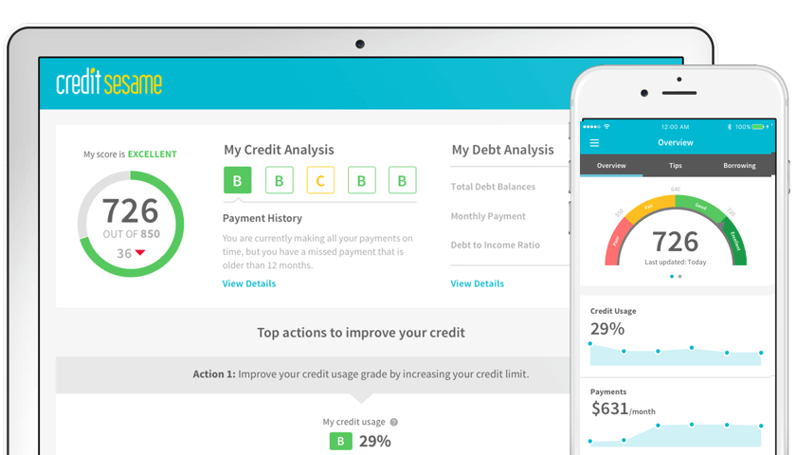
Identifying Valuable Credit Sesame Customers

Slide 2

What does it mean for a user to be valuable?
Credit Sesame offers free services, so they generate revenue from targeted advertising.
When users click “apply” on a Credit Sesame page for one of these targeted offers, Credit Sesame profits.

Slide 3
What makes a valuable user unique?
Are there certain behaviors and demographics that are correlated with users that apply for Credit Sesame offers?
Goal: Build a model which could predict whether or not a given user would eventually click ‘apply’ within their 30 days of usage, and then afterwards determining the most important factors in making that decision.

Slide 4

Methods
Random Forest Classifier
Accurate predictions while controlling for overfitting
Return a measure of the relative importances of the features that we gave as inputs.
Relatively easy interpretability, which lends itself to extracting and analyzing feature importance

Slide 5
Implementation
Random Forest Classifier
-sklearn library of Python
- split the data to hold out 20% for testing
- with the remaining 80% of non-testing data, we trained our model using 3-fold cross-validation with a 150-tree hyperparameter, then used the model to predict data on our testing set, and compare the predicted test values to the true test values.

Slide 6
Findings
Our model retained
71%
test accuracy in determining whether a given user would turn into a valuable customer.
The five most important features for determining classification are
Total Session Length
Average Session Length
Total Tradelines Open Balance
Total Page Views
Total Click Count

Slide 7
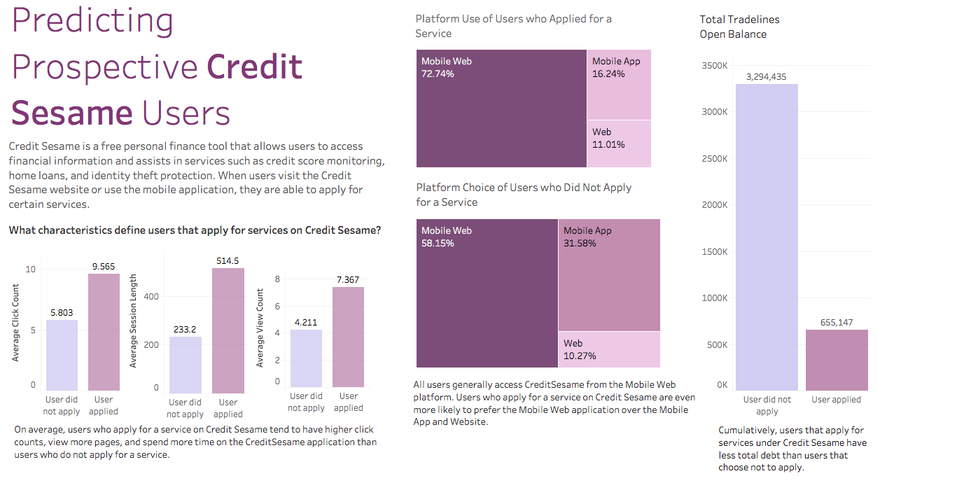
Visualizing Results

Slide 8
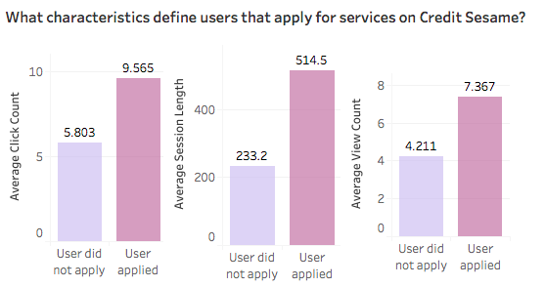
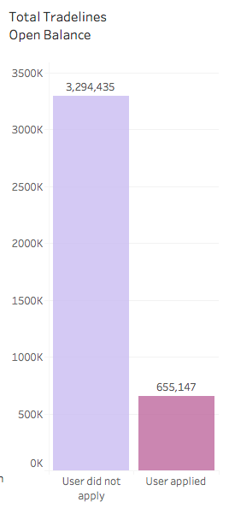
Cumulatively, users that apply for services under Credit Sesame have less total debt than users that choose not to apply.
On average, users who apply for a service on Credit Sesame tend to have higher click counts, view more pages, and spend more time on the Credit Sesame application than users who do not apply for a service.
Visualizing Results

