Slide 1


Pharmacovigilance
Text Analytics
Automated Detection of Adverse Drug Events (ADEs)
Jacob, Lucas, Feroz, Faye and Matthieu
Notes:
Welcome slide. This presentation covers our pharmacovigilance text analytics project — building an automated system to detect Adverse Drug Events from unstructured medical text. The project was completed for INSY 662 at McGill University.

Slide 2

The Problem: Why This Matters
Post-market drug safety monitoring is mandated by FDA and Health Canada
Volume
Cost
Risk
Need
Massive unstructured text from case reports, literature, and patient content
Manual expert review is slow, expensive, and unscalable
Missed ADEs increase patient harm and trigger regulatory action
Automated sentence-level ADE flagging system
2 / 17
Notes:
Pharmacovigilance is a regulatory requirement. After drugs reach the market, companies must continuously monitor for adverse drug events.
Right now, this relies heavily on manual expert review of medical reports and literature. That process is slow, expensive, and doesn’t scale with the growing volume of medical text.
Missing an adverse event can have serious consequences for patient safety and regulatory compliance.
Our goal was to build a system that automatically flags sentences likely describing an adverse drug event — not to replace experts, but to support them.

Slide 3
Analytics Approach
1
2
3
4
5
Text
Preprocessing
→
Named Entity
Recognition
→
Feature
Engineering
→
Classification
Modeling
→
Evaluation
Tokenize, POS-tag,
lemmatize
Drug + disease
extraction
TF-IDF + NER
features
Baseline vs
NER-enhanced
Minimize false
negatives
3 / 17
Notes:
Our pipeline has five stages:
First, text preprocessing to normalize language. Second, Named Entity Recognition to extract drugs and diseases. Third, feature engineering combining text features with entity features. Fourth, classification modeling. And finally, evaluation — with special focus on minimizing false negatives, since missing a true adverse event is the most dangerous mistake.

Slide 4
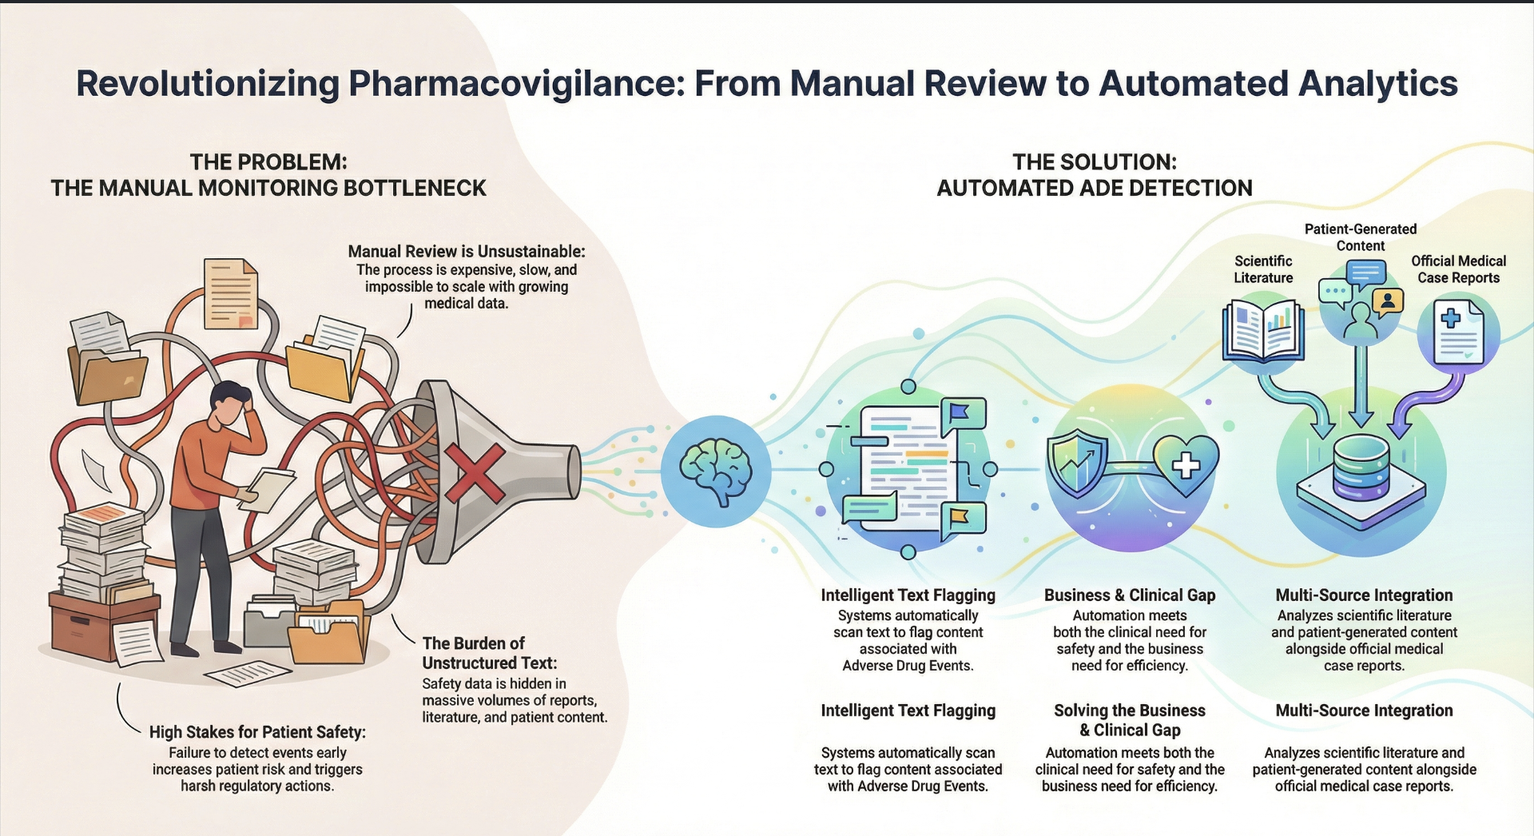
Analytics Approach
1
2
3
4
5
Text
Preprocessing
→
Named Entity
Recognition
→
Feature
Engineering
→
Classification
Modeling
→
Evaluation
Tokenize, POS-tag,
lemmatize
Drug + disease
extraction
TF-IDF + NER
features
Baseline vs
NER-enhanced
Minimize false
negatives
3 / 17

Slide 5

Data Source
ADE Corpus V2
Class Distribution
HuggingFace: SetFit/ade_corpus_v2_classification
17,637 labeled medical sentences
Binary labels: ADE vs. Not-Related
Extracted from case reports & clinical literature
Sentence-level classification granularity
4 / 17
Notes:
We used the ADE Corpus V2 dataset, a benchmark collection of medical sentences labeled as either describing an adverse drug event or not.
Only a minority of sentences contain ADEs, which reflects real-world imbalance in pharmacovigilance data. Because of this imbalance, accuracy alone would be misleading.
So we focused on recall and F1-score — metrics that better reflect performance on the safety-critical class.

Slide 6
Preprocessing Pipeline
Before POS Tagging
POS-Aware Lemmatization
Output
Lowercasing all text
NLTK word_tokenize
Filter punctuation-only tokens
Filter digit-only tokens
Retain alphanumeric medical terms
POS tagging (Penn Treebank)
Map tags → WordNet categories
Nouns, verbs, adjectives, adverbs
Context-correct lemmatization
Preserves medical term integrity
Clean, lemmatized token stream
"was" → "be"
"injections" → "injection"
"regressed" → "regress"
Ready for TF-IDF extraction
→
→
5 / 17
Notes:
Our preprocessing had three phases.
First, we cleaned and tokenized the text, keeping medically meaningful terms.
Second, we performed POS-aware lemmatization. This is important in biomedical language — simple stemming would distort words and reduce feature quality.
By using part-of-speech information, we preserved meaningful word forms while standardizing the text.
The result was a clean token stream ready for feature extraction.

Slide 7

Named Entity Recognition (NER)
scispaCy BC5CDR Model
Engineered Features
en_ner_bc5cdr_md — trained on BioCreative V corpus
has_drug — binary drug presence
has_disease — binary disease presence
drug_count — number of drug entities
disease_count — number of disease entities
has_both — drug + disease co-occurrence
CHEMICAL: Drug & compound mentions
DISEASE: Symptoms, conditions & diseases
Core Hypothesis
Sentences describing ADEs are more likely to mention both a drug and a disease/symptom in close proximity. The has_both feature directly encodes this drug disease co-occurrence signal.
6 / 17
Notes:
We then applied biomedical Named Entity Recognition using a scispaCy model.
It extracts two key entity types: drugs and diseases.
From these extractions, we engineered features indicating whether a sentence contains a drug, a disease, or both.
Our core hypothesis was simple: sentences that mention both a drug and a disease together are more likely to describe an adverse event.
This hypothesis turned out to be correct — the co-occurrence feature became the strongest signal in the final model.

Slide 8
Modeling Strategy
Baseline Models (TF-IDF Only)
NER-Enhanced (TF-IDF + NER)
Multinomial Naive Bayes
Logistic Regression
Random Forest (100 trees)
K-Nearest Neighbors (k=5)
Support Vector Machine (linear)
Logistic Regression + NER
Random Forest + NER
SVM + NER
Naive Bayes and KNN excluded from NER-enhanced testing due to poor baseline F1 (0.65 and 0.38 respectively)
5,005-dimensional feature vector: 5,000 TF-IDF + 5 standardized NER features
7 / 17
Notes:
We tested two tiers of models.
The baseline tier used standard text features only.
The second tier enhanced those models by adding the NER-based features.
We focused on three diverse models — a linear model, an ensemble model, and a margin-based model — to ensure our findings weren’t dependent on a single learning paradigm.

Slide 9
Baseline Results (TF-IDF Only)
Model | Accuracy | Precision | Recall | F1-Score
Naive Bayes | 0.832 | 0.839 | 0.525 | 0.646
Logistic Regression | 0.856 | 0.840 | 0.626 | 0.717
Random Forest | 0.872 | 0.864 | 0.668 | 0.753
KNN | 0.771 | 0.887 | 0.245 | 0.384
SVM (linear) | 0.874 | 0.820 | 0.728 | 0.771
SVM strongest baseline (F1 = 0.771, best recall at 0.728)
KNN severely underperformed (recall = 0.245 — curse of dimensionality in 5,000-feature space)
Naive Bayes: decent precision (0.839) but weak recall (0.525) — independence assumption fails for ADE patterns
8 / 17
Notes:
Among baseline models, SVM performed best using text features alone.
Some models struggled significantly, especially in high-dimensional space, which is common with TF-IDF.
Overall, text-only models worked reasonably well — but left room for improvement.

Slide 10

Impact of NER Features
KEY FINDING
Logistic Regression
Baseline F1
Enhanced F1
→
+0.075
0.717
0.792
+14.7 pp recall
Random Forest
Baseline F1
Enhanced F1
→
+0.067
0.753
0.821
+15.1 pp recall
SVM
Baseline F1
Enhanced F1
→
+0.038
0.771
0.809
+7.2 pp recall
Random Forest (NER) selected as best model — highest F1 across all experiments
9 / 17
Notes:
This is where the key finding emerged.
Adding NER features consistently improved performance across all models.
The improvements were especially strong for the linear model, suggesting that drug-disease co-occurrence provides a clear, structured signal.
The ensemble model achieved the strongest overall balance of precision and recall and became our selected final model.
Most importantly, the improvement was consistent across model types — validating our feature engineering hypothesis.

Slide 11
Best Model: Random Forest (NER)
89.6%
82.3%
81.8%
82.1%
Accuracy
Precision (ADE)
Recall (ADE)
F1 (ADE)
Confusion Matrix (Test Set: 3,528 sentences)
Aggregate Metrics
 | Pred: Not ADE | Pred: ADE
Actual: Not ADE | 2,324 (TN) | 175 (FP)
Actual: ADE | 185 (FN) | 844 (TP)
Macro Avg F1: 87.0%
Weighted Avg F1: 90.0%
Not-ADE F1: 93%
10 / 17
Notes:
Our final model achieved strong balanced performance.
It correctly filtered most non-ADE sentences while capturing the majority of true ADEs.
The most important takeaway from the confusion matrix is this:
False negatives — missed adverse events — were significantly reduced compared to baseline models.
False positives were manageable and represent lower operational risk.

Slide 12

Risk Perspective
False Negatives
HIGH RISK
False Positives
LOW RISK
~18% of true ADE sentences missed
Potential safety signals escape detection
Could delay identification of dangerous drug-event patterns
Patient exposure to preventable harm
~7% of non-ADE sentences flagged
Adds to reviewer workload, not harmful
Tolerable cost in safety-critical context
Recommendation: Deploy as screening tool with human-in-the-loop validation, not as standalone replacement
11 / 17
Notes:
In pharmacovigilance, errors are asymmetric.
Missing a real adverse event is far more dangerous than flagging an extra sentence for review.
That’s why recall matters more than pure accuracy.
This model is best deployed as a screening tool — narrowing down massive volumes of text so human reviewers can focus their expertise where it matters most.

Slide 13
Feature Importance Insights
Key Observations
NER features dominate: top 4 features and 6 of top 6 are NER-derived
has_both alone = ~8% of total importance across 5,005 features
Causal language ("induced", "associated", "cause") is highly predictive
Clinical context terms ("patient", "treatment", "therapy") provide framing
12 / 17
Notes:
Feature importance analysis strongly validated our approach.
NER-derived features ranked among the most influential predictors.
The co-occurrence of a drug and disease was especially powerful.
Traditional text features also contributed, particularly words associated with causality.
Together, structured entity signals and causal language created an effective detection framework.

Slide 14

Error Analysis
Likely False Negative Patterns
Likely False Positive Patterns
Implicit causality — temporal co-occurrence without explicit causal language
Rare drug mentions — uncommon drugs lack discriminative TF-IDF weight
Negation — "No adverse events observed" not handled by bag-of-words
Complex multi-clause sentences requiring cross-sentence reasoning
Drug + disease mentioned without causality (e.g., prescription context)
Drug efficacy descriptions sharing ADE vocabulary ("therapy", "treatment")
Domain ambiguity — same symptom could be pre-existing condition vs. adverse effect
13 / 17
Notes:
Our error analysis revealed patterns.
False negatives often occurred when causality was implied rather than explicitly stated.
Negation and complex sentence structures also created challenges.
False positives often occurred when drugs and diseases co-occurred without a true adverse relationship.
These patterns point clearly toward future improvements.

Slide 15

Business & Clinical Impact
Scenario: Processing 100,000 Sentences (~29% ADE)
~65,100
~23,900
~5,100
~5,300
Non-ADE auto-filtered
ADE correctly flagged
False alarms (brief dismissal)
Missed ADEs (need QA)
Regulatory & Operational Implications
Signal detection timelines: weeks → hours
Auditable classification trails for regulatory submissions
Continuous monitoring of biomedical literature at scale
Threshold tuning via predict_proba enables recall-optimized deployment
14 / 17

Slide 16

Limitations
Data Limitations
Model Limitations
Trained on single dataset (ADE Corpus V2 only)
Sentence-level only — no document context
No temporal validation split
English-only coverage
No explicit negation handling
TF-IDF loses word order & contextual semantics
Fixed vocabulary cannot capture new drug names
Single train/test split (no cross-validation)
15 / 17
Notes:
There are important limitations.
We trained on a single dataset. The classification is sentence-level, not document-level. TF-IDF does not capture word order or contextual nuance. And we did not incorporate advanced semantic models.
These constraints define our next steps.

Slide 17

Future Improvements
Transformer Models
Threshold Optimization
BioBERT / PubMedBERT / SciBERT for contextualized embeddings capturing negation and word order
Target 95% recall for ADE detection using precision-recall curve guidance
Active Learning
Multi-Label Classification
Iteratively identify most informative unlabeled sentences for efficient annotation
Extend to capture ADE type (hepatotoxicity, cardiotoxicity) and severity
PubMed + FAERS Integration
Refine Extraction Pipeline
Cross-reference flagged drugs against FDA FAERS API for real-world signal validation
Further refine entity-level modeling and extraction steps for production deployment
Next Step: Further refine extraction steps and entity-level modeling for production readiness
16 / 17
Notes:
Future improvements include transformer-based biomedical models that better capture context and negation.
We could optimize thresholds specifically for high-recall settings.
Active learning could expand the dataset efficiently.
And integrating real-world adverse event databases would strengthen practical deployment.

Slide 18

Conclusion
NER feature integration significantly improved classification performance across all models
Random Forest (NER) achieved the best balance of precision (82.3%) and recall (81.8%)
Drug–disease co-occurrence (has_both) validated as most powerful predictive signal
System viable as first-pass pharmacovigilance triage tool, dramatically reducing manual review
Human-in-the-loop deployment recommended to address the 18% false negative rate
Thank You
Notes:
To conclude:
The key innovation was combining structured biomedical entity features with traditional text features.
Drug-disease co-occurrence proved to be a powerful signal.
The final model achieved strong, balanced performance and is well-suited as a first-pass screening system.
This approach meaningfully reduces manual workload while maintaining safety sensitivity.
Thank you.

Slide 19
